Slide 1
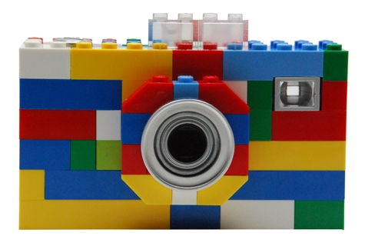
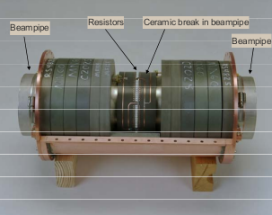

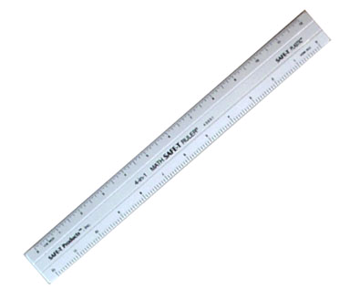
Longitudinal Dynamics
Q: How can we measure the longitudinal phase space distribution?

Slide 2
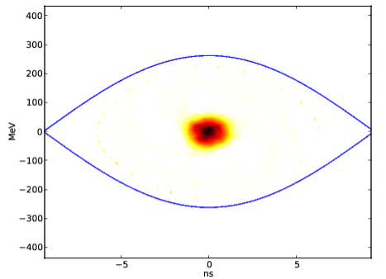
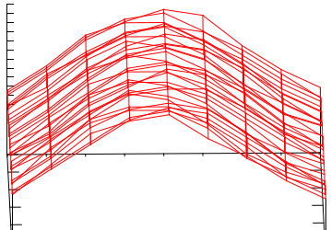

A: With a resistive wall current sensor
Each time the bunch passes by the wall current sensor, we get a longitudinal density profile.
The mountain-range plot (above left) is an accumulation of these profiles, and can be used to construct a phase space diagram.

Slide 3

(some of) The Mathematics
Dn, the distribution after n turns, is measured by the wall monitor.
It is essentially a projection onto the phi axis of the evolution (Tn) of the phase space plot (P).
Inverse problem of solving for the phase space plot, P, is done by code written at Cern.

Slide 4
Why is this useful?
It lets us “view” the dynamics in the accelerator
Plots will be analyzed:
  Of protons before and after pbars are injected into the tevatron
  Of protons and pbars before and after the “squeeze” (reduction of beta* for collision)
  Of protons and pbars over time (on a scale of hours)

