Slide 1
LHC Accelerator Prospects
“LHC: the status, the projections for this year, and the possibilities for the near and far future..”
Mike Lamont for the LHC team
Acknowledgements: Brennan Goddard, Heiko Damerau, Frank Zimmermann, Werner Herr

Slide 2
2011 – a quick look back

Slide 3
2011
Successfully wrestled with:
Total intensity
Bunch spacing
Bunch intensity
Emittance
Beta* & aperture
Good performance from working on all available parameters
Definitely exploring the effects of high intensity beams:
SEUs, beam induced heating, vacuum instabilities…
Operational efficiency suffering as a result

Slide 4
Of note
Operational robustness
Precycle, injection, 450 GeV, ramp & squeeze & collisions routine
Machine protection
Unpinned by superb performance of machine protection and associated systems
Rigorous machine protection follow-up, qualification and monitoring
Routine collimation of 110 MJ LHC beams without a single quench from stored beams.

Slide 5
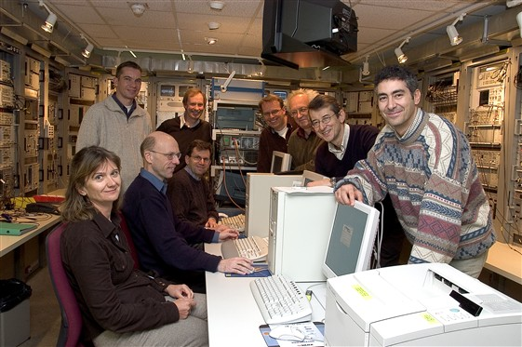
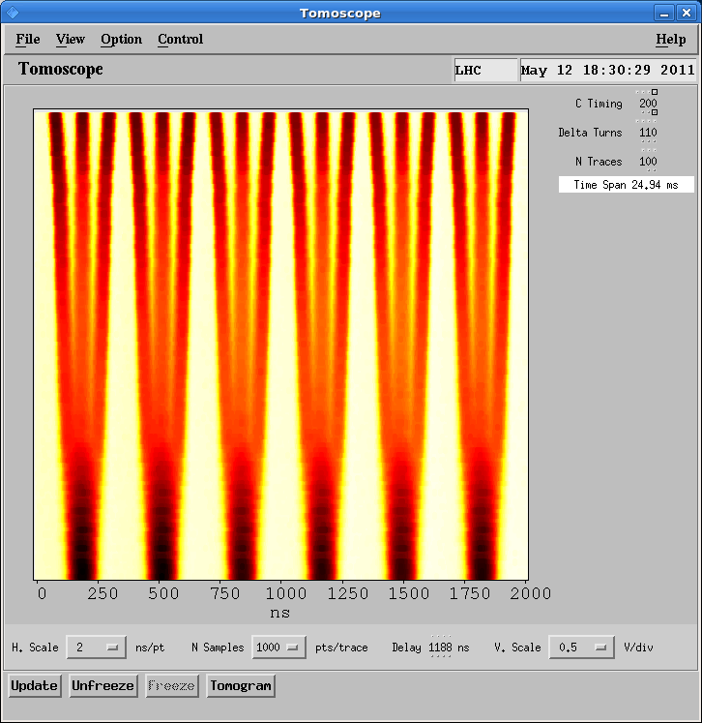
Beam from injectors
Excellent performance – years in the preparation
Best in 2011 with 50 ns:
~1.45 x 10¹¹ ppb
~2.3 microns into collision
Design with 25 ns:
1.15 x 10¹¹ ppb
Normalized emittance 3.75 microns

Slide 6
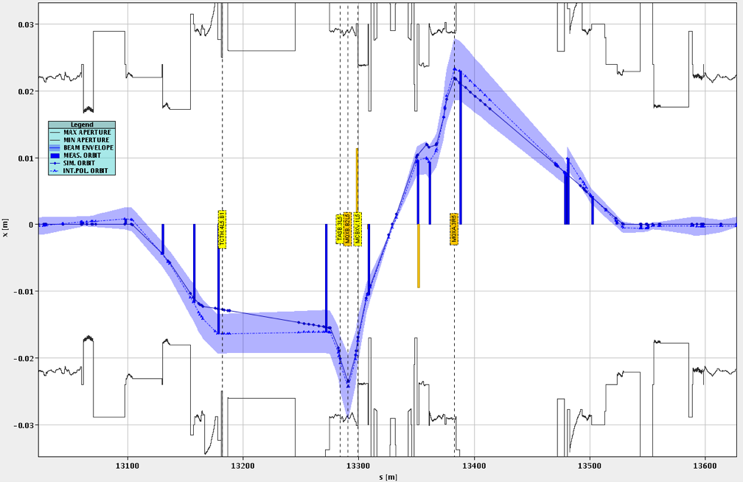
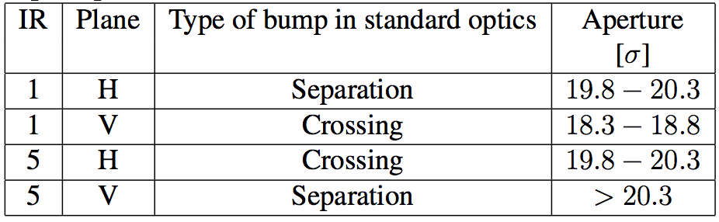
IR1 and IR5 aperture at 3.5 TeV
CMS
2011’s “platinum mine”
We got 4-6 sigmas more than the expected 14 sigma Triplet aperture compatible with a well-aligned machine, a well centred orbit and a ~ design mechanical aperture
~3 cm
Stefano Redaelli
~600 m
Additional margin allowed squeeze to beta* = 60 cm in 2012
big success – 6e33 cm⁻²s⁻¹

Slide 7
2011 to 2012
Well organized, productive Xmas technical stop
Lot of R2E related work
Plus consolidation and improvements of many systems
Vacuum consolidation to address successfully diagnosed causes of instabilities in 2011
Injection collimators issues diagnosed and understood - spare in preparation - fingers crossed in the meantime
Cool-down of machine exactly on schedule
Very smooth hardware commissioning including careful quench-less commissioning of main circuits to 4 TeV
Well oiled Machine checkout final tests and preparation for beam

Slide 8
2012

Slide 9
2012 run configuration
Energy – 4 TeV
Low number of quenches (as in 2011) assumed
Bunch spacing - 50 ns
Tight collimator settings
Now proven operationally
Atlas and CMS beta* - 60 cm
Alice and LHCb beta* - 3 m
Natural satellites versus main bunches in Alice
Tilted crossing in LHCb

Slide 10
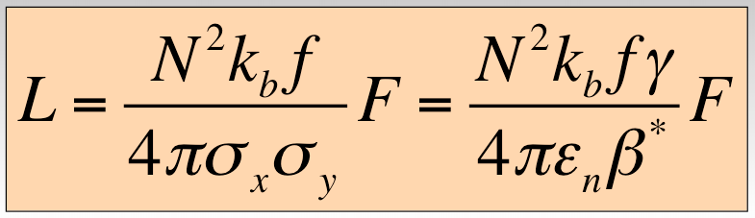
Bunch spacing
Performance from injectors
Bunch spacing | From Booster | Protons per bunch (ppb) | Emittance H&V [mm.mrad]
150 | Single batch | 1.1 x 10¹¹ | 1.6
75 | Single batch | 1.2 x 10¹¹ | 2.0
50 | Single batch | 1.45 x 10¹¹ | 3.5
50 | Double batch | 1.6 x 10¹¹ | 2.0
25 | Double batch | 1.2 x 10¹¹ | 2.7

Slide 11
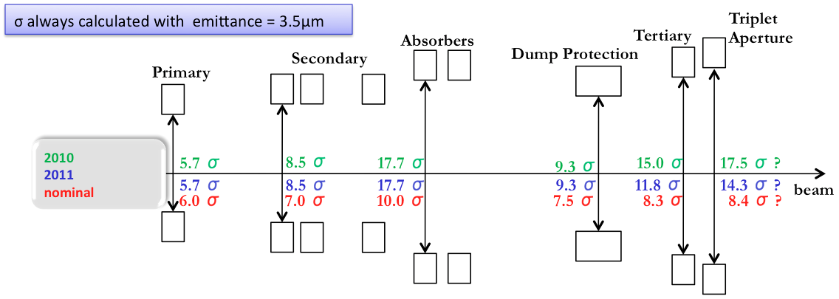
Collimator settings 2012
2012: tight settings
Collimation hierarchy has to be respected in order to achieve satisfactory protection and cleaning.
Aperture plus tight settings allows us to squeeze to 60 cm
 | σ
TCP 7 | 4.3
TCSG 7 | 6.3
TCLA 7 | 8.3
TCSG 6 | 7.1
TCDQ 6 | 7.6
TCT | 9.0
Aperture | 10.5
Roderik Bruce

Slide 12


How tight?
Norway
Iberian
peninsula
Intermediate settings (2011):
~3.1 mm gap at primary collimator
Tight settings (2012):
~2.2 mm gap at primary collimator
Roderik Bruce

Slide 13
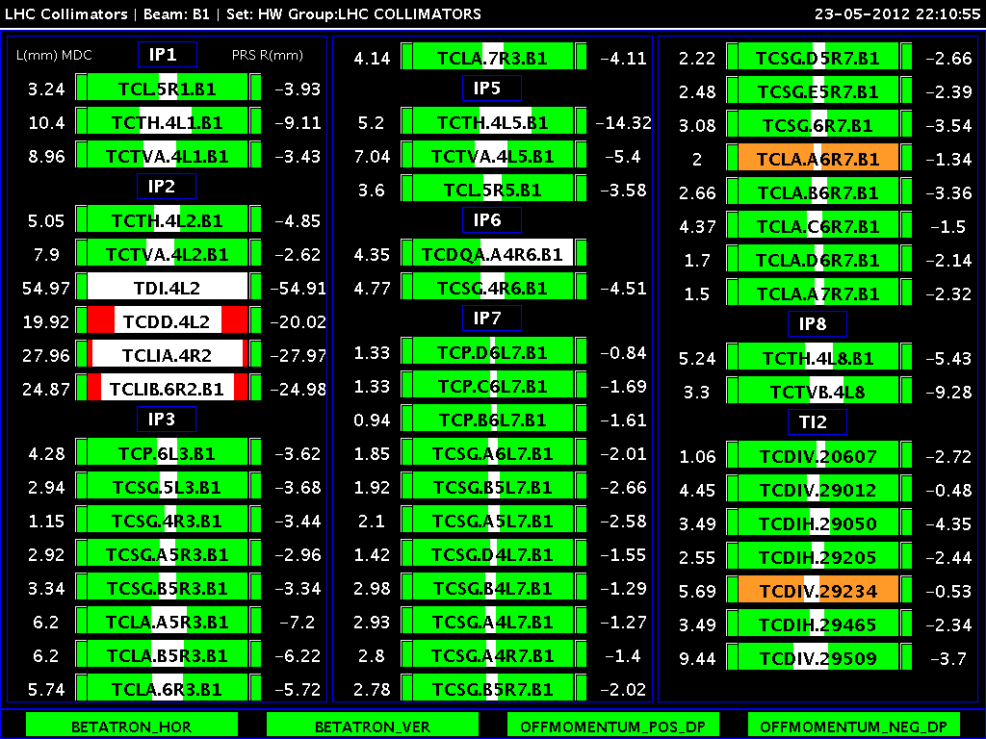

Slide 14
2012 – canonical (long) year
 | Days
Machine check-out | 2
Commissioning with beam | 21
Machine development | 22
Technical stops | 20
Scrubbing (25 ns) | 3
Technical stop recovery | 6
Initial intensity ramp-up | ~21
Proton running | ~126
Special runs | ~8
Ion setup | 4
Ion run | 24
~150 days

Slide 15
50 ns performance estimate
from Moriond
4 TeV, 50 ns, 1380 bunches, 1.6e11, 2.5 microns 150 days of proton physics (assuming similar efficiencies to 2011)
Beta* [cm] | Collimators | Peak Lumi [cm-²s⁻¹] | Int. Lumi [fb⁻¹] | Pile-up | Increase in peak
90 | Intermediate | 5.1e33 | 12.1 – 14.5 | 26
70 | Tight | 6.2e33 | 14.7 – 17.6 | 31 | +22%
60 | Tight | 6.8e33 | 16.2 – 19.3 | 35 | +10%

Slide 16
2012 so far
Date | Milestone
Thu 15.03 | Both beams captured, orbit and Q adjusted
Fri 16.03 | Both beams at 4 TeV
Sun 18.03 | Both beams squeezed to 0.6 m
Thu 5th April | First stable beams – 3 bunches
Wed 18th April | 1380 bunches per beam - peak luminosity ~5.5e33 cm⁻²s⁻¹
20-22 April | Machine development
23-27 April | Technical stop
to 10 May | Struggled back up to 1380 ~4.3e33 cm⁻²s⁻¹
Last weekend | ~6e33 cm⁻²s⁻¹ and ~190 fb⁻¹ in one fill… production running

Slide 17
2012 so far
Smooth re-commissioning
Tight collimator setting operational
Squeeze to 60 cm OK
Excellent peak performance
Peak/delivery rates
Luminosity production hampered by
Injector beam quality (some foot shooting)
Machine availability – in particular cryogenics issues
Some fun with beam-beam instabilities, LHCb’s tilted crossing angle….
Now settling down

Slide 18
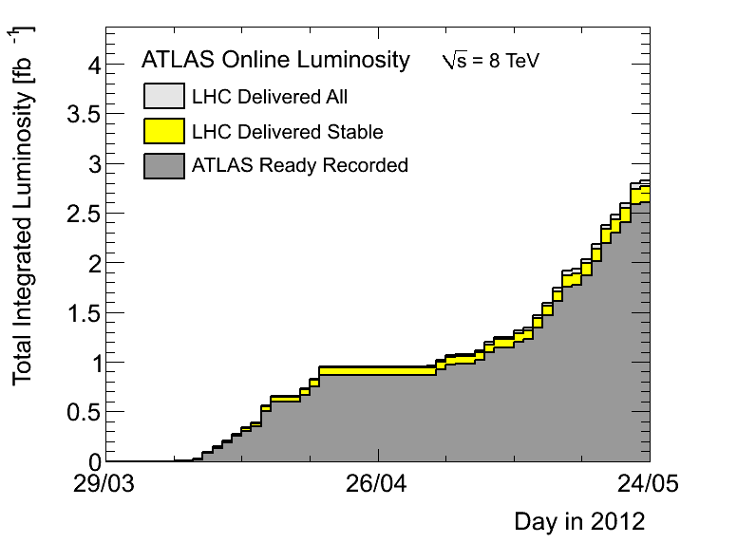
Production running
Over last 11 days: ~1.45 fb⁻¹ or 0.13 fb⁻¹/day
110 days proton physics left in schedule: ~14 fb⁻¹

Slide 19
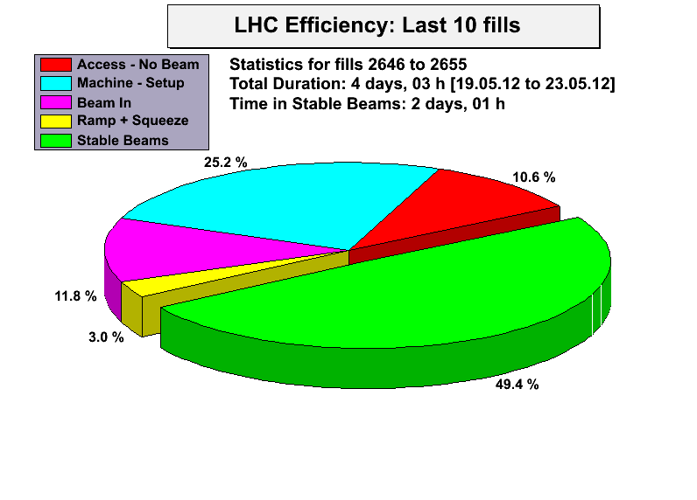
Recent operational efficiency

Slide 20
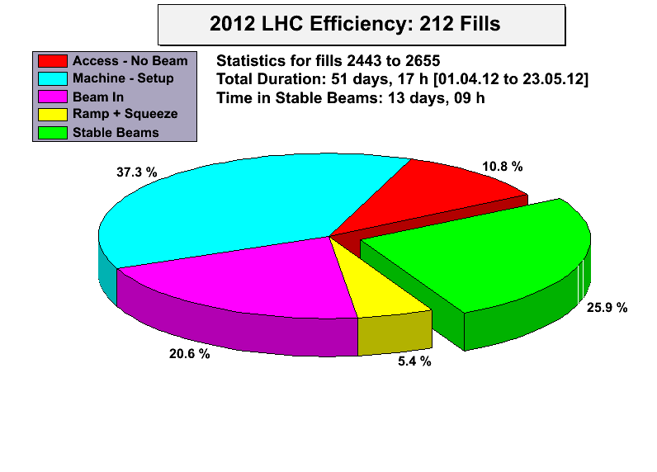
This year

Slide 21
Lessons for the future
Head-on beam-beam is not a limitation
Long range has to be taken seriously
Need separation (otherwise bad lifetime and beam loss)
Small as possible emittances are good
Require separation established (10 to 12 sigma) and thus the crossing angle (important because our F is going to bite at lower beta)
beta* reach (aperture, collimation, optics) established
Levelling tested – it works in LHCb!
Availability issues (SEUs, vacuum, cryogenics…) – vigorous follow-up and consolidation

Slide 22
50 versus 25 ns
50-ns beam: smaller emittance from the PS
less splittings in the PS; i.e. less charge in the PSB
~2 vs ~3.5 micron at LHC injection
25-ns beam: emittance growth due to e-cloud in the SPS and LHC
to be improved by scrubbing in the LHC, and a-C coating in the SPS
25-ns has more long-range collisions
Total current limit (by vacuum; RF) → limit # bunches
Bunch train current limits in SPS & LHC → limit # bunches
UFO rate seems to greatly increase for 25-ns spacing
Ultimately we will (try to) transit to 25-ns spacing because of pile up

Slide 23
Towards exploiting the ‘nominal’ and ‘ultimate’ parameter set of the LHC

Slide 24
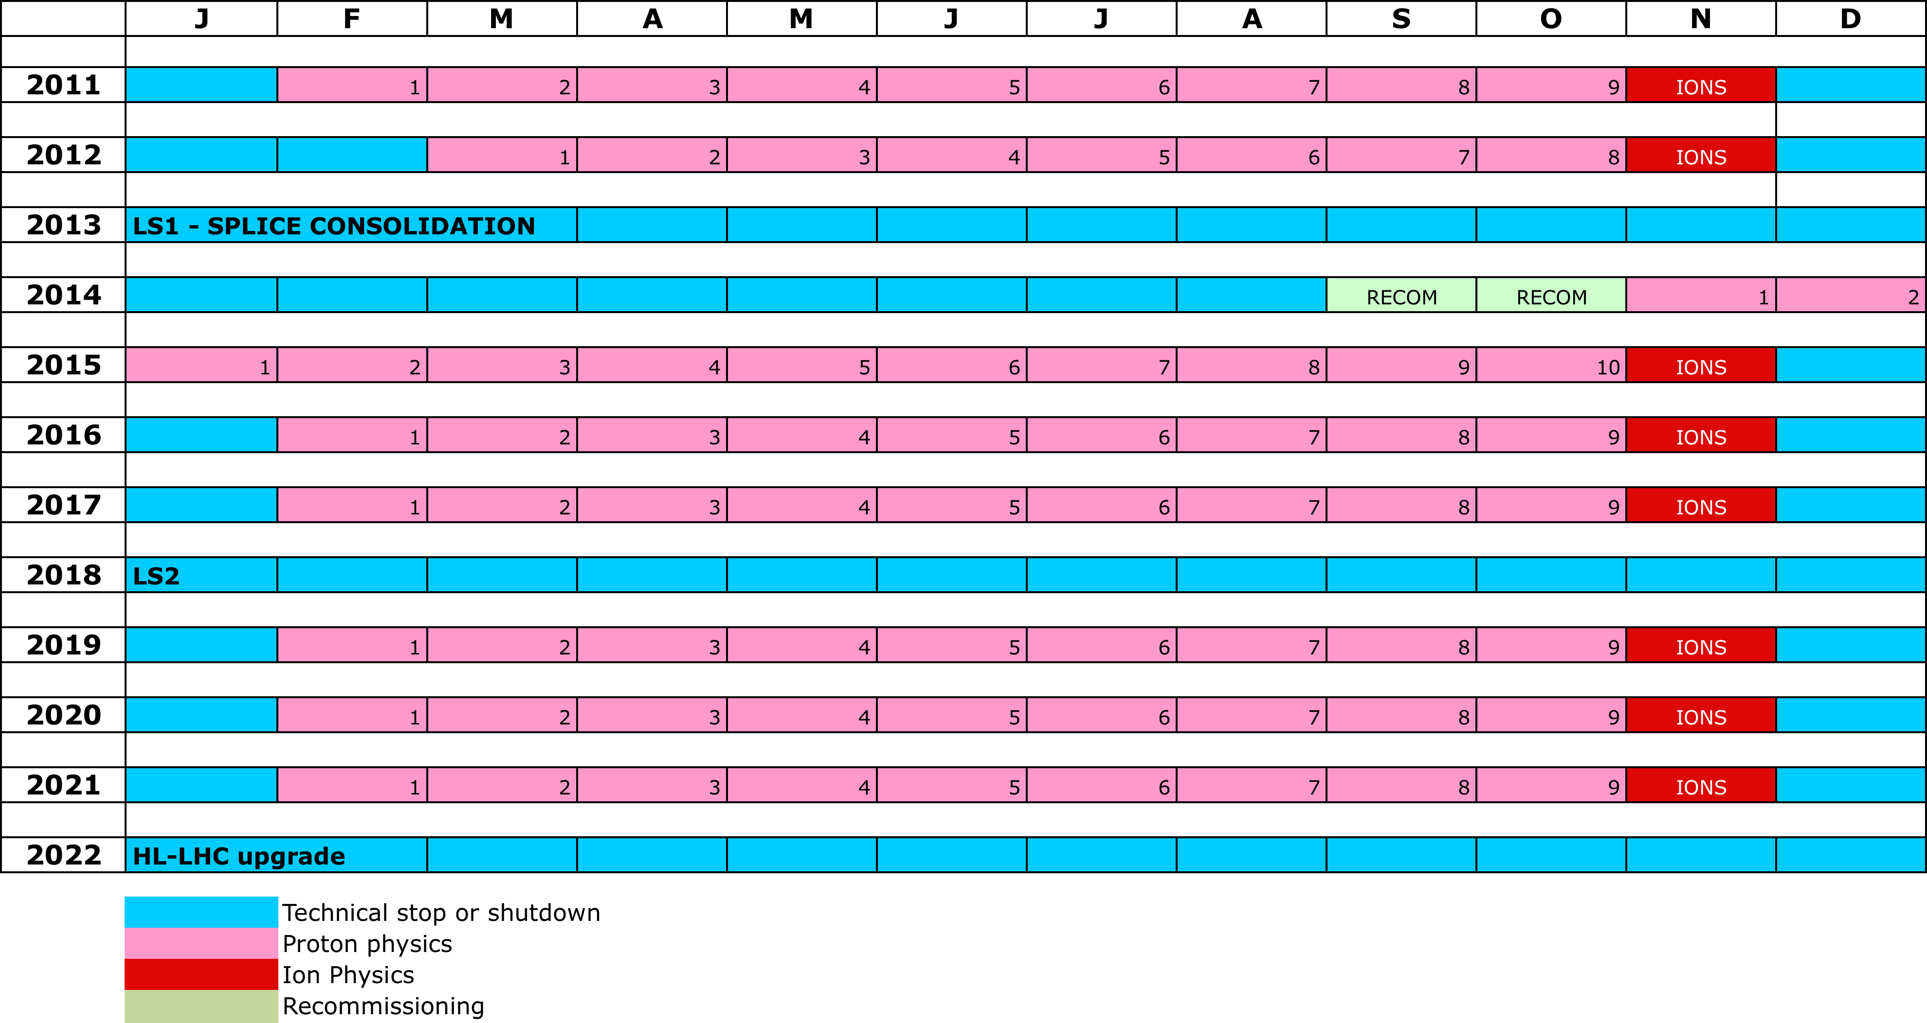
10 year plan
LS1
PHYSICS AT 6.5/7 TeV
LS2
“ULTIMATE” PHYSICS
LS3
HL-LHC
NB: not yet approved

Slide 25
LSs
2013 – 2014: Long Shutdown 1 (LS1) consolidate for 6.5 / 7TeV
Measure all splices and repair the defective
Consolidate interconnects with new design (clamp, shunt)
Finish installation of pressure release valves (DN200)
Magnet consolidation
Measures to further reduce SEE (R2E): relocation, redesign, …
Install collimators with integrated button BPMs (tertiary collimators and a few secondary collimators)
Experiments consolidation/upgrades
2018: LS2 to prepare for ‘ultimate LHC’ parameter set:
Phase II collimation upgrade
Major injectors upgrade (LINAC4, 2GeV PS Booster, SPS coating, …)
Prepare for crab cavities (for HL-LHC)

Slide 26
Future performance
What can the injectors deliver?
What can the LHC take?
RF, cryo, MP, e-cloud…
What can the LHC do with it?
Squeeze, pile-up…
Scheduled time
Machine availability & operational robustness

Slide 27
Injectors

Slide 28
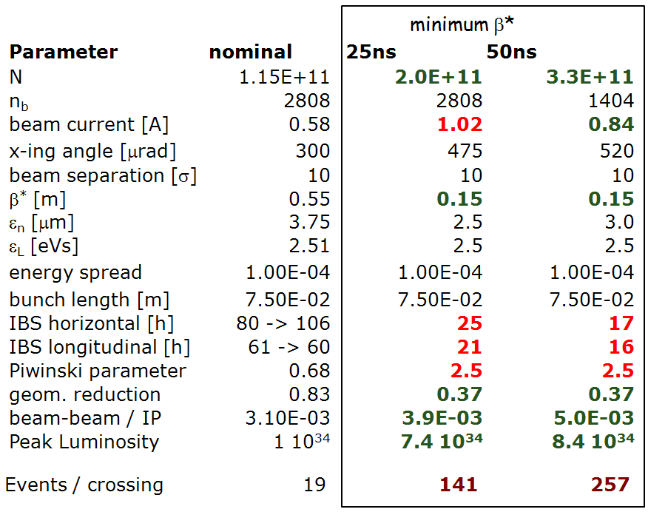
Requirements from HL-LHC
MOTIVATION
Target: 250-300 fb⁻¹ per year
at LHC collision
O.Brüning, HI-LUMI event 16-18 November 2011

Slide 29
2011 to post-LS2
2011 was excellent: 1.5e11 with 2.5 um for 50 ns (at LHC flat-top)
Around 1.1 e11 with 2.8 um for 25 ns, extracted from SPS
Large improvement is required for either 25 or 50 ns beam!
Brennan Goddard

Slide 30
Injector timeline
PSB H⁻ injection could be available
PSB-PS transfer 1.4 GeV → 2 GeV
Chamonix 2012
Linac 4 ready
LS1 for injectors
LS2 for injectors
2012
2013
2014
2015
2016
2017
2018
2019
LS1.5?
SPS aC coating, 200 MHz power upgrade completed
Injectors commissioned
Length of LS2: minimum 12months
2019 commissioning: several months

Slide 31
Injector plans - summary
Situation at the end of ‘injector LS1’ (03/2014)
Linac4 being commissioned, proton operation possible from 2014
PSB injection for H- not yet available (baseline: Q4/2015)
PSB  PS transfer energy: 1.4 GeV
Some potential improvements after LS1
Low emittance beams – to be tested Q3/2012
SPS improvements (optics, RF, impedance)
LINAC4 connection baseline is now LS2
(with a weakening option for LS1.5)
Injectors unable to exploit LINAC4 before LS2 anyway
Major upgrades within LIU project, including increase of PSB-PS transfer energy only during LS2
After LS2 towards HL-LHC beam available from injectors
LHC will only be able partially exploit this beam

Slide 32
After LS1

Slide 33
Beam from injectors 1/2
Operational production scheme |  | 25 ns ~nominal | 50 ns (CBI-limit)
PS injection | Bunch intensity, ×10¹¹ p/b | 16 | 12
 | Emittance, βγε | 2.4 μm | 1.8 μm
 | Vert. tune spread, ΔQ_{y} | -0.26 | -0.25
PS ejection | Bunch intensity, ×10¹¹ p/b | 1.27 | 1.90
 | Emittance, βγε | 2.5 μm | 1.9 μm
 | Bunches per batch | 72 | 36
Brightness limit PSB |  | X | X
Space charge limit PS |  | X | X
Coupled-bunch limit PS |  |  | X
SPS ejection: expected (achieved) | Bunch intensity, ×10¹¹ p/b | 1.15 | 1.7
 | Emittance, βγε | 2.8 μm | 2.1 μm
Relative beam quality factor, q_{ib} |  | 1.2 | 1.7
H. Damerau – Chamonix2012
Potential for nominal luminosity in LHC…

Slide 34
Beam from injectors 2/2
First PS studies in 2012 |  | 25 ns low ε_{x}/ε_{y} | 25 ns ultra-bright
PS injection | Bunch intensity | 0.8⋅10¹² ppb | 0.65⋅10¹² ppb
 | Emittance, βγε | 1.2 μm | 1.0 μm
 | Vert. tune spread, ΔQ_{y} | -0.24/-0.26 | -0.26
PS ejection | Bunch intensity | 1.27⋅10¹¹ ppb | 1.54⋅10¹¹ ppb
 | Emittance, βγε | 1.3 μm | 1.1 μm
 | Bunches per batch | 36/48 | 32
Brightness limit PSB |  | X/- | X
Space charge limit PS |  | -/X | X
Coupled-bunch limit PS
SPS ejection | Bunch intensity | 1.15⋅10¹¹ ppb | Beyond SPS reach
 | Emittance, βγε | 1.4 μm
Relative beam quality factor, q_{ib} |  | 2.2
Potential for ~twice the nominal luminosity in LHC…
H. Damerau – Chamonix2012

Slide 35
LHC after LS1
Energy 6.5 TeV (in 2015)
Aperture not worse than now
Bunch spacing 25 ns or 50 ns
Understand (and control) emittance increase
Pile-up – assume acceptable mean mu of ~40
This will constrain the utility of 50 ns
Beta* ~0.5 m
of limited utility to squeeze further

Slide 36
Potential limitations
Performance could be impacted by:
Radiation to electronics – SEU’s
UFOs at higher energy & with 25 ns
Electron cloud & high energy & at 25 ns
Emittance growth in physics
Total beam intensity limits in the LHC…

Slide 37
Potential performance
 | Beta* [cm] | Ib SPS | Emit SPS [um] | Peak Lumi [cm-²s⁻¹] | ~Pile-up | Int. Lumi [fb⁻¹]
25 ns | 50 | 1.2e11 | 2.8 | 1.2e34 | 28 | 32
25 ns low emit | 50 | 1.2e11 | 1.4 | 2.2e34 | 46 | 57
50 ns level | 50 | 1.7e11 | 2.1 | 1.7e34 level 0.9e34 | 76 level 40 | 40 – 50*
150 days proton physics
5% beam loss, 10% emittance blow-up in LHC
10 sigma separation
70 mb visible cross-section
* different operational model - caveat
All numbers approximate!

Slide 38
After LS2
HL-LHC like beams available

Slide 39
25 ns after LIU upgrade
Limit is 2.3e11 p+/b in 3.6 um at SPS extraction (1.6e11 in 2.3 um)
Fundamental limit: space charge in PS
Brennan Goddard

Slide 40
50 ns after LIU upgrade
Limit is 2.7e11 p+/b in 2.7 um at SPS extraction (closer to HL-LHC requirement)
Limited by longitudinal instabilities in PS and SPS, and by brightness in SPS
Brennan Goddard

Slide 41
LHC limits
Encyclopedic run through by Ralph Assmann at Chamonix
Potential limits from
RF, Vacuum, e-cloud, Cryo, Magnets, Injection and Protection, Collimation, SEUs, Radiation Protection
Ultimate intensity seems a reasonable assumption
1.7e11 x 2808

Slide 42
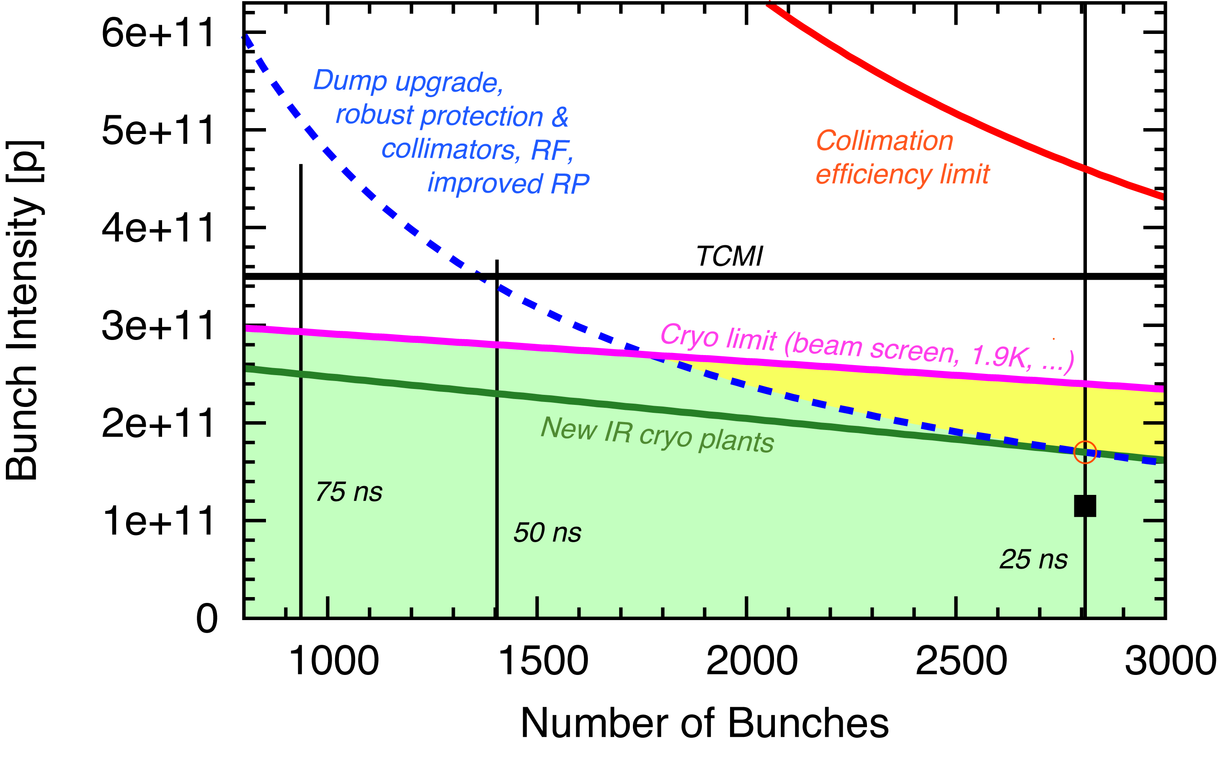
LHC limits

Slide 43
Performance estimate
7 TeV
150 days of proton physics
Hübner Factor = 0.2 for 25 ns
Different OP model for 50 ns levelled
 | Beta* [cm] | Ib (SPS) | Emit (SPS) um | Peak Lumi [cm⁻²s⁻¹] | Pile-up | Int. Lumi [fb⁻¹]
25 ns | 50 | 1.6e11 | 2.3 | 2.5e34 | 56 | ~65
50 ns | 50 | 2.7e11 | 2.7 | 2.8e34 level 0.9e34 | 125 level 40 | ~50
Neglecting low emittance option
All numbers approximate!

Slide 44
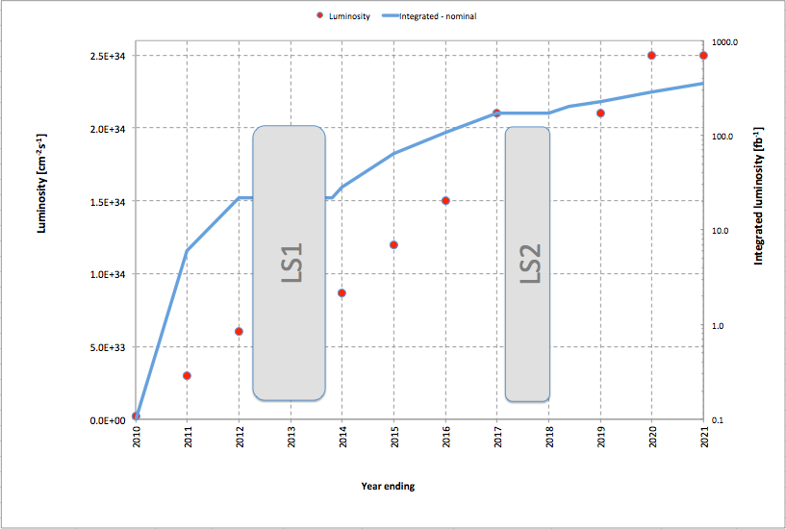
Projection
25 ns
Low emittance option viable between LS1 & LS2
Usual warnings apply

Slide 45
Conclusions
2012 performance, after some more experience, is looking encouraging, goals for year credible
Injector planning stabilizing
LINAC4 connection, LIU upgrades not until LS2
Interesting improvement possible before
Towards HL-LHC beams after
25 ns is baseline with potential to reach ultimate luminosity certainly after, possibly before, LS1
Levelled 50 ns is an interesting option, particularly if there are total intensity limitations
Certainly not yet given

Slide 46
SPARE

Slide 47
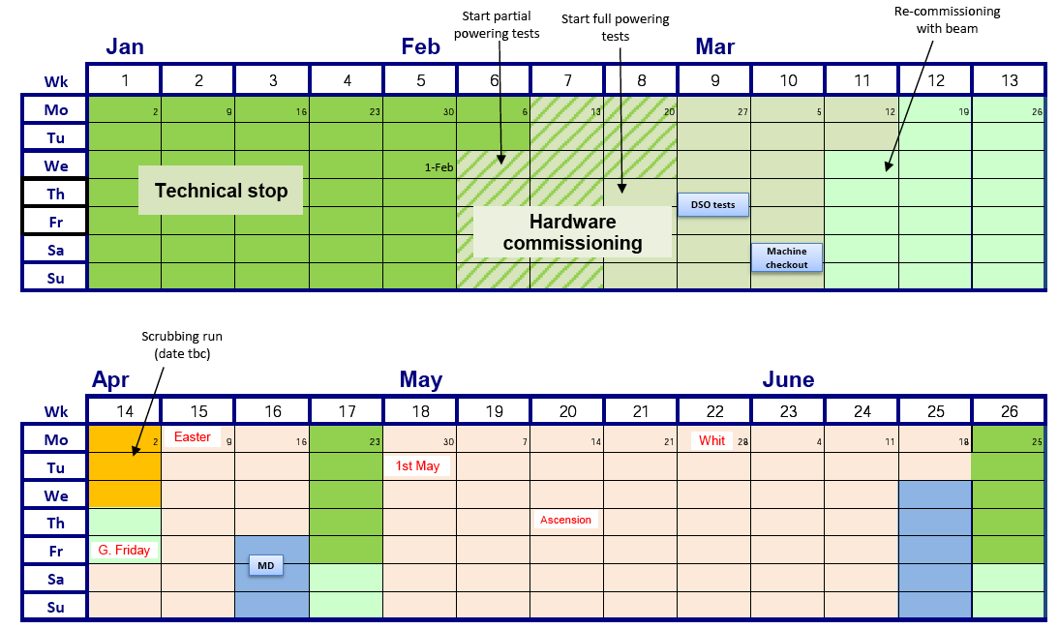

2012 LHC schedule Q1/Q2
Commissioning
Scrubbing
(postponed)
Ramp-up
MD & TS

Slide 48
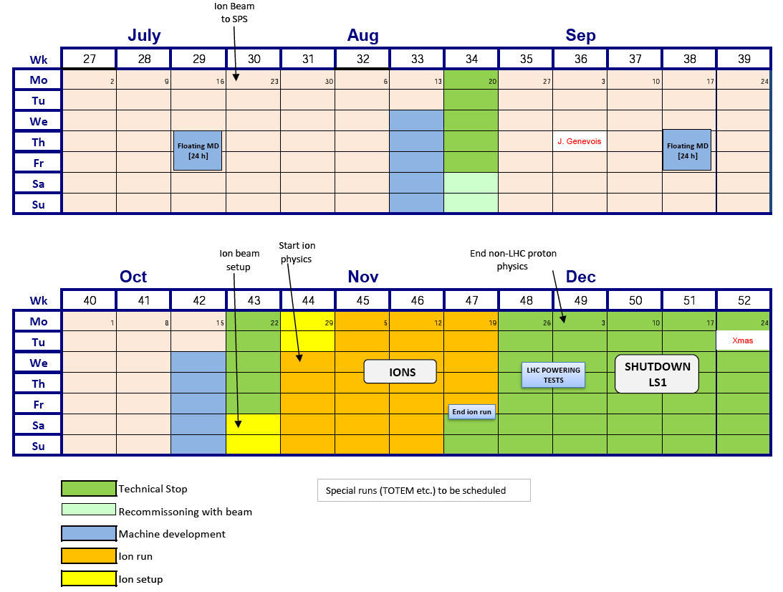
2012 LHC schedule Q3/Q4
Proton-lead
Special runs
High beta* runs for ALFA and TOTEM
Van der Meer scans

