Slide 1
Coupled Oscillations
Eric Prebys, FNAL

Slide 2
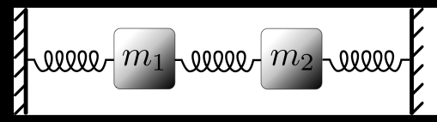
Coupled Harmonic Oscillators
Equations of motion
Define uncoupled frequencies:
Try a solution of he form:
Multiply the top by the bottom:

Slide 3
➔
Weak Coupling
Degenerate Case:
Resonance splitting

Slide 4
Formalism
General coupled equation
General solution
➔
i.e. ω² are the eigenvalues of M and (a,b) are the linear combinations of x and y which undergo simple harmonic motion.

Slide 5
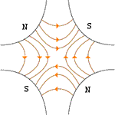
Application to Accelerators
Introduce skew-quadrupole term
Planes coupled
x and y motion not
independent
General Transfer Matrix
Normal Quad

Slide 6
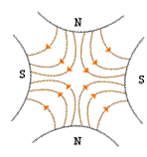
Skew quad
So the transfer matrix for a skew quad would be:
For a normal quad rotated by ϕ it would be (homework)

Slide 7
Coupling in Floquet Coordinates
In Floquet Coordinate (lecture 10)
Motion given by

Slide 8
Motion in Floquet Plane
Phase Changes

Slide 9
Evolution of Perturbation
Assume one perturbation per turn.
Evolution of amplitude
Evolution of phase

Slide 10
Angular Gymnastics
Recall

Slide 11
Difference Resonances
Focus on case when
The sum terms will oscillate quickly, so we focus in the difference terms
Note that
Sum of emittances in transverse planes stays constant!

Slide 12
Transformation of Variable
Transform into a rotating frame
In one (unperturbed) rotation
Equations Become

Slide 13
Trial solutions
Try
Hey, this (finally!) looks like simple coupled harmonic motion

Slide 14
Rearrange
Apply usual coupled oscillation formalism. Define normal modes

Slide 15
Solutions
Solve for eigenvalues of M
Recall

Slide 16
Coupled Tunes
If there’s no coupling, then
If there’s coupling, then there will always be a tune split

Slide 17
The normal modes are given by (homework)
Restrict ourselves to u_{±0} real
Emmittance oscillates between planes. Period = turns

Slide 18
Sum Resonances
Returning to the original equations, but examining the sum terms
Same sign!
Following the same math as before, we get
In other words, emittances can grow in both planes simultaneously.

Slide 19
We won’t re-do the entire analysis for the sum resonances, but we find that the eigenmodes are
integer
“Stop band width”. The stronger the coupling, the further away you have to keep the tune from a sum resonance.

Slide 20
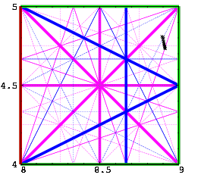
General Case
Although we won’t derive it in detail, it’s clear that if motion is coupled, we can analyze the system in terms of the normal coordinates, and repeat the analysis in the last chapter. In this case, the normal tunes will be linear combinations of the tunes in the two planes, and so the general condition for resonance becomes.
This appears as a set of crossing
lines in the nx,ny “tune space”.
The width of individual lines
depends on the details of the
machine, and one tries to pick
a “working point” to avoid
the strongest resonances.

