Slide 1
Cooling
Eric Prebys, FNAL

Slide 2
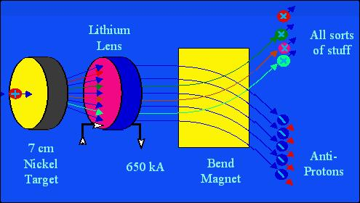
Stochastic Cooling (antiprotons or ions)
Anti-protons are created by hitting a target with an energetic proton beam. Most of what’s created are pions, but a small fraction are anti-protons.
These are captured in a transport beam, but initially have a very large energy spread and transverse distribution. They must be “cooled” to be useful in collisions.
We learned that electrons will naturally cool through synchrotron damping, but this doesn’t happen on a useful time scale for antiprotons, so at one time it was considered impossible to consider colliding protons with antiprotons, until..

Slide 3
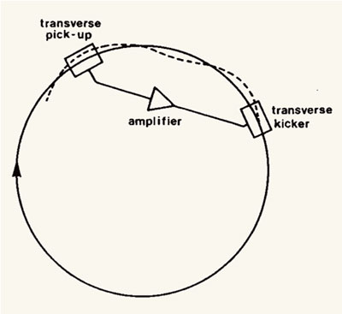
The basis of “stochastic cooling” is to detect the displacement at one point in the ring and provide a restoring kick at a second.
For a single particle
gain
For a single particle, we could set g=1 and remove any deviation in a single turn.

Slide 4
However, we’re not dealing with single particles. If all particles retain their same relative longitudinal position, the Liouville’s Theorem tells us that the best we could do is correct the offset of the centroid – which is not cooling. We will therefore see that cooling will require the particles to “mix”.
Consider an ensemble of particles
sampling period
bandwidth of pickup/kicker system
Pickups measure the mean position, and act on all particles equally, so for the i^{th} particle, the change in one turn is

Slide 5
Isolate one particle (dropping turn index), and write
mean of all other particles
Plugging this back in, we get
If the samples are statistically independent (not true in general), then over many turns
RMS of x distribution
Cooling
stochastic heating =“Schottky noise”

Slide 6
Average over all particles
This is the change in the RMS for one turn, so
sample
Recall
total
want high bandwidth

Slide 7
Note, electrical thermal noise will heat the system. This is typically normalized to the statistical Schottky noise
In our analysis, we assumed that he sample was statistically independent from turn to turn, which is clearly not the case. This technique works via “mixing”, the fact that particles of different momenta have different periods. In general, it will take M turns to completely renew the samle.
variation in periods
Recall that
revolution frequency

Slide 8
The effect on the test particle will be the same, but the net effect will be to increase the net Schottky heating by a factor of M
Electronic noise
Mixing time (turns)
The optimum gain is then the max of
Example: Fermilab Debuncher
Noise ~twice beam signal

Slide 9
“Stacking” and Longitudinal Cooling
The operation of “stacking” (accumulating beam) and longitudinal cooling both rely on placing pickups in a dispersive region. In the Fermilab antiproton source, injected beam is decelerated onto the core orbit.
injected beam
“core”
Because of the η slip factor, beam will only “see” RF tuned to its momentum, and so beam can be selectively decelerated onto the core.

Slide 10
Once the beam is stacked, then the pickup system can be used to “kick” the beam energy and cool longitudinally, in the same way that the beam was colled transversely.
core
“stacktail”
injected beam

Slide 11
Electron Cooling
Electron cooling works by injecting “cold electrons” into a beam of negative ions (antiprotons or other) and cooling them through momentum exchange.
Layout
ion beam
electron gun
electron decelerator and collector
Want

Slide 12
The electrons act like a drag force on the ions. At low velocity, the ionization loss varies as
The velocity spread of the electrons is dominated by the energy distribution out of the cathode. In the rest frame, motion is non-relativistic
relative velocity
Energy spread. Typically ~.5 eV

Slide 13
Longitudinal Electron Cooling
The momentum and energy between the rest and lab frames are related by
beta of frame
For efficient cooling, we want
So for low energy beams, large momentum spreads can be tolerated, but as energy grows, only small momentum spreads can be efficiently cooled.

Slide 14
Transverse Electron Cooling
Again, we want
We have
gets less effective for large gamma
Electron cooling involves large currents, so it’s generally necessary to recover the energy from the non-interacting electrons and reuse them➔”pelletron”

Slide 15
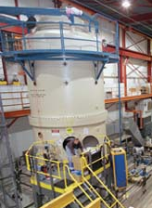
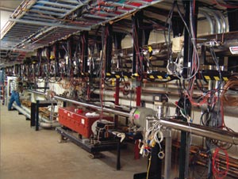
Electron Cooling in the Fermilab Recycler
One of the highest energy and most successful electron cooling systems was in the Fermilab “Recycler” – an 8 GeV permanent storage ring which was used to store anti-protons for use in the Tevatron collider.
pelletron
.5 A “u-beam”

Slide 16
Ionization Cooling (Muons Only)
There has long been interest in the possibility of using muons to produce high energy interactions. They have two distinct advantages
Like electrons, the are point-like, so the entire beam energy is available to the interaction – in contrast to protons.
Because they are much heavier than electrons, synchrotron radiation does not become a serious issue until extremely high energies (10s or 100s or TeV).
Of course, they have one big disadvantage
They are unstable, with a lifetime of 2.2 μsec.
For this reason, traditional cooling methods are far to slow to be useful.
Don’t radiate enough for radiative damping
Don’t live long enough for stochastic cooling.

Slide 17
Principle of ionization cooling
absorber
accelerator
Particles lose energy along their path. The position and angle do not change, so the un-normalized emittance remains constant; however, because the energy is lower, that means the normalized emittance has been reduced.
As they accelerate back to their initial energy, the normalized emittance is therefore reduced (ie, adiabatic damping).
Of course, there’s also heating from multiple scattering.
so the change in the normalized emittance is
<0 ➔ cooling term
heating from multiple scattering

Slide 18
Use
define dE/dx as energy loss, which changes sign
cooling term
heating

Slide 19
From our discussion of multiple scattering, we have
The equilibrium emittance is
Want
small β_{x}
large X₀➔low Z
H₂?
Li?
~independent of material
drops with Z

