Slide 1
Moving HINS to IOTA Update
Eric Prebys

Slide 2
Update
As FY15 begins, we’re starting to get serious about moving HINS stuff to ASTA (or safe storage) before anything else disappears.
Getting Kermit Carlson involved and bringing Henryk Piekarz on board (he was largely responsible for the ion source and entire upstream vacuum system).
Starting discussions with the people who know where things are:
Bruce Hannah
Steve Hays
Jim Steimel
Jeff Reid
Cons Gattuso (magnets)

Slide 3
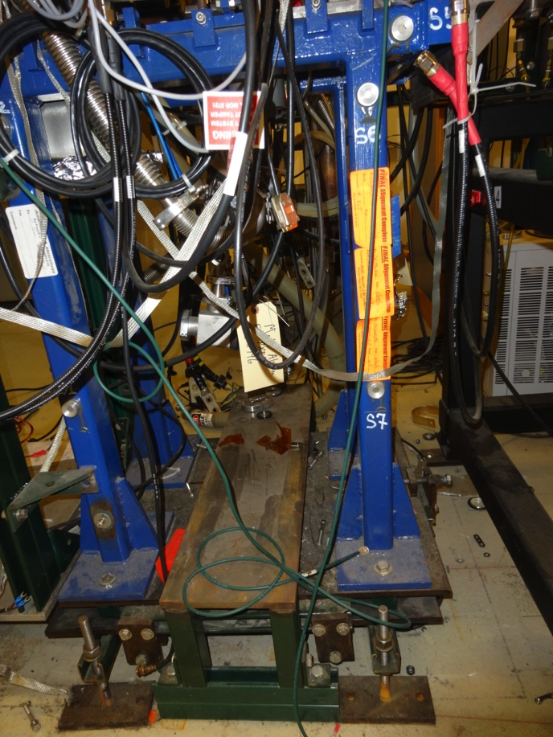
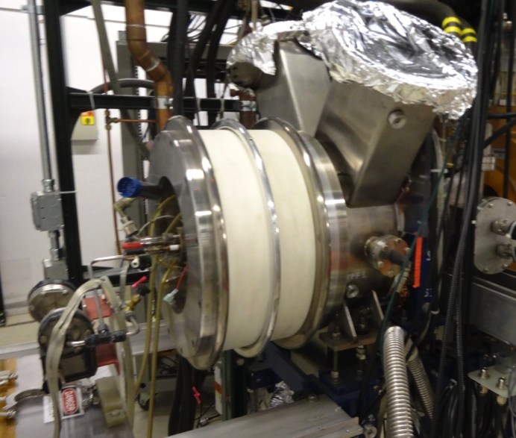
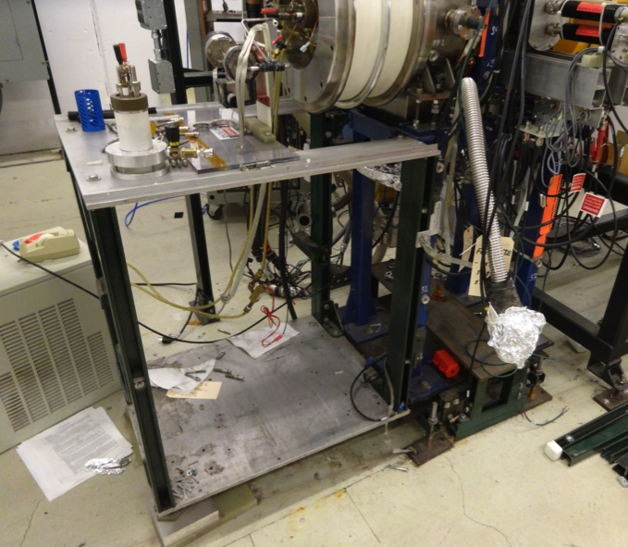
Current Status
These pictures say it all:
Major hardware is there, but almost everything attached to that hardware is gone
Vacuum systems
Power supplies

Slide 4
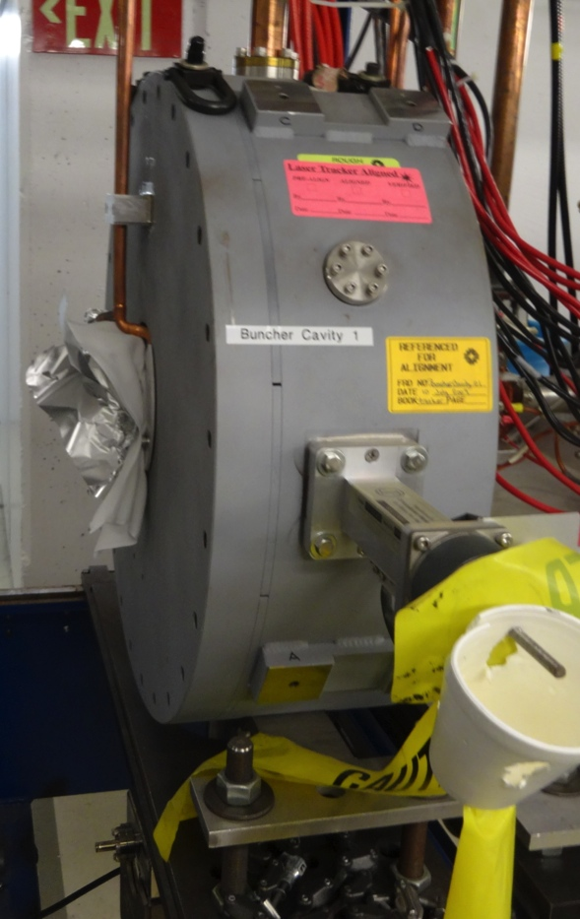
Some good finds
Two buncher cavities available
smaller than we hoped, but probably OK

Slide 5
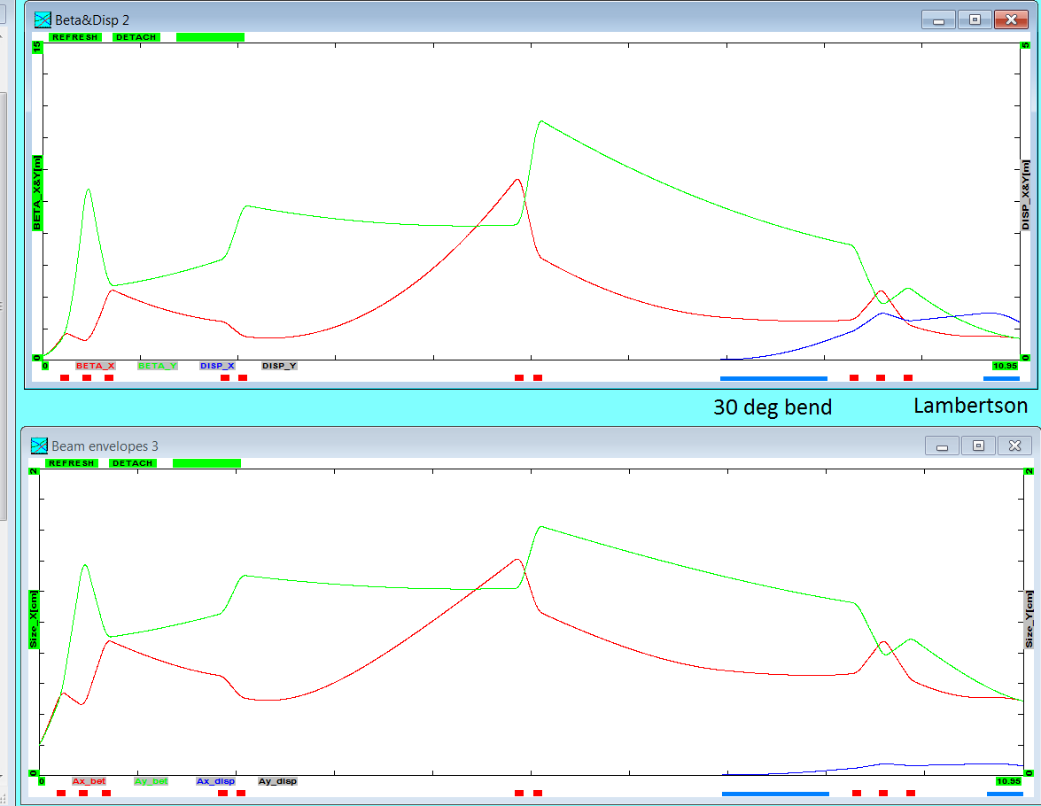
Latest Optics*
Debuncher location
*S. Antipov

Slide 6
Required Quads
qF1 L[cm]=10 G[kG/cm]=0.9 Tilt[deg]=0
qF11 L[cm]=10 G[kG/cm]=0.55 Tilt[deg]=0
qD1 L[cm]=10 G[kG/cm]=-1.0 Tilt[deg]=0
qF3 L[cm]=10 G[kG/cm]=0.230165 Tilt[deg]=0
qD3 L[cm]=10 G[kG/cm]=-0.2346747 Tilt[deg]=0
qF2 L[cm]=10 G[kG/cm]=0.371036 Tilt[deg]=0
qD2 L[cm]=10 G[kG/cm]=-0.3205972 Tilt[deg]=0
q_Disp1 L[cm]=10 G[kG/cm]=-0.225 Tilt[deg]=0
q_Disp2 L[cm]=10 G[kG/cm]=0.45 Tilt[deg]=0
q_Disp3 L[cm]=10 G[kG/cm]=-0.225 Tilt[deg]=0
Too big for trims. Working to identify available candidates

Slide 7
Reminder: Our Proposed Budget
Probably in the right ball park for most stuff
Assumes we can scrounge magnets and power supply

Slide 8
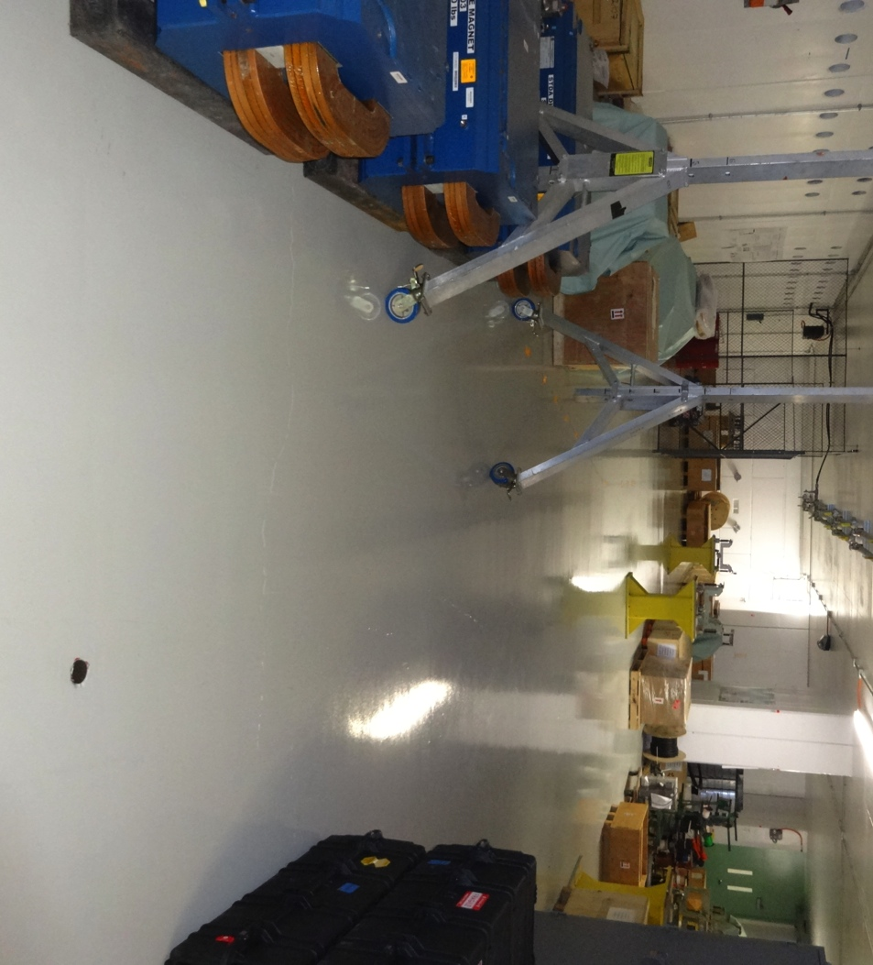
Near Term Action Items
Identify exactly what we have and what we need.
Figure out what to move and where to move it.
Would be nice to move at least the source and RFQ to their real location so we can start assembling things and commissioning.
~view from the RFQ

