Slide 1
Simulation of Protons in IOTA Using Synergia
Eric Prebys, FNAL

Slide 2
What is Synergia?*
Synergia is a hybrid Python/C++ package for single or multiple bunch accelerator simulations utilizing PIC methods. It includes:
Fully nonlinear and symplectic independent-particle physics, as well as symplectic linear maps and arbitrary-order polynomial maps.
Collective effects, including space charge and wake fields, in various approximations ranging from the very simple to computationally-intense, 3-dimensional field calculations.
Synergia is open source​.
Synergia was developed under the DOE SciDAC program as part of the ComPASS​ project by James Amundson, Steve Goldhaber, Paul Lebrun, Qiming Lu, Alexandru Macridin, Leo Michelotti (CHEF libraries), Chong Shik Park, Panagiotis Spentzouris and Eric Stern.
*from the Synergia web page

Slide 3
Pros and Cons
Pros:
Extremely powerful
Very scalable and adaptable
Lots of handles for custom user interfaces
Lots of (very responsive) local support
Reasonably user friendly
Imports Mad8 and MadX files directly
Operation fairly intuitive, (which is good because…)
Cons:
Documentation virtually nonexistant!
A couple of simple examples and lots of placeholders
Usually end up asking Jim Amundsen or reading source code
Extremely limited user base
Still plenty of bugs and “features”
Found one running examples, a second a couple days later.
Quickly fixed by Jim

Slide 4
Example Script
# space charge or no space charge
use_space_charge=1
# fill ring with uniform beam
turns=200 # number of turns
# Define a lattice
# Read the lattice named "machine" from the Madx file "iota6.madx"
lattice = synergia.lattice.MadX_reader().get_lattice("machine", "iota6.madx”)
# Define a bunch
x_emit = 3.9e-6 # m-rad, RMS
y_emit = 3.9e-6 # m-rad, RMS
z_std = 2*.0018 # z bunch size,
z_period = 6.73E-02 # space between bunches
dpop = 1e-3 # unitless, RMS \frac{\delta p}{p_{tot}}
real_particles = 1.5e8 # real particles, used for space charge, impedance, etc
macro_particles = 50000 # Used for PIC calculations
# Set up the space charge model
commxx = Commxx(True)
grid = [32, 32, 32]
if use_space_charge==1:
space_charge = Space_charge_2d_open_hockney(commxx, grid)
else:
space_charge = Dummy_collective_operator("null space charge")
# Define a set of simulation steps
map_order = 1
steps_per_element = 1 # simulation steps per element
# this tells it to do both a tracking simulation and
# and a space charge update at each stepp
stepper = Split_operator_stepper_elements(lattice, map_order,
space_charge,
steps_per_element)
lattice_simulator = stepper.get_lattice_simulator()

Slide 5
Example Script (cont’d)
# Create a periodic bunch that matches the optics
seed = 1415926 # random number seed; 0 for automatic calculation (GSL)
bunch = synergia.optics.generate_matched_bunch_transverse(
lattice_simulator,
x_emit, y_emit, z_std, dpop,
real_particles, macro_particles,
seed=seed,z_period_length=z_period)
z_period = bunch.get_z_period_length()
print z_period
# Define a bunch simulator
bunch_simulator = Bunch_simulator(bunch)
# Define a set of bunch diagnostics
# Apply *average* bunch diagnostics every step
diagnostics = Diagnostics_full2("diagnostics.h5")
bunch_simulator.add_per_step(diagnostics)
# apply macroparticle diagnostics every n turns
tracker = Diagnostics_particles("tracks.h5")
bunch_simulator.add_per_turn(tracker,10)
# Perform the simulation
propagator = Propagator(stepper)
max_turns = 0 # Number of turns to run before writing checkpoint and stopping
# When max_turns is 0, the simulation continues until the end.
verbosity = 2 # Display information about each simulation step
propagator.propagate(bunch_simulator, turns, max_turns, verbosity)

Slide 6
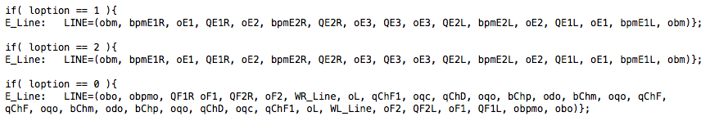
A couple small issues with iota6.madx
MadX reader is less forgiving than MadX
Caught missing semicolons that MadX ignored
MadX interprets all lines, even those that are not selected.
Missing comma in a line wich was not used (would have been an error in MadX if loption==0)

Slide 7
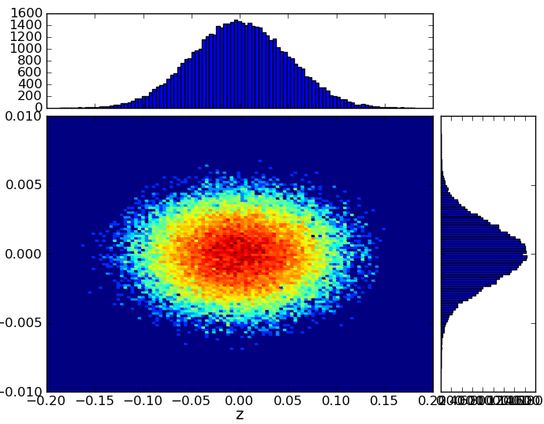
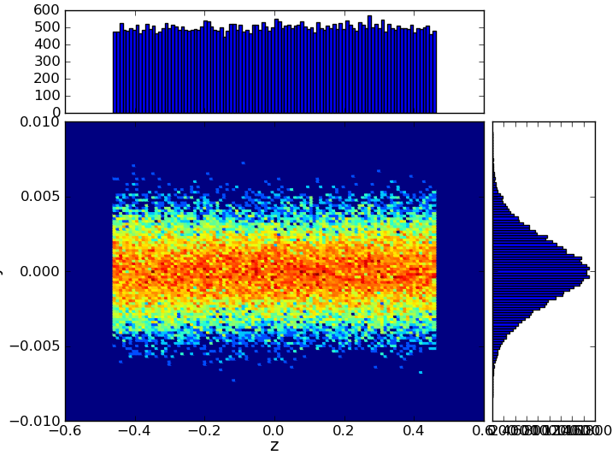
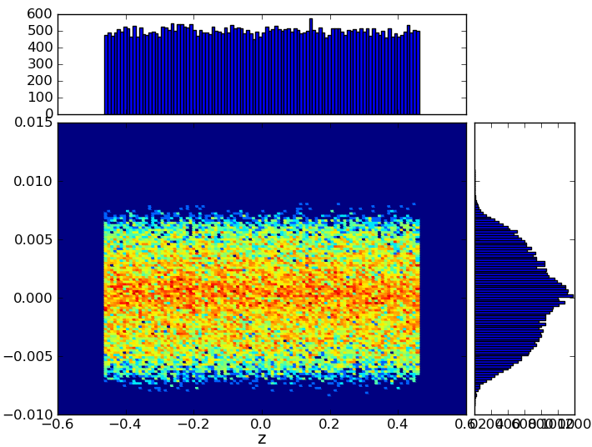
Example Results
Remember, no nonlinearities, impedances or RF yet
Expect no instabilities
7 s/turn on my MacBook
Distribution at injection, 10, and 200 turns (Recall, bunch diagnostics every 10 turns in my script)
>synbeamplot tracks_00nn.h5 –-bins=100 z x
nn=00
nn=01
nn=20
Note: “z” is really cΔt (one of the “features” I discovered)

Slide 8
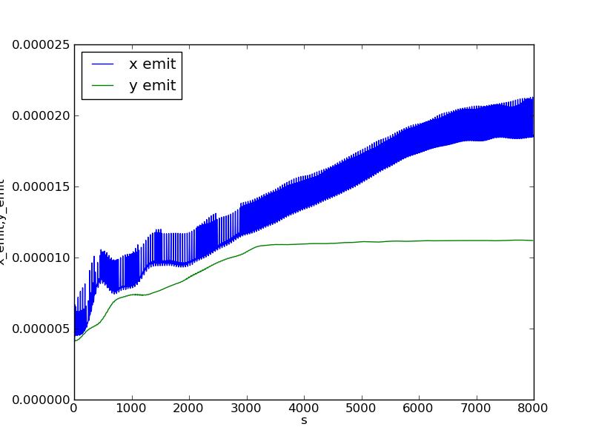
Emittance Growth (first 200 turns)
> syndiagplot diagnostics.h5 –-oneplot x_emit y_emit
Emittance a bit quirky in dispersive regions

Slide 9
IOTA Users
Current users
David Bruhwiler, RadiaSoft
Working on octopoles, nonlinear elements, and impedance modeling
Me
Introducing RF, setting up for parallel running
Sergey Antipov
Getting started
Future users
Talk to me first
Most people install it on their own computers:
Mostly Scientific Linux (not entirely painless)
Probably other Linux
Mac version coming “soon”

