Slide 1
Protons->IOTA Meeting
Eric Prebys

Slide 2
Reminder: Motivation
The primary motivation for nonlinear integrable optics is to reduce the sensitivity to harmonic instabilities and thereby enable stable beams with higher space charge or beam-beam tune shifts.
This cannot be directly measured with the electron beam.
electron beam must be used as pencil beam to probe tune space.
Eventually, we can experiment with space charge compensation techniques (e-lens, etc)
DOE review recognized this as a high priority
“…the high priority R&D goal for Fermilab is to develop the standalone IOTA ring, including its proton source. A revised cost estimate that includes these additional items [injection, instrumentation, experiments] should be provided…prior to finalizing a funding decision.”

Slide 3
Reminder: General Plan
Move HINS RFQ and proton source to IOTA ring
Locate RF hardware upstream in the NML gallery

Slide 4
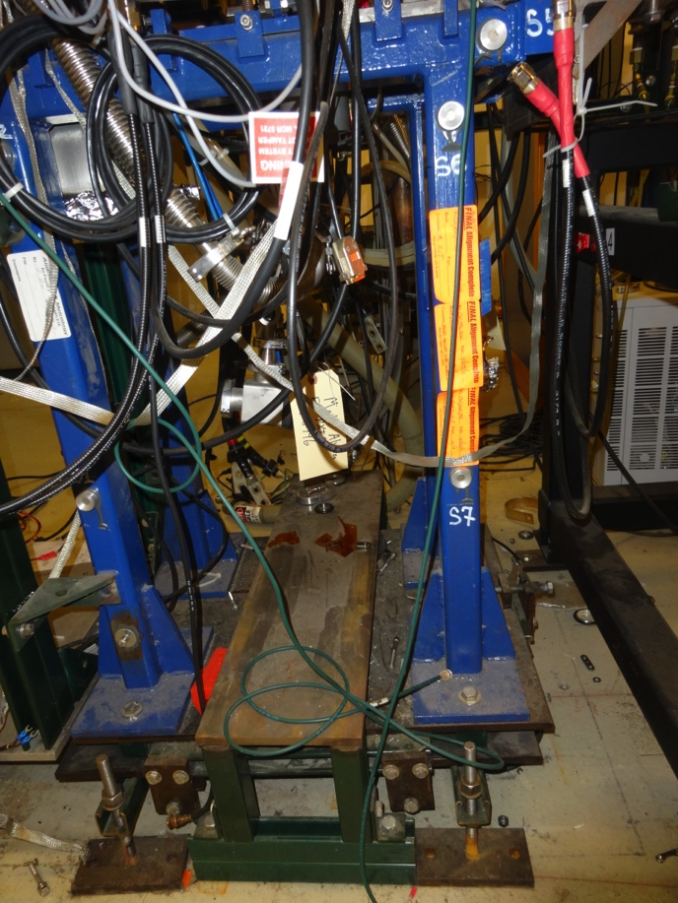
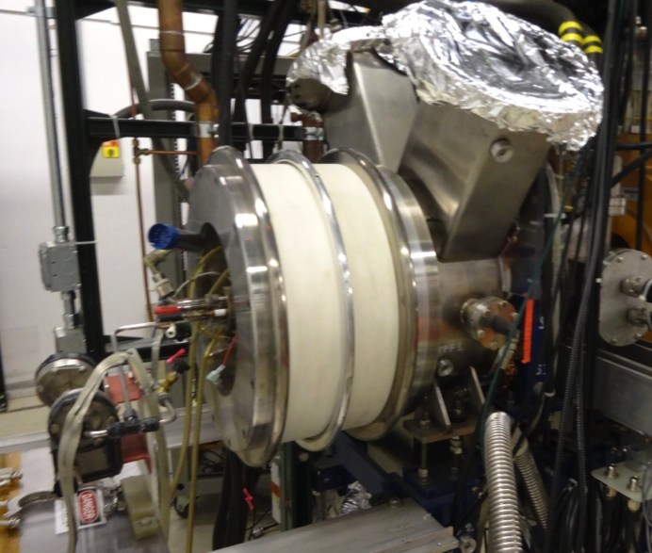
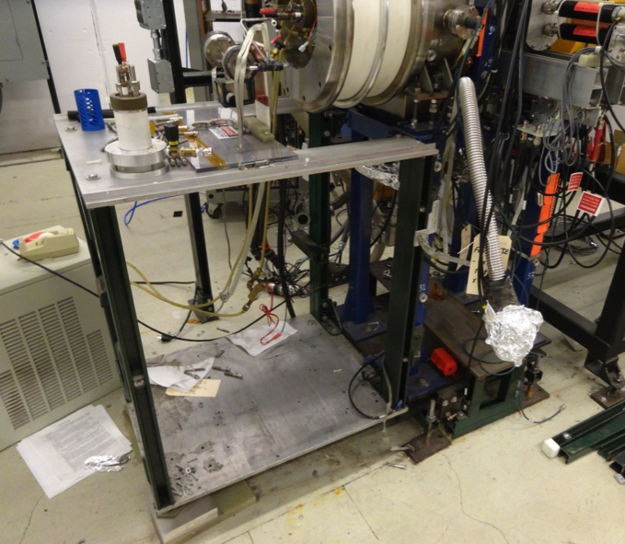
Current Status
These pictures say it all:
Major hardware is there, but almost everything attached to that hardware is gone
Vacuum systems
Power supplies

Slide 5
Two Efforts
Design/simulation:
Injection beam line design (S. Antipov)
Beam simulation in ring (S. Webb, D. Bruhwiler, E. Prebys, S. Antipov)
Shielding assessment (E. Prebys)
Hardware:
Identify what we have and what we haven’t (E. Prebys, Jerry Leibfritz, Kermit Carlson, Henryk Piekarz + lots of help)
Start making a plan to get the things we need
Scrounge wherever possible
No serious money until FY17
Begin to resurrect ion source in HINS cave (Henryk Piekarz, et al)

Slide 6
Reminder: Our Proposed Budget
Working on more accurate budget (particularly Henryk)
Probably in the right ball park for most stuff
Assumes we can scrounge magnets and power supply

Slide 7
Meetings
I plan to have meetings every two weeks
Probably alternate between hardware and software/design until things begin to pick up.

