Slide 1
Protons->IOTA Meeting
Eric Prebys

Slide 2
Reminder: Motivation
The primary motivation for nonlinear integrable optics is to reduce the sensitivity to harmonic instabilities and thereby enable stable beams with higher space charge or beam-beam tune shifts.
This cannot be directly measured with the electron beam.
electron beam must be used as pencil beam to probe tune space.
Eventually, we can experiment with space charge compensation techniques (e-lens, etc)
DOE review recognized this as a high priority
“…the high priority R&D goal for Fermilab is to develop the standalone IOTA ring, including its proton source. A revised cost estimate that includes these additional items [injection, instrumentation, experiments] should be provided…prior to finalizing a funding decision.”

Slide 3
Reminder: General Plan
Move HINS RFQ and proton source to IOTA ring
Locate RF hardware upstream in the NML gallery

Slide 4
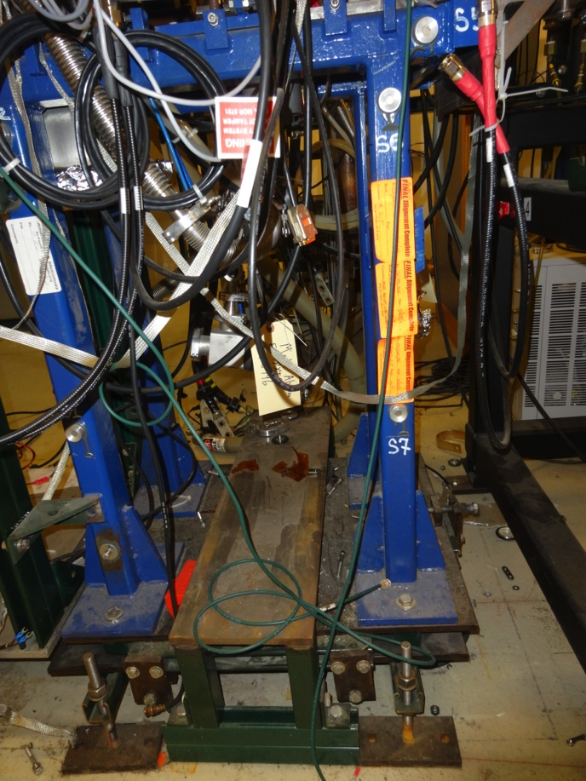
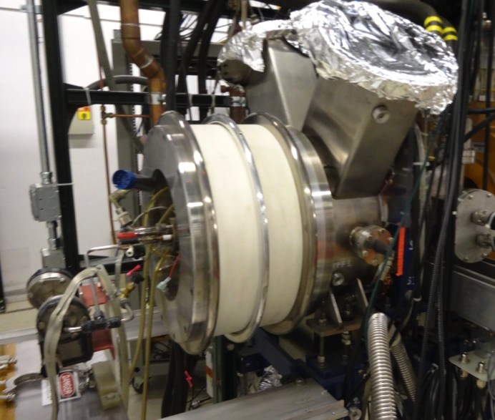
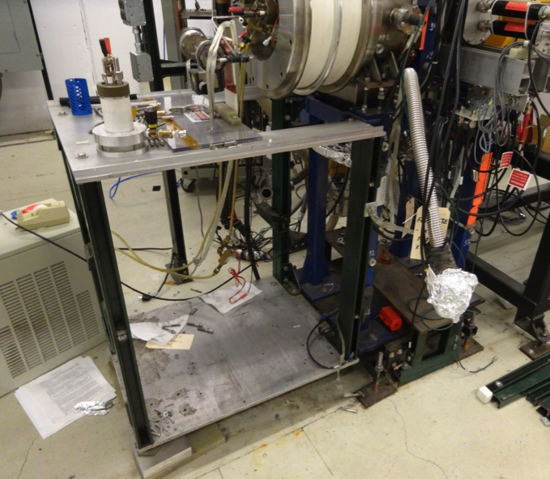
Current Status
These pictures say it all:
Major hardware is there, but almost everything attached to that hardware is gone
Vacuum systems
Power supplies

Slide 5
Two Efforts
Design/simulation:
Injection beam line design (S. Antipov)
Beam simulation in ring (S. Webb, D. Bruhwiler, E. Prebys, S. Antipov)
Shielding assessment (E. Prebys)
Hardware:
Identify what we have and what we haven’t (E. Prebys, Jerry Leibfritz, Kermit Carlson, Henryk Piekarz + lots of help)
Start making a plan to get the things we need
Scrounge wherever possible
No serious money until FY17
Begin to resurrect ion source in HINS cave (Henryk Piekarz, et al)

Slide 6
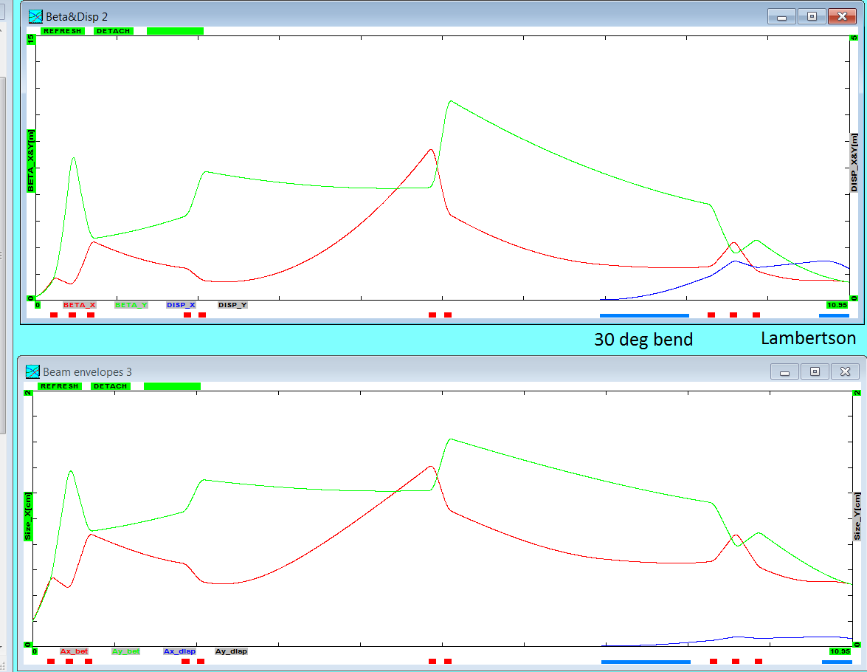
Latest Optics*
Debuncher location
*S. Antipov

Slide 7
Required Quads: looking for these
qF1 L[cm]=10 G[kG/cm]=0.9 Tilt[deg]=0
qF11 L[cm]=10 G[kG/cm]=0.55 Tilt[deg]=0
qD1 L[cm]=10 G[kG/cm]=-1.0 Tilt[deg]=0
qF3 L[cm]=10 G[kG/cm]=0.230165 Tilt[deg]=0
qD3 L[cm]=10 G[kG/cm]=-0.2346747 Tilt[deg]=0
qF2 L[cm]=10 G[kG/cm]=0.371036 Tilt[deg]=0
qD2 L[cm]=10 G[kG/cm]=-0.3205972 Tilt[deg]=0
q_Disp1 L[cm]=10 G[kG/cm]=-0.225 Tilt[deg]=0
q_Disp2 L[cm]=10 G[kG/cm]=0.45 Tilt[deg]=0
q_Disp3 L[cm]=10 G[kG/cm]=-0.225 Tilt[deg]=0
Too big for trims. Working to identify available candidates

Slide 8
Simulation effort: What is Synergia?*
Synergia is a hybrid Python/C++ package for single or multiple bunch accelerator simulations utilizing PIC methods. It includes:
Fully nonlinear and symplectic independent-particle physics, as well as symplectic linear maps and arbitrary-order polynomial maps.
Collective effects, including space charge and wake fields, in various approximations ranging from the very simple to computationally-intense, 3-dimensional field calculations.
Synergia is open source​.
Synergia was developed under the DOE SciDAC program as part of the ComPASS​ project by James Amundson, Steve Goldhaber, Paul Lebrun, Qiming Lu, Alexandru Macridin, Leo Michelotti (CHEF libraries), Chong Shik Park, Panagiotis Spentzouris and Eric Stern.
*from the Synergia web page

Slide 9
Pros and Cons
Pros:
Extremely powerful
Very scalable and adaptable
Lots of handles for custom user interfaces
Lots of (very responsive) local support
Reasonably user friendly
Imports Mad8 and MadX files directly
Operation fairly intuitive, (which is good because…)
Cons:
Documentation virtually nonexistant!
A couple of simple examples and lots of placeholders
Usually end up asking Jim Amundsen or reading source code
Extremely limited user base
Still plenty of bugs and “features”
Found one running examples, a second a couple days later.
Quickly fixed by Jim

Slide 10
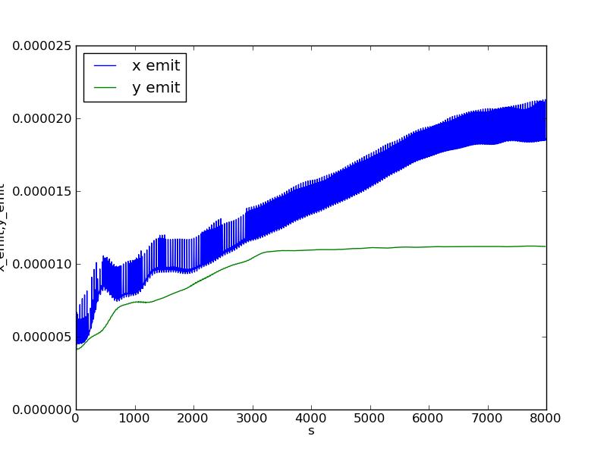
Emittance Growth (first 200 turns)
Starting to run in parallel on Wilson Cluster to run more turns
Emittance calculation a bit quirky in dispersive regions

Slide 11
Reminder: Our Proposed Budget
Working on more accurate budget (particularly Henryk)
Probably in the right ball park for most stuff
Assumes we can scrounge magnets and power supply
Working to secure HINS cave so more stuff doesn’t walk away

