Slide 1
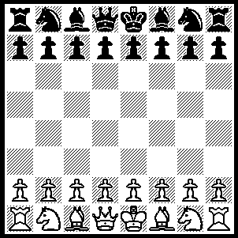
Board Setup and Basic Game Play
White on right
Turn the board so that each player has a white square by his or her right hand ("white on right"). If the board is numbered, the white rooks should be on squares 1a and 1h.
Each queen goes on her own color.
White moves first.
Each player makes one move per turn. A player MUST make a move on his or her turn.
You “capture” an opponent’s piece by moving your piece onto its square (there are some special rules about capturing with pawns).
You cannot move onto a square occupied by one of your own pieces.
The knight is the only piece that can jump over other pieces when it moves. All others have to have a clear path.
The object of the game is not really to capture pieces, but to put the other player’s king in “checkmate”, which is described on the next page.

Slide 2
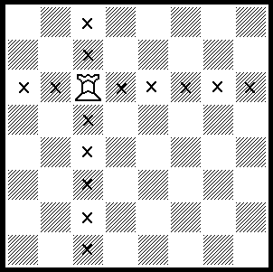
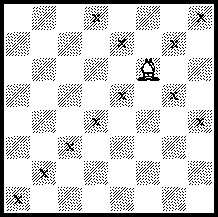
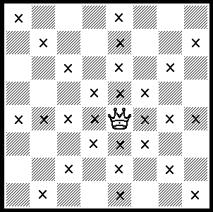
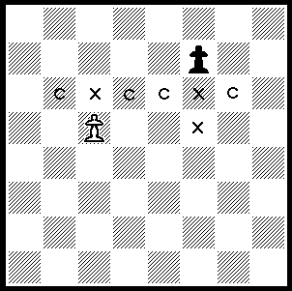
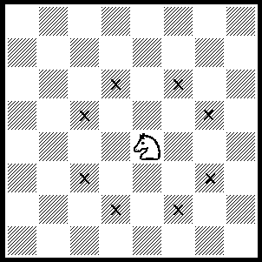
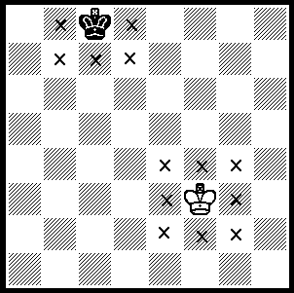
Basic Moves and Rules
queen
rook
bishop
Pawns move forward “X” one space at a time, but capture “C” by moving diagonally one space onto an occupied square. They cannot capture directly forward.
On the first move ONLY, a pawn may move one OR two spaces forward.
If a pawn makes it to the other side, you can turn it in to any other piece except the king or another pawn. This is called “pawn promotion”. In most cases, you’ll change the pawn to a queen, but in some special cases other pieces make more sense.
pawn
knight
In one move, the knight moves two spaces straight in one direction and one in the other. For example, starting as shown, it can move to any of the spaces marked “X”.
The knight is the only piece that can jump over other pieces.
The king can only move one space in any direction, except when “castling”, which is discussed on the next page.
The king cannot be captured. If it is in a position to be captured, we say it is “in check”. A player can never put his or her own king in check.
If the king is in check, the player MUST get it out of check on the next move. This can be done by moving the king, or by capturing or blocking the threatening piece.
The game ends when one player cannot get his king out of check. This is called “checkmate”. The other player wins.
king

Slide 3
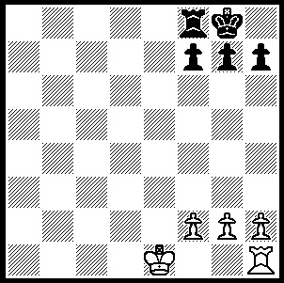
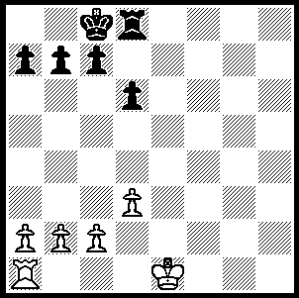
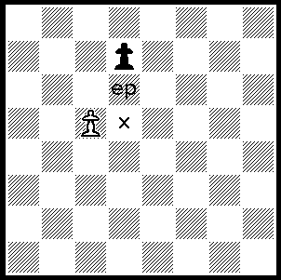
Some Weird Moves
Castling – King’s Side
If the king and rook are in the positions shown by white AND
  there is nothing between them AND
  neither piece has moved yet AND
  the king is not in check, and would not be in check on either of the two squares next to it in the direction of the rook,
the king a the rook may jump over each other in one move and end up in the positions shown by black.
Castling – Queen’s Side
The rules are the same as the King’s Side Castle, except the pieces start (white) and end (black) as shown. Note that in this case, castling may occur if the space next to the rook is threatened by an opposing piece, since the king never actually moves through that space.
NOTE: The strict rules say that when castling in a game, you should first move the king two spaces, then the rook. Moving the king two spaces is also how you castle in most computer chess games (since it’s the only case in which a king can move more than one space).
Pawn Capture “En Passant”
If a pawn moves two spaces on the first move and ends up next to a pawn from the other side (as shown by black moving to “X”), then the other side may capture it as if it had only moved one space; that is, in this case, the white may move to the square marked “ep” and take the pawn.
This is called capturing “en passant” (French for “in passing”).
NOTE: Many people have never heard of this move, and others get it wrong. If you think you might use it, it’s a good idea to mention it before the game starts!

Slide 4
The Value of Pieces
A very important part of chess is knowing when to “sacrifice” one or more pieces; that is, when it’s OK to lose one or more of your pieces in order to capture pieces of higher value (or get a checkmate).
To figure out whether to sacrifice, chess pieces are usually assigned the following values:
  Checkmate: infinite
  Queen: 9
  Rook: 5
  Bishop: 3 (or 3½, a tiny bit more than a knight)
  Knight: 3
  Pawn: 1
For example, you would not try to capture your opponents rook (5 points) if it meant losing your queen (9 points), but it would be worth losing your queen to capture both of your opponents rooks (5+5=10 points).
A guaranteed checkmate is worth any sacrifice.
Other Resources
Web:
  Google “chess”: 13,800,000 hits
  http://dir.yahoo.com/Recreation/Games/Board_Games/Chess/ is a good place to start.
Books:
  Lots.
  Believe it or not, “The Complete Idiot’s Guide to Chess” comes pretty highly recommended.
Programs:
  Lots of free ones on the web, but most only good for advanced players.
  “Chessmaster” is excellent. Lots of tutorials. Plays like a person of selectable skill. Not designed for kids, but kids have no trouble with it. Current version is “Chessmaster 9000”. I’m quite happy with 8000, which you can find for under $10 if you look.
  “ChessMates” is a great chess game for kids. Adults can learn from it, too.

