Slide 1
Formalities
Eric Prebys, UC Davis

Slide 2
Goals of this course
I hope this course will provide you with…
a rigorous foundation of the underlying physics of particle accelerators,
Fairly sophisticated understanding of their operations.
The background to pursue more advanced studies on your own (or in further classes).
a quantitative overview of the state of the art, as well as current and future challenges.
familiarity with enabling and related technologies:
Magnets
RF
Instrumentation
etc.

Slide 3
Course Personnel
Instructor:
Eric Prebys, UC Davis, eprebys@ucdavis.edu, 630-336-1893
Lab Instructors:
Elvin Harms, FNAL, harms@fnal.gov
Amber Johnson, University of Maryland, ajohns37@umd.edu
TA:
Nicole Neveu, Illinois Institute of Technology, nneveu@hawk.itt.edu
Graders
Laura Boon, lauraeboon@gmail.com
Robert Hipple, Michigan State University, hipple@msu.edu
Course Website (everything gets posted here!): http://home.fnal.gov/~prebys/misc/uspas_2018/

Slide 4
Some warnings right up front
This course is intended to cover in two very intense weeks the material that would be in a full semester university course
That’s the mandate; there’s nothing I can do about it
Students have a pretty broad range of backgrounds, so some will struggle more than others, particularly in the beginning.
If you get behind, you will never catch up!
Ask questions
Attend help sessions
Work together

Slide 5
Class Demographics

Slide 6

My Background
1984: BS in Engineering Physics, University of Arizona
Got a job in an HEP group after being fired from a gas station.
1984-1990: Grad Student, University of Rochester
PhD topic: Direct Photon Production in Hadronic Interactions
1990-1992: CERN Fellow, CERN
Studied e+e- reactions on the OPAL Experiment at LEP
1992-2001: Postdoc and Assistant Professor, Princeton U.
GEM Experiment at the Superconducting Super Collider
Belle CP Violation Experiment at KEK, Japan
Nonlinear QED in E-144 Experiment at SLAC
2001-2017: Scientist, Fermilab
MiniBooNE short baseline neutrino oscillation experiment
Proton Source Department Head
Director of LHC Accelerator Research Program (LARP)
Mu2e rare muon conversion experiment
Created Lee Teng Internship and ran it for 10 years
2017-present, Professor, UC Davis
Mu2e
Director, Crocker Nuclear Laboratory (cyclotron)
Experimental HEP
Accelerator Physics (mostly)

Slide 7
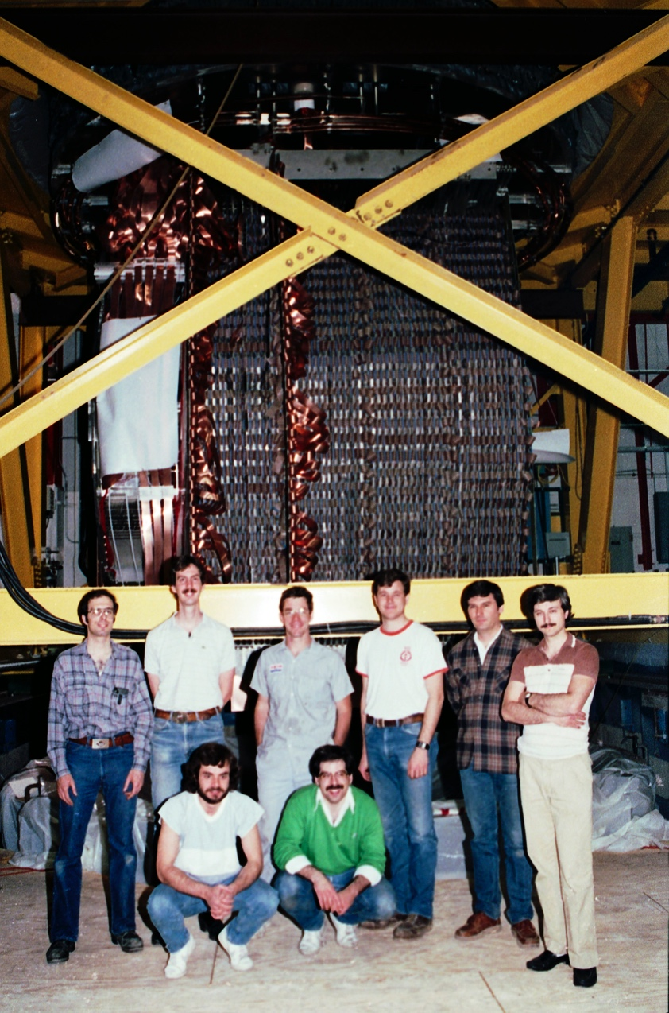
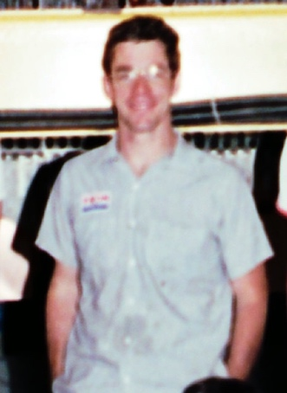
Me
“Buck’s River Road Exxon”
Fermilab E-706 Rochester Group
~1987

Slide 8
General Plan
I’m going to spend today on the basics, as well as a fairly qualitative overview of everything we’re going to learn
This will hopefully level the playing field in terms of previous experience and exposure to the concepts
I’m planning to give an in depth treatment of
Transverse motion
Strong focuusing
Lattice functions
Longitudinal motion
Acceleration
Synchrotron motion
More qualitative treatment of general topics in the field
Will mix up the two, to give your brains a rest.

Slide 9
A note on text
I chose Edwards and Syphers “An Introduction to the Physics or High Energy Accelerators” as the primary course text because
It’s the book I learned from
I find the mathematical level appropriate to a broad range of students.
It was written by Fermilab people, so it uses conventions that I’m familiar with.
It’s the same book I use for the graduate course, but we’ll cover much less of it, and at a less rigorous level.
I won’t stick to the order of the book. In particular, like most people who use it, I’ll switch the order of Chapter 2 (longitudinal motion) and 3 (transverse motion)

Slide 10
Other references
Edmund Wilson, “Particle Accelerators”
A bit lower level than E&S. Often used for this course.
Concise reference on a number of major topics
Available in paperback (important if you are paying)
Klaus Wille “The Physics of Particle Accelerators”
Same comments
Welmut Wiedemann, “Particle Accelerator Physics”
Probably the most complete and thorough book around (originally two volumes)
Scope very large and mathematical level very high, even for the graduate course.
Fermilab “Accelerator Concepts” (“Rookie Book”)
http://tinyurl.com/FNAL-concepts
Particularly chapters II-IV

Slide 11
Tentative Schedule
Lecture: 9-12
Will lecture in the afternoon a bit today.
Lunch: 12-1:30
Labs: 1:30-5:00
Problem sessions: 7-??
Homework every day except Friday and next Thursday, to be turned in the next day.
Students are encouraged to work together on homework
In-class exam next Friday.
As lectures, homework, and other material are ready, they will be put at:
http://home.fnal.gov/~prebys/misc/uspas_2018/

Slide 12
Course Schedule (very approximate)
Time | Day
 | Mon. (6/4) | Tues. (6/5) | Wed. (6/6) | Thu. (6/7) | Fri. (6/8)
9:00 AM | Lecture: Formalities Introduction Basics | Lecture: - Transverse Motion 1 | Lecture - Transverse Motion 2 | Lecture: - Longitudinal Motion | Guest Lecture: Nicole Neveu - Linacs
10:00 AM
11:00 AM
12:00 AM | Lunch | Lunch | Lunch | Lunch | Lunch
1:00 PM
 | Lecture (cont’d) | Lab | Lab | Lab | Lab
2:00 PM
3:00 PM | Lab Introduction
4:00 PM
Time | Day
 | Mon. (6/11) | Tues. (6/12) | Wed. (6/13) | Thu. (6/14) | Fri. (6/15)
9:00 AM | Lecture Lattice Imperfections Insertions | Guest Lecture: Nicole Neveu Cavity Development Sources | Lecture Collective effects Instability Colliders and Luminosity | Lecture Special topics Requests | In-class final exam
10:00 AM
11:00 AM
12:00 AM | Lunch | Lunch | Lunch | Lunch | End
1:00 PM
 | Lab | Lab | Lab | Lab
2:00 PM
3:00 PM
4:00 PM

Slide 13
Lecture Style
All the details of my lectures will be in my PowerPoint slides, which I will copy and hand out (they’ll also be available online).
There will probably be some mistakes in the slides, which I’ll correct in the online version if and when we catch them.
I will often write on the board simply as a way to pace myself (otherwise, I find I go way too fast). Sometimes this will involve simply copying what’s on the slides.
I’ll also work through a lot of problems and examples that aren’t in the slides, so that’s where you’ll want to take notes. I’ll copy and distribute any I think are particularly valuable, but don’t count on it.
I used to think that if people didn’t ask questions, it’s because they understood everything I was saying. Now I know the opposite is true, so if I don’t get any questions, I’ll keep slowing down until I do.

