Slide 1

Annotation Is (Almost) Indispensable: The Limitations of Unpaired Domain Translation and Semi-Supervised Approaches to Ultrasound Simplification
Precious Kolawole and Matthew S. Holden
Carleton University, School of Computer Science, Ottawa, Ontario, Canada

Slide 2
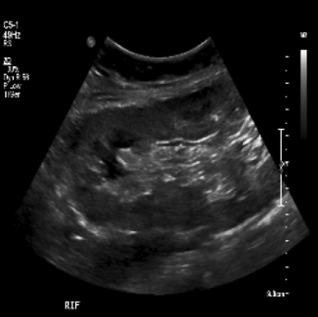
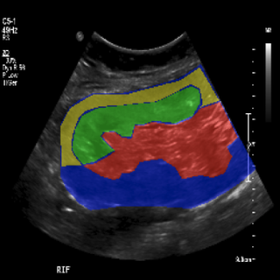
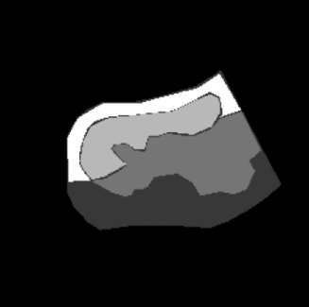
Background
US image
expert drawn mask
US segmentation
Notes:
Ultrasound imaging is a radiation free, non-invasive diagnostic tool
But there is a gap between what ultrasound offers and what clinicians and researchers can extract from it1.
Simplifying ultrasound scans into interpretable representations requires extensive manual annotations.
Segmentation requires each image to have a mask drawn by an expert.
This is hard in resource limited environments2

Slide 3
Prior Work
U-Net¹ for fully supervised segmentation needs paired data
MLAU-Net² solution to US low contrast and speckle noise also requires paired annotation
Unpaired domain translation, CycleGAN³ used in cardiac US with constrained shape has questionable performance for complex US structures
Semi-supervised with consistency regularization⁴ and adversarial training uses limited annotation, but minimum effective annotation remains unquantified
1. Ronneberger, O., et al, “U-net: Convolutional networks for biomedical image segmentation,” (2015).
2. Khan, R., et al, “Mlau-net: Deep supervised attention and hybrid loss strategies for enhanced segmentation of low-resolution kidney ultrasound,” DIGITAL HEALTH (2024).
3. Zhu, J.-Y., et al, “Unpaired image-to-image translation using cycle-consistent adversarial networks,” ICCV (2017).
4. Zhang, Z., et al, “Translating and segmenting multimodal medical volumes with cycle-and shape-consistency generative adversarial network,” 9242–9251 (2018)

Slide 4
Objective
Research Question: Can we effectively simplify ultrasound through segmentation without
paired annotation?
Determine whether unpaired approaches can produce clinically useful segmentations.
Quantify the minimum annotation required for viable simplification.
Determine how segmentation complexity fundamentally reshapes these requirements.

Slide 5
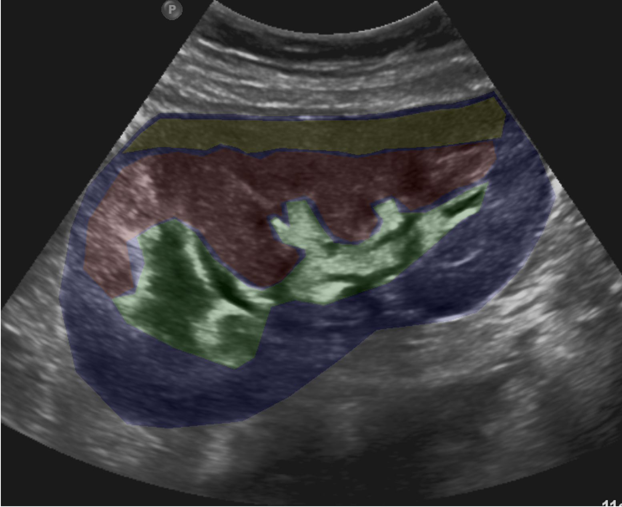
Dataset
Open kidney dataset⁵
534 US images of patients with chronic kidney disease, donor and transplant recipients
Four kidney regions annotated: cortex, capsule, medulla, and central echo complex
5. Singla, R., et al, “The open kidney ultrasound data set,” in [International Workshop on Advances in Simplifying Medical Ultrasound (ASMUS)], Springer Nature Switzerland (2023).
Notes:
two sonographers

Slide 6
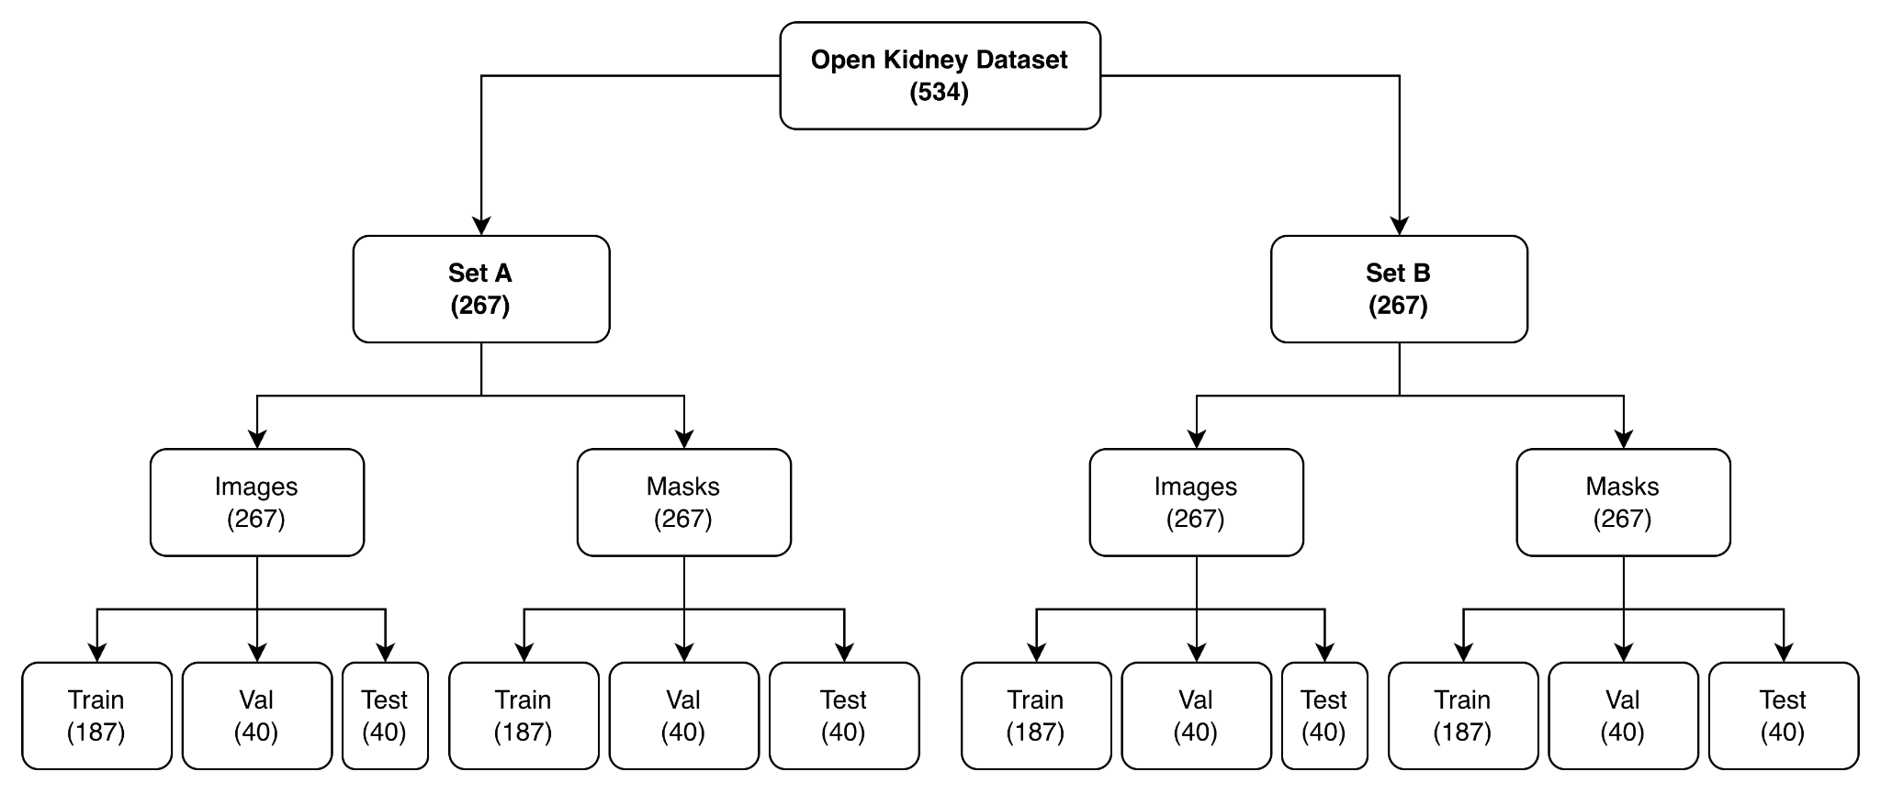
Preprocessing
Image-mask center cropped by 70%
Resized to 256 x 256 pixels
[0,1] normalized for supervised; [-1,1] normalized for GANs
Prevented information leakage:
Notes:
two sonographers

Slide 7
Method
3 major approaches:
Fully supervised learning
Unpaired CycleGAN learning
Semi supervised (hybrid) learning
Notes:
fully supervised learning - the ideal annotation where there is paired image-mask sample.
unpaired cyclegan learning - addresses the challenge of no labelled data - it shows labelling constraint.
semi supervised (hybrid) learning - shows limited paired data in the presence of abundant unlabelled data.

Slide 8
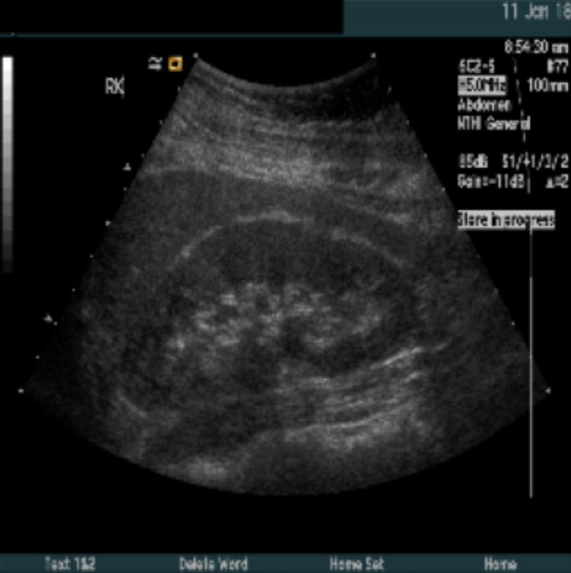
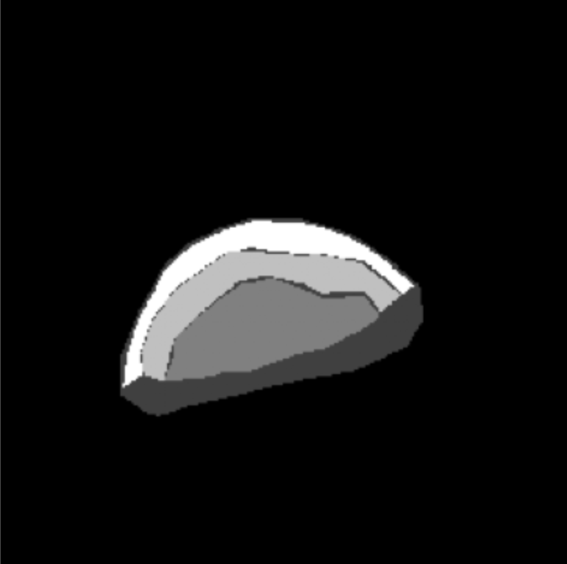
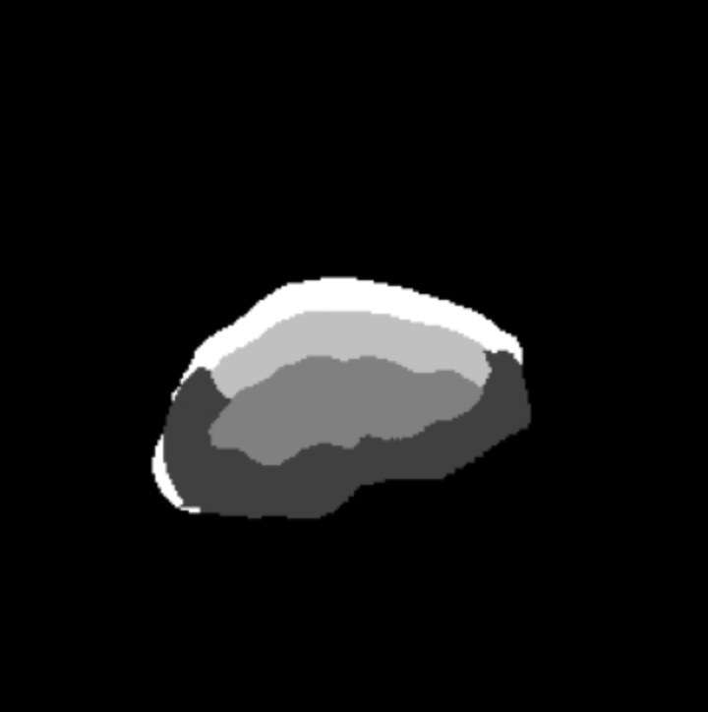
Method - Fully Supervised Learning
Used only paired image-mask from Set A
Trained with U-NET++ (pretrained: ImageNet; encoder: ResNet-101)
Dice Loss: 1 - DS = 1 - 2TP/ 2TP + FP + FN
Paired image-mask
Prediction
UNET++ ResNet101
ImageNet Encoder
same patient
C x 256 x 256
Notes:
mimics the ideal annotation scenario where there is paired-image mask.

Slide 9
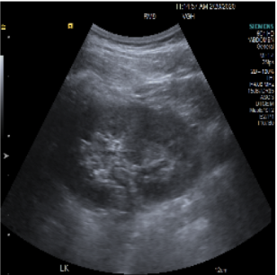
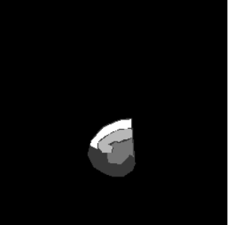
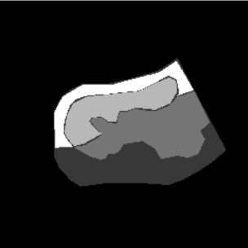
Method - Unpaired CycleGAN Learning
Used images from Set A and masks from Set B
Two generator-discriminator pairs:
G_{A→B} (US →mask) and G_{B→A} (mask→US)
PatchGAN discriminator (D_{A} and D_{B})
Generators have U-Net++ backbones & ResNet-101 encoders
Loss: ℒ^{A}_{adv} + ℒ^{B}_{adv} + ℒ^{A}_{cyc} + ℒ^{B}_{cyc} (+ ℒ_{id} binary only)
Segmentation model = G_{A→B} at inference
D_{A} PatchGAN
D_{B} PatchGAN
G_{A->B} (UNet++)
US -> Mask
Domain A
Domain B
G_{B->A} (UNet++)
Mask -> US
Set A ultrasounds
Set B masks
Notes:
No paired data scenario.
The generator creates synthetic data to mimic a real dataset, while the discriminator acts as a classifier, attempting to distinguish between real data and the generator's fake, synthetic output.
Identity loss was omitted for multiclass due to the fundamental incompatibility between
continuous ultrasound and discrete one-hot label representations.

Slide 10
Method - Semi Supervised (Hybrid) Learning
Each training has:
Unpaired images from Set A
Unpaired masks from Set B
Paired image-mask of Set A
Paired loss: cross entropy segmentation loss in G_A→B outputs (direct supervision)
Discriminators exclusively unpaired
Total loss = ℒ_{G} = ℒᴬ_{adv} + ℒᴮ_{adv} + λ_{cyc}(ℒᴬ_{cyc} + ℒᴮ_{cyc}) + λ_{seg} ℒ_{seg} + λ_{id}ℒ_{id}
D_A PatchGAN
D_B PatchGAN
G_{A->B} (UNet++)
US -> Mask
Domain A
Domain B
G_{B->A} (UNet++)
Mask -> US
Set A ultrasounds
Set B masks
N Paired (same patient)
L_seg
CE loss
Notes:
mimics where there is limited ground truth in the presence of abundant unlabeled data
answers if incorporating a few annotations could meaningfully boost segmentation esp when all data remained unpaired.

Slide 11
Ablation
Each approach is partitioned
By complexity
Multiclass: labels 1-4 (cortex, capsule, medulla, central echo complex), 0 (background)
Binary: labels 1 (kidney), 0 (background)
By the amount of annotated (paired) data available
N-paired (5, 10, 25, 50, 93)
Weighted Dice : 0.0 (background), 0.25 (each anatomical region), 1.0 (all kidney)
Output: thresholding (binary), argmax (multiclass)

Slide 12
Implementation Details
All models used the segmentation-models-pytorch library
40 (Epochs), 1x10⁻⁴ (LR)
λ_{cyc} = 10, λ_{seg} = 3, and λ_{id} = 5
Validation = Dice & IOU from per class (tp, fp, tn, fn)
All evaluation used held-out Set A test split

Slide 13
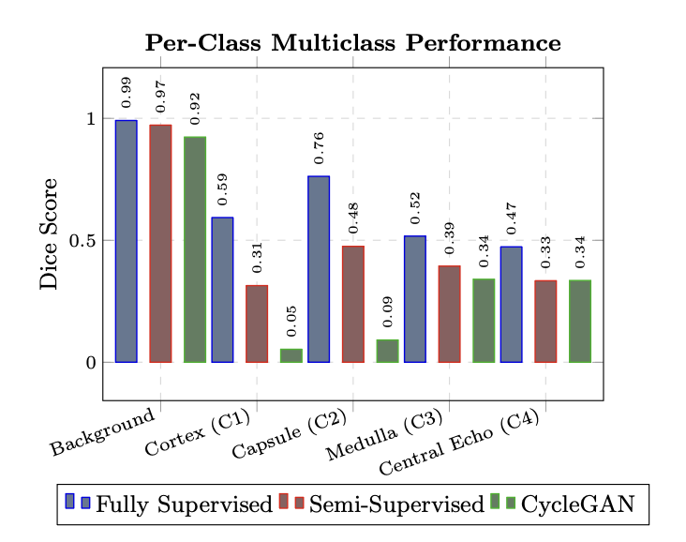
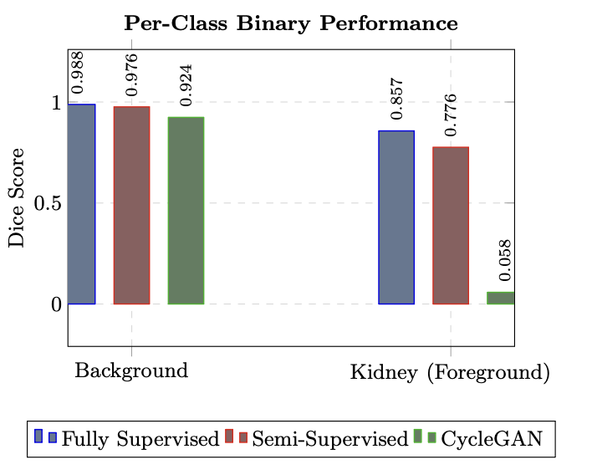
Results
Fully Supervised (highest overall performance)
Binary all: 0.90 (Dice), 0.82 (IoU)
Multiclass all: 0.63 (Dice), 0.47 (IoU)
Unpaired CycleGAN
Binary all: 0.058 (Dice), 0.030 (IoU)
Multiclass all: 0.043 (Dice), 0.024 (IoU)
Semi-Supervised Hybrid
Binary all: 0.842 (Dice), 0.732 (IOU)
Multiclass all: 0.274 (Dice), 0.179(IOU)

Slide 14
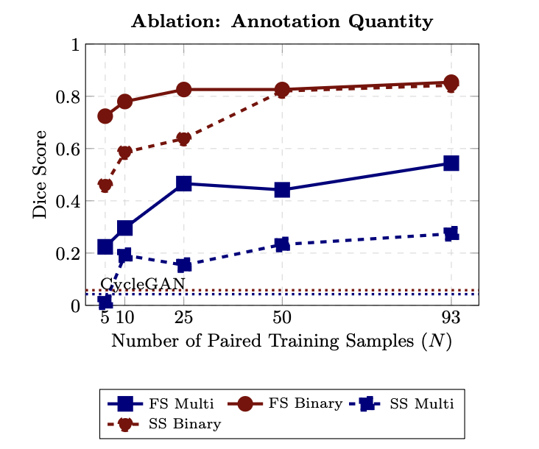
Results
Fully Supervised (highest overall performance)
Binary Ablation: 0.725 at N=5 → 0.854 at N=93 (17.8% increase)
Multiclass Ablation: 0.224 at N=5 → 0.544 at N=93 (143% increase)
Semi-Supervised Hybrid
Binary Ablation: 0.464 at N=5 → 0.842 at N=93; approached FS at N=50
Multiclass Ablation: 0.010 at N=5 → 0.274 at N=93 (50.4% of FS)
Notes:
Performance scaling with paired annotations.

Slide 15
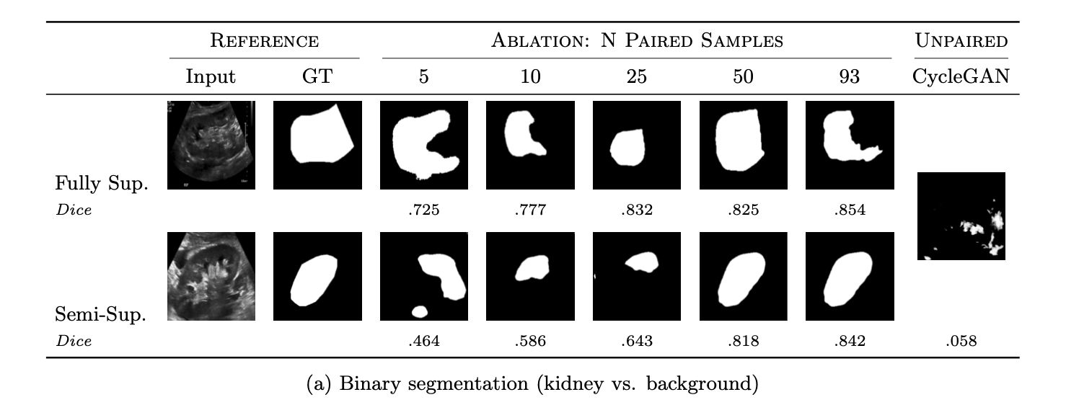
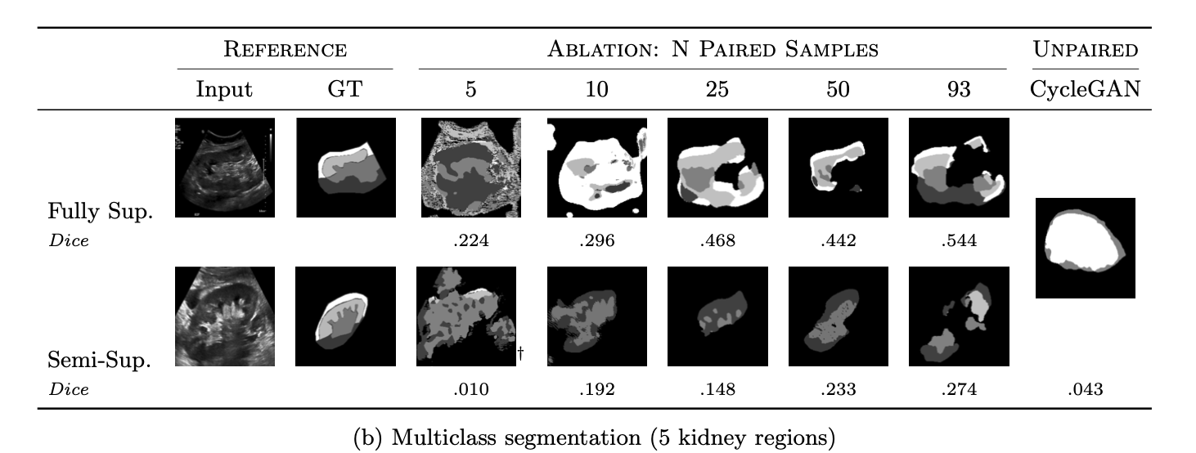
Results
Notes:
Predictions improve left-to-right as paired samples increase.

Slide 16
Discussion
Unpaired CycleGAN failed to produce usable segmentations for either task; semi supervised hybrid improved substantially over unpaired baselines.
Binary kidney segmentation (Dice > 0.70) is achievable with 25-50 paired samples using either FS or SS, while multiclass requires maximum available annotation.
Smaller anatomical structures require more annotations to achieve stable performance according to per-class ablation results.
Limitations
A single dataset limited to the kidney anatomy was used, and inter-rater variability between the two annotating sonographers was not evaluated.
Semi supervised formulation could explore alternatives like consistency regularization.
Notes:
Determine whether unpaired approaches can produce clinically useful segmentations.
Quantify the minimum annotation required for viable simplification.
Determine how segmentation complexity fundamentally reshapes these requirements.

Slide 17
Conclusion
We suggest using paired datasets for ultrasound simplification whenever possible
The paired dataset can be collected using tracked ultrasound⁶
6. China, D., et al “Automated labeling using tracked ultrasound imaging: Application in tracking vertebrae during spine surgery,” Medical image analysis (2025).
Notes:
by reconstructing the volumetric image of the relevant anatomy and co-register the image to a CT or MRI of the anatomy. Perform simplification once on the CT or MR image, then find the slice of the simplified 3D image of an arbitrary US using the transformation computed during registration.

Slide 18
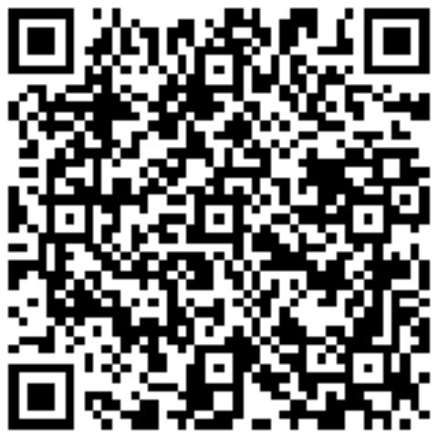
LinkedIn:
Acknowledgements
This work was supported by;
The Natural Sciences and Engineering Research Council of Canada grant RGPIN-2020-05582.
Black and Indigenous Summer Research Internship (BISRI) program at Carleton University.
Compute Ontario and the Digital Research Alliance of Canada.
THANK YOU
Name: Precious Kolawole
Email: preciouskolawole@cmail.carleton.ca
Notes:
mimics the ideal annotation scenario where there is paired-image mask.

