Slide 1

Limited Paired Labels Suffice for Binary but Not Multiclass Ultrasound Segmentation
Precious Kolawole and Matthew S. Holden
Carleton University, School of Computer Science, Ottawa, Ontario, Canada

Slide 2
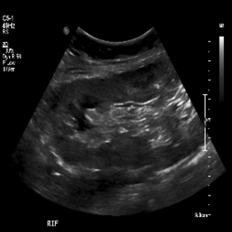
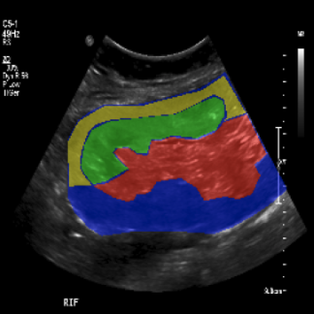
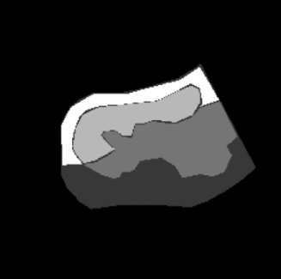
Background
US image
expert drawn mask
US segmentation
Notes:
Ultrasound imaging provides real time, radiation free views of internal anatomy.
But raw images are noisy; difficult for clinicians to interpret.
We can simplify ultrasound through segmentation
However, it requires many scans with detailed annotated masks
Expensive and challenging in resource limited environments.

Slide 3
Prior Work
U-Net¹ for fully supervised segmentation needs paired data
Unpaired domain translation, CycleGAN² used in cardiac US with constrained shape has questionable performance for complex US structures
Semi-supervised with consistency regularization³ and adversarial training uses limited annotation, but the effect of task complexity (binary vs. multiclass) on these methods remains unclear
1. Ronneberger, O., et al, “U-net: Convolutional networks for biomedical image segmentation,” (2015).
2. Zhu, J.-Y., et al, “Unpaired image-to-image translation using cycle-consistent adversarial networks,” (2017).
3. Zhang, Z., et al, “Translating and segmenting multimodal medical volumes with cycle-and shape-consistency generative adversarial network,” (2018).

Slide 4
Objective
Research Question: Can we effectively simplify ultrasound through segmentation with limited or no paired annotation?
Determine whether unpaired approaches can produce clinically useful segmentations.
Determine how segmentation complexity (binary vs. multiclass) fundamentally reshapes these requirements.

Slide 5
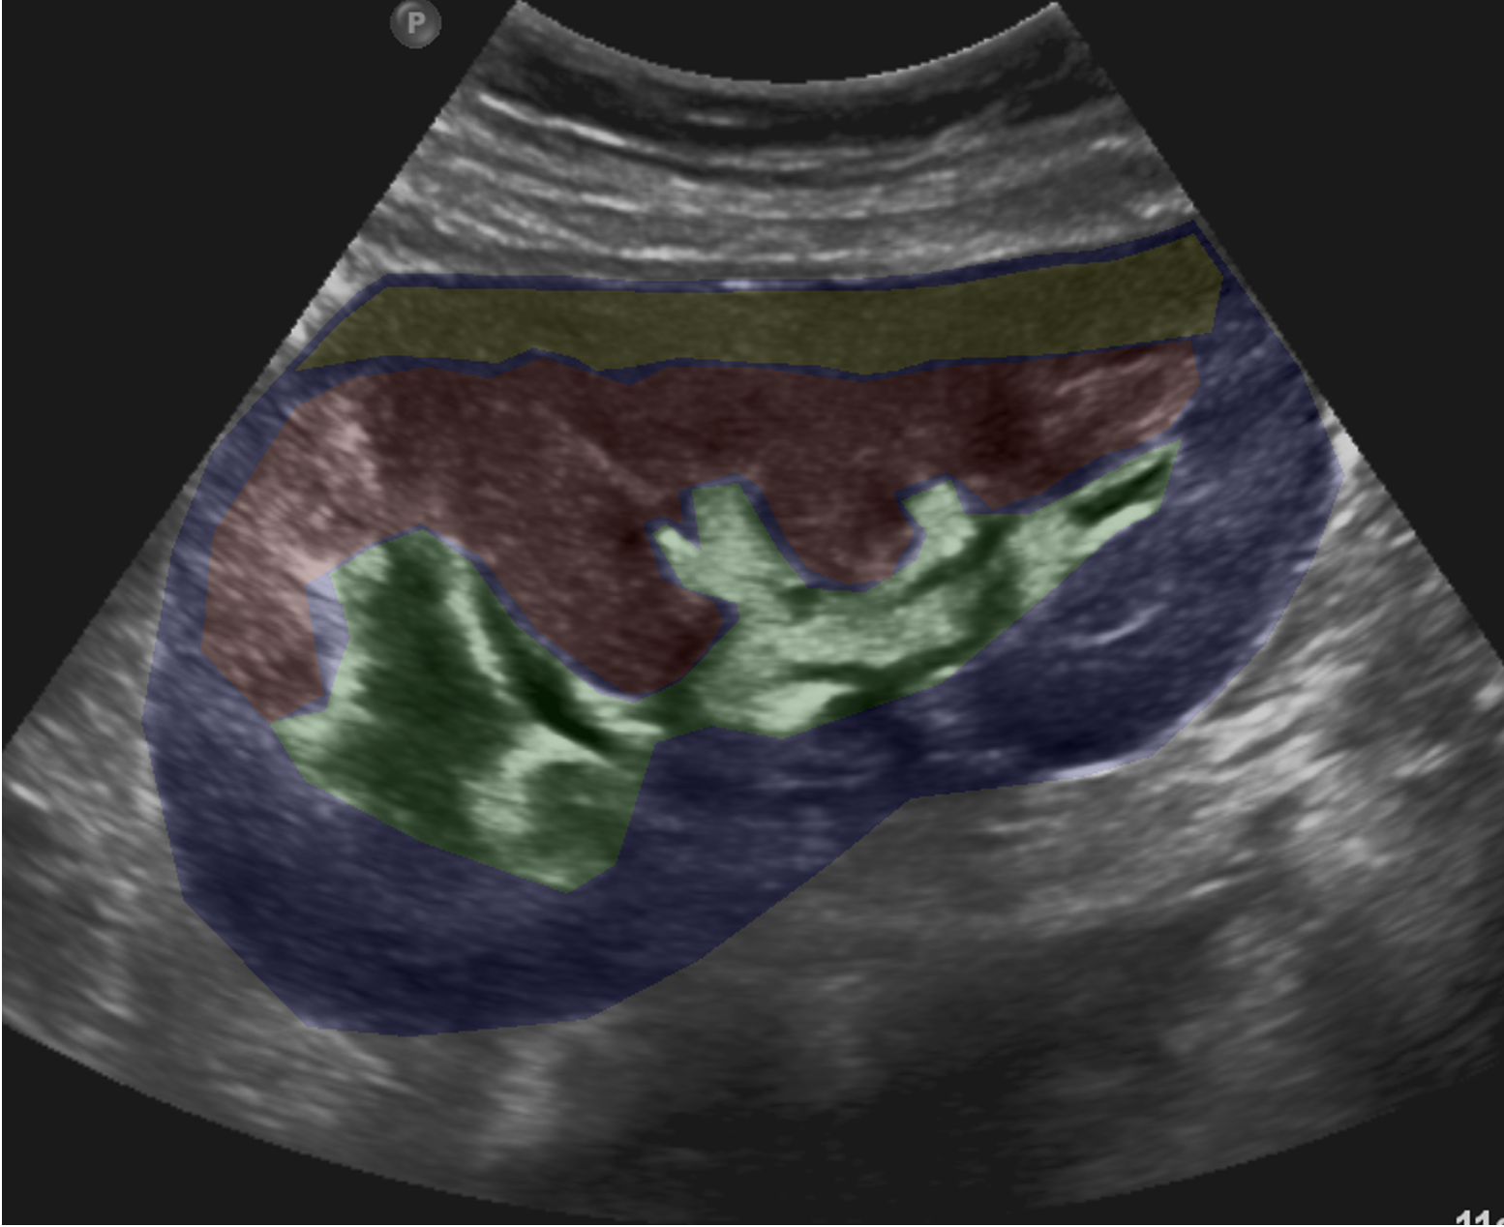
Dataset
Open kidney dataset⁴
534 US images of patients with chronic kidney disease, donor and transplant recipients
Four kidney regions annotated: cortex, capsule, medulla, and central echo complex
4. Singla, R., et al, “The open kidney ultrasound data set,” (2023).
Notes:
two sonographers

Slide 6
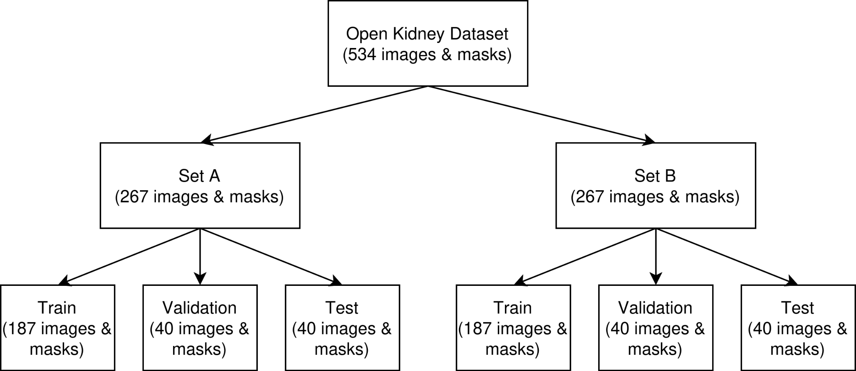
Preprocessing
Image-mask center cropped by 70%
Resized to 256 x 256 pixels
[0,1] normalized for supervised; [-1,1] normalized for GANs
Prevented information leakage:
Notes:
two sonographers

Slide 7
Method
3 major approaches:
Fully supervised learning
Unpaired CycleGAN learning
Semi supervised (hybrid) learning
Notes:
fully supervised learning - the ideal annotation where there is paired image-mask sample.
unpaired cyclegan learning - addresses the challenge of no labelled data - it shows labelling constraint.
semi supervised (hybrid) learning - shows limited paired data in the presence of abundant unlabelled data.

Slide 8
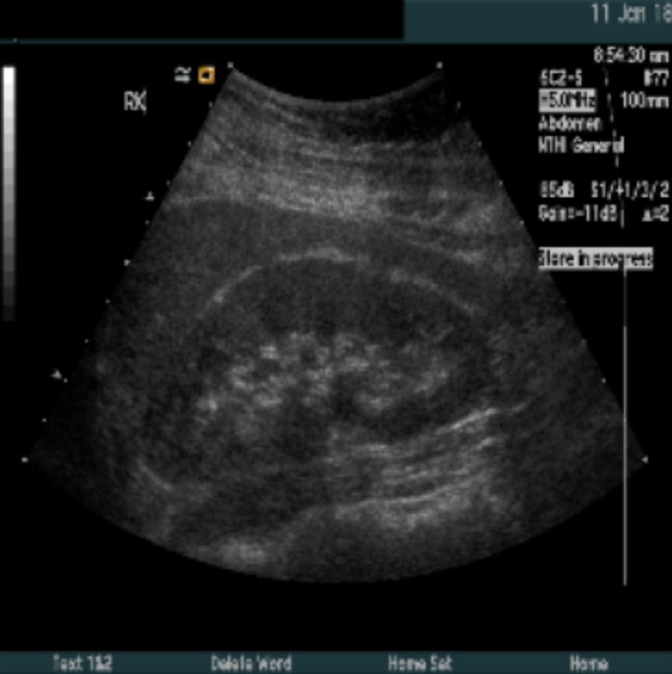
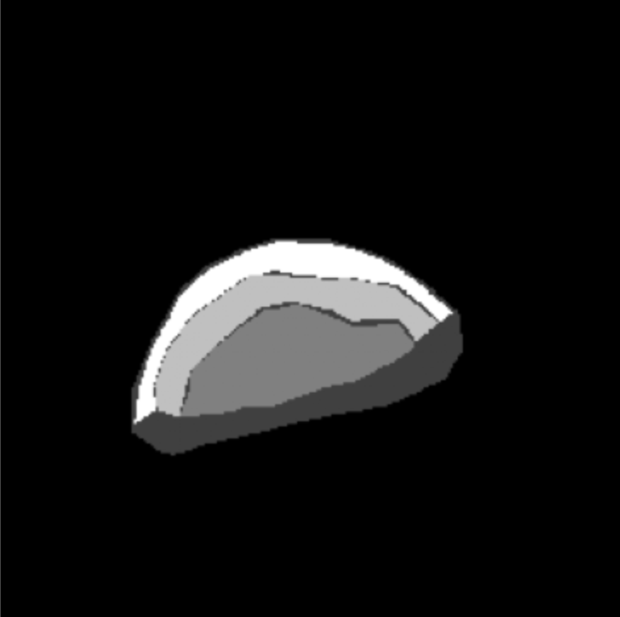
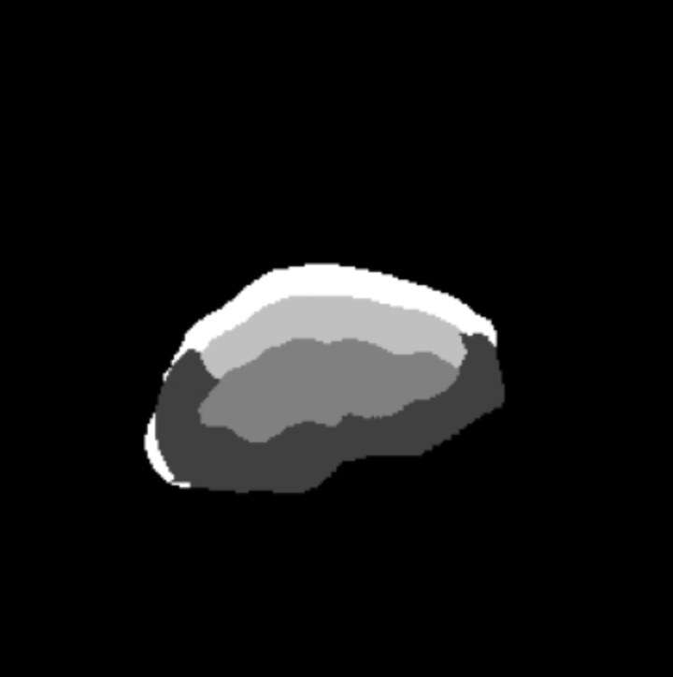
Method - Fully Supervised Learning
Used only paired image-mask from Set A
Trained with U-NET++ (pretrained: ImageNet; encoder: ResNet-101)
Dice Loss: 1 - DS = 1 - 2TP/ 2TP + FP + FN
Paired image-mask
Prediction
UNET++ ResNet101
ImageNet Encoder
same patient
C x 256 x 256
Notes:
mimics the ideal annotation scenario where there is paired-image mask. (for both binary and multiclass)

Slide 9
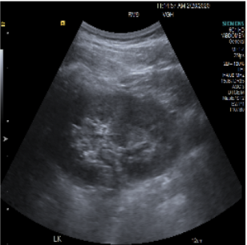

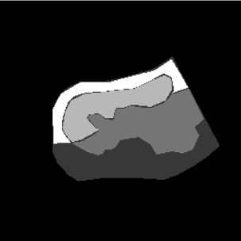
Method - Unpaired CycleGAN Learning
Used images from Set A and masks from Set B
Two generator-discriminator pairs:
G_{US→Mask} and G_{Mask→US}
PatchGAN discriminator (D_{US} and D_{Mask})
Generators have U-Net++ backbones & ResNet-101 encoders
Loss: ℒ^{US}_{adv} + ℒ^{Mask}_{adv} + ℒ^{US}_{cyc} + ℒ^{Mask}_{cyc} (+ ℒ_{id} binary only)
Segmentation model = G_{US→Mask} at inference
D_{US} PatchGAN
D_{Mask} PatchGAN
G_{US->Mask} (UNet++)
Domain US
Domain Mask
G_{Mask->US} (UNet++)
Set A ultrasounds
Set B masks
Notes:
No paired data scenario.
The generator creates synthetic data to mimic a real dataset, while the discriminator acts as a classifier, attempting to distinguish between real data and the generator's fake, synthetic output.
Identity loss was omitted for multiclass due to the fundamental incompatibility between
continuous ultrasound and discrete one-hot label representations.

Slide 10
Method - Semi Supervised (Hybrid) Learning
L_{seg}
(N paired masks from Set A)
Each training has:
Unpaired images from Set A
Unpaired masks from Set B
Paired image-mask of Set A
Paired loss: cross entropy segmentation loss in G_{US→Mask} outputs (direct supervision)
Discriminators exclusively unpaired
Total loss = ℒ_{G} = ℒ^{US}_{adv} + ℒ^{Mask}_{adv} + λ_{cyc}(ℒ^{US}_{cyc} + ℒ^{Mask}_{cyc}) + λ_{seg} ℒ_{seg} + λ_{id}ℒ_{id}
D_{US} PatchGAN
D_{Mask} PatchGAN
G_{US->Mask} (UNet++)
Domain US
Domain Mask
G_{Mask->US} (UNet++)
Set A ultrasounds
Set B masks
Notes:
mimics where there is limited ground truth in the presence of abundant unlabeled data
answers if incorporating a few annotations could meaningfully boost segmentation esp when all data remained unpaired.

Slide 11
Task Complexity
Each approach is then partitioned
By complexity
Multiclass: labels 1-4 (cortex, capsule, medulla, central echo complex), 0 (background)
Binary: labels 1 (kidney), 0 (background)
Weighted Dice : 0.0 (background), 0.25 (each anatomical region), 1.0 (all kidney)
Output: thresholding (binary), argmax (multiclass)

Slide 12
Implementation Details
All models used the segmentation-models-pytorch library
40 (Epochs), 1x10⁻⁴ (LR)
λ_{cyc} = 10, λ_{seg} = 3, and λ_{id} = 5
Validation = Dice & IOU from per class (tp, fp, tn, fn)
All evaluation used held-out Set A test split

Slide 13
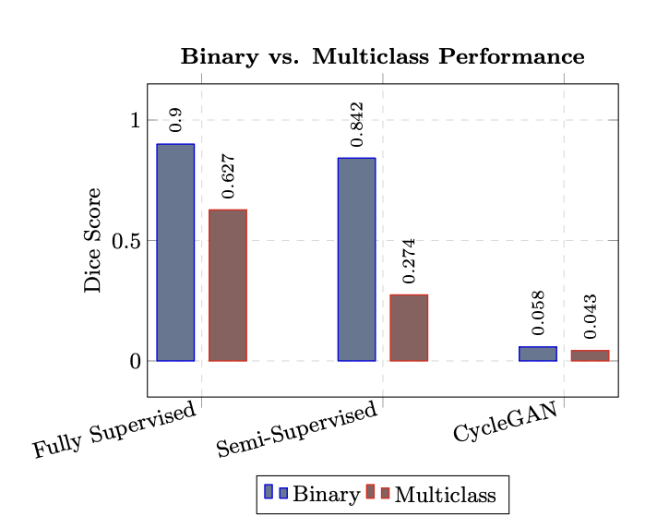
Results
Fully Supervised (highest overall performance)
Binary all: 0.90 (Dice), 0.82 (IoU)
Multiclass all: 0.63 (Dice), 0.47 (IoU)
Unpaired CycleGAN
Binary all: 0.058 (Dice), 0.030 (IoU)
Multiclass all: 0.043 (Dice), 0.024 (IoU)
Semi-Supervised Hybrid
Binary (N=93): 0.842 (Dice), 0.732 (IOU)
Multiclass (N=93): 0.274 (Dice), 0.179(IOU)

Slide 14
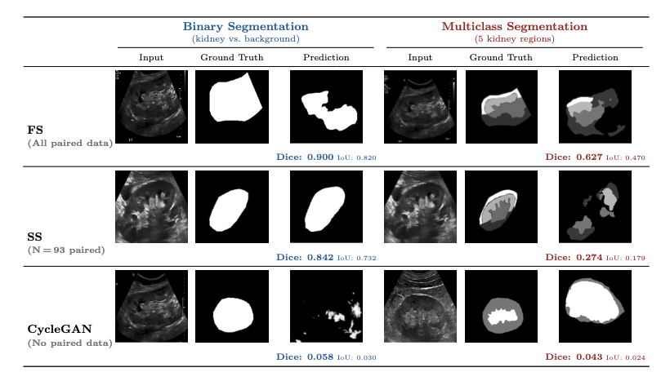
Results

Slide 15
Limitations and Future work
A single dataset limited to the kidney anatomy was used, and inter-rater variability between the two annotating sonographers was not evaluated.
Semi supervised formulation could explore alternatives like pseudo labeling and consistency regularization.
Notes:
Determine whether unpaired approaches can produce clinically useful segmentations.
Determine how segmentation complexity fundamentally reshapes these requirements.

Slide 16
Conclusions
Use paired datasets when possible; semi supervised hybrid learning improved substantially over unpaired baselines.
Simpler (i.e. binary) segmentation achieved near-supervised performance with limited labels, while more complex (i.e. multiclass) segmentation did not, confirming that task complexity fundamentally reshapes annotation requirements.

Slide 17
Acknowledgements
This work was supported by;
The Natural Sciences and Engineering Research Council of Canada grant RGPIN-2020-05582.
Black and Indigenous Summer Research Internship (BISRI) program at Carleton University.
Compute Ontario and the Digital Research Alliance of Canada.
THANK YOU
Contact the primary author at: preciouskolawole@cmail.carleton.ca
Notes:
mimics the ideal annotation scenario where there is paired-image mask.

