Slide 1


Files and directories in the Linux filesystem
Dave Dalsveen

Slide 2
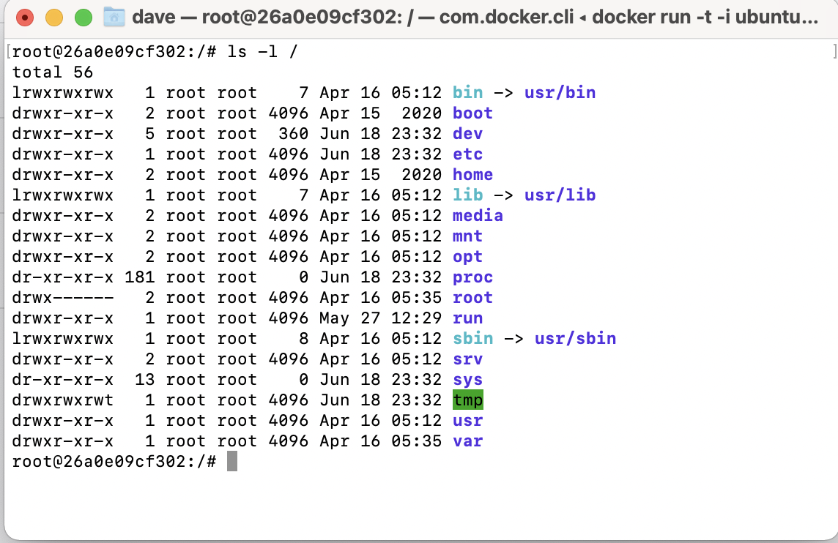
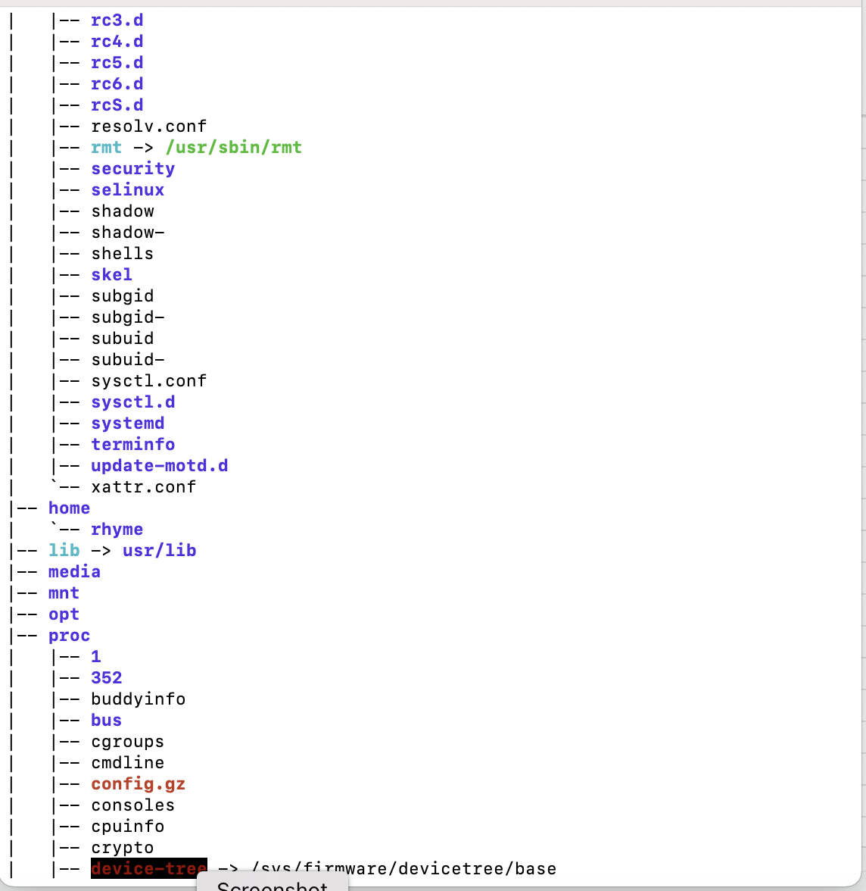
Linux File System Command Output.

Slide 3
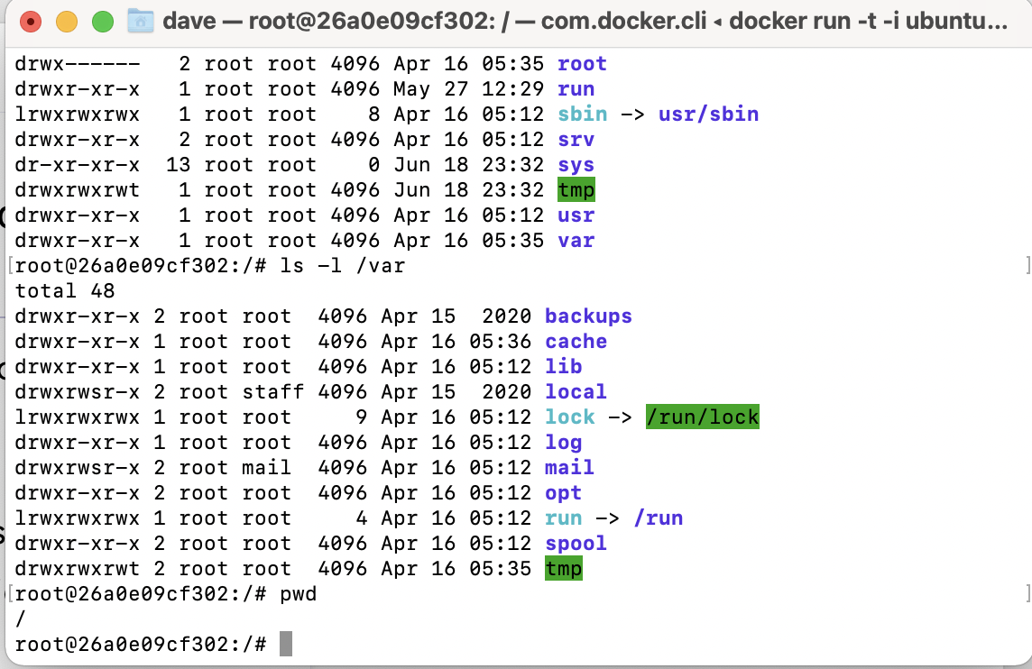
Task1: Use various commands to explore and view the Linux file system.
Print the current (working) directory using the pwd command.
Traverse directories using the cd command.
List the contents of a directory using ls
Observer a graphical directory view on the command line using tree.
Use the Ubuntu file explorer to view files and directories.

Slide 4
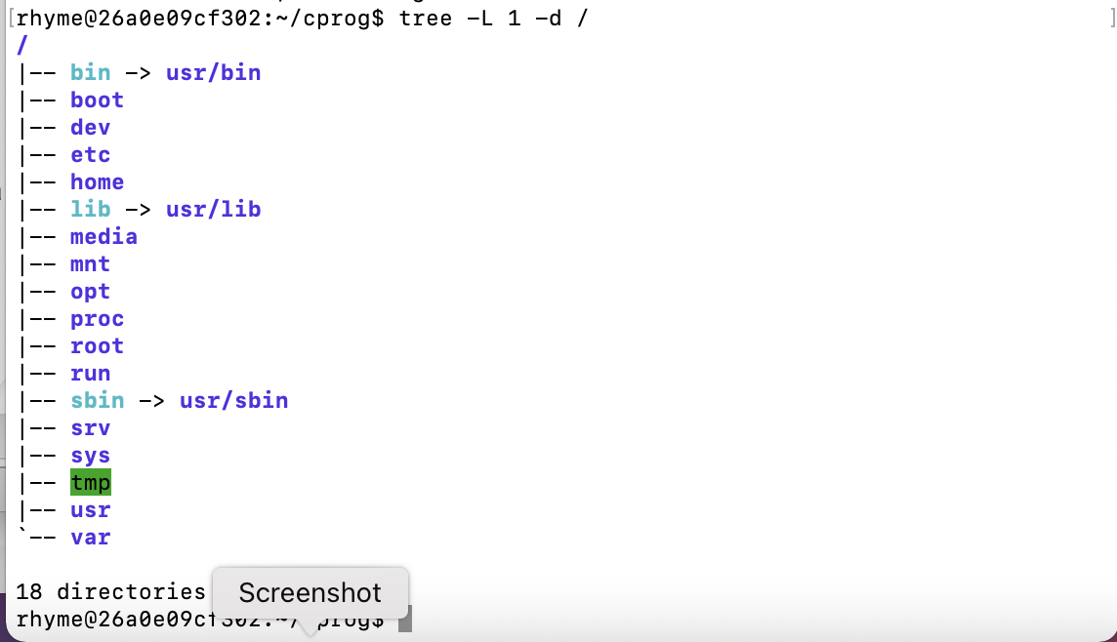
Task2: Determine where to place files in the Linux file system.
List the files in each of the subdirectories in root (/).
Discover the purpose of each directory.
/boot
/etc
/usr
/var
…
Use the knowledge to determine where a file should be or will be stored in the filesystem.

Slide 5
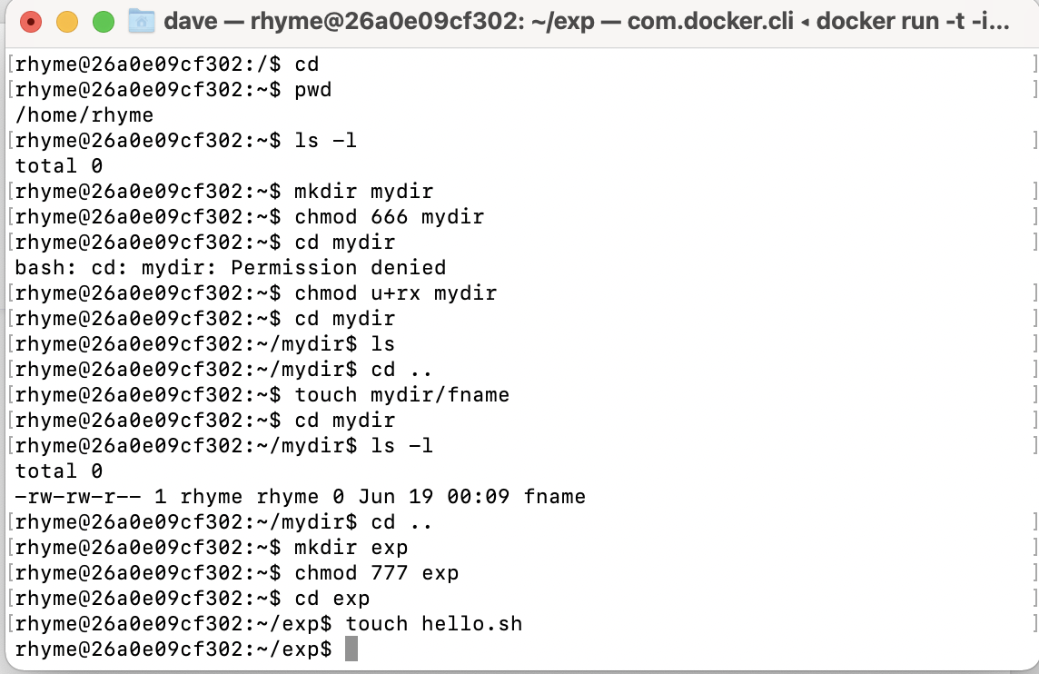
Task3: Create permissions on Files and directories.
Make a directory.
Create a file within a directory.
Change Permissions on the directory and file
  Permission Levels:
    User: the user logged in
    Group: the group assigned to the file
    Other: Everyone else
  Each level has read, write, and execute bits. (rwx)
  Assign using bits and characters.

Slide 6
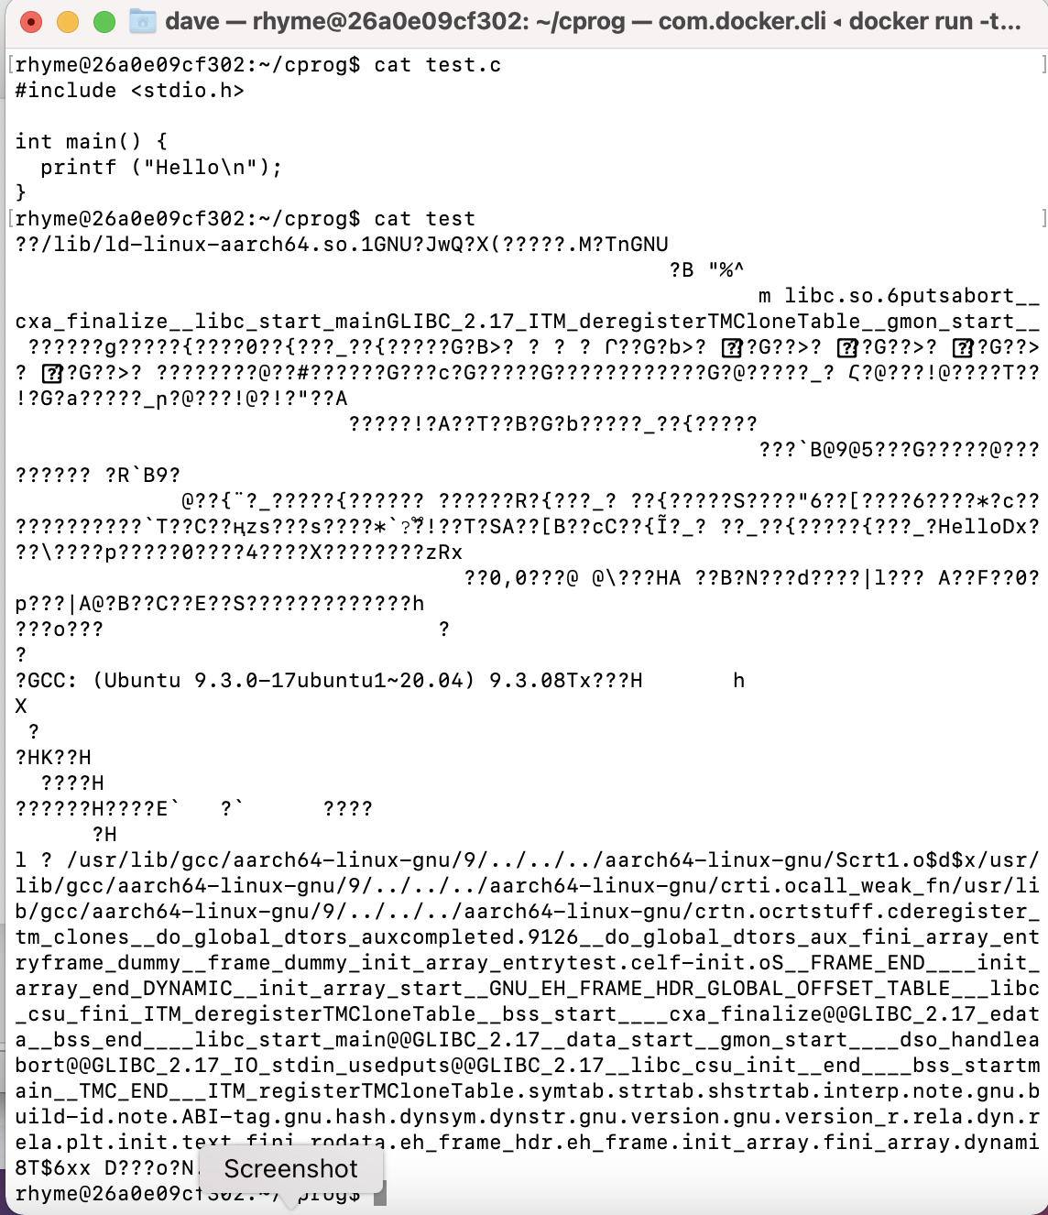
Task4: Use a compiler to create and observe text, binary and assembler file types.
Observe a C source code file using the cat command.
Compile the C Source code.
Observe a C binary executable file.
Create and observe an Assembly code file.

Slide 7
Task5: Use Hard links and Symbolic links to link files.
Links are used to create a shortcut or reference to another file or directory.
Each file contains an inode data structure and associated number.
Links may be used to allow minimal script modifications as files (links) used are always in the same place.
Soft Links: Different file with a link(pointer) to the original file. If the original is moved, link fails.
Hard Link: Same file with a different file name. Modifying any link modifies the same file. Removing original file(name) does not remove file if another hard link exists.
Symbolic or Soft Link:
ln –s originalFile LinkFile
ln -s test linktotest
Hard Link:
ln originalFile LinkFile
ln test linktotest

