Slide 1
Uninformed Search
Chapter 3

Slide 2
Building Goal-Based Agents
We have a goal to reach
  Driving from point A to point B
  Put 8 queens on a chess board such that no one attacks another
  Prove that John is an ancestor of Mary
We have information about the current state, where we are now at the beginning and after each action
We have a set of actions we can take to move around (change from where we are) if the preconditions are met
Objective: find a sequence of legal actions which will bring us from the start point to a goal

Slide 3
What is the goal to be achieved?
Could describe a situation we want to achieve, a set of properties that we want to hold, etc.
Requires defining a “goal test” so that we know what it means to have achieved/satisfied our goal.
This is a hard part that is rarely tackled in AI, usually assuming that the system designer or user will specify the goal to be achieved.

Slide 4
What are the actions?
Quantify all of the primitive actions or events that are sufficient to describe all necessary changes in solving a task/goal.
No uncertainty associated with what an action does to the world. That is, given an action (aka operator or move) and a description of the current state of the world, the action completely specifies
  Precondition: if that action CAN be applied to the current world (i.e., is it applicable and legal), and
  Effect: what the exact state of the world will be after the action is performed in the current world (i.e., no need for "history" information to be able to compute what the new world looks like).

Slide 5
Actions
Note also that actions can all be considered as discrete events that can be thought of as occurring at an instant of time.
  That is, the world is in one situation, then an action occurs and the world is now in a new situation. For example, if "Mary is in class" and then performs the action "go home," then in the next situation she is "at home." There is no representation of a point in time where she is neither in class nor at home (i.e., in the state of "going home").
The number of operators needed depends on the representation used in describing a state.
Actions often are associated with costs

Slide 6
Representing states
At any moment, the relevant world is represented as a state
  Initial (start) state: S
  An action (or an operation) changes the current state to another state (if it is applied): state transition
  An action can be taken (applicable) only if the its precondition is met by the current state
  For a given state, there might be more than one applicable actions
  Goal state: a state satisfies the goal description or passes the goal test
  Dead-end state: a non-goal state to which no action is applicable

Slide 7
Representing states
Stat space:
  Includes the initial state S and all other states that are reachable from S by a sequence of actions
  A state space can be organized as a graph:
  nodes: states in the space
  arcs: actions/operations
The size of a problem is usually described in terms of the number of states (or the size of the state space) that are possible.
  Tic-Tac-Toe has about 3^9 states.
  Checkers has about 10^40 states.
  Rubik's Cube has about 10^19 states.
  Chess has about 10^120 states in a typical game.
  GO has more states than Chess

Slide 8
Closed World Assumption
We will generally use the Closed World Assumption.
All necessary information about a problem domain is available in each percept so that each state is a complete description of the world.
There is no incomplete information at any point in time.

Slide 9
Some example problems
Toy problems and micro-worlds
  8-Puzzle
  Missionaries and Cannibals
  Cryptarithmetic
  Remove 5 Sticks
  Traveling Salesman Problem (TSP)
Real-world-problems

Slide 10
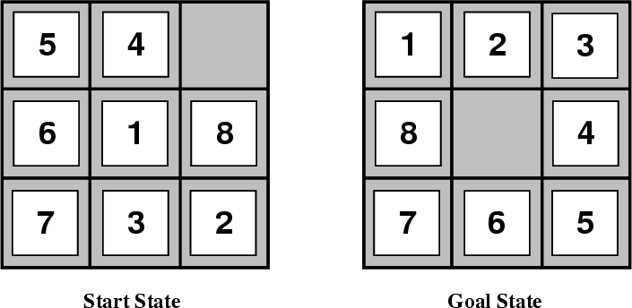
8-Puzzle
Given an initial configuration of 8 numbered tiles on a 3 x 3 board, move the tiles in such a way so as to produce a desired goal configuration of the tiles.

Slide 11
8 puzzle
State: 3 x 3 array configuration of the tiles on the board.
Operators: Move Blank square Left, Right, Up or Down.
  This is a more efficient encoding of the operators than one in which each of four possible moves for each of the 8 distinct tiles is used.
Initial State: A particular configuration of the board.
Goal: A particular configuration of the board.
The state space is partitioned into two subspaces
NP-complete problem, need to examine O(2^k) states where k is the length of the solution path.
15-puzzle problems (4 x 4 grid with 15 numbered tiles), and N-puzzles (N = n^2-1)

Slide 12
A portion of the state space of a 8-Puzzle problem
5 | 4
6 | 1 | 8
7 | 3 | 2
5 |  | 4
6 | 1 | 8
7 | 3 | 2
5 | 4 | 8
6 | 1
7 | 3 | 2
5 | 1 | 4
6 |  | 8
7 | 3 | 2
 | 5 | 4
6 | 1 | 8
7 | 3 | 2
5 | 1 | 4
6 | 8
7 | 3 | 2

Slide 13
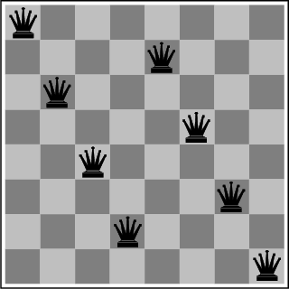
The 8-Queens Problem
Place eight queens on a chessboard such that no queen attacks any other!
Total # of states: 4.4x10^9
Total # of solutions:
12 (or 96)

Slide 14
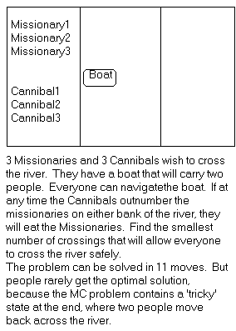
Missionaries and Cannibals
There are 3 missionaries, 3 cannibals, and 1 boat that can carry up to two people on one side of a river.
Goal: Move all the missionaries and cannibals across the river.
Constraint: Missionaries can never be outnumbered by cannibals on either side of river, or else the missionaries are killed.
State: configuration of missionaries and cannibals and boat on each side of river.
Operators: Move boat containing 1 or 2 occupants across the river (in either direction) to the other side.

Slide 15
Missionaries and Cannibals Solution
Near side Far side
0 Initial setup: MMMCCC B -
1 Two cannibals cross over: MMMC B CC
2 One comes back: MMMCC B C
3 Two cannibals go over again: MMM B CCC
4 One comes back: MMMC B CC
5 Two missionaries cross: MC B MMCC
6 A missionary & cannibal return: MMCC B MC
7 Two missionaries cross again: CC B MMMC
8 A cannibal returns: CCC B MMM
9 Two cannibals cross: C B MMMCC
10 One returns: CC B MMMC
11 And brings over the third: - B MMMCCC

Slide 16
Cryptarithmetic
Find an assignment of digits (0, ..., 9) to letters so that a given arithmetic expression is true. examples: SEND + MORE = MONEY and
    FORTY Solution: 29786
    + TEN 850
    + TEN 850
    ----- -----
    SIXTY 31486
    F=2, O=9, R=7, etc.
Note: In this problem, the solution is NOT a sequence of actions that transforms the initial state into the goal state, but rather the solution is simply finding a goal node that includes an assignment of digits to each of the distinct letters in the given problem.

Slide 17
Remove 5 Sticks
Given the following configuration of sticks, remove exactly 5 sticks in such a way that the remaining configuration forms exactly 3 squares.

Slide 18
Traveling Salesman Problem
Given a road map of n cities, find the shortest tour which visits every city on the map exactly once and then return to the original city (Hamiltonian circuit)
(Geometric version):
  a complete graph of n vertices.
  n!/2n legal tours
  Find one legal tour that is shortest

Slide 19
Formalizing Search in a State Space
A state space is a graph, (V, E) where V is a set of nodes and E is a set of arcs, where each arc is directed from a node to another node
node: corresponds to a state
  state description
  plus optionally other information related to the parent of the node, operation to generate the node from that parent, and other bookkeeping data)
arc: corresponds to an applicable action/operation.
  the source and destination nodes are called as parent (immediate predecessor) and child (immediate successor) nodes with respect to each other
  ancestors( (predecessors) and descendents (successors)
  each arc has a fixed, non-negative cost associated with it, corresponding to the cost of the action

Slide 20
node generation: making explicit a node by applying an action to another node which has been made explicit
node expansion: generating all children of an explicit node by applying all applicable operations to that node
One or more nodes are designated as start nodes
A goal test predicate is applied to a node to determine if its associated state is a goal state
A solution is a sequence of operations that is associated with a path in a state space from a start node to a goal node
The cost of a solution is the sum of the arc costs on the solution path

Slide 21
State-space search is the process of searching through a state space for a solution by making explicit a sufficient portion of an implicit state-space graph to include a goal node.
  Hence, initially V={S}, where S is the start node; when S is expanded, its successors are generated and those nodes are added to V and the associated arcs are added to E. This process continues until a goal node is generated (included in V) and identified (by goal test)
During search, a node can be in one of the three categories:
  Not generated yet (has not been made explicit yet)
  OPEN: generated but not expanded
  CLOSED: expanded
  Search strategies differ mainly on how to select an OPEN node for expansion at each step of search

Slide 22
A General State-Space Search Algorithm
Node n
  state description
  parent (may use a backpointer) (if needed)
  Operator used to generate n (optional)
  Depth of n (optional)
  Path cost from S to n (if available)
OPEN list
  initialization: {S}
  node insertion/removal depends on specific search strategy
CLOSED list
  initialization: {}
  organized by backpointers

Slide 23
A General State-Space Search Algorithm
open := {S}; closed :={};
repeat
n := select(open); /* select one node from open for expansion */
if n is a goal
then exit with success; /* delayed goal testing */
expand(n)
/* generate all children of n
put these newly generated nodes in open (check duplicates)
put n in closed (check duplicates) */
until open = {};
exit with failure

Slide 24
Some Issues
Search process constructs a search tree, where
  root is the initial state S, and
  leaf nodes are nodes
    not yet been expanded (i.e., they are in OPEN list) or
    having no successors (i.e., they're "deadends")
Search tree may be infinite because of loops even if state space is small
Search strategies mainly differ on select(open)
Each node represents a partial solution path (and cost of the partial solution path) from the start node to the given node.
  in general, from this node there are many possible paths (and therefore solutions) that have this partial path as a prefix.

Slide 25
Evaluating Search Strategies
Completeness
  Guarantees finding a solution whenever one exists
Time Complexity
  How long (worst or average case) does it take to find a solution? Usually measured in terms of the number of nodes expanded
Space Complexity
  How much space is used by the algorithm? Usually measured in terms of the maximum size that the “OPEN" list becomes during the search
Optimality/Admissibility
  If a solution is found, is it guaranteed to be an optimal one? For example, is it the one with minimum cost?

Slide 26
Uninformed vs. Informed Search
Uninformed Search Strategies
  Breadth-First search
  Depth-First search
  Uniform-Cost search
  Depth-First Iterative Deepening search
Informed Search Strategies
  Hill climbing
  Best-first search
  Greedy Search
  Beam search
  Algorithm A
  Algorithm A*

Slide 27
Breadth-First
Algorithm outline:
  Always select from the OPEN the node with the smallest depth for expansion, and put all newly generated nodes into OPEN
  OPEN is organized as FIFO (first-in, first-out) list, i.e., a queue.
  Terminate if a node selected for expansion is a goal
Properties
  Complete
  Optimal (i.e., admissible) if all operators have the same cost. Otherwise, not optimal but finds solution with shortest path length (shallowest solution).
  Exponential time and space complexity,
  O(b^d) nodes will be generated, where
  d is the depth of the solution and
  b is the branching factor (i.e., number of children) at each node

Slide 28
Breadth-First
s
  A complete search tree of depth d where each non-leaf node has b children, has a total of 1 + b + b^2 + ... + b^d = (b^(d+1) - 1)/(b-1) nodes
  Time complexity (# of nodes generated): O(b^d)
  Space complexity (maximum length of OPEN): O(b^d)
1
1
b
2
b^2
d
b^d
  For a complete search tree of depth 12, where every node at depths 0, ..., 11 has 10 children and every node at depth 12 has 0 children, there are 1 + 10 + 100 + 1000 + ... + 10^12 = (10^13 - 1)/9 = O(10^12) nodes in the complete search tree.
BFS is suitable for problems with shallow solutions

Slide 29
Example Illustrating Uninformed Search Strategies
S
1
8
5
A
B
C
3
9
7
4
5
D
E
G

Slide 30
Breadth-First Search
exp. node OPEN list CLOSED list
{ S } {}
S { A B C } {S}
A { B C D E G } {S A}
B { C D E G G' } {S A B}
C { D E G G' G" } {S A B C}
D { E G G' G" } {S A B C D}
E { G G' G" } {S A B C D E}
G { G' G" } {S A B C D E}
Solution path found is S A G <-- this G also has cost 10
Number of nodes expanded (including goal node) = 7

Slide 31
CLOSED List: the search tree connected by backpointers
S
1
8
5
A
B
C
3
9
7
4
5
D
E
G
G’
G”

Slide 32
Depth-First (DFS)
Algorithm outline:
  Always select from the OPEN the node with the greatest depth for expansion, and put all newly generated nodes into OPEN
  OPEN is organized as LIFO (last-in, first-out) list.
  Terminate if a node selected for expansion is a goal
goal
May not terminate without a "depth bound," i.e., cutting off search below a fixed depth D (How to determine the depth bound?)
Not complete (with or without cycle detection, and with or without a cutoff depth)
Exponential time, O(b^d), but only linear space, O(bd), required
Can find deep solutions quickly if lucky
When search hits a deadend, can only back up one level at a time even if the "problem" occurs because of a bad operator choice near the top of the tree. Hence, only does "chronological backtracking"

Slide 33
Depth-First Search
return GENERAL-SEARCH(problem, ENQUEUE-AT-FRONT)
exp. node OPEN list CLOSED list
{ S }
S { A B C }
A { D E G B C}
D { E G B C }
E { G B C }
G { B C }
Solution path found is S A G <-- this G has cost 10
Number of nodes expanded (including goal node) = 5
S
1
8
5
A
B
C
3
9
7
D
E
G

Slide 34
Uniform-Cost (UCS)
Let g(n) = cost of the path from the start node to an open node n
Algorithm outline:
  Always select from the OPEN the node with the least g(.) value for expansion, and put all newly generated nodes into OPEN
  Nodes in OPEN are sorted by their g(.) values (in ascending order)
  Terminate if a node selected for expansion is a goal
Called “Dijkstra's Algorithm” in the algorithms literature and similar to “Branch and Bound Algorithm” in operations research literature

Slide 35
Uniform-Cost Search
GENERAL-SEARCH(problem, ENQUEUE-BY-PATH-COST)
exp. node nodes list CLOSED list
{S(0)}
S {A(1) B(5) C(8)}
A {D(4) B(5) C(8) E(8) G(10)}
D {B(5) C(8) E(8) G(10)}
B {C(8) E(8) G’(9) G(10)}
C {E(8) G’(9) G(10) G”(13)}
E {G’(9) G(10) G”(13) }
G’ {G(10) G”(13) }
Solution path found is S B G <-- this G has cost 9, not 10
Number of nodes expanded (including goal node) = 7
S
1
8
5
A
B
C
3
9
4
5
7
D
E
G
G’
G”

Slide 36
Uniform-Cost (UCS)
Complete (if cost of each action is not infinitesimal)
  The total # of nodes n with g(n) <= g(goal) in the state space is finite
  If n’ is a child of n, then g(n’) = g(n) + c(n, n’) > g(n)
  Goal node will eventually be generated (put in OPEN) and selected for expansion (and passes the goal test)
Optimal/Admissible
  Admissibility depends on the goal test being applied when a node is removed from the OPEN list, not when it's parent node is expanded and the node is first generated (delayed goal testing)
  Multiple solution paths (following different backpointers)
  Each solution path that can be generated from an open node n will have its path cost >= g(n)
  When the first goal node is selected for expansion (and passes the goal test), its path cost is less than or equal to g(n) of every OPEN node n (and solutions entailed by n)
Exponential time and space complexity,
  worst case: becomes BFS when all arcs cost the same

Slide 37
Depth-First Iterative Deepening (DFID)
BF and DF both have exponential time complexity O(b^d)
  BF is complete but has exponential space complexity (conservative)
  DF has linear space complexity but is incomplete (radical)
Space is often a harder resource constraint than time
Can we have an algorithm that
  Is complete
  Has linear space complexity, and
  Has time complexity of O(b^d)
DFID by Korf in 1985 (17 years after A*)
  First do DFS to depth 0 (i.e., treat start node as
  having no successors), then, if no solution found,
  do DFS to depth 1, etc.
    until solution found do
    DFS with depth bound c
    c = c+1

Slide 38
Depth-First Iterative Deepening (DFID)
Complete (iteratively generate all nodes up to depth d)
Optimal/Admissible if all operators have the same cost. Otherwise, not optimal but does guarantee finding solution of shortest length (like BF).
Linear space complexity: O(bd), (like DF)
Time complexity is a little worse than BFS or DFS because nodes near the top of the search tree are generated multiple times, but because almost all of the nodes are near the bottom of a tree, the worst case time complexity is still exponential, O(b^d)

Slide 39
Depth-First Iterative Deepening
If branching factor is b and solution is at depth d, then nodes at depth d are generated once, nodes at depth d-1 are generated twice, etc., and node at depth 1 is generated d times.
  Hence
  total(d) = b^d + 2b^(d-1) + ... + db
  <= b^d / (1 - 1/b)^2 = O(b^d).
  If b=4, then worst case is 1.78 * 4^d, i.e., 78% more nodes searched than exist at depth d (in the worst case).

Slide 40
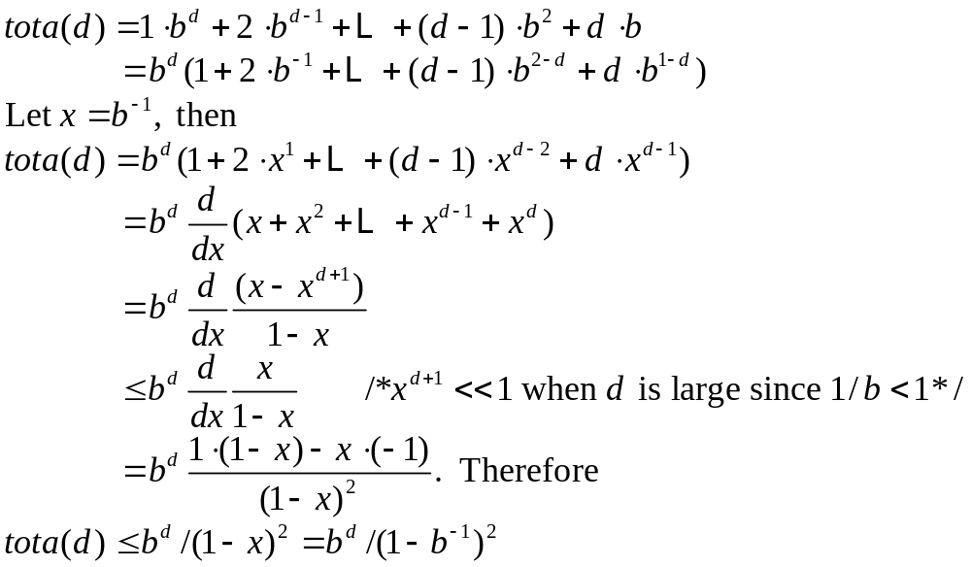

Slide 41
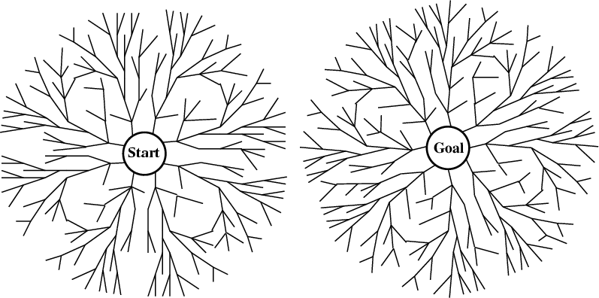
Bi-directional search
Alternate searching from the start state toward the goal and from the goal state toward the start.
Stop when the frontiers intersect.
Works well only when there are unique start and goal states and when actions are reversible
Can lead to finding a solution more quickly (but watch out for pathological situations).

Slide 42
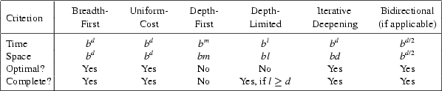
Comparing Search Strategies

Slide 43
When to use what
Depth-First Search:
  Many solutions exist
  Know (or have a good estimate of) the depth of solution
Breadth-First Search:
  Some solutions are known to be shallow
Uniform-Cost Search:
  Actions have varying costs
  Least cost solution is required
  This is the only uninformed search that worries about costs.
Iterative-Deepening Search:
  Space is limited and the shortest solution path is required

