Slide 2
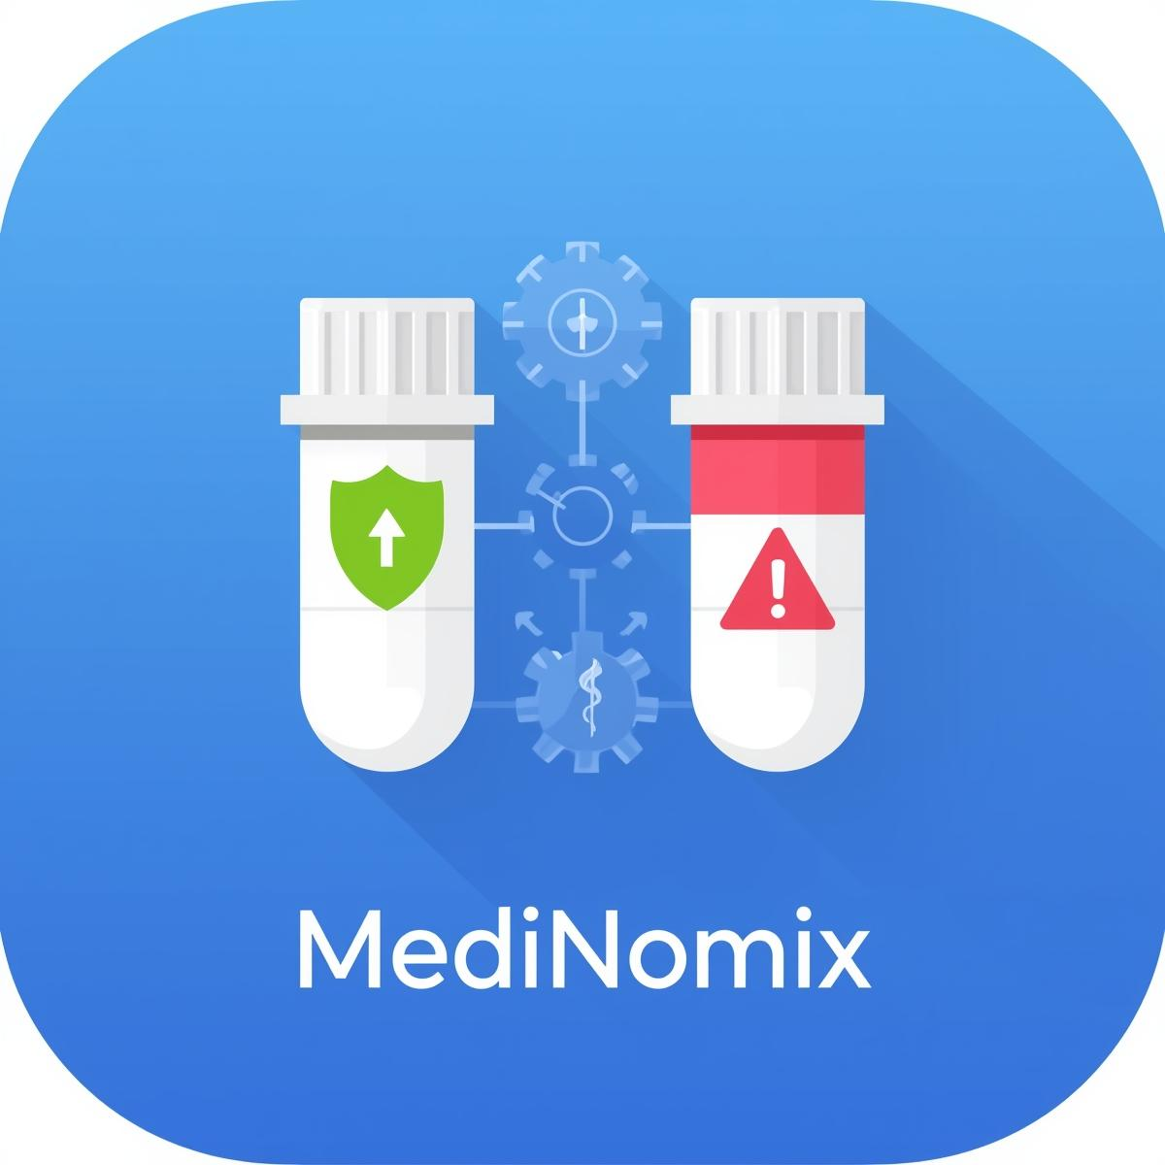

Project: MediNomix Advance Medication Error prevention and risk analysis system
ADVANCE DATABASE SYSTEMS
Submitted By: Alina Liaquat
Submitted to: Sir Faisal Hafeez
Department of Computer Science
UNIVERSITY OF LAYYAH MAIN CAMPUS, HAFIZABAD

Slide 3

Acknowledgement
With Profound Gratitude
To My Esteemed Supervisor
Sir Faisal Hafeez
Your unwavering guidance and expert mentorship have been the cornerstone of this project's success. Your insightful feedback transformed technical challenges into valuable learning experiences, while your emphasis on excellence inspired me to push beyond limits. Thank you for being more than a supervisor , a mentor who shaped not just this project but my entire approach to problem-solving and professional growth.
With deepest respect and appreciation
Alina Liaquat Roll No: BSCSM-A-23-19 Department of Computer Science

Slide 4

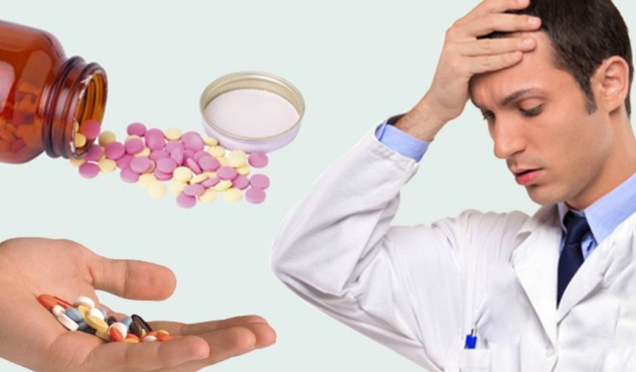
PROBLEM STATEMENT
THE SILENT EPIDEMIC IN HEALTHCARE
Medication Errors: A Global Crisis
A medication error is any preventable mistake during prescribing, preparing, dispensing, administering or monitoring medications that can cause patient harm, ranging from mild injury to severe complications or death, and can occur due to system failures or human factors like fatigue, impacting the right drug, dose, patient, or time. These errors are a major cause of preventable patient harm, often stemming from poor communication, complex processes, or environmental issues, costing healthcare systems billions annually.

Slide 5

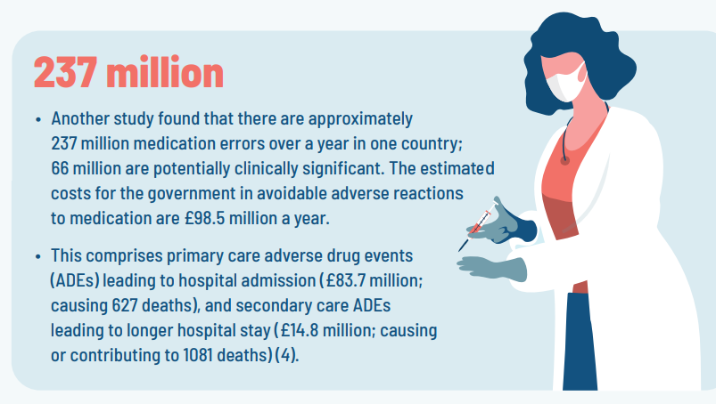
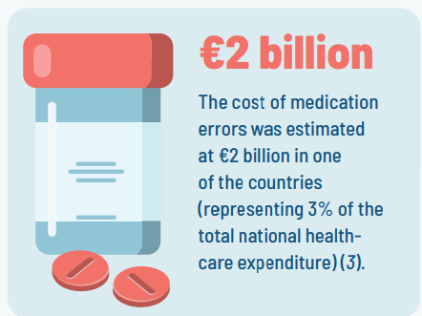
WHO REPORT ABOUT MEDICATION ERROR

Slide 6

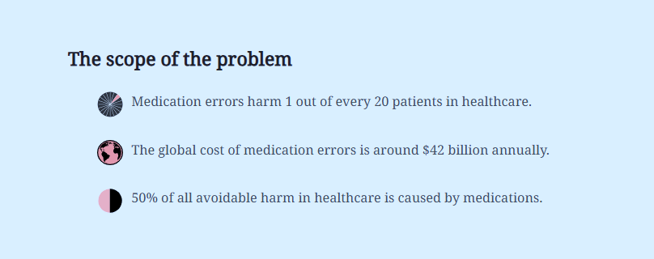
https://uppsalareports.org/deep-dive/medication-errors

Slide 7

BOSTON 2020 CASE
SPECIFIC LASA DRUG PAIRS DOCUMENTED
From Ontario College of Pharmacists (2020):
Hydroxyzine ↔ Hydralazine (case study with detailed analysis)
Additional pairs: Lasix® ↔ Losec®,
Ceftin® ↔ Cefzil®, etc.
Citation: Focus on Error Prevention, Spring-Summer 2020
https://ocpinfo.com/ocp-resources/focus-on-error-prevention-spring-summer-2020/?

Slide 8

SOLUTION – HIGH LEVEL OVERVIEW
App Name: MediNomix Medication Error and risk assessment
Purpose: Real-time drug name validation using multiple algorithms
How: Compares input against known drug names using:
Spelling (Levenshtein, Fuzzy)
Phonetic (Soundex, Metaphone)
Therapeutic Suffix Analysis
Outcome: Flags high-risk similarities before dispensing

Slide 9
TECHNOLOGY STACK
Backend: FastAPI (async, high-performance)
Database: PostgreSQL with SQLAlchemy ORM
Frontend: Streamlit
Algorithms: Fuzzy matching (RapidFuzz), Phonetic libs

Slide 10
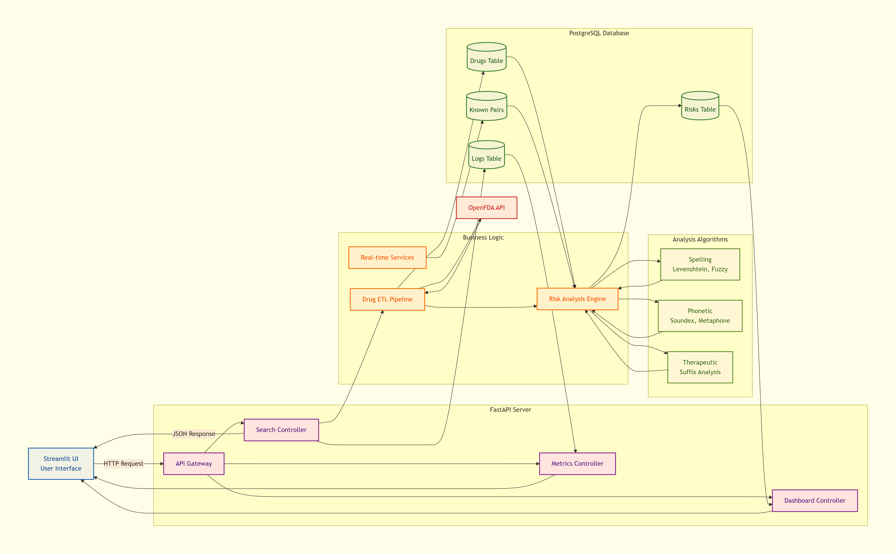
SYSTEM ARCHITECTURE

Slide 11
SIMPLE ETL PIPELINE

Slide 12
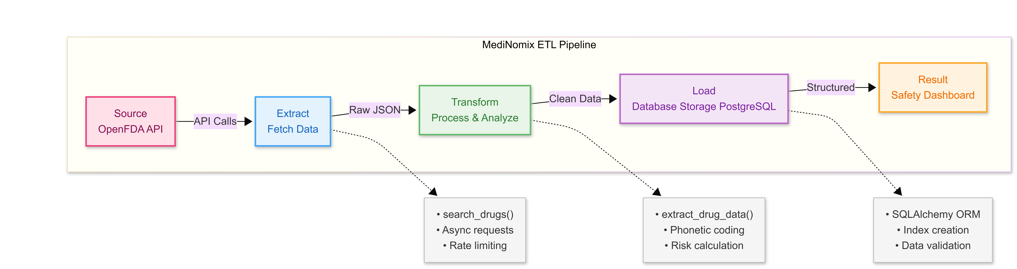
DETAILED ETL PIPELINE

Slide 13
PROJECT
DEMO

Slide 14
THANK
YOU

