Slide 1
Marketing Performance Analytics Report: Tech
Savvy Solutions
SKILL2SCALE
4-Week Virtual Internship Programme
BY
Precious Onyedum
Cohort 6
8/07/2026

Slide 2
Client Overview: Tech Savvy Solutions Client: Linda Williams – Marketing Manager
Business Context:
Tech Savvy Solutions wanted to evaluate Q3 marketing performance, understand campaign effectiveness, identify growth opportunities, and improve decision-making for Q4 planning.
Objectives:
Analyze campaign performance
Identify top-performing channels
Understand revenue trends
Provide recommendations for Q4 strategy

Slide 3
Data Cleaning & Preparation
Dataset Overview
Dataset: Marketing campaign performance data for Tech Savvy Solutions
Analysis Period: July–September (Q3)
Records: 30 marketing campaigns (31 rows including the header)
Variables: 13 columns, including Campaign Name, Channel, Launch Date, Ad Spend, Revenue, Leads, Conversions, ROI, and Conversion Rate
Data Quality Issues Resolved:
Reviewed the dataset for missing values, inconsistencies, and duplicate records to improve data quality before analysis.
Standardized date and currency formats.
Calculated ROI and Conversion Rate.
Created a Month column for monthly trend analysis.
Added a Segment column to classify campaign performance (High, Average, and Low Performer).

Slide 4
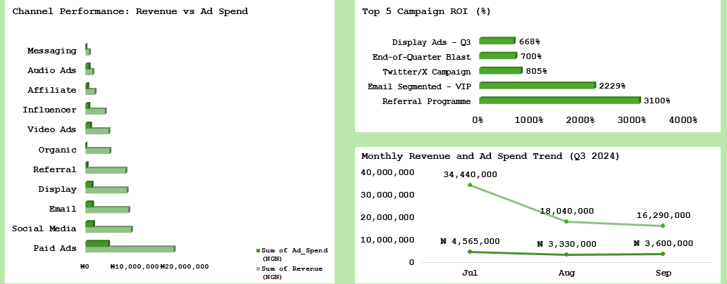
Marketing Performance Dashboard
KPI Snapshot
Dashboard Snapshot

Slide 5
Key Business Insights
Insight 1
Paid Ads Drove Revenue Growth:
Paid Ads generated the highest Q3 revenue (₦17.63M), making it the strongest revenue contributor.
Insight 2
High ROI Channels Presented Growth Opportunities:
Referral and Email campaigns achieved strong ROI, showing potential for scaling efficient channels.
Insight 3
Revenue Declined Throughout Q3:
Revenue reduced after July, highlighting the need to optimize campaigns before Q4.

Slide 6
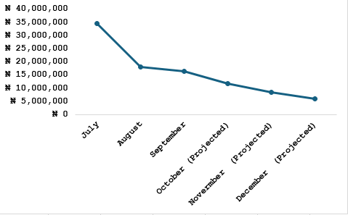
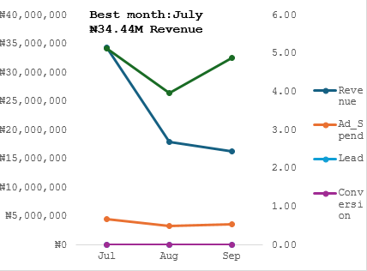
Q3 Trends and Q4 Forecast
Monthly Revenue Trend Q4 Revenue Projection
forecast Assumption: Q3 growth pattern continues with no significant market or operational change . .
Key Insight: Revenue peaked in July before declining in August and September. Based on this trend, Q4 projected to continue declining if current campaign performance remains unchanged.

Slide 7
Q4 Strategic Recommendations
Scale High-Performing Campaigns:
Increase focus on campaigns and channels delivering strong revenue and ROI.
Optimize Underperforming Campaigns:
Review targeting, creatives, and budget allocation.
Improve Reporting Efficiency:
Introduce a standardized marketing data entry and reporting template to reduce manual reporting time.

Slide 8
Reflection and Growth
Tools Used:
Excel
Pivot Tables
Charts & Dashboards
Data Cleaning Techniques
Skills Developed:
Data preparation
KPI analysis
Business insight generation
Data storytelling

