Slide 1

OPEN SPOT
BOOK A SPOT.
NOT A COURT.
A platform that matches New Yorkers by sport, level and time into games on courts already booked.
Team 8: Alara, Kobe, Obiari, Lingkai, Yunji · HCDIx Design Document · 2026

Slide 2

OPEN SPOT
BOOK A SPOT.
NOT A COURT.
Matches New Yorkers by sport, level and time into games on courts already booked.
6:30 PM
Central Park
Doubles · NTRP 3.5
$15/spot
1 spot left
7:30 PM
McCarren Park
Doubles · NTRP 3.0
$12/spot
1 spot left
7:00 AM
Prospect Park
Doubles · NTRP 3.5
$30/spot
2 spots left
1 Say what you play. Sport, level, borough, time.
2 Take a spot on a court that is already booked.
3 Pay your share. $60 court ÷ 4 = $15 each.
4 Play. The waitlist fills any dropout.
THE NEED
WHY IT WINS
WHAT’S NEXT
4 of 5
Finds the people
Backfills dropouts
Splits fees for you
Play again
No-show prediction
Venue and city tools
interviewees had no one to play with.
Page 1 · Poster
“I just drop into a game at my level.” Tennis player, concept test
Alara, Kobe, Obiari, Lingkai, Yunji · A small fee per spot

Slide 3
New Yorkers in their 20s and 30s who want a game
PRIMARY USER
PRIMARY USER
The solo newcomer
The game organizer
Recently arrived, owns the gear, knows no one to play with. Seeking same-day, level-matched network to play with.
Holds court bookings, but deals with dropouts and payment chasing. Wants full headcount and upfront payment.
Matthew: moved from Boston, played once in 2 months.
Priya: runs a weekly basketball group, played 4 times in 10 months.
Other key stakeholders, and what Open Spot offers them
Private clubs and venues:
Protects revenue by filling spots and last-minute cancellations.
NYC Parks:
Maximizes public court utilization while staying within permit rules.
Waitlisted players:
Provides fair, automated access to game openings.
Page 2 · Target users and stakeholders

Slide 4
People and planning keep New Yorkers off the court
5 of 5
wanted to play, yet scheduling failures stopped them or disrupted their plans
“I’m not downloading 2–3 different apps just to play tennis.”
Jadon, frustrated local
4 of 5
“I want to learn and meet people through tennis, but I don’t even know where to start.” Sue, newcomer in NY
had no one to play with. A free court alone would not have be sufficient for them
4 games
in 10 months for an organizer. Dropouts wear down the groups that do exist.
“Half the group drops out before I find one.” Priya, on finding a gym
10,000+
open matches in the US in 2025 on Playtomic. People will play with strangers.
“Open Spot is how I might actually meet partners.”
Solo pickleball player, prototype testing
Page 3 · Insights

Slide 5
People want to play but can’t get a game together
New Yorkers in their 20s and 30s want to play, but finding partners, managing dropouts, and chasing payments stops them before they reach the court.
No group
Scarce Court
Rigid Rules
4 of 5 interviewees lack local game partners, leaving gear unused at home.
NYC court capacity sits 98% below the national average, making half-empty games a waste of scarce space.
$15 permits and 7-day advance limits block same-day online booking, stopping spontaneous play.
Page 4 · Problem

Slide 6
From “I want to play” to a game in minutes
Morning
Then
2 hours out
Late cancel
Game time
A newcomer opens Open Spot to find a game tonight.
Claims the last spot in a 3.5 doubles match for $15.
Receives automated confirmation as the match fills.
A player cancels; the waitlist auto-fills the spot.
Four matched players play. Tap "Play again" for next week
Player feels
Organizer feels
Venue feels
"I found a level-matched game and new partners instantly."
"I listed open spots, skipped the admin, and just played."
"Maximum court capacity with zero wasted slots."
Page 5 · Ideal experience

Slide 7
How a booked court becomes a full game
1
2
3
4
Match
Take a spot
Split
Play
Choose sport, level, borough and time. See only games within half a level of yours.
Join a court that is already booked. No permit search, no group needed.
$60 court ÷ 4 players = $15 each. Settled automatically at check-in.
Confirmed two hours out. The waitlist fills dropouts, and alerts flag open spots.
Where courts come from
How it makes money
How it grows
Organizers post open spots first. Partner venues follow.
A small fee on each spot filled, on top of the court share.
One sport in one neighborhood, then only where games fill.
Page 6 · How the solution works

Slide 8


Open Spot connects booked courts to open players
Court supply
open spots
games
Players
Organizers’ bookings
Private clubs and venues
NYC Parks courts
OPEN SPOT
Solo newcomers
Spontaneous regulars
Waitlisted players
Matching · waitlist
fee split · alerts
court fees
spot + fee
Runs on: payments · NTRP and DUPR ratings · phone alerts · venue and NYC Parks rules
How court access expands
Now: organizers post open spots on courts they booked.
Next: partner venues release slots that would sit half-empty.
Later: a tool for the city to fill its pre-booked courts.
Page 7 · Ecosystem

Slide 9
How Open Spot compares to the alternatives
Open Spot
Playtomic
Plei
Pickleheads
Volo
Sports
Racket first, then team sports
Padel, pickleball, tennis
Soccer only
Pickleball only
Many, by league
You commit to
One spot in one game
A court or an open match
One pickup game
One open-play session
A full season
Level match
NTRP or DUPR band per game
Its own level estimate
Not listed
Self-rated
League divisions
Dropouts
Waitlist backfills, two hours out
Organizer replaces
Not listed
Not listed
Not listed
Payment
Auto-split at check-in
Booker pays, or players split
Pay for your spot
Not listed
League fee
Proof of demand:
Playtomic reports 4M users and 6,700+ clubs, and more than 20% of its UK bookings are open matches.
Page 8 · Alternatives

Slide 10
Elevator pitch
New Yorkers in their 20s and 30s, especially recent arrivals, are eager to play sports but struggle to organize sports games. People wanted to play, but recurring hurdles- finding teammates, last-minute dropouts, and payment headaches- forced them to play less or give up entirely.
On the other hand, apps like Playtomic and Plei have shown that players will join games with strangers.
We have created a platform that matches players by sport, level and time into games on courts already booked. Players find a game, organizers fill every spot - we just take a small fee per spot.
Page 9 · Elevator pitch

Slide 11
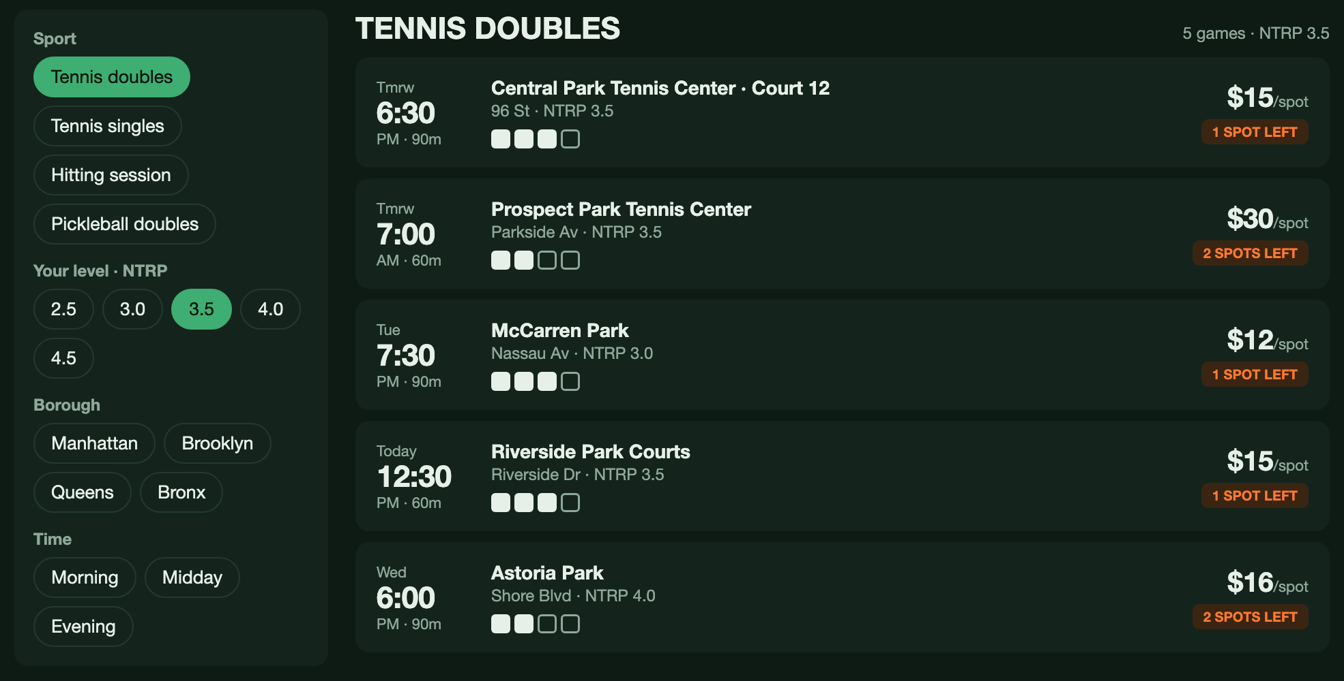
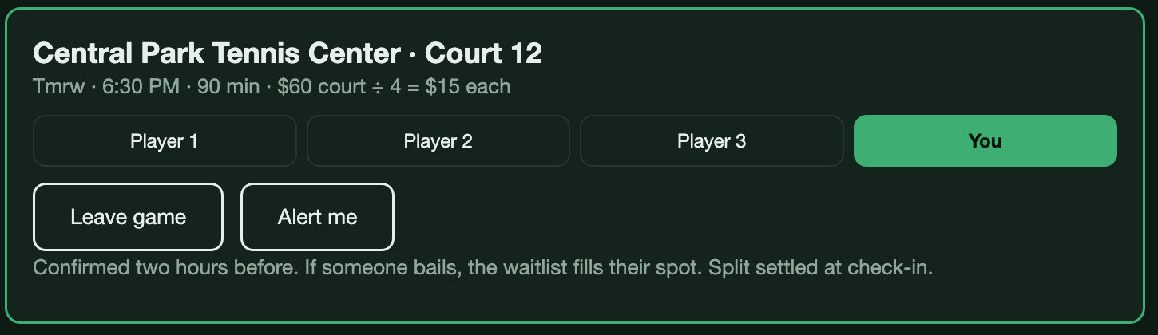
A working prototype that testers ranked first
What testers said
2 of 3 ranked it first among the concepts tested; none ranked it last.
“I don’t need a pre-existing group or court. I just drop into a game at my level.”
Built from feedback
Singles and hitting sessions, plus alerts for spots opening in the next three hours.
Next refinements
“Play again” with favorite players, standing weekly games and a map of games.
Future technology
No-show prediction, DUPR and NTRP rating import and live venue booking links.
Page 10 · Prototype · preciousdocuments.github.io/hcdi-prototypes/open-spot.html

