Slide 1

Welcome to the AI-Hackathon!
Orientation
AI Working Group
March 11, 2026

Slide 2


Welcome!

Slide 3
Welcome!
Today’s agenda
Welcome
Who’s in the room
AI Working Group Leadership Team
Hackathon Rules
Office Hours
Get to know your team!

Slide 4
Who is in the room?
Expected Attendance: 150-200 industry and government professionals
80 + hackathon participants
3-5 Government Judges
20 Teams

Slide 5

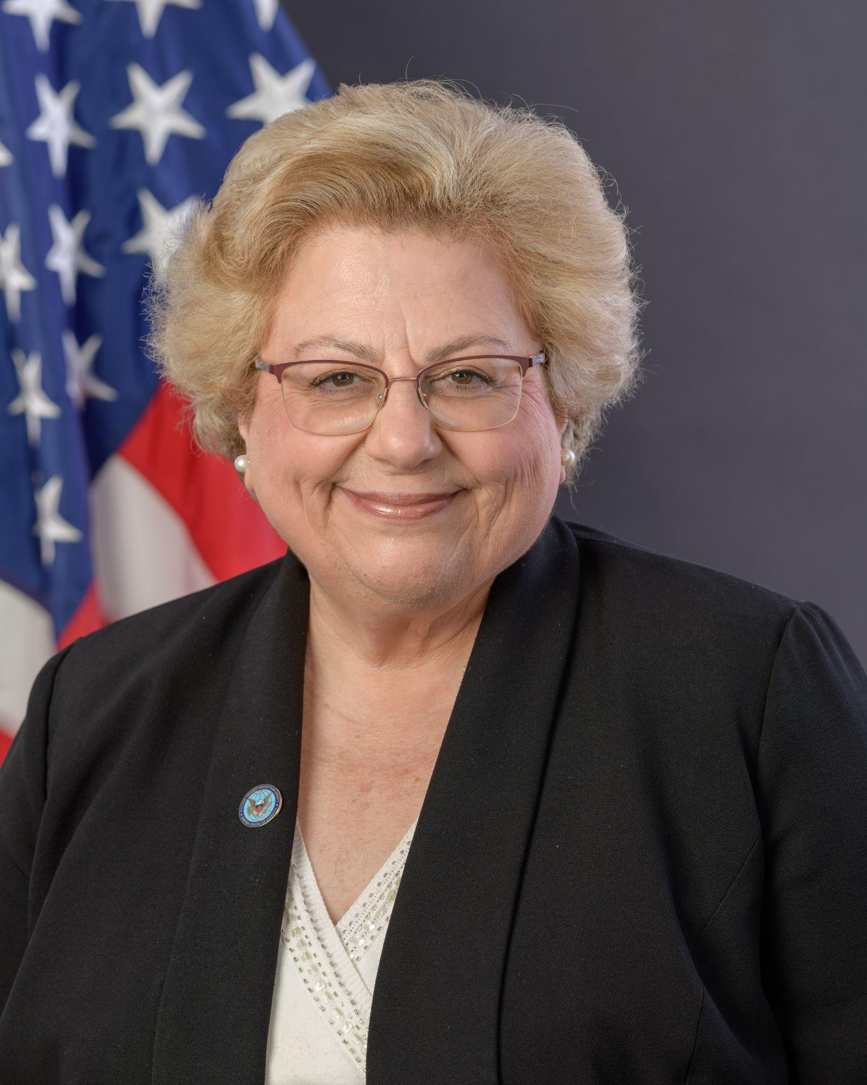
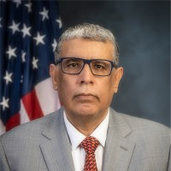


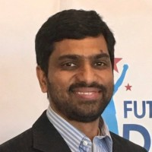







Our Leadership Team
AI Working Group Chairs
Paul Tibbits, M.D.
VA
Government Chair
Dr. Gabrielle Bedewi
Government Chair
Defense Threat Reduction Agency (DTRA)
Omar E. Bouaichi
Government Chair
HUD | Ginnie Mae Office of Enterprise Data & Technology Solutions
Gopa Nair
Government Chair
Department of Labor (DOL)
OASAM/OCIO
Ravi Gourineni
Industry Chair
Lithe Solutions
Co-Founder/CSO
Bethlehem Belaineh
Industry Vice Chair
Theory AI
Founder & CEO

Slide 6
Hackathon Rules (part 1)
Eligibility & Team Formation
Team size limits (e.g., 2–5 members per team)
Participants must register by the deadline
Each person can only be on one team
Teams must have at least one designated team lead
Intellectual Property & Originality
All work must be original and built during the Hackathon period
No pre-built projects or significant prior work submitted as new
Teams retain ownership of their work
Any open-source tools/libraries must be disclosed
Code of Conduct
Respectful communication among all participants
No plagiarism or cheating
No harassment or discrimination of any kind
Violations result in disqualification

Slide 7
Hackathon Rules (part 2)
Submission Requirements
Projects must be submitted by the deadline (no exceptions)
Must include a demo, README, or presentation
Code must be pushed to a shared repository (e.g., GitHub)
Teams must present/demo their project to judges
Judging Criteria
Innovation & creativity
Technical complexity
Practicality / real-world impact
Quality of presentation/demo
Use of AI Tools
Disclose any AI tools used (e.g., GitHub Copilot, ChatGPT)
AI-generated code must be reviewed and understood by the team
General
Judges' decisions are final
Organizers reserve the right to disqualify teams for rule violations
Participants must be available during judging windows

Slide 8
Hackathon Key Dates and TimeLines
Time Frame | Phase | Description | Milestone
Feb 2, 2026 | Hackathon Announcement | Public announcement; registration opens; structure and rules published (use cases excluded) | Registration opens
Feb 2 – Feb 20, 2026 | Use Case Development & Intake | Use cases developed by Steering Committee; industry use cases solicited and reviewed | Use cases finalized
Feb 20, 2026 | Use Case Publication | Four (4) approved use cases published publicly with leads and sponsors identified | Use cases released
Feb 2 – Mar 6, 2026 | Registration | Participants register and indicate use case and environment preferences | Registration closes
Mar 6 – Mar 11, 2026 | Team Formation, Use Case & Environment Lock | Teams finalized based on registration option and interest, Use Case finalized and environment access checked | Teams confirmed
Mar 12 – Mar 25, 2026 | Solutioning Sprint | 14-day sprint to design and build MVP solutions | Working MVPs complete
Mar 25, 2026 (EOD, 5 PM) | Submission Lock | Final solutions and artifacts submitted | Submissions closed
Mar 27, 2026 | Demo Day & Judging | Live demos, panels, judging, and awards | Winners announced

Slide 9
What’s Next ?
Office Hours: Hosted Daily March 13-25
Confirm Your Teams
Confirm your Use-Cases
Confirm your preferred environment
Attend Office Hours
Form a Project Plan
Submit your Hackathon Project by 02/25/2026

Slide 10
Thank you! Q & A Time
Questions? Concerns?
Contact
Bethlehem (Be): be@theoryai.co
Ravi: rgourineni@lithesolutions.com

