Slide 1
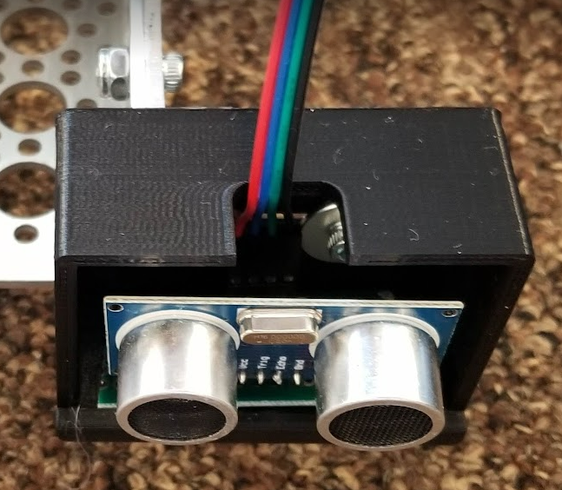
Sensor Diagram
Back
Ribbon + 4 feet Extensions
Back
Red – Power
Blue – Trigger
Green – Echo
Black – Ground
Ribbon + 16 feet Extensions
Right
Side
Left
Side
RPI
Front
Front
Only Ribbon Needed
Forward
Forward
Put hot glue at the bottom of the circuit to attach the sensor to the enclosure
Extensions should be made by cutting one end of the ribbon cable and soldering the cables of the appropriate length. The extended cables should be connected to the RPI following the pinout on the next slide.

Slide 2
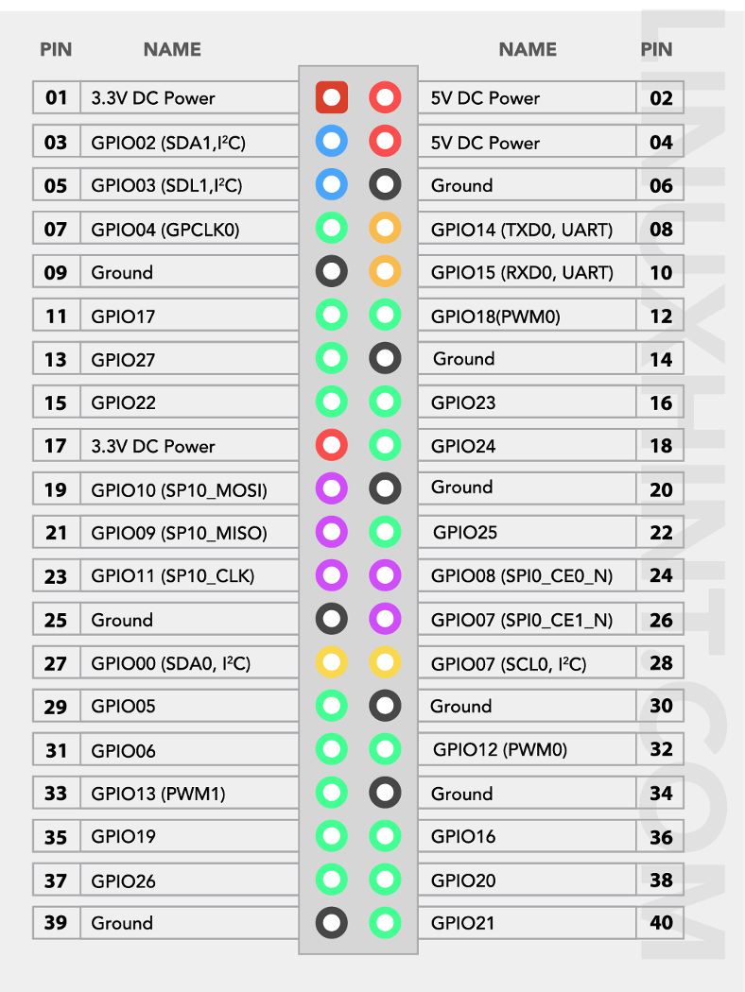
Sensor Pinout
Collision right trigger 15 echo 13
Front right trigger 12 echo 16
Back right trigger 11 echo 7
Collision left trigger 29 echo 35
Front left trigger 22 echo 24
Back left trigger 3 echo 5

Slide 3
Power & Networking
Connect the RPI, Machine Motion and Laptop to the ethernet switch
Power all the devices by connecting them to the power inverter. Note that a power strip may be needed. The RPI and the switch could be powered by USB 3.0 ports.

