Slide 1
Mouse GBM:
A Pilot Collection on NBIA
Sunny Jansen
Postdoctoral Fellow
Terry Van Dyke Lab
Mouse Cancer Genetics Program
NCI
Collaboration with
Paul Mulhern and Brian Hughes

Slide 2
Introduction
Preclinical Goals
Goal 1: Develop a molecular and imaging based classification for genetically engineered mouse models (GEMs) of glioblastoma multiforme (GBM)
Goal 2: Use imaging to asses response of GBM GEMs to novel therapeutic regimens

Slide 3
Introduction caBIG® Tools for Preclinical Data
Data from NBIA (National Biomedial Imaging Archive) and caArray (Gene Expression microarrays) are integrated in caIntegrator
NBIA
caArray
National Biomedical Imaging Archive
Gene expression microarrays
caIntegrator
Integrate NBIA, clinical data (survival, IHC…), gene expression

Slide 4
Mouse GBM Pilot Collection
Purpose
Utilize NBIA and caIntegrator to correlate image-based features with ‘clinical’ data in GBM mouse models
  Image-based features
    Qualitative
    Quantitative blood brain barrier permeability
  ‘Clinical’ features
    Genotype
    Tumor histologic characteristics
    IHC— e.g., CD31
One time imaging in n=62 mouse patients

Slide 5
Mouse GBM Pilot Collection
Animal models
Intracranial injection of cell lines derived from several GEMs
Genotypes:
  Rb inactivation + Ras activation (TR)
  Rb inactivation + Ras activation + PTEN loss (TRP)
  Rb inactivation + Ras activation + EGFR loss (TRE)

Slide 6
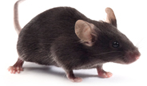
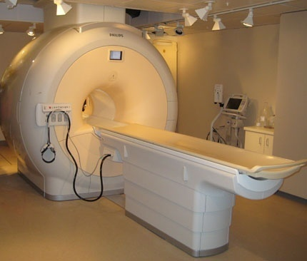
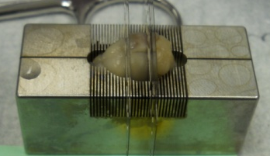
Mouse GBM Pilot Collection
Brain Imaging Workflow
4 mice are imaged at once in a Philips Intera Achieva 3.0T MRI clinical scanner ~1hr imagining time→ post imaging euthanize and histology
Four mice imaged
at once
Philips Intera Achieva
3.0T MRI clinical scanner
~1hour imaging time
Post imaging euthanize
and histology

Slide 7
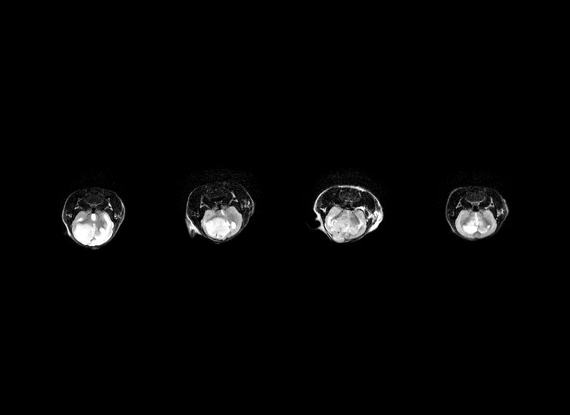
Mouse GBM Pilot Collection
MRI Pulse Sequences
T2 weighted pre contrast

Slide 8
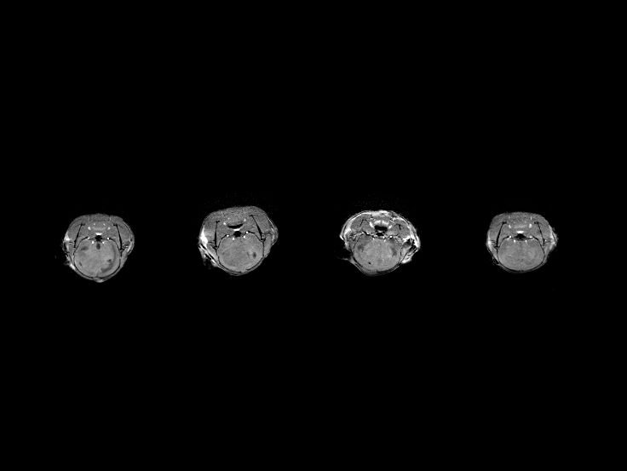
Mouse GBM Pilot Collection
MRI Pulse Sequences
T1 weighted pre contrast

Slide 9
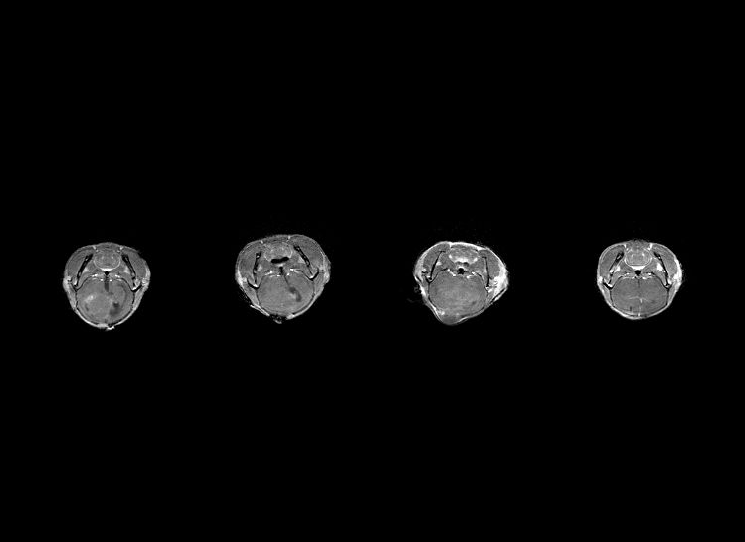
Mouse GBM Pilot Collection
MRI Pulse Sequences
T1 weighted post contrast

Slide 10
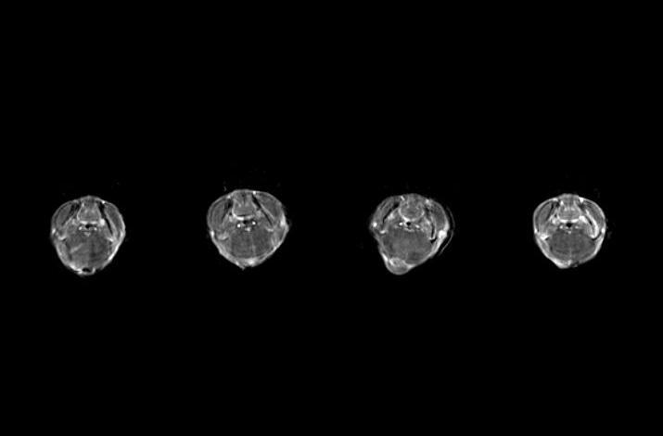
Mouse GBM Pilot Collection
MRI Pulse Sequences
Dynamic contrast enhanced series

Slide 11
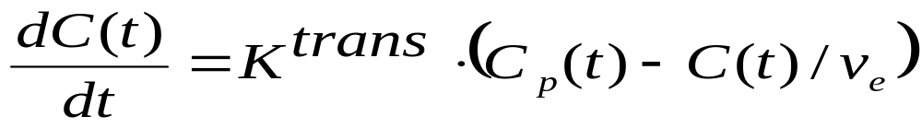
Mouse GBM Pilot Collection
DCEMRI and two compartment model parameters
Quantifiable information on the blood brain barrier permeability is extracted from the pattern of contrast agent uptake
v_{e}
K^{trans}
In-flow/arterial
Out-flow/venous
From Cheng Yang

Slide 12
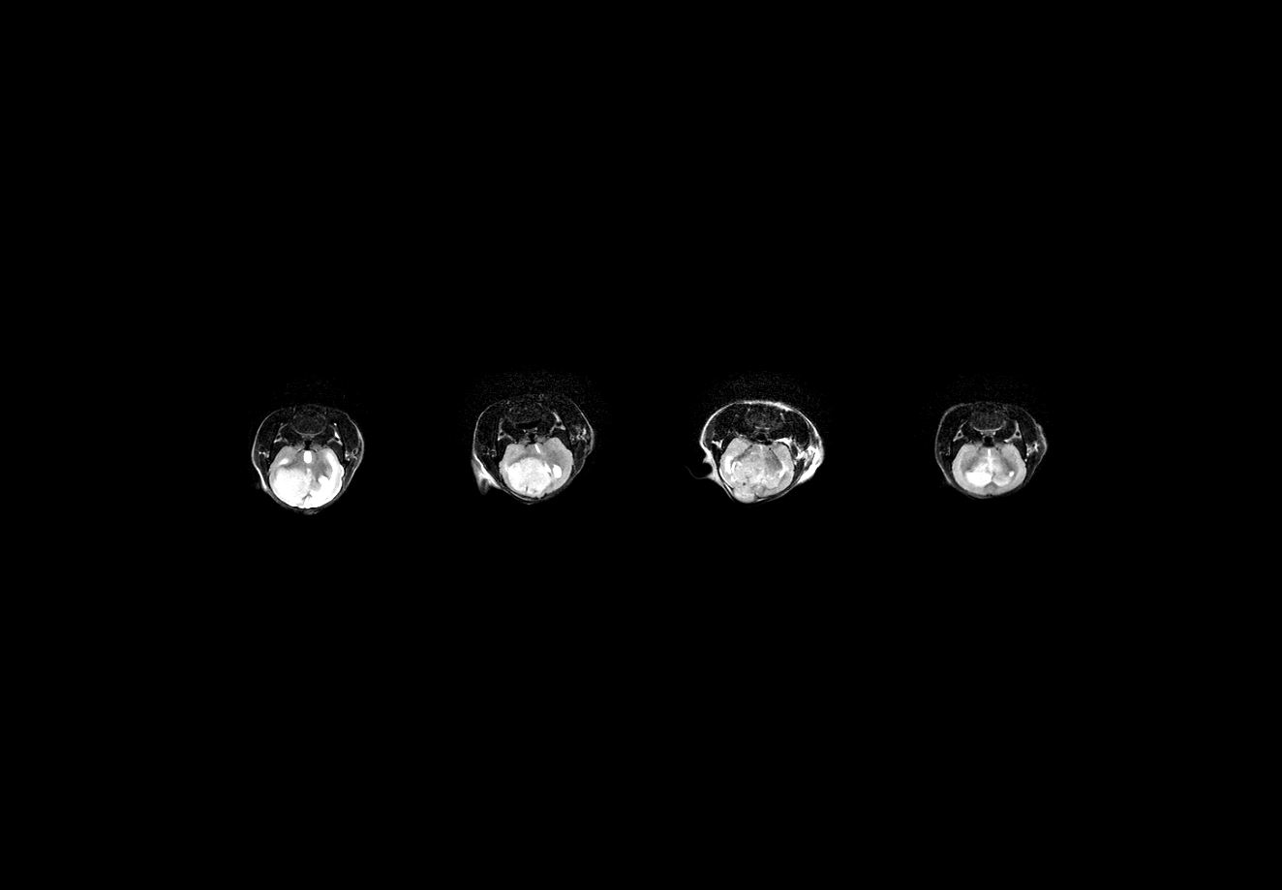
Mouse GBM Pilot Collection
Challenge: Cropping and splitting the image data
Mouse 10
Mouse 11
Mouse 66
Mouse 82

Slide 13
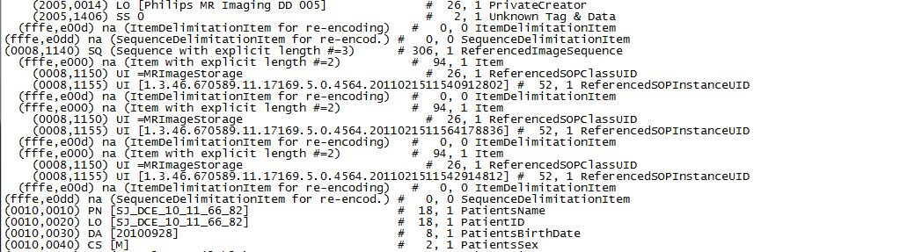
Mouse GBM Pilot Collection
Challenge: Cropping and splitting the metadata
DICOM header

Slide 14

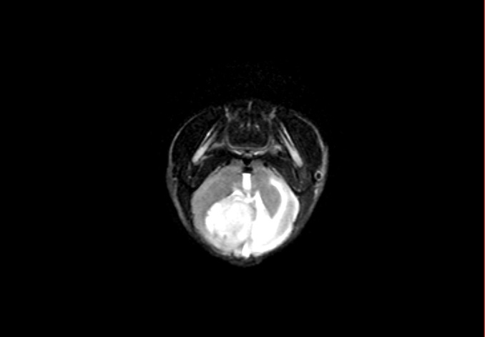
Mouse GBM Pilot Collection
Cropping and splitting the image data
Program written in IDL
10 11 66 82
Mouse 10
Advantage: Image arrays 16 times smaller

Slide 15
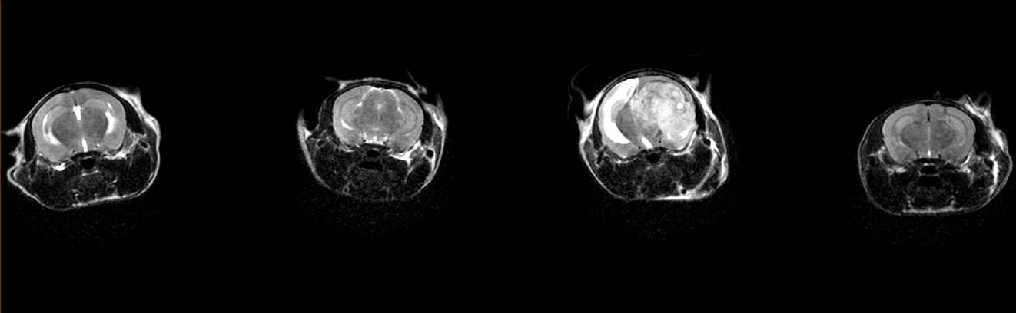
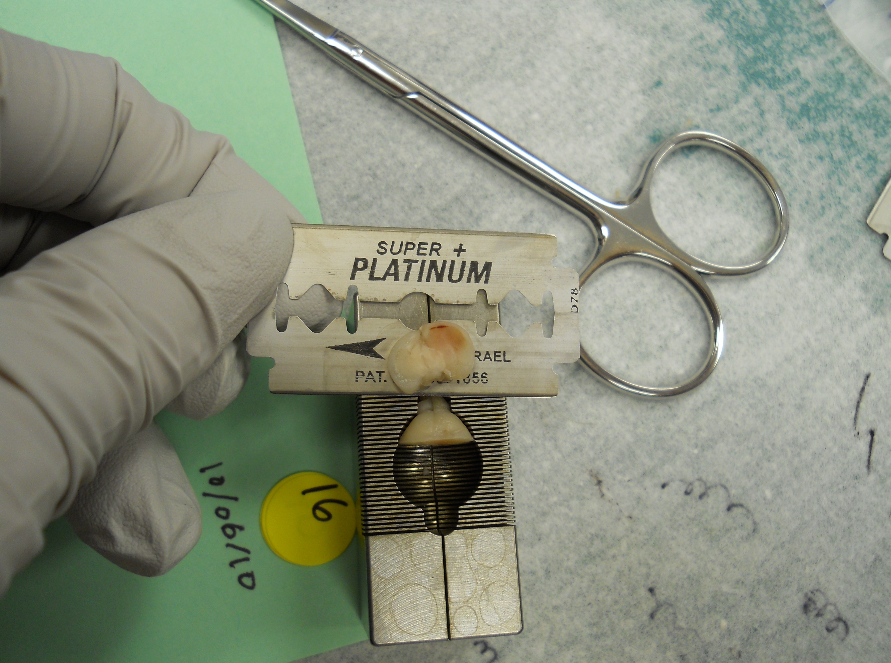
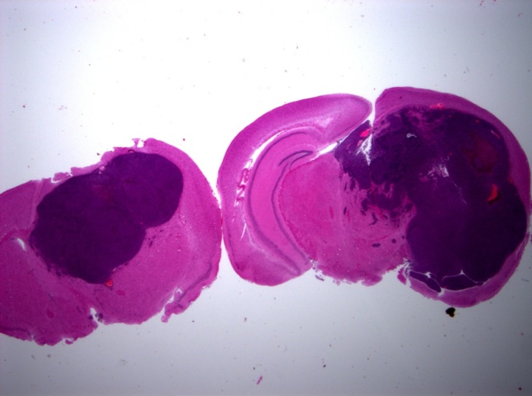
Mouse GBM Pilot Collection
Cropping and splitting the image data

Slide 16
Mouse GBM Pilot Collection
Cropping and splitting the metadata
DICOM header
Program written in IDL

Slide 17
Mouse GBM Pilot Collection
Deployment to CBIIT instance of NBIA
Demo: Mouse GBM on NBIA

Slide 18
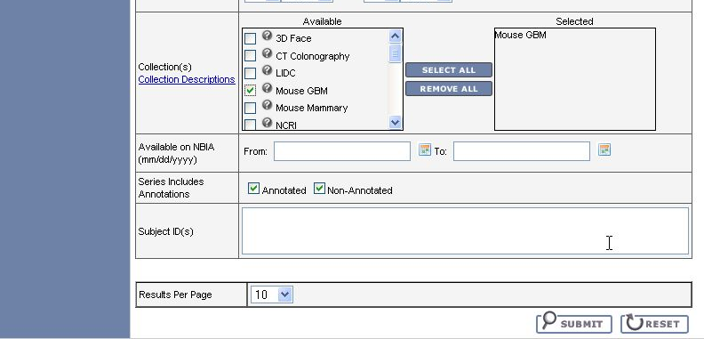
Mouse GBM Pilot Collection
Deployment to CBIIT instance of NBIA

Slide 19
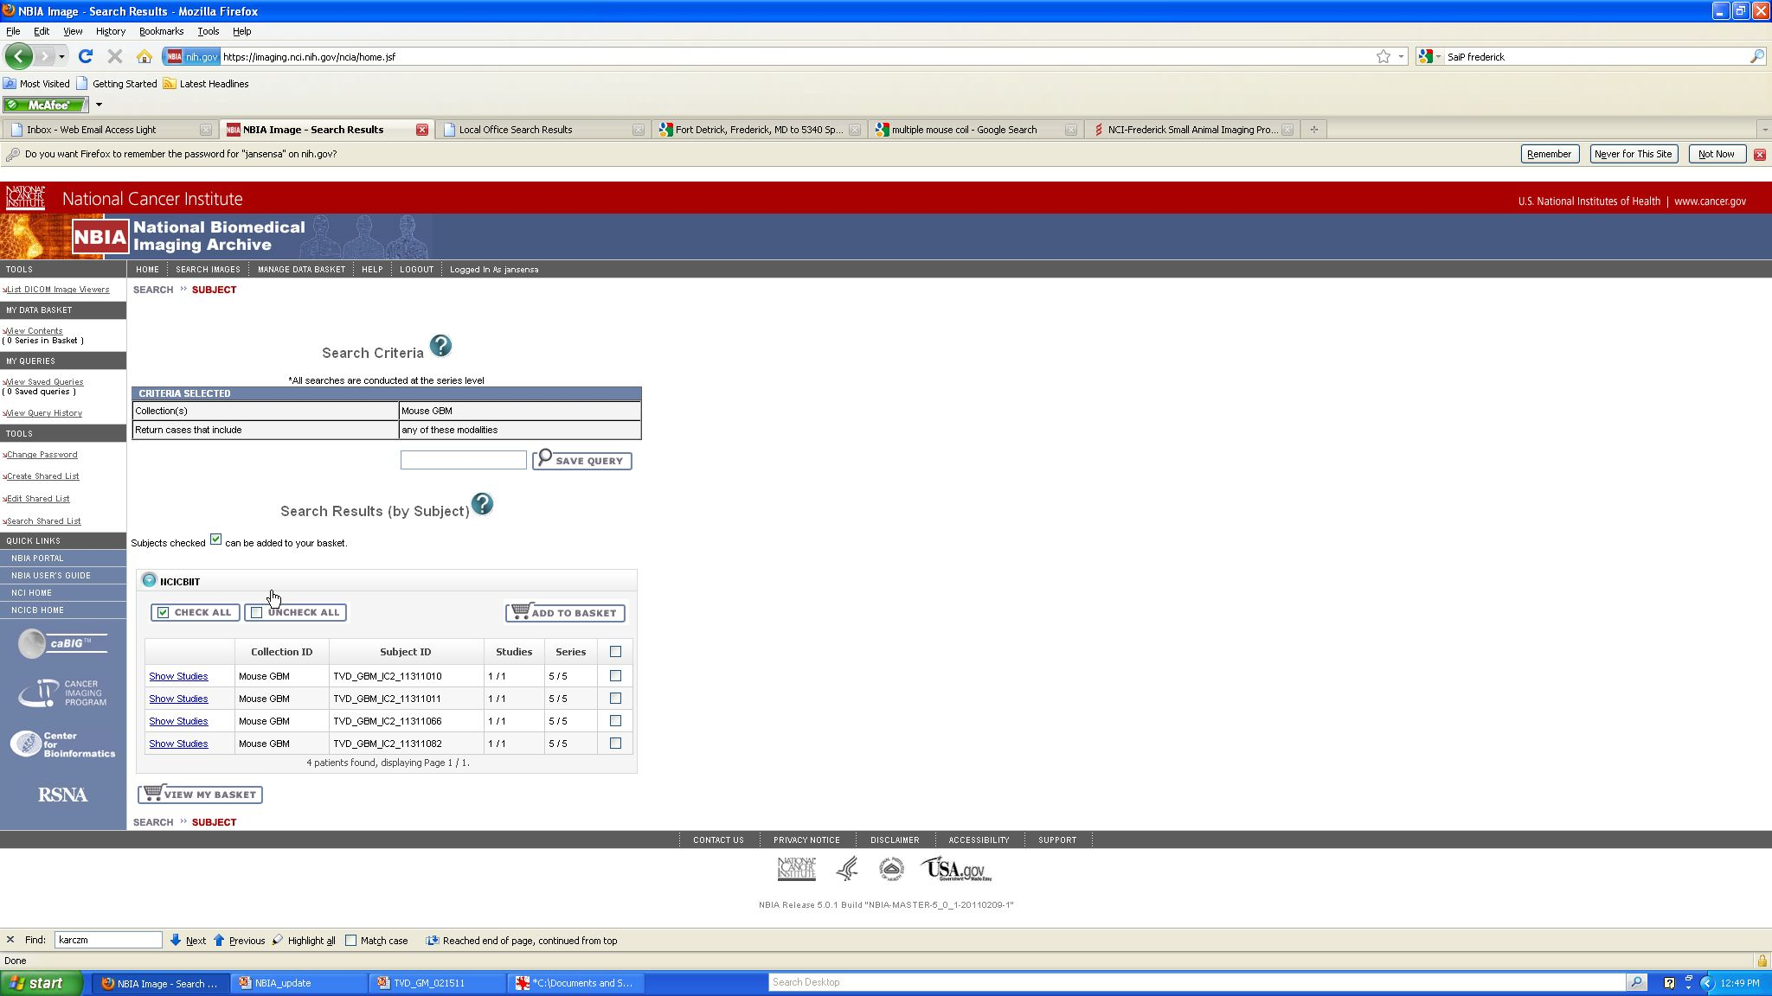
Mouse GBM Pilot Collection
Deployment to CBIIT instance of NBIA

Slide 20
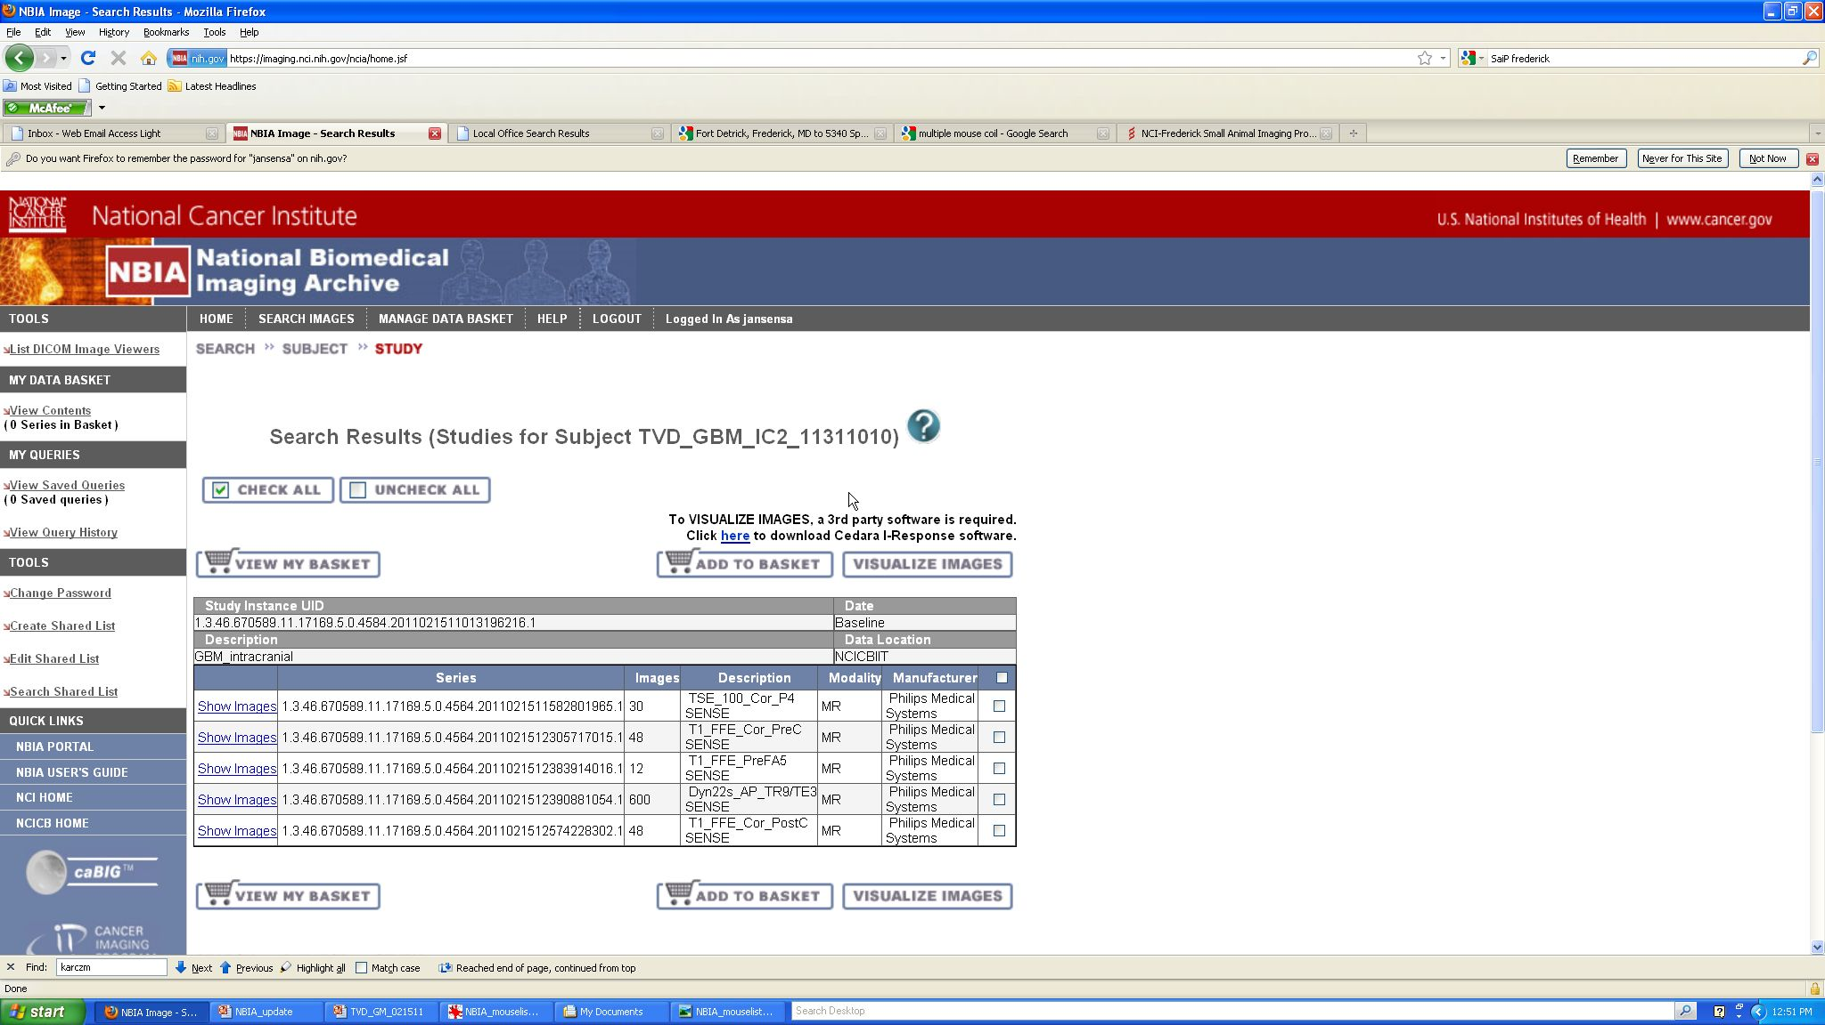
Mouse GBM Pilot Collection
Deployment to CBIIT instance of NBIA

Slide 21
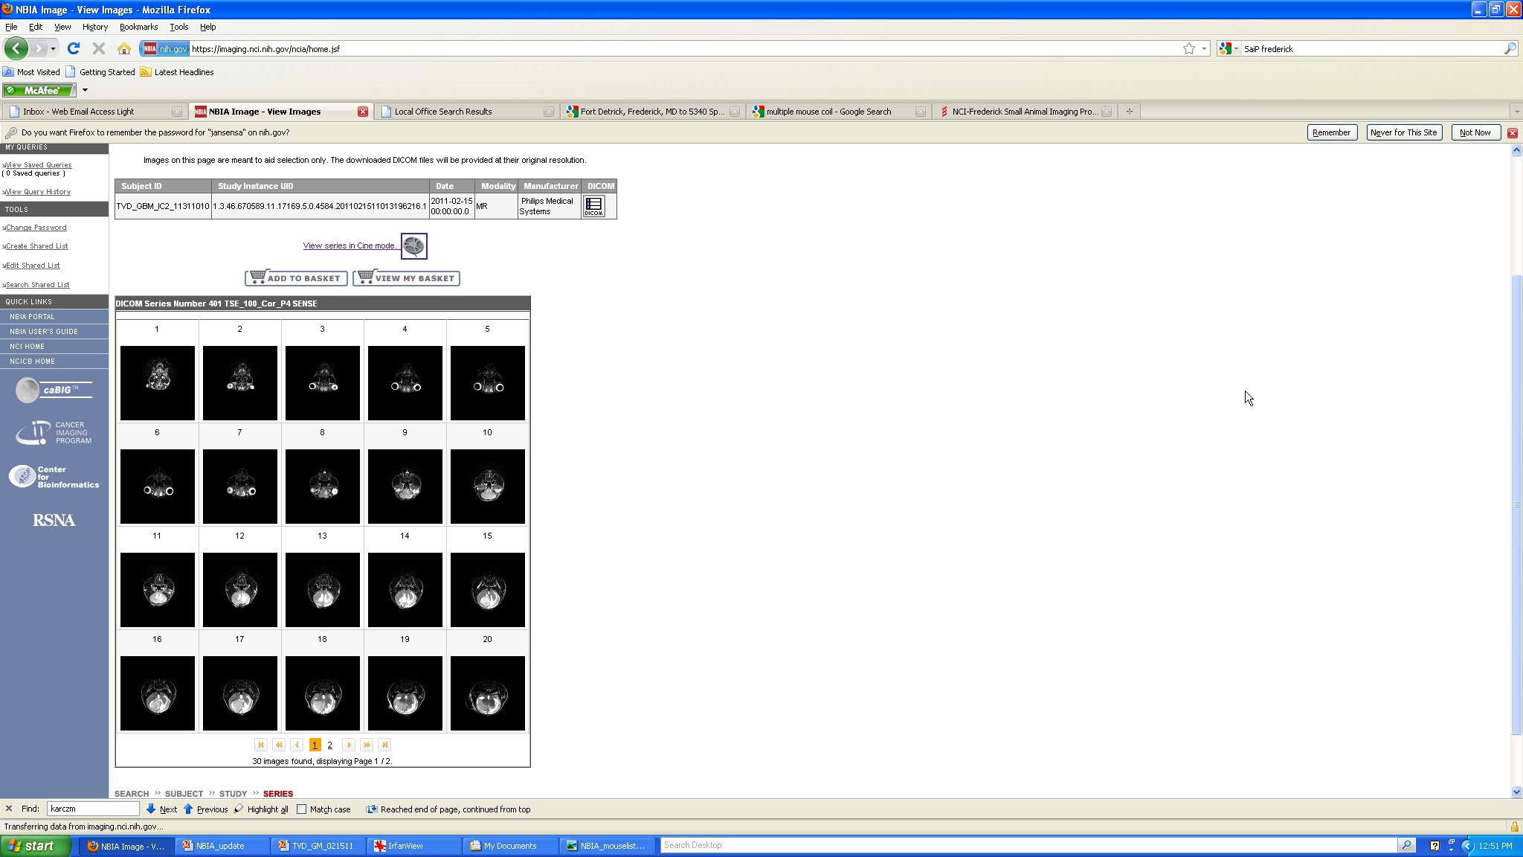
Mouse GBM Pilot Collection
Deployment to CBIIT instance of NBIA

Slide 22
Summary
Progress to date: Successfully deployed individual mouse GBM MRI datasets to NBIA
Next steps
  Set up own instance of NBIA
  Qualitative and quantitative image analysis
    AIM features
    K^{trans}, v_{e}
  Correlation of image-based features with genotype, histology, pathology
    caIntegrator

Slide 23
Mouse GBM Pilot Collection
Deployment to CBIIT instance of caInt
Demo: Mouse GBM on caIntegrator

Slide 24
Summary
Future directions
  caArray
  Center for Advanced Preclinical Research (CAPR)
  Mouse Mammary pilot collection and image-based prognostic markers

