Slide 1
Probabilistic Programming
Marius Popescu
popescunmarius@gmail.com
2023 - 2024

Slide 2
Variational Bayesian Methods

Slide 3
Variational Bayesian Methods
Variational Bayesian methods are a family of techniques for approximating intractable integrals arising in Bayesian inference and machine learning. They are typically used in complex statistical models consisting of observed variables (usually termed "data") as well as unknown parameters and latent variables, with various sorts of relationships among the three types of random variables.
Variational Bayesian methods are primarily used for two purposes:
To provide an analytical approximation to the posterior probability of the unobserved variables, in order to do statistical inference over these variables.
To derive a lower bound for the marginal likelihood (sometimes called the "evidence") of the observed data (i.e. the marginal probability of the data given the model, with marginalization performed over unobserved variables). This is typically used for performing model selection, the general idea being that a higher marginal likelihood for a given model indicates a better fit of the data by that model and hence a greater probability that the model in question was the one that generated the data.

Slide 4
Variational Inference

Slide 5
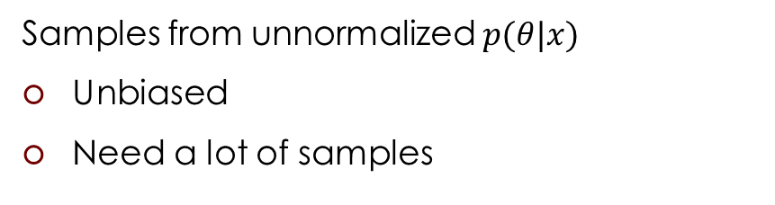
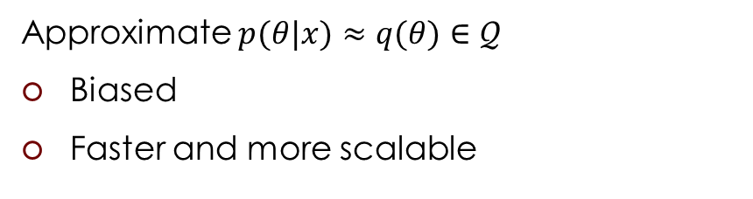

Approximate inference
Probabilistic model: $p\left(x,θ\right)=p\left(x | θ\right)p(θ)$
Variational Inference
MCMC
Approximate $p(θ|x)≈q(θ)∈𝒬$
Biased
Faster and more scalable
Samples from unnormalized $p(θ|x)$
Unbiased
Need a lot of samples

Slide 6
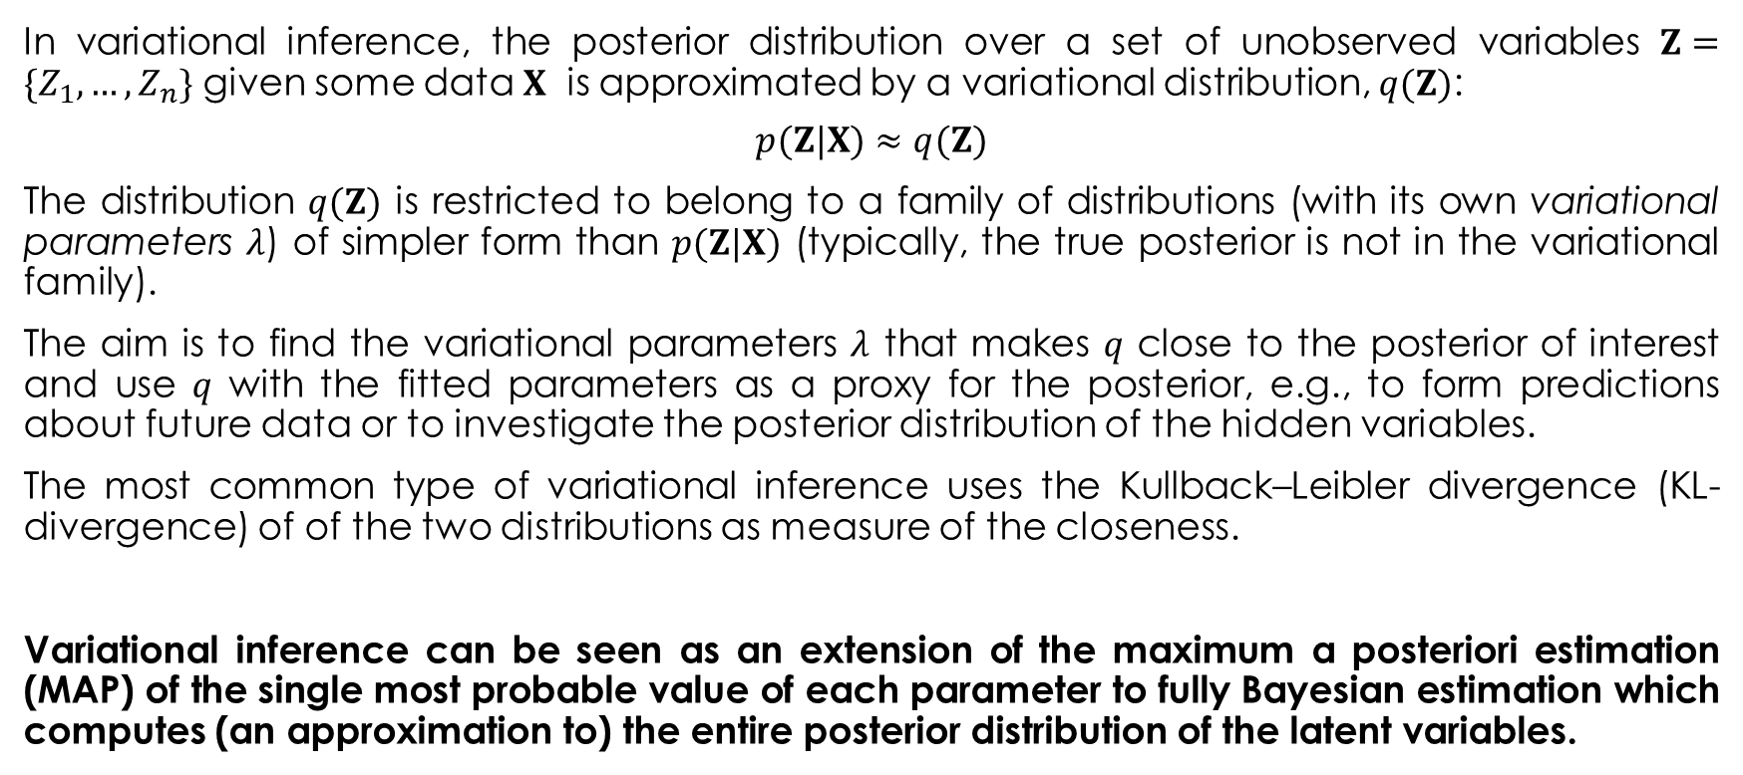
Variational Inference
In variational inference, the posterior distribution over a set of unobserved variables $Z=\{Z_{1},…,Z_{n}\}$ given some data $X$ is approximated by a variational distribution, $q(Z)$:
$$p(Z|X)≈q(Z)$$
The distribution $q(Z)$ is restricted to belong to a family of distributions (with its own variational parameters $λ$) of simpler form than $p(Z|X)$ (typically, the true posterior is not in the variational family).
The aim is to find the variational parameters $λ$ that makes $q$ close to the posterior of interest and use $q$ with the fitted parameters as a proxy for the posterior, e.g., to form predictions about future data or to investigate the posterior distribution of the hidden variables.
The most common type of variational inference uses the Kullback–Leibler divergence (KL-divergence) of of the two distributions as measure of the closeness.
Variational inference can be seen as an extension of the maximum a posteriori estimation (MAP) of the single most probable value of each parameter to fully Bayesian estimation which computes (an approximation to) the entire posterior distribution of the latent variables.

Slide 7

KL-divergence comes from Information Theory

Slide 8
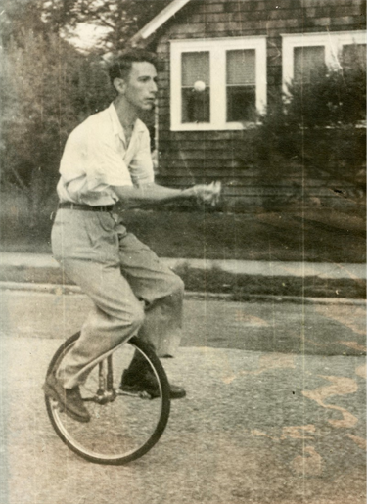
Information Theory
In the early 1940s it was thought to be impossible to send information at a positive rate with negligible probability of error. Shannon surprised the communication theory community by proving that the probability of error could be made nearly zero for all communication rates below channel capacity. The capacity can be computed simply from the noise characteristics of the channel. Shannon further argued that random processes such as music and speech have an irreducible complexity below which the signal cannot be compressed. This he named the entropy, in deference to the parallel use of this word in thermodynamics, and argued that if the entropy of the source is less than the capacity of the channel, asymptotically error-free communication can be achieved.
Information theory answers two fundamental questions in communication theory: What is the ultimate data compression (answer: the entropy H), and what is the ultimate transmission rate of communication (answer: the channel capacity C).

Slide 9
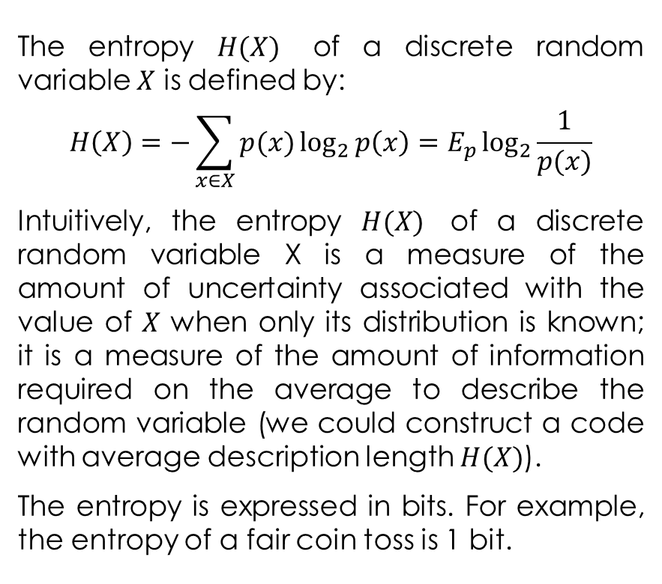
The Entropy
The entropy $H(X)$ of a discrete random variable $X$ is defined by:
$$H\left(X\right)=−\sum_{x∈X}{p(x)\log_{2}{p\left(x\right)=E_{p}\log_{2}{\frac{1}{p(x)}}}}$$
Intuitively, the entropy $H(X)$ of a discrete random variable X is a measure of the amount of uncertainty associated with the value of $X$ when only its distribution is known; it is a measure of the amount of information required on the average to describe the random variable (we could construct a code with average description length $H(X)$).
The entropy is expressed in bits. For example, the entropy of a fair coin toss is 1 bit.

Slide 10
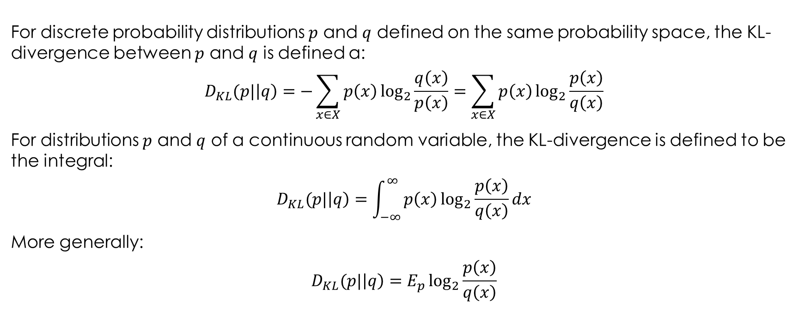
Kullback–Leibler Divergence
For discrete probability distributions $p$ and $q$ defined on the same probability space, the KL-divergence between $p$ and $q$ is defined a:
$$D_{KL}(p|\left|q\right)=−\sum_{x∈X}{p\left(x\right)\log_{2}{\frac{q\left(x\right)}{p\left(x\right)}}}=\sum_{x∈X}{p\left(x\right)\log_{2}{\frac{p\left(x\right)}{q\left(x\right)}}}$$
For distributions $p$ and $q$ of a continuous random variable, the KL-divergence is defined to be the integral:
$$D_{KL}(p|\left|q\right)=\int_{−∞}^{∞}{p\left(x\right)\log_{2}{\frac{p\left(x\right)}{q\left(x\right)}}dx}$$
More generally:
$$D_{KL}(p|\left|q\right)=E_{p}\log_{2}{\frac{p\left(x\right)}{q\left(x\right)}}$$

Slide 11
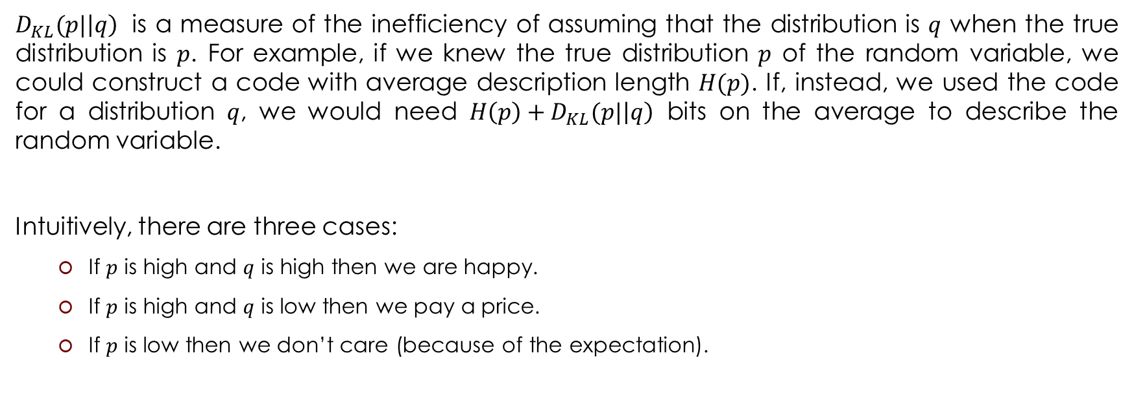
Kullback–Leibler Divergence
$D_{KL}(p|\left|q\right)$ is a measure of the inefficiency of assuming that the distribution is $q$ when the true distribution is $p$. For example, if we knew the true distribution $p$ of the random variable, we could construct a code with average description length $H(p)$. If, instead, we used the code for a distribution $q$, we would need $H\left(p\right)+D_{KL}(p|\left|q\right)$ bits on the average to describe the random variable.
Intuitively, there are three cases:
If $p$ is high and $q$ is high then we are happy.
If $p$ is high and $q$ is low then we pay a price.
If $p$ is low then we don’t care (because of the expectation).

Slide 12


Coming Back to Variational Inference
Note that $q$ and $p$ are reversed from what one might expect
We want:
$$\min{D_{KL}(q(Z)|\left|p(Z|X)\right)}$$

Slide 13
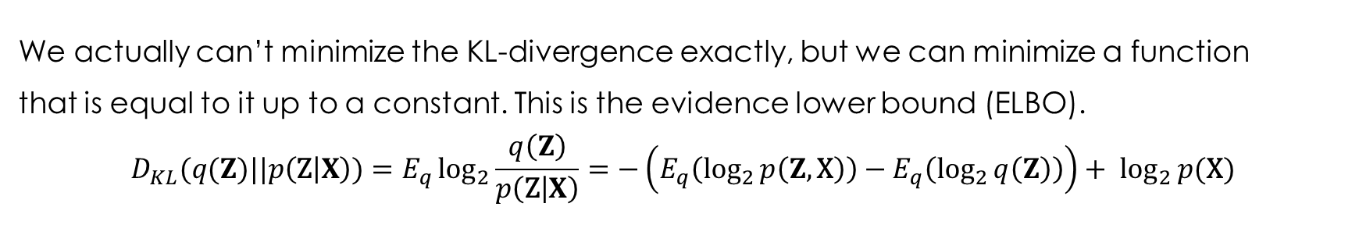
The Evidence Lower Bound (ELBO)
We actually can’t minimize the KL-divergence exactly, but we can minimize a function
that is equal to it up to a constant. This is the evidence lower bound (ELBO).
$$D_{KL}(q(Z)||p\left(\text{Z} | X\right))=E_{q}\log_{2}{\frac{q\left(Z\right)}{p\left(\text{Z} | X\right)}}=−\left(E_{q}\left(\log_{2}{p\left(Z,\text{X}\right)}\right)−E_{q}\left(\log_{2}{q\left(Z\right)}\right)\right)+ \log_{2}{p(\text{X})}$$
ELBO
Notice that $\log_{2}{p(\text{X})}$ does not depend on $q$. So, as a function of the variational distribution, minimizing the KL-divergence is the same as maximizing the ELBO.

Slide 14
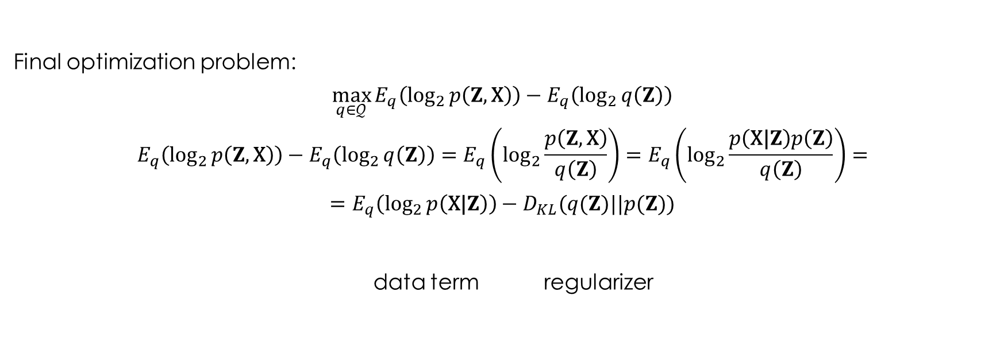
Variational Inference
Final optimization problem:
$$\max_{q∈𝒬}{E_{q}\left(\log_{2}{p\left(Z,\text{X}\right)}\right)−E_{q}\left(\log_{2}{q\left(Z\right)}\right)}$$
$$E_{q}\left(\log_{2}{p\left(Z,\text{X}\right)}\right)−E_{q}\left(\log_{2}{q\left(Z\right)}\right)=E_{q}\left(\log_{2}{\frac{p\left(Z,\text{X}\right)}{q\left(Z\right)}}\right)=E_{q}\left(\log_{2}{\frac{p\left(\text{X}\text{|}Z\right)p\left(Z\right)}{q\left(Z\right)}}\right)=$$
$$=E_{q}\left(\log_{2}{p\left(\text{X}\text{|}Z\right)}\right)−D_{KL}(q(Z)||p(Z))$$
data term regularizer

Slide 15

Variational Inference
Final optimization problem:
$$\max_{q∈𝒬}{E_{q}\left(\log_{2}{p\left(Z,\text{X}\right)}\right)−E_{q}\left(\log_{2}{q\left(Z\right)}\right)}$$
Mean field approximation (factorized family)
Parametric approximation (parametric family)
How to perform an
optimization w.r.t.
a distribution?

Slide 16
Example: Bayesian Neural Networks
Bridging Deep Learning and Probabilistic Programming

Slide 17
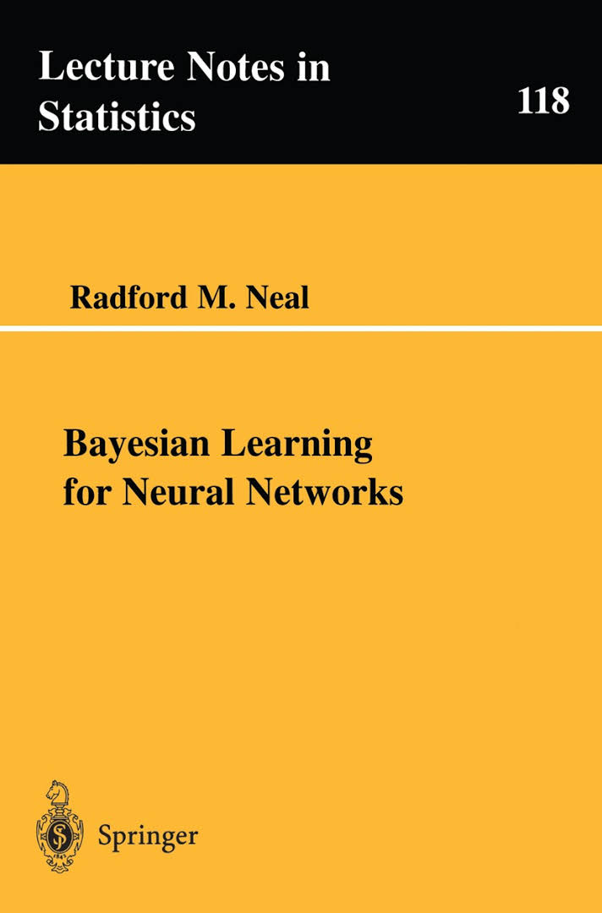
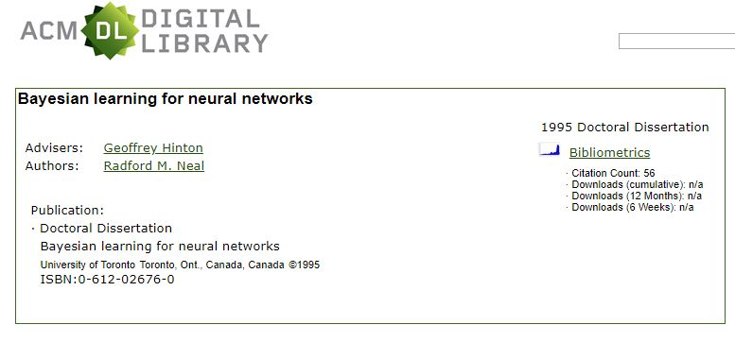
Bayesian Neural Networks
http://citeseerx.ist.psu.edu/viewdoc/download?doi=10.1.1.446.9306&rep=rep1&type=pdf

Slide 18
Bayesian Neural Networks
A Bayesian neural network is a neural network with a prior distribution on its weights
Define the prior on the weights and biases $\text{w}$ to be the standard normal:
$$p\left(\text{w}\right)=\text{Normal}(0, \text{I})$$
Define the likelihood for a data point as:
$$p\left(y | \text{x},\text{w}\right)=\text{Bernoulli}(NN(\text{x},\text{w}\text{))}$$
Where $\text{x}∈ℝ^{d}$ is the feature vector, $y∈\{0,1\}$ is the output (binary classification), and $NN(\text{x},\text{w}\text{)}$ is the function (deterministic) implemented by the neural network whose weights and biases form the latent variables $\text{w}$. The output of the neural network must be a value between 0 and 1 (for example the last layer has only one sigmoid neuron).
Or:
$$p\left(y | \text{x},\text{w}\right)=\text{Catego}\text{r}\text{ica}\text{l}(NN(\text{x},\text{w}\text{))}$$
Where $\text{x}∈ℝ^{d}$ is the feature vector, $y∈\{1,2,…k\}$ is the output (multiclass classification), and $NN(\text{x},\text{w}\text{)}$ is the function (deterministic) implemented by the neural network whose weights and biases form the latent variables $\text{w}$. The outputs of the neural network must sum to 1 (for example the last layer is a softmax layer).

Slide 19
Why Bayesian Neural Networks?
Uncertainty in predictions: the Bayesian Neural Network informs us about the uncertainty in its predictions
Uncertainty in representations: We also get uncertainty estimates of our weights which could inform us about the stability of the learned representations of the network
Regularization with priors: Weights are often L2-regularized to avoid overfitting, this very naturally becomes a Gaussian prior for the weight coefficients. We could, however, imagine all kinds of other priors
Transfer learning with informed priors: If we wanted to train a network on a new object recognition data set, we could bootstrap the learning by placing informed priors centered around weights retrieved from other pre-trained networks

Slide 20
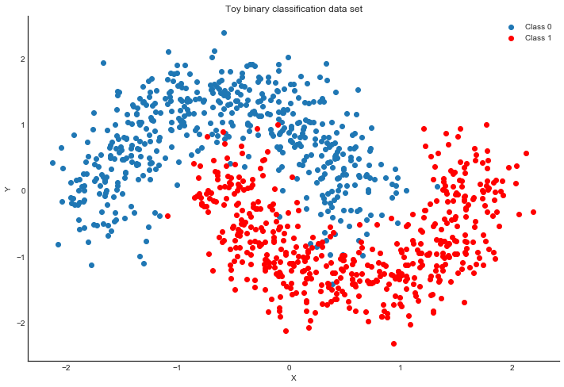
Generating Data
“Two Moons” dataset: toy dataset for a simple binary classification problem that's not linearly separable.
import numpy as np
import pymc as pm
import pytensor
import pytensor.tensor as pt
from sklearn.datasets import make_moons
from sklearn.model_selection import train_test_split
from sklearn.preprocessing import scale
floatX = pytensor.config.floatX
RANDOM_SEED = 9927
rng = np.random.default_rng(RANDOM_SEED)
X, Y = make_moons(noise=0.2, random_state=0, n_samples=1000)
X = scale(X)
X = X.astype(floatX)
Y = Y.astype(floatX)
X_train, X_test, Y_train, Y_test = train_test_split(X, Y, test_size=0.5)

Slide 21
Model Specification
def construct_nn(ann_input, ann_output):
n_hidden = 5
# Initialize random weights between each layer
init_1 = rng.standard_normal(size=(X_train.shape[1], n_hidden)).astype(floatX)
init_2 = rng.standard_normal(size=(n_hidden, n_hidden)).astype(floatX)
init_out = rng.standard_normal(size=n_hidden).astype(floatX)
coords = {
"hidden_layer_1": np.arange(n_hidden),
"hidden_layer_2": np.arange(n_hidden),
"train_cols": np.arange(X_train.shape[1]),
"obs_id": np.arange(X_train.shape[0]),
}
with pm.Model(coords=coords) as neural_network:
ann_input = pm.Data("ann_input", X_train, mutable=True, dims=("obs_id", "train_cols"))
ann_output = pm.Data("ann_output", Y_train, mutable=True, dims="obs_id")
# Weights from input to hidden layer
weights_in_1 = pm.Normal(
"w_in_1", 0, sigma=1, initval=init_1, dims=("train_cols", "hidden_layer_1")
)
# Weights from 1st to 2nd layer
weights_1_2 = pm.Normal(
"w_1_2", 0, sigma=1, initval=init_2, dims=("hidden_layer_1", "hidden_layer_2")
)
# Weights from hidden layer to output
weights_2_out = pm.Normal("w_2_out", 0, sigma=1, initval=init_out, dims="hidden_layer_2")

Slide 22
Model Specification
# Build neural-network using tanh activation function
act_1 = pm.math.tanh(pm.math.dot(ann_input, weights_in_1))
act_2 = pm.math.tanh(pm.math.dot(act_1, weights_1_2))
act_out = pm.math.sigmoid(pm.math.dot(act_2, weights_2_out))
# Binary classification -> Bernoulli likelihood
out = pm.Bernoulli(
"out",
act_out,
observed=ann_output,
total_size=Y_train.shape[0], # IMPORTANT for minibatches
dims="obs_id",
)
return neural_network
neural_network = construct_nn(X_train, Y_train)

Slide 23
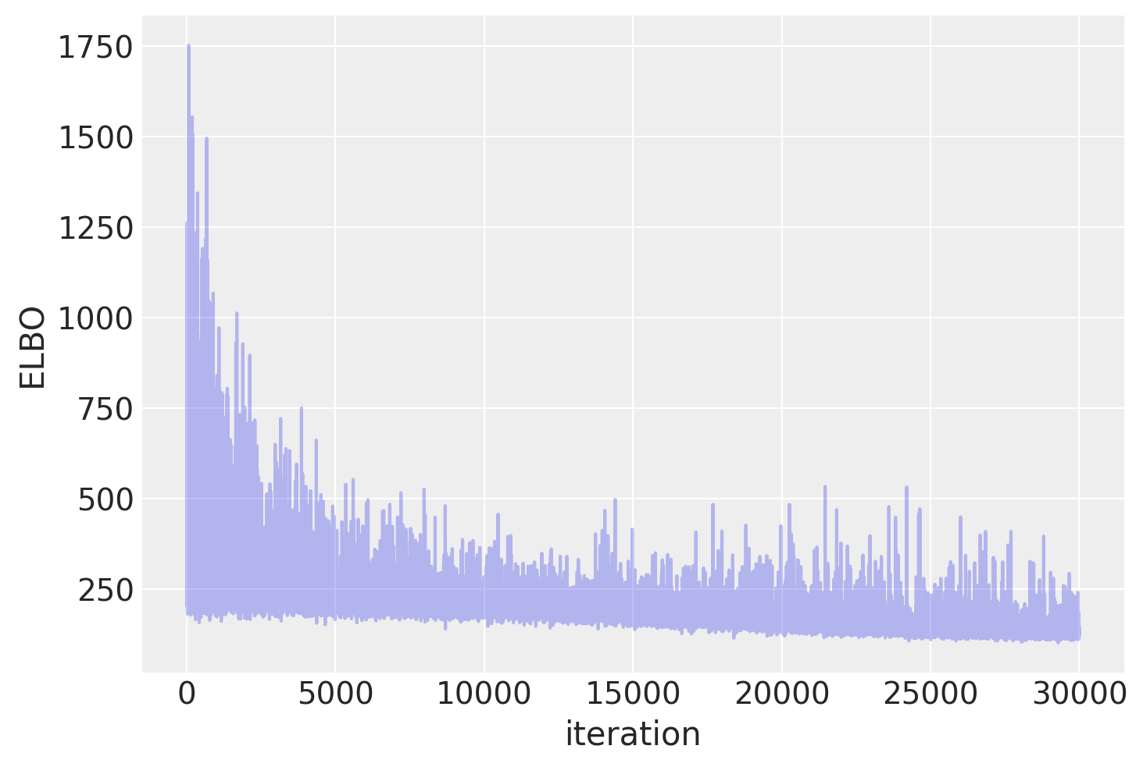
Automatic Differentiation Variational Inference (ADVI)
with neural_network:
approx = pm.fit(n=30_000)
plt.plot(approx.hist, alpha=0.3)
plt.ylabel("ELBO")
plt.xlabel("iteration")

Slide 24
Prediction
We can use sample_posterior_predictive() to generate new data (in this case class predictions) from the posterior (sampled from the variational estimation)
trace = approx.sample(draws=5000)
with neural_network:
pm.set_data(new_data={"ann_input": X_test})
ppc = pm.sample_posterior_predictive(trace)
trace.extend(ppc)
We can average the predictions for each observation to estimate the underlying probability of class 1
pred = ppc.posterior_predictive["out"].mean(("chain", "draw")) > 0.5
print(f"Accuracy = {(Y_test == pred.values).mean() * 100}%") # output: Accuracy = 95.0%

