Slide 1
Probabilistic Programming
Marius Popescu
popescunmarius@gmail.com
2023 - 2024

Slide 2
Bayesian Regression with PyMC
Logistic | Linear | Ridge | LASSO

Slide 3
The Bayesian Perspective
Unlike in the ordinary regression case, we don't get a single regression line - we get a probability distribution on the space of all such lines. The width of this posterior represents the uncertainty in our estimate.
Why to use it?
Although computationally it's a LOT harder than ordinary least squares, one can easily formulate and solve a very flexible model that addresses most of the problems with ordinary least squares: extreme sensitivity to outliers, inability to incorporate priors, and little ability to quantify uncertainty.
When to use it?
The distribution of errors is not normal or close to it
Don’t have enough data

Slide 4
Bayesian Logistic Regression

Slide 5

Challenger Space Shuttle Disaster
On January 28, 1986, the twenty-fifth flight of the U.S. space shuttle program ended in disaster when one of the rocket boosters of the Shuttle Challenger exploded shortly after lift-off, killing all seven crew members. The presidential commission on the accident concluded that it was caused by the failure of an O-ring in a field joint on the rocket booster, and that this failure was due to a faulty design that made the O-ring unacceptably sensitive to a number of factors including outside temperature. Of the previous 24 flights, data were available on failures of O-rings on 23, (one was lost at sea), and these data were discussed on the evening preceding the Challenger launch, but unfortunately only the data corresponding to the 7 flights on which there was a damage incident were considered important and these were thought to show no obvious trend.

Slide 6

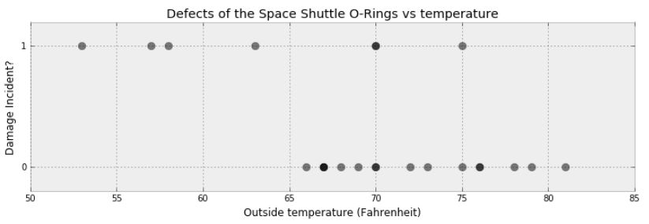
The Data

Slide 7
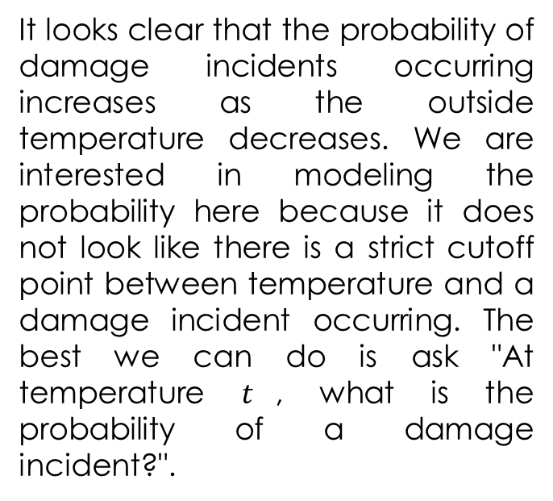
The Problem
It looks clear that the probability of damage incidents occurring increases as the outside temperature decreases. We are interested in modeling the probability here because it does not look like there is a strict cutoff point between temperature and a damage incident occurring. The best we can do is ask "At temperature $t$, what is the probability of a damage incident?".

Slide 8
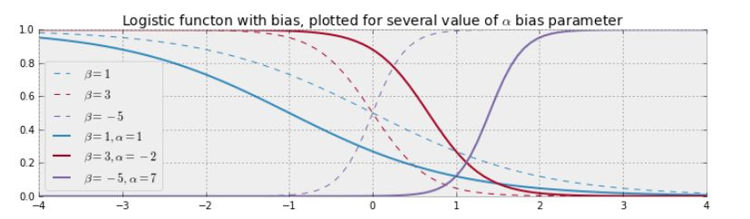
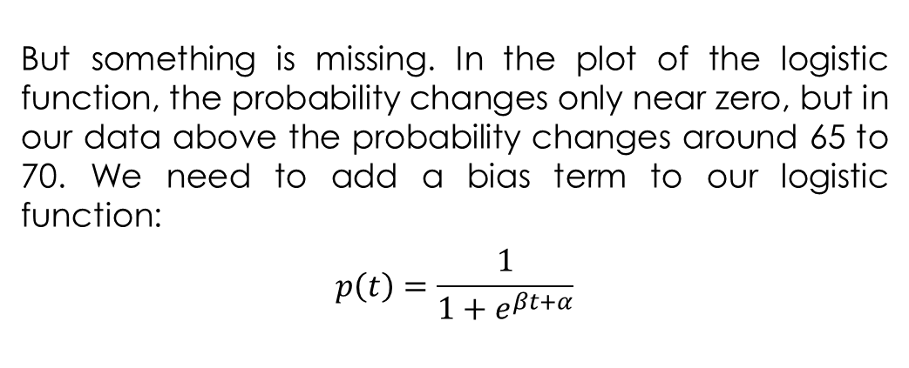
Modeling
But something is missing. In the plot of the logistic function, the probability changes only near zero, but in our data above the probability changes around 65 to 70. We need to add a bias term to our logistic function:
$$p\left(t\right)=\frac{1}{1+e^{βt+α}}$$

Slide 9
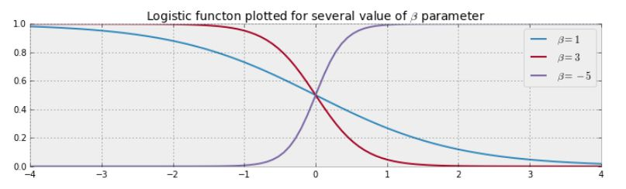
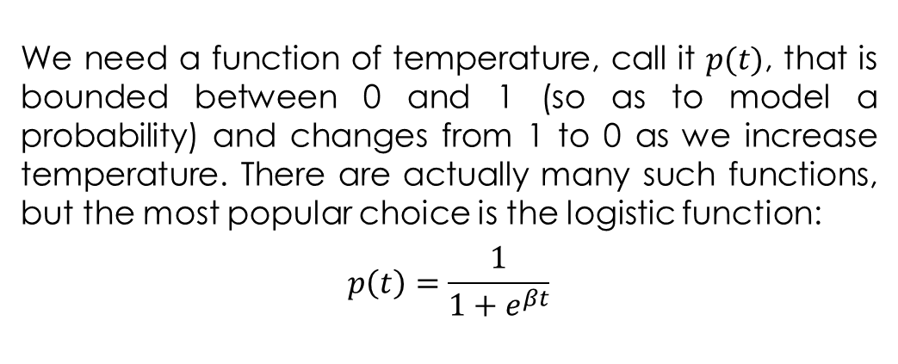
Modeling
We need a function of temperature, call it $p(t)$, that is bounded between 0 and 1 (so as to model a probability) and changes from 1 to 0 as we increase temperature. There are actually many such functions, but the most popular choice is the logistic function:
$$p\left(t\right)=\frac{1}{1+e^{βt}}$$

Slide 10
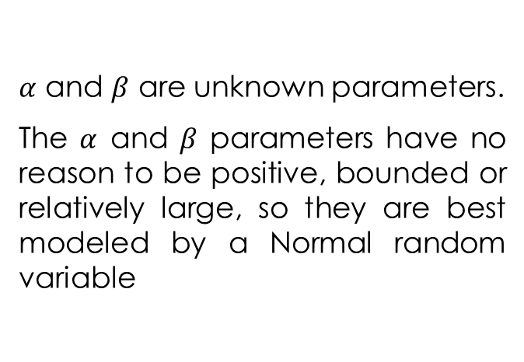
Modeling
challenger_data = np.genfromtxt("challenger_data.csv", skip_header=1,
usecols=[1, 2], missing_values="NA",
delimiter=",")
# drop the NA values
challenger_data = challenger_data[~np.isnan(challenger_data[:, 1])]
temperature = challenger_data[:, 0]
D = challenger_data[:, 1] # defect or not?
def logistic(x, beta, alpha=0):
return 1.0 / (1.0 + np.exp(np.dot(beta, x) + alpha))
# notice the`value` here. We explain why below.
with pm.Model() as model:
beta = pm.Normal("beta", mu=0, tau=0.001, initval=0)
alpha = pm.Normal("alpha", mu=0, tau=0.001, initval=0)
p = pm.Deterministic("p", 1.0/(1. + at.exp(beta*temperature + alpha)))
$α$ and $β$ are unknown parameters.
The $α$ and $β$ parameters have no reason to be positive, bounded or relatively large, so they are best modeled by a Normal random variable

Slide 11
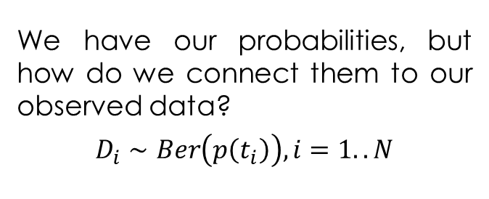
Modeling
# connect the probabilities in `p` with our observations through a
# Bernoulli random variable.
with model:
observed = pm.Bernoulli("bernoulli_obs", p, observed=D)
start = pm.find_MAP()
step = pm.Metropolis()
trace = pm.sample(120000, step=step, initvals=start, chains=1)
#burned_trace = trace[100000::2]
# best to make them 1d
alpha_samples = np.concatenate(trace.posterior.alpha.data[:,100000::2])[:, None]
beta_samples = np.concatenate(trace.posterior.beta.data[:,100000::2])[:, None]
We have our probabilities, but how do we connect them to our observed data?
$$D_{i}∼Ber\left(p\left(t_{i}\right)\right), i=1..N$$
Notice in the above code we had to set the values of beta and alpha to 0. The reason for this is that if beta and alpha are very large, they make p equal to 1 or 0. Unfortunately, pm.Bernoulli does not like probabilities of exactly 0 or 1, though they are mathematically well-defined probabilities. So by setting the coefficient values to 0, we set the variable p to be a reasonable starting value. This has no effect on our results, nor does it mean we are including any additional information in our prior. It is simply a computational caveat in PyMC.

Slide 12
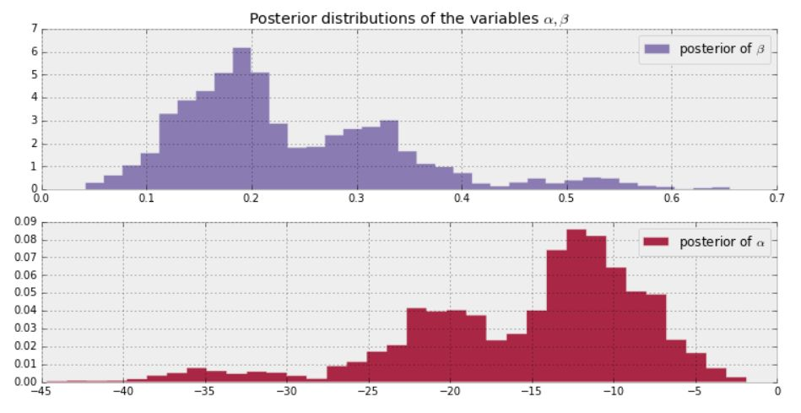
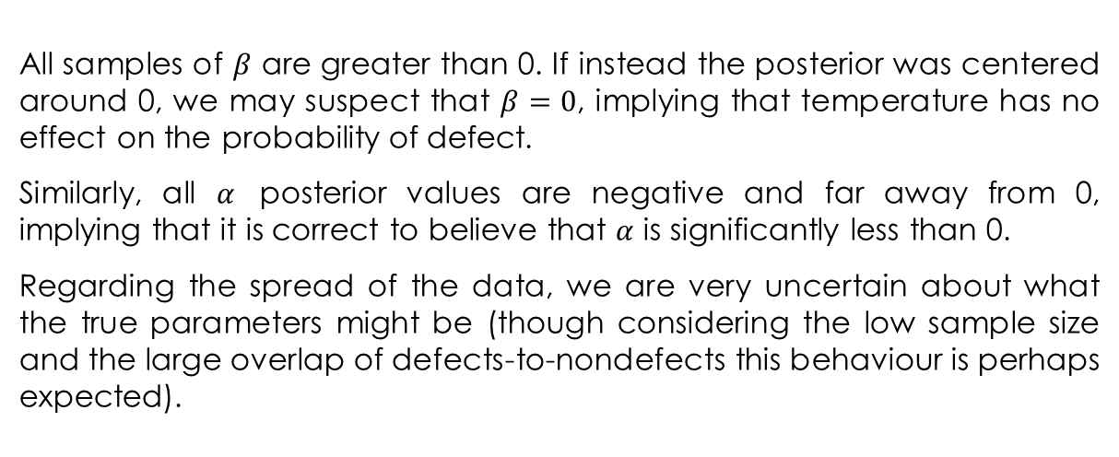
The Results
All samples of $β$ are greater than 0. If instead the posterior was centered around 0, we may suspect that $β=0$, implying that temperature has no effect on the probability of defect.
Similarly, all $α$ posterior values are negative and far away from 0, implying that it is correct to believe that $α$ is significantly less than 0.
Regarding the spread of the data, we are very uncertain about what the true parameters might be (though considering the low sample size and the large overlap of defects-to-nondefects this behaviour is perhaps expected).

Slide 13
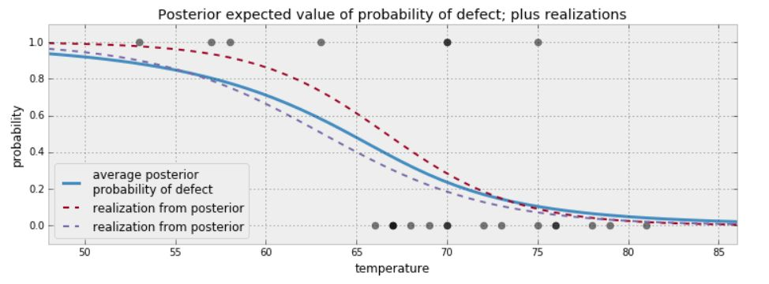
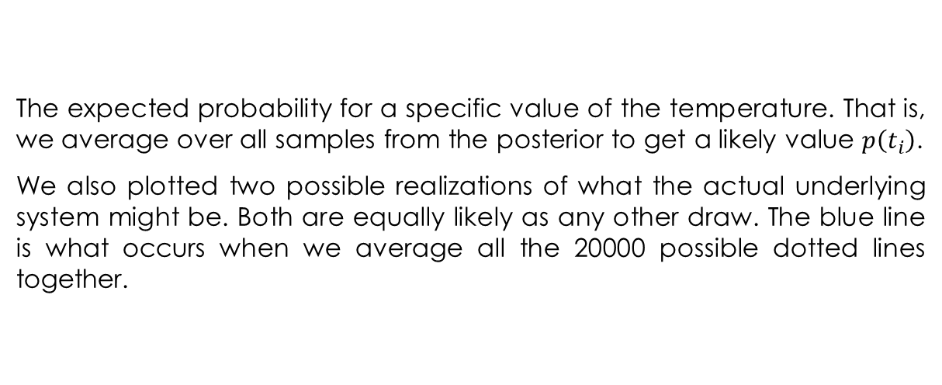
The Results
The expected probability for a specific value of the temperature. That is, we average over all samples from the posterior to get a likely value $p\left(t_{i}\right)$.
We also plotted two possible realizations of what the actual underlying system might be. Both are equally likely as any other draw. The blue line is what occurs when we average all the 20000 possible dotted lines together.

Slide 14
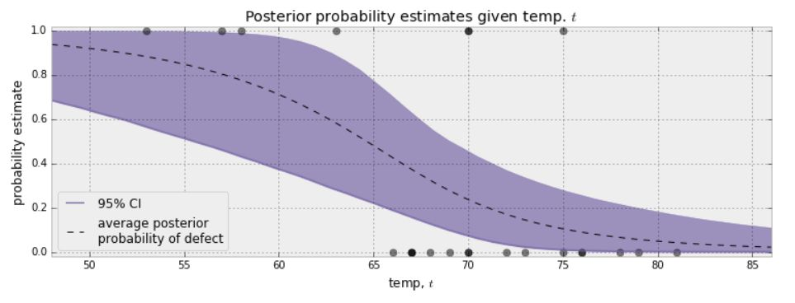
The Results
An interesting question to ask is for what temperatures are we most uncertain about the defect-probability? Below we plot the expected value line and the associated 95% intervals for each temperature.
The 95% credible interval, or 95% CI, painted in purple, represents the interval, for each temperature, that contains 95% of the distribution. For example, at 65 degrees, we can be 95% sure that the probability of defect lies between 0.25 and 0.75.

Slide 15
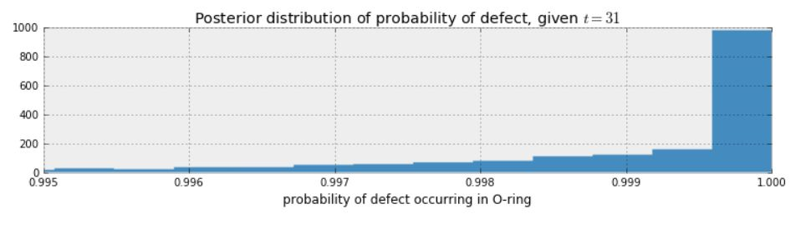
What about the day of the Challenger disaster?
prob_31 = logistic(31, beta_samples, alpha_samples)
plt.xlim(0.995, 1)
plt.hist(prob_31, bins=1000, density=True, histtype='stepfilled')
plt.title("Posterior distribution of probability of defect, given $t= 31$")
plt.xlabel("probability of defect occurring in O-ring")
plt.show()

Slide 16
Bayesian Linear Regression

Slide 17
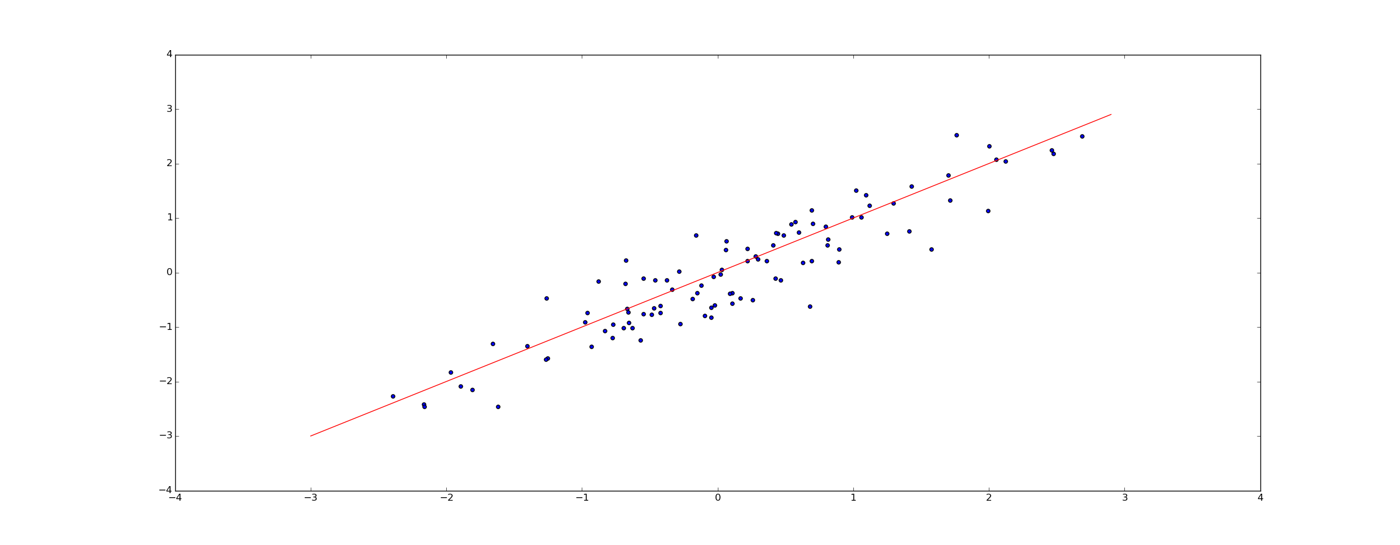
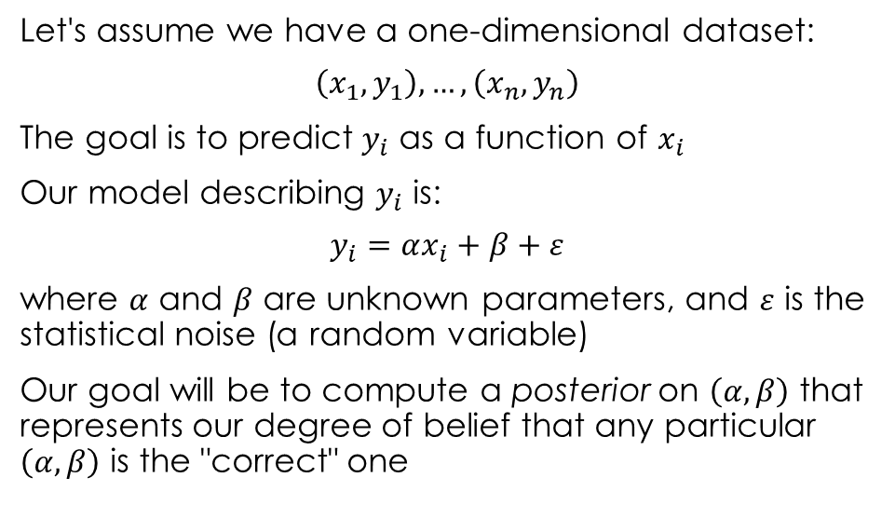
Simple Linear Regression
Let's assume we have a one-dimensional dataset:
$$\left(x_{1},y_{1}\right), …,\left(x_{n},y_{n}\right)$$
The goal is to predict $y_{i}$ as a function of $x_{i}$
Our model describing $y_{i}$ is:
$$y_{i}=αx_{i}+β+ε$$
where $α$ and $β$ are unknown parameters, and $ε$ is the statistical noise (a random variable)
Our goal will be to compute a posterior on $\left(α,β\right)$ that represents our degree of belief that any particular $\left(α,β\right)$ is the "correct" one

Slide 18
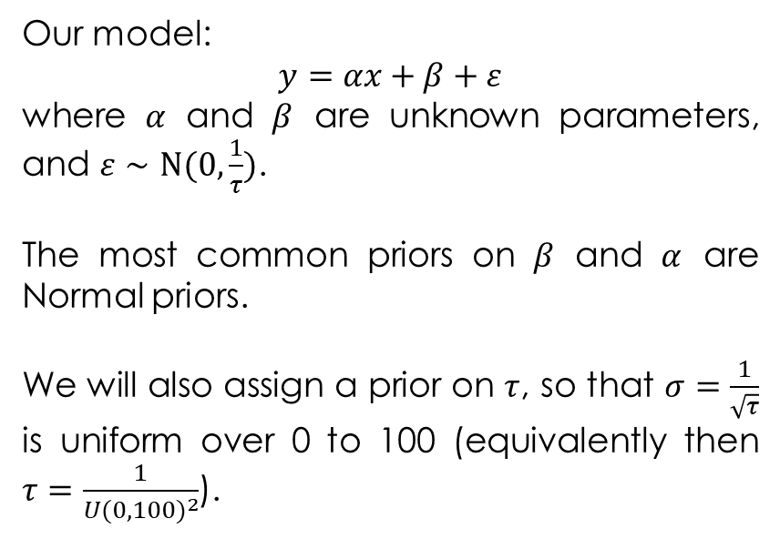
Simple Linear Regression
n = 100 # number of data points
x_data = np.random.normal(0, 1, n)
y_data = x_data + 0.5 + np.random.normal(0, 0.35, n)
with pm.Model() as model:
std = pm.Uniform("std", 0, 100)
beta = pm.Normal("beta", 0, 100)
alpha = pm.Normal("alpha", 0, 100)
linear_regress = x_data*alpha+beta
y = pm.Normal('y', linear_regress, std, observed=y_data)
with model:
# Use the default NUTS for sampling
trace = pm.sample(50000, tune=30000, return_inferencedata=False,
chains=1)
alpha_samples = trace['alpha']
beta_samples = trace['beta']
std_samples = trace['std']
Our model:
$$y=αx+β+ε$$
where $α$ and $β$ are unknown parameters, and $ε∼N(0, \frac{1}{τ})$.
The most common priors on $β$ and $α$ are Normal priors.
We will also assign a prior on $τ$, so that $σ=\frac{1}{\sqrt{τ}}$ is uniform over 0 to 100 (equivalently then $τ=\frac{1}{{U(0,100)}^{2}}$).

Slide 19
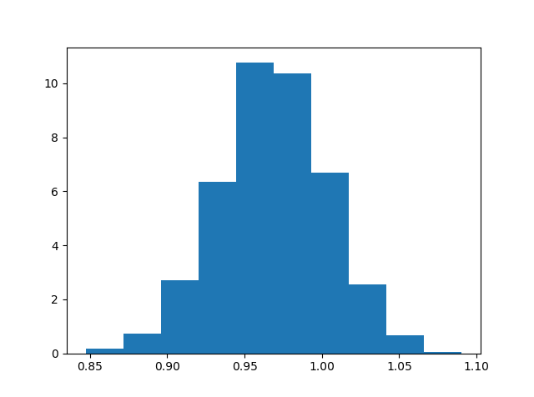

Posterior of $α$

Slide 20
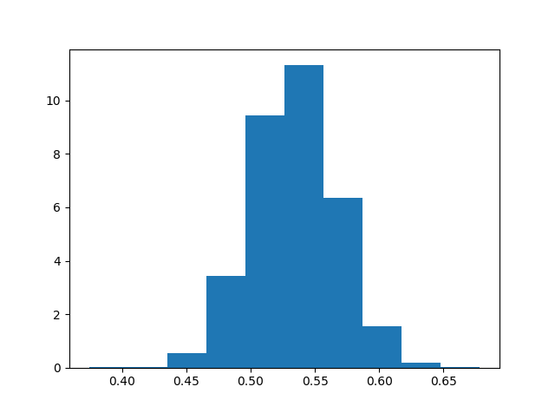

Posterior of $β$

Slide 21
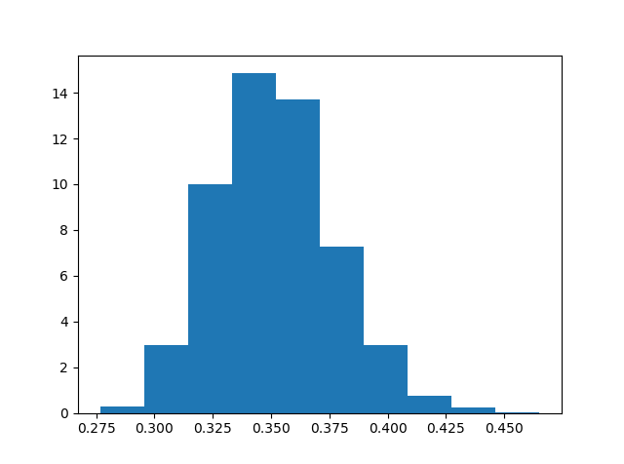

Posterior of $σ$

Slide 22
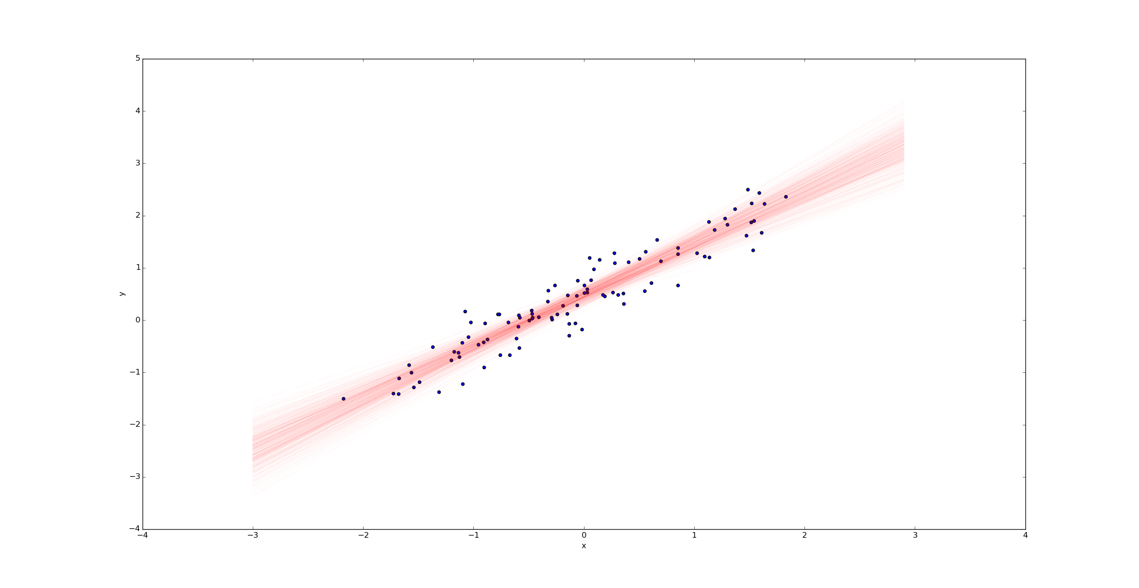
A Sample of Regression Lines

Slide 23
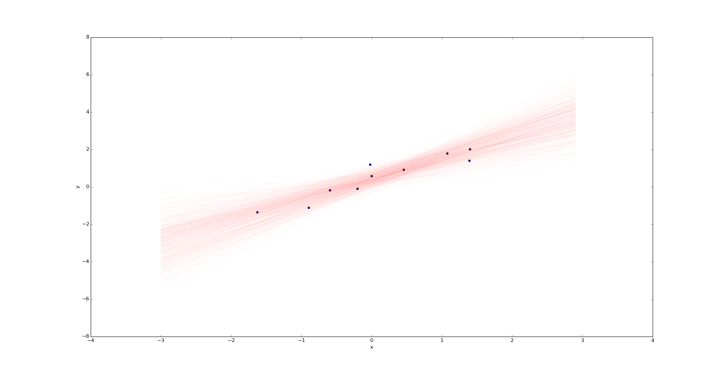
A Sample of Regression Lines (n = 10)

Slide 24
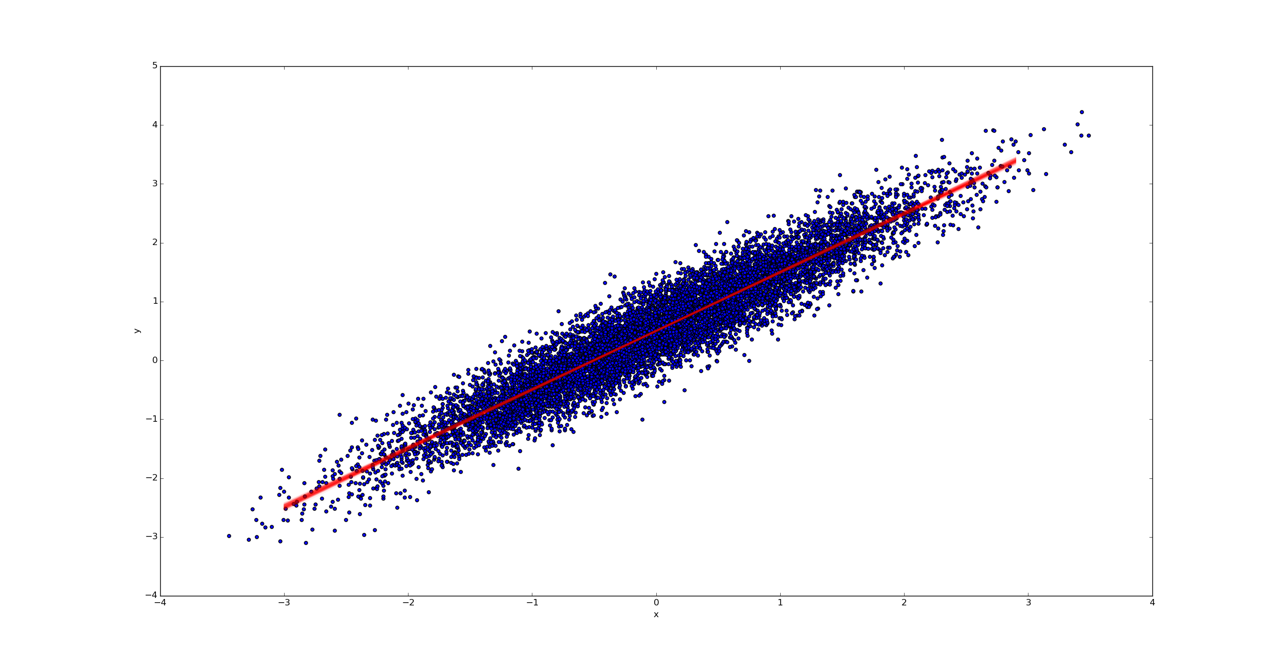
A Sample of Regression Lines (n = 1000)

Slide 25
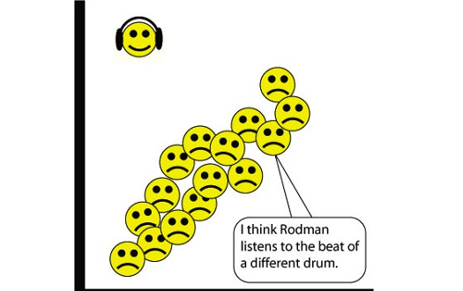
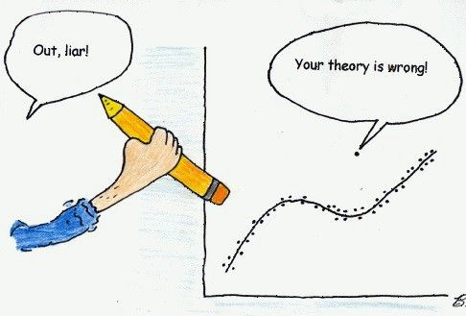
Incorporating Priors - Handling Outliers
In statistics, an outlier is an observation point that is distant from other observations. An outlier may be due to variability in the measurement or it may indicate experimental error;. An outlier can cause serious problems in statistical analyses.
Outliers are often treated as data points which need to be specially handled - often ignored - because they don't fit the model and can heavily skew results.

Slide 26
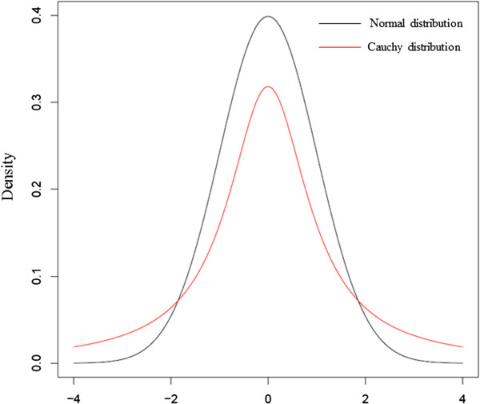
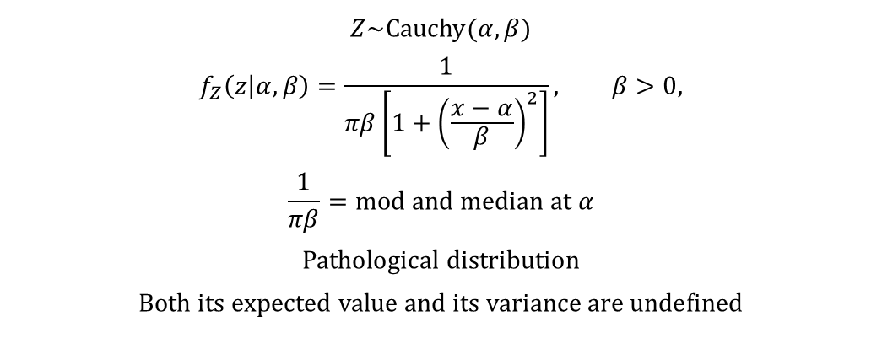
Cauchy Distribution
$$Z\sim \text{Cauchy}(α,β)$$
$$f_{Z}\left(z | α,β\right)=\frac{1}{πβ\left[1+{\left(\frac{x−α}{β}\right)}^{2}\right]}, β>0,$$
$$\frac{1}{πβ}=\text{mod} \text{and} \text{median} \text{at} α$$
$$\text{P}\text{athological} \text{distribution}$$
$$\text{B}\text{oth} \text{its} \text{expected} \text{value} \text{and} \text{its} \text{variance} \text{are} \text{undefined}$$
Z=pymc.Cauchy(“Z”, alpha, beta)

Slide 27
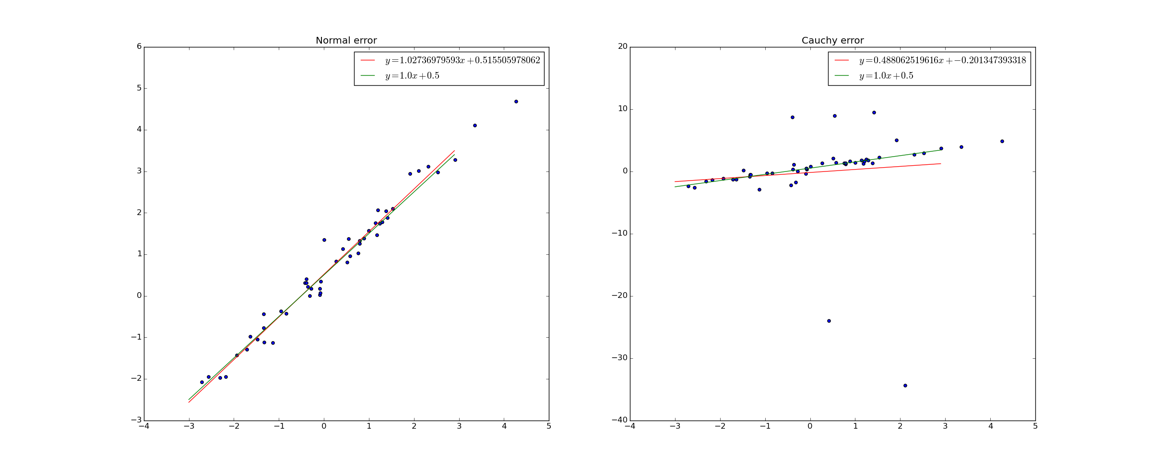

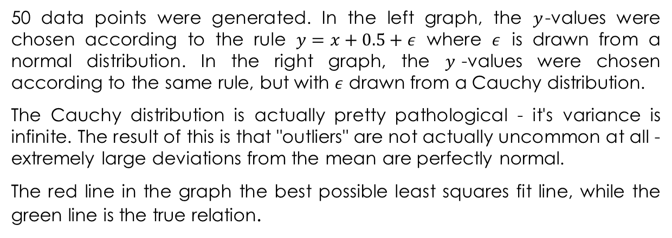
Changing the distribution of $ε$
50 data points were generated. In the left graph, the $y$-values were chosen according to the rule $y=x+0.5+ε$ where $ε$ is drawn from a normal distribution. In the right graph, the $y$-values were chosen according to the same rule, but with $ε$ drawn from a Cauchy distribution.
The Cauchy distribution is actually pretty pathological - it's variance is infinite. The result of this is that "outliers" are not actually uncommon at all - extremely large deviations from the mean are perfectly normal.
The red line in the graph the best possible least squares fit line, while the green line is the true relation.

Slide 28
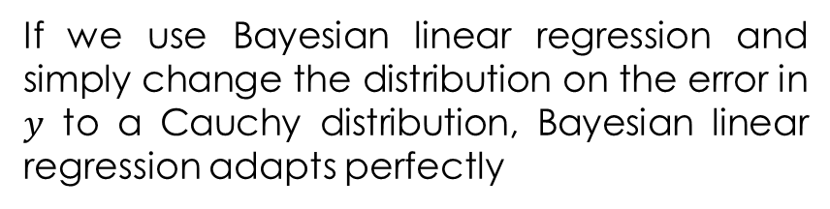
Incorporating Priors
All we have to do
…
with pm.Model() as model:
std = pm.Uniform("std", 0, 100)
beta = pm.Normal("beta", 0, 100)
alpha = pm.Normal("alpha", 0, 100)
linear_regress = x_data*alpha+beta
y = pm.Normal('y', linear_regress, std, observed=y_data)
y = pm.Cauchy('y', linear_regress, 0.35, observed=y_data)
If we use Bayesian linear regression and simply change the distribution on the error in $y$ to a Cauchy distribution, Bayesian linear regression adapts perfectly

Slide 29
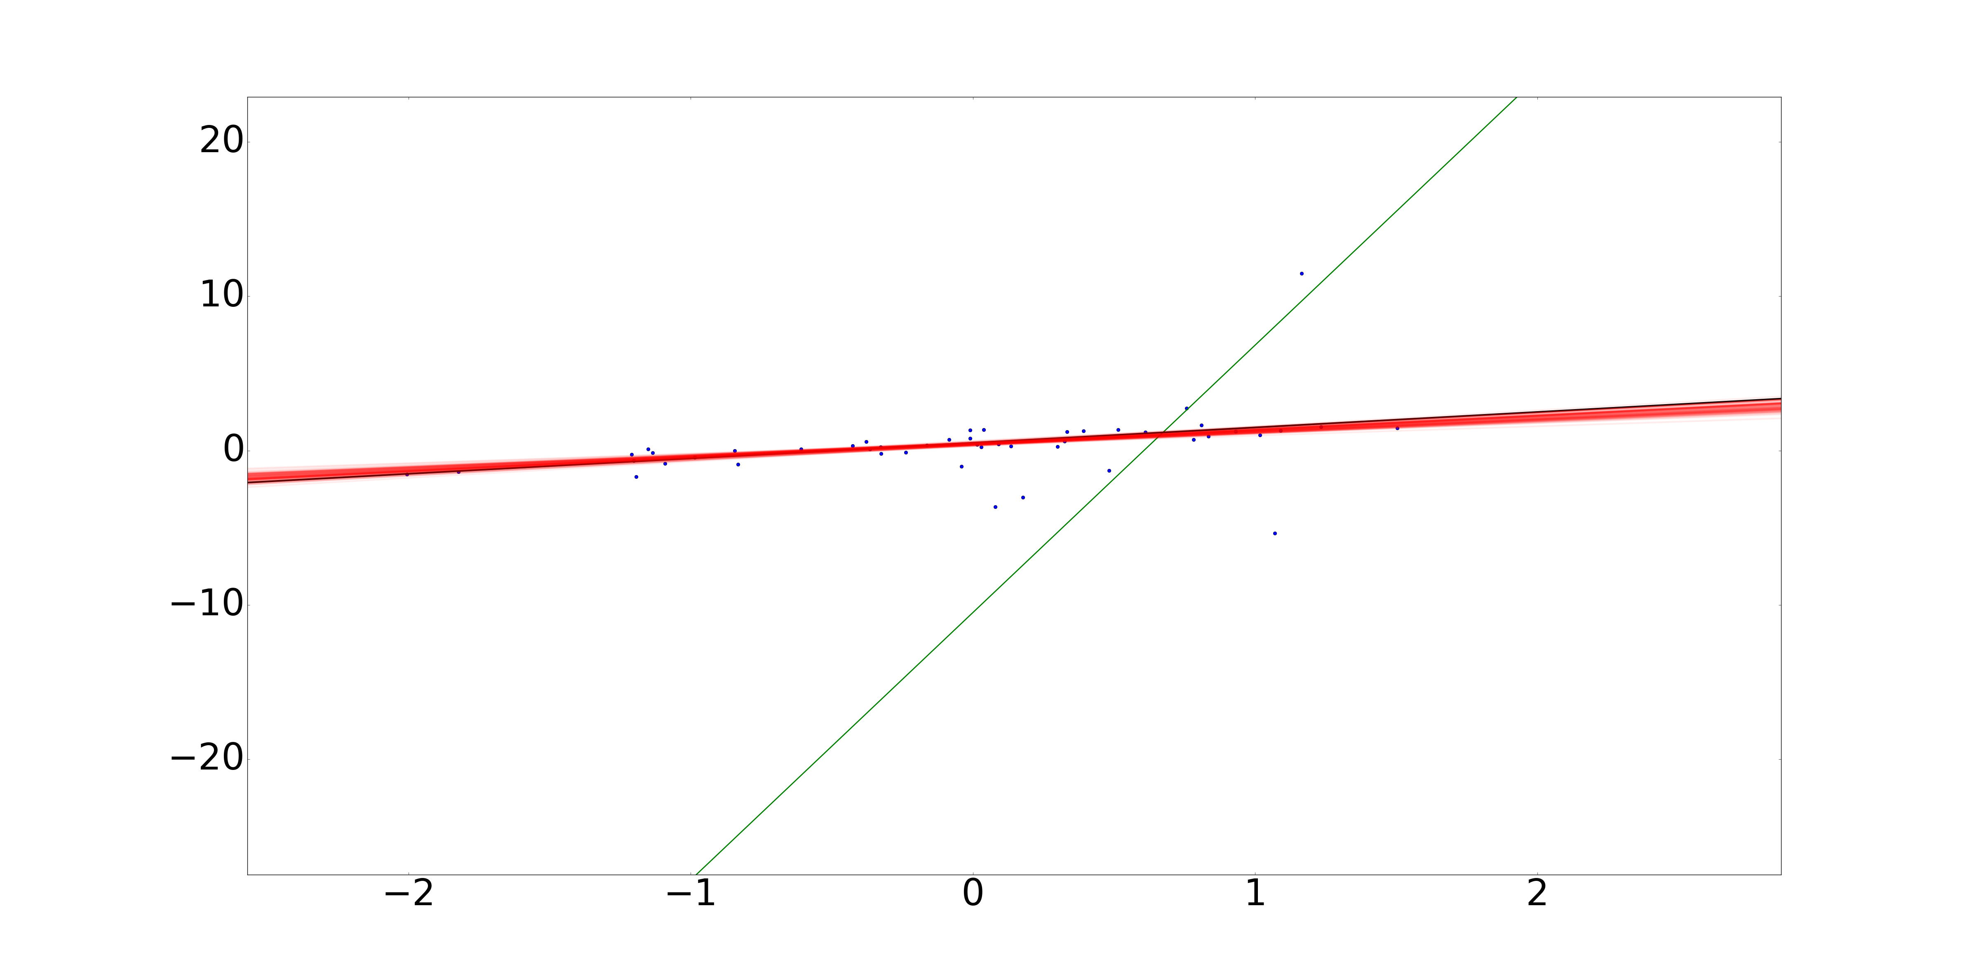
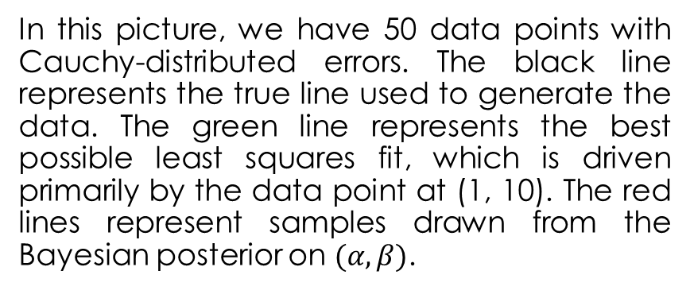
The Results
In this picture, we have 50 data points with Cauchy-distributed errors. The black line represents the true line used to generate the data. The green line represents the best possible least squares fit, which is driven primarily by the data point at (1, 10). The red lines represent samples drawn from the Bayesian posterior on $(α,β)$.

Slide 30
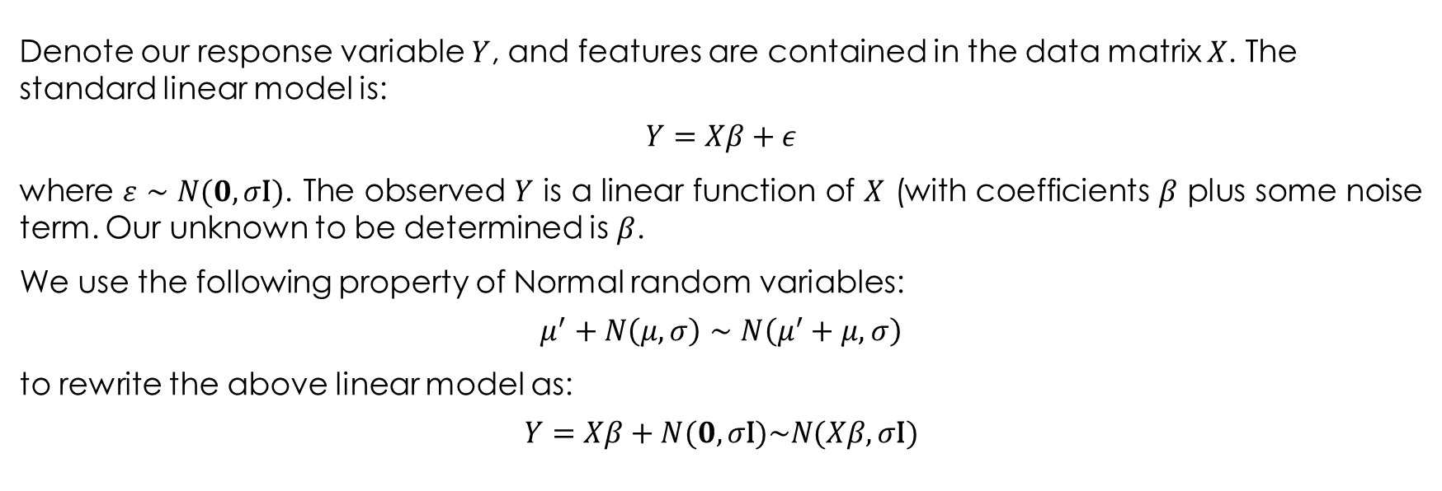
The Probabilistic Interpretation of Least-Squares Linear Regression
Denote our response variable $Y$, and features are contained in the data matrix $X$. The standard linear model is:
$$Y=Xβ+ε$$
where $ε∼N(0,σ\text{I})$. The observed $Y$ is a linear function of $X$ (with coefficients $β$ plus some noise term. Our unknown to be determined is $β$.
We use the following property of Normal random variables:
$$μ^{′}+N\left(μ,σ\right)∼N\left(μ^{′}+μ,σ\right)$$
to rewrite the above linear model as:
$$Y=Xβ+N(0,σ\text{I})\sim N(Xβ,σ\text{I})$$

Slide 31
Bayesian Perspective of Penalized Linear Regressions

Slide 32
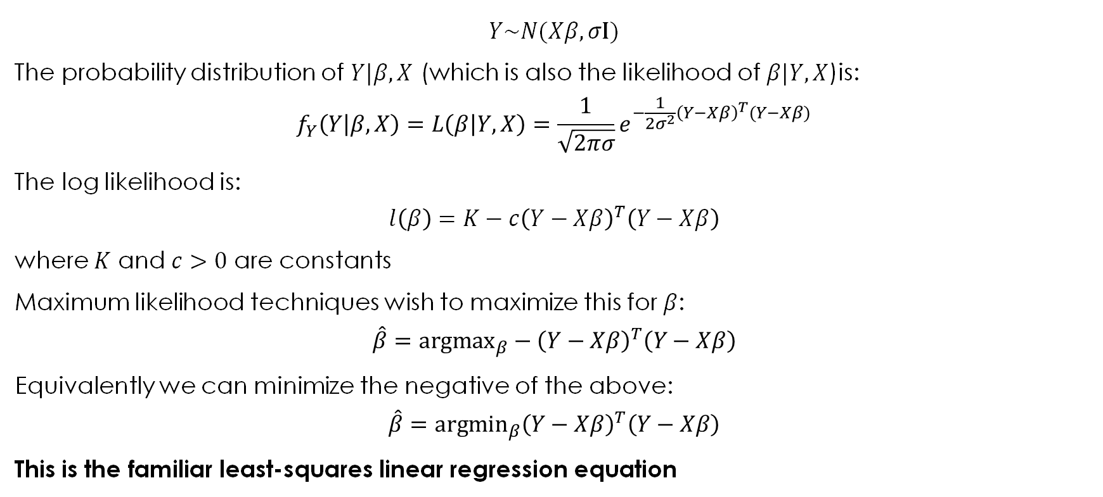
The Probabilistic Interpretation of Least-Squares Linear Regression
$$Y\sim N(Xβ,σ\text{I})$$
The probability distribution of $Y|β,X$ (which is also the likelihood of $β|Y,X$)is:
$$f_{Y}\left(Y | β,X\right)=L\left(β | Y,X\right)=\frac{1}{\sqrt{2πσ}}e^{−\frac{1}{2σ^{2}}{\left(Y−Xβ\right)}^{T}(Y−Xβ)}$$
The log likelihood is:
$$l\left(β\right)=K−c{\left(Y−Xβ\right)}^{T}\left(Y−Xβ\right)$$
where $K$ and $c>0$ are constants
Maximum likelihood techniques wish to maximize this for $β$:
$$\hat{β}={\text{argmax}}_{β}−{\left(Y−Xβ\right)}^{T}\left(Y−Xβ\right)$$
Equivalently we can minimize the negative of the above:
$$\hat{β}={\text{argm}\text{in}}_{β}{\left(Y−Xβ\right)}^{T}\left(Y−Xβ\right)$$
This is the familiar least-squares linear regression equation

Slide 33
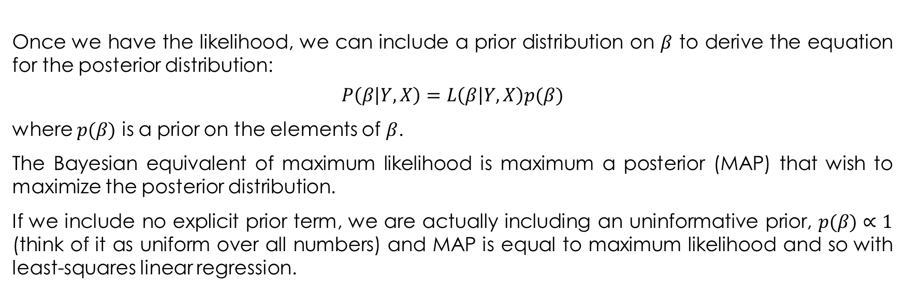
The Bayesian Perspective
Once we have the likelihood, we can include a prior distribution on $β$ to derive the equation for the posterior distribution:
$$P\left(β | Y,X\right)=L\left(β | Y,X\right)p(β)$$
where $p(β)$ is a prior on the elements of $β$.
The Bayesian equivalent of maximum likelihood is maximum a posterior (MAP) that wish to maximize the posterior distribution.
If we include no explicit prior term, we are actually including an uninformative prior, $p(β)∝1$ (think of it as uniform over all numbers) and MAP is equal to maximum likelihood and so with least-squares linear regression.

Slide 34
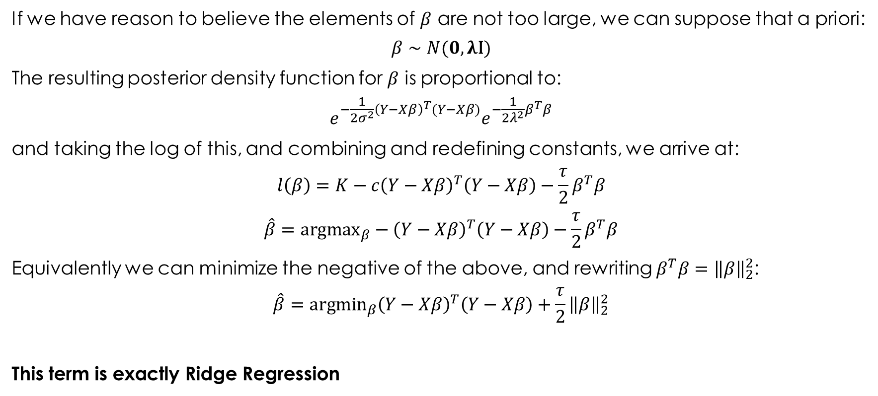
Ridge Regression
If we have reason to believe the elements of $β$ are not too large, we can suppose that a priori:
$$β∼N(0,λ\text{I})$$
The resulting posterior density function for $β$ is proportional to:
$$e^{−\frac{1}{2σ^{2}}{\left(Y−Xβ\right)}^{T}(Y−Xβ)}e^{−\frac{1}{2λ^{2}}β^{T}β}$$
and taking the log of this, and combining and redefining constants, we arrive at:
$$l\left(β\right)=K−c{\left(Y−Xβ\right)}^{T}\left(Y−Xβ\right)−\frac{τ}{2}β^{T}β$$
$$\hat{β}={\text{argmax}}_{β}−{\left(Y−Xβ\right)}^{T}\left(Y−Xβ\right)−\frac{τ}{2}β^{T}β$$
Equivalently we can minimize the negative of the above, and rewriting $β^{T}β={\left\|β\right\|}_{2}^{2}$:
$$\hat{β}={\text{argmin}}_{β}{\left(Y−Xβ\right)}^{T}\left(Y−Xβ\right)+\frac{τ}{2}{\left\|β\right\|}_{2}^{2}$$
This term is exactly Ridge Regression

Slide 35

LASSO
Similarly, if we assume a Laplace prior on $β$:
$$f_{β}(β)∝e^{−λ{\left\|β\right\|}_{1}}$$
and following the same steps as above, we recover:
$$\hat{β}={\text{argmin}}_{β}{\left(Y−Xβ\right)}^{T}\left(Y−Xβ\right)+λ{\left\|β\right\|}_{1}$$
which is LASSO regression

