Slide 1
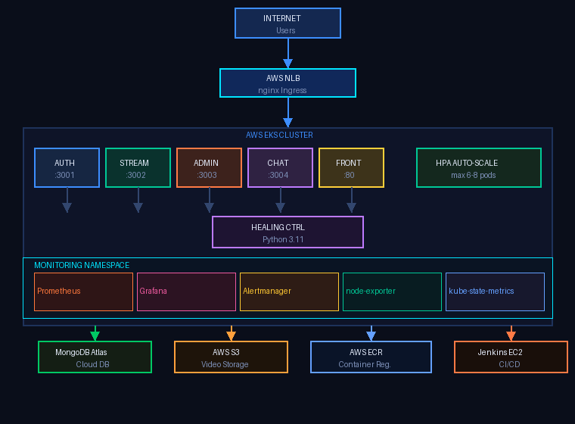
DEVOPS PROJECT · VIVA 2026
StreamingApp
Kubernetes Cluster
Health Checker &
Auto-Healing System
Author
Priyank Pandey
Platform
AWS EKS · Kubernetes 1.32
Stack
MERN + Helm + Jenkins
Region
us-west-1 · t3.medium × 2
System Architecture Overview

Slide 2
Problem Statement
Our Solution
Pod crashes go undetected
1
No automated detection in traditional setups
Automated Health Monitoring
[OK]
Prometheus metrics at 15s intervals
Manual recovery is slow
2
Python Self-Healing Controller
MTTR = 10–30 min with on-call engineers
[OK]
Detect & fix in < 60 seconds
Zero cluster visibility
3
Alertmanager + Slack
No real-time dashboard for health status
[OK]
Real-time alerts to DevOps team
Traffic spikes cause outages
4
Grafana Dashboards
No auto-scaling → node resource exhaustion
[OK]
30s auto-refresh live cluster state

Slide 3
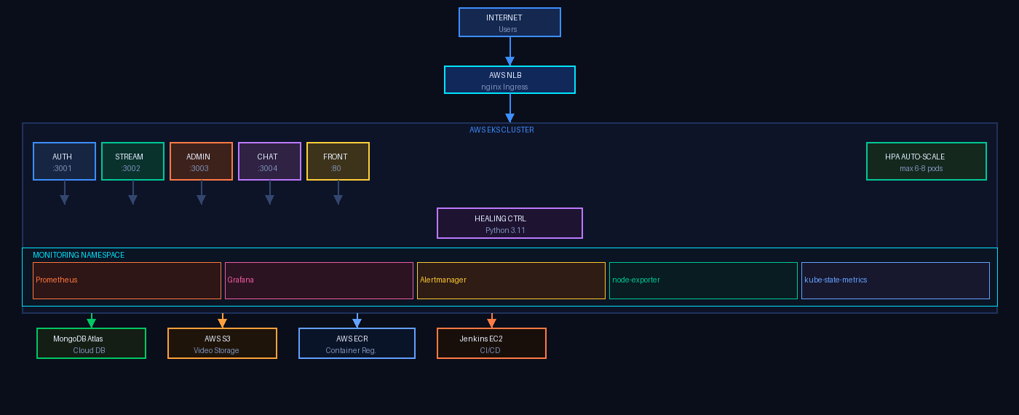
System Architecture
AWS EKS · us-west-1 · Kubernetes 1.32

Slide 4
Technology Stack
CLOUD & INFRA
ORCHESTRATION
APPLICATION
MONITORING
AWS EKS
Kubernetes 1.32
Node.js 18 Alpine
Prometheus
Managed Kubernetes 1.32
Container orchestration
4 backend microservices
Metrics collection (15s scrape)
AWS EC2 t3.medium
Helm v4
React 18 + Nginx
Grafana
Worker nodes + Jenkins
Package management
SPA — 23MB multi-stage image
Dashboards (30s refresh)
AWS ECR
eksctl v0.227
MongoDB Atlas
Alertmanager
Container registry
Cluster lifecycle
Cloud managed database
Alert routing to Slack
AWS S3
nginx Ingress
Socket.IO
kube-state-metrics
Video file storage
Reverse proxy + routing
Real-time WebSocket chat
Kubernetes object metrics
AWS NLB
HPA + PDB
Python 3.11
node-exporter
internet-facing load balancer
Auto-scale + disruption budget
Self-healing controller
OS-level CPU/memory metrics

Slide 5
Application Microservices
6 Containerised Services on EKS
:3001
auth-service
:3004
chat-service
JWT login, register, verify
Socket.IO real-time chat
Probe: httpGet /health
HPA max 6
Probe: TCP socket :3004
2 replicas
streamingapp-auth-pp
streamingapp-chat-pp
:3002
streaming-service
:80
frontend
Video catalog + S3 signed URLs
React SPA via nginx (~23MB)
Probe: httpGet /api/health
HPA max 8
Probe: httpGet /health
HPA max 6
streamingapp-streaming-pp
streamingapp-frontend-pp
:3003
admin-service
—
healing-controller
Video upload management
Python K8s self-healing watch
Probe: TCP socket :3003
2 replicas
Probe: — (system pod)
1 replica
streamingapp-admin-pp
streamingapp-healing-controller-pp

Slide 6
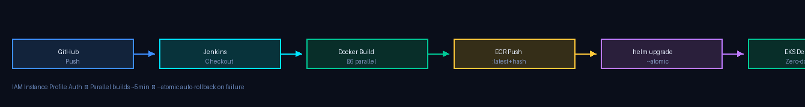
CI/CD Pipeline — Jenkins
Parallel builds · Dual tags · Atomic Helm deploy
Parallel Builds
Dual Image Tagging
--atomic Deploy
All 6 Docker images build concurrently ~5 min total vs ~20 min sequential
:latest for convenience :<git-hash> for immutable rollbacks
Helm auto-rolls back if any pod fails health checks post-deploy
Zero Credentials
ECR Integration
Helm History
Jenkins EC2 uses IAM Instance Profile No static AWS keys stored anywhere
6 repos with -pp suffix scanOnPush=true for vulnerability scanning
Every deploy versioned helm rollback streamingapp-pp 1

Slide 7
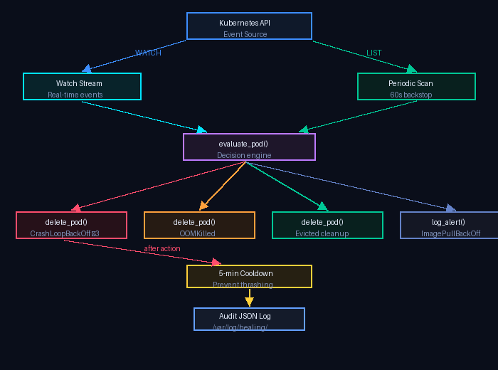
Self-Healing System
Sprint 3 — Automated Pod Recovery (Python 3.11)
Failure Mode
Action
Cooldown
CrashLoopBackOff
delete_pod()
5 min
restarts ≥ 3
OOMKilled
delete_pod()
5 min
last_state.reason
Evicted
delete_pod()
None
phase=Failed
ImagePullBackOff
log_alert()
None
waiting.reason
RBAC — Least Privilege
pods: get · list · watch · delete events: get · list · watch · create · patch deployments / replicasets: get · list · watch (read-only)
Audit Log → /var/log/healing/actions.log
{"action":"delete_pod","pod":"streaming-7dd-mlkch","reason":"CrashLoopBackOff:restarts=4","result":"success"}

Slide 8
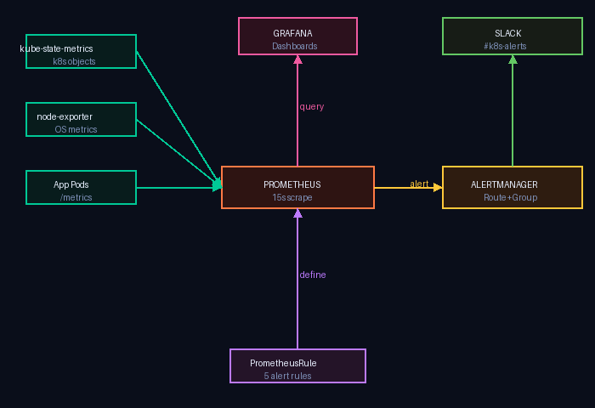
Monitoring & Observability
kube-prometheus-stack · Prometheus · Grafana · Alertmanager
Metric
PromQL Key
Threshold
Pod Restart Rate
> 1 / 5min
> 1 / 5min
kube_pod_container_status _restarts_total
OOMKilled
Any
Any
kube_pod_container_status _last_terminated_reason
Pod Pending
> 5 min
> 5 min
kube_pod_status_phase {phase=Pending}
Node CPU
> 80%
> 80%
node_cpu_seconds_total {mode=idle}
Node Memory
> 85%
> 85%
node_memory_MemAvailable _bytes
Scrape interval: 15s · Dashboard auto-refresh: 30s · Retention: 15 days default

Slide 9
Alerting System
PrometheusRule CRD · Alertmanager · Slack Integration
Sev
Alert Name
Alert Name
PromQL Condition
PromQL Condition
For
Slack
For
Channel
PodCrashLooping
rate(kube_pod_container_status_restarts_total[5m]) * 300 > 1
C
2 min
#k8s-alerts
CRITICAL
PodOOMKilled
kube_pod_container_status_last_terminated_reason == 1
W
0 min
#k8s-alerts
WARNING
PodPendingTooLong
kube_pod_status_phase{phase='Pending'} == 1
C
5 min
#k8s-alerts
CRITICAL
NodeHighCPU
(1 - avg(rate(node_cpu_seconds_total{mode='idle'}[5m]))) > 0.8
W
5 min
#k8s-warnings
WARNING
NodeHighMemory
(1 - node_memory_MemAvailable / node_memory_MemTotal) > 0.85
C
5 min
#k8s-alerts
CRITICAL
groupBy: alertname · namespace · pod · groupWait: 30s · repeatInterval: 3h · sendResolved: true

Slide 10
Auto-Scaling & High Availability
HPA · Cluster Autoscaler · PodDisruptionBudget
Horizontal Pod Autoscaler (HPA)
Cluster Autoscaler
streaming-service
Scale-Up Trigger
Trigger: CPU 65% + Mem 75%
Any pod stuck Pending due to insufficient CPU/memory
min 2 → max 8
auth-service
Scale-Down
Trigger: CPU 70%
Node underutilized for 10 min (expander: least-waste)
min 2 → max 6
frontend
ASG Range
Trigger: CPU 60%
min: 1 node → max: 4 nodes t3.medium — 2vCPU / 4GB
min 2 → max 6
ASG Tags
k8s.io/cluster-autoscaler/enabled pre-configured in cluster-config.yaml
PodDisruptionBudget · minAvailable: 1
auth-service · streaming-service · frontend — Guarantees ≥ 1 pod survives node drains and cluster upgrades

Slide 11
Security Implementation
Zero Static Credentials · RBAC · CORS · JWT
Zero Static Credentials Principle
Jenkins EC2 → AWS
EKS Nodes → ECR
EKS Nodes → S3
IAM Instance Profile
Node IAM Role
Node IAM Role
StreamingApp-EC2-Role
imageBuilder addon policy
AmazonS3FullAccess
kubectl → EKS
Pods → MongoDB
aws-auth ConfigMap
Kubernetes Secret
Instance profile → system:masters
app-secrets (encrypted at rest in etcd)
Additional Security Layers
.dockerignore prevents .env in images · Non-root user in healing controller · CORS origin validation on all services · JWT tokens for all authenticated calls · CloudWatch EKS control-plane audit logging

Slide 12
Key Challenges & Solutions
10 production issues encountered and resolved
kubectl 401 Unauthorized
Auth 404 on /api/auth/login
Cause: ~/.aws/credentials overrode instance profile
Cause: Route mounted at /api not /api/auth
Fix: mv credentials .bak — instance profile wins
Fix: Fixed: app.use('/api/auth', route)
NLB Internal (not internet-facing)
Streaming doubled path prefix
Cause: Missing annotation on ingress service
Cause: React baseURL + route path concatenation
Fix: Added aws-load-balancer-scheme=internet-facing
Fix: Dual mount: /api/streaming + /api/streaming/streaming
Frontend PLACEHOLDER URLs
S3 InvalidAccessKeyId
Cause: Docker cached compiled JS bundle
Cause: Placeholder string in Kubernetes Secret
Fix: docker build --no-cache to force recompile
Fix: Empty string → SDK falls back to instance profile
CORS errors after URL change
Healer blocked debugging
Cause: Pods cached old ConfigMap value in memory
Cause: Controller deleting pods during investigation
Fix: kubectl rollout restart all services
Fix: kubectl scale healing-controller --replicas=0

Slide 13
Cost Analysis & Optimisation
~$220/month · 10% evaluation criterion
Monthly Cost Breakdown
Cost Optimisations Applied
EKS Control Plane
$73.00
MongoDB Atlas Free Tier
EC2 Worker Nodes
Saves ~$57/month vs AWS DocumentDB
$60.35
Single NLB via nginx Ingress
EC2 Jenkins
$30.17
Saves ~$65/month vs 1 ALB per service
NAT Gateway
$32.85
gp3 EBS Volumes
Network LB
20% cheaper than gp2, better throughput
$16.43
S3 for Video Storage
EBS Volumes
$4.80
Far cheaper than EBS for large files
ECR + S3 + CW
$2.73
Spot Instances (Future)
60–70% reduction on worker nodes
TOTAL ~$220 / month

Slide 14
Sprint Summary
6 Sprints × 20 Hours Each — All Deliverables Complete
Sprint 1: Project Setup & Cluster Access
Sprint 4: Node Scaling & Resource Balancing
[OK]
EKS cluster created (Kubernetes 1.32, AmazonLinux2023)
[OK]
HPA: streaming (max 8), auth (max 6), frontend (max 6)
[OK]
Jenkins EC2 bootstrapped with Docker, AWS CLI, Helm, kubectl
[OK]
PodDisruptionBudget: minAvailable=1 for critical services
[OK]
IAM Instance Profile configured — zero static credentials
[OK]
Cluster Autoscaler ASG tags pre-configured (min 1, max 4 nodes)
[OK]
Prometheus installed via kube-prometheus-stack
[OK]
Resource requests tuned to fit t3.medium (2vCPU/4GB) nodes
Sprint 2: Health Monitoring Module
Sprint 5: Alerting & Notification System
[OK]
Pod + node health checks via Prometheus kube-state-metrics
[OK]
AlertmanagerConfig CRD created with severity-based Slack routing
[OK]
5 PrometheusRule alerts (CrashLooping, OOMKilled, PodPending, CPU, Memory)
[OK]
Critical → #k8s-alerts, Warning → #k8s-warnings channels
[OK]
Grafana dashboards: Cluster overview + Node Exporter Full (ID 1860)
[OK]
groupBy: alertname + namespace + pod, repeatInterval: 3h
[OK]
15s scrape interval, 30s dashboard auto-refresh
[OK]
Slack secret stored as Kubernetes Secret (not in Git)
Sprint 3: Self-Healing Mechanisms
Sprint 6: Dashboard & Documentation
[OK]
Python 3.11 controller with Kubernetes Watch stream + 60s periodic scan
[OK]
Grafana nginx Ingress for permanent /grafana URL access
[OK]
CrashLoopBackOff, OOMKilled, Evicted detection and remediation
[OK]
README2.md: 1710 lines — full deployment + troubleshooting guide
[OK]
5-minute cooldown per pod — prevents healing storms
[OK]
docs/: QUICK_REFERENCE.md, VALIDATION_CHECKLIST.md, VIVA_QA.md
[OK]
Structured JSON audit log to stdout + /var/log/healing/actions.log
[OK]
10 challenges documented with root cause + solution

Slide 15
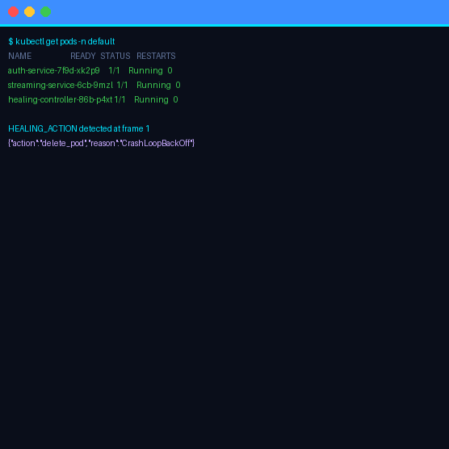
Results & Key Metrics
What was achieved and measured
~3–4 min
MTTR (Mean Time to Recovery)
CrashLoopBackOff → healed (was: manual, 10–30 min)
100%
Pod Auto-Recovery Rate
All CrashLoop / OOMKill / Evicted pods recovered
< 2 min
Alert Detection Time
PrometheusRule for: 2m on crash-loop alerts
~5 min
Build Pipeline Duration
Parallel ×6 builds (vs ~20 min sequential)
~23 MB
Container Image Size
Frontend: multi-stage node:18 → nginx:1.27-alpine
~$220
Monthly Cost
With Atlas free tier + single NLB + gp3 storage

Slide 16
Future Improvements
Next steps and architectural evolution
Immediate Next Steps
Future Enhancements
Loki + Fluent Bit
ArgoCD GitOps
Centralized log aggregation — currently logs are per-pod only
Pull-based deployment replacing Jenkins push model
HTTPS / TLS
Canary Deployments
AWS Certificate Manager + nginx TLS annotation — no HTTPS today
Flagger — gradual traffic shift with auto-rollback on error rate
IRSA
Service Mesh (Istio)
Pod-level IAM via OIDC — replace node-wide AmazonS3FullAccess role
mTLS, distributed tracing (Jaeger), circuit breaking
Cluster Autoscaler
Go Operator
ASG tags configured, Helm install pending — auto node provisioning
Rewrite healing controller using controller-runtime (production-grade)

Slide 17
Thank You
StreamingApp · Kubernetes Health Checker & Auto-Healing System
6
Python
5
Jenkins
~$220
100%
Microservices on EKS
Self-Healing Controller
Alert Rules in Prometheus
CI/CD 6-stage pipeline
Monthly Cost
Auto-Recovery Rate
Questions & Discussion
GitHub: github.com/PriyankP2/StreamingApp · AWS EKS: streamingapp-cluster-pp · Region: us-west-1
Priyank Pandey · Viva 2026

