Slide 1
FastAccounts
User Guide — Client Books and Payroll for Accounting Bureaus
Invoices, banking, ledger, VAT and Estonian payroll in one bureau workspace.
Worked example: Põhjatäht Teenused OÜ, Northstar Studio Ltd and Demo OÜ (sample payroll)
v0.4.0 · 9 October 2026 · Local demonstration edition

Slide 2
Contents
Screenshots come from a local instance seeded with synthetic demo books. Names, personal codes, IBANs and e-mail addresses are test data, not real people or companies. The FastHR import uses a mocked FastHR API.
Section | Pages / slides | What you will do
01 · Get started | 3–11 | Sign in with Google or email, create an account, reset a password, switch client books
02 · Sales, purchases and automation | 12–18 | Invoices, bills, contacts, recurring invoices and reminders
03 · Banking, accounting and tax | 19–22 | Reconcile the bank, read reports, prepare Estonian KMD workpapers
04 · Payroll for accounting bureaus | 23–32 | Part-time, hourly and board pay, social tax minimum, pay runs, payslips
05 · Integrations and HR import | 33–40 | Connect FastHR or import a CSV, and review employees before payroll changes
06 · Reference | 41–43 | 2026 Estonian rates, exemptions, languages and limits
FastAccounts · User guide · v0.4.0 · 2026-10-09 · fastaccounts.org · 2

Slide 3
SECTION 01
Get started
One workspace for every client: switch books from the sidebar, keep each client's ledger separate, and work in English or Estonian.
FastAccounts · User guide · v0.4.0 · 2026-10-09 · fastaccounts.org · 3

Slide 4
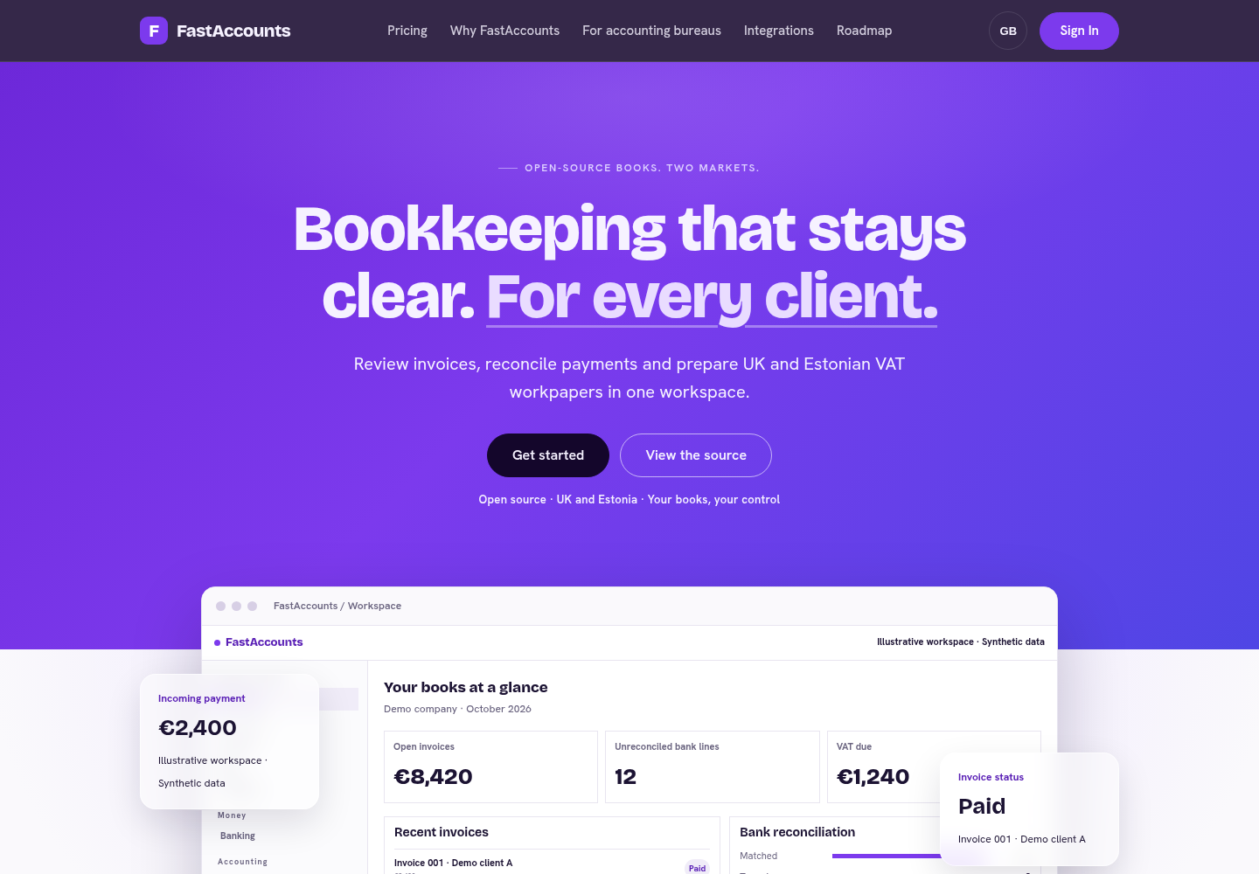
The public site
fastaccounts.org introduces the product for UK and Estonian books.
• Get started and Sign in lead to the workspace.
• Integrations lists every connector with its real status.
• Pricing, Why FastAccounts, For accounting bureaus and Roadmap explain the offer.
• Switch the language with the language button (GB / EE) in the top bar; the choice is remembered.
The version link in the footer opens /healthz, which shows the running release and database status.
FastAccounts · User guide · v0.4.0 · 2026-10-09 · fastaccounts.org · 4

Slide 5
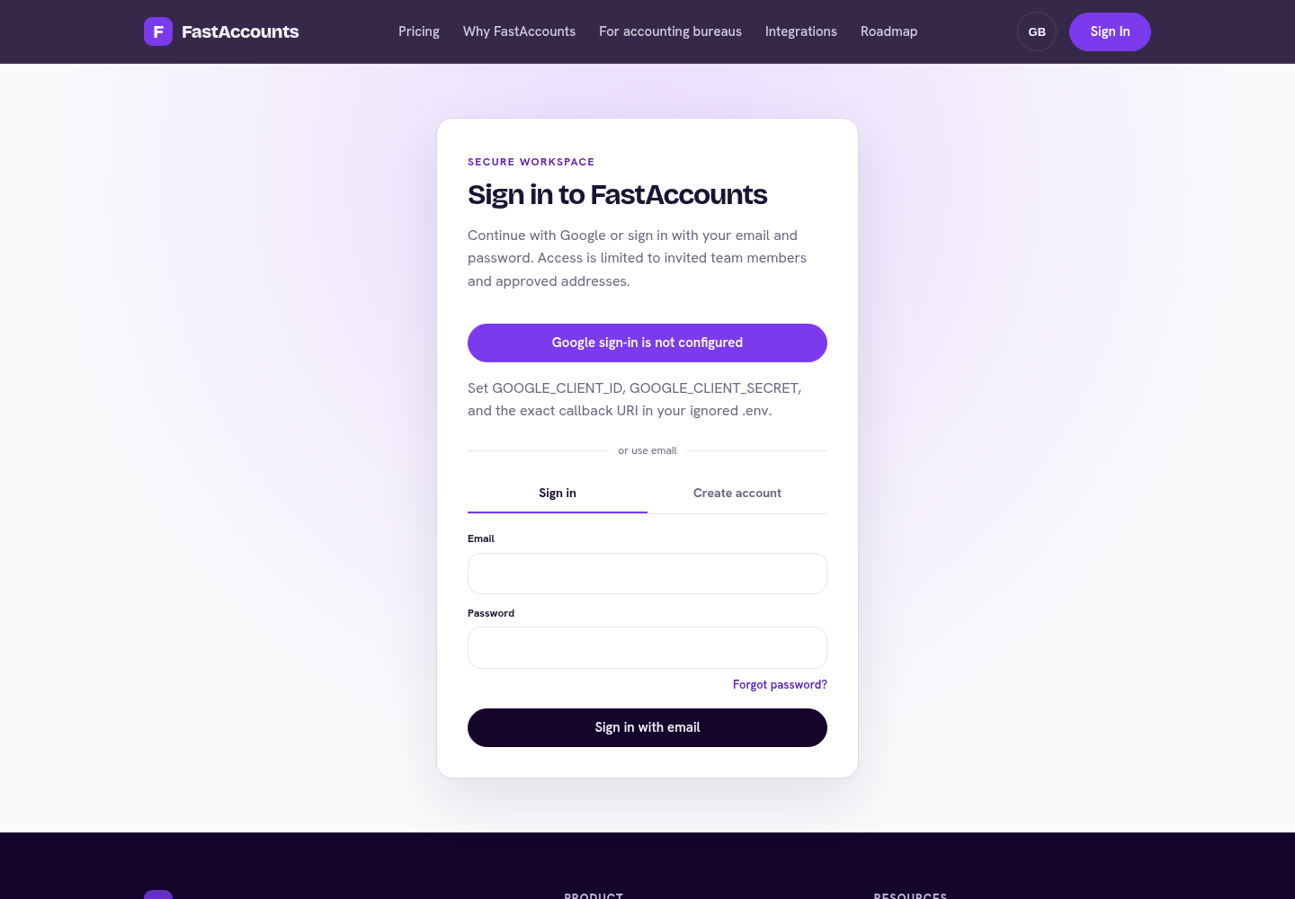
Sign in
• Open Sign in and choose Continue with Google, or enter your Email and Password and choose Sign in with email.
• Use the address your bureau invited or approved; both methods open the same account, so a Google user can also set a password.
• The workspace opens on the Overview.
The local demonstration shown here has no Google credentials configured, so the Google button reports that; production offers both options.
FastAccounts · User guide · v0.4.0 · 2026-10-09 · fastaccounts.org · 5

Slide 6
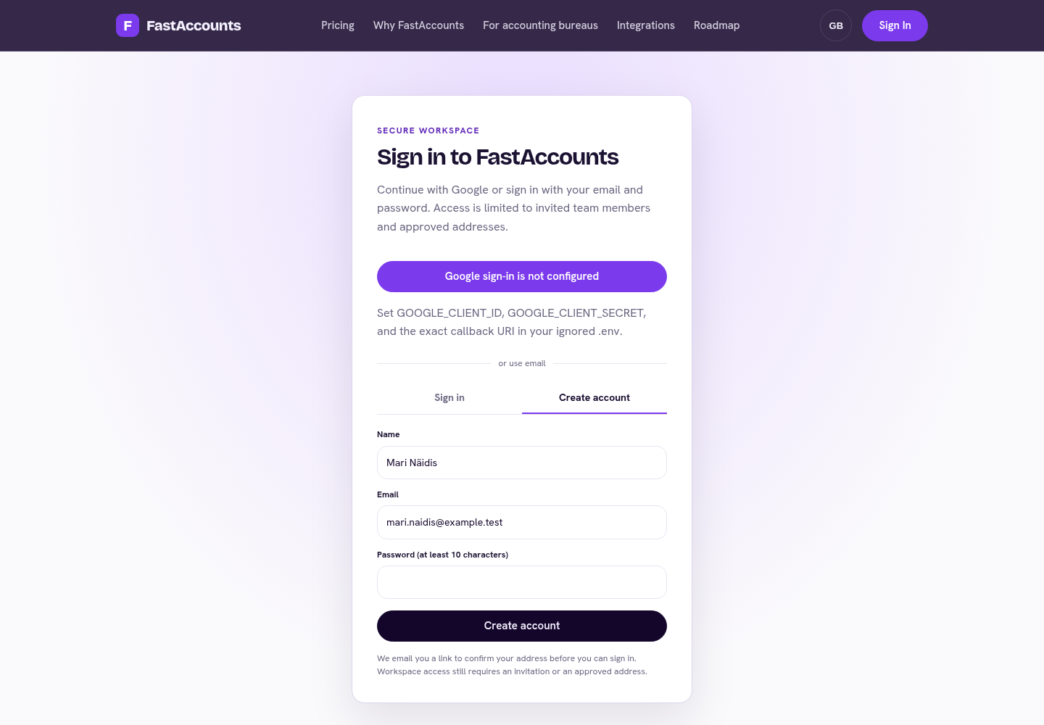
Create an account
• On Sign in, open the Create account tab.
• Enter your Name, Email and a Password (at least 10 characters).
• Choose Create account and open the confirmation link we email you.
• Enter the same password to Confirm email; the workspace opens.
Access still requires an invitation or an approved address. The message after sign-up is the same whether or not the address can register.
FastAccounts · User guide · v0.4.0 · 2026-10-09 · fastaccounts.org · 6

Slide 7
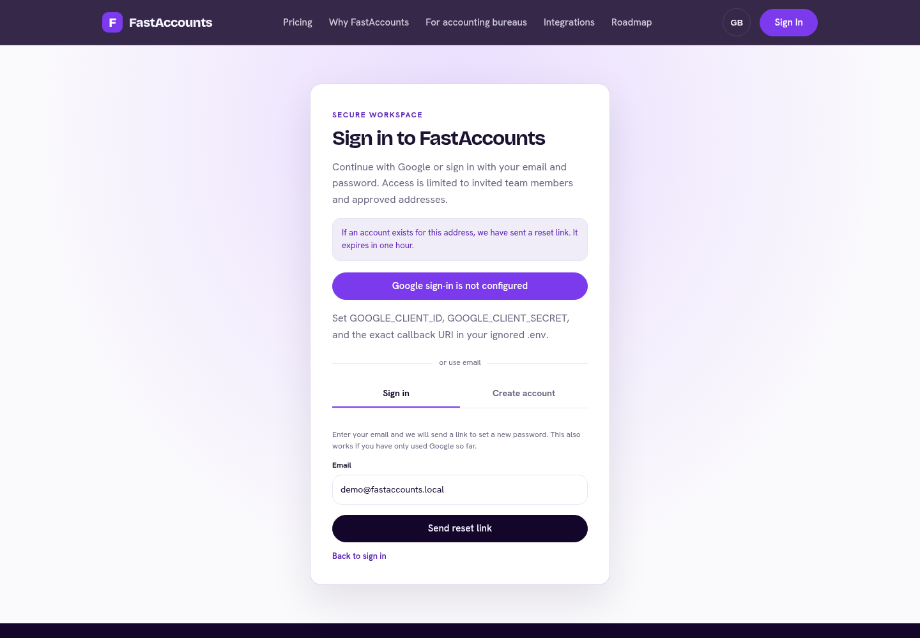
Forgot your password
• Choose Forgot password? under the password field.
• Enter your Email and choose Send reset link.
• Open the link in the email within one hour; it works once.
This is also how a Google user adds a password. Repeated attempts are paused for a while to protect accounts.
FastAccounts · User guide · v0.4.0 · 2026-10-09 · fastaccounts.org · 7

Slide 8
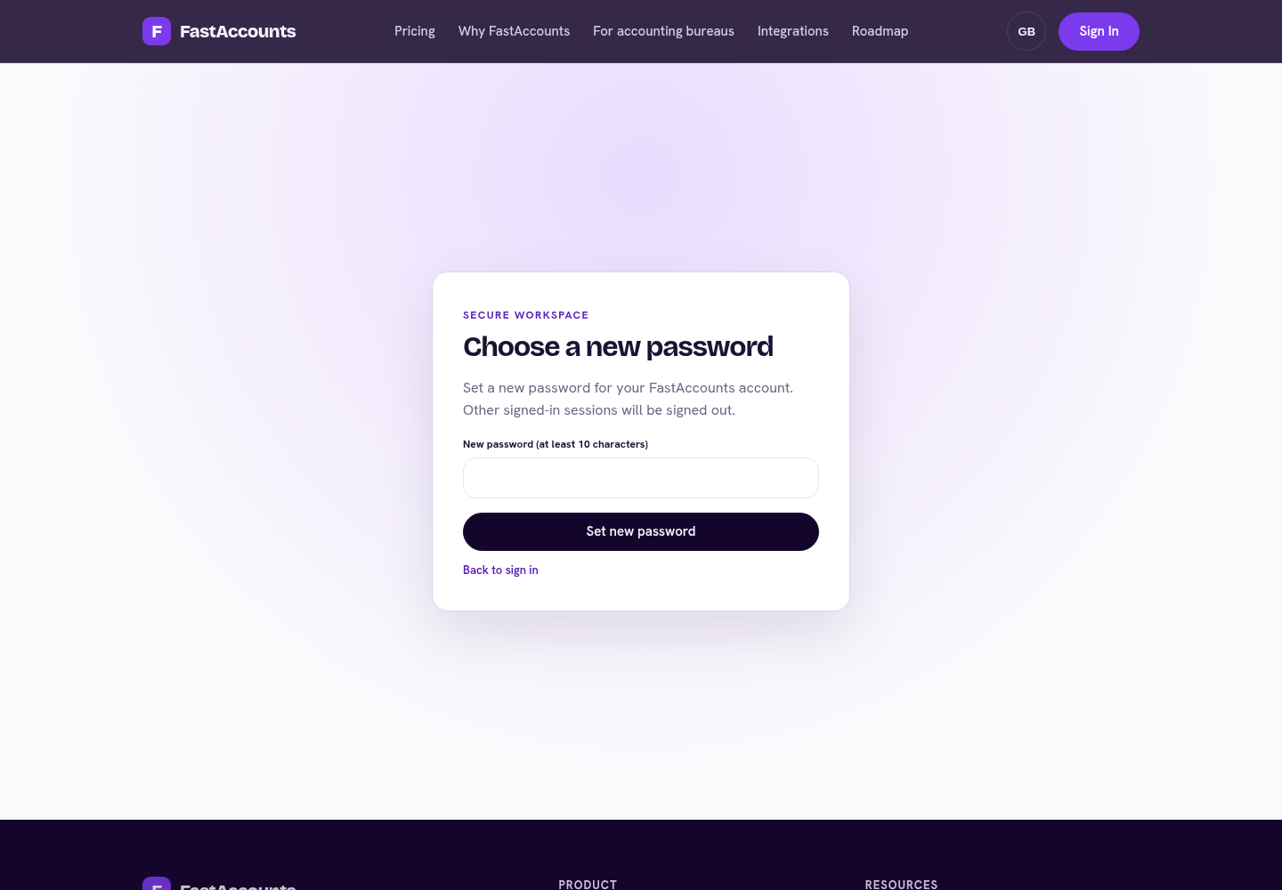
Choose a new password
• Enter a New password (at least 10 characters).
• Choose Set new password.
• Sign in again with the new password.
Changing the password signs out every other browser where the account was signed in.
FastAccounts · User guide · v0.4.0 · 2026-10-09 · fastaccounts.org · 8

Slide 9
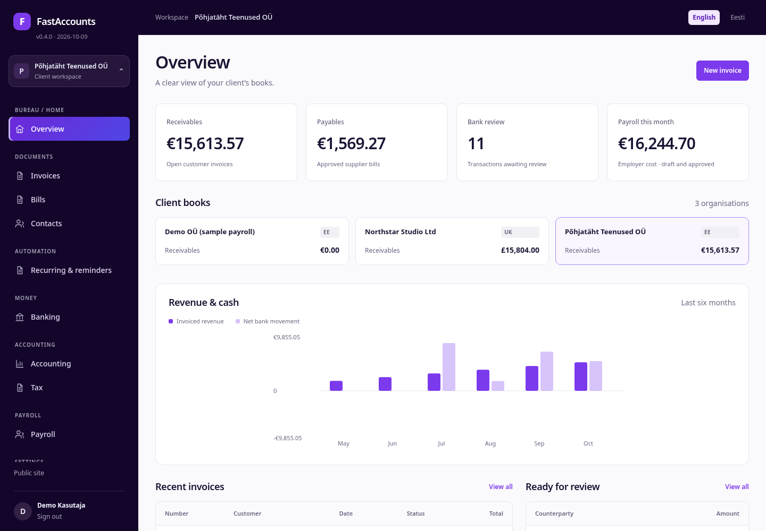
Bureau overview
Overview summarises the selected client's books:
• Receivables and Payables — open customer invoices and approved bills.
• Bank review — bank lines still waiting for a match.
• Payroll this month — employer cost of draft and approved pay runs.
Client books lists every organisation you can access, with receivables per client. The chart compares invoiced revenue with net bank movement for the last six months. New invoice starts a sales invoice straight away.
FastAccounts · User guide · v0.4.0 · 2026-10-09 · fastaccounts.org · 9

Slide 10
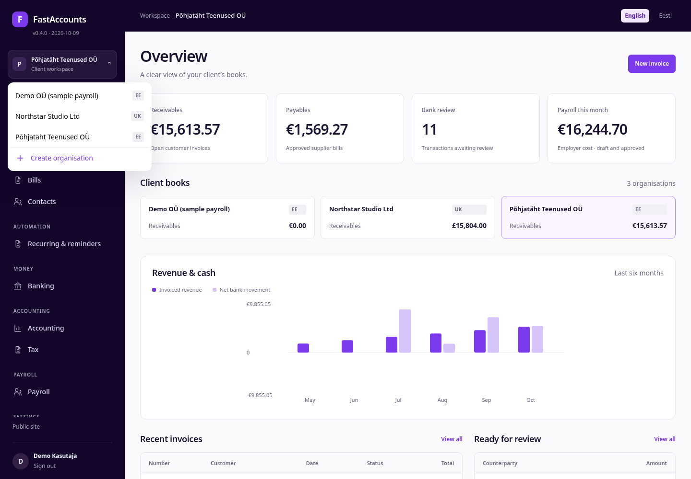
Switch between clients
Each client is a separate organisation with its own chart of accounts, documents, bank accounts, payroll and integrations.
• Click the organisation card at the top of the sidebar.
• Pick a client; the country badge (EE / UK) shows its rule set.
• Create organisation adds a new client's books.
Payroll is enabled only for Estonian organisations with EUR books; for other clients the Payroll menu item is greyed out with an explanation.
FastAccounts · User guide · v0.4.0 · 2026-10-09 · fastaccounts.org · 10

Slide 11
Workspace language and version
• English / Eesti in the top bar switches every label, message and error. Your choice is kept for the next visit. Estonian payslips are always in Estonian.
• The version chip under the logo (v0.4.0 · 2026-10-09) shows the release you are using; click it to open the health check.
• Public site and Sign out are at the bottom of the sidebar.
On narrow screens the sidebar folds into the ☰ menu.
FastAccounts · User guide · v0.4.0 · 2026-10-09 · fastaccounts.org · 11

Slide 12
SECTION 02
Sales, purchases and automation
Issue invoices, review supplier bills and let recurring invoices and the reminder ladder do the routine work.
FastAccounts · User guide · v0.4.0 · 2026-10-09 · fastaccounts.org · 12

Slide 13
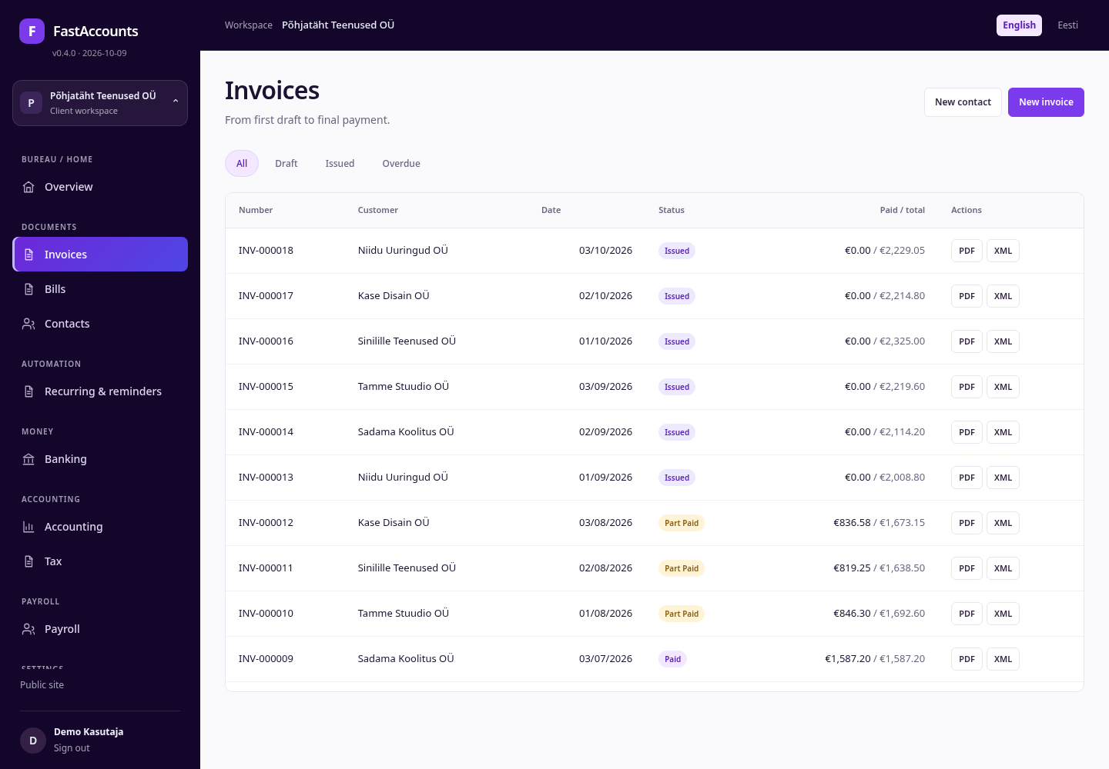
Sales invoices
Invoices shows every sales invoice with its status: Draft, Issued, Part paid, Paid or Overdue. Filter with the tabs above the list.
• PDF downloads the invoice; XML downloads it as structured XML.
• Open a draft to edit, issue or delete it. Issued invoices are immutable and are posted to the ledger.
• New contact adds a customer without leaving the page.
FastAccounts · User guide · v0.4.0 · 2026-10-09 · fastaccounts.org · 13

Slide 14
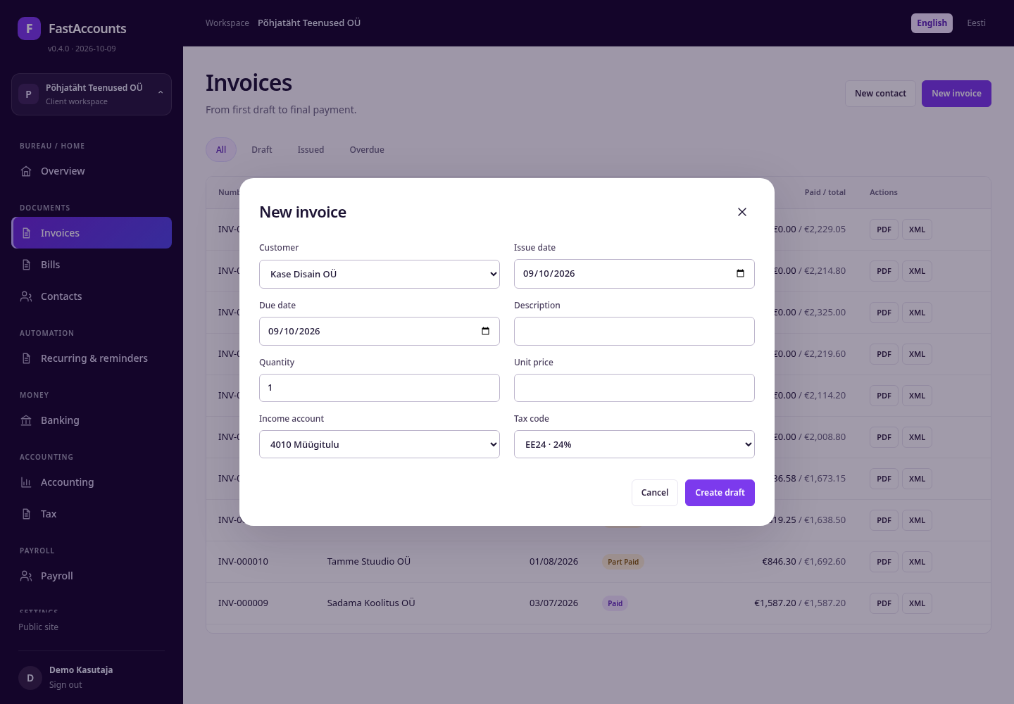
Create an invoice
• Click New invoice.
• Choose the Customer, Issue date and Due date.
• Enter the Description, Quantity and Unit price.
• Pick the Income account and Tax code (for example EE24 – 24%).
• Create draft, review it, then Issue.
VAT is calculated per line with exact decimals and posted to the client's VAT accounts when the invoice is issued.
FastAccounts · User guide · v0.4.0 · 2026-10-09 · fastaccounts.org · 14

Slide 15

Supplier bills
Bills holds supplier documents before they reach the ledger.
• Statuses run In review → Approved → Part paid → Paid.
• Approve posts the bill; nothing is posted while it is in review.
• New bill and New supplier add documents and counterparties.
Use the review step for anything an accountant must check first, such as reverse-charge or non-deductible VAT.
FastAccounts · User guide · v0.4.0 · 2026-10-09 · fastaccounts.org · 15

Slide 16
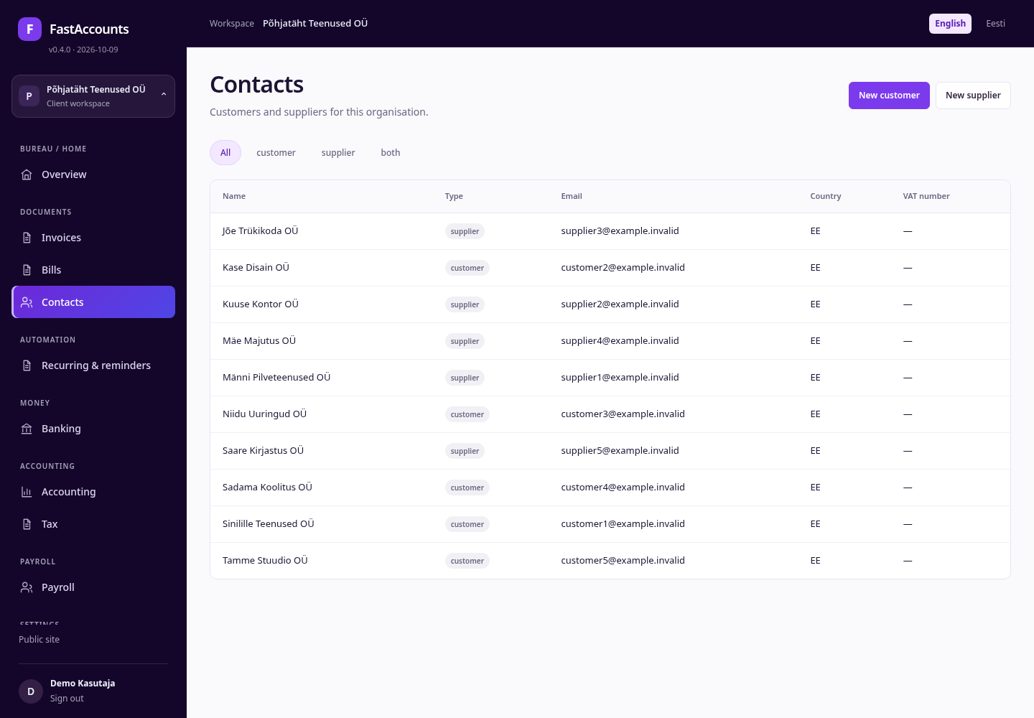
Contacts
Contacts keeps customers and suppliers per client, with type, e-mail, country and VAT number. Filter by customer, supplier or both.
Contacts are reused by invoices, bills, bank matching and recurring schedules, so keep e-mail addresses current: payment reminders go there.
FastAccounts · User guide · v0.4.0 · 2026-10-09 · fastaccounts.org · 16

Slide 17
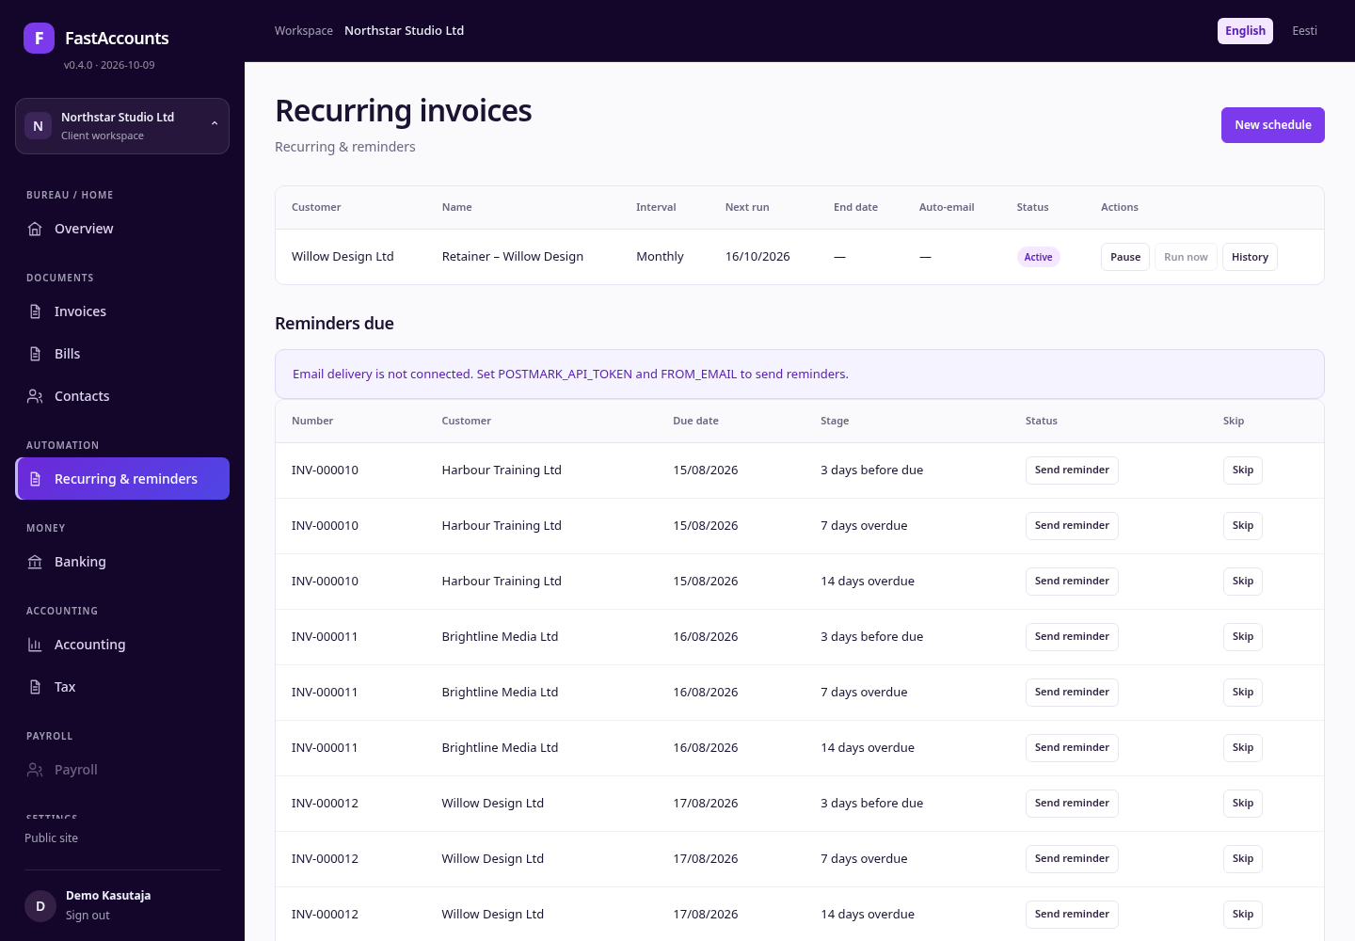
Recurring invoices and reminders
Recurring & reminders lists invoice schedules and the reminder ladder.
• A schedule copies a template invoice weekly, monthly, quarterly or every n days. Run now is enabled once the next run date is due; Pause and History manage the schedule.
• Reminders due lists overdue invoices at each step: 3 days before due, 7 days overdue and 14 days overdue. Send reminder or Skip each one.
E-mail delivery needs POSTMARK_API_TOKEN and FROM_EMAIL; until then the page says so and nothing is sent.
FastAccounts · User guide · v0.4.0 · 2026-10-09 · fastaccounts.org · 17

Slide 18
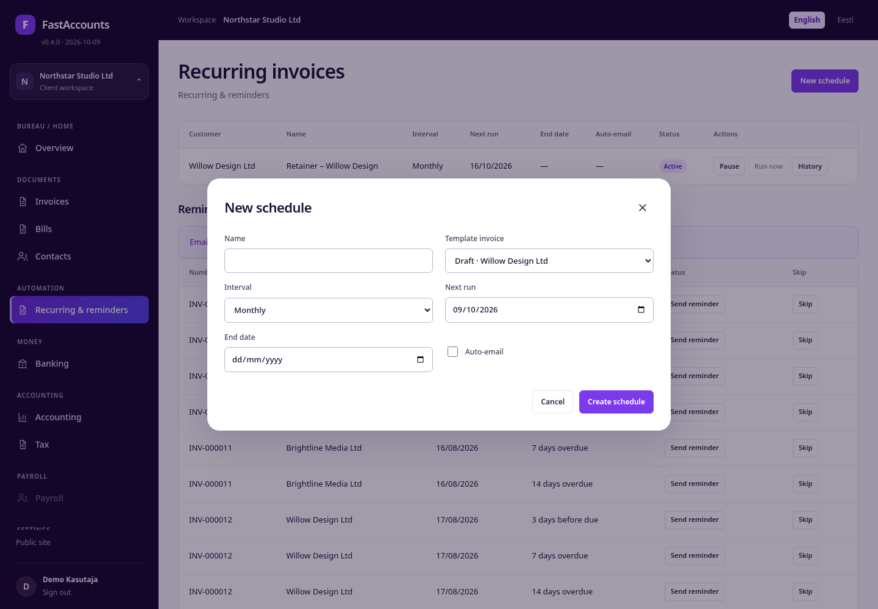
Create a recurring schedule
• Create and save a draft invoice to use as the Template invoice.
• Click New schedule and give it a Name.
• Choose the Interval, the Next run date and an optional End date.
• Tick Auto-email to send each new invoice automatically.
• Create schedule.
Each run creates a normal invoice from the template, so numbering, VAT and posting follow the same rules as invoices you create by hand.
FastAccounts · User guide · v0.4.0 · 2026-10-09 · fastaccounts.org · 18

Slide 19
SECTION 03
Banking, accounting and tax
Match bank lines to documents, read the ledger and prepare VAT workpapers for accountant review.
FastAccounts · User guide · v0.4.0 · 2026-10-09 · fastaccounts.org · 19

Slide 20
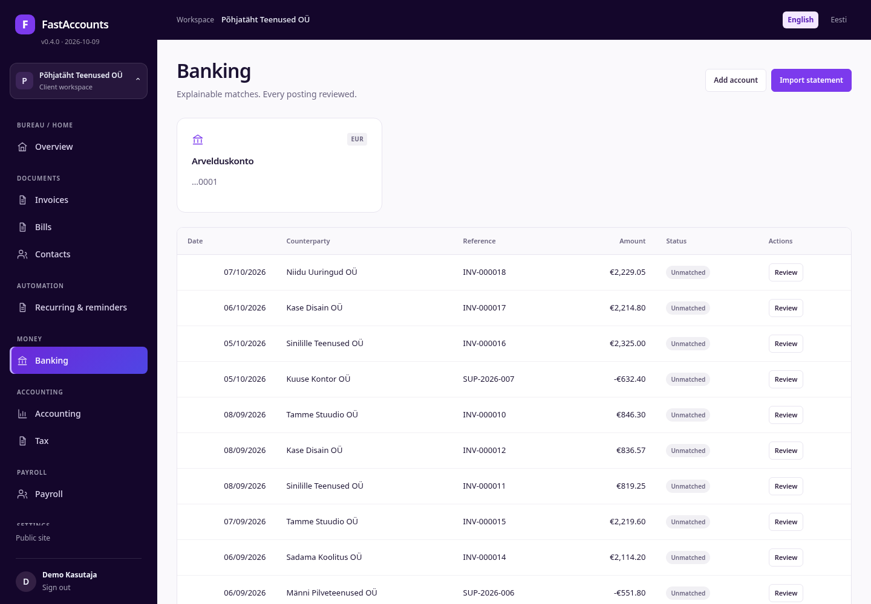
Banking and reconciliation
Banking shows each bank account and its imported transactions.
• Import statement (CSV or CAMT.053 XML).
• Each unmatched line offers explainable match suggestions; click Review.
• Confirm match to allocate the payment to invoices or bills.
Add account registers another bank account for the client. Confirmed matches post the payment and update invoice and bill statuses.
FastAccounts · User guide · v0.4.0 · 2026-10-09 · fastaccounts.org · 20

Slide 21
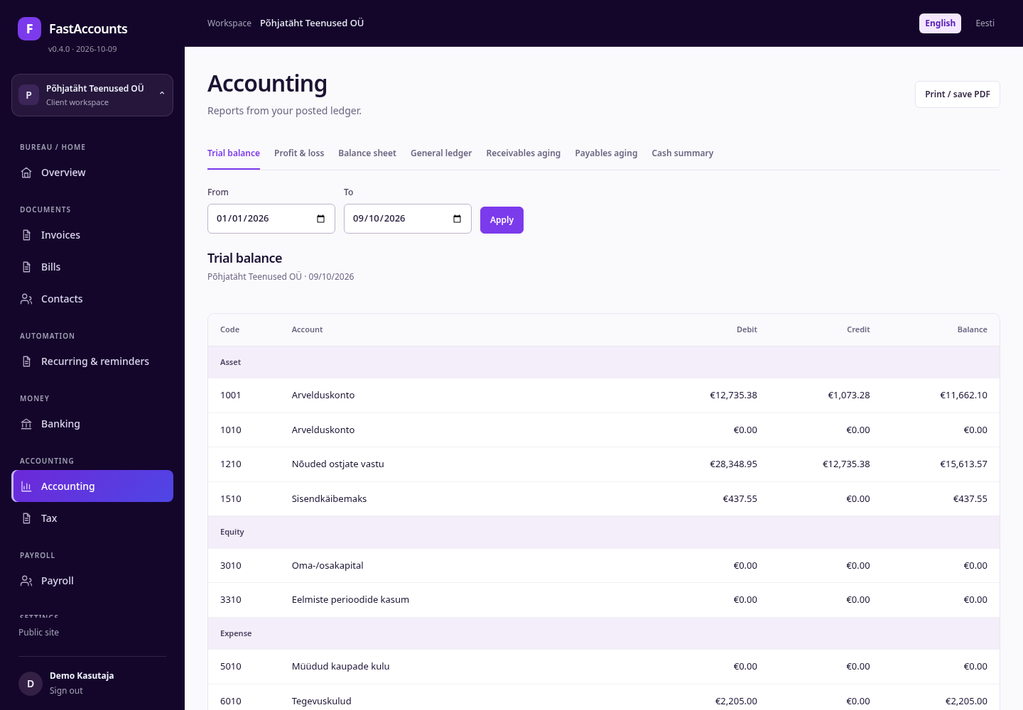
Accounting reports
Accounting builds reports from the immutable, balanced ledger:
• Trial balance, Profit & loss, Balance sheet
• General ledger with every posting and its reference
• Receivables aging, Payables aging and Cash summary
Choose From and To, click Apply, and use Print / save PDF for the client file. Postings are never edited; corrections are new entries.
FastAccounts · User guide · v0.4.0 · 2026-10-09 · fastaccounts.org · 21

Slide 22
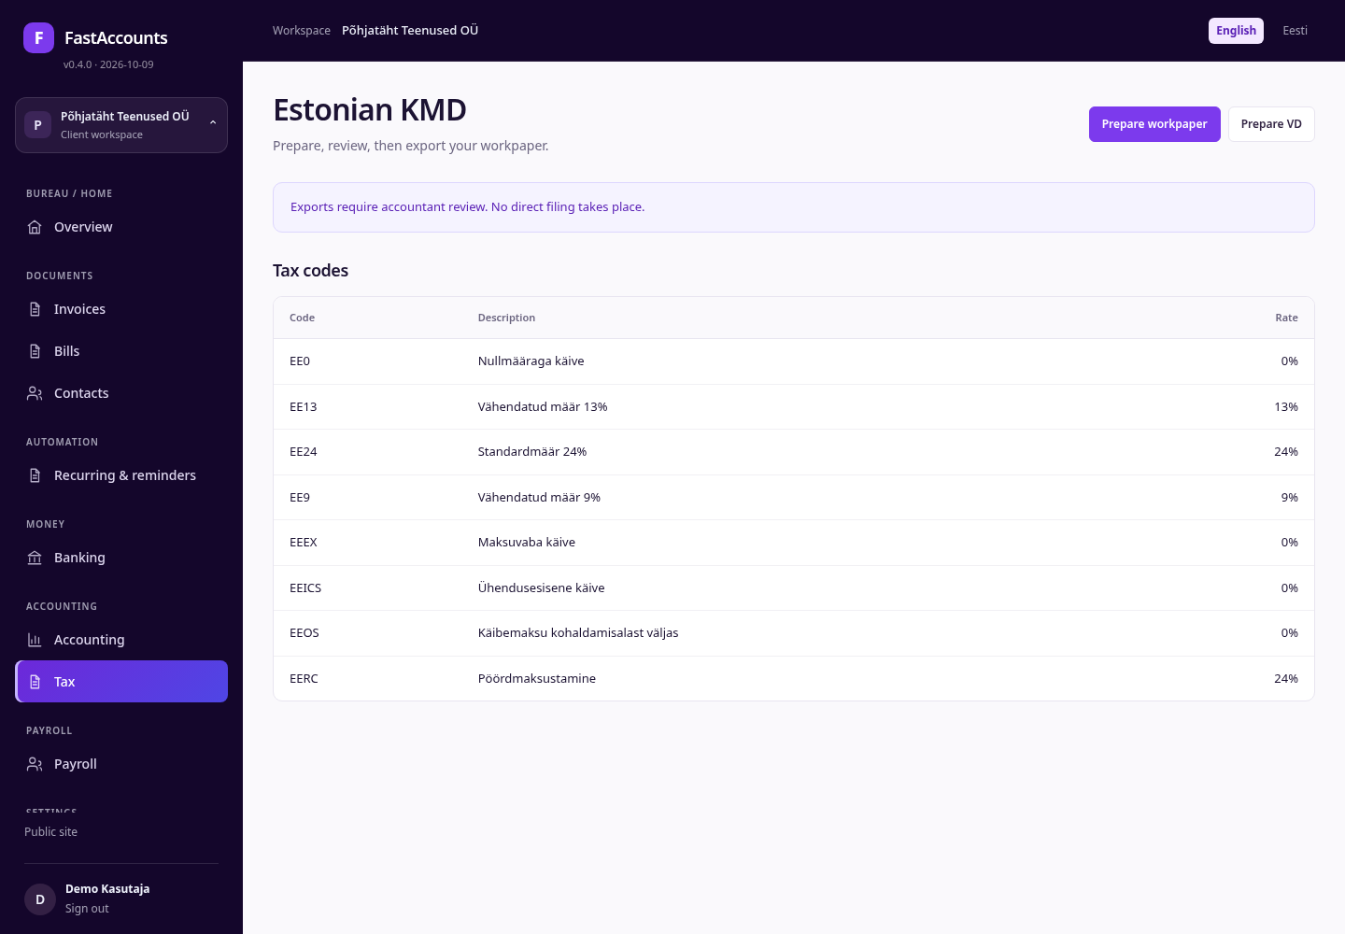
Estonian VAT (KMD) workpapers
Tax prepares the Estonian KMD (and the UK nine-box VAT return for UK books).
• Prepare workpaper for the period.
• Check the boxes against the listed tax codes.
• Mark accountant reviewed before exporting.
Prepare VD builds the EU sales listing. Exports require accountant review; FastAccounts does not file directly with EMTA or HMRC.
FastAccounts · User guide · v0.4.0 · 2026-10-09 · fastaccounts.org · 22

Slide 23
SECTION 04
Payroll for accounting bureaus
Estonian 2026 payroll per client: monthly, part-time, hourly and board-member pay, the social tax minimum, payslips and automatic ledger postings.
FastAccounts · User guide · v0.4.0 · 2026-10-09 · fastaccounts.org · 23

Slide 24
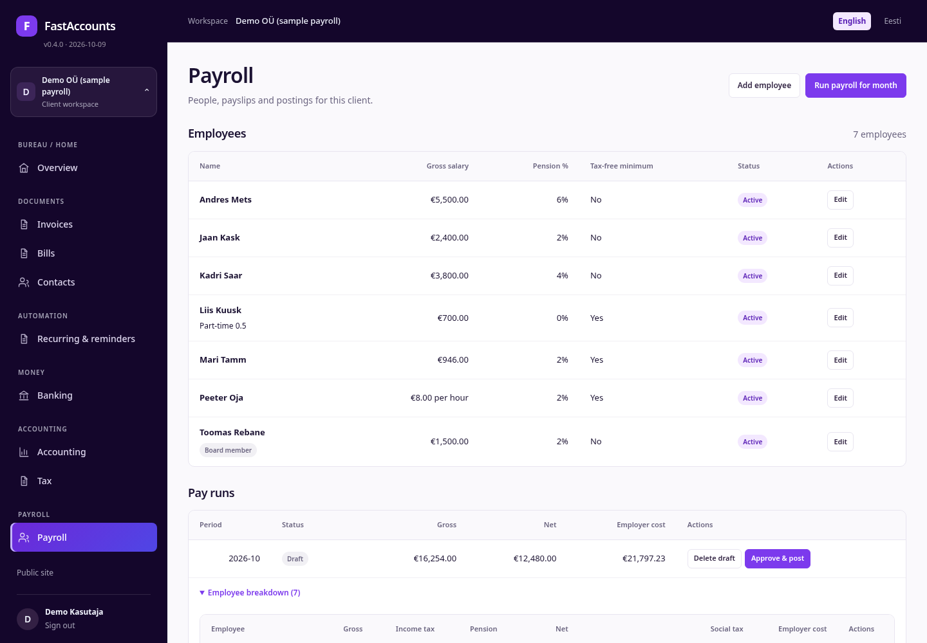
Employees
Open Payroll in an Estonian EUR client (here Demo OÜ (sample payroll)).
• Gross salary shows monthly pay, or the hourly rate per hour.
• Part-time staff show their fraction (Part-time 0.5); board members carry a Board member badge.
• Pension % is the II pillar rate (0, 2, 4 or 6%).
• Tax-free minimum shows who applies the €700 basic exemption here.
Add employee and Run payroll for month are at the top right.
FastAccounts · User guide · v0.4.0 · 2026-10-09 · fastaccounts.org · 24

Slide 25
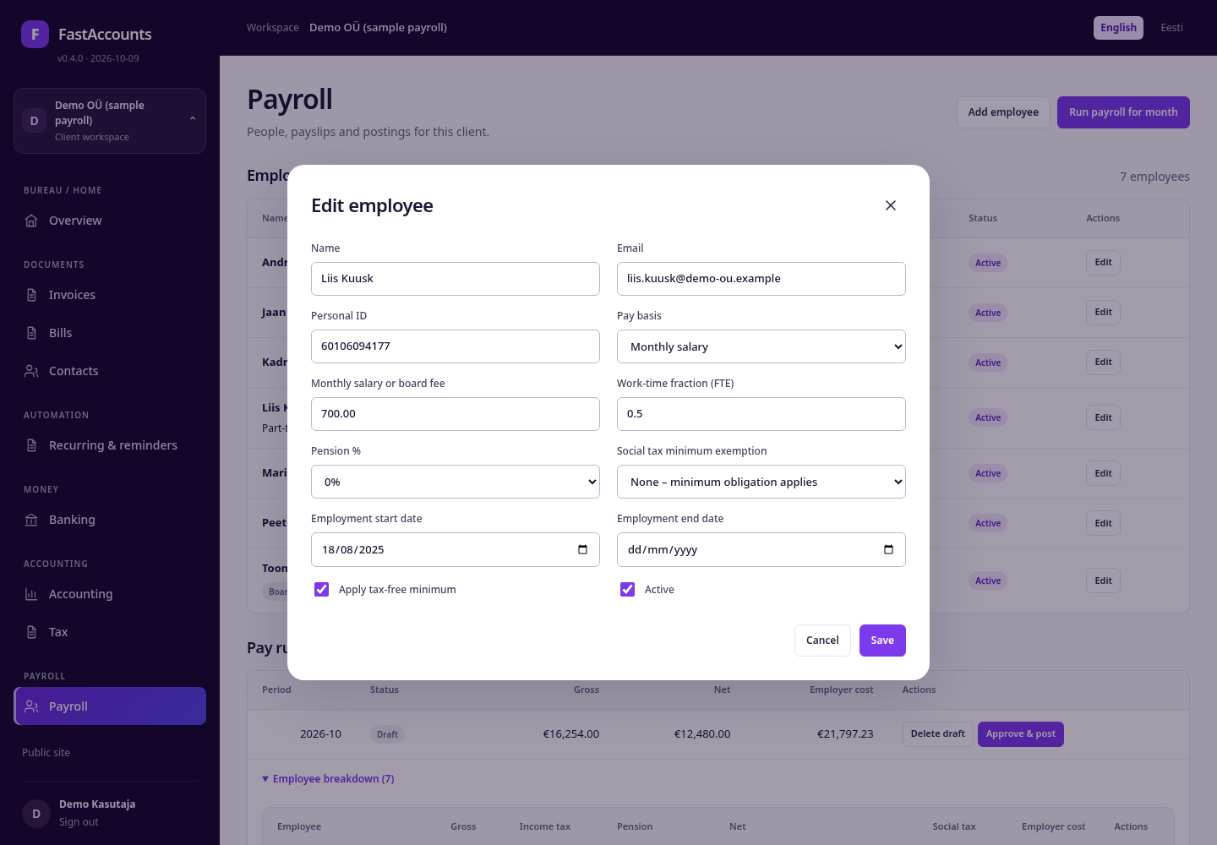
Part-time employee
• Pay basis: Monthly salary.
• Monthly salary or board fee: the contractual monthly gross (€700).
• Work-time fraction (FTE): 0.5 for half time.
• Pension %: 0% is allowed for anyone not in the II pillar.
The minimum-wage check is pro-rated: €946 × 0.5 = €473 from 1 April 2026 (€886 before). Set Employment start date and end date so pay runs skip people outside their employment.
FastAccounts · User guide · v0.4.0 · 2026-10-09 · fastaccounts.org · 25

Slide 26

Hourly employee
• Pay basis: Hourly pay.
• Hourly rate: €8.00 here; the minimum is €5.67/h from 1 April 2026 (€5.31 before).
• Hours are entered in each month's pay run.
Board member fee is the third pay basis: no unemployment insurance and no social tax minimum. Social tax minimum exemption records why the minimum does not apply to a person (see the reference section).
FastAccounts · User guide · v0.4.0 · 2026-10-09 · fastaccounts.org · 26

Slide 27
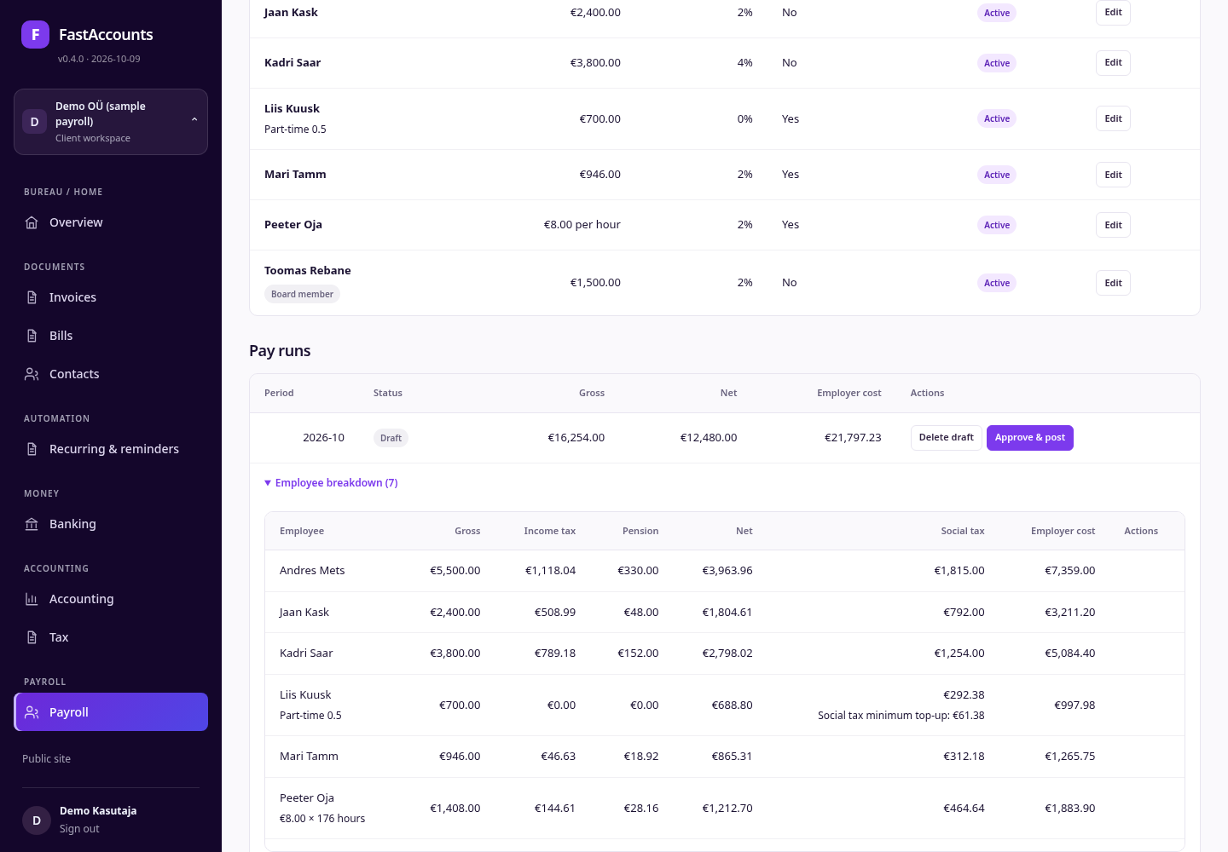
Review a draft pay run
The October 2026 draft lists gross, net and employer cost for the client (€16,254.00 gross, €21,797.23 employer cost). Employee breakdown shows:
• Peeter Oja: €8.00 × 176 hours = €1,408.00 gross.
• Liis Kuusk (0.5 FTE, €700): social tax €292.38, including a Social tax minimum top-up of €61.38 paid by the employer.
• Income tax, II pillar, net pay and employer cost per person.
FastAccounts · User guide · v0.4.0 · 2026-10-09 · fastaccounts.org · 27

Slide 28
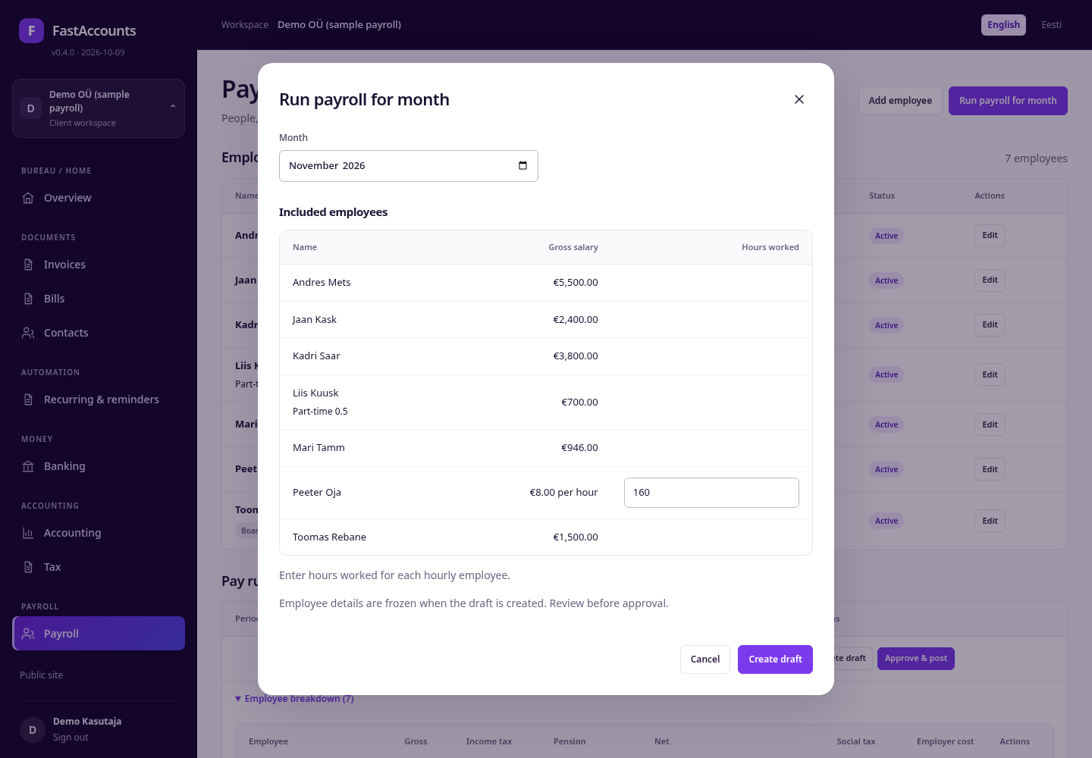
Run payroll for a month
• Click Run payroll for month and choose the Month.
• Check the Included employees (active and employed in that month).
• Enter Hours worked for each hourly employee.
• Create draft and confirm.
Employee details are frozen in the draft, so later edits do not change it. A failed minimum-wage check names the employee and the amount.
FastAccounts · User guide · v0.4.0 · 2026-10-09 · fastaccounts.org · 28

Slide 29
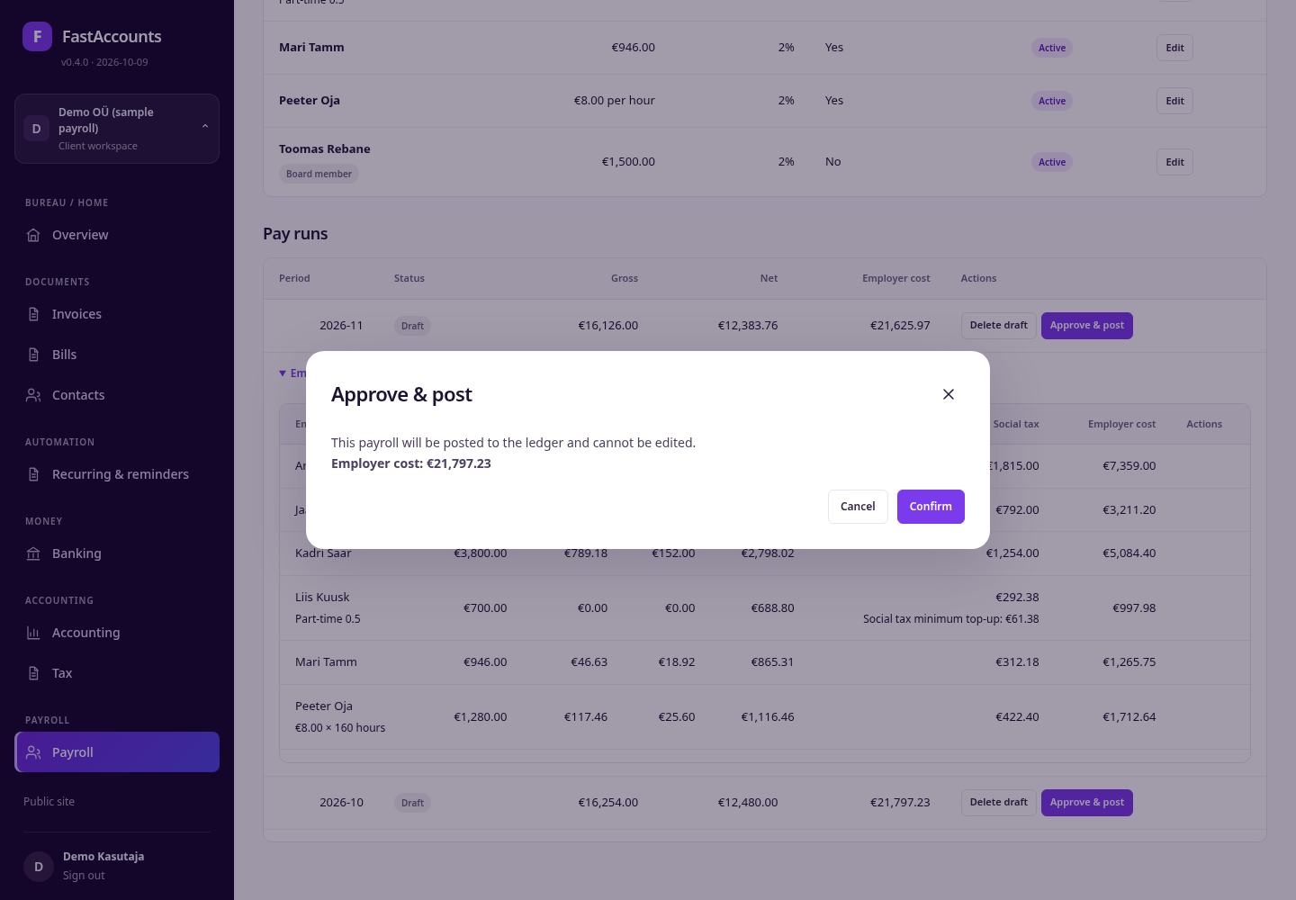
Approve and post
Approve & post shows the employer cost and asks for confirmation. Approval:
• posts one balanced payroll entry to the client's ledger;
• locks the run (delete or edit only while it is a draft);
• makes the Payslips PDF available.
Delete a wrong draft with Delete draft and create it again.
FastAccounts · User guide · v0.4.0 · 2026-10-09 · fastaccounts.org · 29

Slide 30
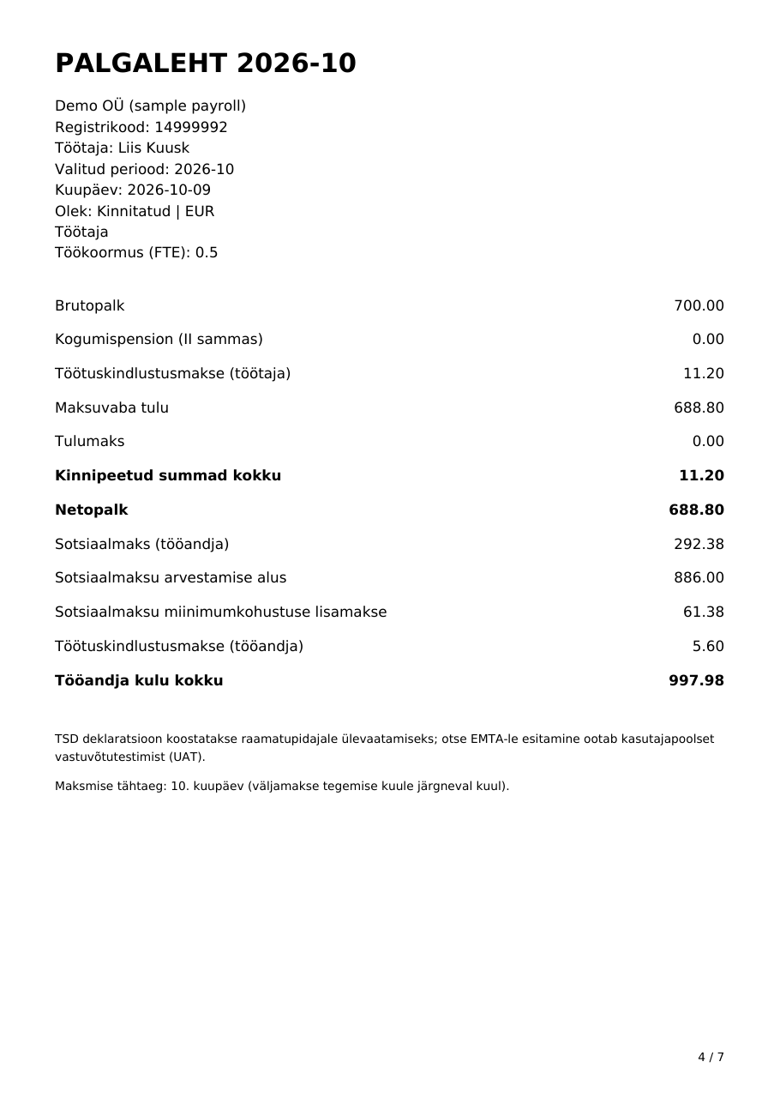
Payslips
Payslips PDF produces one page per employee (Estonian palgaleht):
• gross pay, or hourly rate × hours, and the work-time fraction;
• II pillar, employee unemployment insurance, tax-free minimum used, income tax;
• net pay, social tax with its base and any minimum top-up, employer unemployment insurance and total employer cost.
Submitting the TSD return to EMTA is not automated; the accountant files it.
FastAccounts · User guide · v0.4.0 · 2026-10-09 · fastaccounts.org · 30

Slide 31
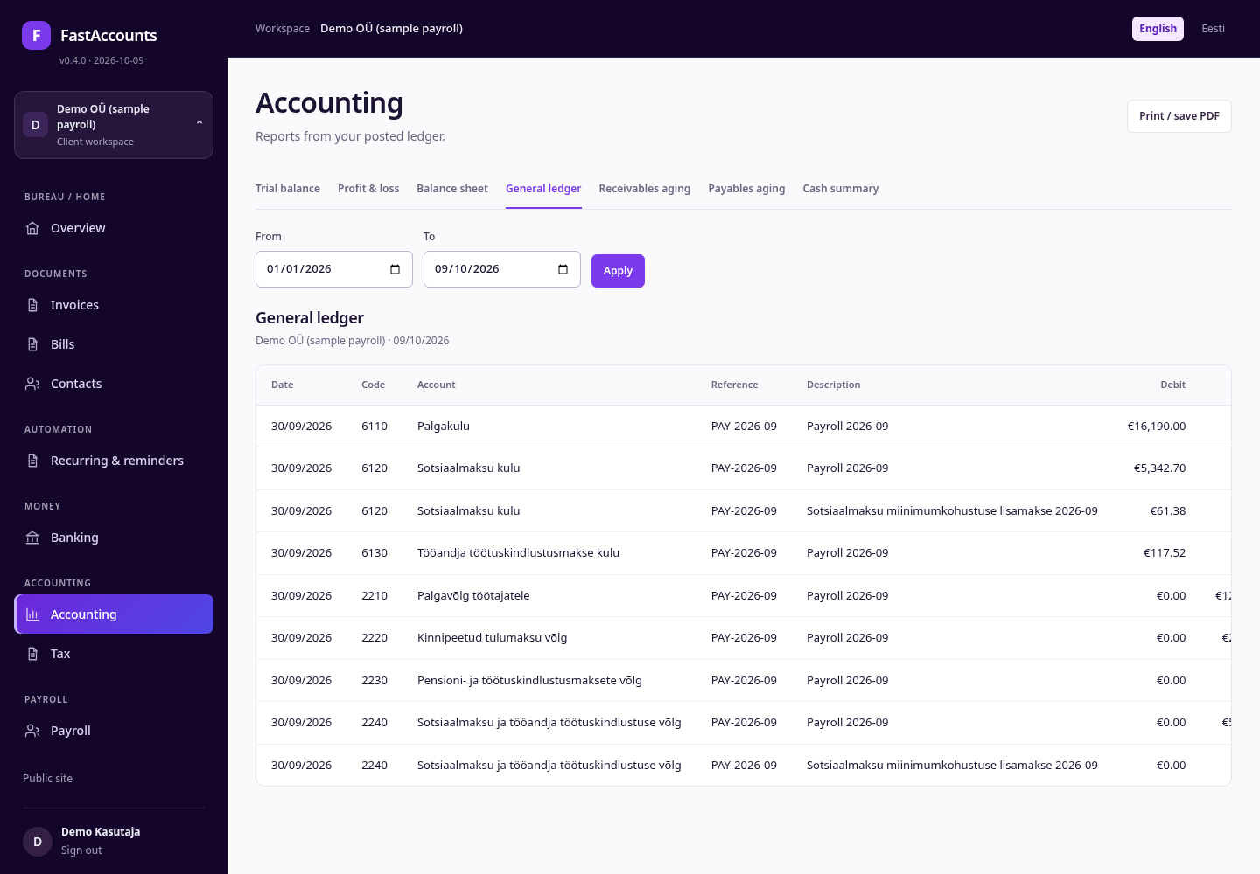
Payroll in the ledger
Each approved run posts to the client's payroll accounts, for example:
• 6110 salaries, 6120 social tax, 6130 employer unemployment insurance;
• 2210 net pay owed, 2220 income tax withheld, 2230 pension and unemployment insurance, 2240 social tax payable.
The social tax minimum top-up is a separate line with its own description, so it is easy to explain to the client. Postings appear under their period end.
FastAccounts · User guide · v0.4.0 · 2026-10-09 · fastaccounts.org · 31

Slide 32
Social tax minimum
Sources: Sotsiaalmaksuseadus § 2 lg 2–4; Rahandusministri määrus nr 17; EMTA "Sotsiaalmaks". Choose the matching Social tax minimum exemption on the employee; it is printed on the payslip.
Rule | 2026
Monthly minimum base | €886 → minimum social tax €292.38 per employee
Who pays the shortfall | Employer, as an extra employer cost
Part-month employment | Base pro-rated by calendar days employed
Board-member fees | Outside the obligation
Exemption recorded per employee | Pensioners, reduced work ability, child care, students, previously unemployed, shortened working time, council members, ship crew, foreign-service spouses, long-term sick leave, absent all month, another employer applies the exemption
FastAccounts · User guide · v0.4.0 · 2026-10-09 · fastaccounts.org · 32

Slide 33
SECTION 05
Integrations and HR import
Connect each client's HR system once, then review every imported employee before payroll data changes.
FastAccounts · User guide · v0.4.0 · 2026-10-09 · fastaccounts.org · 33

Slide 34
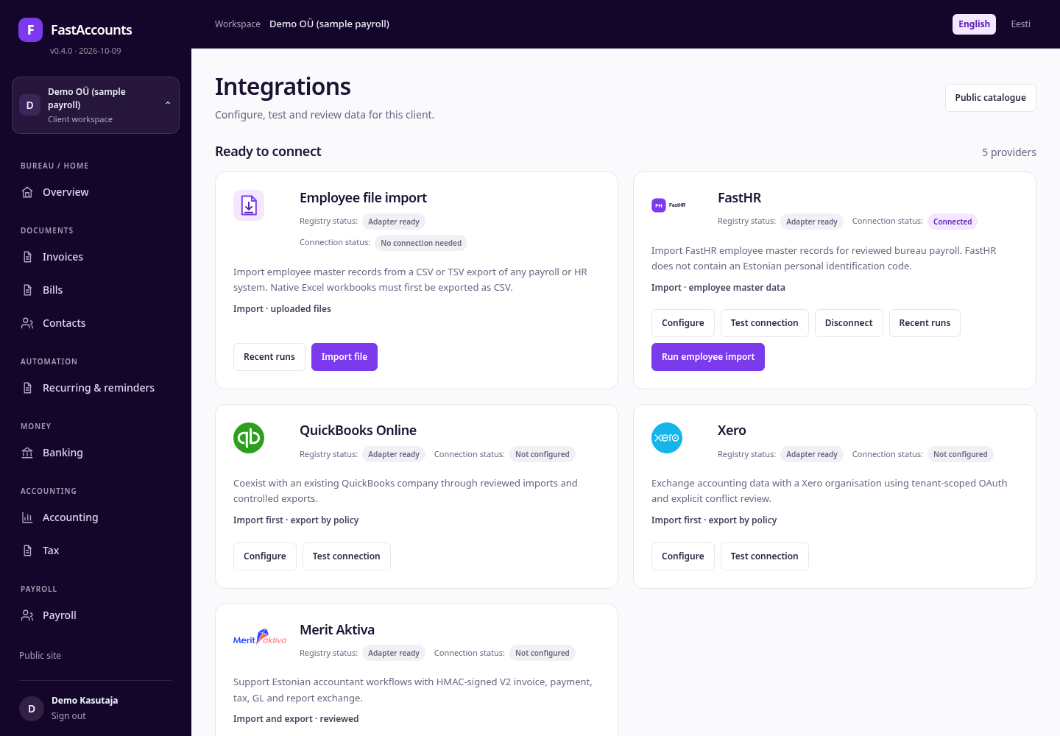
Integrations
Integrations (under Settings) lists ready connectors first, with:
• Registry status — what the adapter supports today;
• Connection status — this client's connection.
Employee file import needs no connection; FastHR, QuickBooks Online, Xero and Merit Aktiva are ready to connect. Planned integrations are listed below; Public catalogue opens the full list on the public site.
FastAccounts · User guide · v0.4.0 · 2026-10-09 · fastaccounts.org · 34

Slide 35
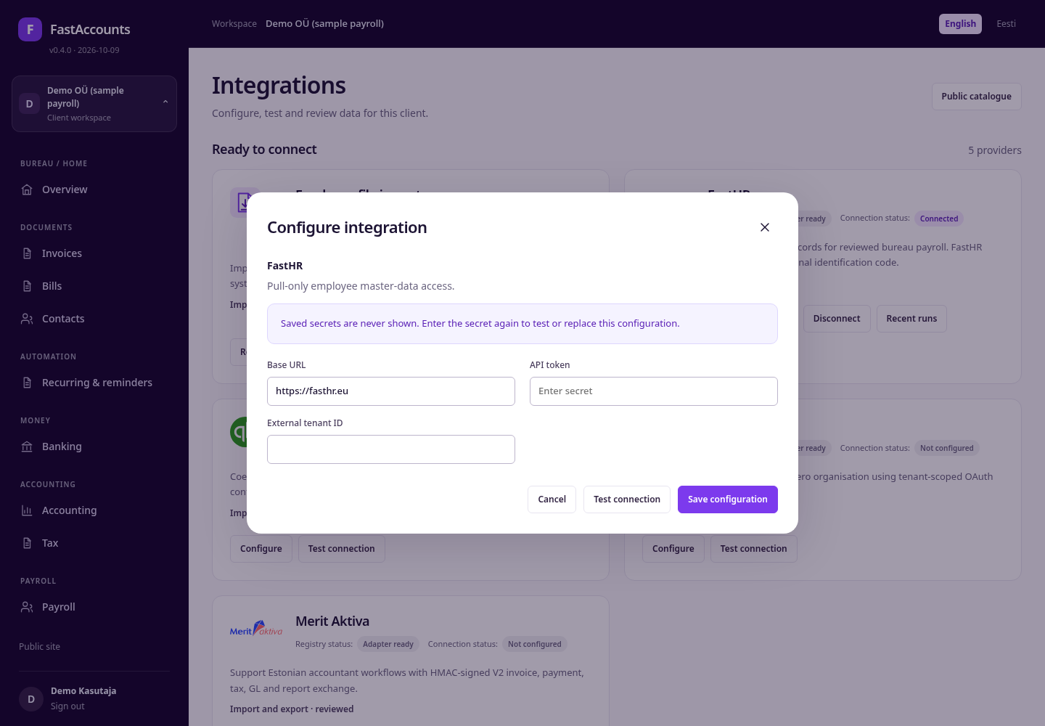
Connect FastHR
• Click Configure on the FastHR card.
• Enter the Base URL and the client's API token.
• Save configuration, then Test connection.
Secrets are encrypted per client and never shown again; enter a new token to replace one. Disconnect removes the connection; FastHR is read-only, so nothing is ever written back.
FastAccounts · User guide · v0.4.0 · 2026-10-09 · fastaccounts.org · 35

Slide 36
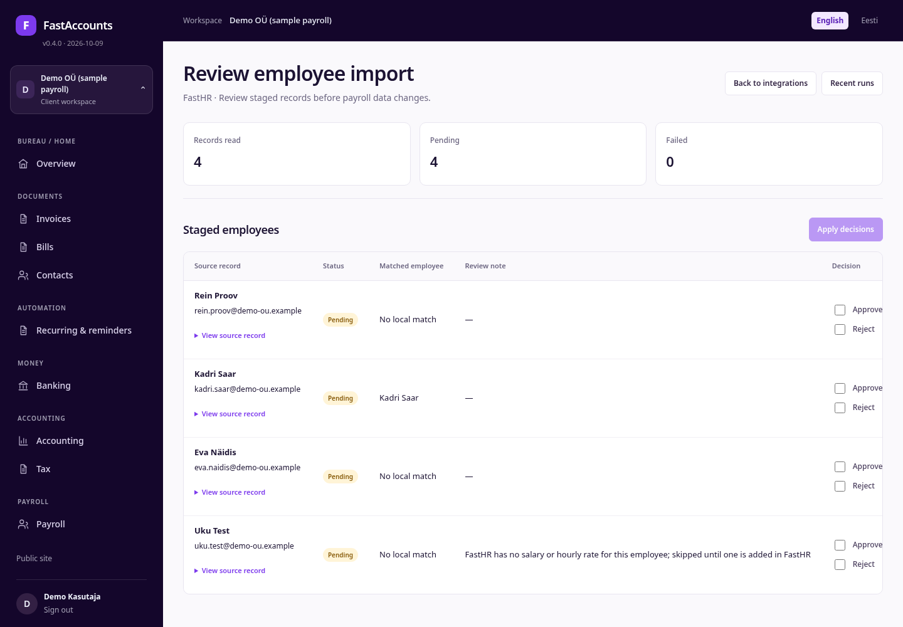
Run an employee import
Run employee import stages FastHR employees for review; nothing changes yet.
• Matched employee links a record to an existing employee by e-mail or personal code.
• FastHR's annual base salary becomes the monthly gross (÷ 12); its work-time ratio becomes the FTE; hourly staff become hourly pay.
• A Review note warns when FastHR has no salary or hourly rate.
FastAccounts · User guide · v0.4.0 · 2026-10-09 · fastaccounts.org · 36

Slide 37
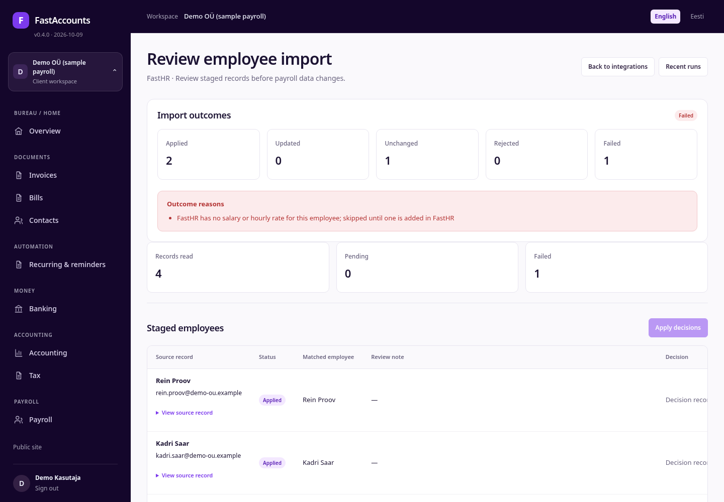
Apply decisions
• Tick Approve or Reject for each record.
• Apply decisions.
Import outcomes counts applied, updated, unchanged, rejected and failed records and lists the reasons. A record without pay is skipped, not guessed; fix it in FastHR and use Retry apply. Recent runs keeps the history.
FastAccounts · User guide · v0.4.0 · 2026-10-09 · fastaccounts.org · 37

Slide 38
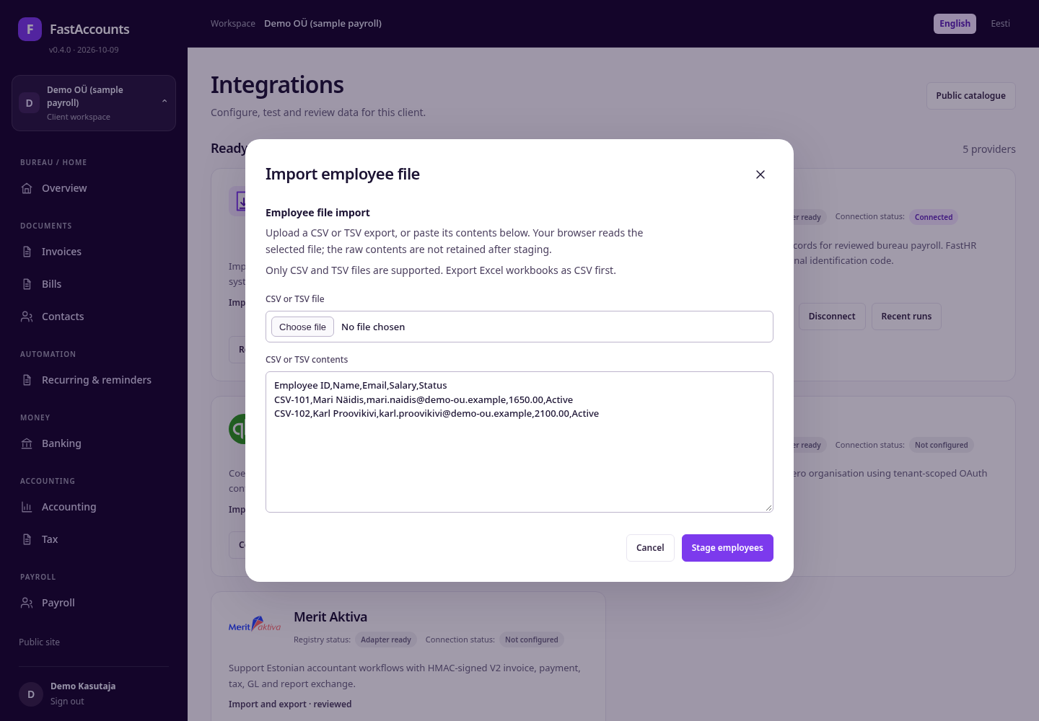
Import an employee file
For clients whose payroll or HR system has no connector, use a file export.
• On the Employee file import card, click Import file.
• Choose a CSV or TSV file, or paste its contents.
• Stage employees.
Recognised headers include Employee ID, Name, Email, Salary (monthly), Personal ID and Status, also in Estonian (Nimi, E-post, Palk, Isikukood). Export Excel workbooks as CSV first. The raw file is not stored.
FastAccounts · User guide · v0.4.0 · 2026-10-09 · fastaccounts.org · 38

Slide 39
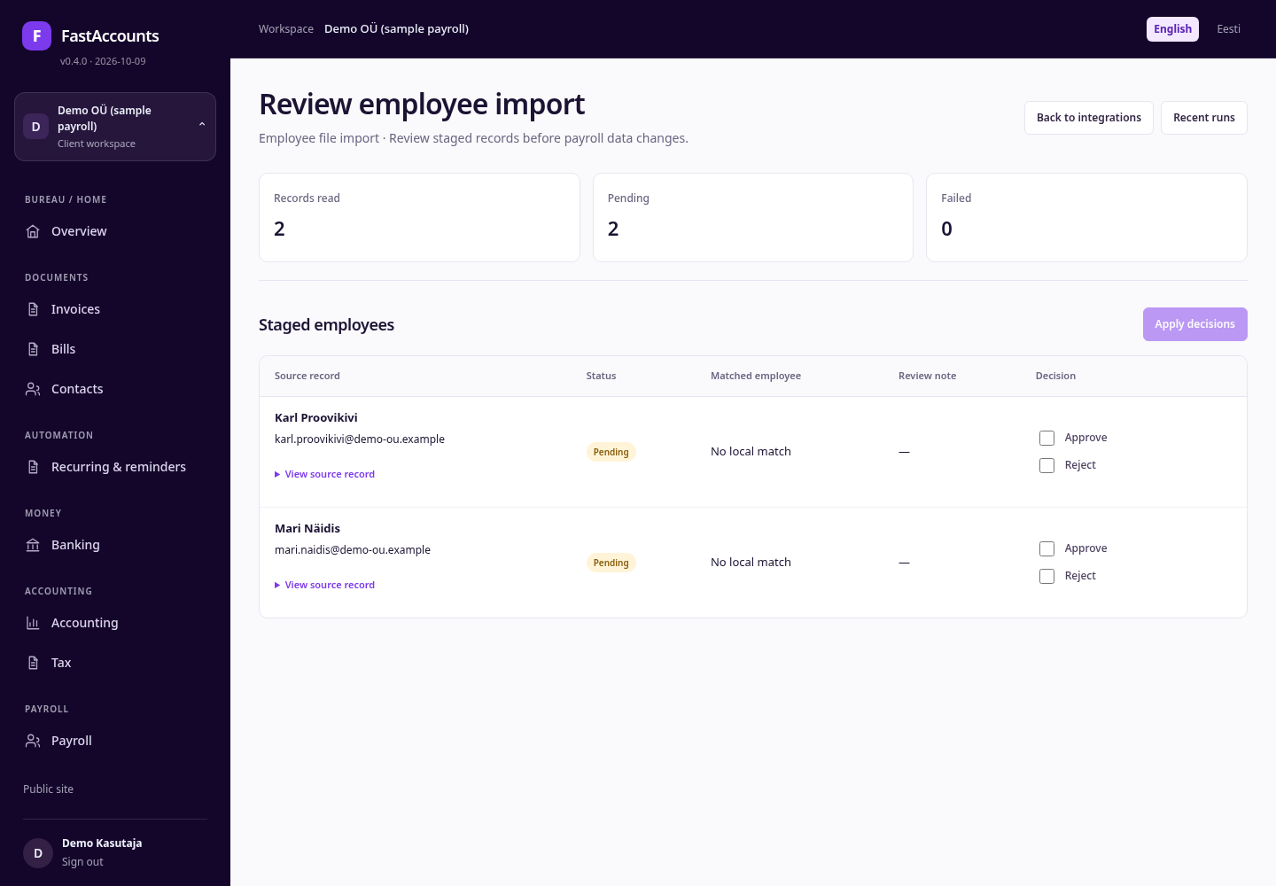
Review a file import
A file import uses the same review as FastHR: each row is staged as Pending, matched to existing employees by e-mail or personal ID, and changes nothing until you Approve it and Apply decisions.
Re-importing the same file is safe: unchanged rows are reported as Unchanged instead of creating duplicates. Recent runs lists earlier file imports for this client.
FastAccounts · User guide · v0.4.0 · 2026-10-09 · fastaccounts.org · 39

Slide 40

Imported employees in payroll
Approved records appear in Payroll like any other employee: here Eva Näidis (part-time 0.6, €1,200.00 a month from €14,400 a year) and Rein Proov (hourly, €7.50).
Before the next pay run, complete what FastHR does not hold: II pillar rate, basic exemption application and any social tax minimum exemption.
FastAccounts · User guide · v0.4.0 · 2026-10-09 · fastaccounts.org · 40

Slide 41
SECTION 06
Reference
2026 Estonian payroll rates, what FastAccounts does not do, and where to find help.
FastAccounts · User guide · v0.4.0 · 2026-10-09 · fastaccounts.org · 41

Slide 42
Estonian payroll rates 2026
Sources: EMTA "Maksumäärad"; Vabariigi Valitsuse määrus nr 36 (23.03.2026). Money is calculated with exact decimals and rounded half-up to cents.
Item | Rate or amount
Income tax | 22%
Basic exemption (on written application) | €700 per month
Social tax (employer) | 33%, minimum base €886 per month
Unemployment insurance | employee 1.6%, employer 0.8%
Funded pension (II pillar) | 0%, 2%, 4% or 6%
Minimum wage until 31.03.2026 | €886 per month, €5.31 per hour
Minimum wage from 01.04.2026 | €946 per month, €5.67 per hour
FastAccounts · User guide · v0.4.0 · 2026-10-09 · fastaccounts.org · 42

Slide 43
Limits and next steps
• Filing: KMD and VD workpapers are prepared for accountant review and exported; nothing is filed with EMTA or HMRC automatically.
• E-mail: reminders and auto-e-mailed invoices need Postmark settings.
• Payroll: Estonian EUR books and 2026 periods only. Leave, sickness, benefits, non-resident cases, TSD submission and salary payments are outside the calculation; accountant UAT is pending (docs/payroll_rules.md).
• Imports: FastHR imports employee master data, not hours or leave.
Release notes are in docs/change_log.md; rebuild this guide with docs/USER_GUIDE_BUILD.md.
FastAccounts · User guide · v0.4.0 · 2026-10-09 · fastaccounts.org · 43

