Slide 1
FastCPI
User Guide — Source-backed Market Price Intelligence
Search · compare · monitor · verify
Goods and services · CPV 2008 · SKU / MPN / GTIN · ten EU markets
Version 1.0.0 · 9 September 2026 · cpi.fastsme.com

Slide 2
Contents
Section | Pages | What it covers
Start | 3–5 | Product scope, account access and workspace
Ask & verify | 6–10 | English/French questions, source evidence and CPV
Monitor | 11–14 | Watchlists, daily scans and market views
Integrate | 15–17 | REST API, developer docs and scoped keys
Operate responsibly | 18 | Coverage limits and a practical workflow

Slide 3
Start
Orient your team around evidence that can be opened, dated and reviewed—not an unsupported “best price” claim.

Slide 4
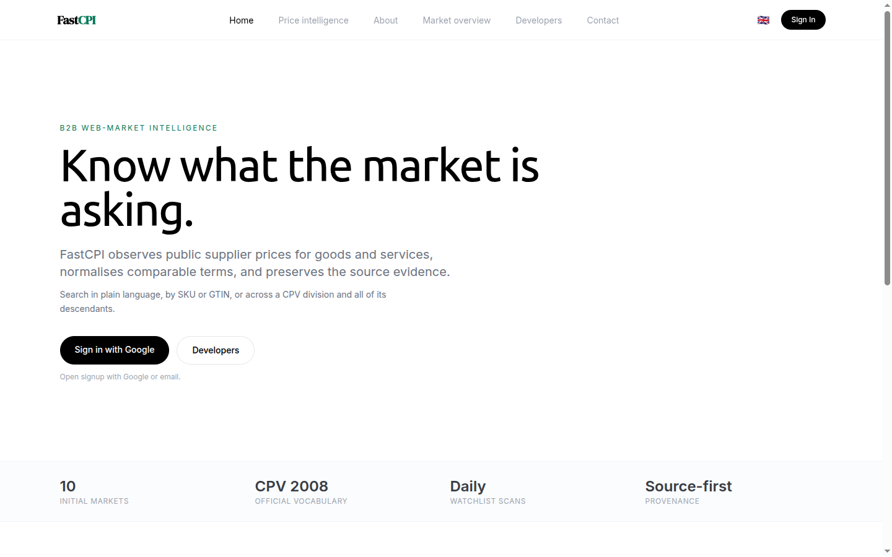
FastCPI at a glance
FastCPI discovers public pages with Exa, fetches candidate pages, extracts attributable prices and preserves the source URL, capture time, extraction method and warnings.
Use it for public B2B market observation across Germany, Denmark, Estonia, Finland, France, Lithuania, Latvia, the Netherlands, Poland and Sweden.
Search in plain language or with CPV, SKU, MPN and GTIN identifiers.
Compare only offers whose units and commercial terms are compatible.
Turn a recurring requirement into a user-specific daily watch.
English landing page

Slide 5
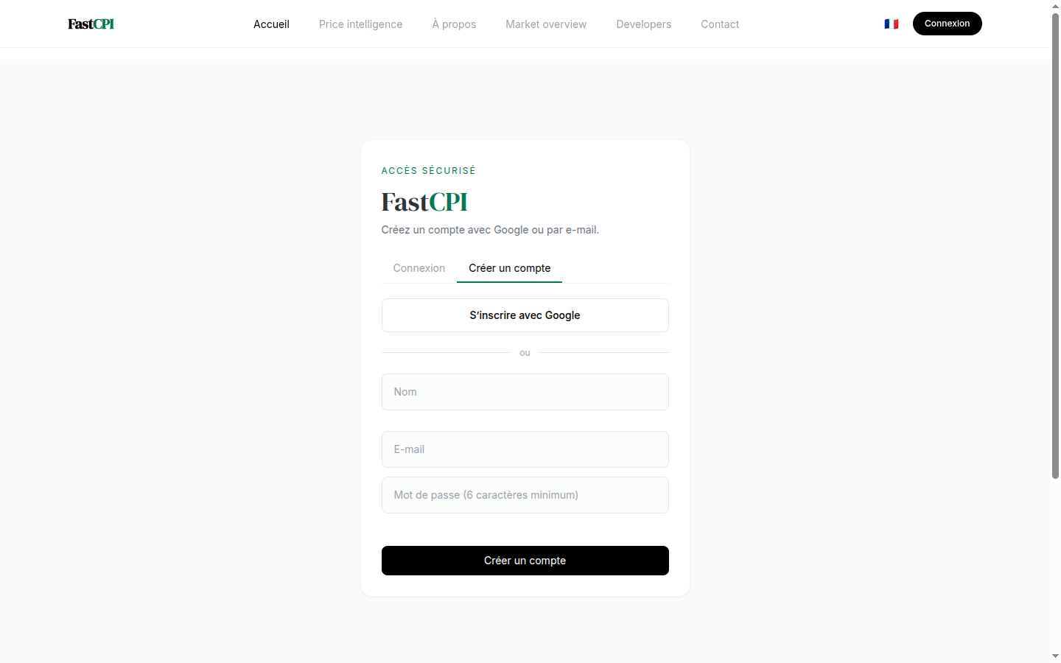
Sign in and choose a language
Open https://cpi.fastsme.com and choose Sign In. Google and verified email signup are available without an invitation. Email users confirm ownership before entering the app.
The language control appears on both the landing page and inside the authenticated left pane, so you can switch later without signing out. French covers the complete active workspace: chat, agents, evidence, watchlists, daily scan, market overview and account/API-key controls.
The interface locale does not force the assistant’s language. Each answer follows the language of the latest question.
French signup page

Slide 6
Ask & verify
Ask naturally, keep identifiers exact, and open the cited page before using a price in a sourcing decision.

Slide 7
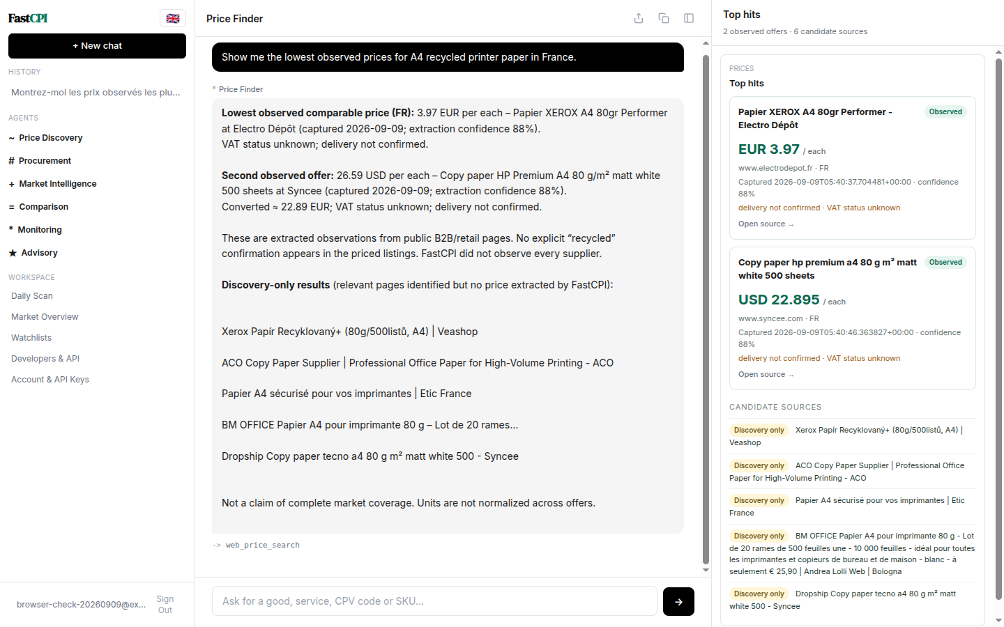
Ask for prices in English
Describe the required good or service and name the market. Add a precise identifier, pack size, unit, VAT basis, delivery destination or contract period when you know it.
The middle pane contains the full answer and limitations. The right pane opens to a compact set of top hits: at most three extracted observations and five discovery-only sources. Every source is clickable; the evidence pane does not repeat the assistant’s full narrative.
“Lowest” always means lowest observed comparable price in the returned public-source sample.
English price conversation

Slide 8
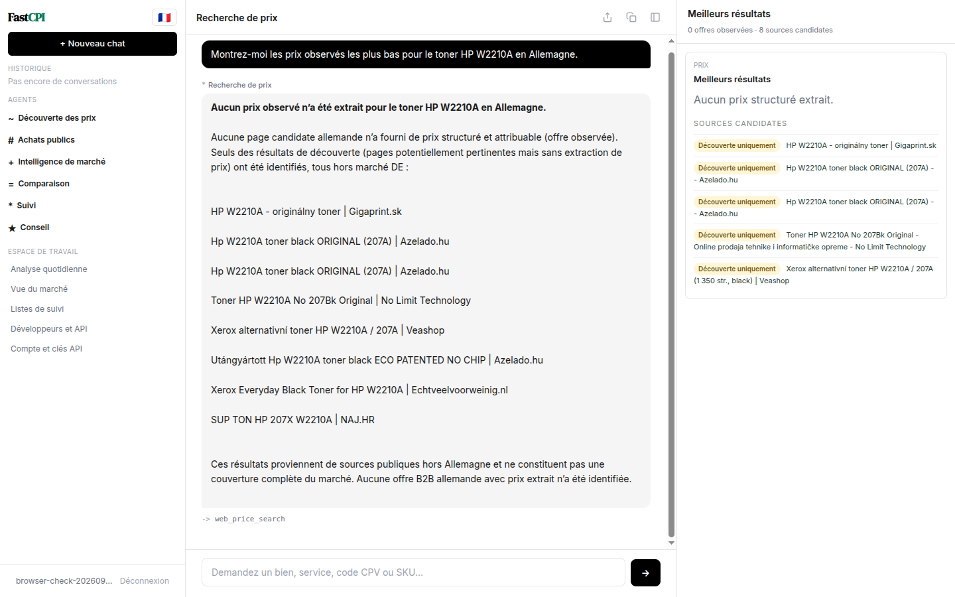
Ask in French
Ask directly in French—for example, « Montrez-moi les prix observés les plus bas pour le toner HP W2210A en Allemagne. » FastCPI sends the original question to the agent and search tools; it does not translate or rewrite the query first.
When no attributable in-market price can be extracted, the answer says so. Candidate pages remain visible as Découverte uniquement and must not be treated as observed prices.
This distinction is useful: an honest empty result is safer than turning a search snippet, an out-of-market offer or an incompatible substitute into a benchmark.
French price conversation

Slide 9
Read provenance and comparability
Each observed offer should provide:
Supplier/page title and clickable HTTP(S) URL.
Original amount, currency and advertised unit.
Comparable amount/unit when normalization is supportable.
Capture time, extraction method, confidence and warnings.
Market and a coverage statement.
Do not rank items when VAT, shipping, MOQ, pack quantity, product variant or service scope is unresolved. Open the source and verify that it is current and deliverable to the intended market.
Discovery-only means “potentially relevant page found”; it does not mean FastCPI observed a usable price there.

Slide 10
Search CPV categories
Enter an eight-digit Common Procurement Vocabulary code, with or without its check digit, or ask for a CPV label in plain language. Broad CPV divisions expand through their imported CPV Version 2008 descendants before market searching.
Useful patterns:
CPV 30100000-0 and descendants in France
Trouver les descendants CPV des machines de bureau
Compare CPV 72611000 hourly support in Estonia and Latvia
Treat a broad-division result as category reconnaissance. Narrow the description, unit and commercial terms before making a supplier comparison.

Slide 11
Monitor
Convert recurring sourcing requirements into daily checks and review both changes and evidence.

Slide 12
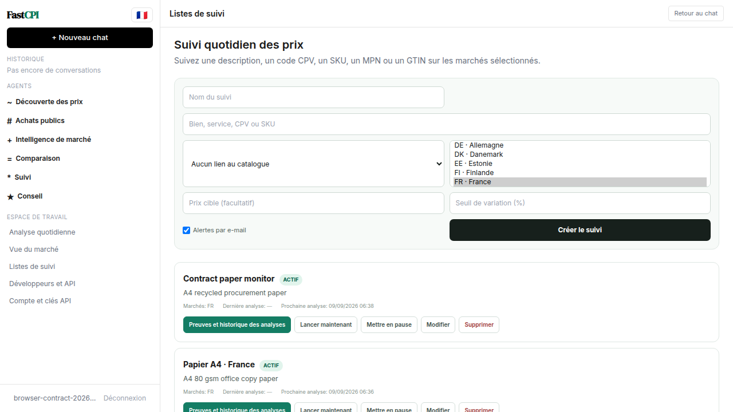
Create and manage a watch
Open Listes de suivi / Watchlists, name the requirement, enter a description or identifier, choose a market and optionally set a target price. New accounts receive three examples:
A4 office paper in France;
HP W2210A toner in Germany;
hourly technical computer support (CPV 72611000) in Estonia.
Starter watches are user-specific. Deleting one is respected; it is not recreated on every login. Create your own goods or services dynamically, optionally link them to a catalogue item, and select one or more markets. Each watch can be edited, paused/resumed, deleted or run immediately. Open Evidence and run history / Preuves et historique des analyses to inspect durable queued, running, partial, successful or failed scan states and the latest clickable source evidence.
French watchlists

Slide 13
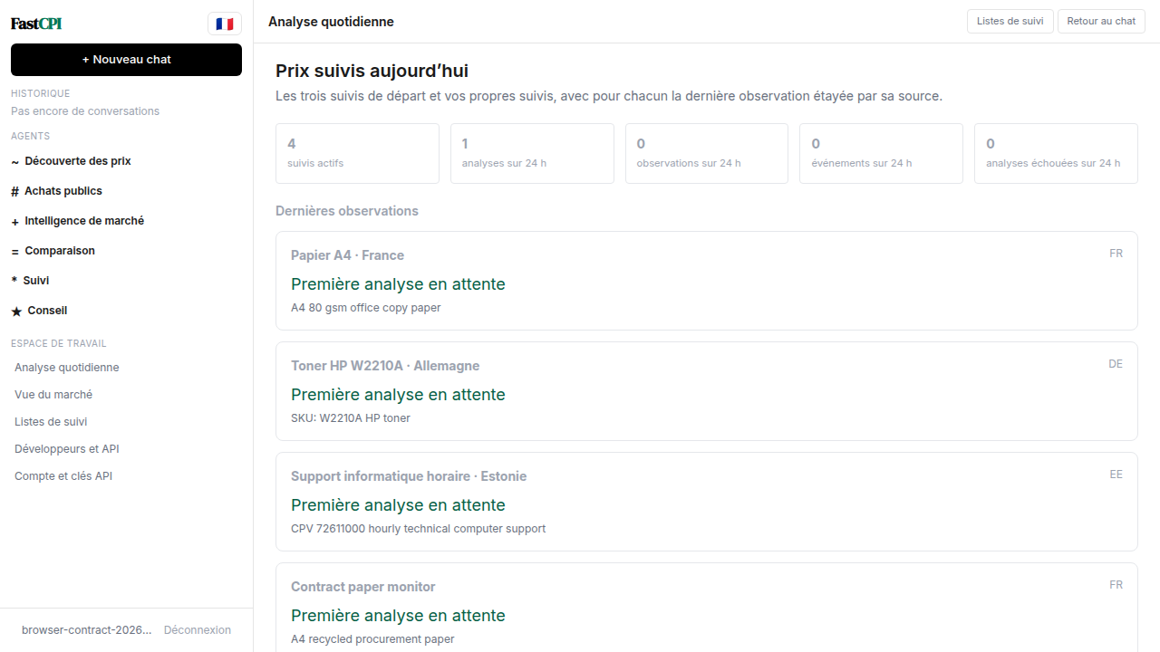
Review the Daily Scan
Daily Scan shows active-watch count, 24-hour scan runs, observations, threshold events and failed runs. Each watch shows its latest source-backed observation or Pending first scan / Première analyse en attente. Recent runs link back to their per-watch evidence history.
Threshold events carry the source URL that caused the alert. Email alerts are sent only when the watch enables notification. Use the page as a morning exception queue: inspect missing scans, review price movements, open evidence, then decide whether procurement action is warranted.
Scan requests are durable PostgreSQL jobs with idempotency keys, leases, bounded retries and per-market outcomes. Production worker separation, domain throttling and one shared usage ledger across all paid discovery paths are the next operational slice.
French daily scan

Slide 14
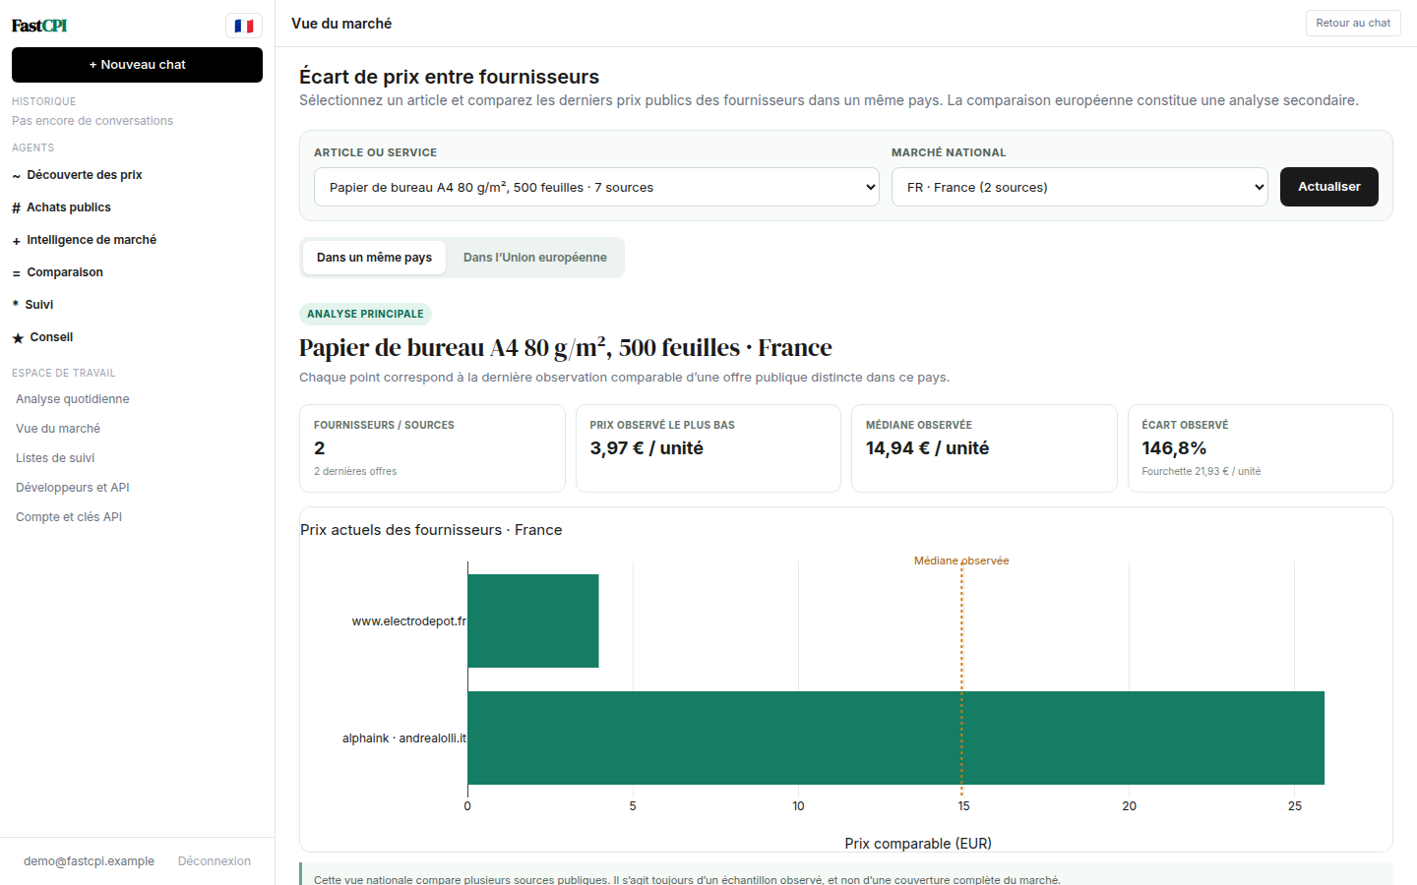
Use the market overview
The default Within one country / Dans un même pays view starts with one selected catalogue item and one country. It compares the latest comparable observation for each distinct supplier offer, showing the lowest price, median, observed spread and clickable source evidence. This is the primary procurement review because prices from competing suppliers in the same country are usually more directly comparable.
Use the item and country selectors to change the benchmark. Open Across the EU / Dans l’Union européenne only as a secondary review: it plots each observed country’s median and price range, then preserves the underlying supplier links below the chart.
Repeated captures of the same offer do not receive extra weight: the dashboard uses its latest observation. Read every result with its source count, freshness, unit, VAT/delivery warnings and coverage note. The spread remains an observed web sample—not an official inflation measure or a claim of complete market coverage.
French market overview

Slide 15
Integrate
Use documented, scoped interfaces so external systems receive the same provenance contract as the application.

Slide 16
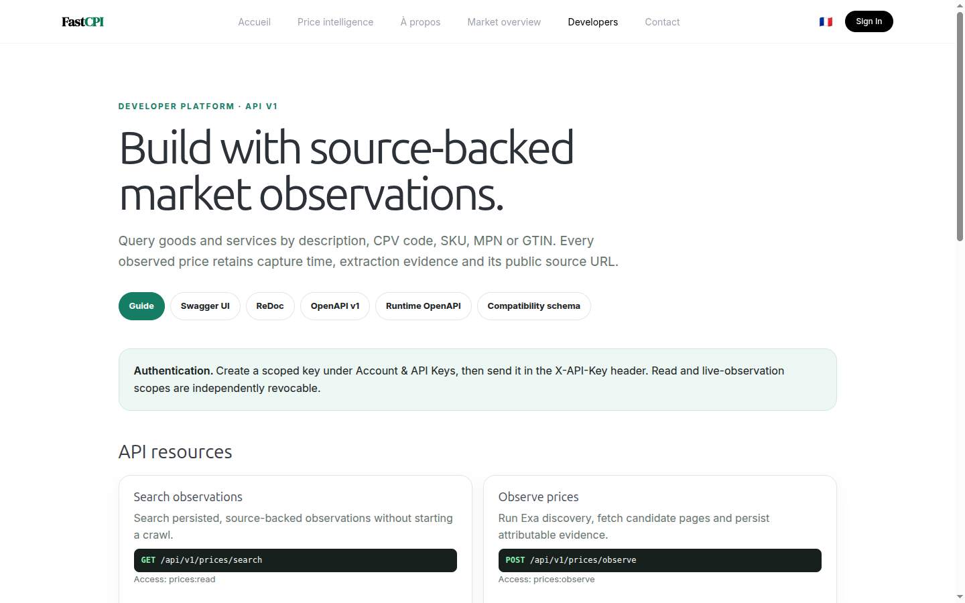
Developer portal and OpenAPI
Open https://cpi.fastsme.com/developers for the resource guide and links to:
Swagger UI at /api/docs;
ReDoc at /api/redoc;
versioned OpenAPI at /api/openapi/v1.json;
runtime and compatibility schemas.
Core resources search persisted observations, queue live observation jobs, resolve CPV descendants, read market coverage and indices, manage user watchlists and access catalog items. Use GET /items/{item_id}/price-variance?market=FR for the same latest-offer country benchmark and secondary EU context shown by the dashboard. Prefer POST /observation-jobs with an Idempotency-Key, then poll its returned status URL; it has per-user daily quota headers. Live discovery requires a stronger scope than read-only access.
Developer portal

Slide 17
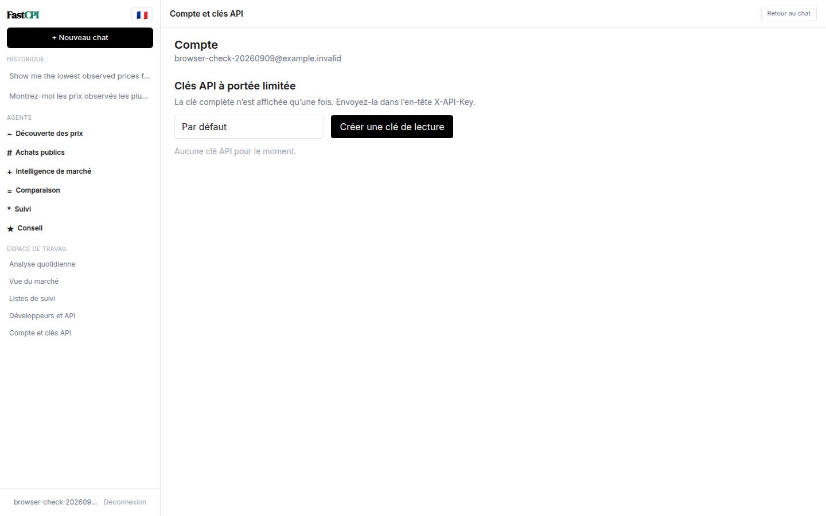
Scoped keys and the MCP path
Create an API key under Account & API Keys. The full fcpi_… value is shown once; store it in a secret manager and send it in the X-API-Key header. Revoke and rotate keys independently of your Google/password session.
The MCP alpha is live at https://cpi.fastsme.com/mcp/ over Streamable HTTP. Pass the same key as Authorization: Bearer fcpi_…. LLM clients can discover six read-only tools: catalogue search, CPV search, same-country price variance, country overview, tenant-scoped watchlists and scan-run status, plus fastcpi://methodology. The official SDK provides current and 2025-era protocol compatibility; OAuth authorization and consent remain the next access-control phase. No live crawl or watchlist mutation is exposed through MCP.
See docs/ROADMAP.md for the complete MCP surface and staged acceptance criteria.
French account and API keys

Slide 18
A safe weekly operating rhythm
Specify: capture exact identity, unit, quantity, VAT, delivery, MOQ and service period.
Observe: search the correct market and separate extracted evidence from discovery-only pages.
Verify: open every cited URL and exclude stale, substituted or geographically invalid offers.
Compare: rank only compatible terms; state sample count, capture time and coverage limits.
Monitor: save important requirements, review Daily Scan and investigate threshold events.
Export/integrate: use scoped keys and preserve provenance fields downstream.
Current gaps include JavaScript-only/PDF/quote-only sources, shallow supplier-specific parsers, incomplete pack/VAT/shipping/MOQ normalization, a not-yet-separated production worker and transitional MCP API-key authentication. Report questionable evidence rather than silently treating it as comparable.
Support: use the Contact page. API: /developers. Roadmap: docs/ROADMAP.md.

