Slide 1
FastCRM Platform Guide
2026-08-19 • https://crm.fastsme.com
**FastCRM** is an open-source **sales CRM** built with — a server-side, HTMX-driven reimagining of the core of . Python-first, no JavaScript framework: leads, a Kanban deal pipeline, contacts, organizations, tasks, an activity timeline, and an AI assistant grounded in your live data.

Slide 2
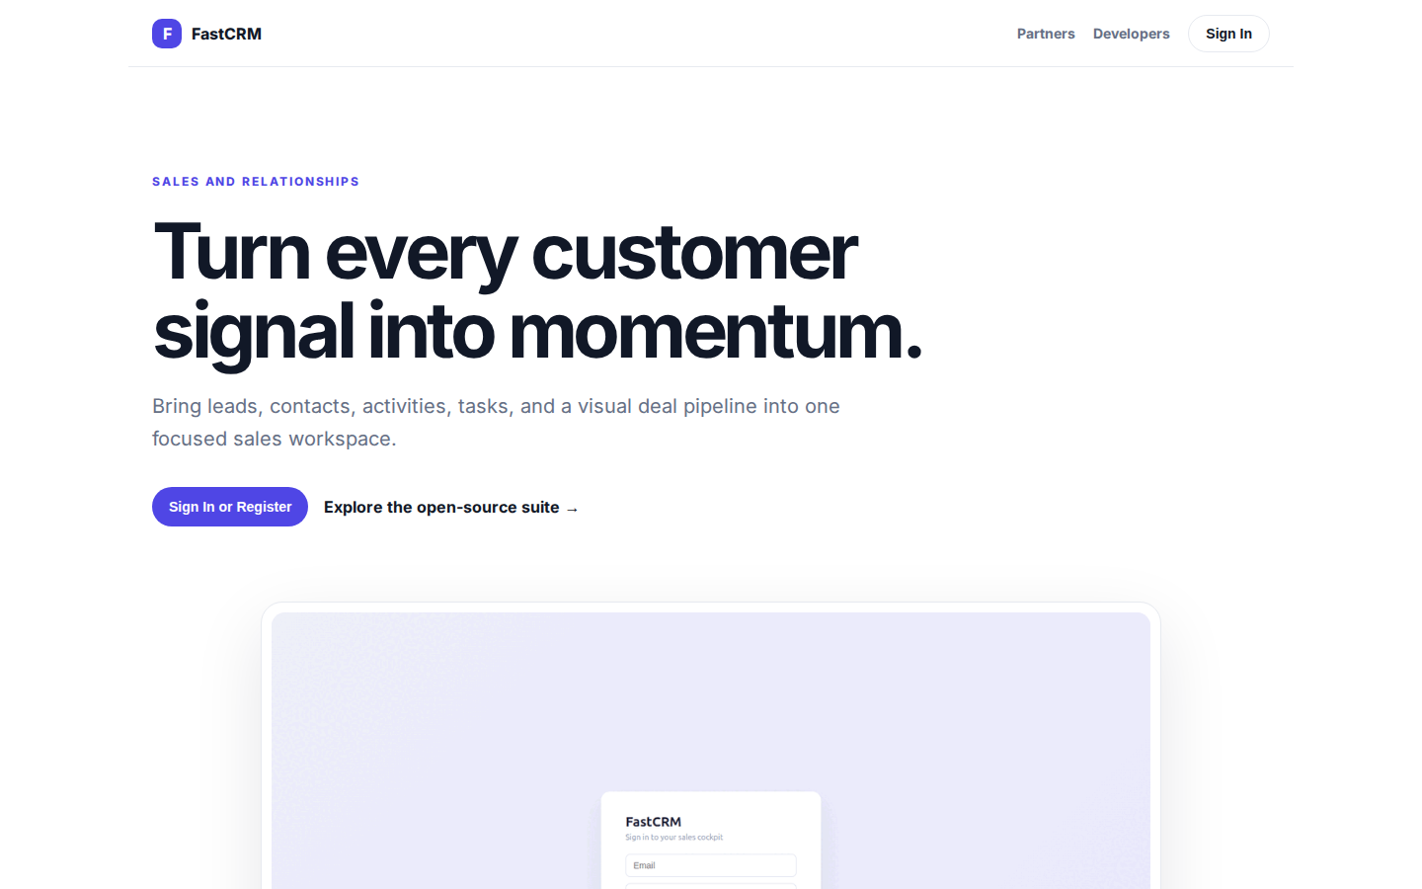
Turn every customer signal into momentum.
SALES AND RELATIONSHIPS Turn every customer signal into momentum. Bring leads, contacts, activities, tasks, and a visual deal pipeline into one focused sales workspace. Sign In or Register Explore the open-source suite → Product tour · see the workspace in act
https://crm.fastsme.com/

Slide 3
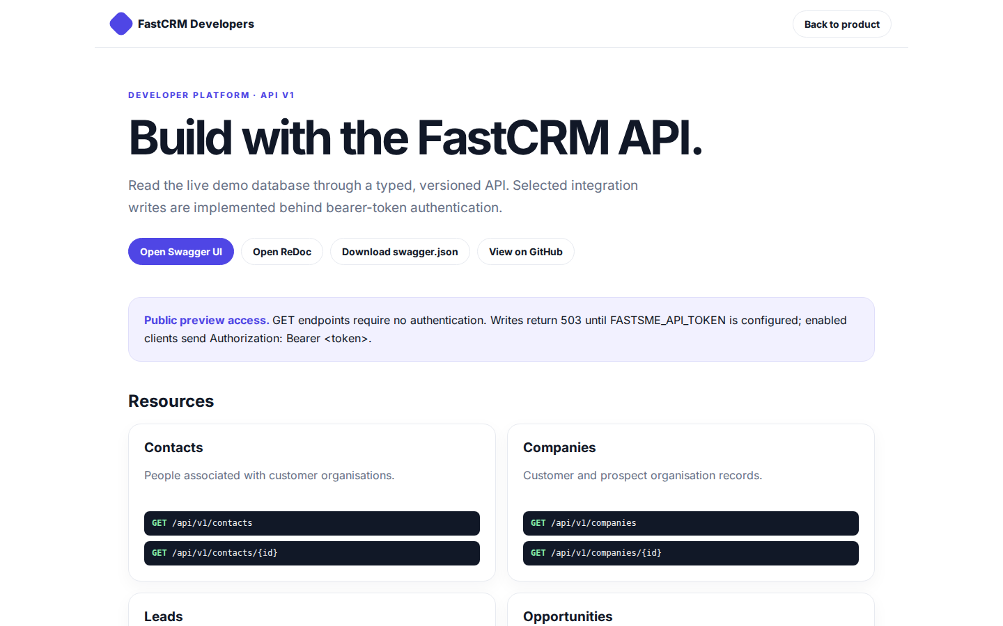
Build with the FastCRM API.
FastCRM Developers Back to product DEVELOPER PLATFORM · API V1 Build with the FastCRM API. Read the live demo database through a typed, versioned API. Selected integration writes are implemented behind bearer-token authentication. Open Swagger UI Open ReDoc Do
https://crm.fastsme.com/developers

Slide 4
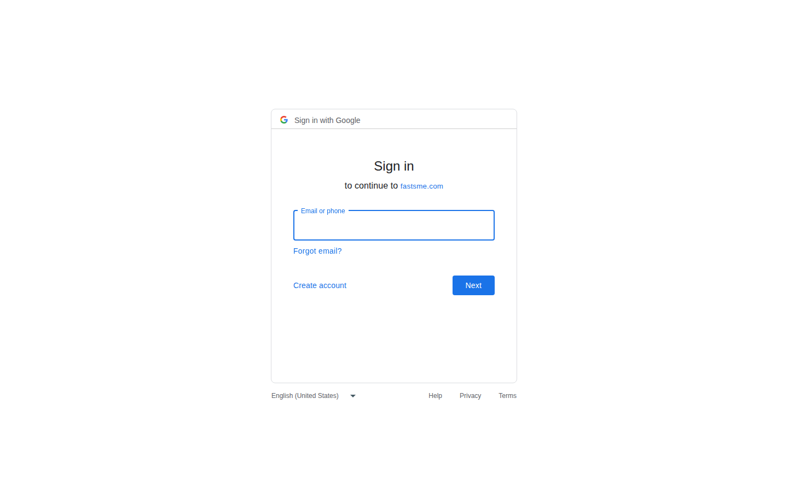
Sign in
Sign in with Google Sign in to continue to fastsme.com Email or phone Forgot email? Next Create account Afrikaans azərbaycan bosanski català Čeština Cymraeg Dansk Deutsch eesti English (United Kingdom) English (United States) Español (España) Español (Latinoam
https://accounts.google.com/v3/signin/identifier?opparams=%253F&dsh=S772928290%3A1787122643639021&access_type=online&client_id=887059023987-2a7spj1m82eivobdbt1itb3cqca6tpt1.apps.googleusercontent.com&o2v=2&prompt=select_account&redirect_uri=https%3A%2F%2Fcrm.fastsme.com%2Fauth%2Fgoogle%2Fcallback&response_type=code&scope=openid+email+profile&service=lso&state=9QMpeN8_PDHAJBVhe2UIG2YTiPPSJ23G_x6VzoI3ug4&flowName=GeneralOAuthLite&continue=https%3A%2F%2Faccounts.google.com%2Fsignin%2Foauth%2Flegacy%2Fconsent%3Fauthuser%3Dunknown%26part%3DAJi8hAPQ-2hHAaZEOzRgsAjese8CFYlhFl1t3fnDq3mI-7_HIigEQOFgZOQUf8pzgzd9c27SCdjky-ddISMKyYobGQOJKWKTAQ4wiu90c8C9Xjo8szy5sRTIzrBq5MZwaDR9-gz2h5Up1eI67l2_tLxhZ3htKkiqaPPfF5TXEjeCeg6OndtqgjdOpIYbhzzYWIC3tauwlQShnzXIetzsF9WpwhNO4ut-N-lRK8plOQDII2wUgmbhSox7oyEVL0a42my9uH-m5sPtUsyagF3kfz3bacy0iM0x3H4x6FB6xOABfwrfwF3Bl2uF3VLxSTXd8Vrvefv9q7hwFpv8gHjEPHsgImY93rkLFgtXhP5-6HUvY_QTiTgjKXPCDxrSnW9hcEONyrTF-rMSZoQF6HJOa-G7V4dAv1nBNEGWPFcDSY82UJ3YL1qmm2TSSlbpXCpo7ktdOnsm9qynQORK8iKvl8Z_tZIcaC6Xzg%26flowName%3DGeneralOAuthFlow%26as%3DS772928290%253A1787122643639021%26client_id%3D887059023987-2a7spj1m82eivobdbt1itb3cqca6tpt1.apps.googleusercontent.com%23&app_domain=https%3A%2F%2Fcrm.fastsme.com&rart=ANgoxceFpCK4Il7JZ6W05TYYZpJ0-mZmyEhk2NJp18MUEZZGltNgUoIHhxm7zZ87MScQRht1_3UCg4NUL8o06ikjst70VxrTbqEEjFosxaDkm9yIdmG0RtM

