Slide 1
FastClinic
User Guide — Run Your Multi-Specialty Clinic
Modern clinical care, made personal.
General practice · surgical specialties · dental — one operations platform
fastclinic.example

Slide 2
Contents
Get started
• What FastClinic is — the operations cockpit
• Sign in & the 3-pane layout
• The AI Copilot — just ask
Run the clinic
• Treatments & Specialties — the case-mix lens
• Appointments & booking
• Patients &nbsp;·&nbsp; 7. Patient profile &nbsp;·&nbsp; 8. Clinical
• Revenue &nbsp;·&nbsp; 10. Billing & payments
Keep patients in the loop
• Recalls Due
• Lapsed Patients &nbsp;·&nbsp; 13. Post-Visit Follow-up
• The Recall Loop — queue, send, measure
Reach & connect
• SMS &nbsp;·&nbsp; 16. Email &nbsp;·&nbsp; 17. AI Assistant &nbsp;·&nbsp; 18. Web Presence
• Data & Import — keep the records fresh
Run it every week
• The weekly playbook
FastClinic · Modern clinical care, made personal · fastclinic.example

Slide 3
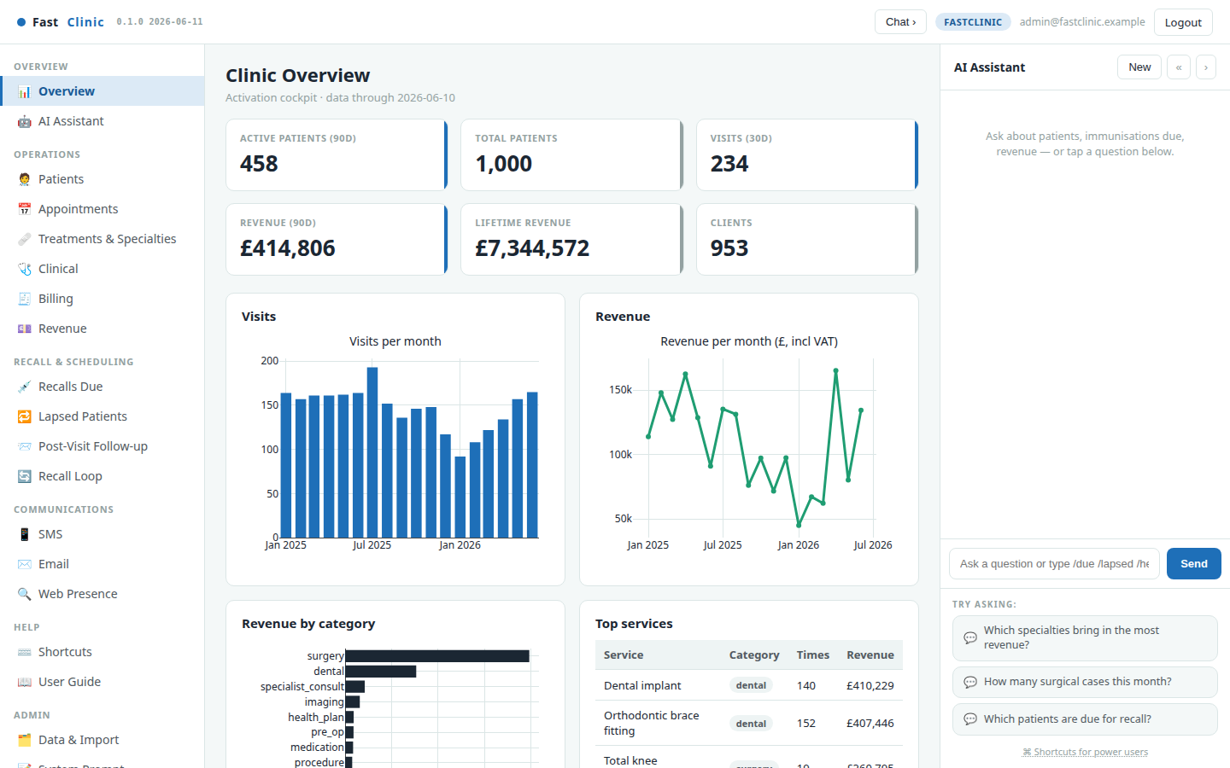
What FastClinic is — the operations cockpit
FastClinic runs the back office of a multi-specialty clinic — general practice, surgical specialties (orthopaedics, ophthalmology, ENT, general surgery, gynaecology, urology and more) and dental care — in one workspace. The Overview is your daily scorecard: active and total patients, recent visits, revenue and trends, all dated so you always know how fresh the picture is.
Everything the clinic runs on is here: the case mix and revenue across every department, appointments booked into real availability, billing with a balanced ledger, and patient recall. It's built for the whole operations team — reception, practice managers, and finance — not just clinicians.
FastClinic · Modern clinical care, made personal · fastclinic.example

Slide 4
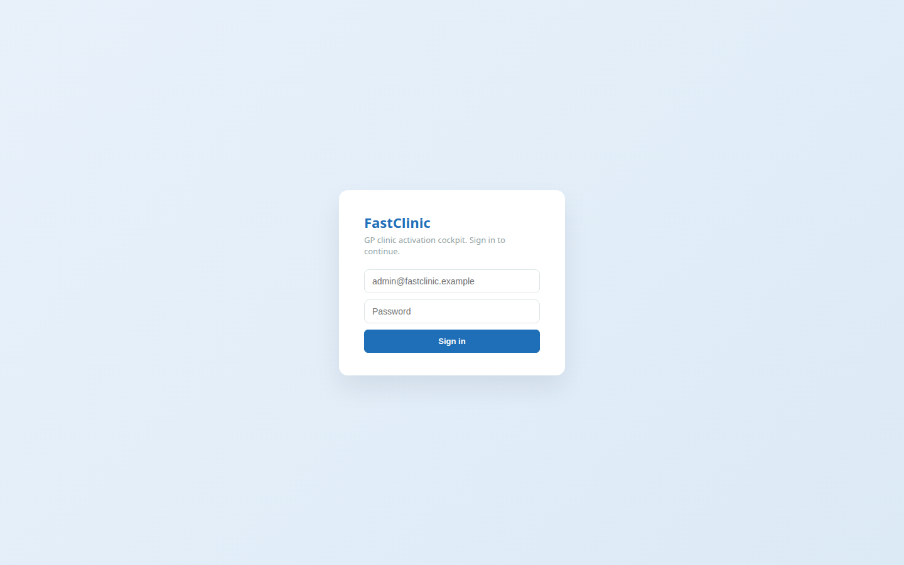
Sign in & the layout
Open fastclinic.example and sign in with your clinic login. The screen then has three panes that stay consistent everywhere:
• Left — navigation, grouped by job: Overview · Operations · Recall & Scheduling · Communications · Admin.
• Centre — the workspace: lists, tables, charts and forms.
• Right — the AI Copilot, always on hand to answer questions about your clinic. It can be collapsed to give the workspace more room.
Everything is server-rendered and fast; if you can read a list and press a button, you can run the clinic from here.
FastClinic · Modern clinical care, made personal · fastclinic.example

Slide 5
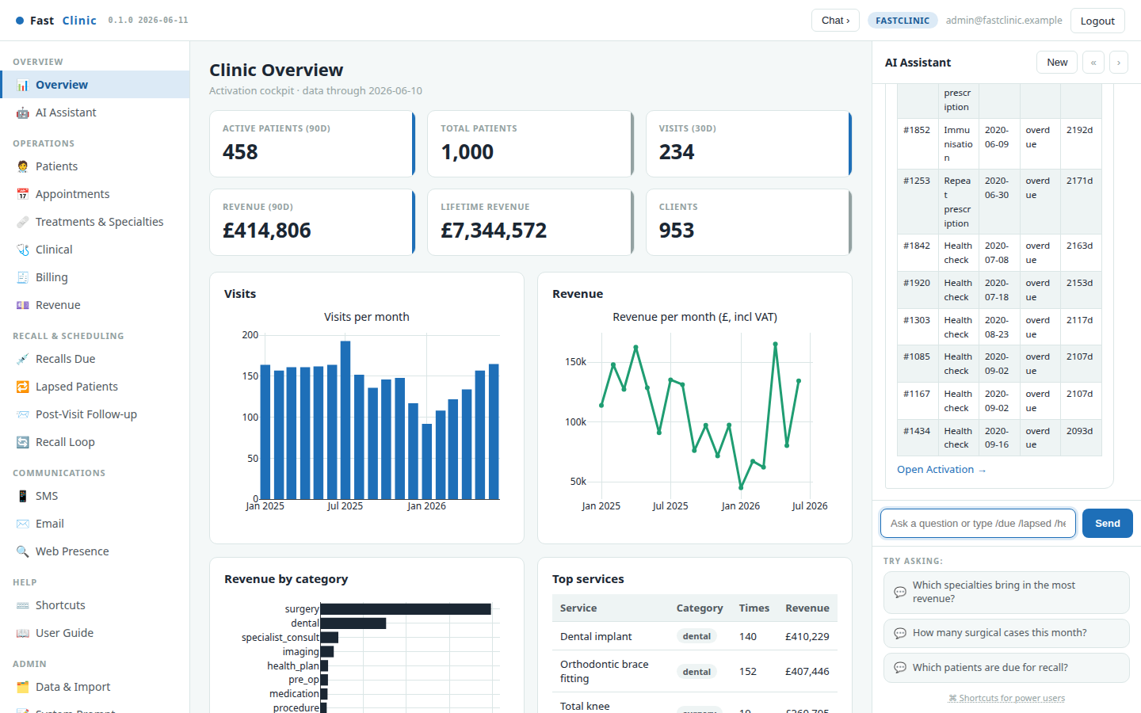
The AI Copilot — just ask
The Copilot on the right turns plain questions into answers from your live data. Ask "Which specialties bring in the most revenue?", "How many surgical cases this month?" or "Which patients are due for recall?" and it replies with a ready-to-read table.
Power users can type slash-commands for instant results — /kpi, /due, /lapsed, /followup, /revenue, /patient 1206. The suggested questions under the box are a good starting point.
FastClinic · Modern clinical care, made personal · fastclinic.example

Slide 6
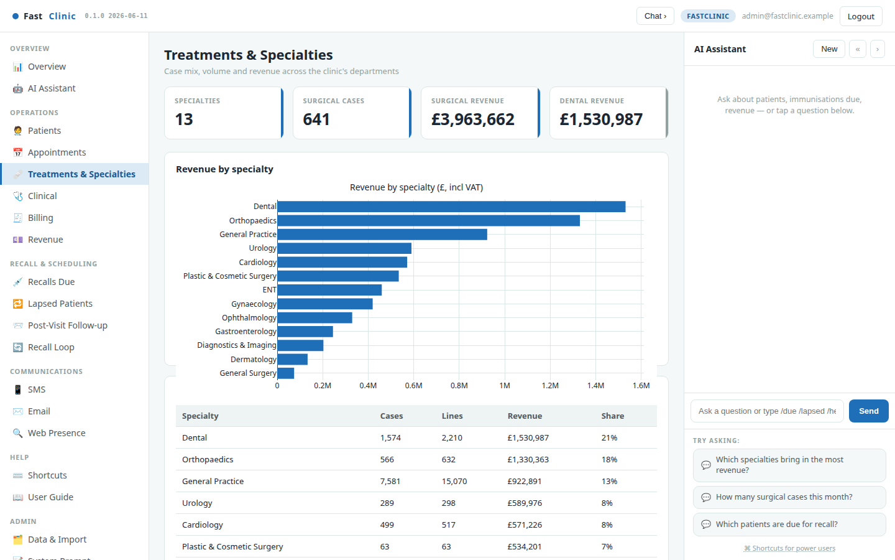
Treatments & Specialties — the case-mix lens
This is the operations heart of the platform. Every treatment is classified on two axes — what it is (consultation, surgery, dental, diagnostic, procedure…) and which specialty delivered it — so you can see the whole clinic at a glance: revenue and case volume across every department, surgical throughput, and the top procedures driving income.
Use it to understand where the work and the money are — which specialties are growing, how much surgical and dental activity you're doing, and which procedures matter most. It's the view a practice manager opens first.
FastClinic · Modern clinical care, made personal · fastclinic.example

Slide 7
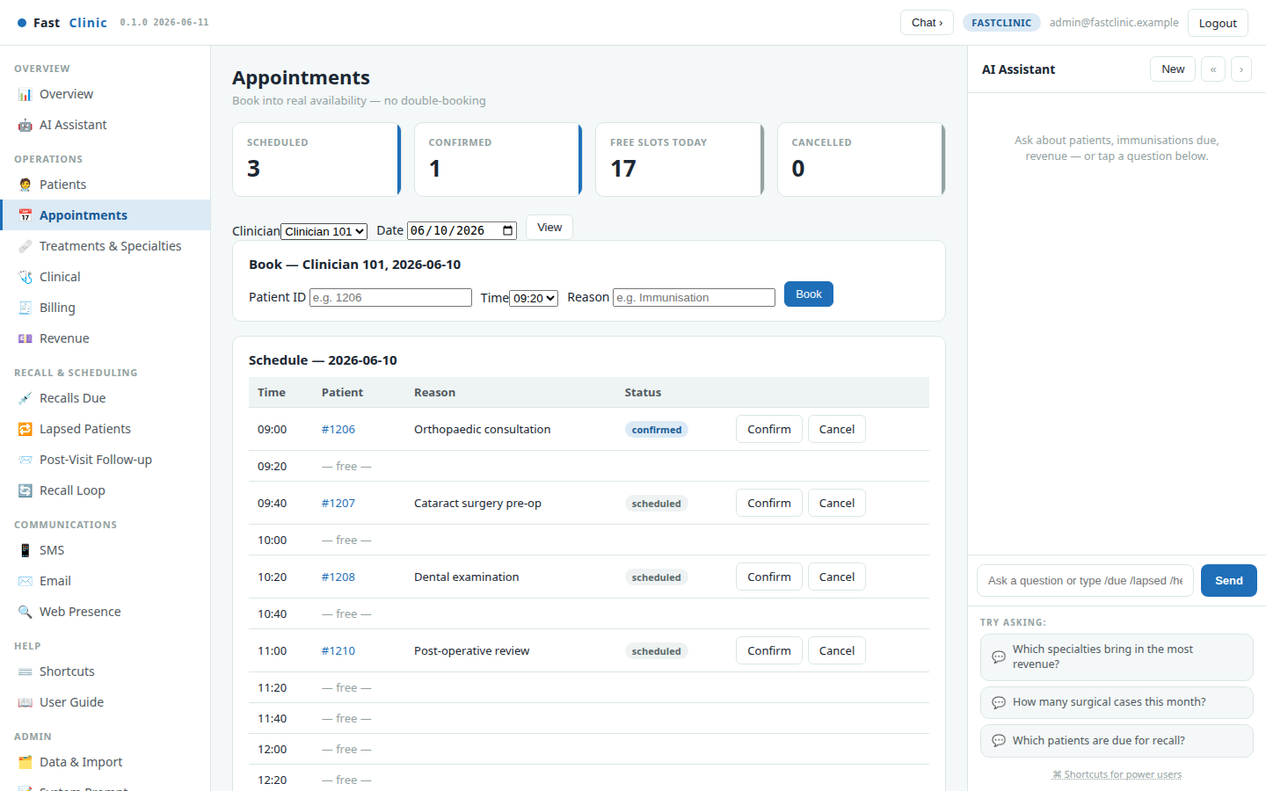
Appointments & booking
Book patients into real availability. Pick a clinician and day and the schedule shows every slot, free or taken. Booking checks for conflicts, so a clinician can never be double-booked; the same time on another clinician is still free. Confirm or cancel with one click, and every booking automatically queues a reminder the day before.
FastClinic · Modern clinical care, made personal · fastclinic.example

Slide 8
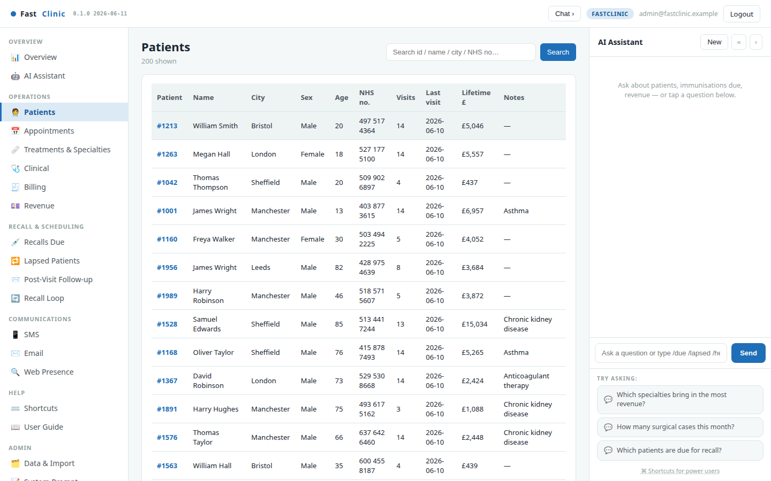
Patients
A fast, searchable list of the whole patient base — search by name, town, or NHS number. Each row shows visits, last-seen date and lifetime value, so the people who matter most are easy to find. Click any patient to open their profile.
FastClinic · Modern clinical care, made personal · fastclinic.example

Slide 9
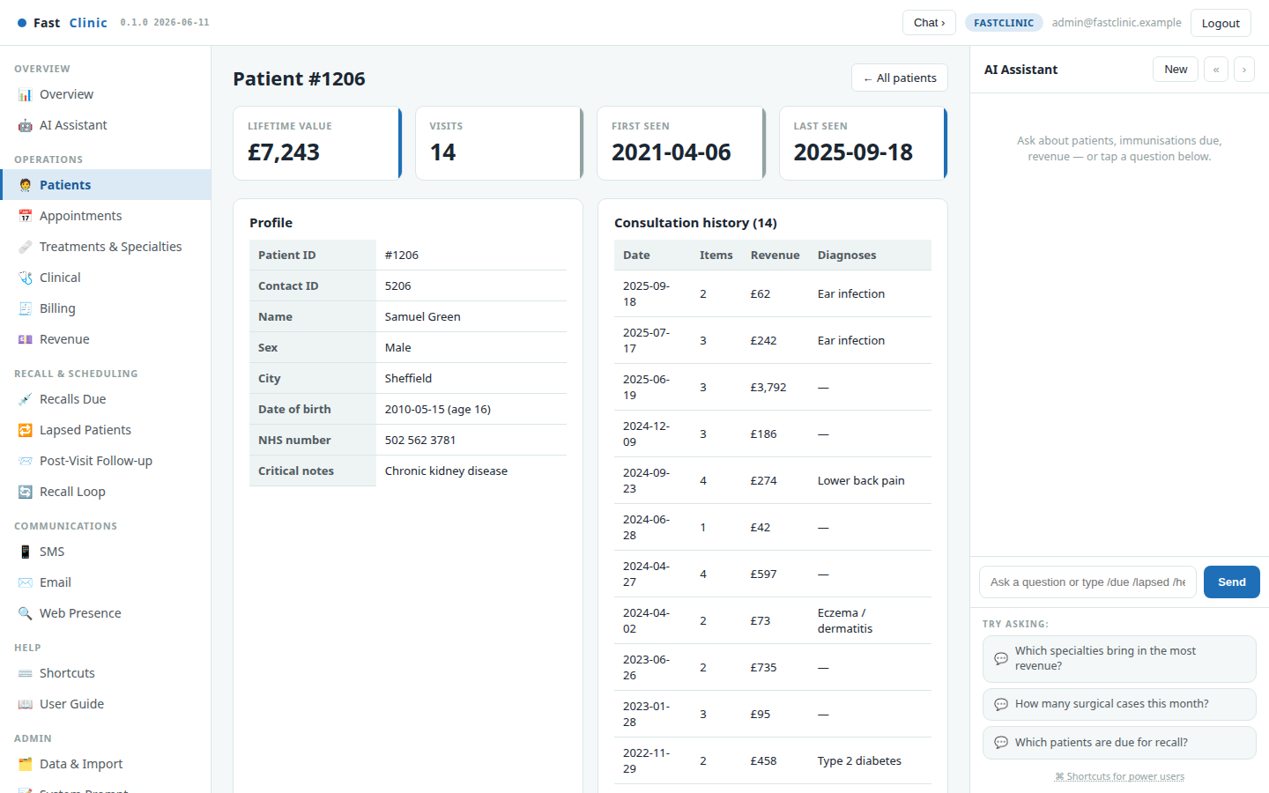
Patient profile
A single view of one patient: demographics and contact, lifetime value and visit count, the full consultation history across every specialty they've seen, and recent billed items — everything the team needs before a call or a visit.
FastClinic · Modern clinical care, made personal · fastclinic.example

Slide 10
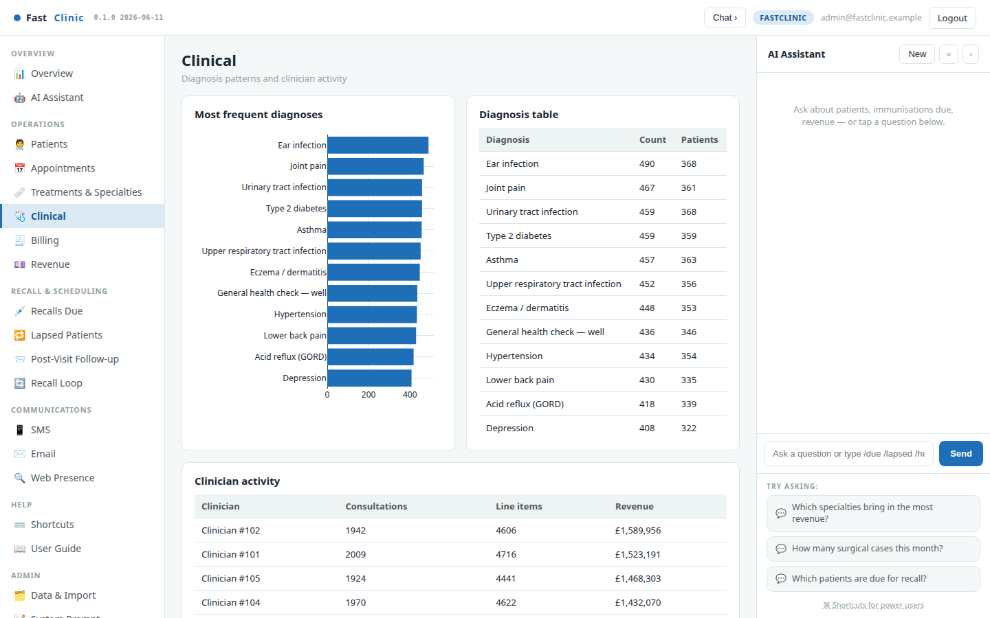
Clinical
The clinical picture across the practice: the most common diagnoses and a breakdown of activity by clinician. Useful for spotting trends, planning services, and understanding where the clinical workload sits.
FastClinic · Modern clinical care, made personal · fastclinic.example

Slide 11
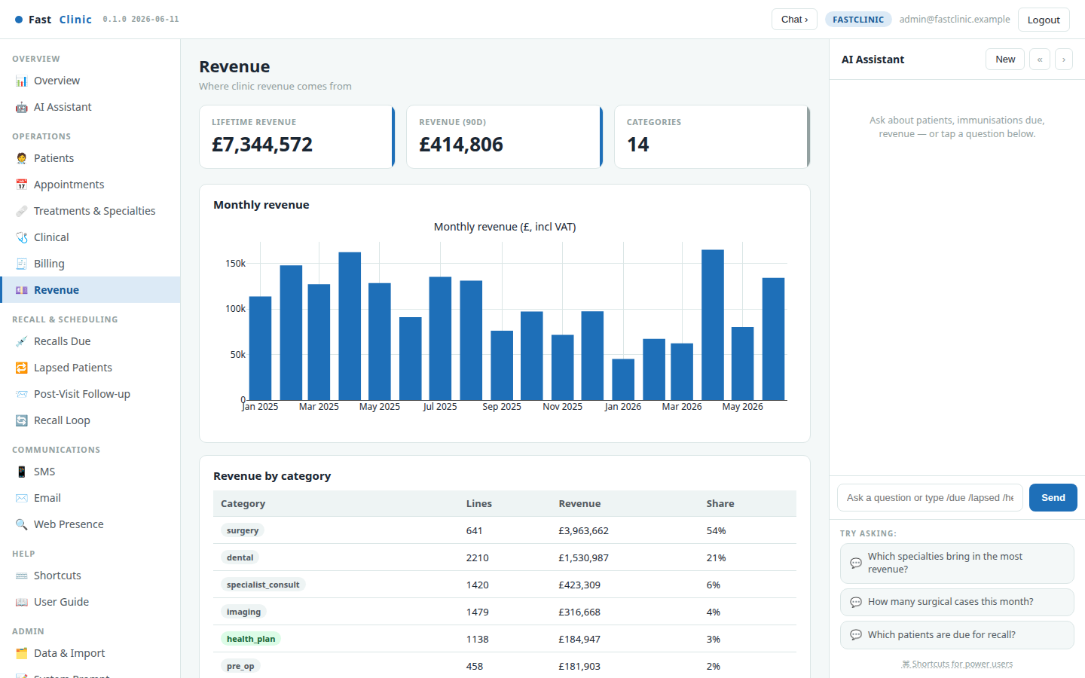
Revenue
Where the money comes from: revenue by service category and the monthly trend. See at a glance which kinds of work drive income and how the clinic is tracking over time — the financial companion to the Treatments & Specialties view.
FastClinic · Modern clinical care, made personal · fastclinic.example

Slide 12
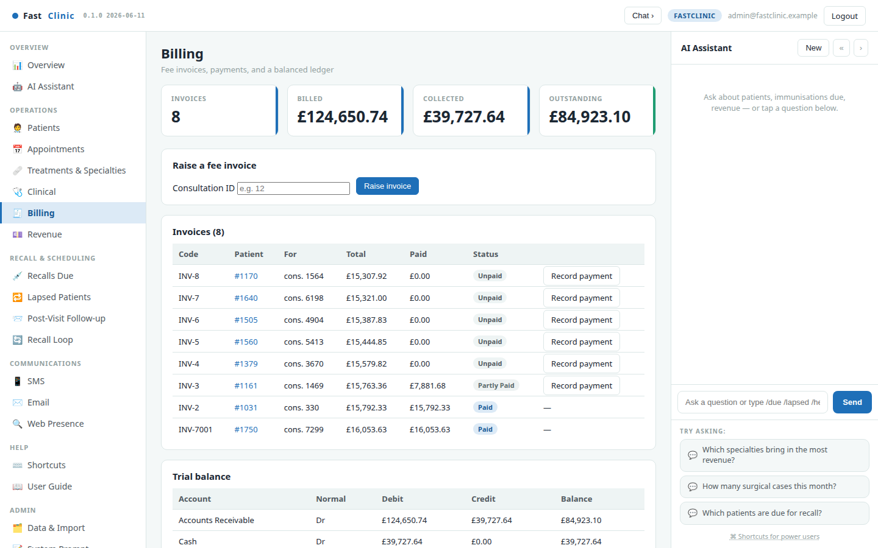
Billing & payments
Raise fee invoices against consultations — from a routine GP visit to a high-value surgical case — record part or full payments, and watch the numbers stay honest: a live balanced ledger underneath means every pound billed and collected is accounted for. Because the payer is tracked separately from the patient, a parent's invoice for a child — or an insurer's — is handled naturally.
FastClinic · Modern clinical care, made personal · fastclinic.example

Slide 13
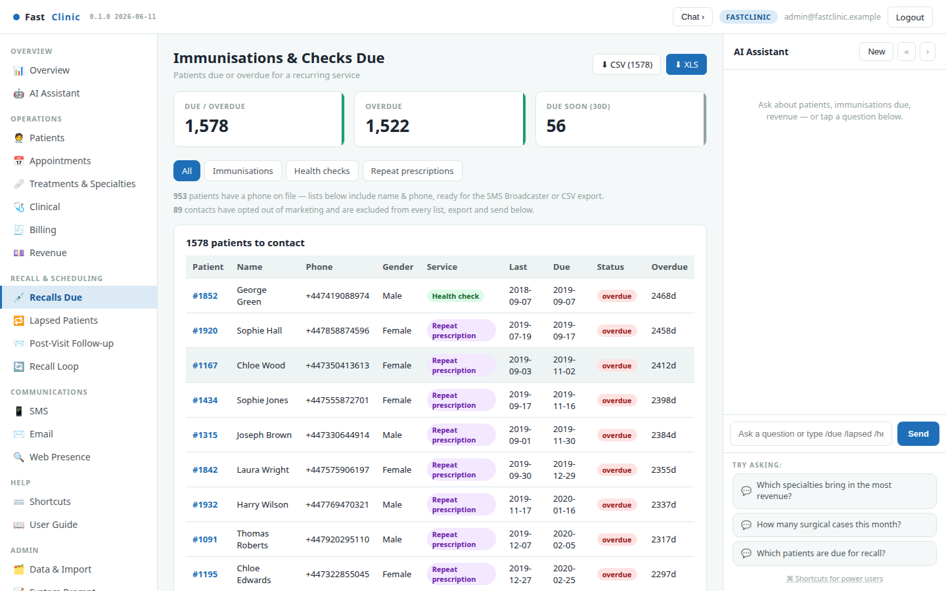
Recalls Due
Recall keeps patients on track. This engine surfaces exactly who is due or overdue for a recurring service — childhood and adult immunisations, annual health checks, and repeat-prescription reviews — ranked most-overdue first.
Recall intervals are age- and cohort-aware: a flu booster for an over-65, a childhood immunisation, and a medication review each follow their own schedule. Each row comes with a drafted message, ready to send or export.
FastClinic · Modern clinical care, made personal · fastclinic.example

Slide 14
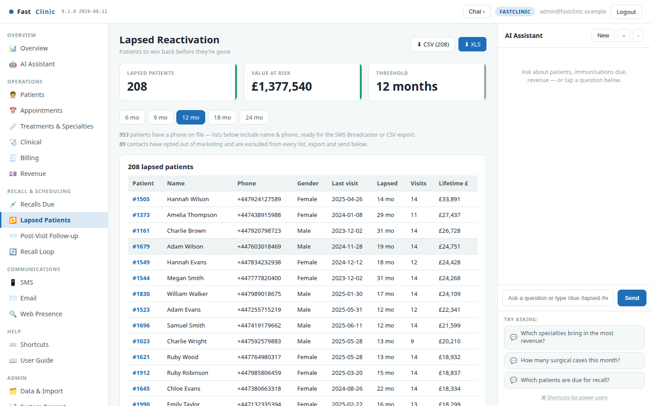
Lapsed Patients
Good patients drift away quietly. Lapsed Patients lists everyone with no visit in the last N months, ranked by lifetime value so you re-engage the most valuable relationships first. Adjust the window (6 / 12 / 24 months) to widen or tighten the net.
FastClinic · Modern clinical care, made personal · fastclinic.example

Slide 15
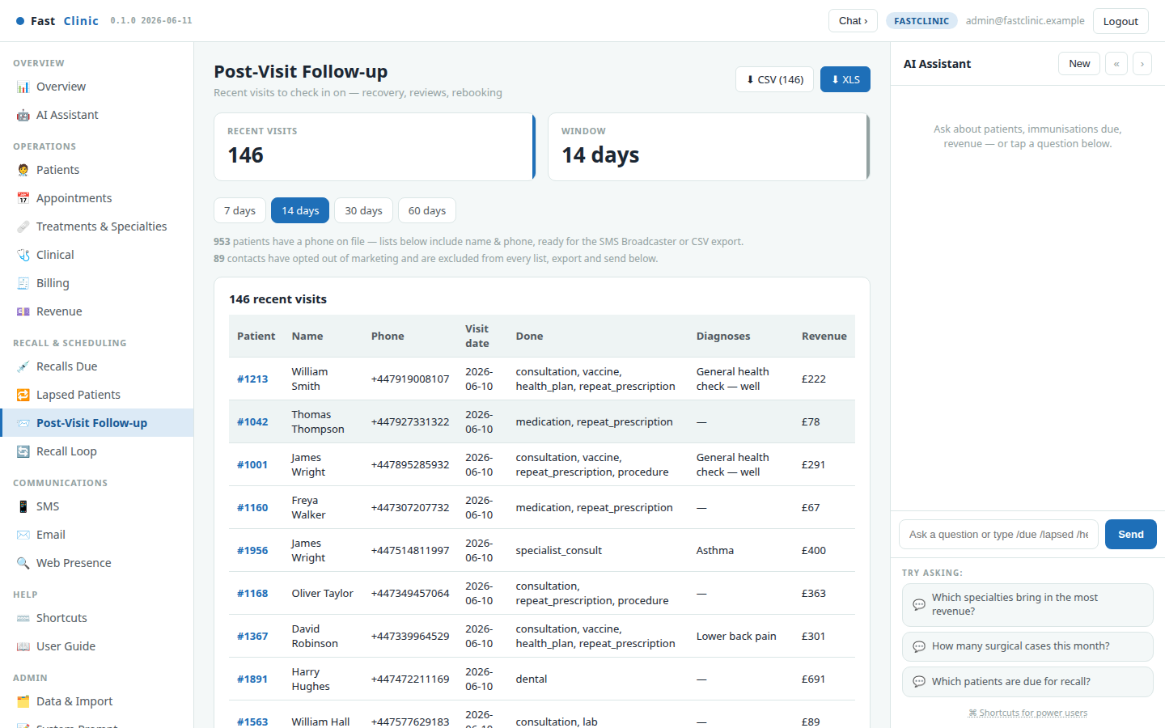
Post-Visit Follow-up
Care doesn't end when the patient leaves. Post-Visit Follow-up lists recent visits — including post-operative reviews — so you can check on recovery, prompt a review, or rebook within a window you choose (7 / 14 / 30 / 60 days).
FastClinic · Modern clinical care, made personal · fastclinic.example

Slide 16
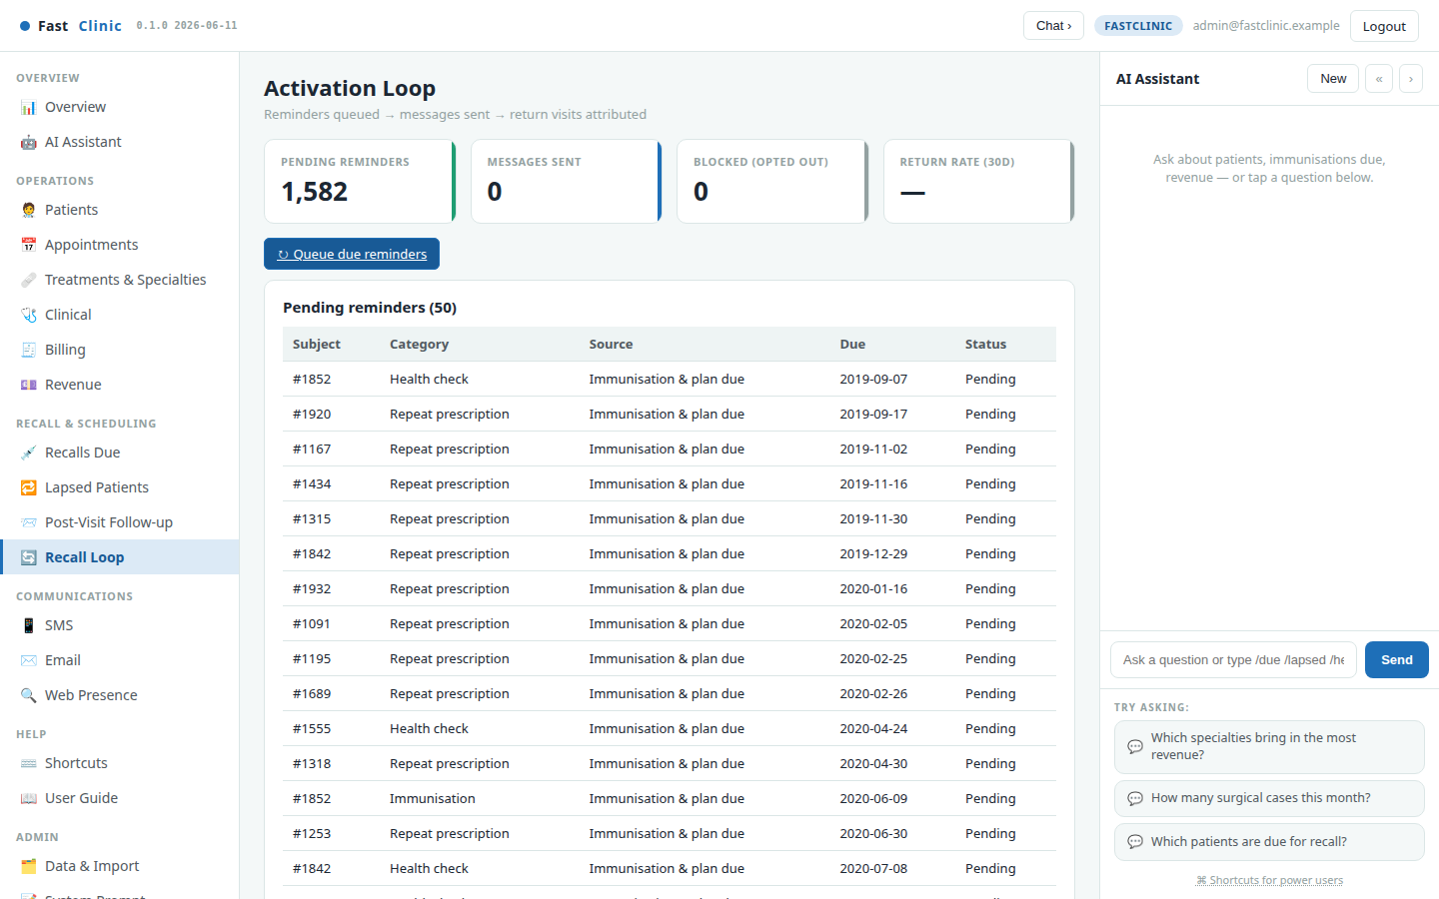
The Recall Loop — queue, send, measure
This closes the loop. Queue due reminders turns the recall lists into tracked reminders. Every message you then send is logged — sent, failed, or blocked because the patient opted out — so nobody is contacted twice and consent is always respected. The scorecard tracks pending reminders, messages sent, blocked contacts, and the return rate: how many contacted patients came back within 30 days.
FastClinic · Modern clinical care, made personal · fastclinic.example

Slide 17
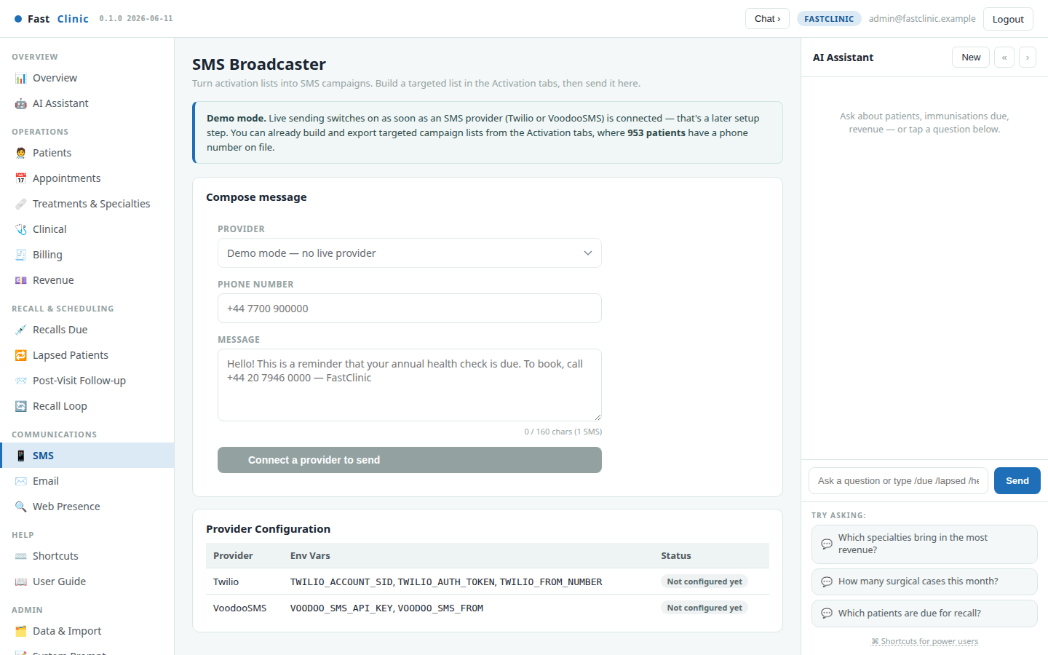
SMS & Email
Send reminders through your SMS or email provider. Paste a drafted message from any recall list, or write your own. Opted-out patients are automatically suppressed at the point of sending, so a message never reaches someone who has asked not to be contacted.
FastClinic · Modern clinical care, made personal · fastclinic.example

Slide 18
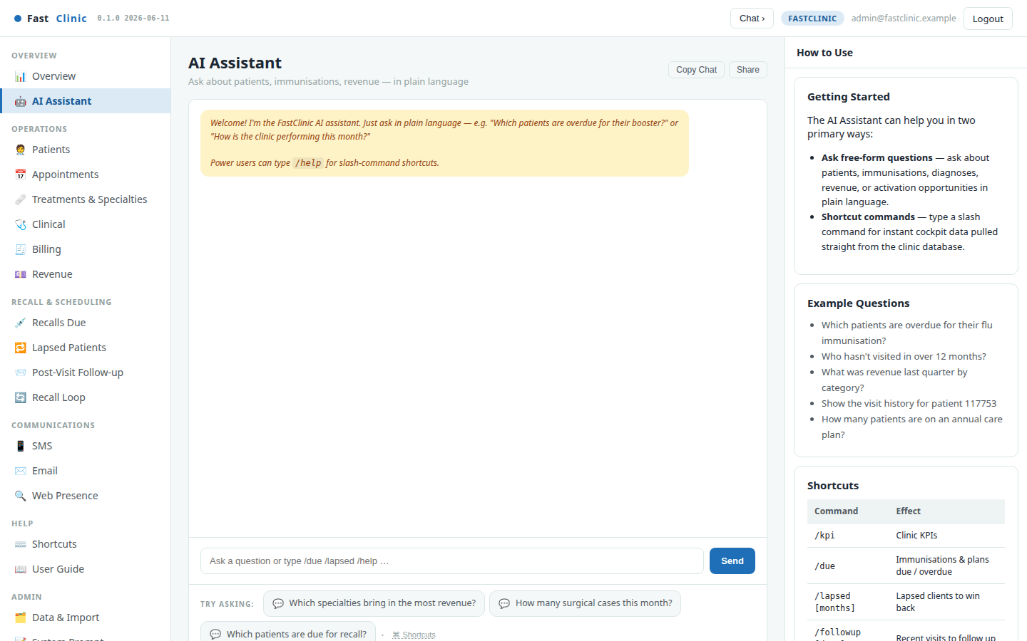
AI Assistant
A full-page version of the Copilot for deeper questions. Ask about specialties, revenue, scheduling or recall in plain language and get answers grounded in your live data — a knowledgeable colleague who has read every record.
FastClinic · Modern clinical care, made personal · fastclinic.example

Slide 19
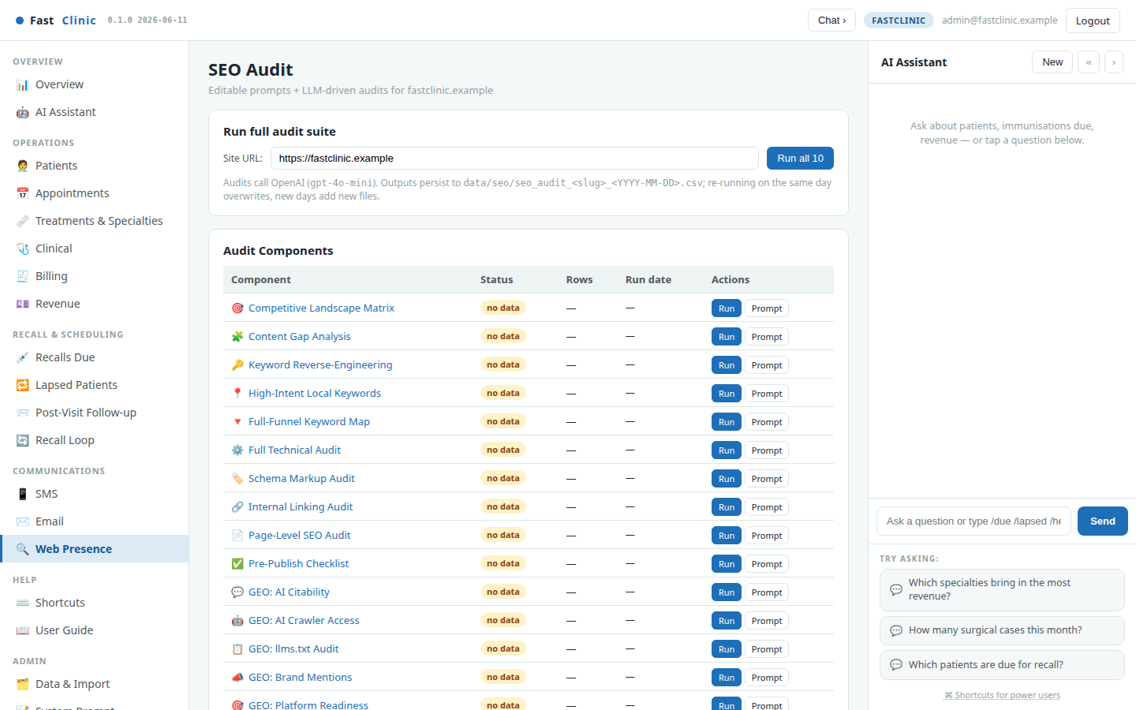
Web Presence
Grow the top of the funnel too. The audit suite checks how well your clinic shows up in search and in AI answer engines, and writes dated reports you can act on — so new patients can find you as easily as existing ones come back.
FastClinic · Modern clinical care, made personal · fastclinic.example

Slide 20
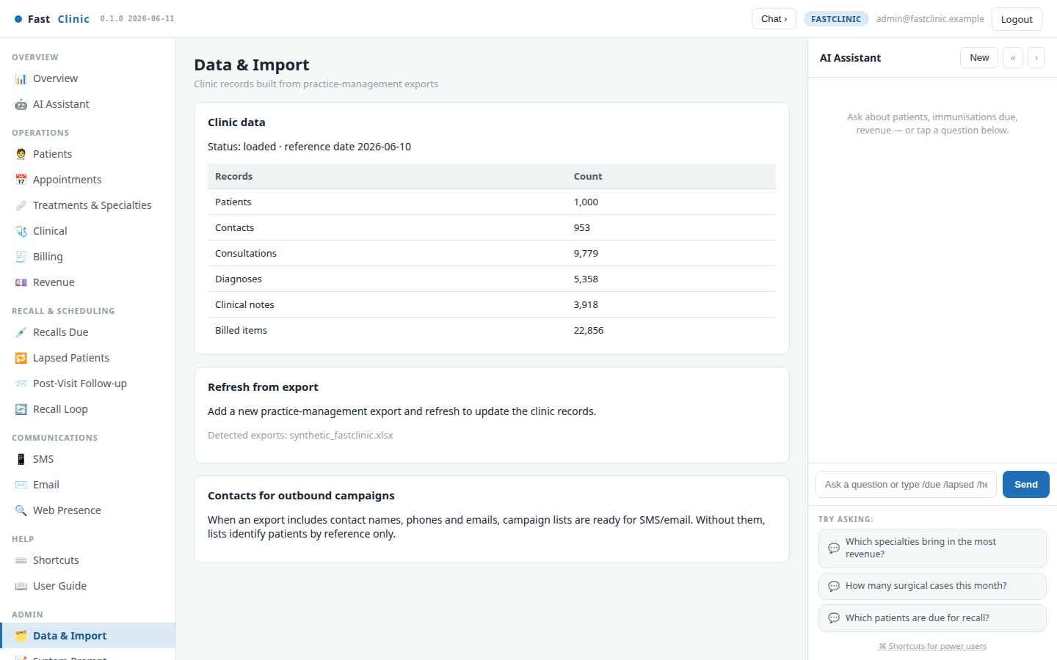
Data & Import — keep the records fresh
FastClinic works from your practice-management export. This page shows what's loaded — patients, contacts, consultations and more — and how to refresh it when a new export arrives. When contact details are included, recall lists are ready to send.
FastClinic · Modern clinical care, made personal · fastclinic.example

Slide 21
The weekly playbook
A simple weekly rhythm keeps the clinic running well:
• See. Open the Overview, then Treatments & Specialties for the week's case mix and revenue by department.
• Schedule. Work the Appointments board — fill slots, confirm bookings, keep surgical lists moving.
• Bill. Raise invoices for the week's work and record payments; the ledger keeps itself balanced.
• Recall. Queue due reminders on the Recall Loop, review the drafted messages, and send — opted-out patients are handled for you.
• Measure. Check the Recall Loop's return rate and the Overview's active- patient and revenue trends.
The one question FastClinic answers every day: "How is the clinic running across every specialty — and what needs attention today?"
FastClinic · Modern clinical care, made personal · fastclinic.example

