Slide 1
FastClinic Platform Guide
2026-08-19 • https://clinic.fastsme.com
**FastClinic** is an open-source **multi-specialty clinic operations platform** — a FastHTML server-side web app that runs the back office of a modern clinic spanning **general practice, surgical specialties** (orthopaedics, ophthalmology, ENT, general surgery, gynaecology, urology, dermatology, plastics, cardiology, g

Slide 2
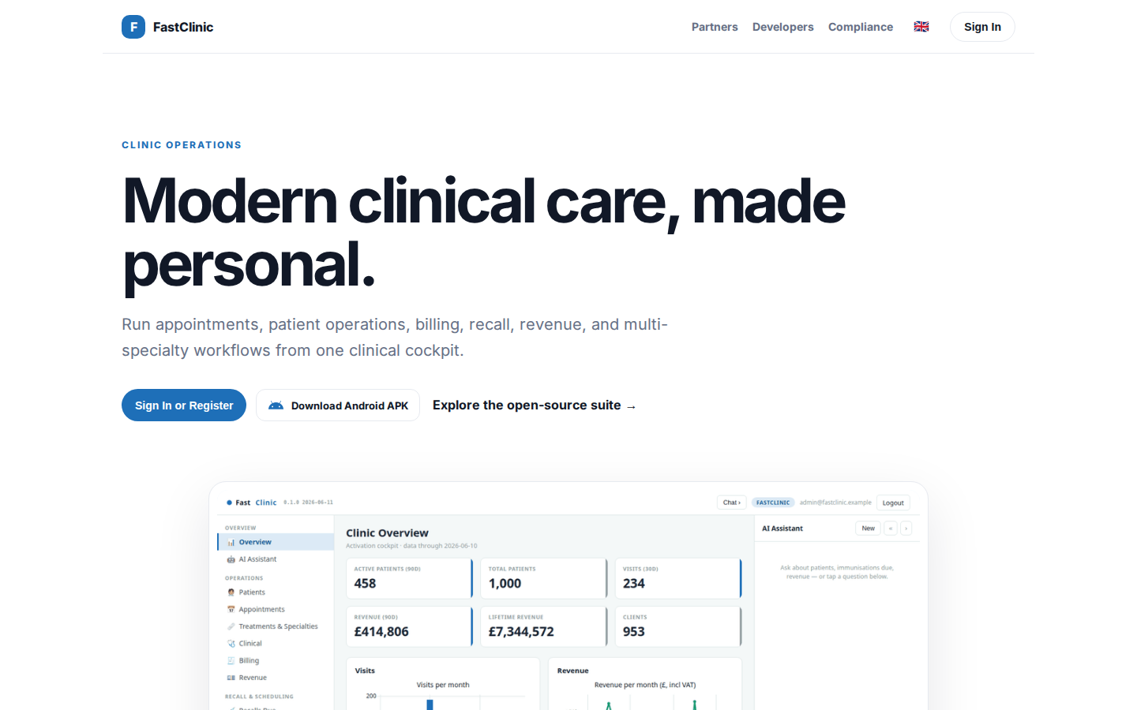
Modern clinical care, made personal.
CLINIC OPERATIONS Modern clinical care, made personal. Run appointments, patient operations, billing, recall, revenue, and multi-specialty workflows from one clinical cockpit. Sign In or Register Download Android APK Explore the open-source suite → Product tou
https://fastclinic.dev/

Slide 3
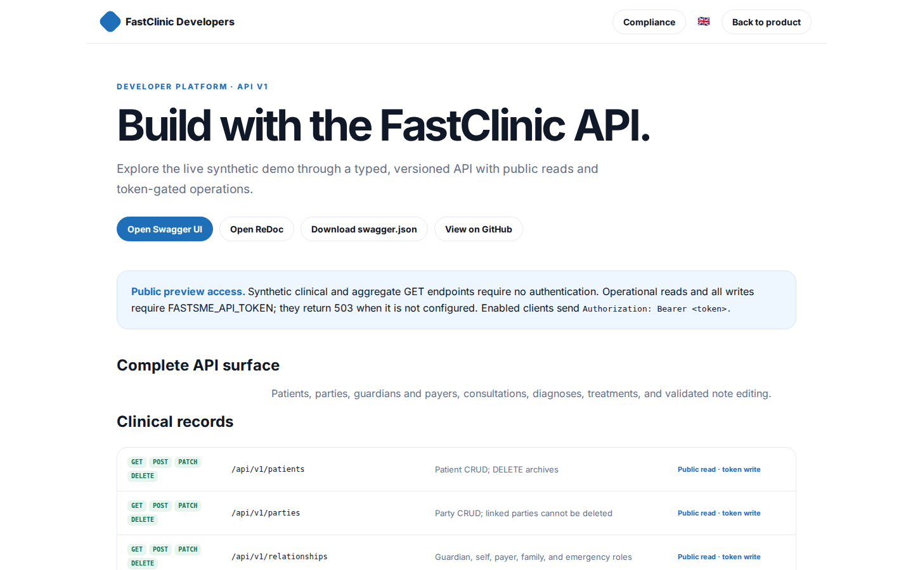
Build with the FastClinic API.
FastClinic Developers Compliance 🇬🇧 Back to product DEVELOPER PLATFORM · API V1 Build with the FastClinic API. Explore the live synthetic demo through a typed, versioned API with public reads and token-gated operations. Open Swagger UI Open ReDoc Download swag
https://fastclinic.dev/developers

Slide 4
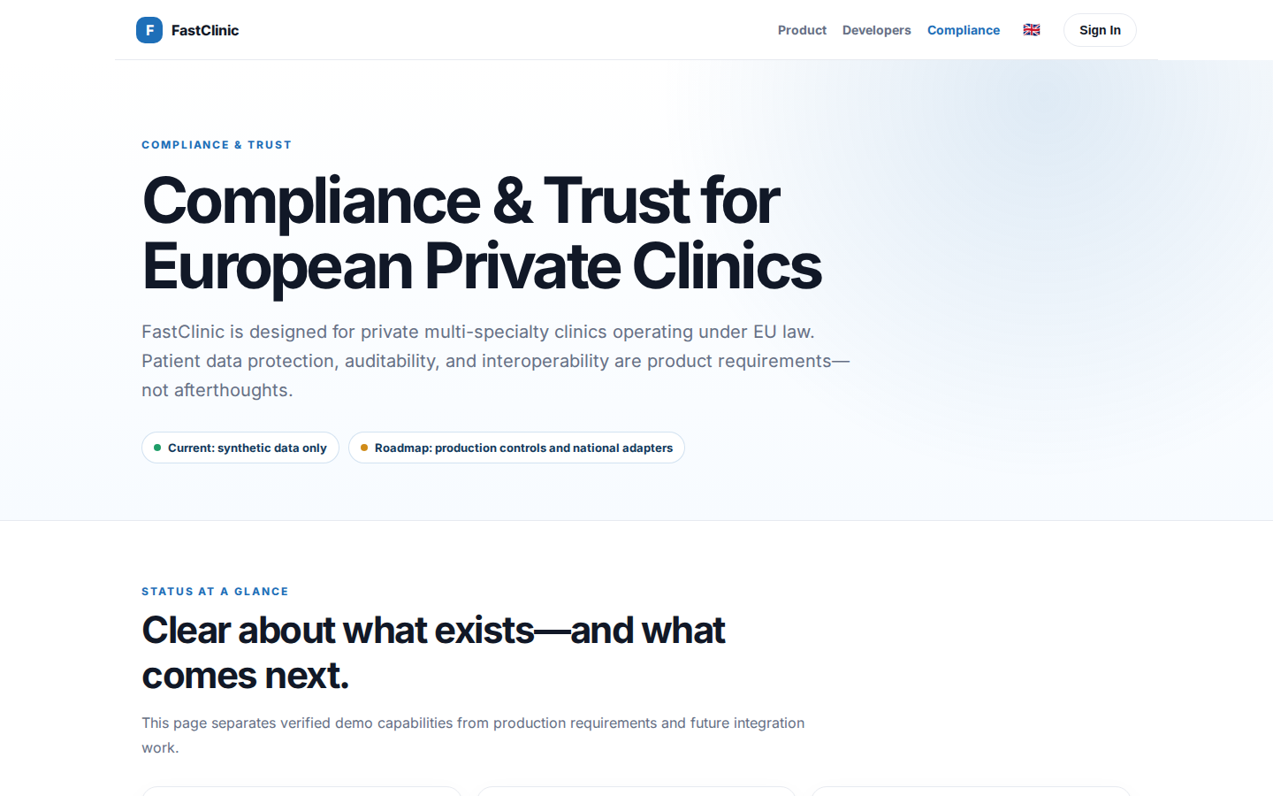
Compliance & Trust for European Private Clinics
COMPLIANCE & TRUST Compliance & Trust for European Private Clinics FastClinic is designed for private multi-specialty clinics operating under EU law. Patient data protection, auditability, and interoperability are product requirements—not afterthoughts. Curren
https://fastclinic.dev/compliance

Slide 5
Modern clinical care, made personal.
CLINIC OPERATIONS Modern clinical care, made personal. Run appointments, patient operations, billing, recall, revenue, and multi-specialty workflows from one clinical cockpit. Sign In or Register Download Android APK Explore the open-source suite → Product tou
https://fastclinic.dev/

