Slide 1
FastClinic
User Guide — Run Your Multi-Specialty Clinic
Modern clinical care, made personal.
General practice · surgical specialties · dental · patient activation
Version 0.1.0 · 14 August 2026 · fastclinic.dev

Slide 2
Contents
The PDF page numbers and PowerPoint slide numbers are intentionally identical.
Component | Pages / slides | What it covers
Get started | 3–6 | Overview, sign-in, layout, and Copilot
Run the clinic | 7–14 | Treatments, appointments, patients, clinical, revenue, and billing
Keep patients in the loop | 15–19 | Recall, lapsed patients, follow-up, and measured outreach
Reach, automate & integrate | 20–25 | Communications, AI, web presence, API, and data operations
Compliance & interoperability | 26–30 | Current posture, GDPR path, FHIR/EHDS, and national adapters
Run it every week | 31–33 | Weekly operating rhythm and quick reference
FastClinic · Modern clinical care, made personal · v0.1.0 · 2026-08-14 · fastclinic.dev · 2

Slide 3
SECTION 01
Get started
Orient the team around one operations cockpit, one consistent layout, and one assistant grounded in clinic data.
FastClinic · Modern clinical care, made personal · v0.1.0 · 2026-08-14 · fastclinic.dev · 3

Slide 4
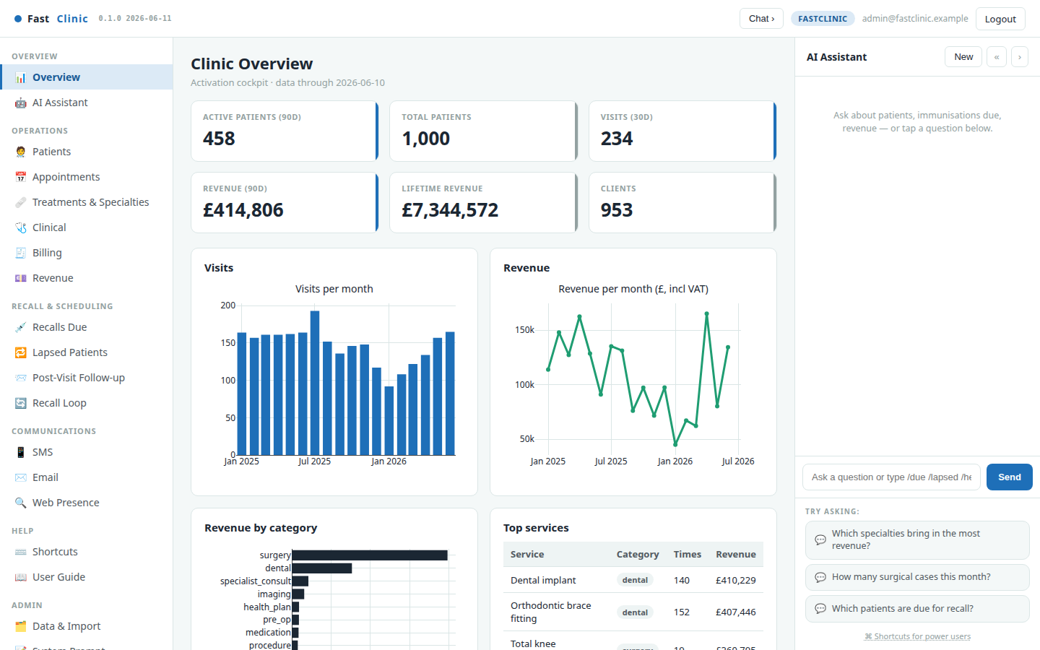
FastClinic at a glance
FastClinic is an open-source operations platform for European private multi-specialty clinics. The Overview is the daily scorecard: active and total patients, visits, revenue, service mix, and trends—all dated so the team knows how fresh the picture is.
The platform combines real availability and conflict-safe appointments, patient and contact-party operations, recall, communications, balanced billing, multi-specialty analytics, and an AI assistant. The public demo contains only synthetic records; it is designed for safe exploration rather than clinical use.
FastClinic · Modern clinical care, made personal · v0.1.0 · 2026-08-14 · fastclinic.dev · 4

Slide 5
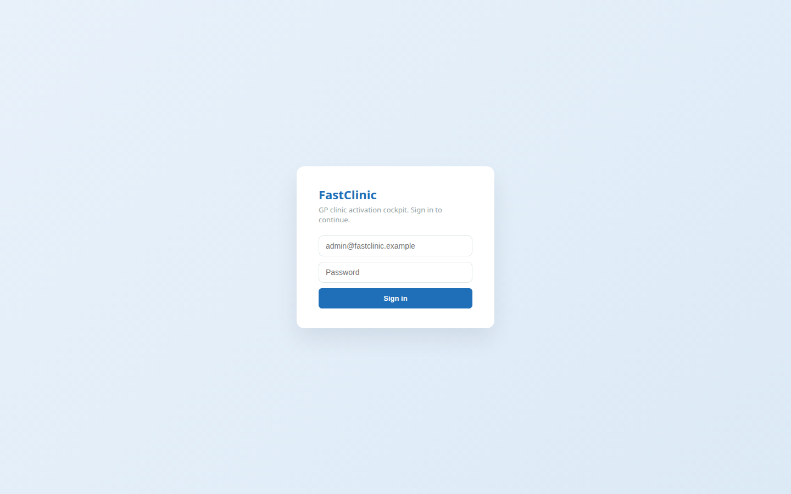
Sign in & the three-pane layout
Open https://fastclinic.dev and choose Sign In. Use the account method configured for your clinic; the public demo may offer local or Google sign-in.
• Left — navigation grouped by job: Overview, Operations, Recall & Scheduling, Communications, Help, and Admin.
• Centre — the active workspace: dashboards, lists, forms, and reports.
• Right — the collapsible AI Copilot, available without leaving the current task.
The public landing page, account flow, compliance page, developer page, app, chat, and dashboards support the same European language catalogue.
FastClinic · Modern clinical care, made personal · v0.1.0 · 2026-08-14 · fastclinic.dev · 5

Slide 6
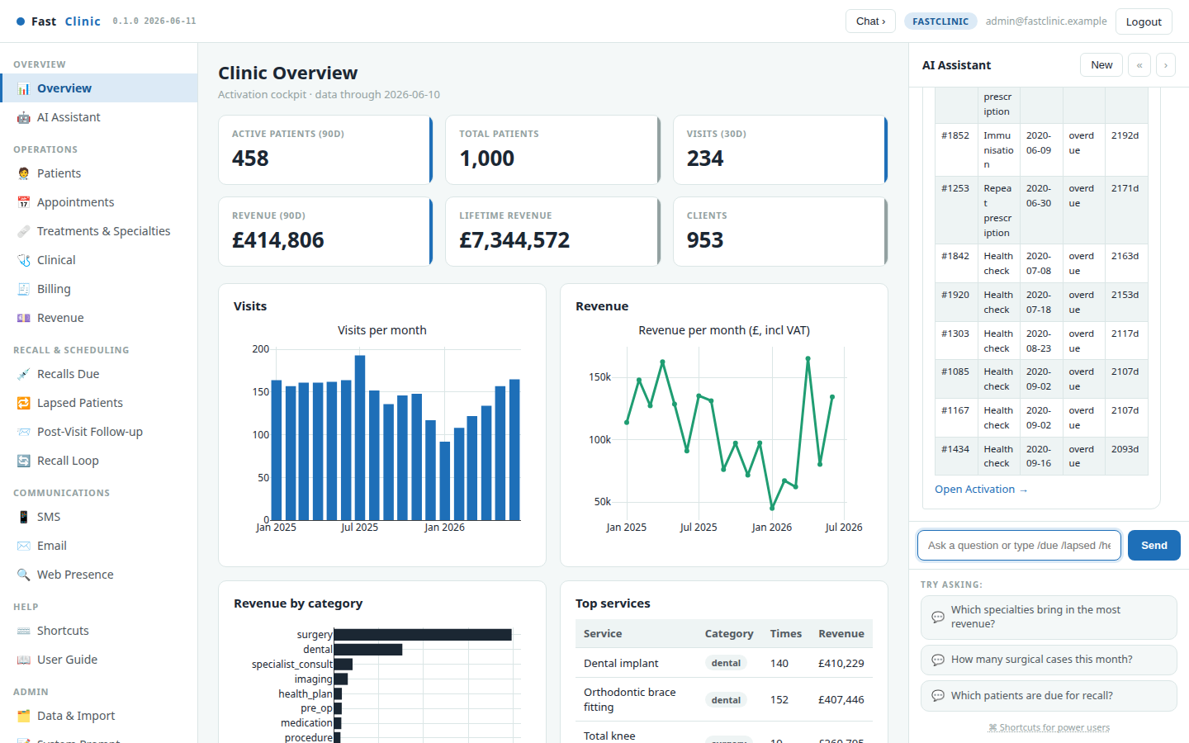
The AI Copilot — just ask
The Copilot turns plain-language questions into answers grounded in FastClinic's tools and current conversation. Ask “Which specialties bring in the most revenue?”, “How many surgical cases did we run?”, or “Who is due for recall?”
• Conversation history is checkpointed per account and thread, with bounded retention and context limits.
• The selected request language is propagated into agent tool execution so the answer and underlying labels stay aligned.
• Slash commands provide deterministic pulls: /kpi, /due, /lapsed, /followup, /revenue, and /patient <id>.
The assistant is scoped to operations and information retrieval; it is not a diagnostic or treatment-recommendation system.
FastClinic · Modern clinical care, made personal · v0.1.0 · 2026-08-14 · fastclinic.dev · 6

Slide 7
SECTION 02
Run the clinic
Plan work, protect availability, understand the patient base, and keep the financial record balanced across every specialty.
FastClinic · Modern clinical care, made personal · v0.1.0 · 2026-08-14 · fastclinic.dev · 7

Slide 8
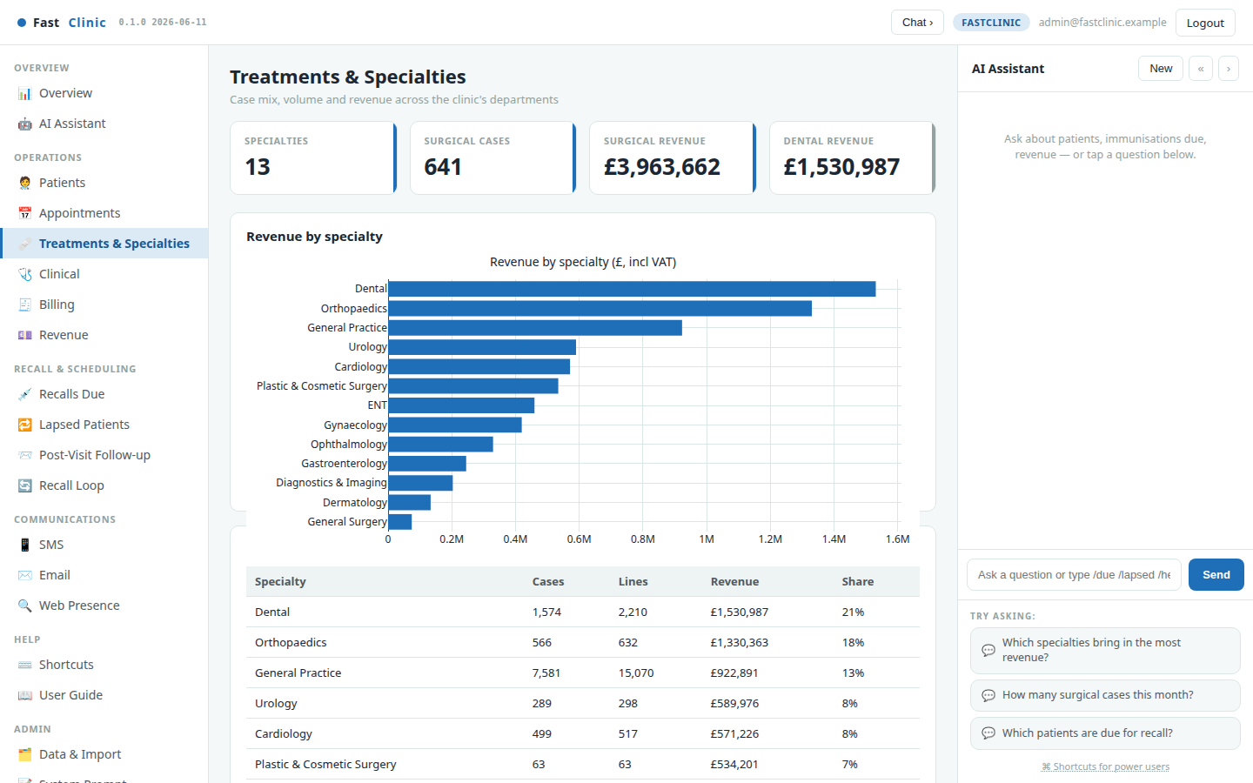
Treatments & Specialties — the case-mix lens
Every treatment line is classified on two axes: what was delivered (consultation, surgery, dental, diagnostic, procedure, and more) and which specialty delivered it.
Use this view to compare revenue and case volume across general practice, orthopaedics, ophthalmology, ENT, general surgery, gynaecology, urology, dermatology, plastics, cardiology, gastroenterology, dental, and diagnostics. Surgical throughput and top procedures make the operational mix visible without flattening the clinic into a single revenue total.
FastClinic · Modern clinical care, made personal · v0.1.0 · 2026-08-14 · fastclinic.dev · 8

Slide 9
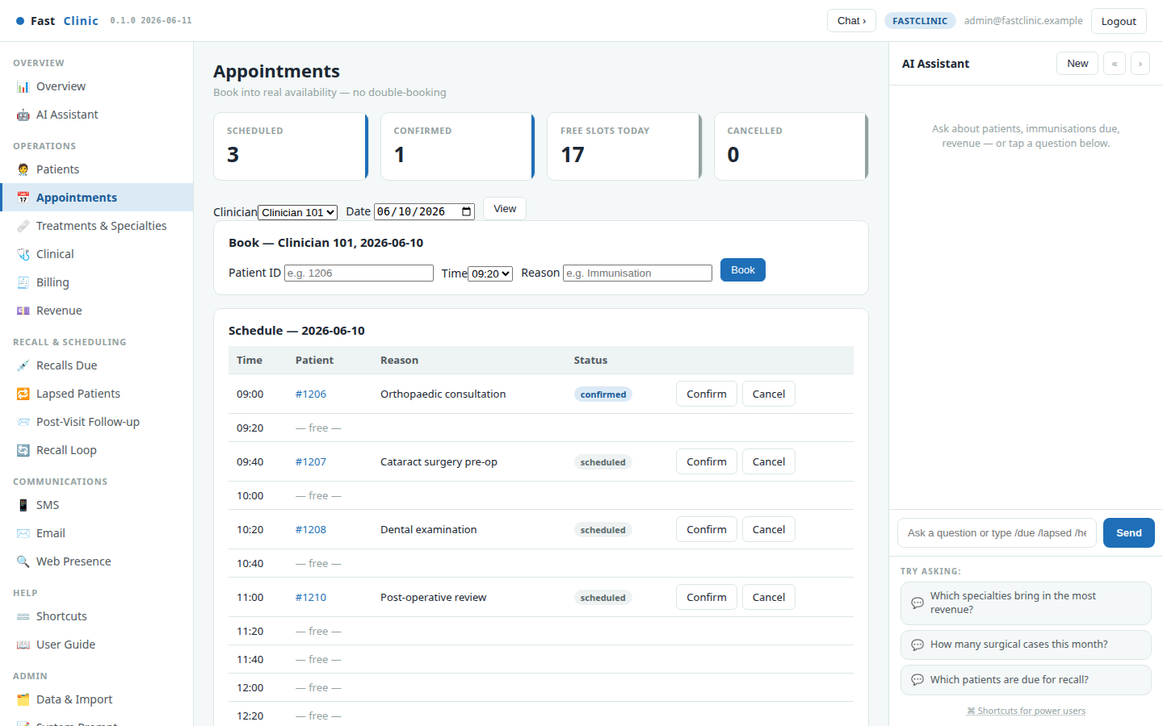
Appointments & booking
Book into real clinician availability. Choose a clinician and date to see free and occupied slots, then create, confirm, reschedule, complete, or cancel an appointment.
• Conflict detection prevents the same clinician being double-booked.
• A parallel slot can remain available for another clinician.
• Booking changes retain operational history and can queue reminders.
• The integration API exposes availability and idempotent external reservation primitives for booking adapters.
FastClinic · Modern clinical care, made personal · v0.1.0 · 2026-08-14 · fastclinic.dev · 9

Slide 10
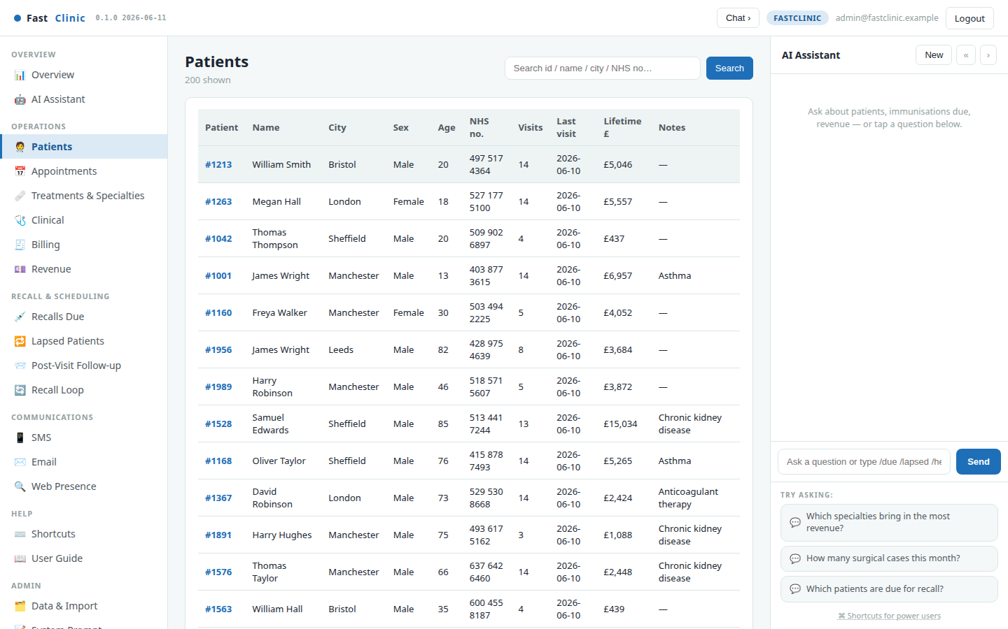
Patients, contacts & representatives
The searchable patient register shows visit count, last-seen date, and lifetime value. FastClinic deliberately separates the subject of care from the contactable or billable party.
That model supports a patient acting for themselves, a guardian representing a minor, a family contact, an emergency contact, or a separate payer. Consent, communications, and invoices are attributed to the correct party instead of assuming the patient is always directly contactable.
FastClinic · Modern clinical care, made personal · v0.1.0 · 2026-08-14 · fastclinic.dev · 10

Slide 11
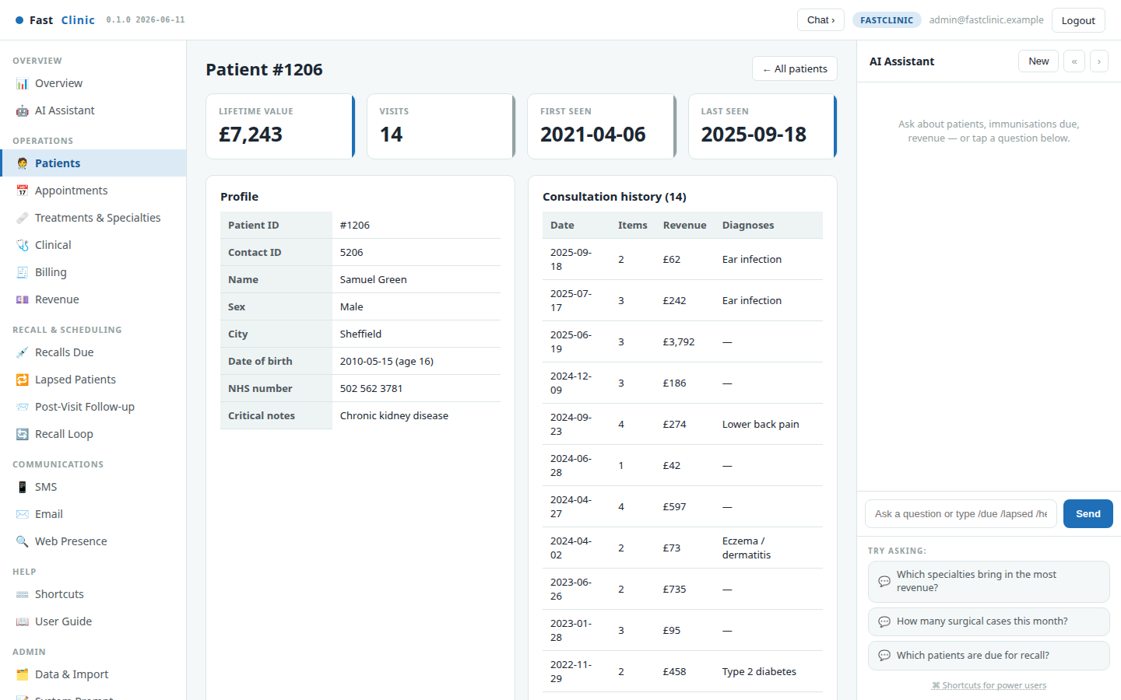
Patient profile
The profile brings together demographics, representatives, lifetime value, visit count, consultation history, diagnoses, notes, and recent billable items.
Use it before a call or visit to understand the relationship context as well as the care history. API mutations follow domain-safe behaviour: clinical subjects and notes are archived instead of silently erased, and linked parties cannot be deleted until their relationships are resolved.
FastClinic · Modern clinical care, made personal · v0.1.0 · 2026-08-14 · fastclinic.dev · 11

Slide 12
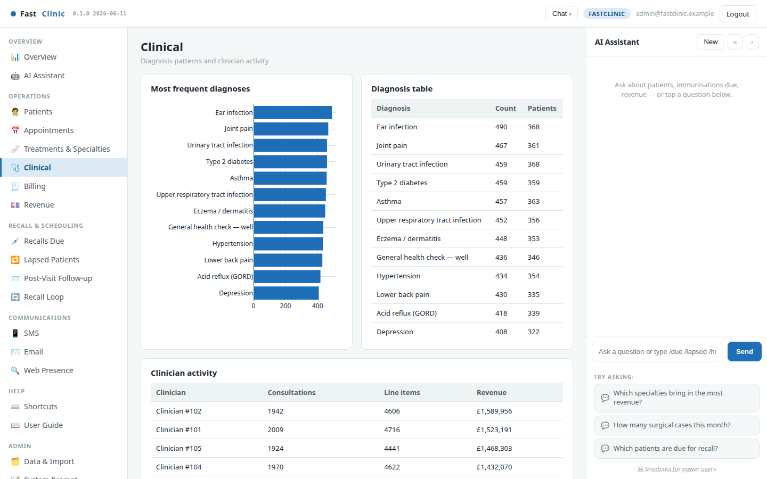
Clinical operations
The Clinical view summarises common diagnoses and clinician activity across the practice. It is an operational workload and service-planning lens—not clinical decision support.
Use it to identify capacity pressure, recurring condition cohorts, and where follow-up programmes may be useful. Imported diagnoses and performed-care facts remain traceable to their synthetic consultations.
FastClinic · Modern clinical care, made personal · v0.1.0 · 2026-08-14 · fastclinic.dev · 12

Slide 13
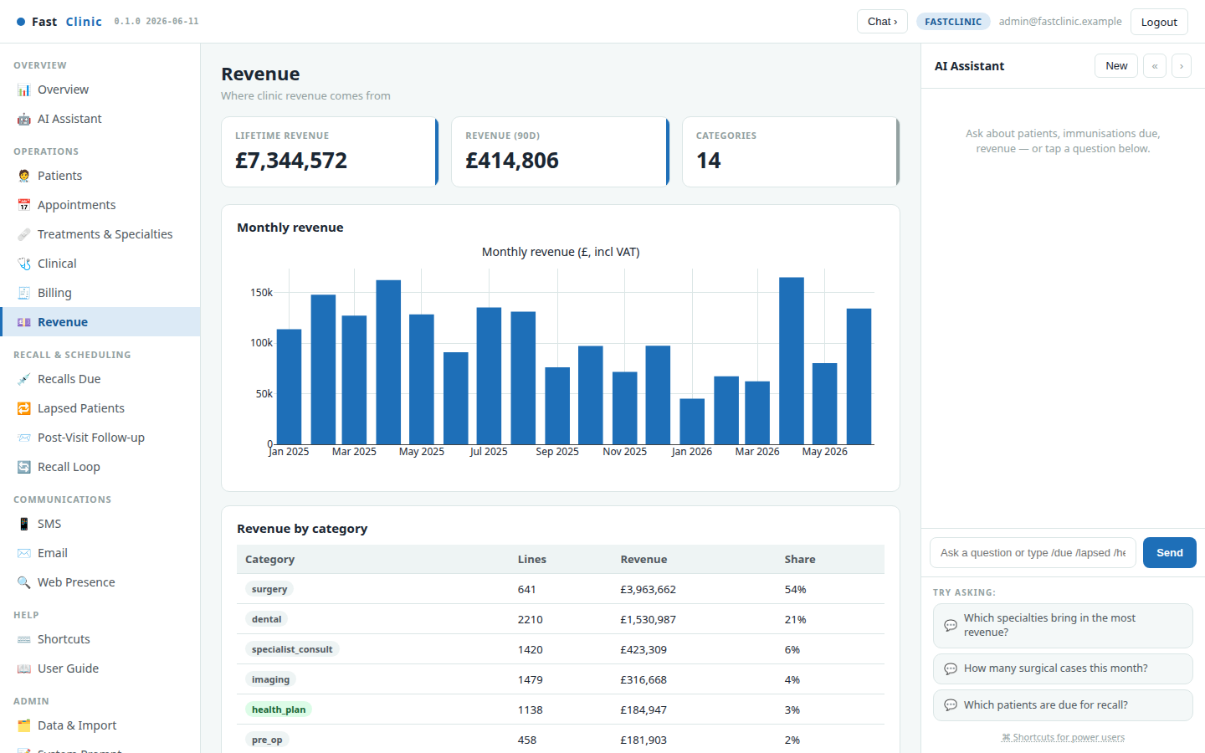
Revenue
Revenue is shown by month, service category, specialty, and top procedure. Pair it with Treatments & Specialties to understand both the money and the work behind it.
The analytics endpoints expose the same synthetic aggregates used by the dashboard, so an authorised integration can reconcile its reports against the user interface.
FastClinic · Modern clinical care, made personal · v0.1.0 · 2026-08-14 · fastclinic.dev · 13

Slide 14
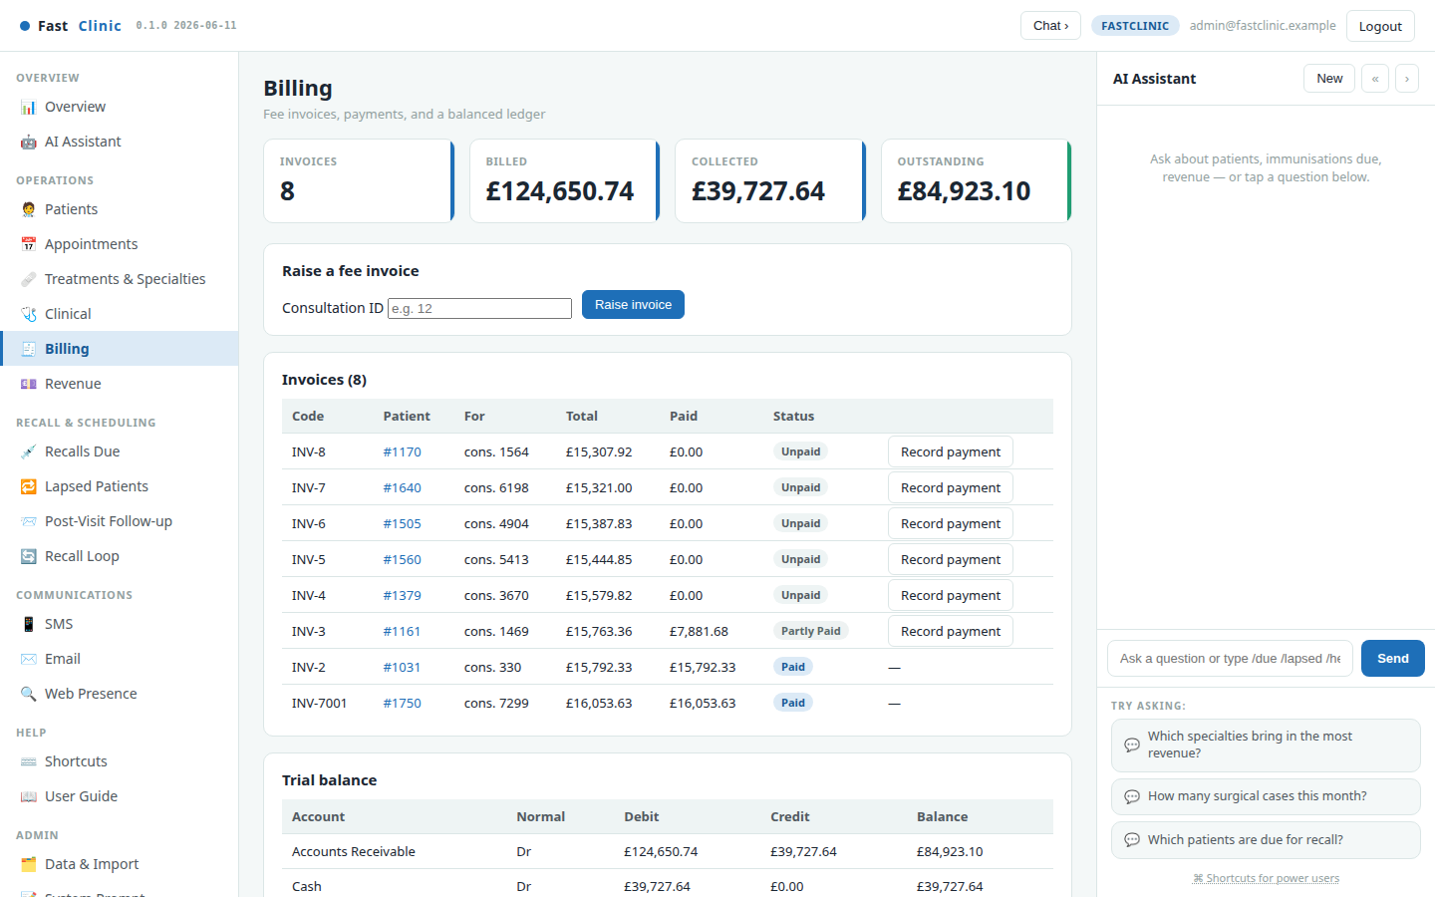
Billing & payments
Raise invoices from consultations, record part or full payments, issue refunds, and void invoices through reversing entries. A balanced double-entry ledger keeps every billed and collected amount accounted for.
Because payer and patient are separate, a guardian or insurer can pay for a subject of care naturally. API idempotency keys prevent the same payment being recorded twice, while the audit trail records operational mutations.
FastClinic · Modern clinical care, made personal · v0.1.0 · 2026-08-14 · fastclinic.dev · 14

Slide 15
SECTION 03
Keep patients in the loop
Turn due care, lapsed relationships, and recent visits into reviewable, consent-aware outreach with measurable outcomes.
FastClinic · Modern clinical care, made personal · v0.1.0 · 2026-08-14 · fastclinic.dev · 15

Slide 16
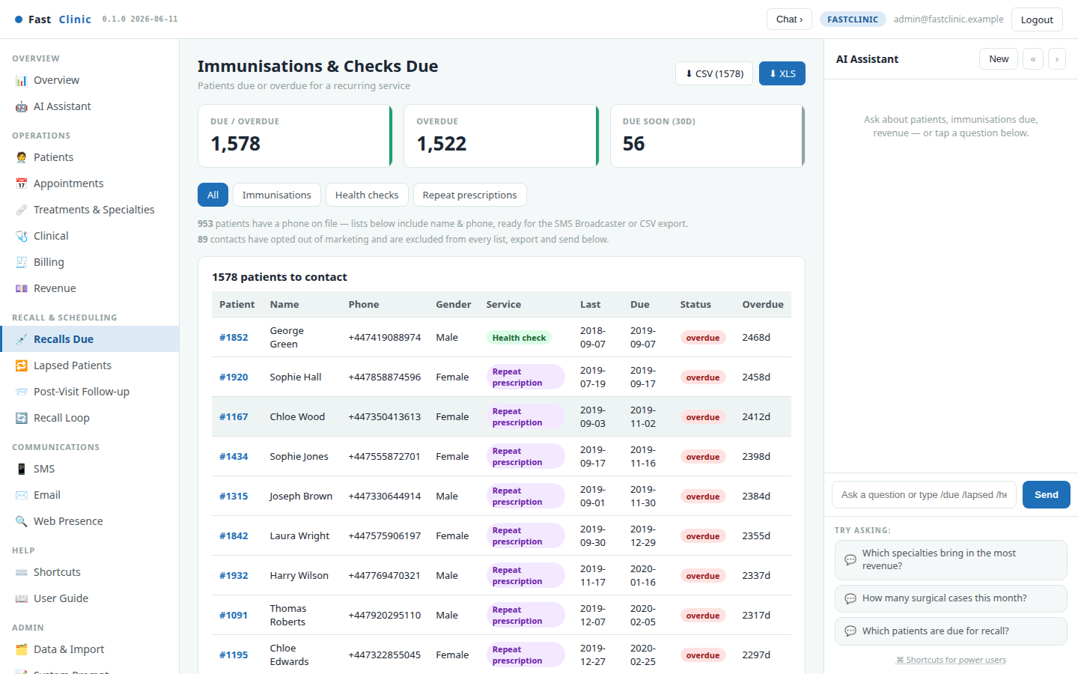
Recalls Due
Recalls Due surfaces who is due or overdue for recurring services such as immunisations, health checks, and repeat-prescription reviews. Rows are ranked by urgency and include a drafted message.
Intervals can account for age and cohort. Filters and CSV/XLS exports let the team review the cohort before queuing anything. No campaign is sent merely because a person appears in a list.
FastClinic · Modern clinical care, made personal · v0.1.0 · 2026-08-14 · fastclinic.dev · 16

Slide 17
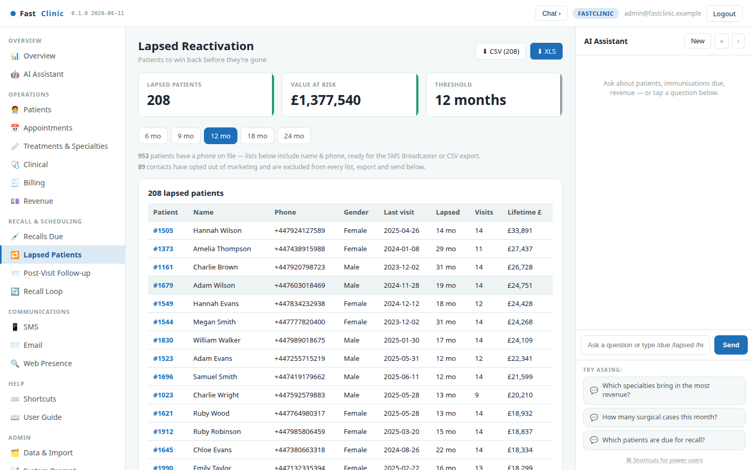
Lapsed Patients
Lapsed Patients finds people with no visit inside a chosen window and ranks them by lifetime value. Adjust the period to narrow or widen the cohort.
The view supports a deliberate win-back workflow: verify the relationship and contact channel, review the drafted message, respect purpose and opt-out rules, then measure whether outreach resulted in a return visit.
FastClinic · Modern clinical care, made personal · v0.1.0 · 2026-08-14 · fastclinic.dev · 17

Slide 18
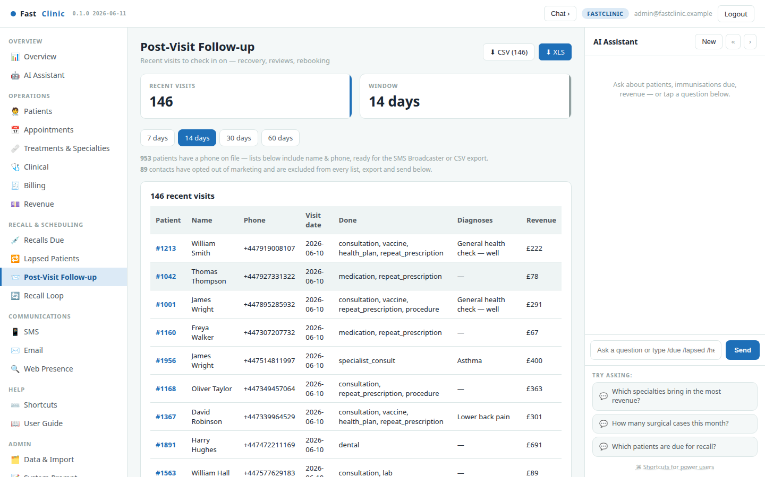
Post-Visit Follow-up
Post-Visit Follow-up lists recent visits—including post-procedure reviews—within a chosen 7, 14, 30, or 60-day window.
Use it for operational check-ins, recovery calls, review requests, or rebooking. Marketing and necessary clinical follow-up must be treated as distinct purposes; deployment policy determines the correct lawful basis and channel.
FastClinic · Modern clinical care, made personal · v0.1.0 · 2026-08-14 · fastclinic.dev · 18

Slide 19
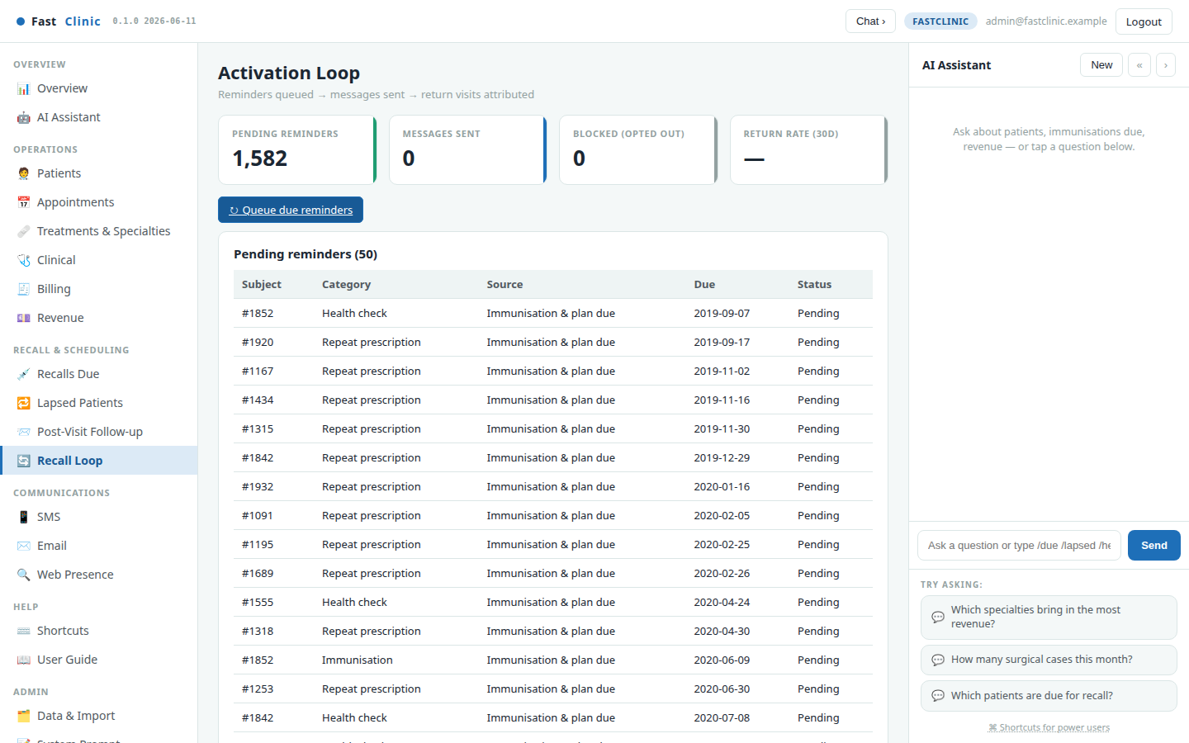
The Recall Loop — queue, send, measure
Queue reviewed cohorts as persistent reminders. Every communication attempt is logged as sent, failed, or blocked, and marketing opt-outs are enforced at the point of delivery.
The loop tracks pending work, delivery outcomes, blocked contacts, and the 30-day return rate. This provides an operational record of what the clinic did, not merely a static export of who appeared eligible.
FastClinic · Modern clinical care, made personal · v0.1.0 · 2026-08-14 · fastclinic.dev · 19

Slide 20
SECTION 04
Reach, automate & integrate
Connect approved communication providers, use the assistant responsibly, expose typed APIs, and keep clinical and operational stores under control.
FastClinic · Modern clinical care, made personal · v0.1.0 · 2026-08-14 · fastclinic.dev · 20

Slide 21
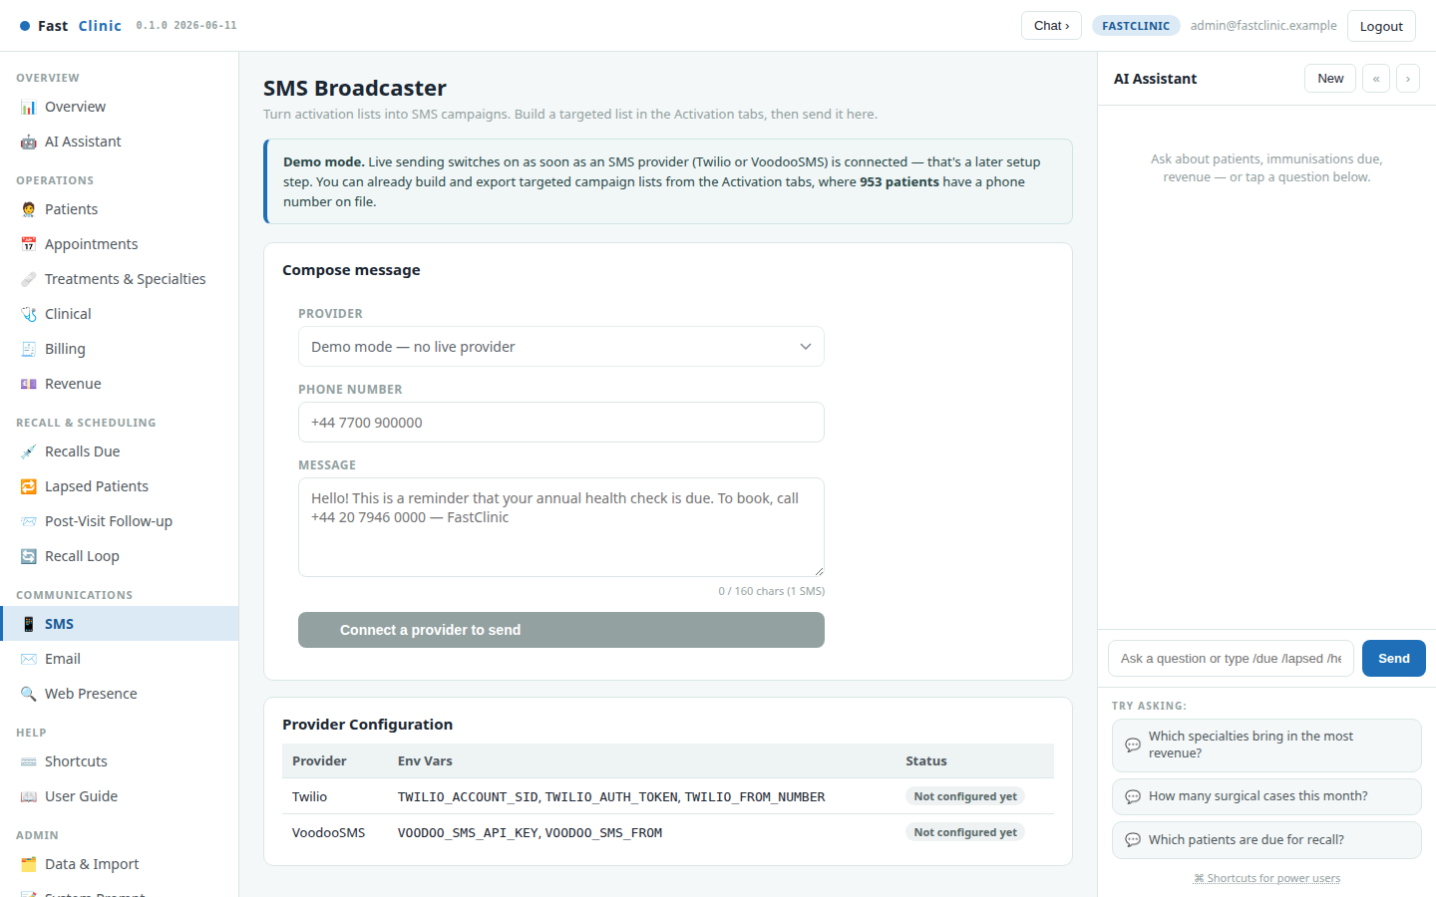
SMS & Email
Send through configured SMS and email providers after reviewing the recipient, purpose, and message. FastClinic suppresses opted-out marketing contacts at send time and retains immutable delivery outcomes.
Provider contracts, data location, processor terms, retention, and transfer controls remain deployment decisions. In environments without a configured provider, cohorts can still be exported for an approved clinic workflow.
FastClinic · Modern clinical care, made personal · v0.1.0 · 2026-08-14 · fastclinic.dev · 21

Slide 22
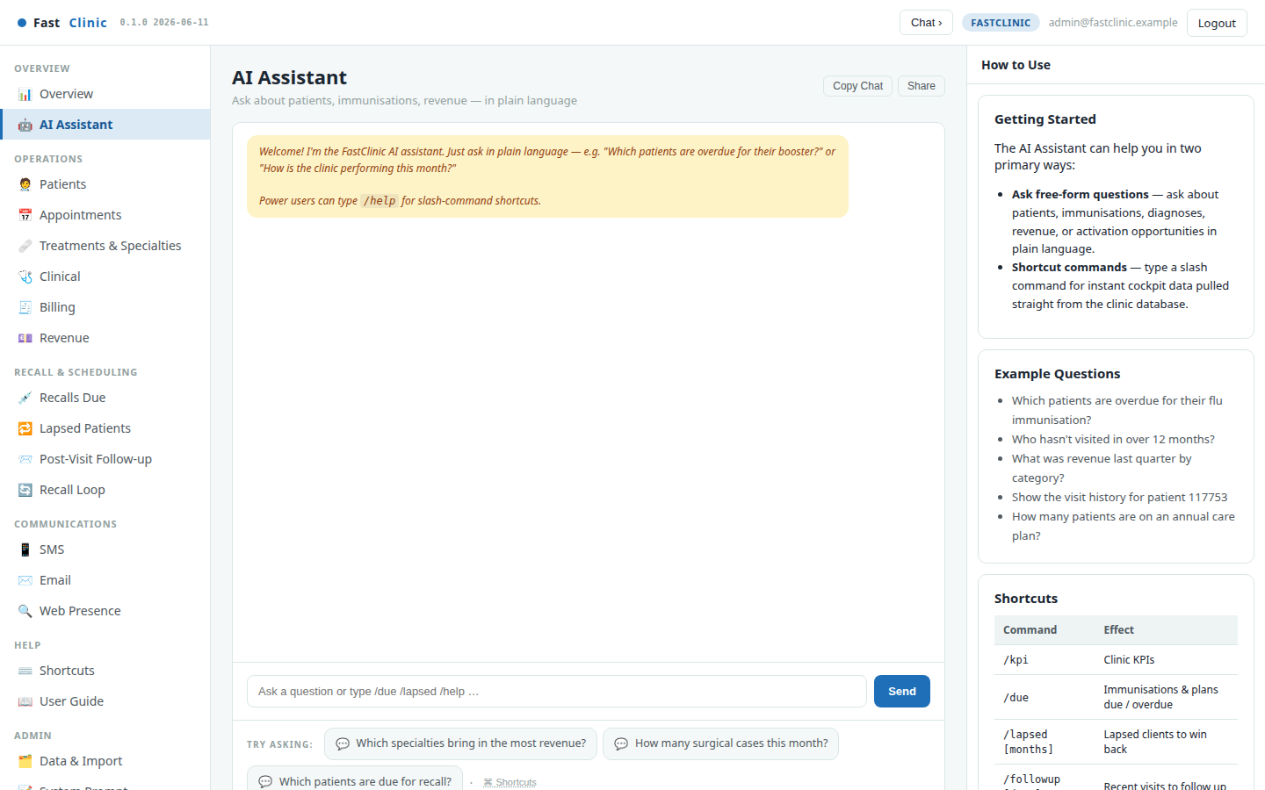
AI Assistant
The full-page assistant supports deeper operational questions across revenue, scheduling, patients, and recall. Its agent tools are read-oriented and its evaluation suite checks grounding, tool routing, supported languages, privacy, prompt injection, safety, robustness, streaming, and memory.
Before real patient data is introduced, clinics must resolve the model provider, EU/EEA processing location, contracts, minimisation, retention, human oversight, and international-transfer position.
FastClinic · Modern clinical care, made personal · v0.1.0 · 2026-08-14 · fastclinic.dev · 22

Slide 23
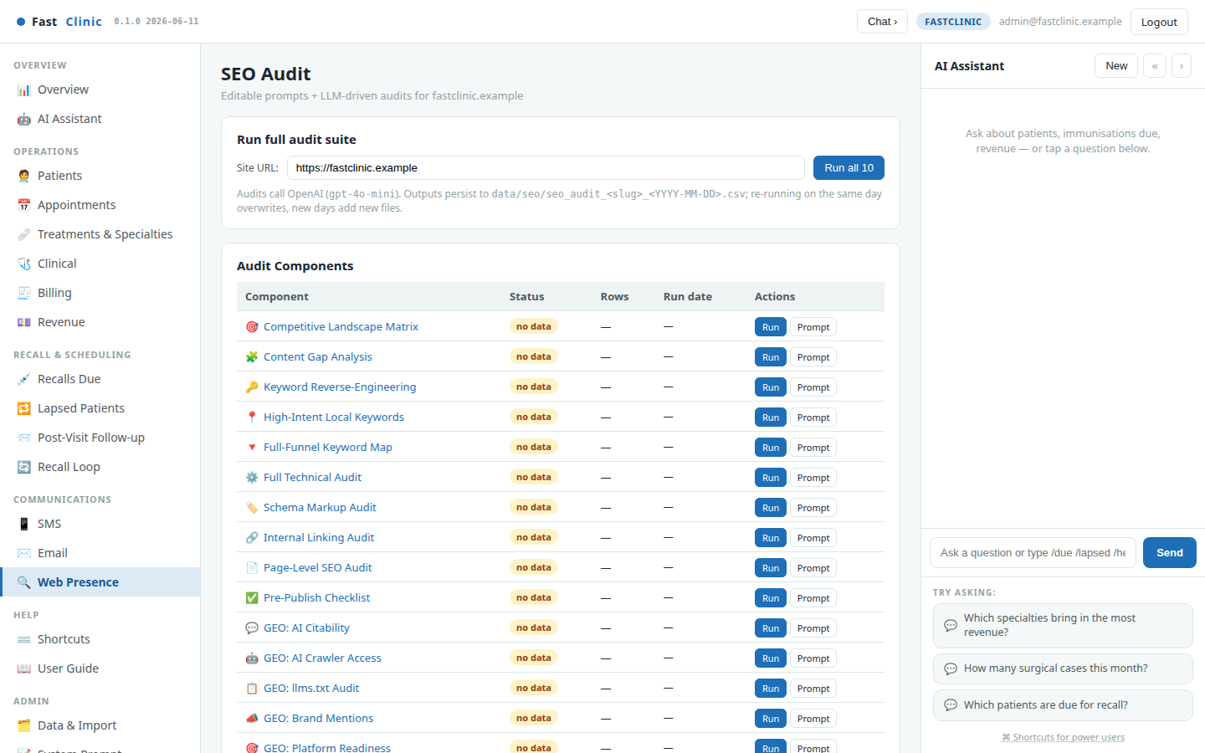
Web Presence
The audit suite checks how the clinic appears in search and AI answer engines, then writes dated reports for review. It complements patient retention with a top-of-funnel view of how prospective patients discover the clinic.
Keep published clinical claims, pricing, professional credentials, and privacy notices under human approval; the audit identifies issues but does not publish changes automatically.
FastClinic · Modern clinical care, made personal · v0.1.0 · 2026-08-14 · fastclinic.dev · 23

Slide 24
Developer API
The API is typed and versioned. Destructive verbs use domain-safe semantics: archive, cancel, refund, or reverse rather than bypassing clinical and financial history. FastBooking uses a separate least-privilege token.
Surface | Location | Access model
Human guide | https://fastclinic.dev/developers | Public
Swagger UI | /api/docs | Public documentation
OpenAPI | /api/openapi.json and /swagger.json | Public schema
Clinical reads & analytics | /api/v1/... | Public synthetic reads
Clinical CRUD | Patients, parties, relationships, notes | Bearer token
Operations | Appointments, recall, communications, billing, audit | Bearer token
FastClinic · Modern clinical care, made personal · v0.1.0 · 2026-08-14 · fastclinic.dev · 24

Slide 25
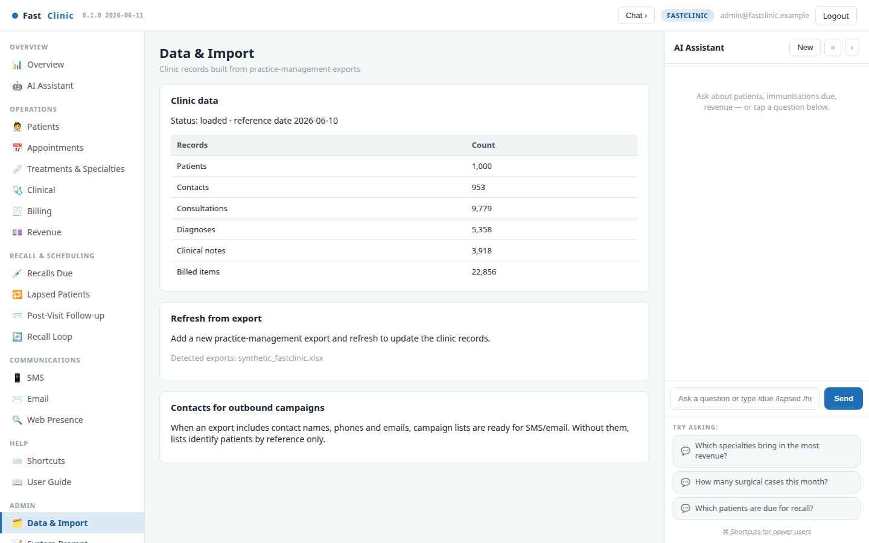
Data, import & database backends
The synthetic clinical model can run on SQLite or PostgreSQL. Production PostgreSQL data is isolated in the fast_clinic schema; operational state such as chat, appointments, reminders, billing, and audit records remains separately configured.
The migration verifies table counts, subject/party relationships, orphan checks, and the treatment-revenue checksum before commit. The public demo and repository continue to contain synthetic data only—no PHI.
FastClinic · Modern clinical care, made personal · v0.1.0 · 2026-08-14 · fastclinic.dev · 25

Slide 26
SECTION 05
Compliance & interoperability
FastClinic's Europe-first design approach, current limitations, and potential FHIR/EHDS integration path. See fastclinic.dev/compliance for the full public statement.
FastClinic · Modern clinical care, made personal · v0.1.0 · 2026-08-14 · fastclinic.dev · 26

Slide 27
Compliance posture — current vs planned
Available today
• Synthetic public demo and repository; no PHI.
• Separate subject-of-care and party/representative model.
• Consent-aware communications, mutation audit events, persistent conversation history, typed API, and balanced accounting.
Required before production health-data deployment
• Enforceable EU/EEA data residency, encryption and key management, fine-grained RBAC, MFA/SSO paths, append-only audit evidence, retention and legal holds.
• DPIA and processing records, processor agreements, incident procedures, backup/recovery evidence, and national legal review.
FastClinic does not currently claim ISO 27001/27701 certification, production EHR conformity, or automatic legal compliance for a deploying clinic.
FastClinic · Modern clinical care, made personal · v0.1.0 · 2026-08-14 · fastclinic.dev · 27

Slide 28
GDPR integration approach
FastClinic is designed to give the clinic controller usable controls and the processor relationship auditable evidence.
Legal basis, national retention duties, controller responsibilities, and whether a DPO is required remain deployment-specific decisions.
Concern | Product / adapter approach
Privacy by design | Minimise data, isolate environments, apply least privilege and secure defaults
Lawful purpose | Keep health-care operations distinct from marketing consent and opt-out
Patient rights | Locate, explain, export, restrict, rectify, or erase where legally permitted
Representatives | Route minors and represented adults through the authorised party relationship
Retention | Country-configurable schedules and legal holds; erasure is not absolute for clinical records
Incidents | Structured logs and monitoring to support risk assessment and notification workflows
AI processing | Resolve provider location, contracts, transfers, minimisation, retention, and oversight first
FastClinic · Modern clinical care, made personal · v0.1.0 · 2026-08-14 · fastclinic.dev · 28

Slide 29
FHIR R4 & EHDS integration approach
FastClinic keeps a normalised internal core and places FHIR profiles, national identifiers, terminology, transport, and consent rules in adapters.
FHIR R4 is the planned interoperability spine; conformant FHIR import/export, EHDS exchange-format support, and production national connections are roadmap work—not capabilities claimed by the current synthetic demo.
FastClinic concept | Potential FHIR R4 boundary mapping
Subject of care | Patient
Guardian or contactable party | RelatedPerson / Patient.contact
Appointment and visit | Appointment / Encounter
Diagnosis and performed care | Condition / Procedure
Payer and coverage | Coverage / Organization
Clinician and clinic | Practitioner / PractitionerRole / Organization
Consent and audit evidence | Consent / AuditEvent
FastClinic · Modern clinical care, made personal · v0.1.0 · 2026-08-14 · fastclinic.dev · 29

Slide 30
National adapters & primary references
Potential adapters will materialise country-specific identifiers, profiles, terminology, professional identity, consent, and transport without contaminating the generic core.
Legislation and standards: GDPR · EHDS Regulation · FHIR R4. Adapter conformance must be checked against the authoritative version in force for each deployment.
Market | Discovery target | Primary reference
Estonia | TEHIK health information system / upTIS | TEHIK
Finland | Kanta FHIR transition and national profiles | Kanta
Germany | gematik ePA FHIR implementation guides | gematik
Netherlands | Nictiz profiles and MedMij trust framework | Nictiz / MedMij
FastClinic · Modern clinical care, made personal · v0.1.0 · 2026-08-14 · fastclinic.dev · 30

Slide 31
SECTION 06
Run it every week
A short, repeatable operating rhythm turns the dashboards into controlled action and measurable improvement.
FastClinic · Modern clinical care, made personal · v0.1.0 · 2026-08-14 · fastclinic.dev · 31

Slide 32
The weekly playbook
• See. Review Overview, Treatments & Specialties, and availability.
• Schedule. Fill appropriate slots, confirm bookings, and resolve conflicts.
• Bill. Raise invoices, record payments, and check the balanced trial balance.
• Recall. Review due, lapsed, and follow-up cohorts before queuing reminders.
• Reach. Confirm the party, purpose, consent state, and approved channel.
• Measure. Track delivery outcomes, return rate, active patients, and revenue.
• Improve. Review audit evidence, exceptions, and integration failures.
The daily question: How is the clinic running across every specialty—and what needs attention now?
FastClinic · Modern clinical care, made personal · v0.1.0 · 2026-08-14 · fastclinic.dev · 32

Slide 33
Quick reference
Current public status: open-source operations cockpit, synthetic data only. Production controls, FHIR exchange, certifications, and national-system adapters must be implemented and verified before real health-data use.
Need | Go to
Clinic scorecard | Overview
Case mix and procedures | Treatments & Specialties
Availability and booking | Appointments
Subject, party, and care history | Patients
Invoices, payments, and ledger | Billing
Due, lapsed, and recent-visit cohorts | Recall & Scheduling
Delivery status and return rate | Recall Loop
Operational questions | Copilot / AI Assistant
API schema and examples | fastclinic.dev/developers
Trust statement and roadmap | fastclinic.dev/compliance
FastClinic · Modern clinical care, made personal · v0.1.0 · 2026-08-14 · fastclinic.dev · 33

