Slide 1
FastClinic
User Guide — Run, Grow & Activate Your Practice
Modern primary care, made personal.
A patient-activation & operations cockpit for GP / general practice
fastclinic.example

Slide 2
Contents
Get started
• What FastClinic is & how it grows your practice — the Overview
• Sign in & the 3-pane layout
• The AI Copilot — just ask
Activate — bring patients back
• Immunisation & Plan Due
• Lapsed Reactivation
• Post-Visit Follow-up
• The Activation Loop — queue, send, measure
Run the clinic
• Appointments & booking
• Patients &nbsp;·&nbsp; 10. Patient profile &nbsp;·&nbsp; 11. Clinical &nbsp;·&nbsp; 12. Revenue &nbsp;·&nbsp; 13. Billing & payments
Reach & connect
• SMS Broadcaster &nbsp;·&nbsp; 15. Email Broadcaster &nbsp;·&nbsp; 16. AI Assistant &nbsp;·&nbsp; 17. SEO / GEO Audit &nbsp;·&nbsp; 18. Data & Import
Run it every week
• The weekly playbook & measuring impact
FastClinic · Modern primary care, made personal · fastclinic.example

Slide 3
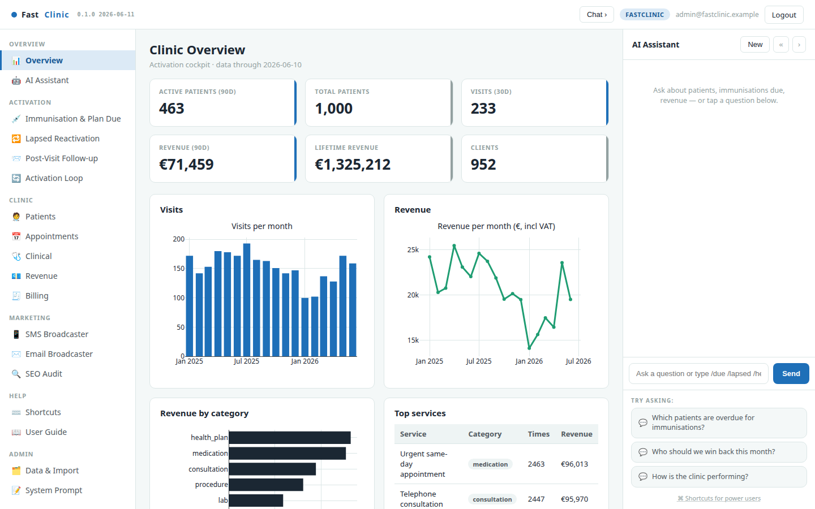
What FastClinic is & how it grows your practice
FastClinic is an all-in-one workspace for a GP practice: a place to see the whole clinic at a glance and an activation engine that turns your own visit history into more booked appointments and revenue. The Overview is your weekly scorecard — active and total patients, recent visits, revenue and trends, all dated so you always know how fresh the picture is.
It runs a simple, repeatable activation loop:
• See — the cockpit ranks who is due, lapsed, or recently seen.
• Reach — a message is drafted for you; you review and send by SMS or email.
• Book — patients return for the immunisation, health check, or review.
• Measure — return visits are attributed back, so you see what worked.
Recurring care is predictable: every patient you re-activate becomes due again next year, so a steady weekly cadence compounds into a growing, healthier list.
FastClinic · Modern primary care, made personal · fastclinic.example

Slide 4
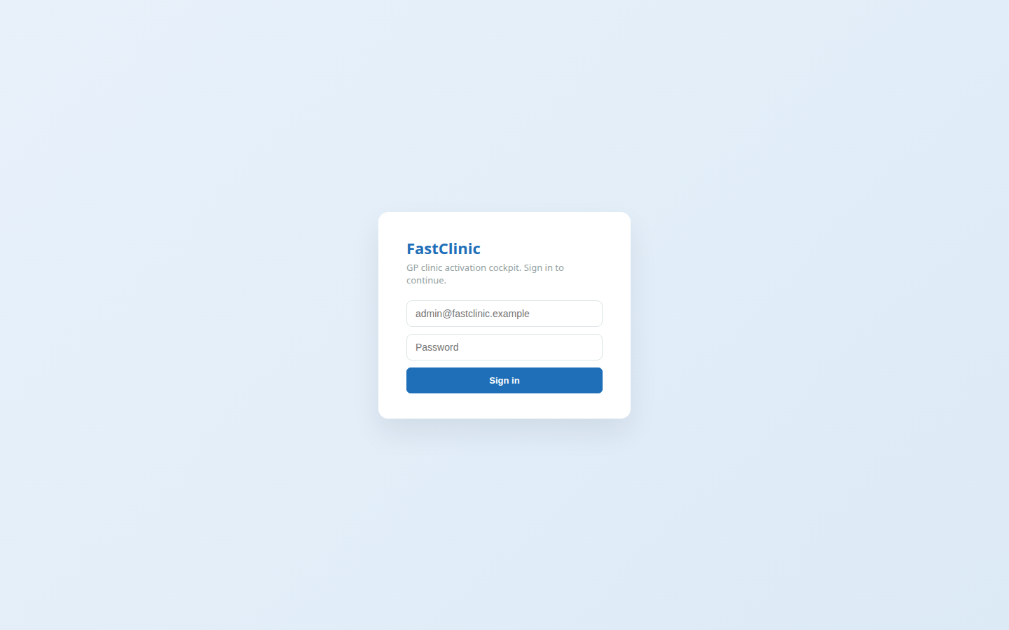
Sign in & the layout
Open fastclinic.example and sign in with your practice login. The screen then has three panes that stay consistent everywhere:
• Left — navigation, grouped by job: Overview · Activation · Clinic · Marketing · Help · Admin.
• Centre — the workspace: lists, tables, charts and forms.
• Right — the AI Copilot, always on hand to answer questions about your data. It can be collapsed to give the workspace more room.
Everything is server-rendered and fast; if you can read a list and press a button, you can run the whole clinic from here.
Your data stays private. FastClinic reads your practice's own records and never contacts a patient without you pressing send.
FastClinic · Modern primary care, made personal · fastclinic.example

Slide 5
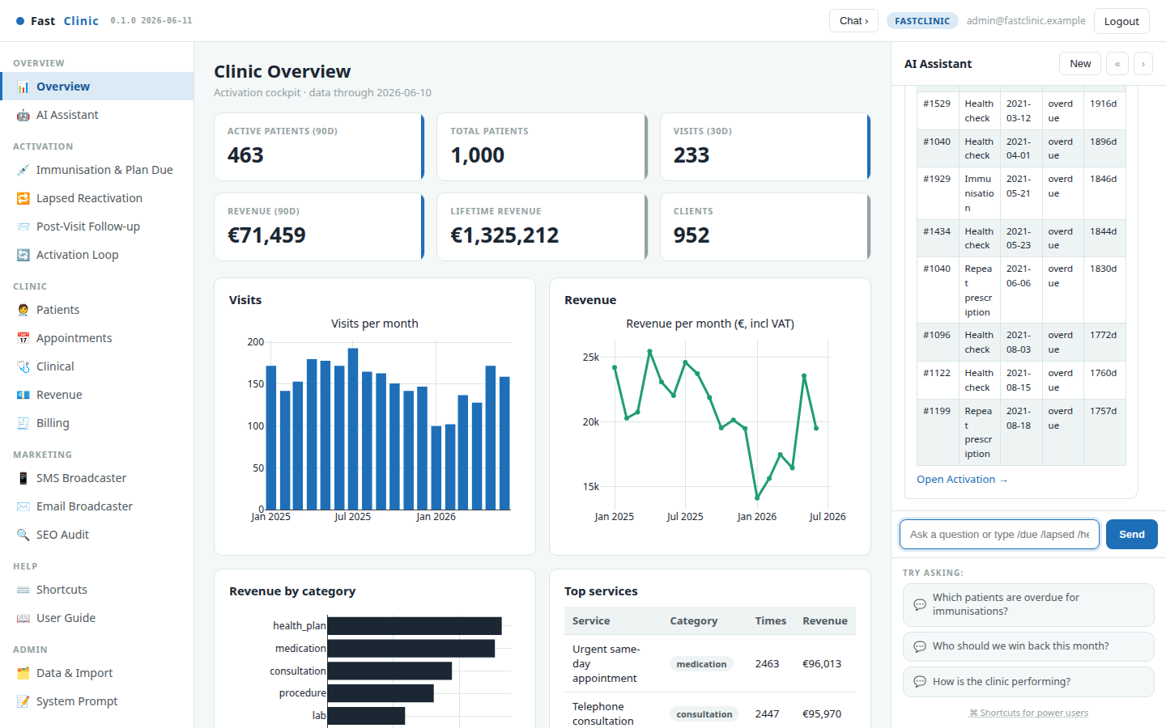
The AI Copilot — just ask
The Copilot on the right turns plain questions into answers from your live data. Ask "Which patients are overdue for immunisations?", "Who should we win back this month?" or "How is the clinic performing?" and it replies with a ready-to-read table.
Power users can type slash-commands for instant results — /due, /lapsed, /followup, /revenue, /patient 1206 — no waiting, no clicks. The suggested questions under the box are a good starting point.
FastClinic · Modern primary care, made personal · fastclinic.example

Slide 6
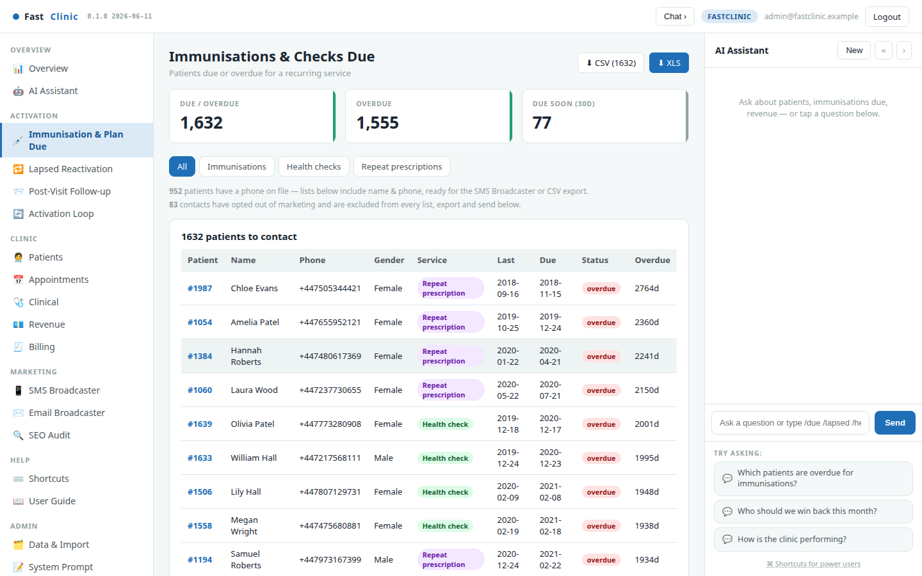
Immunisation & Plan Due
The first activation engine surfaces exactly who is due or overdue for a recurring service — childhood and adult immunisations, annual health checks, and repeat-prescription reviews — ranked most-overdue first.
Recall intervals are age- and cohort-aware: a flu booster for an over-65, a childhood immunisation, and a medication review each follow their own schedule rather than a one-size-fits-all rule. Each row comes with a drafted reminder message and can be exported or sent straight to the broadcaster.
FastClinic · Modern primary care, made personal · fastclinic.example

Slide 7
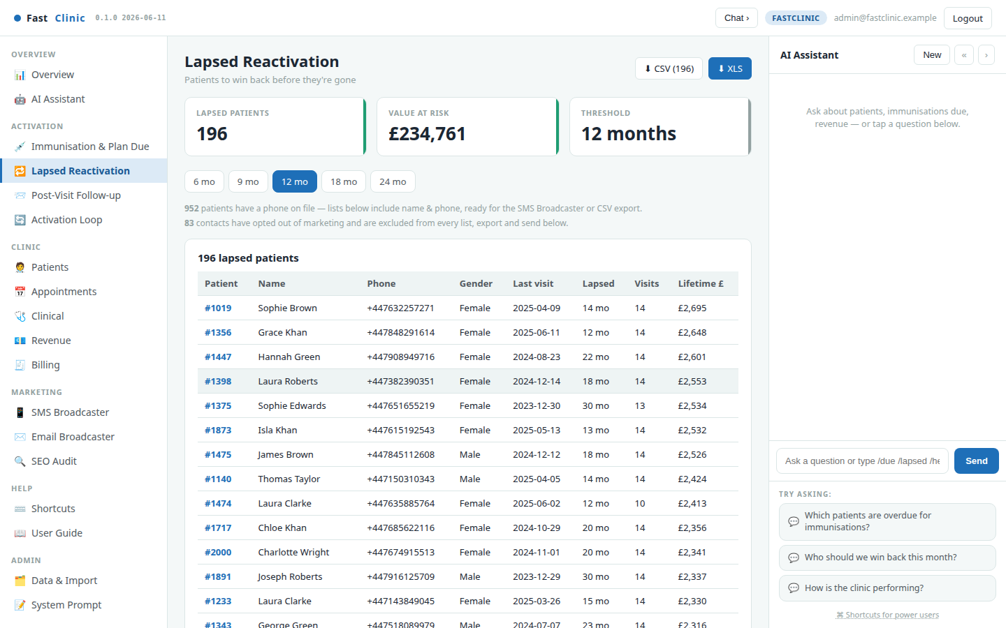
Lapsed Reactivation
Good patients drift away quietly. Lapsed Reactivation lists everyone with no visit in the last N months, ranked by lifetime value so you win back the most valuable relationships first. Adjust the window (6 / 12 / 24 months) to widen or tighten the net. A warm "we miss you" message is drafted for each patient.
FastClinic · Modern primary care, made personal · fastclinic.example

Slide 8
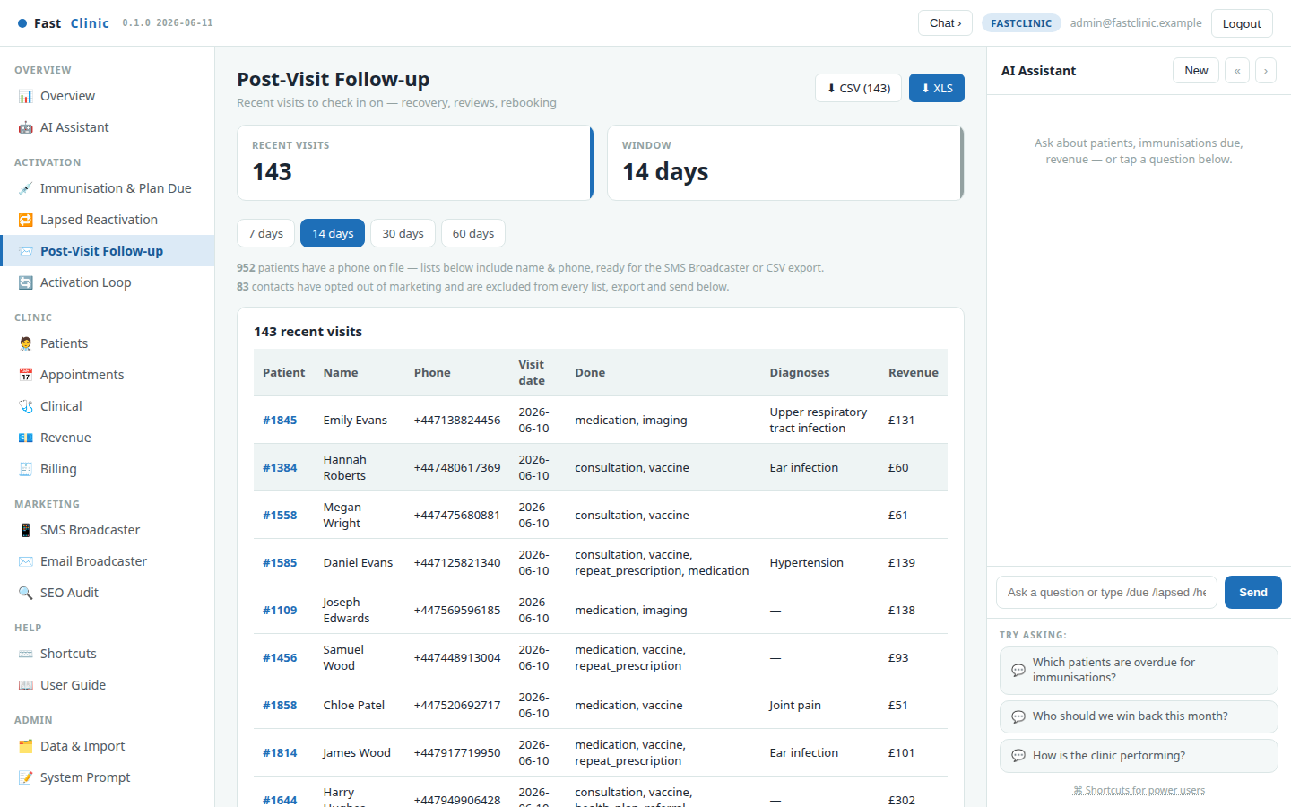
Post-Visit Follow-up
Care doesn't end when the patient leaves. Post-Visit Follow-up lists recent visits so you can check in on recovery, prompt a review, or rebook — within a window you choose (7 / 14 / 30 / 60 days). It's the personal touch that turns a one-off visit into an ongoing relationship.
FastClinic · Modern primary care, made personal · fastclinic.example

Slide 9
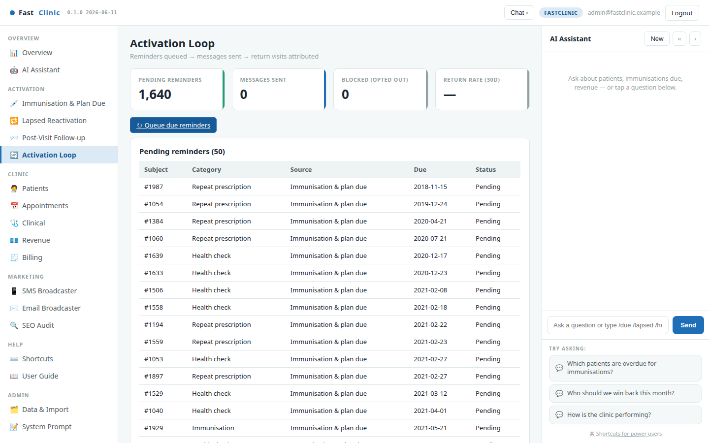
The Activation Loop — queue, send, measure
This is what closes the loop. Queue due reminders turns the lists above into tracked reminders. Every message you then send is logged — sent, failed, or blocked because the patient opted out of marketing — so nobody is contacted twice by accident and consent is always respected.
The scorecard at the top tracks pending reminders, messages sent, blocked (opted-out) contacts, and the return rate: how many contacted patients came back within 30 days. That last number is the whole point — proof the activation work is bringing patients through the door.
FastClinic · Modern primary care, made personal · fastclinic.example

Slide 10
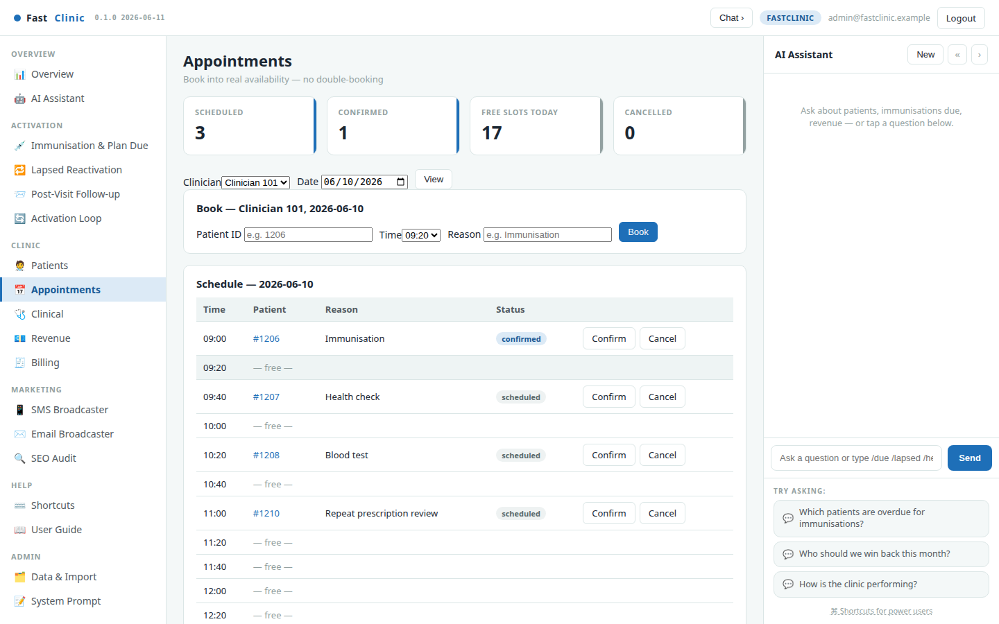
Appointments & booking
Book patients into real availability. Pick a clinician and day and the schedule shows every slot, free or taken. Booking checks for conflicts, so a clinician can never be double-booked; the same time on another clinician is still free. Confirm or cancel with one click, and every booking automatically queues a reminder the day before.
FastClinic · Modern primary care, made personal · fastclinic.example

Slide 11
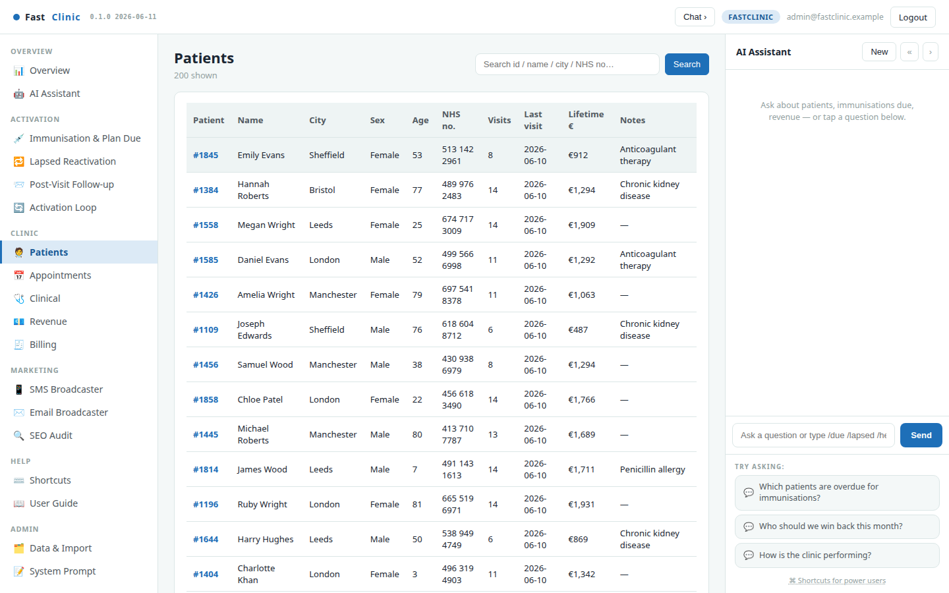
Patients
A fast, searchable list of the whole patient base — search by name, town, or NHS number. Each row shows visits, last-seen date and lifetime value, so the people who matter most are easy to find. Click any patient to open their profile.
FastClinic · Modern primary care, made personal · fastclinic.example

Slide 12
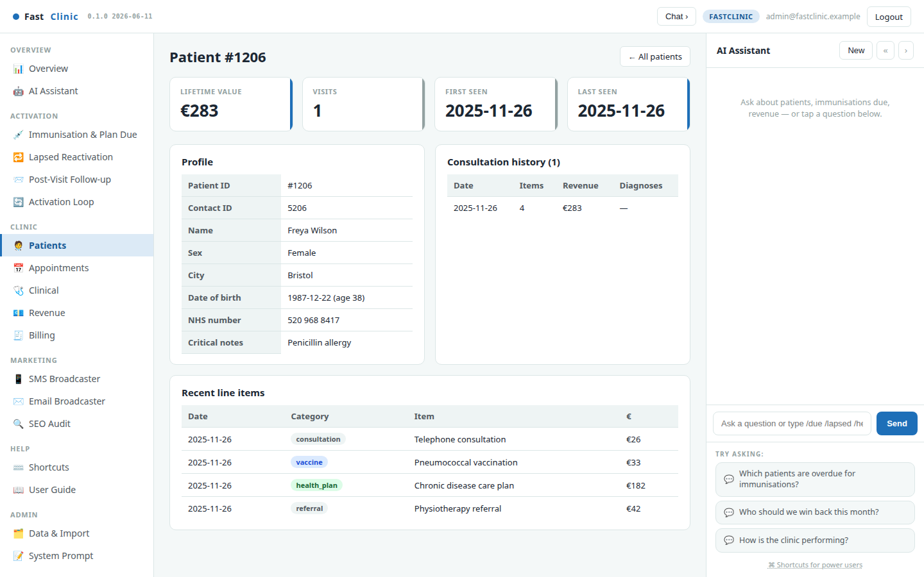
Patient profile
A single view of one patient: demographics and contact, lifetime value and visit count, the full consultation history, and recent billed items — everything the team needs before a call or a visit, on one screen.
FastClinic · Modern primary care, made personal · fastclinic.example

Slide 13
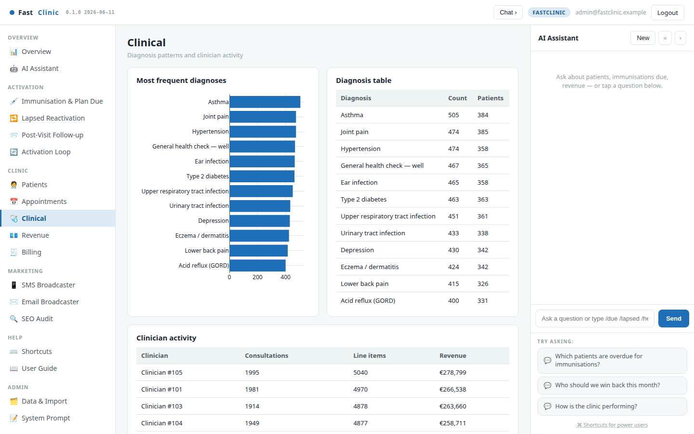
Clinical
The clinical picture across the practice: the most common diagnoses and a breakdown of activity by clinician. Useful for spotting trends, planning services, and understanding where the clinical workload sits.
FastClinic · Modern primary care, made personal · fastclinic.example

Slide 14
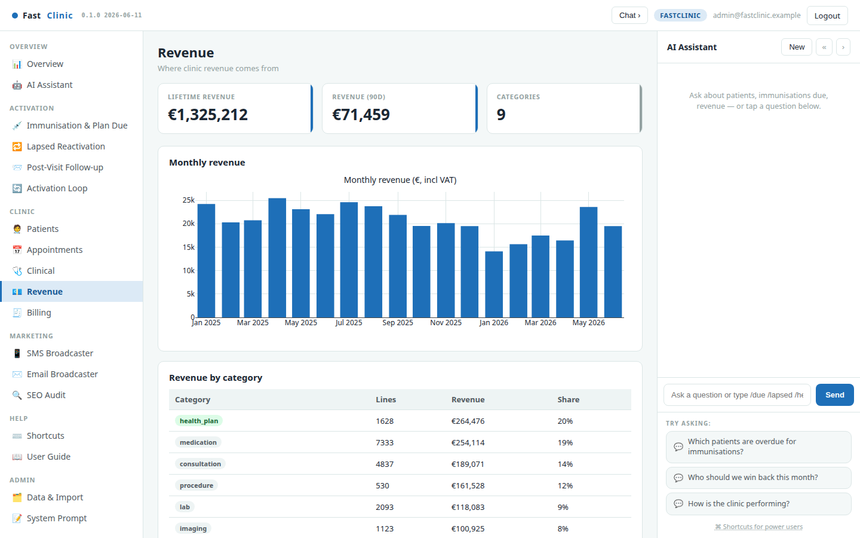
Revenue
Where the money comes from: revenue by service category and the monthly trend. See at a glance which services drive income and how the practice is tracking over time — the financial companion to the activation work.
FastClinic · Modern primary care, made personal · fastclinic.example

Slide 15
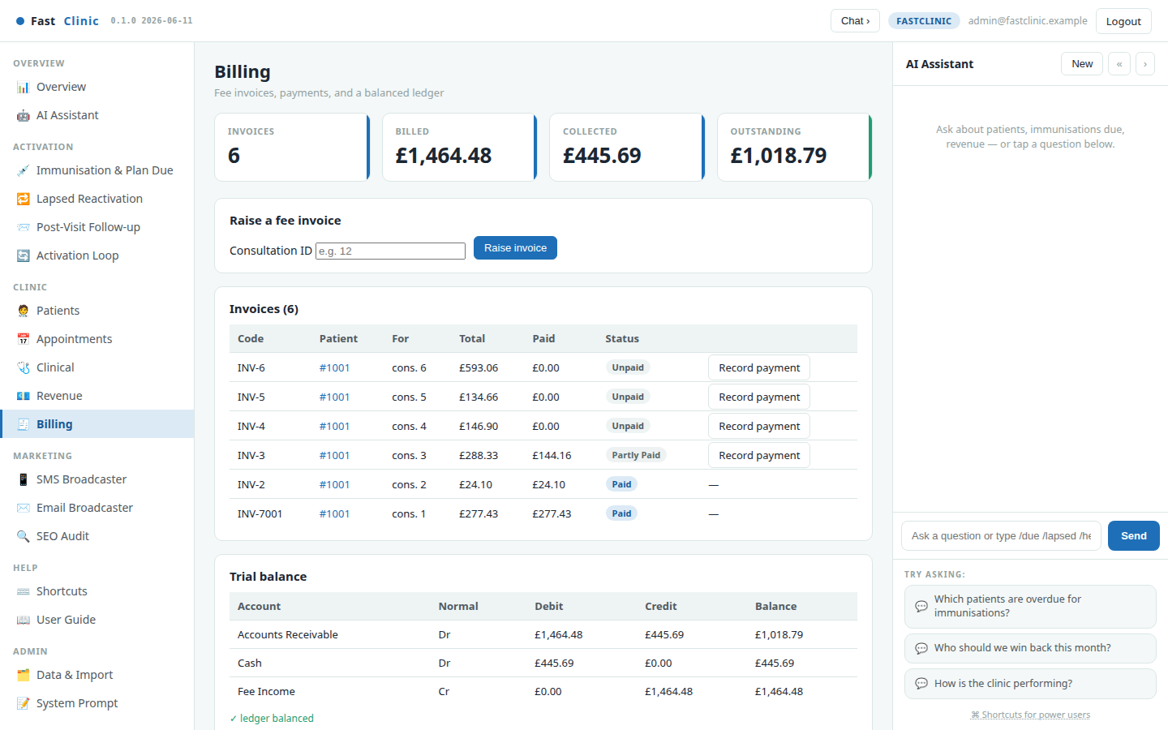
Billing & payments
Raise fee invoices against consultations, record part or full payments, and watch the numbers stay honest: a live balanced ledger underneath means every pound billed and collected is accounted for. Because the payer is tracked separately from the patient, a parent's invoice for a child's treatment — or an insurer's — is handled naturally.
FastClinic · Modern primary care, made personal · fastclinic.example

Slide 16
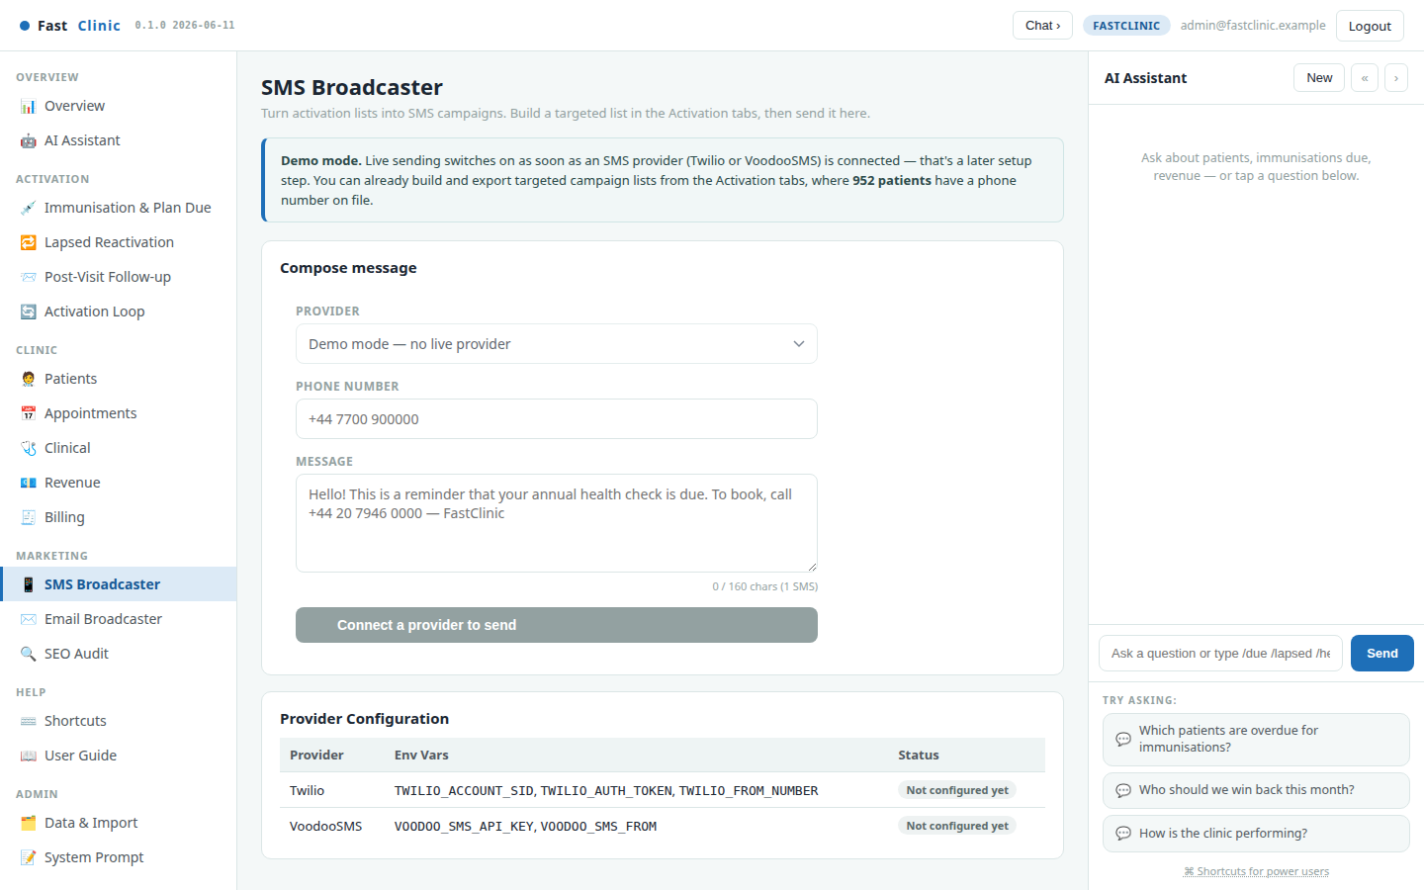
SMS Broadcaster
Send text reminders through your SMS provider. Paste in a drafted message from any activation list, or write your own. Opted-out patients are automatically suppressed at the point of sending, so a campaign never reaches someone who has asked not to be contacted.
FastClinic · Modern primary care, made personal · fastclinic.example

Slide 17
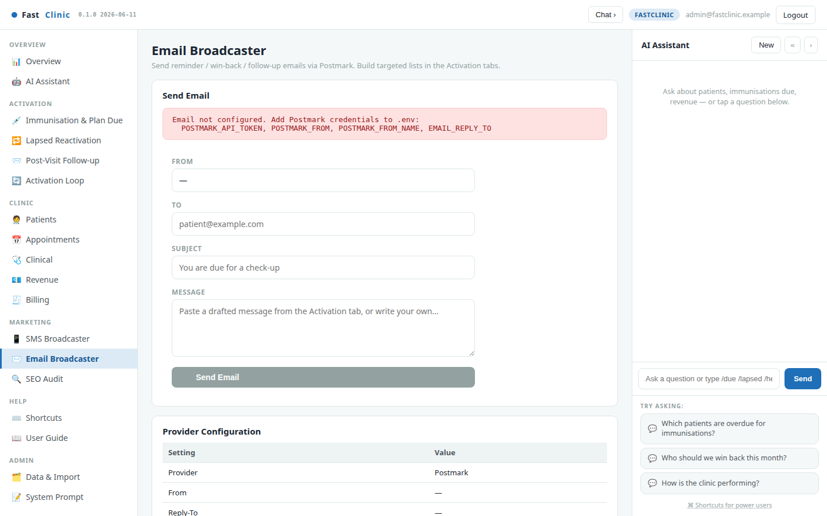
Email Broadcaster
The same, for email. Compose a subject and body — or reuse a drafted message — and send through your email provider, with the same automatic consent protection. Ideal for longer, friendlier win-back and follow-up notes.
FastClinic · Modern primary care, made personal · fastclinic.example

Slide 18
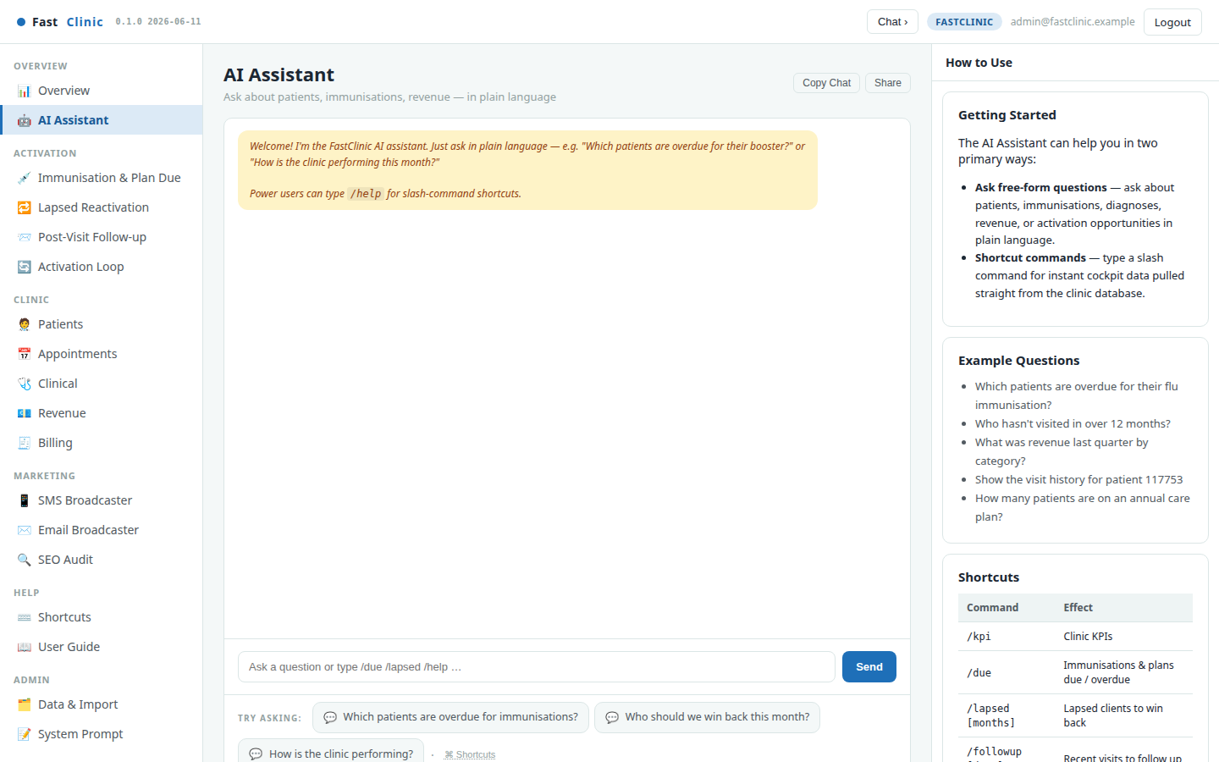
AI Assistant
A full-page version of the Copilot for deeper questions. Ask about patients, immunisations due, revenue or activation opportunities in plain language and get answers grounded in your live data — a knowledgeable colleague who has read every record.
FastClinic · Modern primary care, made personal · fastclinic.example

Slide 19
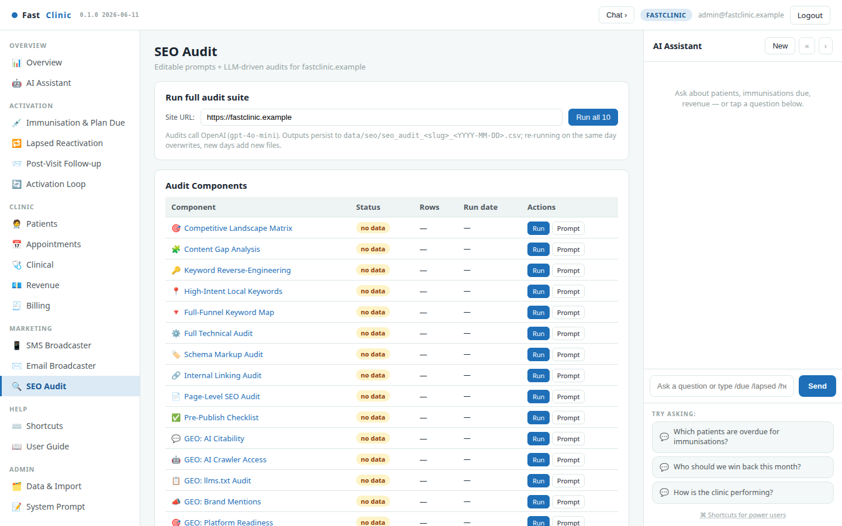
SEO / GEO Audit
Grow the top of the funnel too. The audit suite checks how well your practice shows up in search and in AI answer engines, and writes dated reports you can act on — so new patients can find you as easily as existing ones come back.
FastClinic · Modern primary care, made personal · fastclinic.example

Slide 20
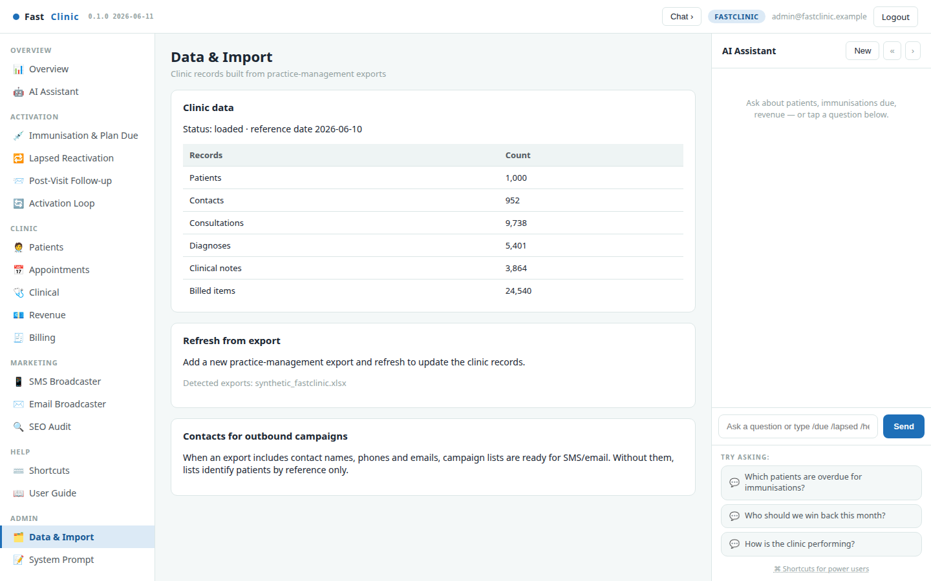
Data & Import — keep the records fresh
FastClinic works from your practice-management export. This page shows what's loaded — patients, contacts, consultations and more — and how to refresh it when a new export arrives. When contact details are included, campaign lists are ready to send; without them, lists identify patients by reference for you to match.
FastClinic · Modern primary care, made personal · fastclinic.example

Slide 21
The weekly playbook & measuring impact
A simple weekly rhythm keeps the practice growing:
• Monday — See. Open the Overview, then the three activation lists. Skim who is due, lapsed, and recently seen.
• Reach. Queue due reminders on the Activation Loop, review the drafted messages, and send by SMS or email. Opted-out patients are handled for you.
• Book. As patients reply, book them into Appointments — no double-booking, with a reminder queued automatically.
• Measure. At week's end, check the Activation Loop's return rate and the Overview's active-patient and revenue trends.
What to watch: active patients, return rate, and revenue trend. Each patient re-activated this year becomes due again next year, so the base of returning patients — and the revenue that comes with it — compounds week over week.
The one question FastClinic answers every day: "Which patients should we contact today to grow the practice — and what do we say?"
FastClinic · Modern primary care, made personal · fastclinic.example

