Slide 1
FastDocs
Platform Guide
2026-08-19 • https://docs.fastsme.com
A server-rendered, **HTMX-driven document editor** built with — a compact port of the core of (Vue 3 + TipTap upstream → server-rendered Python + SQLite here). **No JavaScript framework.**

Slide 2
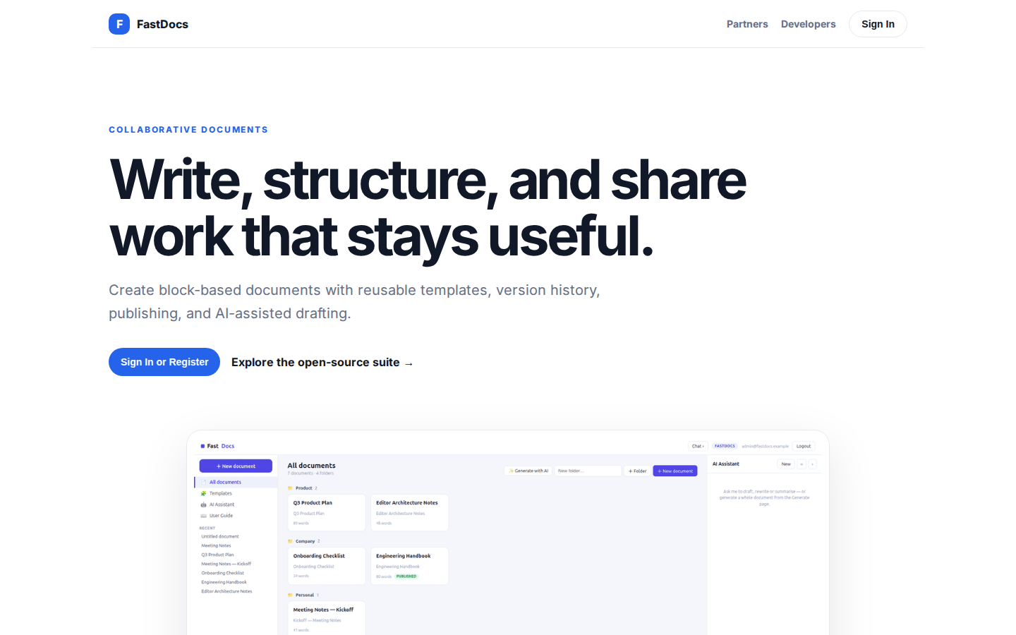
Write, structure, and share work that stays useful.
COLLABORATIVE DOCUMENTS Write, structure, and share work that stays useful. Create block-based documents with reusable templates, version history, publishing, and AI-assisted drafting. Sign In or Register Explore the open-source suite → Product tour · see the
https://docs.fastsme.com/

Slide 3
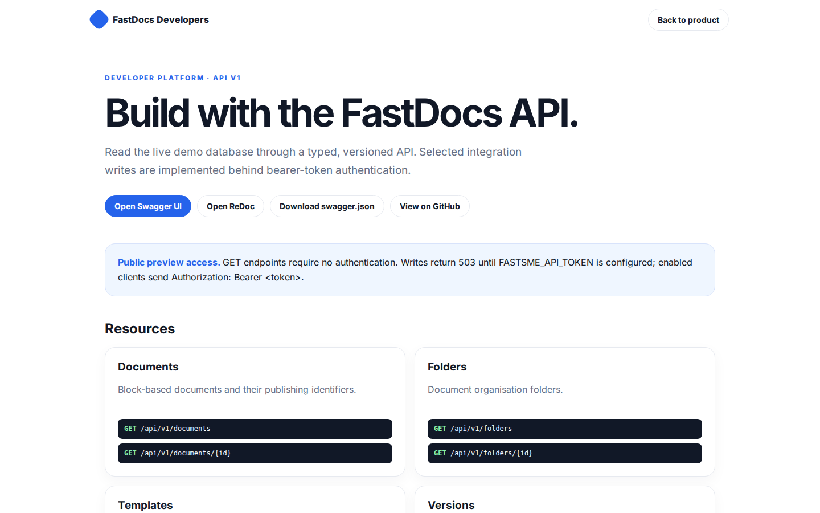
Build with the FastDocs API.
FastDocs Developers Back to product DEVELOPER PLATFORM · API V1 Build with the FastDocs API. Read the live demo database through a typed, versioned API. Selected integration writes are implemented behind bearer-token authentication. Open Swagger UI Open ReDoc
https://docs.fastsme.com/developers

Slide 4
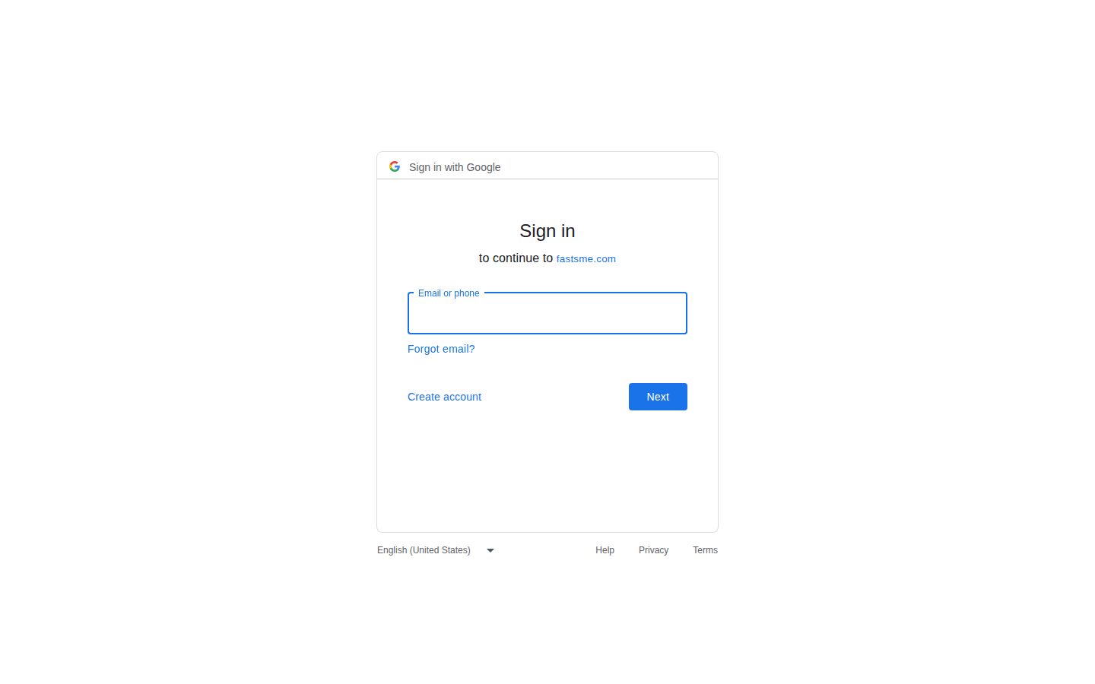
Sign in
Sign in with Google Sign in to continue to fastsme.com Email or phone Forgot email? Next Create account Afrikaans azərbaycan bosanski català Čeština Cymraeg Dansk Deutsch eesti English (United Kingdom) English (United States) Español (España) Español (Latinoam
https://accounts.google.com/v3/signin/identifier?opparams=%253F&dsh=S-1356954309%3A1787122686146270&access_type=online&client_id=887059023987-2a7spj1m82eivobdbt1itb3cqca6tpt1.apps.googleusercontent.com&o2v=2&prompt=select_account&redirect_uri=https%3A%2F%2Fdocs.fastsme.com%2Fauth%2Fgoogle%2Fcallback&response_type=code&scope=openid+email+profile&service=lso&state=1-pta_gMgv0LmJWiJVe1uJgMy-0tYWbueJDN5lsfn0E&flowName=GeneralOAuthLite&continue=https%3A%2F%2Faccounts.google.com%2Fsignin%2Foauth%2Flegacy%2Fconsent%3Fauthuser%3Dunknown%26part%3DAJi8hAO6dXL1I7ZDUQY5fRSY_3eRJZdLXoblJKHYFz7acHkQm12LBlZ37d7SAjVscmhQERI-K7K_4WFKVugyAuYTUte0mAIKWF1l4VKd6W5xWodPMoUrz8gSpIZB81wbKEtfcE2_7bD9ipTX-1_2qhaJrlcKvBi9pXyBohA5c25DJYNmi2g4PEeOXr8u0zfV6X2mzZpx_hUQYWrHuAj44TPOk__WgjDW8WVxCvOMf7L17EmfB5pJUNR0VBykwfcAYRF-QcOhaimRXvnAY1HsvPpaAQqp_2TSsVN1Bp6jrHvrffsnd4IcTIvx37-P0qAdUjOA5vCRWc_IiJ9PbMl-w_PULbkhLZl74yhpFxMPF4TbPXxN3hFrQ6hSwsOf7JfOvqiFj9r5FK5FedDQIvZ5iHKtMrDatcazHVLH7CaZxmfAZFp9yL8yDz2_8e-Ro4nR0sSTeSqSFwcqawUwj7sCBMxbo4hvKQTtRA%26flowName%3DGeneralOAuthFlow%26as%3DS-1356954309%253A1787122686146270%26client_id%3D887059023987-2a7spj1m82eivobdbt1itb3cqca6tpt1.apps.googleusercontent.com%23&app_domain=https%3A%2F%2Fdocs.fastsme.com&rart=ANgoxcdfcIlqkIJjQdbzw8wgVLmgaEF4P8PUvE-lxDZircVe739CnBKWV3cNnx3eh88oTA3jg1TZrpw-PkKYIvu7EsGt_Pv5ULZZ-iW4j-8FjAdy0__5ZaE

