Slide 1
FastERP
Accounting Workspace User Guide
Self-contained synthetic demonstration

Slide 2
Start FastERP
python -m venv .venv
.venv/bin/python -m pip install -r requirements.txt
cp .env.sample .env
.venv/bin/python seed.py
.venv/bin/python web_app.py
Open http://localhost:5011 and sign in as
FastERP · Synthetic accounting workspace · 2026-07-28

Slide 3
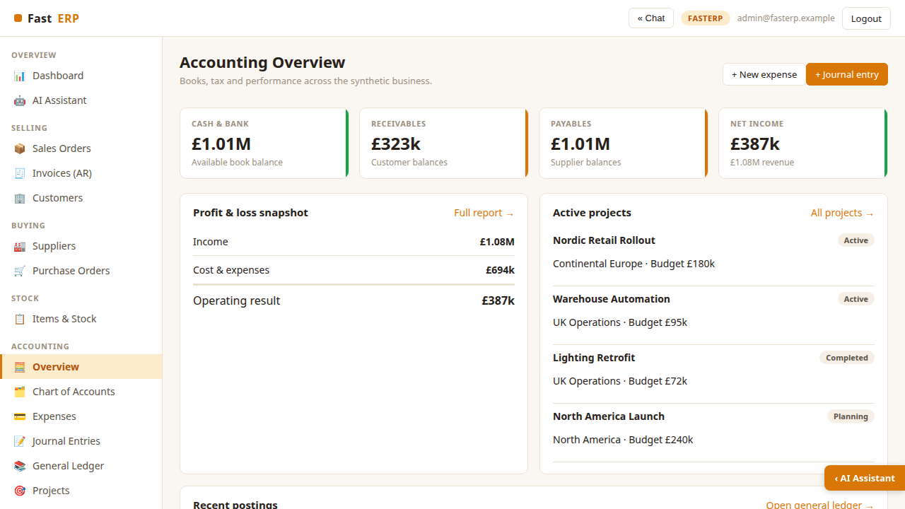
Accounting overview
Open Accounting → Overview for the finance cockpit. The KPI row summarizes
cash and bank, receivables, payables and net income. Below it, review the current
profit-and-loss snapshot, active projects and latest ledger postings.
Use New expense for supplier costs and Journal entry for controlled
adjustments. Every posted workflow writes balanced debit and credit lines.
FastERP · Synthetic accounting workspace · 2026-07-28

Slide 4
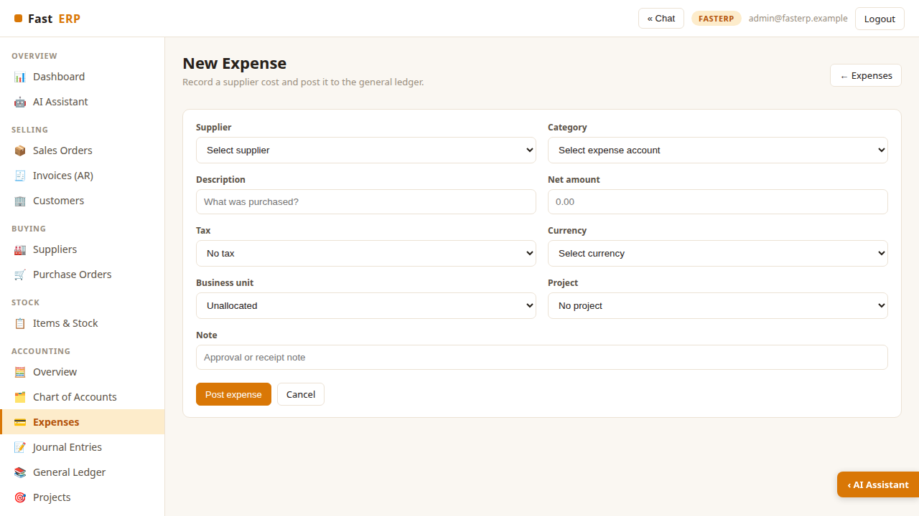
Record a categorized expense
Choose a supplier and expense account, then enter the net amount. Select a tax
code and transaction currency; FastERP converts the posting to GBP using the
seeded rate while retaining the source currency.
Optionally assign a business unit and project. These dimensions flow to
the ledger and project profitability report. Add an approval or receipt note,
then select Post expense.
FastERP · Synthetic accounting workspace · 2026-07-28

Slide 5
Post a journal entry
• Select an account.
• Enter either a debit or credit.
• Optionally allocate the line to a business unit and project.
• Confirm total debits equal total credits.
FastERP · Synthetic accounting workspace · 2026-07-28

Slide 6
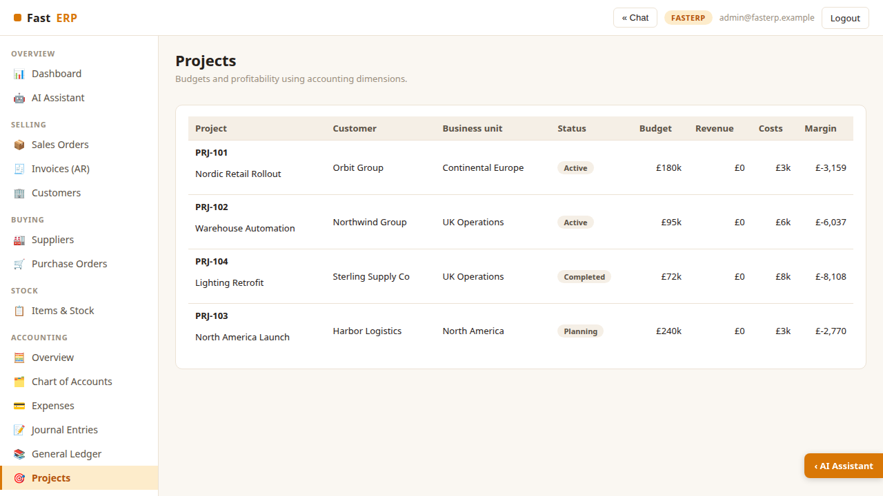
Review projects and business units
The Projects page combines customer, owning business unit, status, budget,
revenue, costs and margin. Expense and journal allocations update costs
immediately.
The synthetic setup includes UK Operations, Continental Europe and North
America. Use these dimensions to compare operational areas without creating
separate ledgers.
FastERP · Synthetic accounting workspace · 2026-07-28

Slide 7
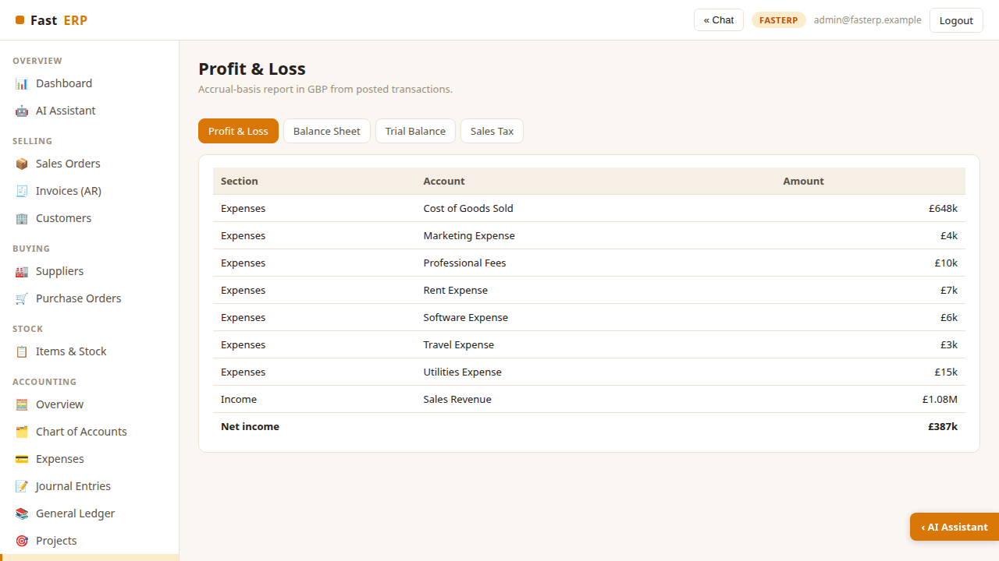
Run financial reports
• Profit & Loss — income, cost of goods sold, operating expenses and result.
• Balance Sheet — assets, liabilities and equity.
• Trial Balance — account debits, credits and normal-side balances.
• Sales Tax — taxable purchases and input tax by period.
FastERP · Synthetic accounting workspace · 2026-07-28

Slide 8
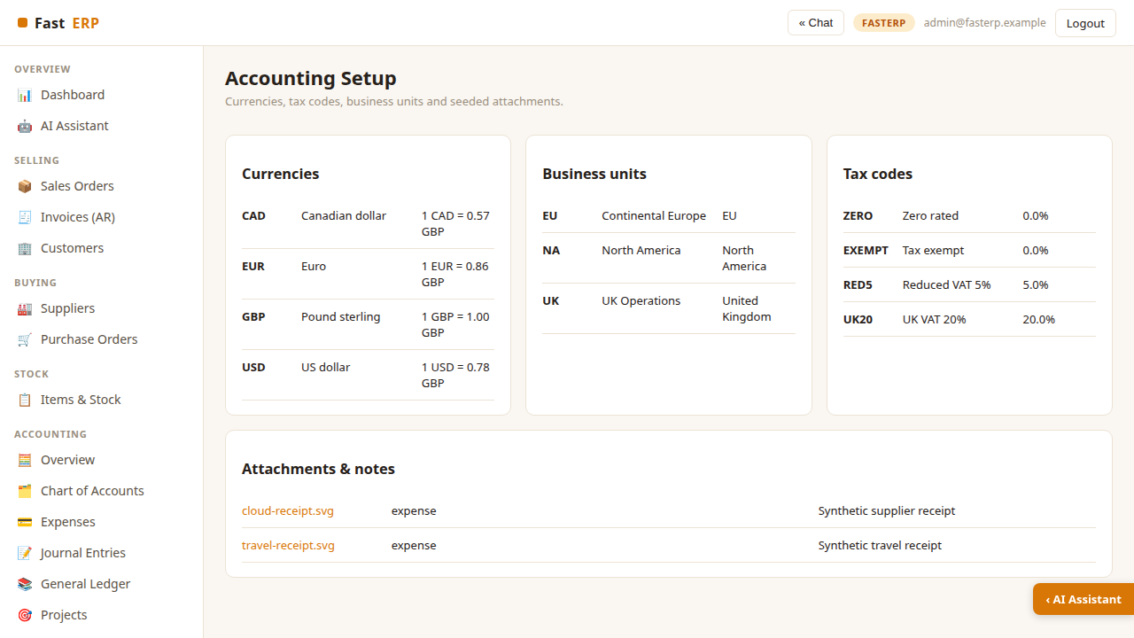
Configure accounting dimensions
• GBP, EUR, USD and CAD exchange rates.
• UK, EU and North America business units.
• zero, exempt, reduced and standard VAT codes.
• synthetic receipt images and notes.
FastERP · Synthetic accounting workspace · 2026-07-28

Slide 9
Follow linked operational transactions
Sales invoices post Accounts Receivable, Sales Revenue, Cost of Goods Sold and
Inventory. Recording payment moves the balance from Accounts Receivable to
Cash. Receiving a purchase order increases Inventory and Accounts Payable.
Use General Ledger to filter an account and trace the shared transaction
reference, such as INV-7042, PO-6018, EXP-8001 or JE-9001. This creates a
clear audit trail between operational workflows and accounting.
FastERP · Synthetic accounting workspace · 2026-07-28

Slide 10
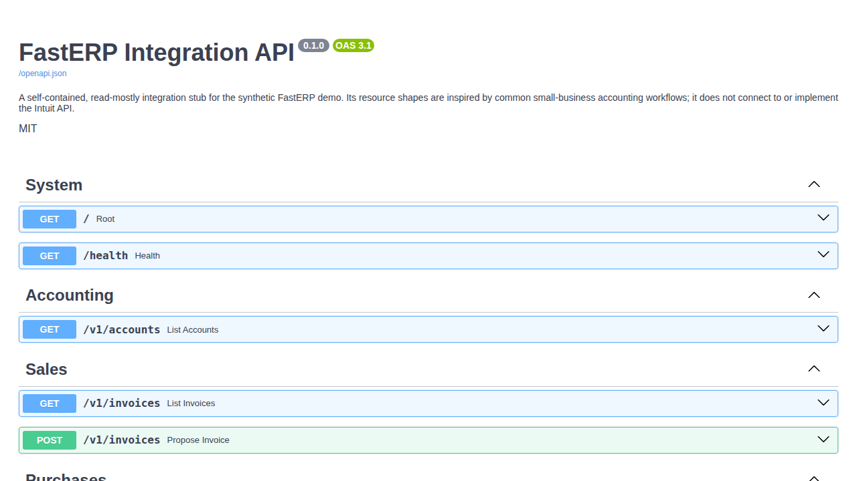
Explore the integration API
Run the API separately:
.venv/bin/uvicorn api_app:app --port 5012
Open http://localhost:5012/docs for Swagger UI. The stub exposes accounts,
invoices, expenses, projects, Profit & Loss, Trial Balance and a webhook example.
POST /v1/invoices validates and previews a payload but deliberately does not
post it. The API is a future connector boundary, not an Intuit integration.
FastERP · Synthetic accounting workspace · 2026-07-28

Slide 11
Verification and safety
Run .venv/bin/python -m pytest -q before changing accounting behavior. Tests
assert that seeded books and new postings remain balanced, invalid journals are
rejected, and API previews are non-posting.
FastERP is a demonstration, not production accounting software. Exchange rates,
tax treatment and reports are illustrative. Never replace the synthetic database
or receipt assets with personal, banking or customer production data.
FastERP · Synthetic accounting workspace · 2026-07-28

