Slide 1
FastESM
Platform Guide
2026-08-19 • https://esm.fastsme.com
**FastESM** is an open-source **Enterprise Service Management (ESM)** platform built with — Python-first, server-side, HTMX-driven, no JavaScript framework. It takes the ITSM ticket/SLA model and extends it across **every department** (IT, HR, Facilities, Finance): a **service catalog** you browse like a webshop, **req

Slide 2
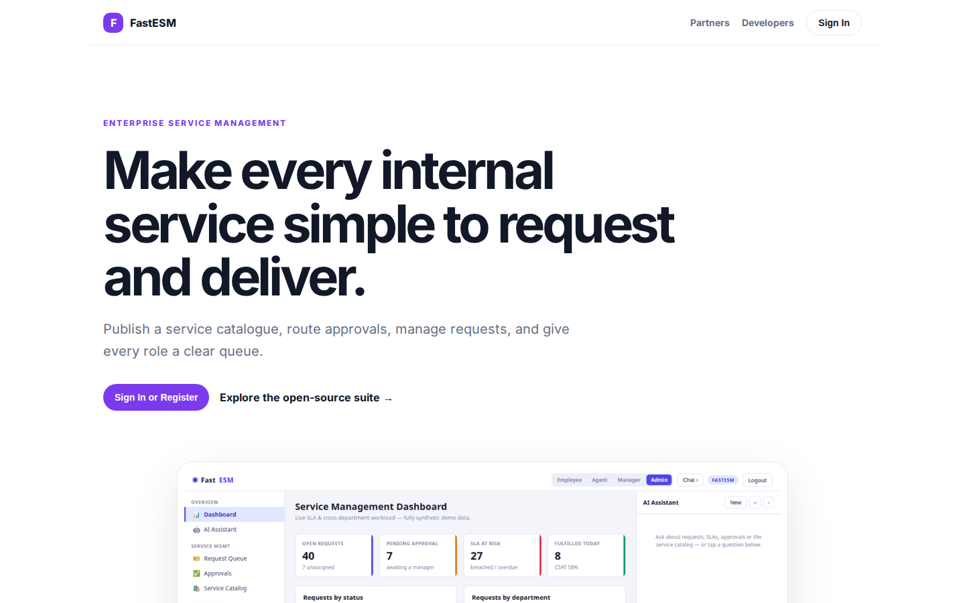
Make every internal service simple to request and deliver.
ENTERPRISE SERVICE MANAGEMENT Make every internal service simple to request and deliver. Publish a service catalogue, route approvals, manage requests, and give every role a clear queue. Sign In or Register Explore the open-source suite → Product tour · see th
https://esm.fastsme.com/

Slide 3
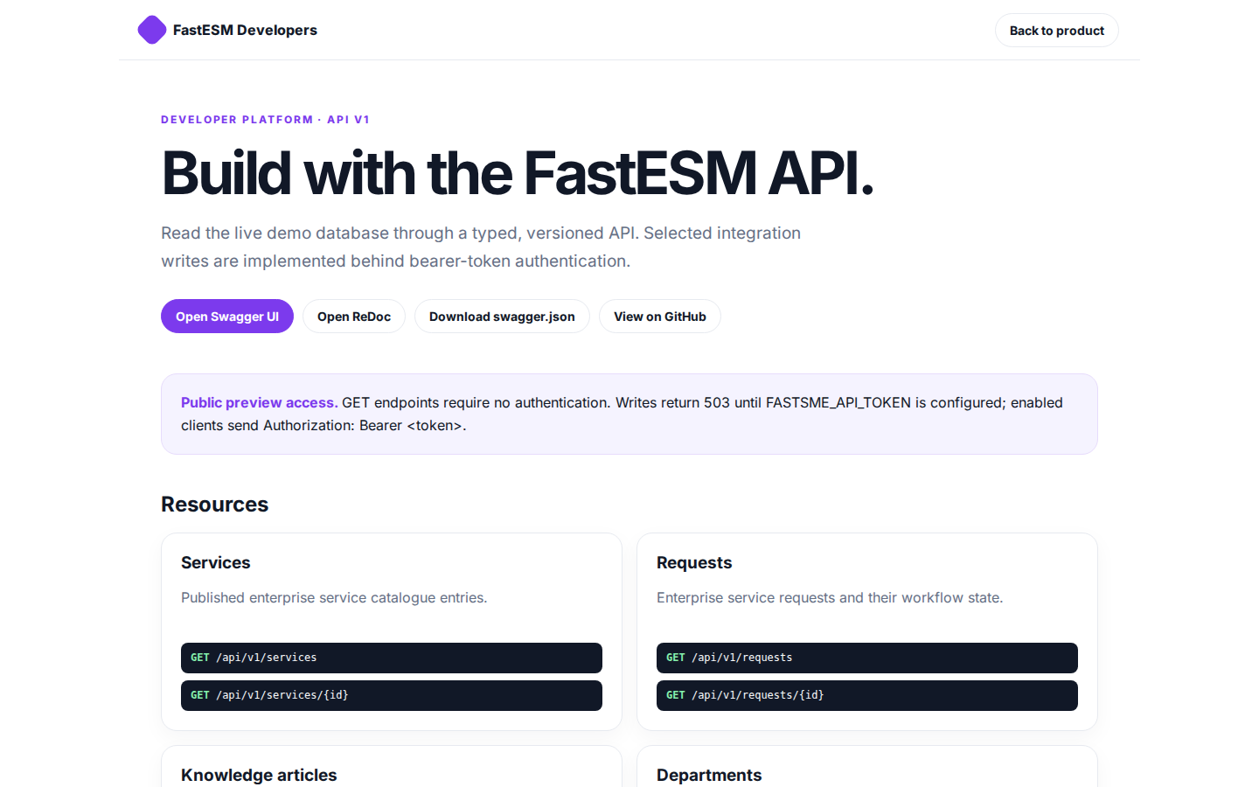
Build with the FastESM API.
FastESM Developers Back to product DEVELOPER PLATFORM · API V1 Build with the FastESM API. Read the live demo database through a typed, versioned API. Selected integration writes are implemented behind bearer-token authentication. Open Swagger UI Open ReDoc Do
https://esm.fastsme.com/developers

Slide 4
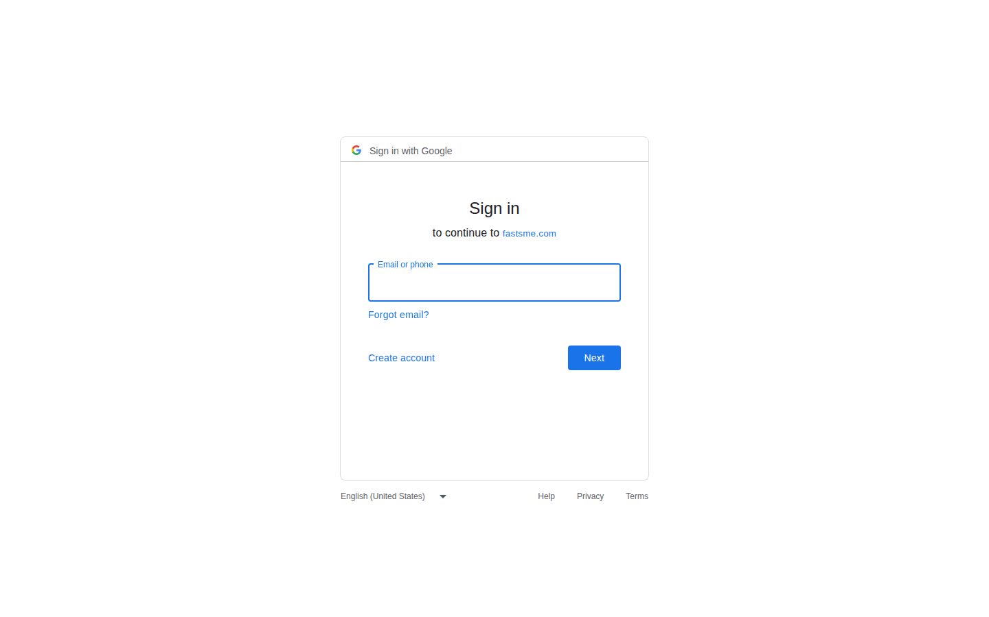
Sign in
Sign in with Google Sign in to continue to fastsme.com Email or phone Forgot email? Next Create account Afrikaans azərbaycan bosanski català Čeština Cymraeg Dansk Deutsch eesti English (United Kingdom) English (United States) Español (España) Español (Latinoam
https://accounts.google.com/v3/signin/identifier?opparams=%253F&dsh=S2098134913%3A1787122713604560&access_type=online&client_id=887059023987-2a7spj1m82eivobdbt1itb3cqca6tpt1.apps.googleusercontent.com&o2v=2&prompt=select_account&redirect_uri=https%3A%2F%2Fesm.fastsme.com%2Fauth%2Fgoogle%2Fcallback&response_type=code&scope=openid+email+profile&service=lso&state=brqJv00iPnVXkUl6LAwpJmZ4as5BoqR_CI4tsePJgKQ&flowName=GeneralOAuthLite&continue=https%3A%2F%2Faccounts.google.com%2Fsignin%2Foauth%2Flegacy%2Fconsent%3Fauthuser%3Dunknown%26part%3DAJi8hAO4L_MbbPFwldikT7P1aQ4h1PY2aCLdFgHpF6CvjLopduxNUXt1R8jDMCbgmKeY6TSbc-cIRt665-P7_1HmtGuxnkLDOpThRguKJxWSynjw4F7rolPfHFbt485eVAtBjXLkXKf-0Gw8613V5-G7CMGz6JbaWzAomIrwpt3_ReSyssD26Cw_RXX8AOC201YDgjzdJjI-2oL017uOjlJ1cN-U11fnI5y04uBOy1WQkqWG1LG1Y7fr1k7_DzdCXWekoJ2S0Hq63YlWyKc_tGndMfjqepU1VG_jfbs8r9f6S9gqfktKATnkFMW9uKI5p-ESOHnYYswzYL3edMLfEN0sKWU55LAkkCAsH54f3onquheBrHrLyPcE38RMLwxw1X8zokYFCVHaLpxw7_n1n-RbveFGj60QDflyFW0Ers1FMSgjhpJYBJlY2UEkWP377AChucHUzNsSxeu-4Po0I164Jambj0nZQA%26flowName%3DGeneralOAuthFlow%26as%3DS2098134913%253A1787122713604560%26client_id%3D887059023987-2a7spj1m82eivobdbt1itb3cqca6tpt1.apps.googleusercontent.com%23&app_domain=https%3A%2F%2Fesm.fastsme.com&rart=ANgoxcf7gR_B15nkIf95XbkVaYxuyybYBoCOtI4dLYwyTLVNcdgeZQKmcYHepBeXd5qgvvjog2oVwKzvm5iMTWZVQay2XiPWrVy7kp1RTKw481y6O1IktX4

