Slide 1
FastFPA Platform Guide
2026-08-19 • https://fpa.fastsme.com
FastFPA is the open-source financial planning and analysis application in the FastSME suite. It combines driver-based budgets, rolling forecasts, scenarios, variance analysis, workflow, and linked P&L, balance sheet, and cash flow.

Slide 2
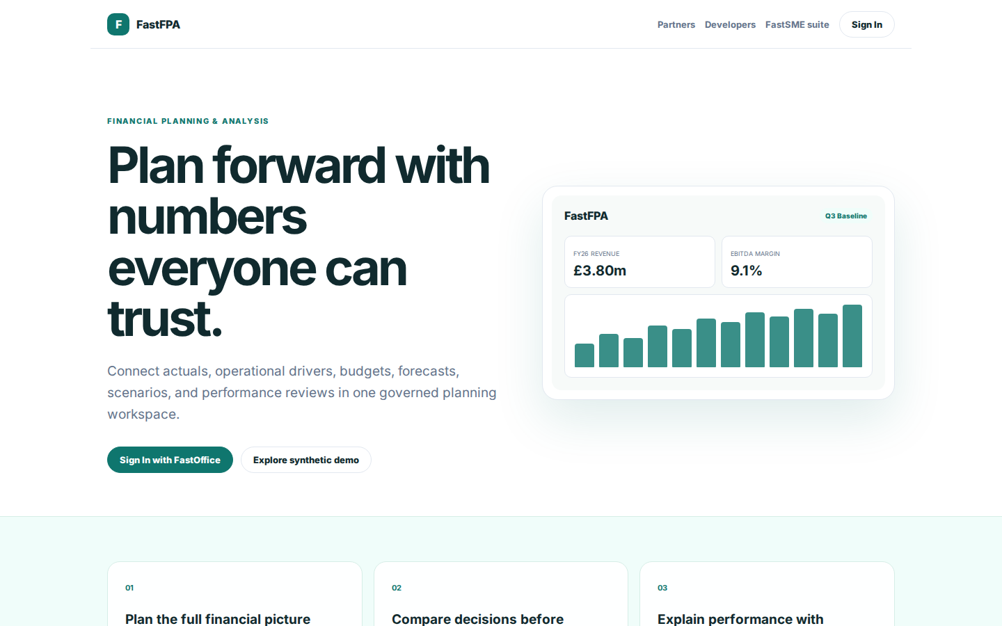
Plan forward with numbers everyone can trust.
FINANCIAL PLANNING & ANALYSIS Plan forward with numbers everyone can trust. Connect actuals, operational drivers, budgets, forecasts, scenarios, and performance reviews in one governed planning workspace. Sign In with FastOffice Explore synthetic demo FastFPA
https://fpa.fastsme.com/

Slide 3
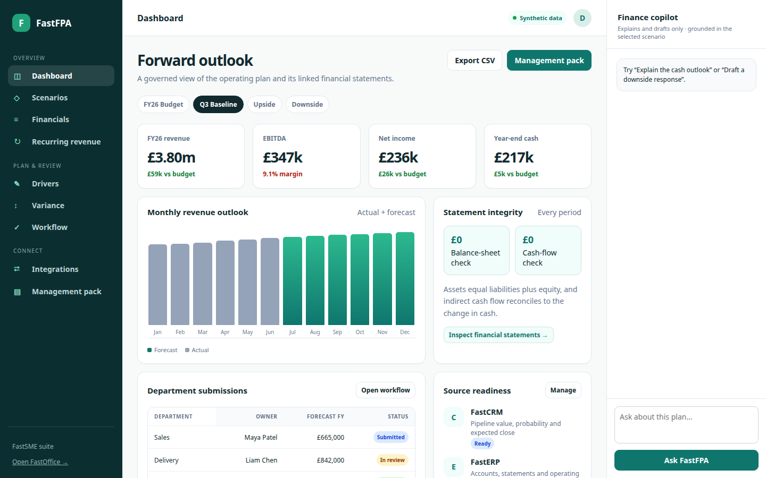
Forward outlook
Dashboard Synthetic data D Forward outlook A governed view of the operating plan and its linked financial statements. Export CSV Management pack FY26 Budget Q3 Baseline Upside Downside FY26 revenue £3.80m £59k vs budget EBITDA £347k 9.1% margin Net income £236
https://fpa.fastsme.com/

Slide 4
Forward outlook
Dashboard Synthetic data D Forward outlook A governed view of the operating plan and its linked financial statements. Export CSV Management pack FY26 Budget Q3 Baseline Upside Downside FY26 revenue £3.80m £59k vs budget EBITDA £347k 9.1% margin Net income £236
https://fpa.fastsme.com/

Slide 5
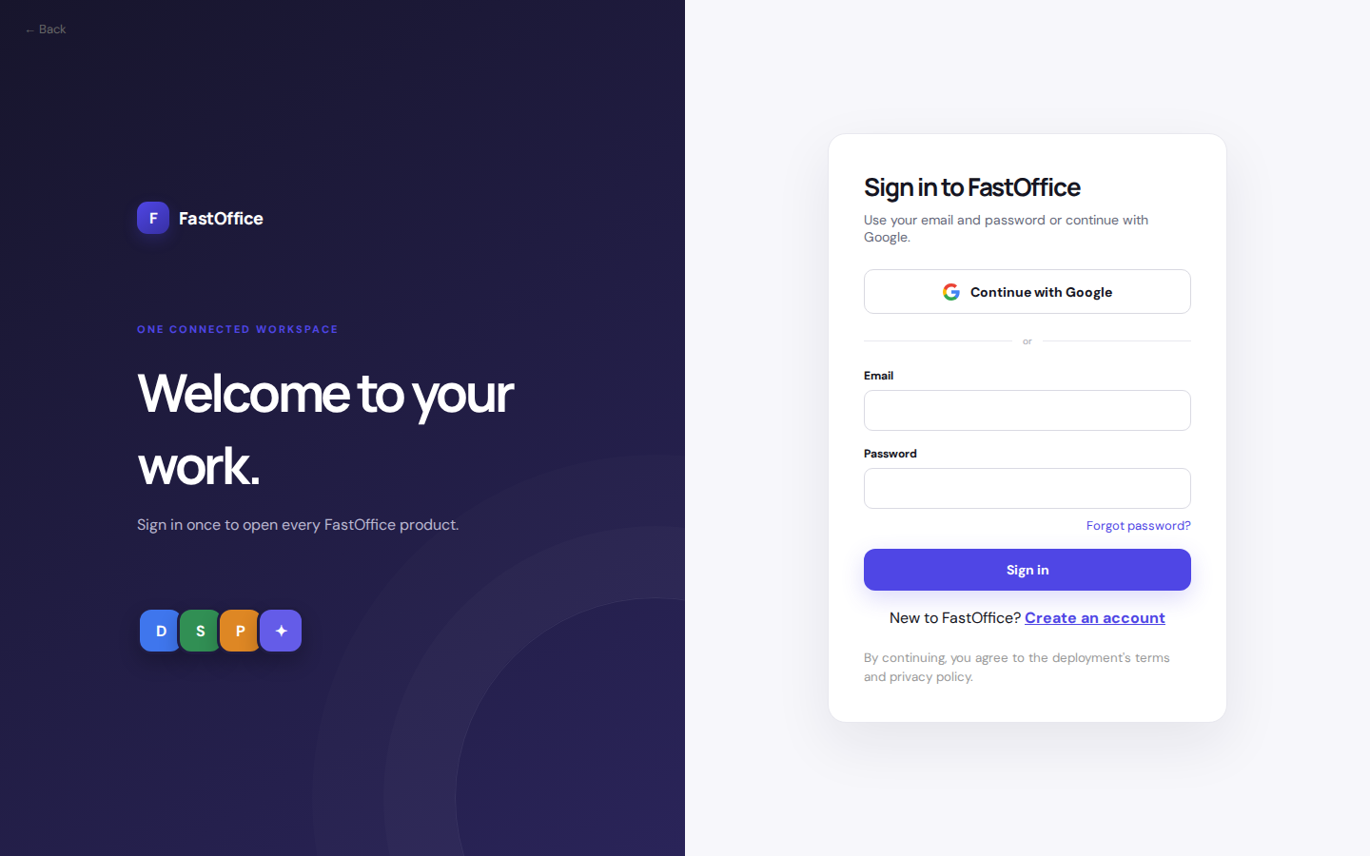
Welcome to your work.
← Back F FastOffice ONE CONNECTED WORKSPACE Welcome to your work. Sign in once to open every FastOffice product. D S P ✦ Sign in to FastOffice Use your email and password or continue with Google. Continue with Google or Email Password Forgot password? Sign in
https://office.fastsme.com/login?next=/launch/fpa

