Slide 1
Factorio — User Guide
Invoice financing, end to end
Generated 2026-07-26 · Live at factorio.co.uk

Slide 2
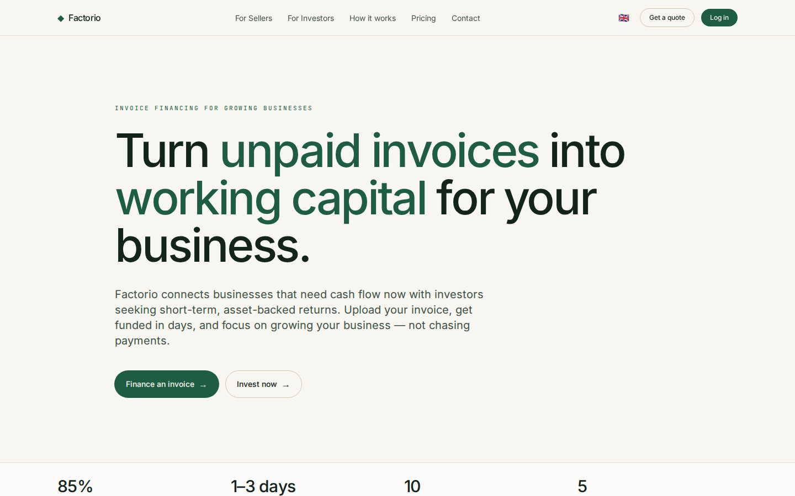
OVERVIEW
What Factorio is
• An invoice-financing marketplace connecting two sides: sellers who need cash now and investors seeking short-term, asset-backed returns.
• One site serves both — a marketing front and an HTMX-driven product app.
• The hero summarizes the model: advance rate, days-to-funding, sectors served and total funded volume (UZS).
• Fully trilingual — English, Oʻzbekcha and Russian — switched from the top navigation.

Slide 3
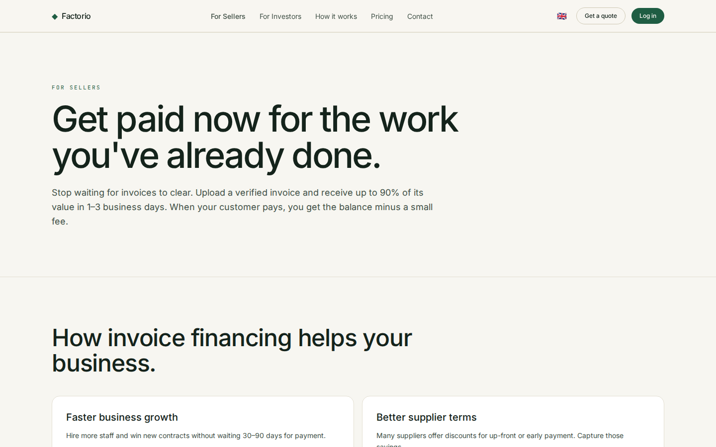
FOR SELLERS
Turn invoices into working capital
• Get a large share of an invoice advanced in days instead of waiting 30–120 days for the debtor to pay.
• The seller journey: submit an invoice → get it verified and risk-graded → receive the advance → settle when the debtor pays.
• Factoring, not a loan — no new debt on the balance sheet; funding scales with sales.
• Built for manufacturing, wholesale, construction, logistics and services.

Slide 4
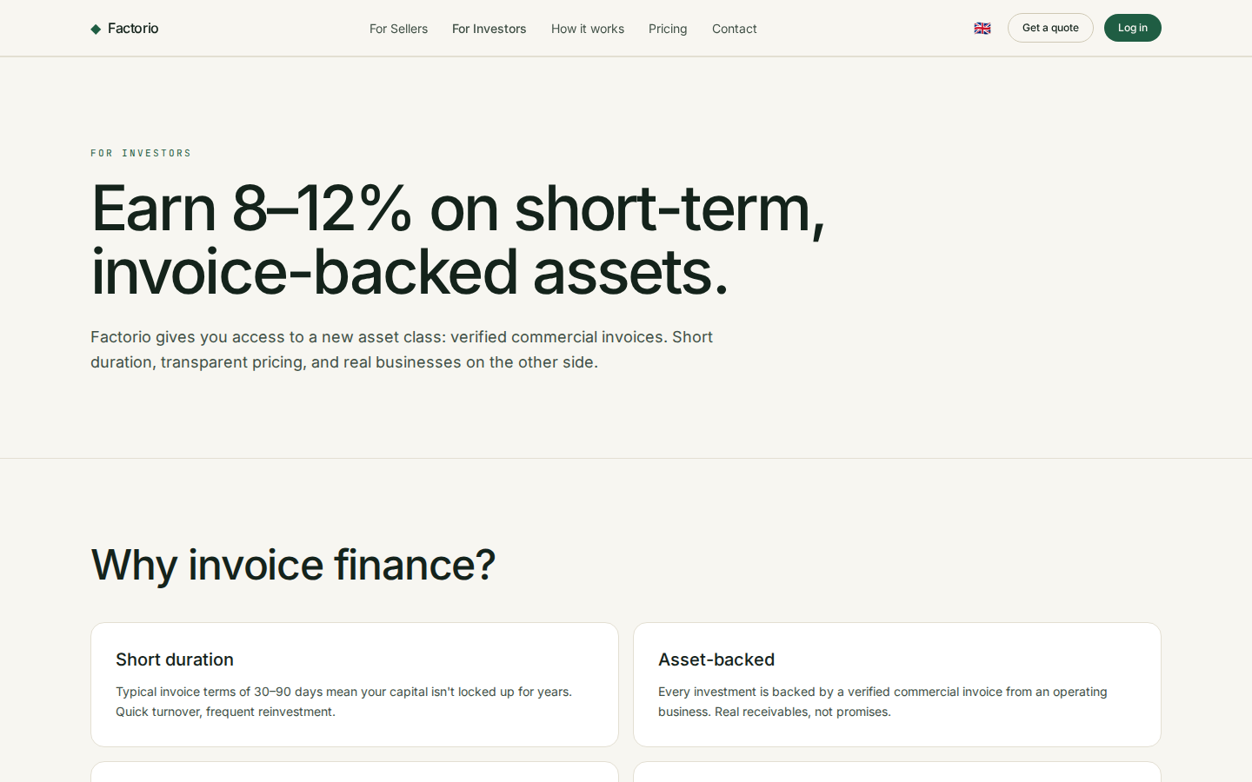
FOR INVESTORS
Short-term, asset-backed returns
• Fund verified invoices and earn a fee/return over a short hold — often just weeks.
• Diversify across debtors, sectors and risk grades (A–D).
• Returns are tied to real receivables, not market speculation.
• Leads into the investor app — dashboard, marketplace and portfolio.

Slide 5
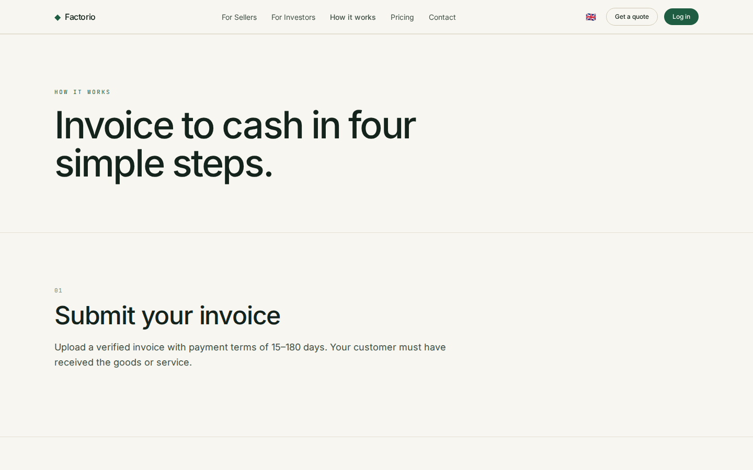
HOW IT WORKS
Four steps, end to end
• Submit — a seller uploads an invoice and company details.
• Verify — Factorio checks the debtor and assigns a risk grade and pricing.
• Fund — the invoice appears on the marketplace; investors fund it to its goal.
• Settle — when the debtor pays, principal + interest are distributed and the position closes.

Slide 6
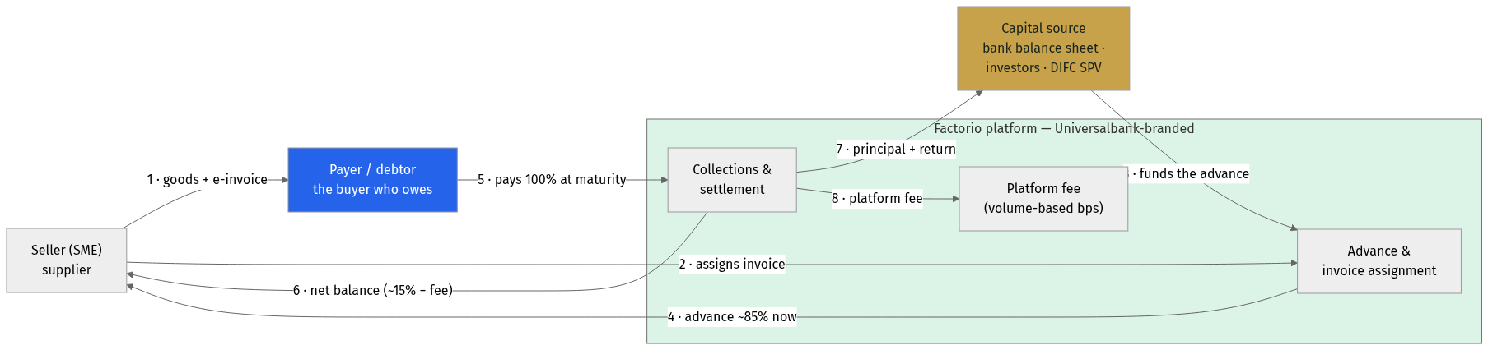
HOW THE MONEY MOVES
Where every party's money comes from
• The seller delivers goods and issues a SoliqOnline e-invoice; the payer (debtor) owes the invoice amount.
• The platform advances ~85% to the seller now, funded by the capital source — the bank's balance sheet, investors, or the DIFC SPV.
• At maturity the payer pays 100% into the collection account; the seller receives the net balance, the capital source gets principal + return, and the platform keeps a volume-based fee.
• The flow is identical whoever funds it — which is what makes the investor / SPV layer pluggable.

Slide 7
JOURNEY · BORROWER (ORIGINATION)
The seller's journey, end to end
• Sign up (bank KYC) → invoice auto-imported from SoliqOnline → request financing in an AI-triage chat.
• Debtor scoring returns indicative terms; the bank approves in one click; collateral is registered with the CBU in under an hour.
• The advance lands in the seller's account in 24–48 hours — no branch visit, no paper.

Slide 8
JOURNEY · INVESTOR
The investor's journey, end to end
• Onboard (KYC / accreditation) → commit capital via the marketplace or the SPV → auto-invest or pick invoices.
• Hold the position with AI portfolio reporting on demand; when the debtor pays at maturity, principal + return are distributed.
• Decomposable: the origination piece (bank-funded) can launch first; the investor marketplace and SPV plug in later, independently.

Slide 9
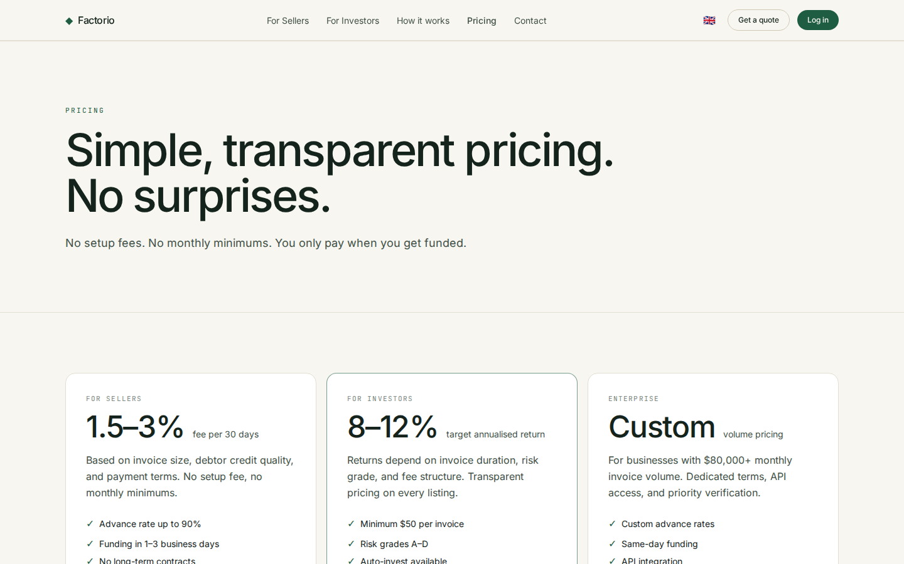
PRICING
Transparent, per-invoice fees
• Pricing is per invoice — a fee per 30 days against the advanced amount, with no hidden charges.
• Shows the headline advance rate and worked example economics.
• No subscription and no commitment to submit an invoice.
• A clear breakdown so both sides understand the return and the cost.

Slide 10
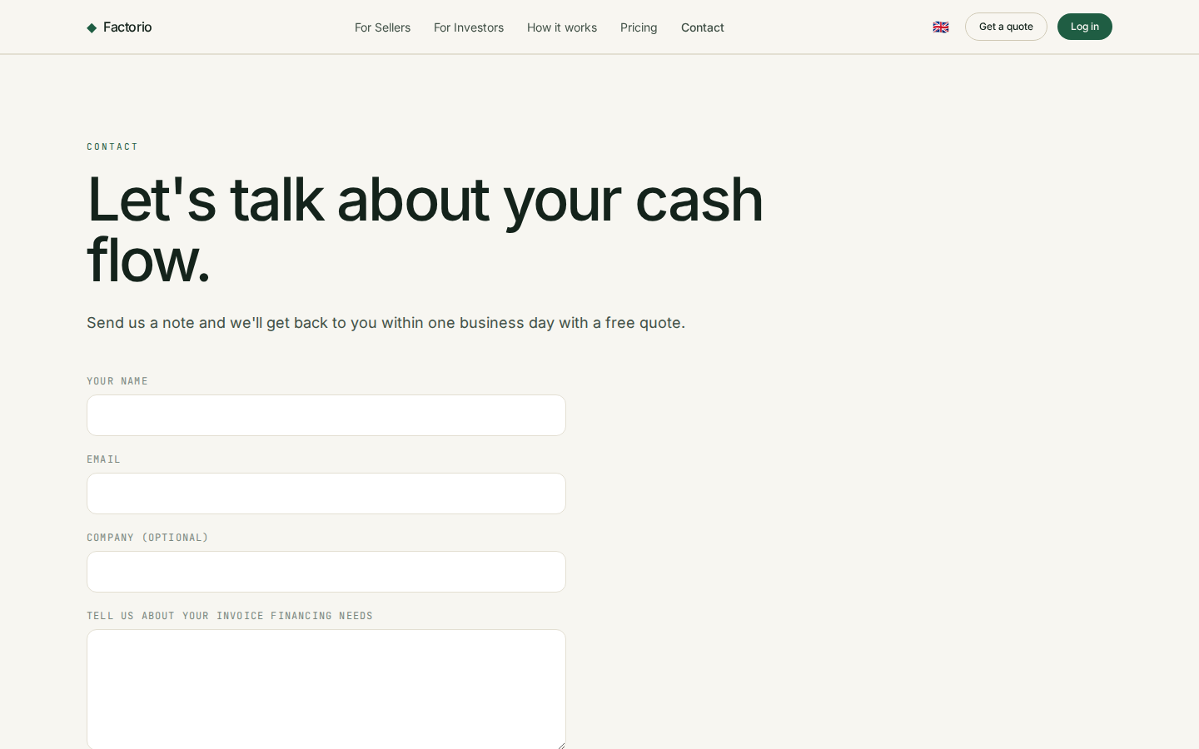
CONTACT
Get in touch
• A contact page for sellers and investors to reach the Factorio team.
• Shows the contact email and a simple enquiry form.
• The entry point to start onboarding.

Slide 11
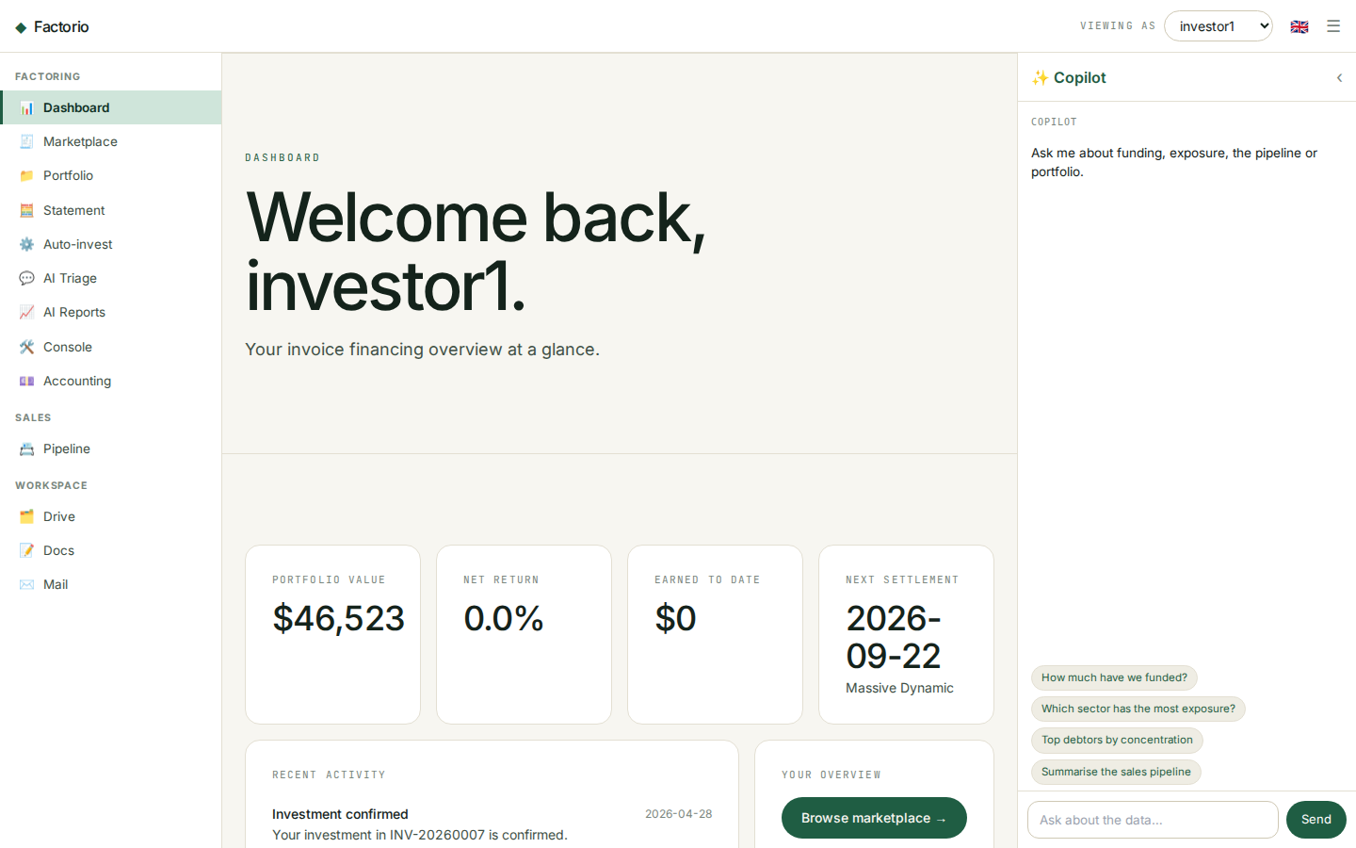
INVESTOR APP · DASHBOARD
Your personalized overview
• The /app home greets the current investor and leads with their own KPIs: portfolio value, net annual return, earned-to-date and the next settlement.
• A recent-activity feed surfaces notifications — fundings, settlements and updates.
• Quick actions jump to the marketplace, portfolio and statement.
• Platform-wide stats are kept as a secondary strip.
• Top-right investor switcher lets you view the app as any investor (demo, no password).

Slide 12
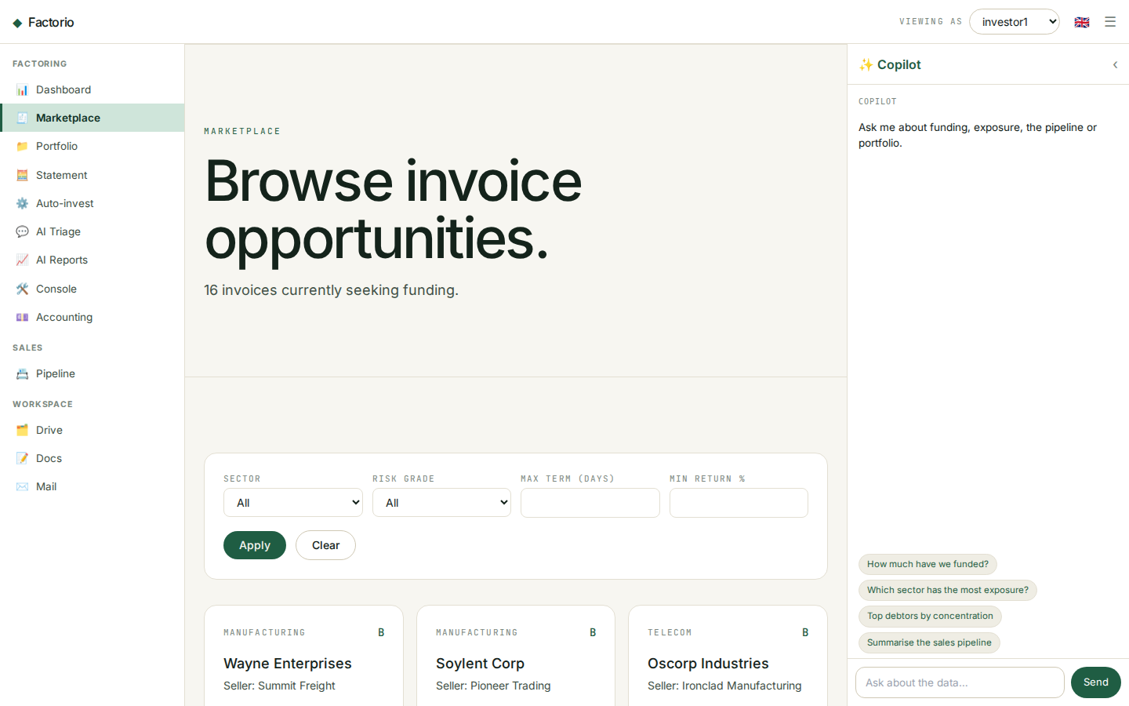
INVESTOR APP · MARKETPLACE
Browse fundable invoices
• Every open, fundable invoice is a card: debtor, sector, risk grade, amount and a live funding-progress bar.
• Each card shows the key economics — advance rate, fee per 30 days and estimated return — plus the target hold in days.
• The filter bar narrows by sector, risk grade, maximum term and minimum return.
• Click a card to open the full invoice detail.

Slide 13
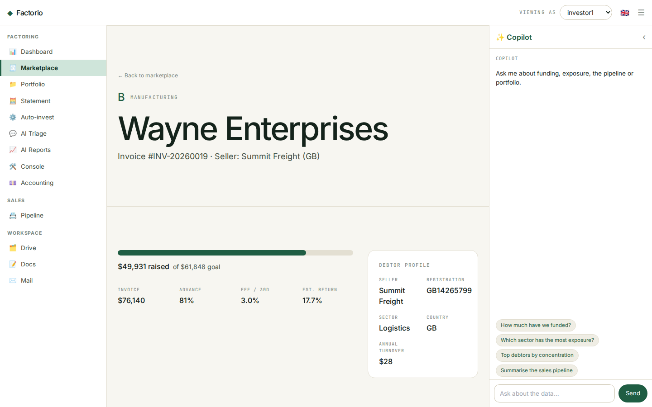
INVESTOR APP · INVOICE DETAIL
Full transparency before you invest
• The headline shows the debtor, risk grade, sector and invoice number.
• A funding panel: amount raised vs goal, advance rate, fee and estimated return.
• A debtor-company profile lists registration number, sector, country and annual turnover.
• Everything needed to make a funding decision on a single screen.

Slide 14
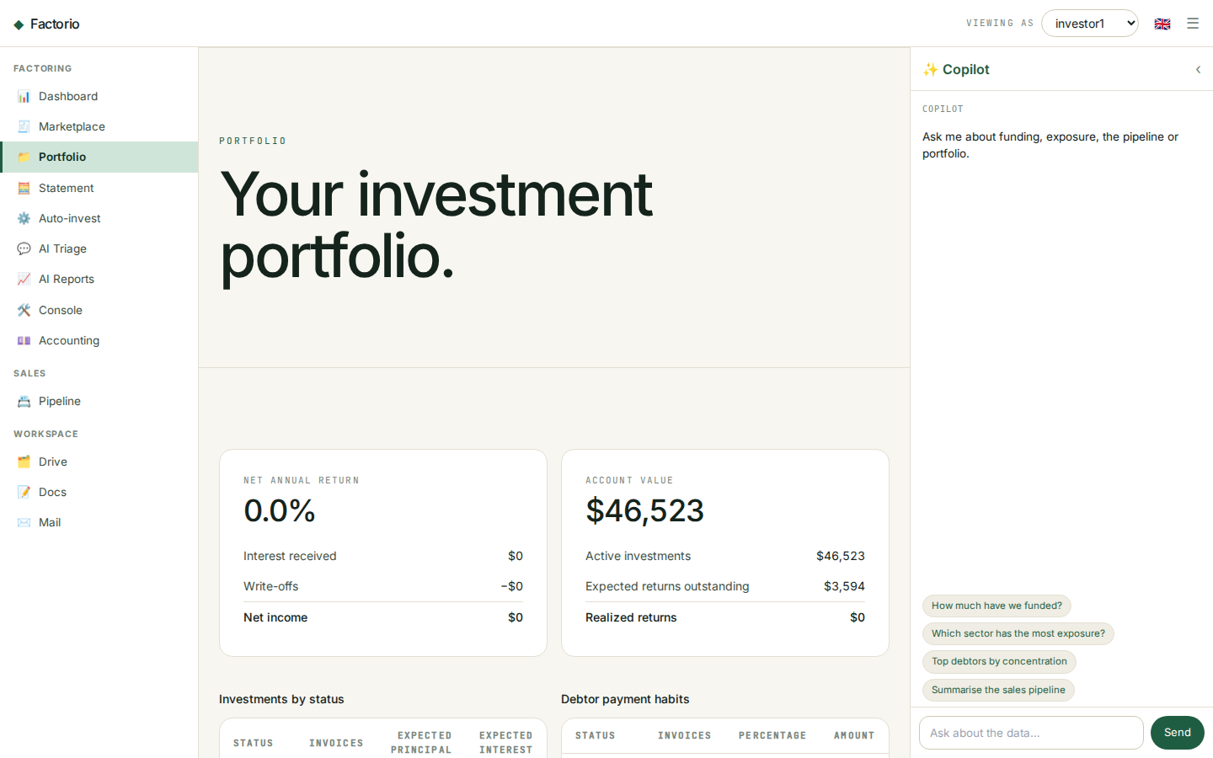
INVESTOR APP · PORTFOLIO
The reporting cockpit
• Two hero panels: net annual return (interest received, write-offs, net income) and account value (active invested, expected outstanding, realized).
• An investments aging table buckets active positions by days to / past due.
• A payment-habits table shows how settled invoices actually paid — early, on time, late or written off.
• A positions table lists every investment with realized return, settlement date, grade and status.

Slide 15
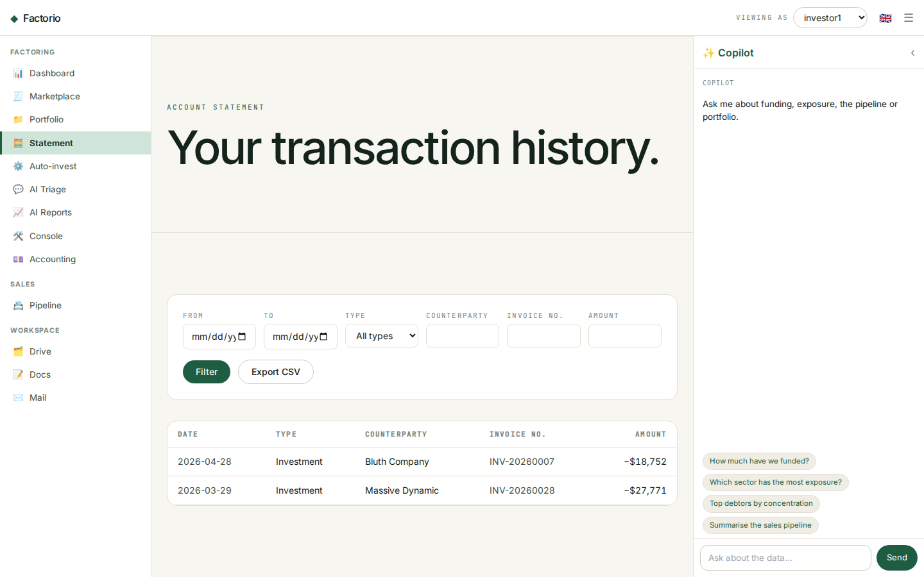
INVESTOR APP · ACCOUNT STATEMENT
Every transaction, filterable
• A unified ledger of cash movements: investments out (−) and settlements in (+).
• Filter by date range, type, counterparty, invoice number and minimum amount.
• Signed amounts in UZS, newest first.
• One-click CSV export for bookkeeping and reconciliation.

Slide 16
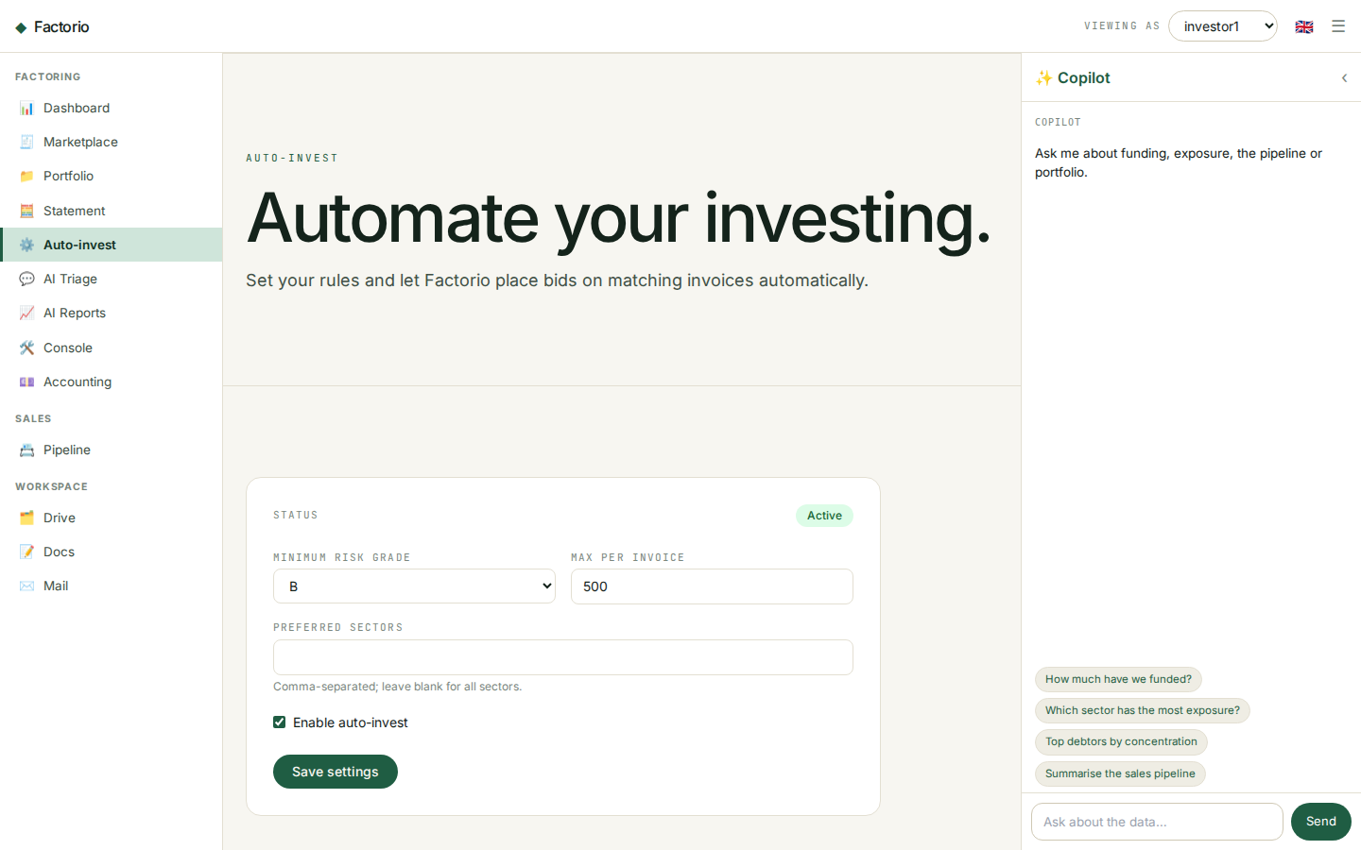
INVESTOR APP · AUTO-INVEST
Set rules, invest automatically
• Configure automated bidding: minimum risk grade, maximum amount per invoice and preferred sectors.
• Toggle the strategy active/inactive; the status is shown at the top.
• Rules are saved per investor and applied to matching new invoices.
• Modelled on investly.co's autobidder.

Slide 17
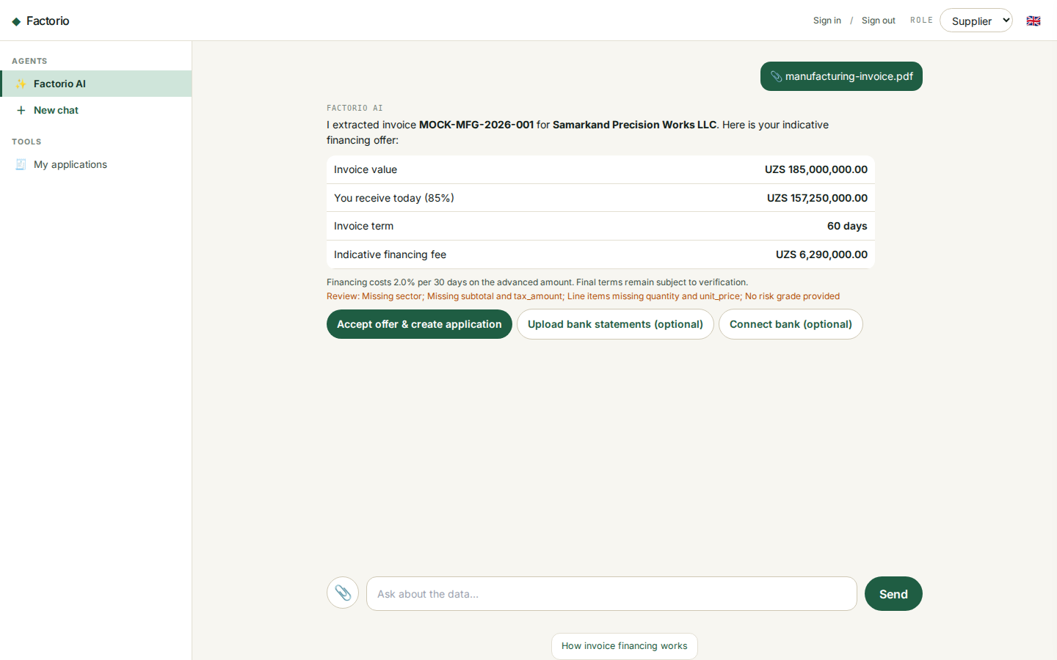
SUPPLIER APP · AI ORIGINATION
From invoice document to financing demand
• Factorio AI is the supplier's default workspace: attach a PDF, image, JSON or text invoice from the chat paperclip.
• Digital PDFs become Markdown locally; only scanned/image-only invoices use the slower xAI vision fallback.
• The chat presents invoice value, the percentage and amount paid today, term and monthly financing cost; bank statements or Open Banking are optional follow-ups.
• Accepting creates the application and a one-page synthetic financing contract between Factorio Ltd and the extracted supplier.

Slide 18
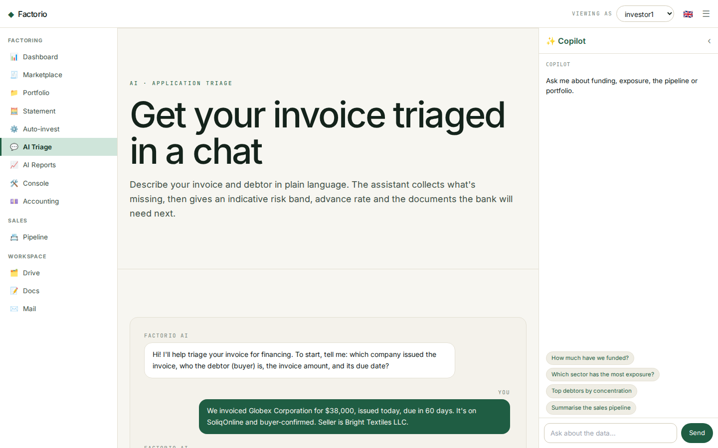
AI · APPLICATION TRIAGE
Chat-based invoice triage
• Sellers describe an invoice and debtor in plain language; the assistant collects only what is still missing.
• It returns an indicative risk band (A–D), an advance rate and the documents the bank needs next — in seconds, not days.
• Powered by Grok (x.ai); everything is indicative and subject to verification — no final decision is automated.
• Fully trilingual — the assistant replies in the visitor's language (English, Oʻzbekcha, Russian).

Slide 19
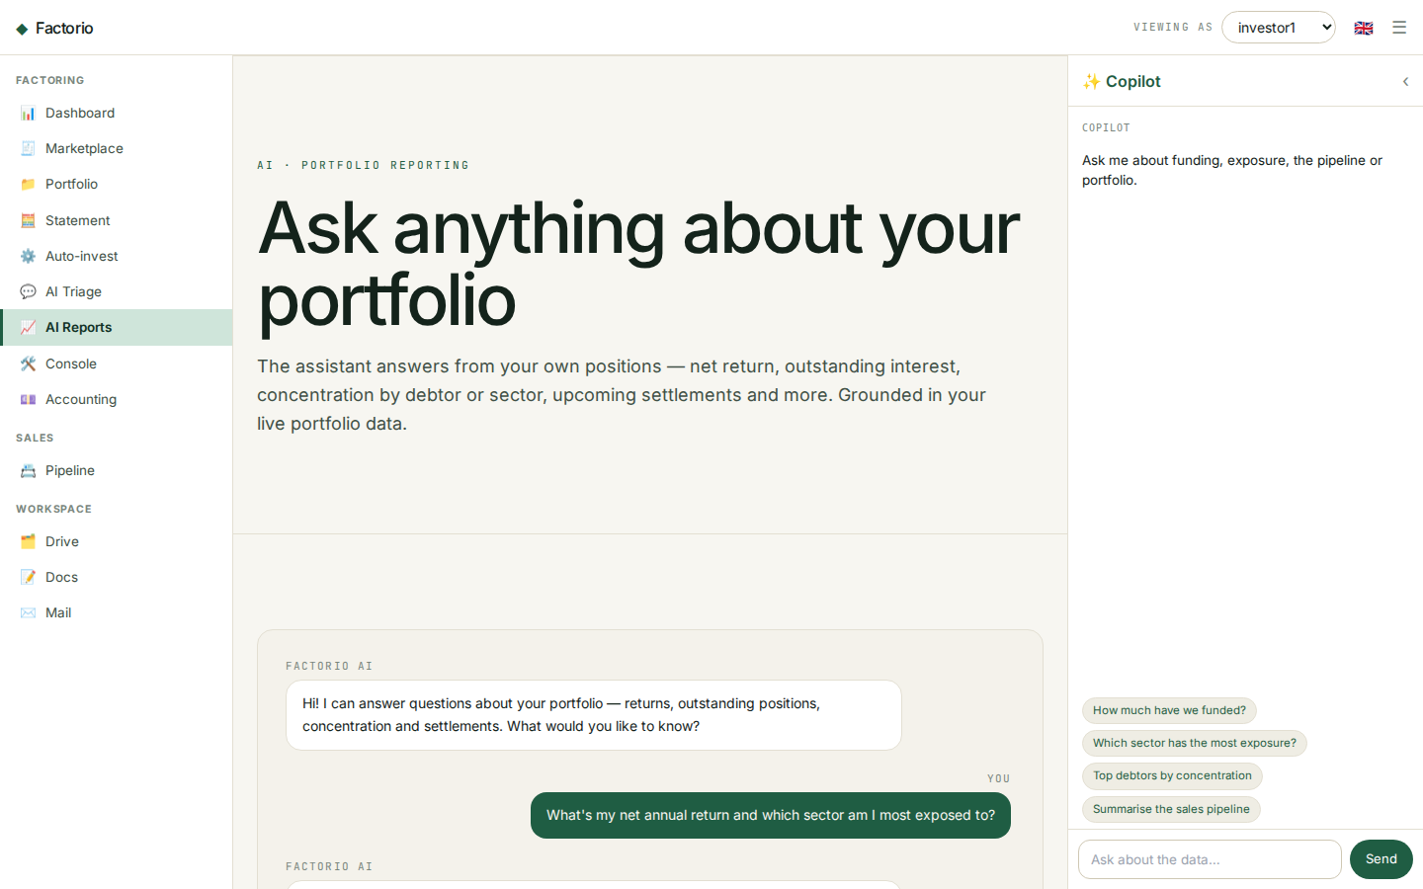
AI · PORTFOLIO REPORTING
Ask your portfolio anything
• Investors ask questions in natural language — net return, exposure by sector or debtor, overdue positions, upcoming settlements.
• Answers are grounded in the investor's own live positions — every figure traces back to real portfolio data, not invented.
• Concrete and specific: it quotes actual amounts and invoice numbers, and says so plainly when the data can't answer.
• The conversational layer on top of the portfolio cockpit — reporting on demand, in the investor's language.

Slide 20
GET STARTED
Start with Factorio
• Sellers — submit an invoice and get an offer in 1–3 working days.
• Investors — browse the marketplace, build a portfolio, automate with auto-invest.
• Live at factorio.co.uk · hello@factorio.co.uk

