Slide 1
FastFactoring Platform Guide
2026-08-19 • https://fastfactoring.org
**FastFactoring** is an open-source invoice-financing platform built with FastHTML, HTMX, and PostgreSQL. It gives product teams an auditable foundation for supplier onboarding, invoice verification, funding, servicing, collections, settlement, and role-specific operations without a proprietary JavaScript application s

Slide 2
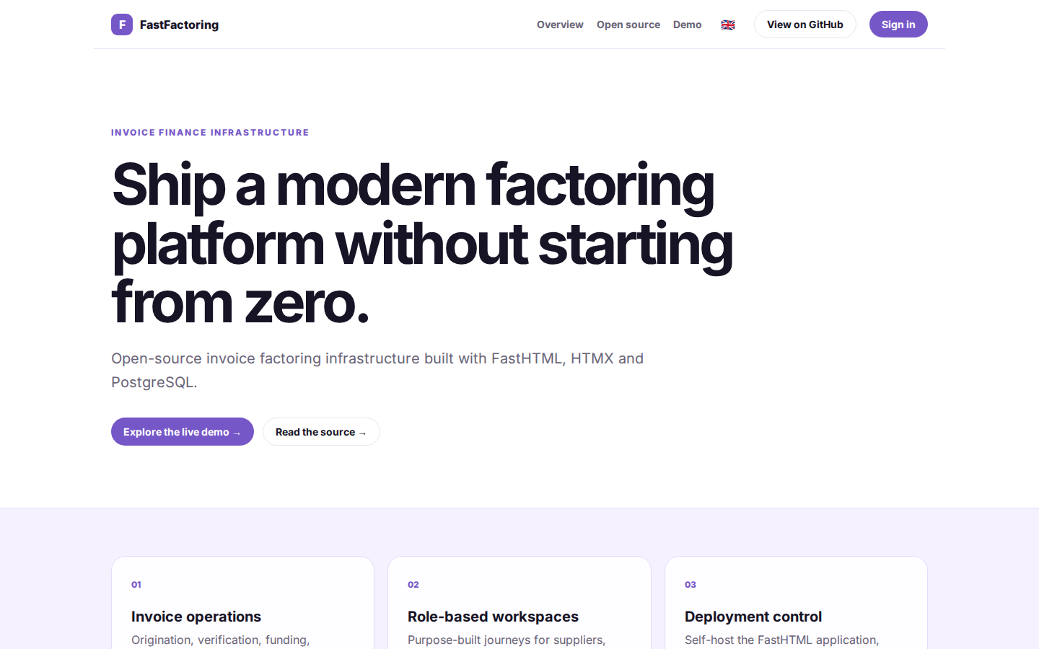
Ship a modern factoring platform without starting from zero.
INVOICE FINANCE INFRASTRUCTURE Ship a modern factoring platform without starting from zero. Open-source invoice factoring infrastructure built with FastHTML, HTMX and PostgreSQL. Explore the live demo → Read the source → 01 Invoice operations Origination, veri
https://fastfactoring.org/

Slide 3
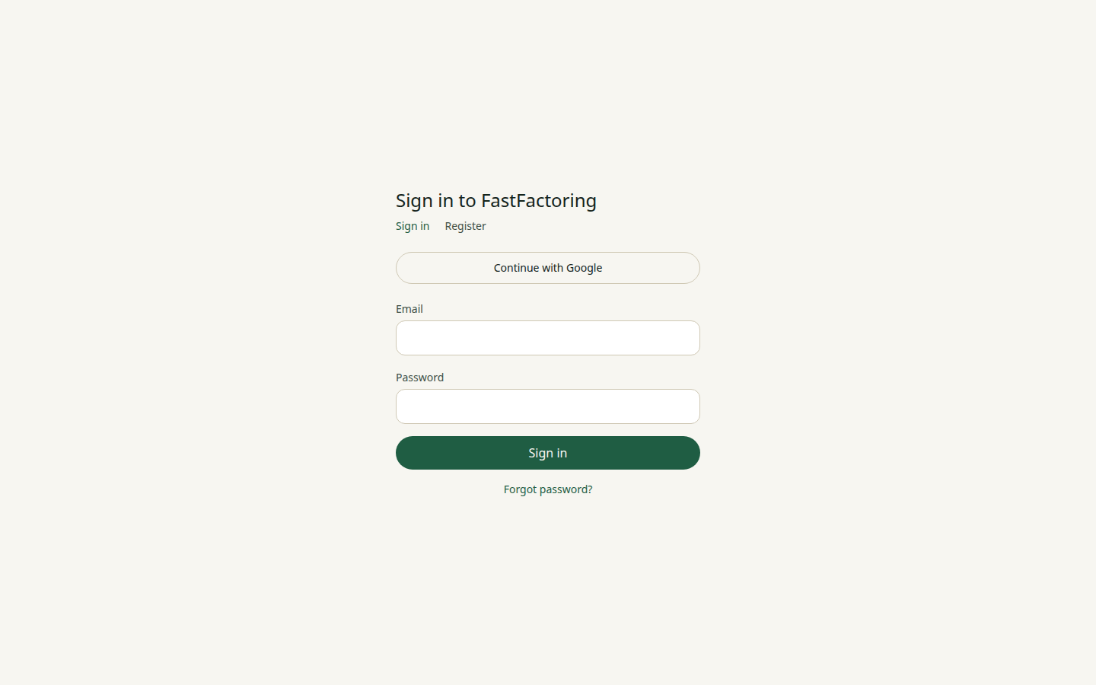
Sign in to FastFactoring
Sign in to FastFactoring Sign in Register Continue with Google Email Password Sign in Forgot password?
https://fastfactoring.org/login

Slide 4
Ship a modern factoring platform without starting from zero.
INVOICE FINANCE INFRASTRUCTURE Ship a modern factoring platform without starting from zero. Open-source invoice factoring infrastructure built with FastHTML, HTMX and PostgreSQL. Explore the live demo → Read the source → 01 Invoice operations Origination, veri
https://fastfactoring.org/fastfactoring

Slide 5
Ship a modern factoring platform without starting from zero.
INVOICE FINANCE INFRASTRUCTURE Ship a modern factoring platform without starting from zero. Open-source invoice factoring infrastructure built with FastHTML, HTMX and PostgreSQL. Explore the live demo → Read the source → 01 Invoice operations Origination, veri
https://fastfactoring.org/fastfactoring

