Slide 1
FACTORIO AI PLATFORM DEMO
User Guide
Supplier · Investor · Admin
Synthetic demonstration data · 2026-07-26

Slide 2
1. Borrower / Supplier

Slide 3
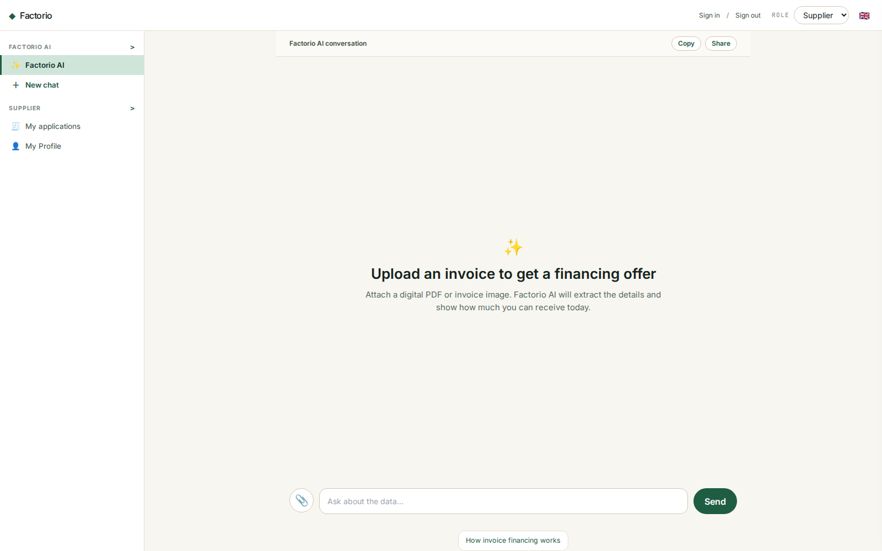
1. BORROWER / SUPPLIER
Start in Factorio AI
• The Supplier demo opens in one AI workspace—there is no marketplace or triage queue.
• Select the paperclip and upload a digital PDF, image, JSON, or text invoice.
• The demo uses synthetic invoices; digital PDFs are converted to Markdown before xAI extraction.
DEMO · SYNTHETIC DATA

Slide 4
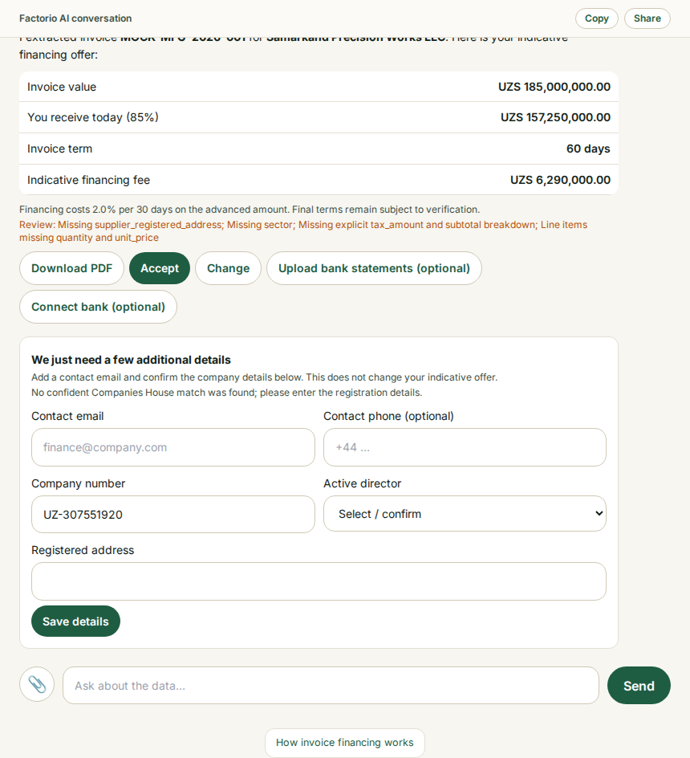
1. BORROWER / SUPPLIER
Upload an invoice and receive an offer
• Factorio AI extracts supplier, debtor, invoice number, amount, dates, bank details, and payment terms.
• The response clearly says “You’re pre-approved!” and presents an indicative offer table.
• Download PDF, Accept, and Change remain visible; final terms are subject to verification.
DEMO · SYNTHETIC DATA

Slide 5
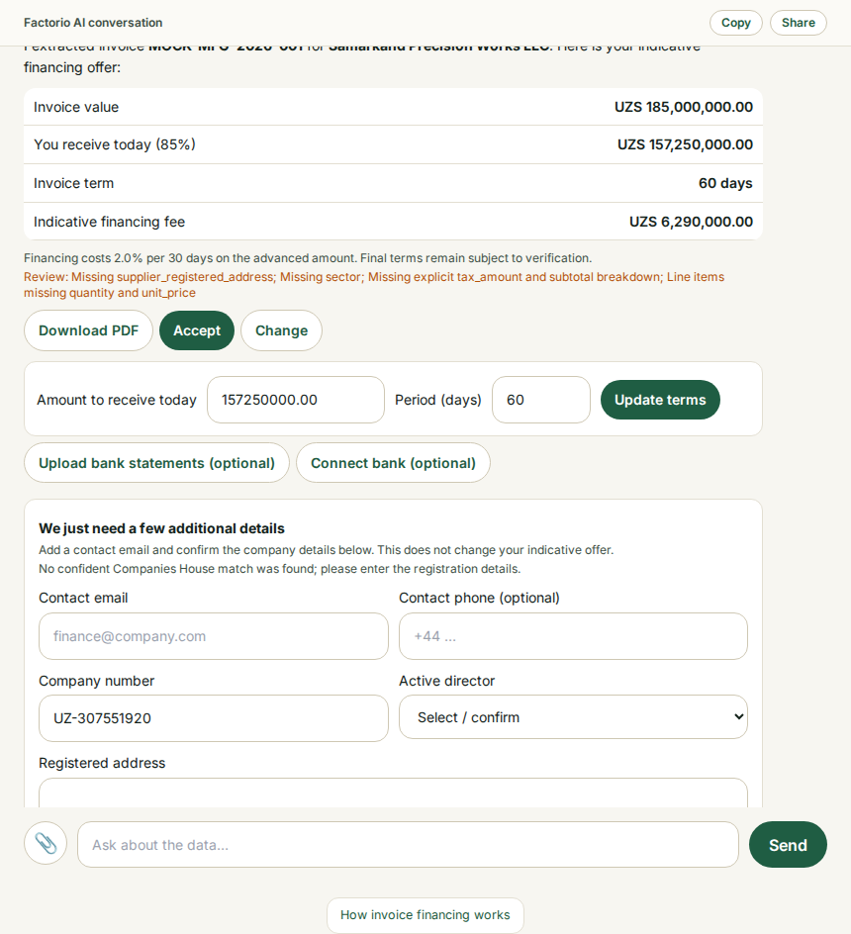
1. BORROWER / SUPPLIER
Change the amount or financing period
• Open Change to request a lower amount paid today or a different period.
• The indicative fee updates from the requested amount and days.
• Add contact details and confirm registry information before acceptance.
DEMO · SYNTHETIC DATA

Slide 6
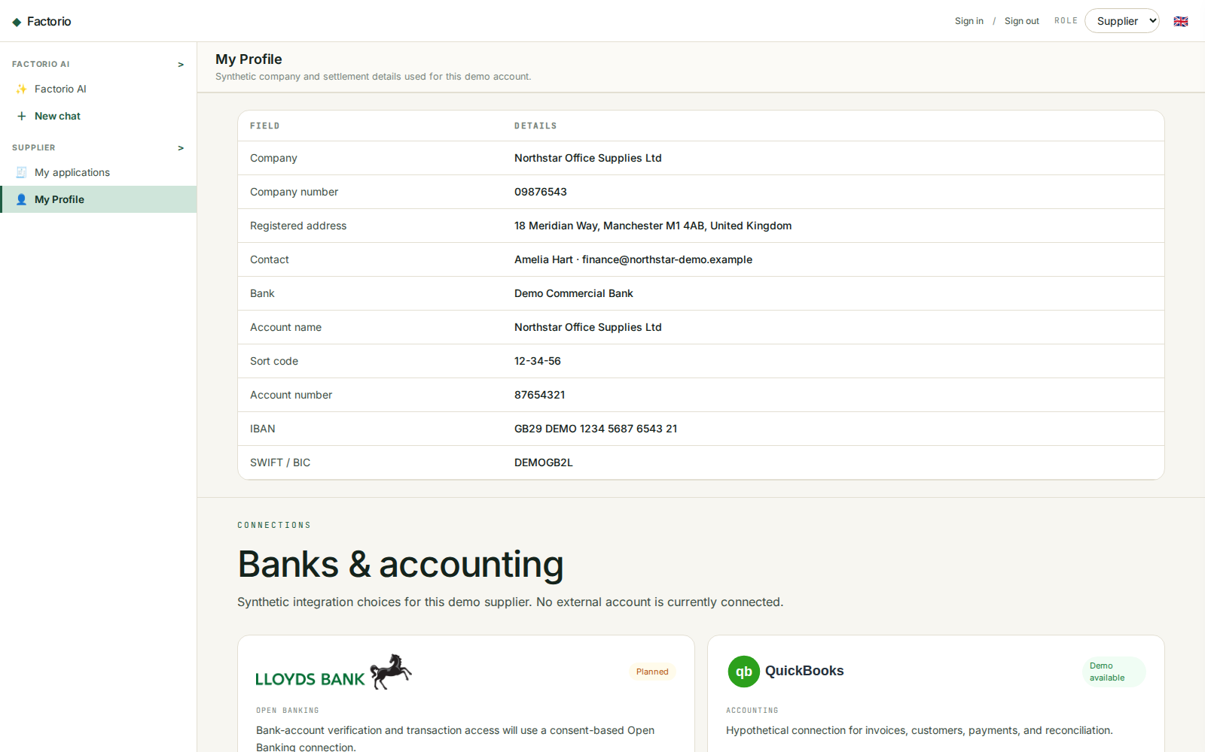
1. BORROWER / SUPPLIER
Profile, banking, and accounting connections
• My Profile contains a hypothetical company identity and masked settlement bank information.
• Lloyds Bank is labelled as a planned Open Banking connection.
• QuickBooks, Xero, and Sage are clearly labelled hypothetical demo integrations.
DEMO · SYNTHETIC DATA

Slide 7
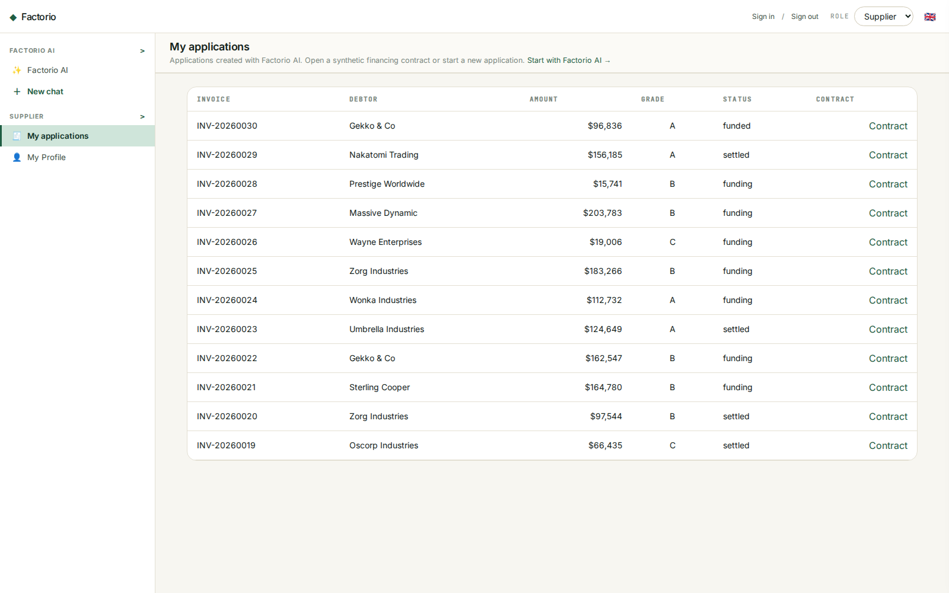
1. BORROWER / SUPPLIER
Track applications and contracts
• My Applications shows synthetic financing requests created from accepted invoices.
• Each accepted request can expose a one-page financing contract between Factorio Ltd and the extracted supplier.
• Downloaded PDFs use supplier, Factorio reference, date, and document-type slugs.
DEMO · SYNTHETIC DATA

Slide 8
2. Investor

Slide 9
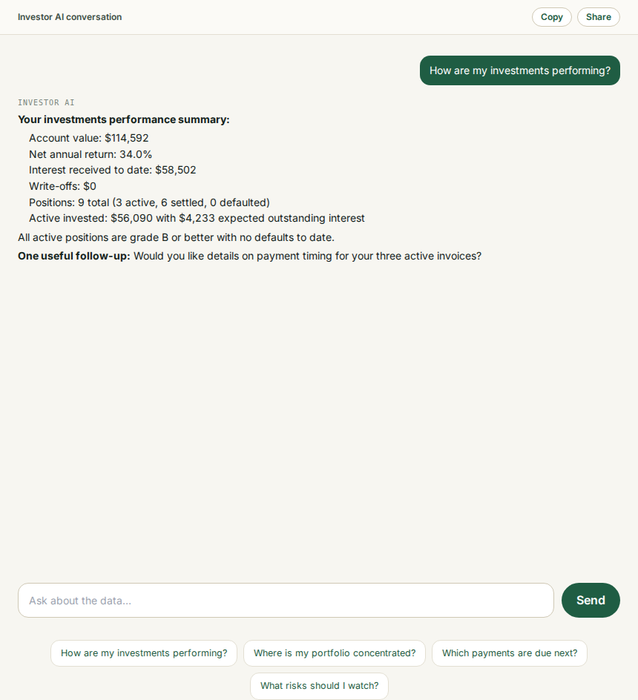
2. INVESTOR
Ask Investor AI about performance
• Investor AI is grounded only in the selected demo investor’s positions and computed metrics.
• Eval question shown: “How are my investments performing?”
• Expected and realised returns are distinguished; the assistant does not guarantee outcomes.
DEMO · SYNTHETIC DATA

Slide 10
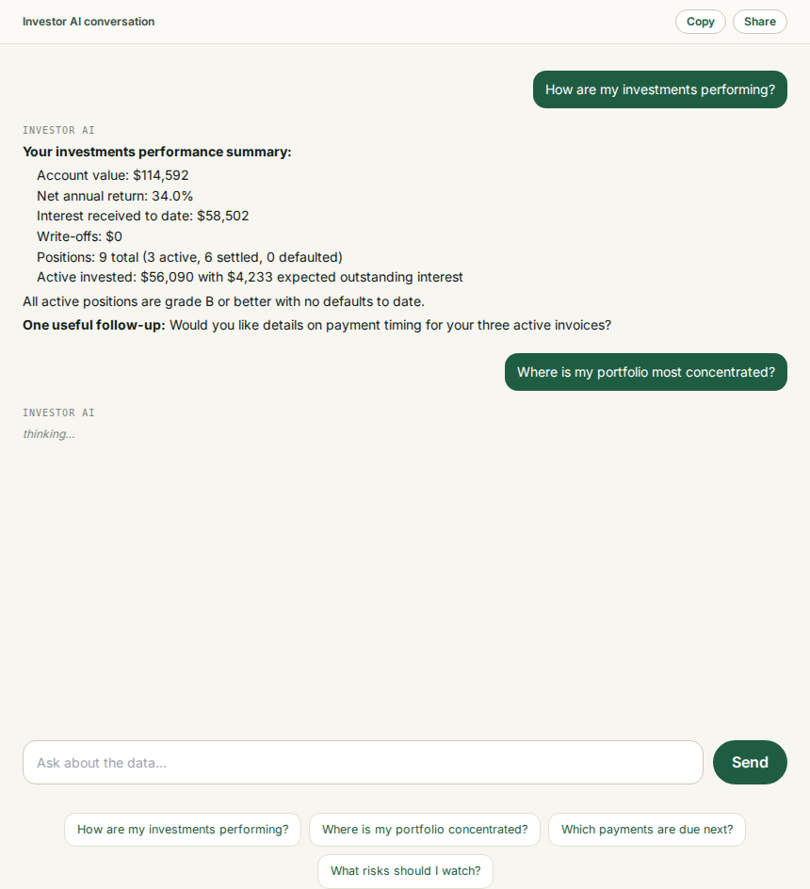
2. INVESTOR
Ask about concentration and risk
• Eval question shown: “Where is my portfolio most concentrated?”
• Debtor and sector exposure percentages are calculated deterministically before reaching the model.
• Copy and Share create portable session transcripts; shared links are read-only snapshots.
DEMO · SYNTHETIC DATA

Slide 11
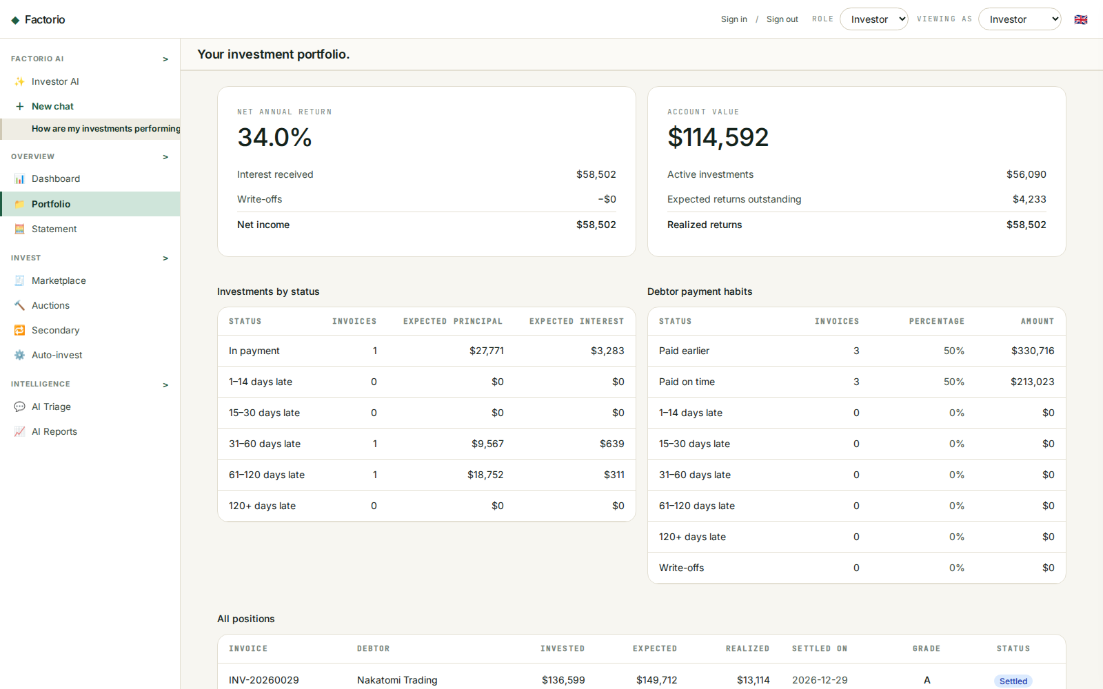
2. INVESTOR
Review the portfolio cockpit
• See account value, net annual return, active invested, expected outstanding, and realised results.
• Aging, payment habits, grades, due dates, and position status support deeper AI questions.
• Use the demo investor selector to compare isolated synthetic portfolios.
DEMO · SYNTHETIC DATA

Slide 12
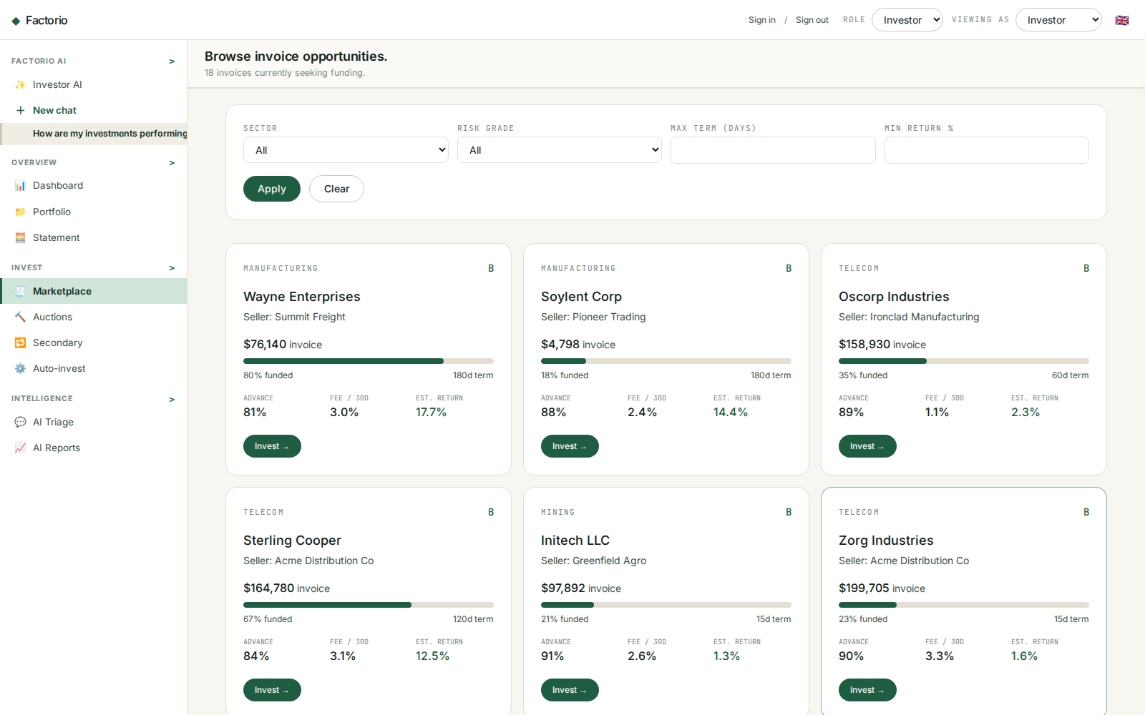
2. INVESTOR
Inspect available invoices
• Browse synthetic open invoices by debtor, sector, risk grade, term, and estimated return.
• Funding progress and invoice economics support manual selection.
• Returns are estimates and invoice financing retains credit, fraud, dilution, concentration, and liquidity risk.
DEMO · SYNTHETIC DATA

Slide 13
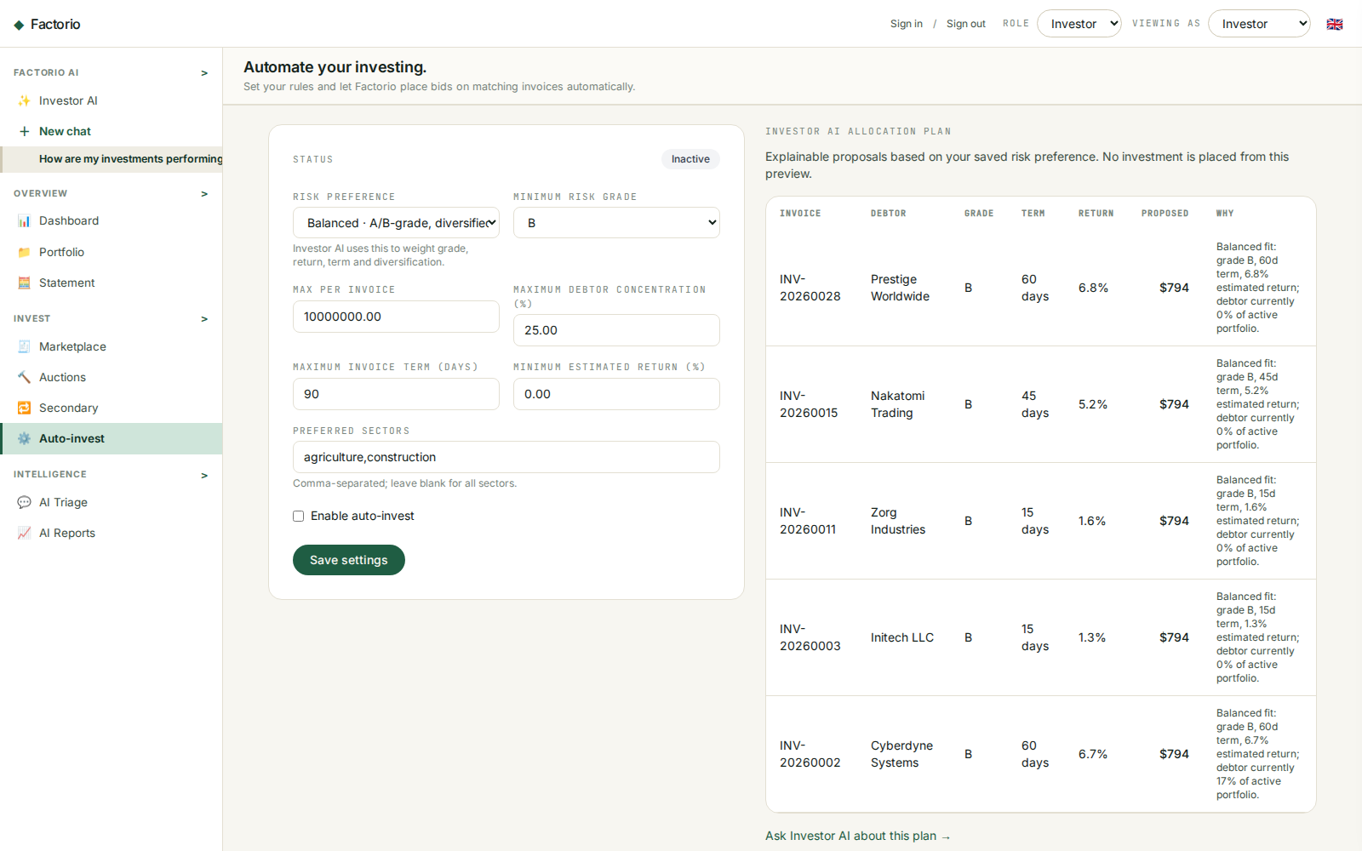
2. INVESTOR
Configure risk-aware Auto-invest
• Choose conservative, balanced, or growth preferences plus grade, term, return, sector, debtor-concentration, and per-invoice limits.
• Investor AI ranks only eligible invoices and explains each proposed allocation.
• The preview does not place money; review or change preferences before execution.
DEMO · SYNTHETIC DATA

Slide 14
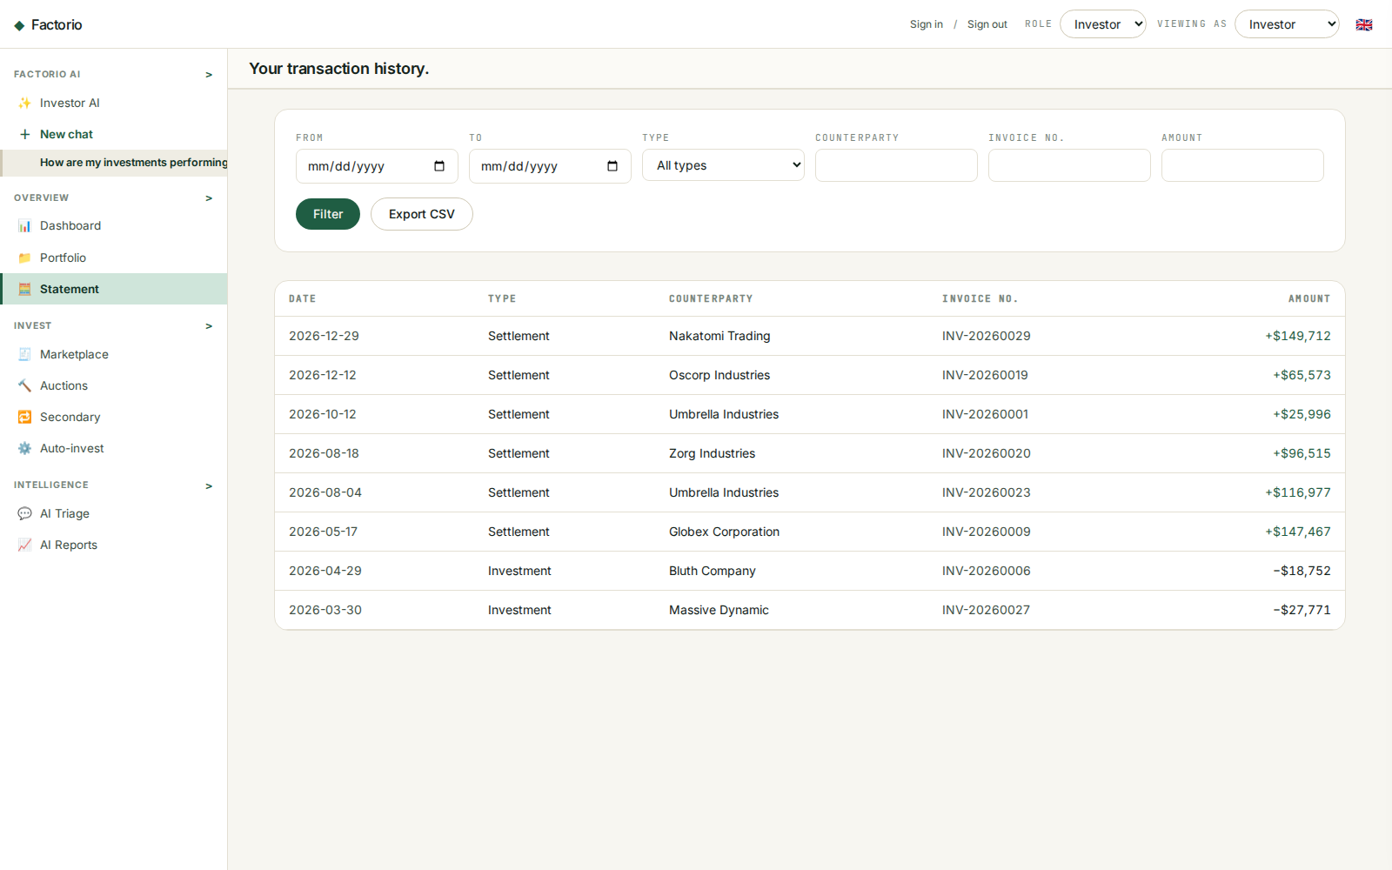
2. INVESTOR
Reconcile investment activity
• The statement records investments and settlements with invoice and counterparty references.
• Filter by date, type, counterparty, invoice, and amount.
• Export CSV for external analysis or reconciliation.
DEMO · SYNTHETIC DATA

Slide 15
3. Admin

Slide 16
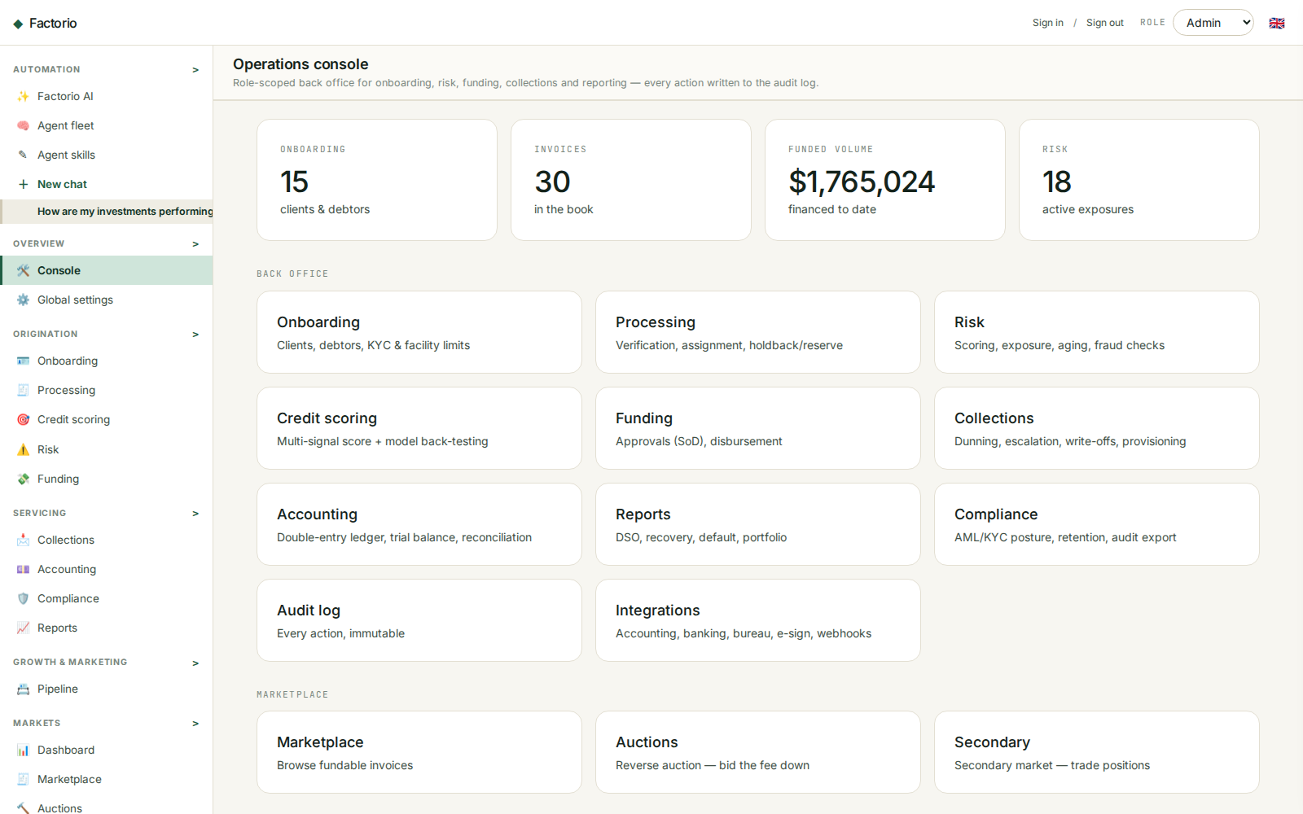
3. ADMIN
Operate the back office
• Admin sees platform KPIs, queues, exceptions, and operational navigation in one workspace.
• Navigation groups are collapsible and can be minimized to keep a complex toolset manageable.
• Global settings include the USD, GBP, EUR, or UZS display-currency override.
DEMO · SYNTHETIC DATA

Slide 17
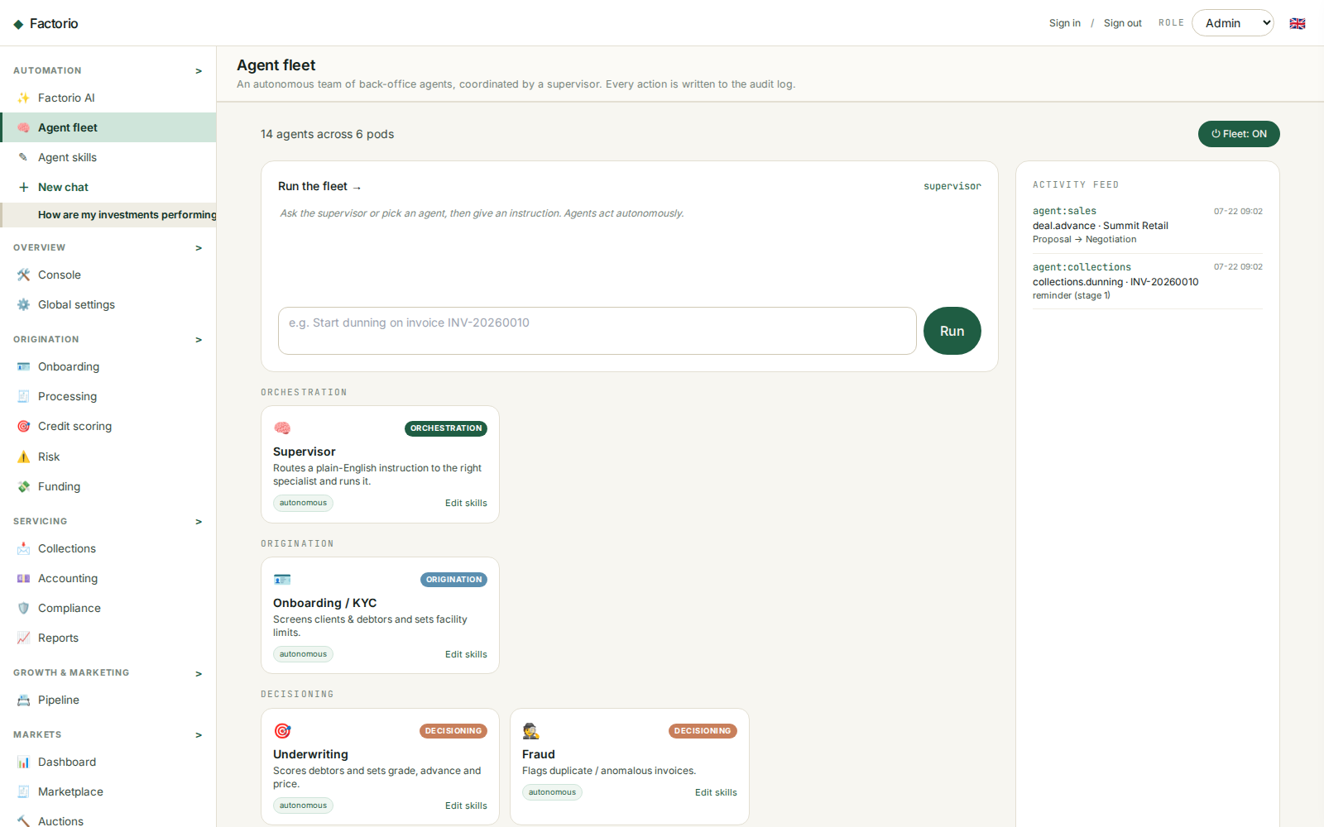
3. ADMIN
Coordinate the Agent Fleet
• Fourteen specialists span orchestration, origination, decisioning, servicing, oversight, and growth.
• Agents use grounded tools and preserve approval gates for credit, communication, publishing, spend, and money movement.
• The activity feed makes agent operations auditable.
DEMO · SYNTHETIC DATA

Slide 18
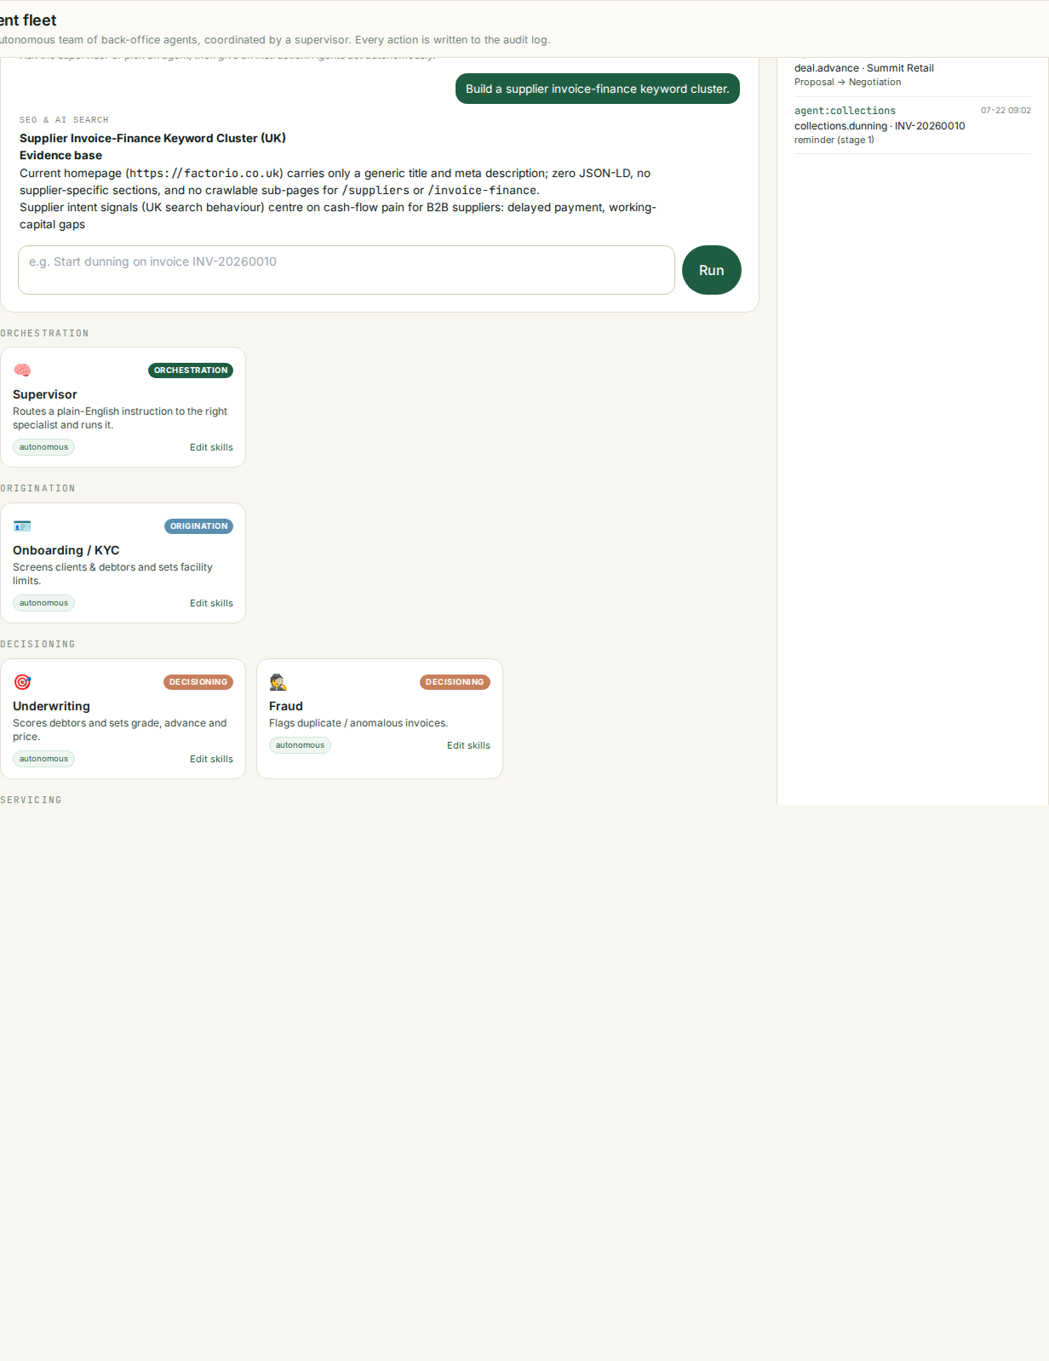
3. ADMIN
Run marketing and SEO agents
• Browser-driven eval question shown: “Build a supplier invoice-finance keyword cluster.”
• SEO & AI Search and Paid Marketing agents create research and drafts without silently publishing or activating spend.
• Campaign work should include audience, intent, evidence, measurement, guardrails, and explicit approval.
DEMO · SYNTHETIC DATA

Slide 19
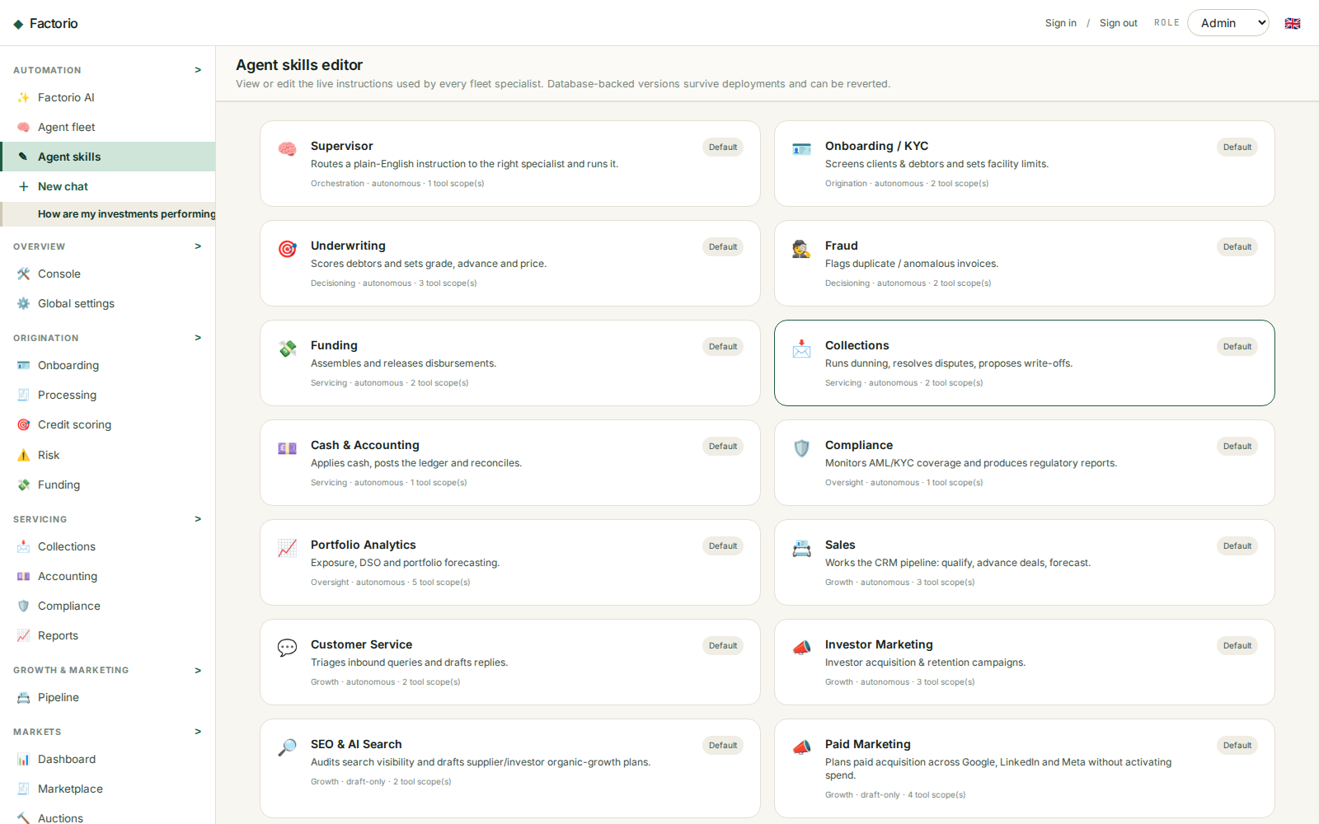
3. ADMIN
Inspect and edit agent skills
• Open Agent Skills to view each specialist’s current Markdown instructions.
• Admin can save a database-backed prompt version and review change history.
• Revert restores a selected earlier version while preserving an audit trail.
DEMO · SYNTHETIC DATA

Slide 20
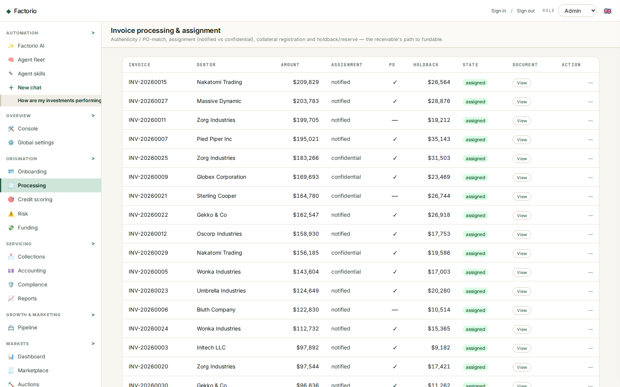
3. ADMIN
Process and approve invoices
• The processing queue supports verification, exceptions, risk review, and funding readiness.
• AI may recommend or draft; final financial and credit actions remain approval-gated.
• Synthetic data makes the workflow safe to explore in the platform demo.
DEMO · SYNTHETIC DATA

Slide 21
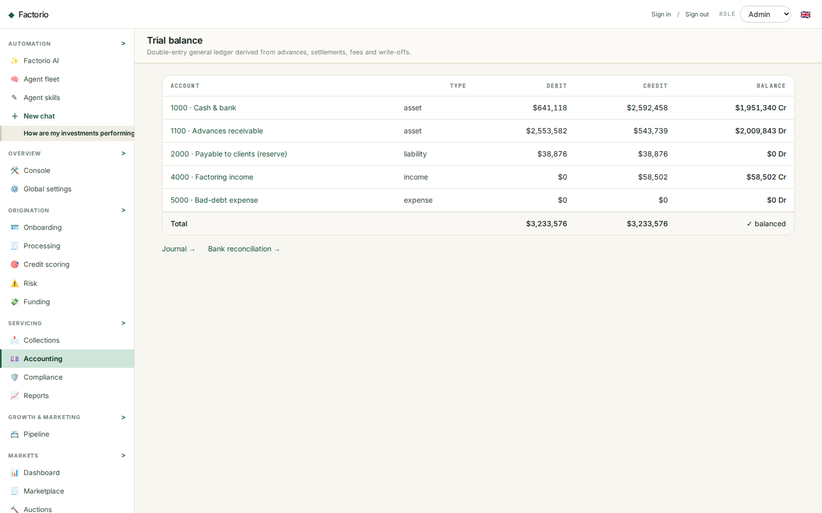
3. ADMIN
Reconcile accounting activity
• Accounting tools cover journal review, reconciliation, receivables, fees, reserves, and settlement evidence.
• Agents must not create balancing plugs or invent transactions.
• Use source records and approval history to resolve differences.
DEMO · SYNTHETIC DATA

Slide 22
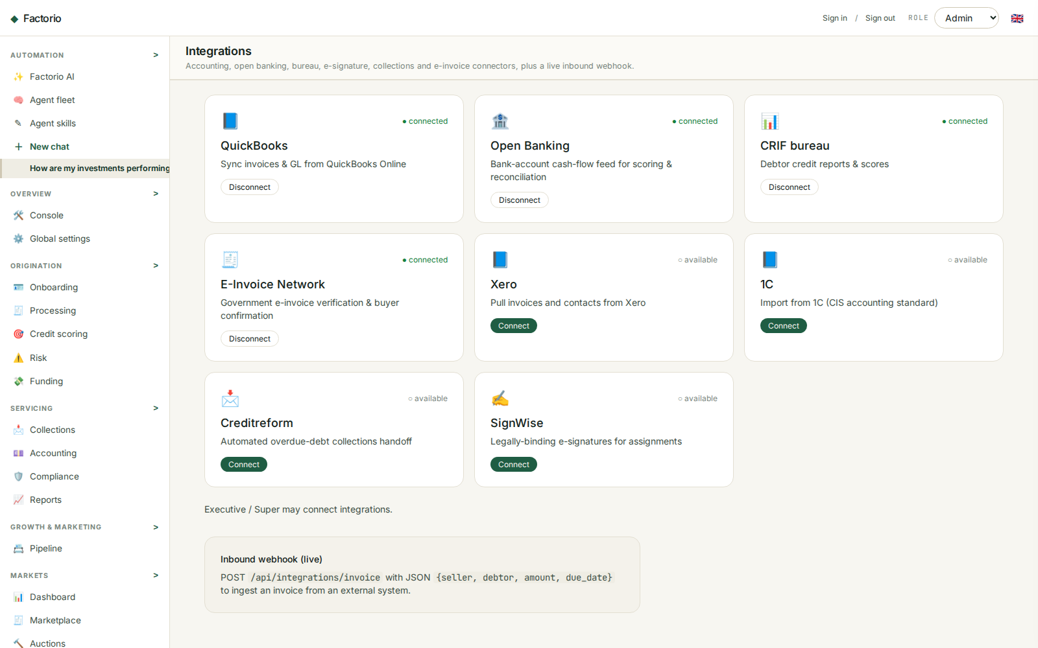
3. ADMIN
Manage platform integrations
• Integration cards show demo connectivity for accounting, banking, communications, and document services.
• Connection status is demonstrative and must not be treated as a live third-party authorization.
• The invoice ingestion endpoint supports structured external demo data.
DEMO · SYNTHETIC DATA

Slide 23
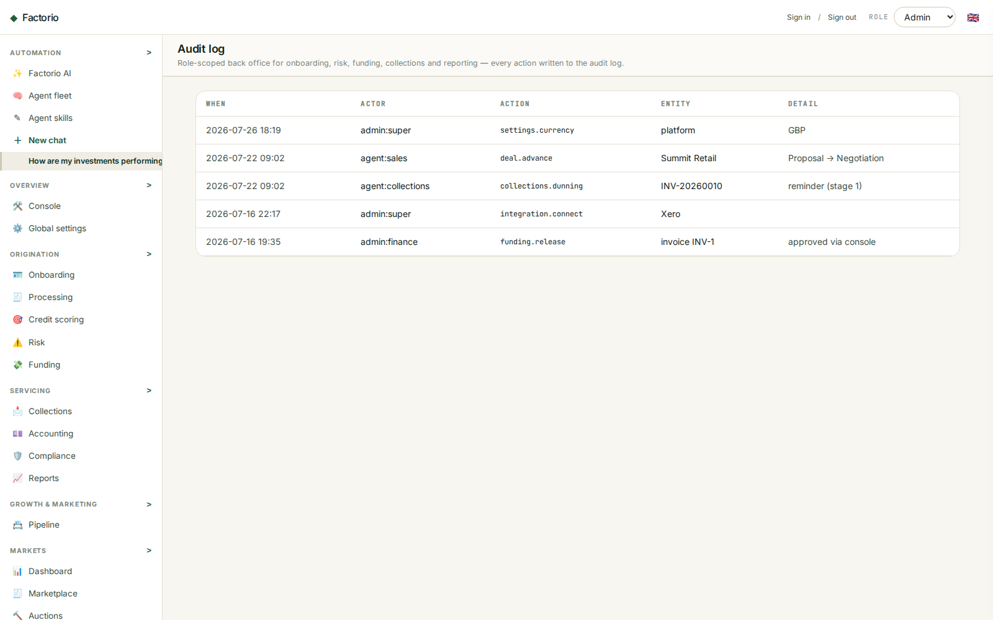
3. ADMIN
Review the audit trail
• Audit records identify actor, action, entity, detail, and time.
• Use the log to inspect human and agent activity, approvals, and configuration changes.
• Prompt-version history and action logs support governance of the agentic platform.
DEMO · SYNTHETIC DATA

Slide 24
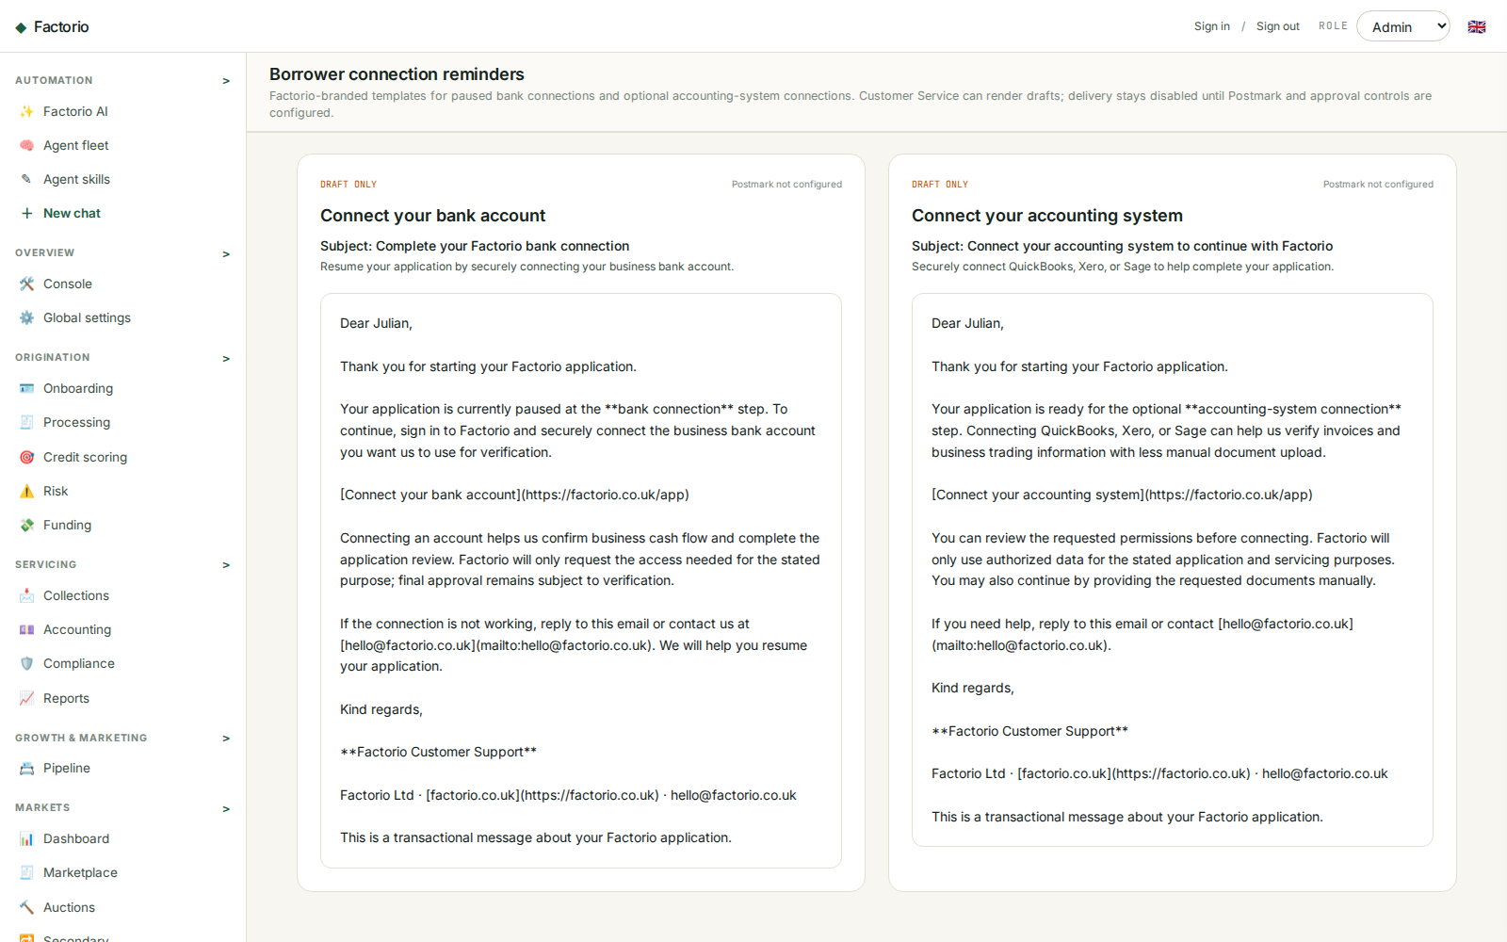
3. ADMIN
Prepare borrower transactional emails
• Customer Service can render Factorio-branded bank-connection and accounting-connection reminders from checked-in Markdown templates.
• Each draft uses a personalized HTTPS resume link, support contact, and application-specific wording without sensitive bank or accounting credentials.
• Delivery is disabled in this demo until Postmark, a verified sender, approval/lifecycle triggers, audit records, and delivery webhooks are configured.
DEMO · SYNTHETIC DATA

