Slide 1
FastFund
• Family-office outreach and multijurisdiction tax filing intelligence
• One open-source product, one relationship-to-filing data model
• User Guide
FastFund · User Guide

Slide 2
One connected operating journey
• Onboard a family office and capture principals, portfolio context and service needs.
• Develop explainable outreach opportunities, proposals and relationship actions.
• Link every fund, trust, company, SPV and holding vehicle to its owning family.
• Determine jurisdiction-specific obligations, deadlines and filing readiness.
• Prepare, review, file and verify while monitoring changes in source law.
FastFund · User Guide

Slide 3
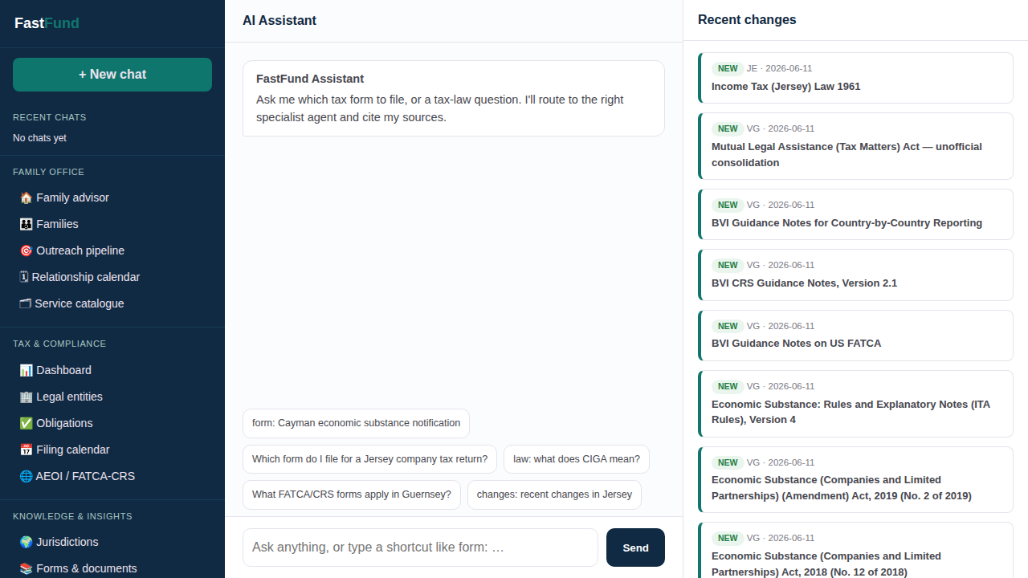
FastFund assistant
• A shared assistant routes questions to tax-law, form, change and data specialists.
• The rationalised sidebar groups work into Family Office, Tax & Compliance, and Knowledge & Insights.
• Answers remain grounded in official source material and linked operational data.
FastFund · User Guide

Slide 4
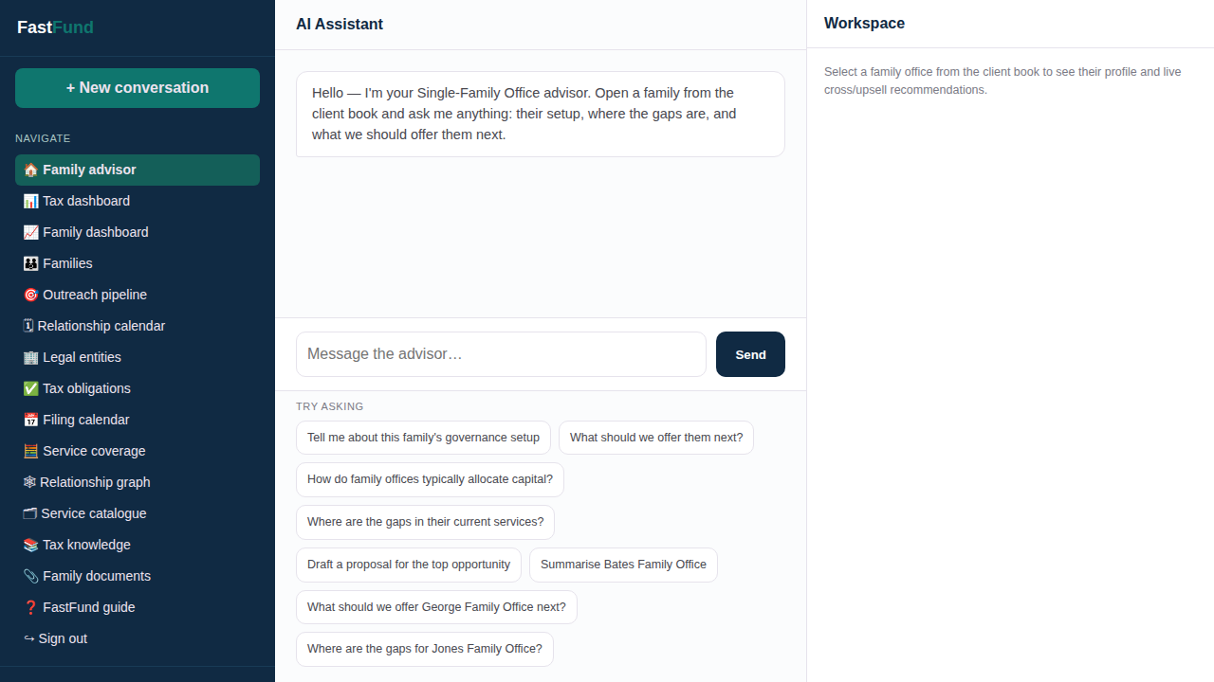
Family-office advisor
• Ask about a family's governance, service gaps, portfolio or next best action.
• Rules and the cross-sell graph produce traceable recommendations.
• The profile and live recommendations stay visible beside the conversation.
FastFund · User Guide

Slide 5
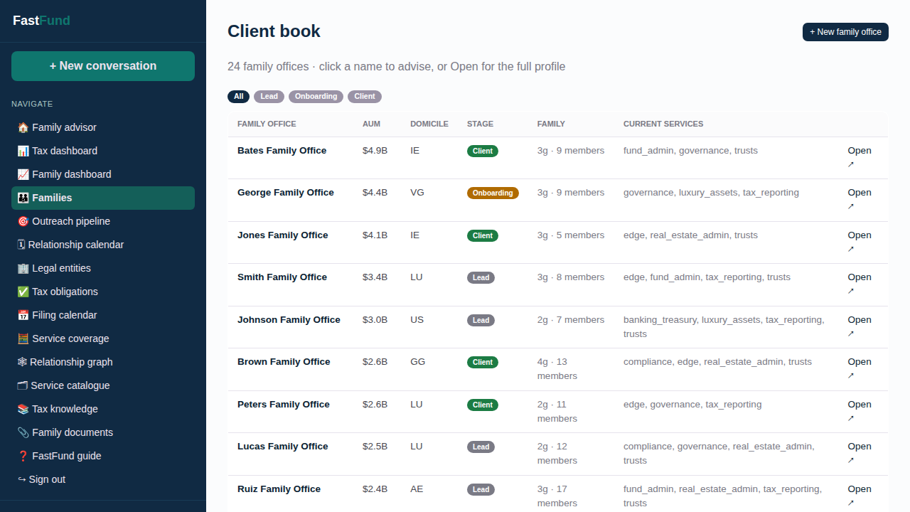
Families and outreach book
• Manage leads, onboarding relationships and established family-office clients.
• Review AUM, domicile, generations, family size and services already held.
• Open any family directly in the advisor or its complete relationship profile.
FastFund · User Guide

Slide 6
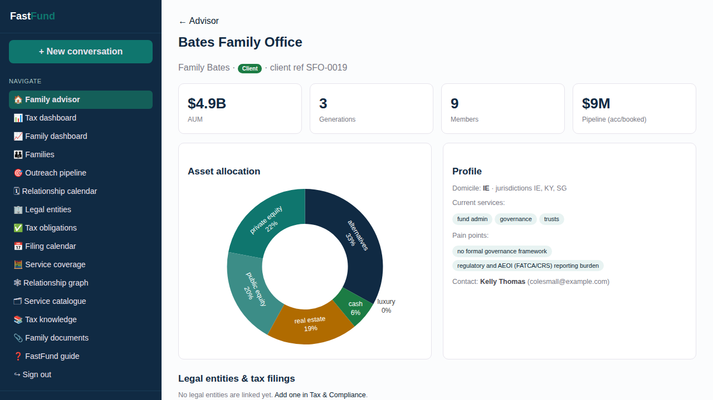
Family profile and ownership
• Portfolio allocation, holdings, transactions, members and relationship history in one view.
• Outreach recommendations and scheduled actions share the same family context.
• Linked legal entities connect relationship work directly to tax filings.
FastFund · User Guide

Slide 7
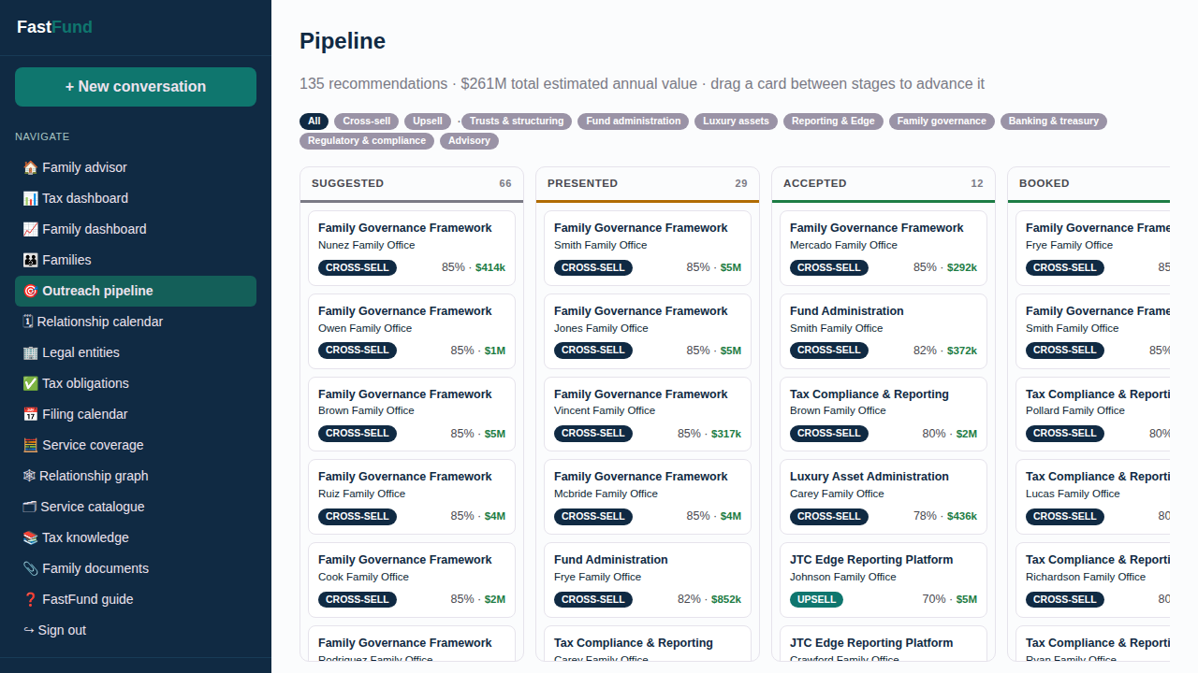
Outreach pipeline
• Move recommendations through suggested, presented, accepted and booked stages.
• Filter cross-sell and upsell opportunities by service category.
• Generate proposals and schedule consultations or follow-ups.
FastFund · User Guide

Slide 8
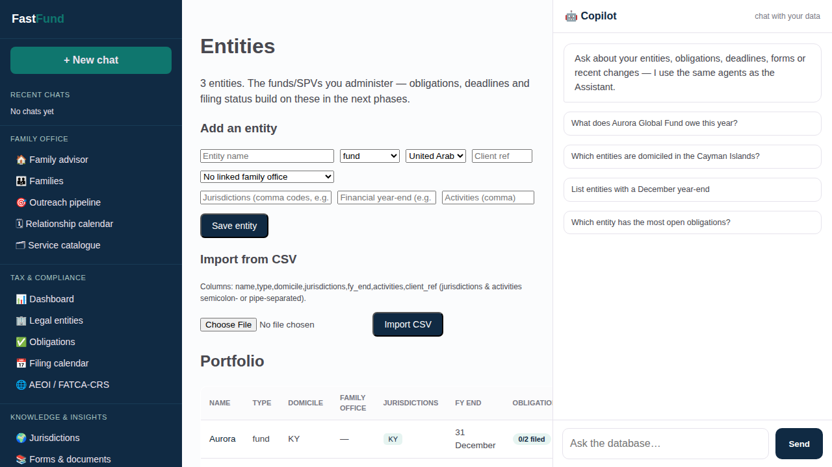
Legal entities
• Funds, trusts, companies, GPs, SPVs and holding vehicles share one portfolio.
• Each entity can be linked to its owning family office.
• Jurisdictions, activities and financial year-end drive deterministic filing obligations.
FastFund · User Guide

Slide 9
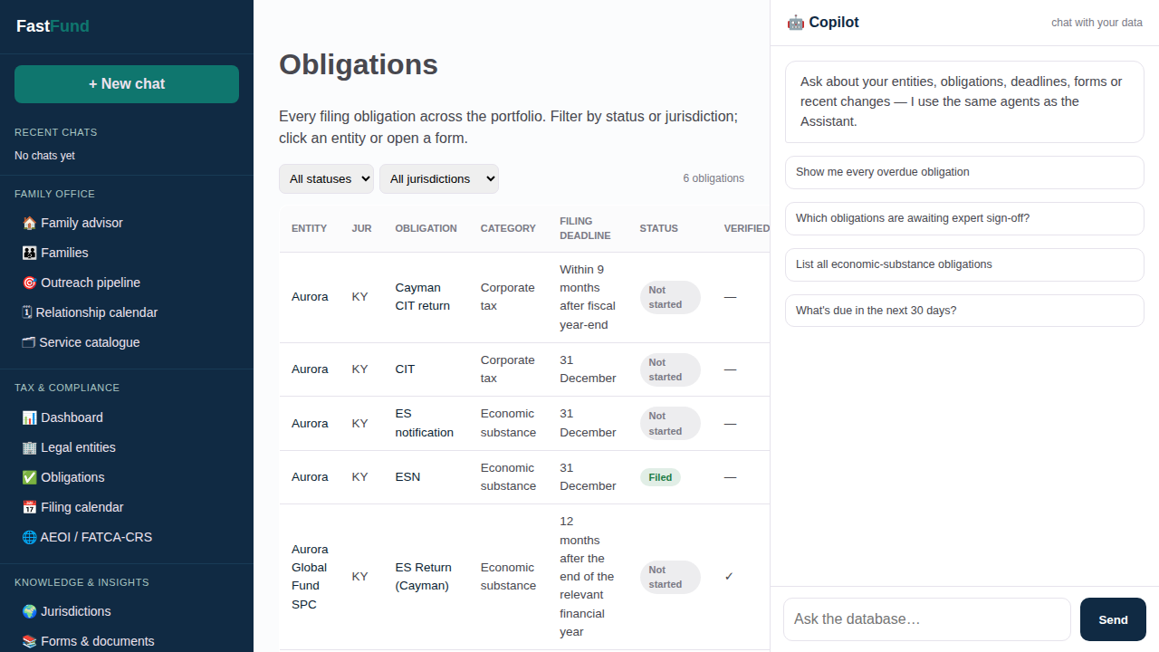
Filing obligations
• Track every filing from determination through preparation, filing and confirmation.
• Statuses and expert verification survive repeat determination runs.
• Filter by jurisdiction, category, urgency, entity and completion state.
FastFund · User Guide

Slide 10
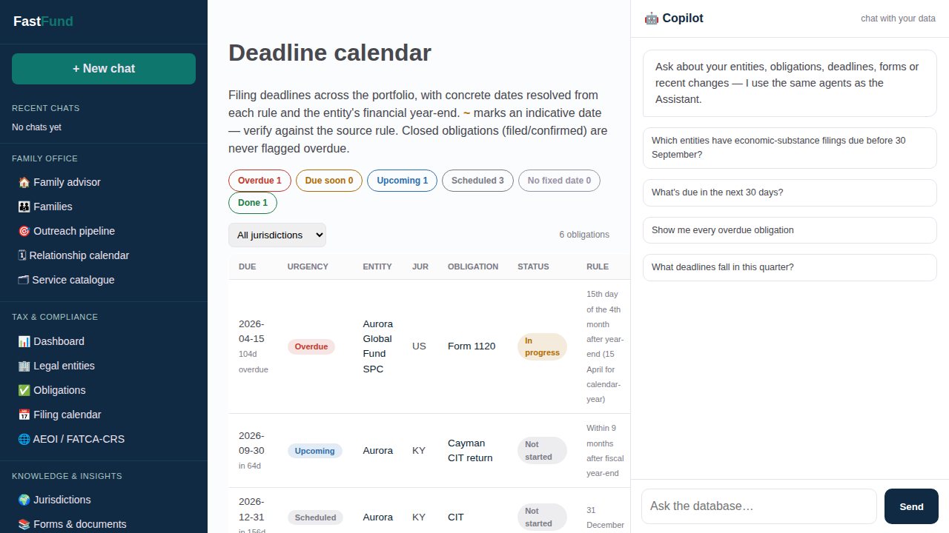
Multijurisdiction filing calendar
• Resolve form rules into real deadlines using the entity's financial year-end.
• Urgency indicators surface overdue, due-soon and upcoming work.
• Calendar and register views provide operational and portfolio-level perspectives.
FastFund · User Guide

Slide 11
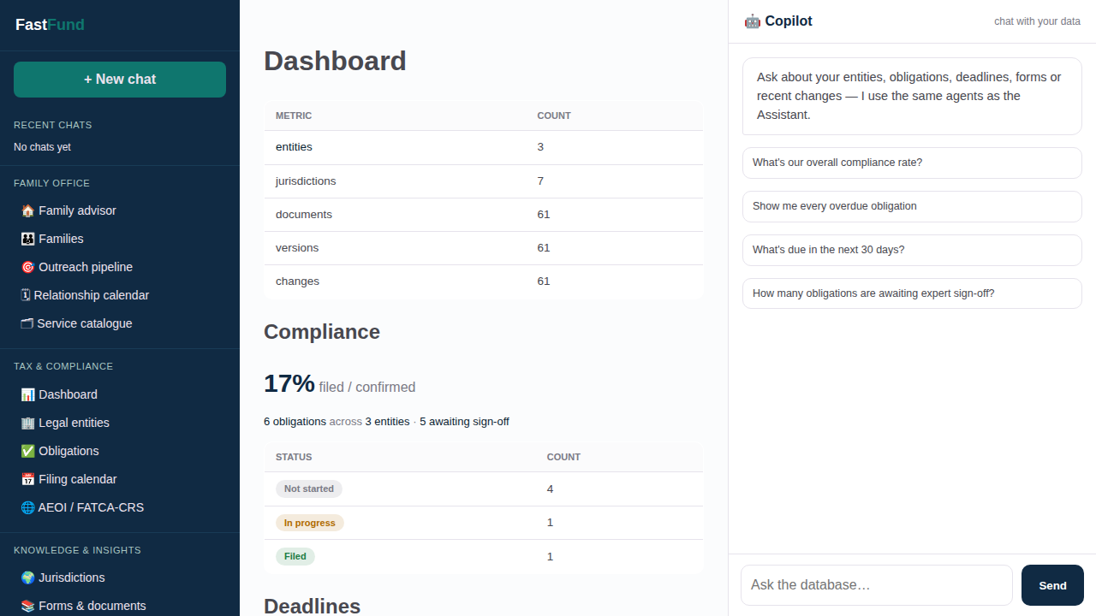
Tax and compliance dashboard
• See entities, open obligations, filed work and verification coverage at a glance.
• Move from portfolio metrics directly to the records behind them.
• Use audit, team and assistant analytics for controlled operations.
FastFund · User Guide

Slide 12
Knowledge, provenance and regulatory change
• Official forms, legislation, guidance, gazettes and treaties are captured by jurisdiction.
• Immutable versions and change records preserve the regulatory audit trail.
• Citations and provenance edges connect answers and forms back to source law.
• SQLite supports zero-infrastructure use; Neo4j adds native graph traversal.
FastFund · User Guide

Slide 13
Human-controlled automation
• FastFund assists with research, determination, preparation and outreach.
• Users review recommendations, validate form readiness and confirm filing status.
• Synthetic demo data is used for family-office examples; official tax sources retain provenance.
FastFund · User Guide

