Slide 1
FastFund
Platform Guide
2026-08-19 • https://fund.fastsme.com
Open-source family-office relationship management and multijurisdiction tax filing intelligence in one application.

Slide 2
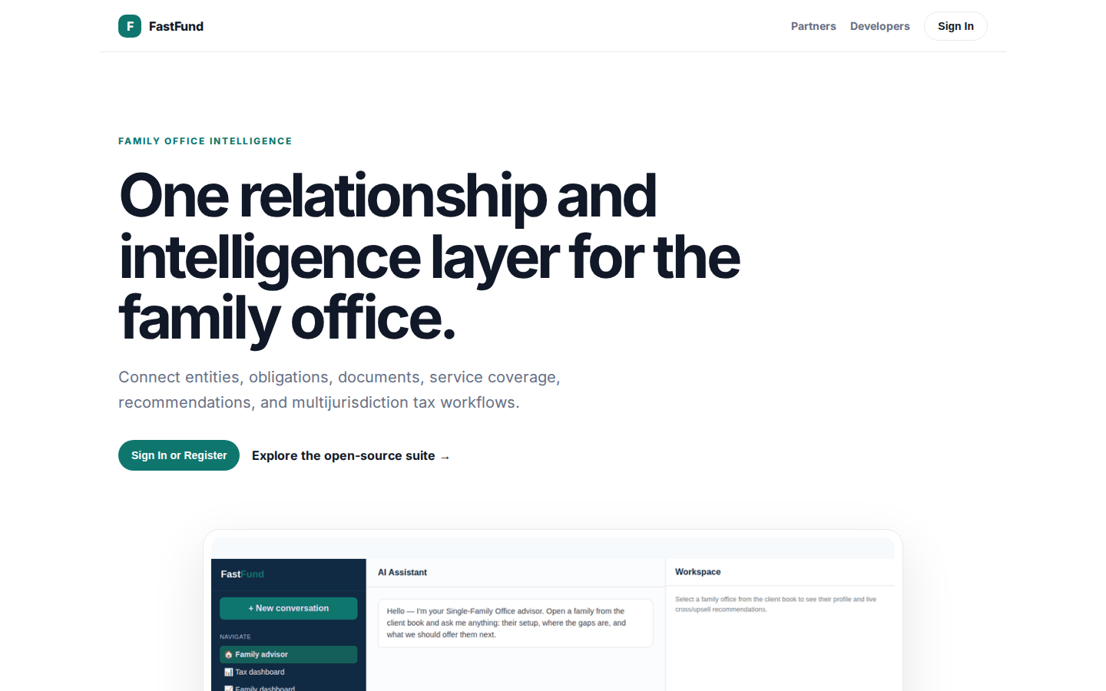
One relationship and intelligence layer for the family office.
FAMILY OFFICE INTELLIGENCE One relationship and intelligence layer for the family office. Connect entities, obligations, documents, service coverage, recommendations, and multijurisdiction tax workflows. Sign In or Register Explore the open-source suite → Prod
https://fund.fastsme.com/

Slide 3
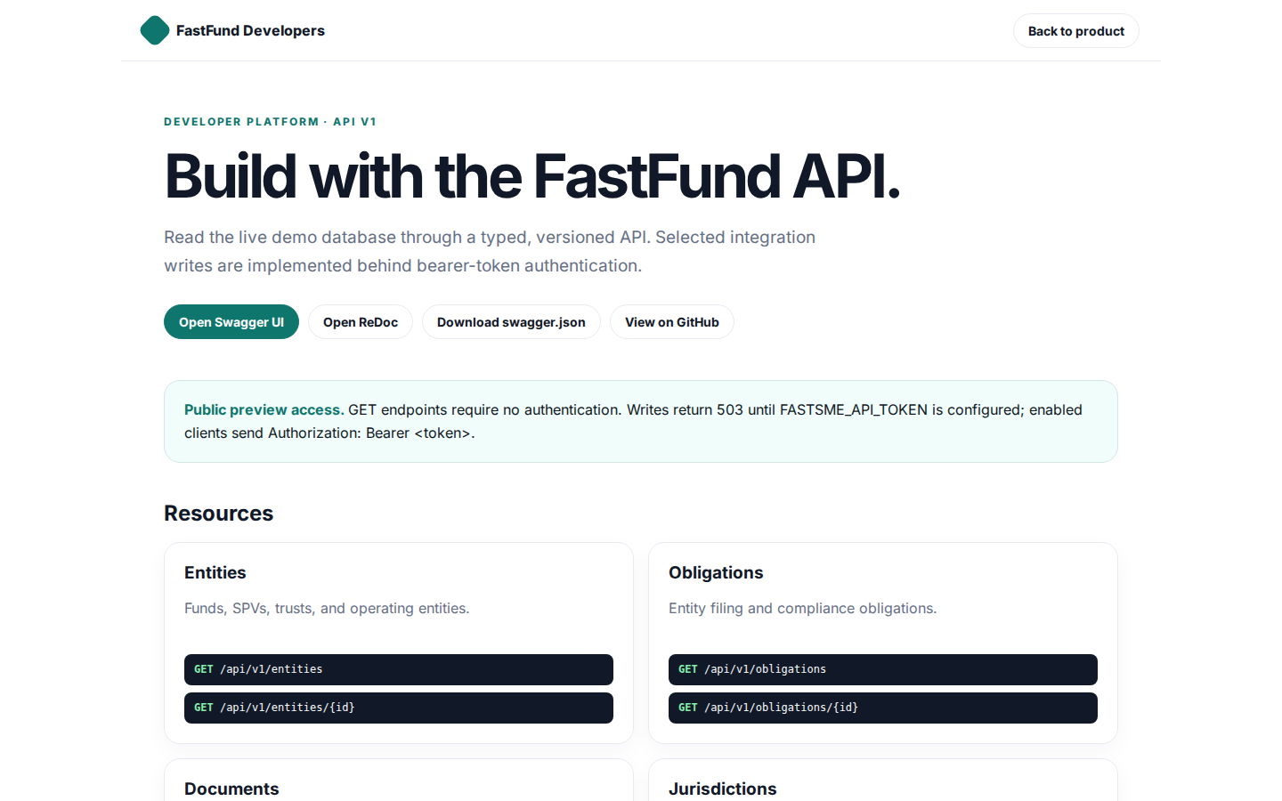
Build with the FastFund API.
FastFund Developers Back to product DEVELOPER PLATFORM · API V1 Build with the FastFund API. Read the live demo database through a typed, versioned API. Selected integration writes are implemented behind bearer-token authentication. Open Swagger UI Open ReDoc
https://fund.fastsme.com/developers

Slide 4
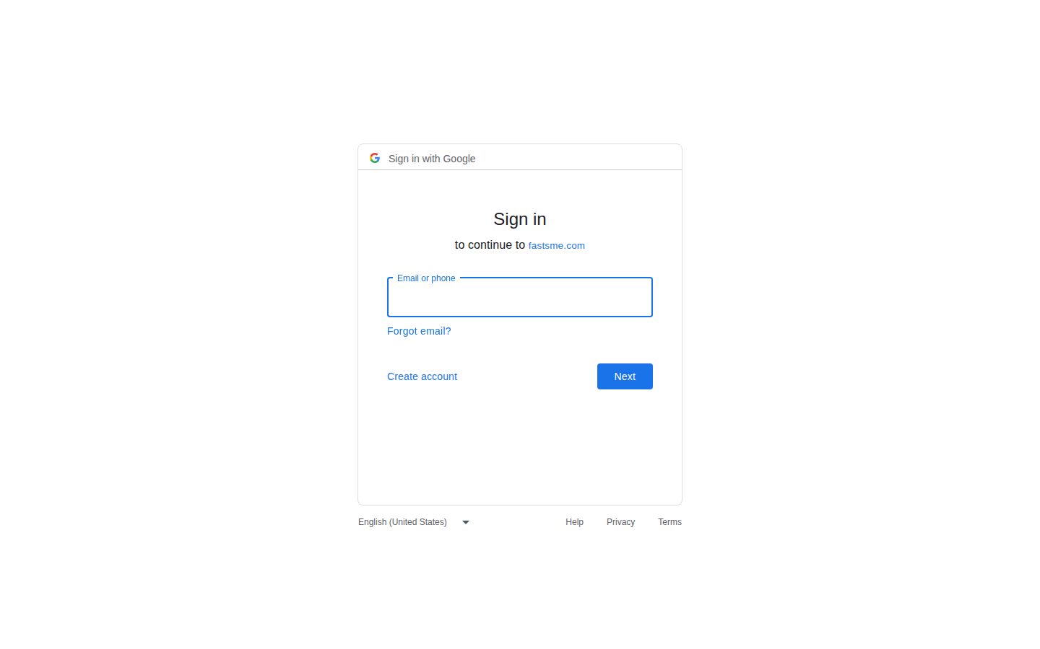
Sign in
Sign in with Google Sign in to continue to fastsme.com Email or phone Forgot email? Next Create account Afrikaans azərbaycan bosanski català Čeština Cymraeg Dansk Deutsch eesti English (United Kingdom) English (United States) Español (España) Español (Latinoam
https://accounts.google.com/v3/signin/identifier?opparams=%253F&dsh=S-650794498%3A1787122743998414&client_id=887059023987-2a7spj1m82eivobdbt1itb3cqca6tpt1.apps.googleusercontent.com&nonce=fh0w0XpT1yr8uysLGYMt&o2v=2&redirect_uri=https%3A%2F%2Ffund.fastsme.com%2Fauth%2Fcallback&response_type=code&scope=openid+email+profile&service=lso&state=MrgL6u4QVtbES5YfERdC29qUwASgRa&flowName=GeneralOAuthLite&continue=https%3A%2F%2Faccounts.google.com%2Fsignin%2Foauth%2Flegacy%2Fconsent%3Fauthuser%3Dunknown%26part%3DAJi8hAMyvqZ-jgcAFAue3CMoJfLfbpSYHn6wU2XXdFpCIU8hfOQj3W1Aqc-B3J3pz3bTcIkq_RFXZeYhhonUaUlEMR3zq6687R0y6RpiOiT8FrC4G7FJCMfCtbNWDGs6cLk3RDBKBPtRpMm8BwyRjMFSKyL4W8rLDb1dnoKLVEM2bHx9axSlclOWK0y1wGmMKy75q5ixJkhOHTnB5YCgrN-whGpkcZ_XZ8cVHKIf4KKVqXBIR0o8f-xheA902m4ottdtGc-g16XsAYUVHXCxwPYn3ohO8pndn4Jb994KS0Lac6KsKXOjLa_mEmSbB8wgTN5nxKxdfhT_XkgG2ORjMu9s6yOaB8lFxzn8aJbREtt7mTp3Dx9-bpy59sJa--oY72YZTF7Pg3dFjEDngnB4yGSQ2T-Wjf4ddGk_2166vWXlopPbIFddrgVU8ehHSt-N7TNLcZwe3qpDys9aha6u_hwtOvQ3xmYk-A%26flowName%3DGeneralOAuthFlow%26as%3DS-650794498%253A1787122743998414%26client_id%3D887059023987-2a7spj1m82eivobdbt1itb3cqca6tpt1.apps.googleusercontent.com%23&app_domain=https%3A%2F%2Ffund.fastsme.com&rart=ANgoxcdXOf7AHoEQOMOnlnghhS4mYgTj4zkOgKFAZH-yPl216QIrriLUwtxMSyj0mmsej56osridIg0O2hN-OhYi5G85cxsi4lMOAMv-17wQn7D8o8NZDY0

