Slide 1
FastHRM Platform Guide
2026-08-19 • https://hrm.fastsme.com
**FastHRM** is an open-source **HR system** built with — a server-side, HTMX-driven port of the core of , scoped to three pillars: **people** (employee directory + departments), **time** (leave + attendance), and **pay** (payslips). Python-first, no JavaScript framework, with an AI assistant grounded in the live (synth

Slide 2
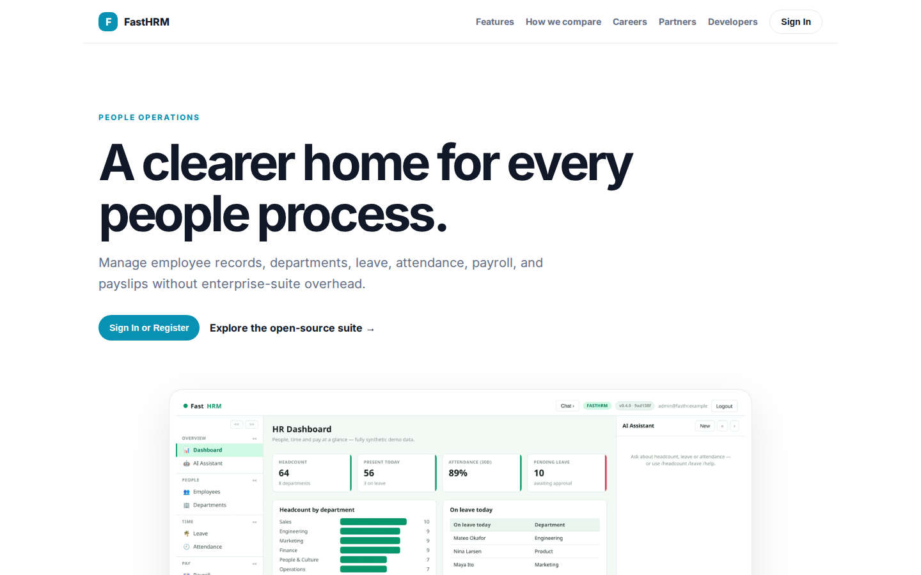
A clearer home for every people process.
PEOPLE OPERATIONS A clearer home for every people process. Manage employee records, departments, leave, attendance, payroll, and payslips without enterprise-suite overhead. Sign In or Register Explore the open-source suite → Product tour · people, time, pay, p
https://hrm.fastsme.com/

Slide 3
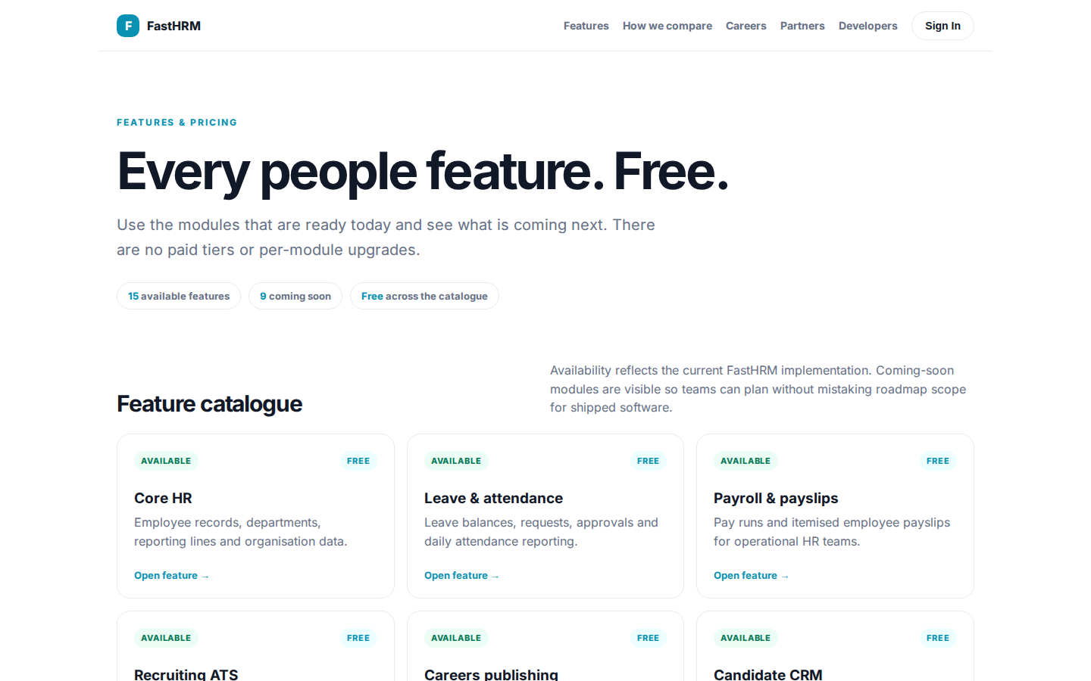
Every people feature. Free.
FEATURES & PRICING Every people feature. Free. Use the modules that are ready today and see what is coming next. There are no paid tiers or per-module upgrades. 15 available features 9 coming soon Free across the catalogue Feature catalogue Availability reflec
https://hrm.fastsme.com/features

Slide 4
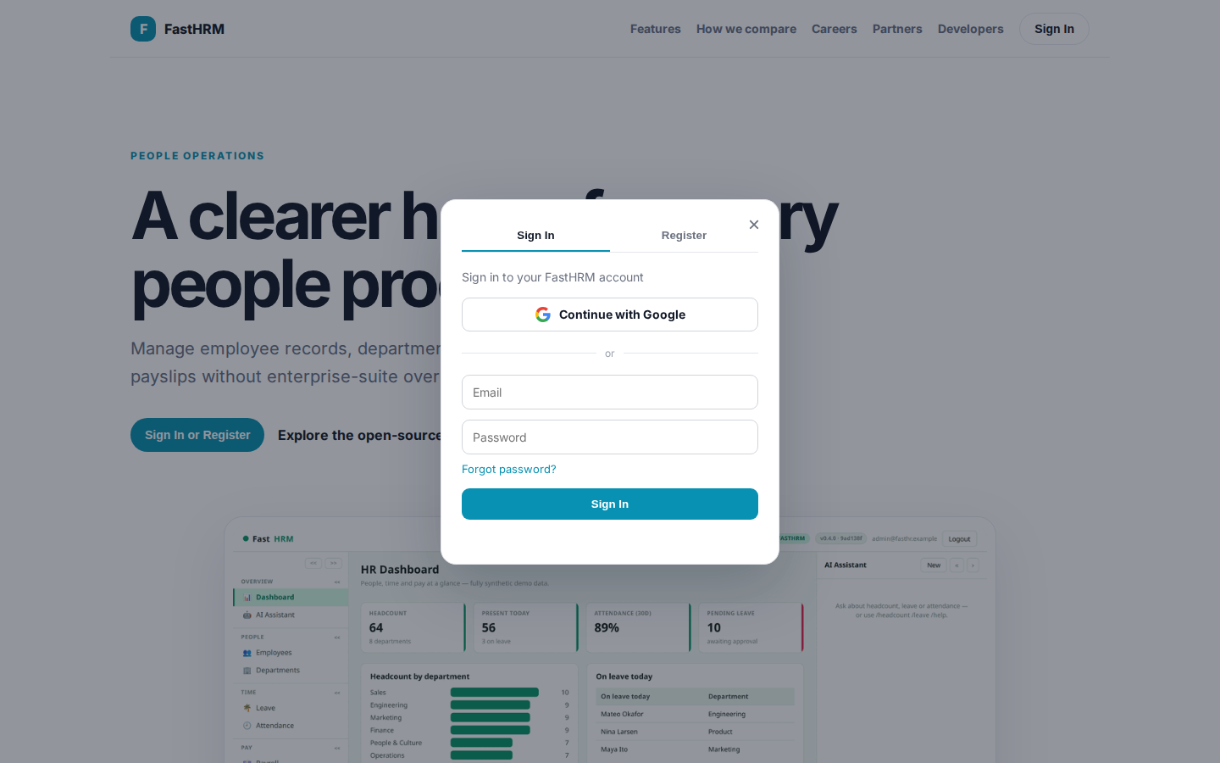
A clearer home for every people process.
PEOPLE OPERATIONS A clearer home for every people process. Manage employee records, departments, leave, attendance, payroll, and payslips without enterprise-suite overhead. Sign In or Register Explore the open-source suite → Product tour · people, time, pay, p
https://hrm.fastsme.com/login?next=%2F

Slide 5
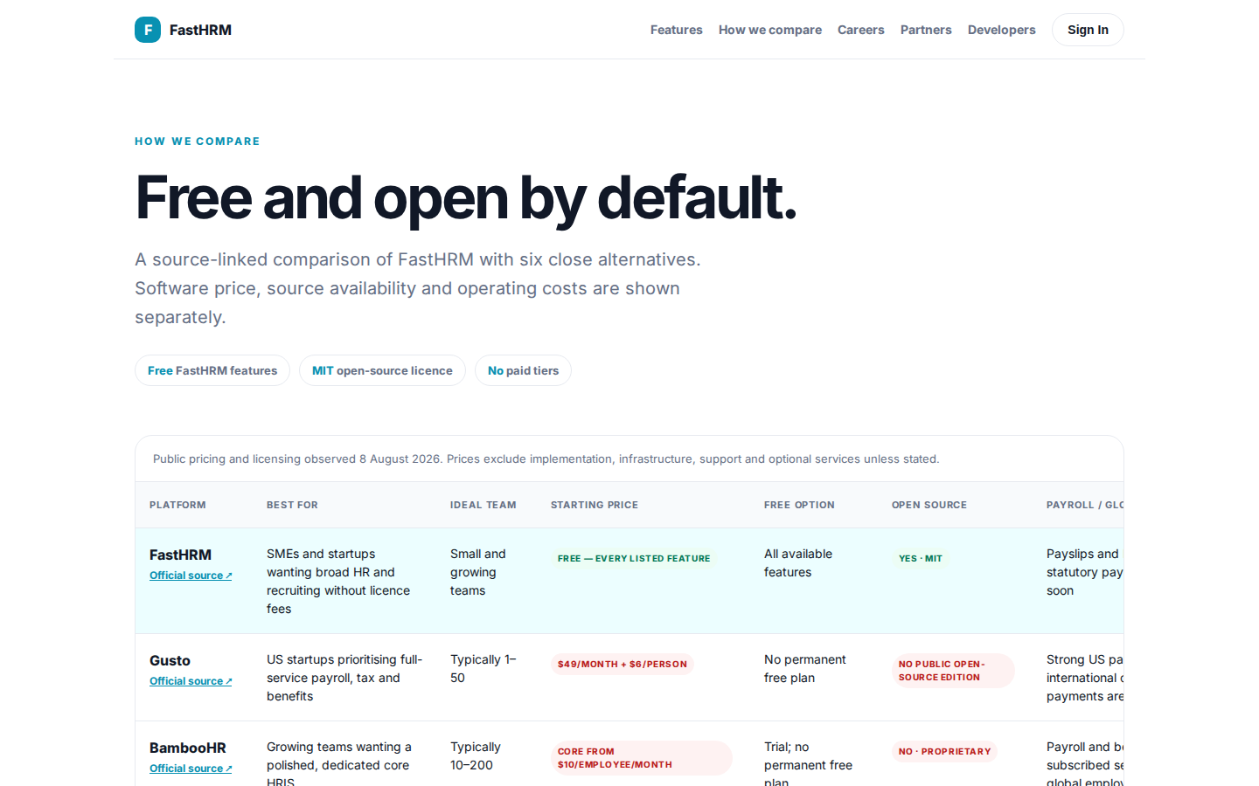
Free and open by default.
HOW WE COMPARE Free and open by default. A source-linked comparison of FastHRM with six close alternatives. Software price, source availability and operating costs are shown separately. Free FastHRM features MIT open-source licence No paid tiers Public pricing
https://hrm.fastsme.com/compare

