Slide 1
FastCMS Platform Guide
2026-08-19 • https://cms.fastsme.com
A modern, lightweight content management system built with and SQLite. Inspired by , reimagined for simplicity and speed.

Slide 2
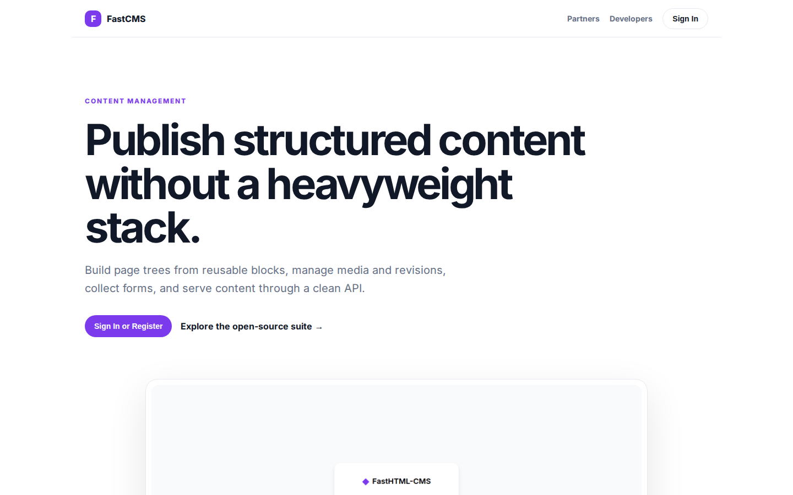
Publish structured content without a heavyweight stack.
CONTENT MANAGEMENT Publish structured content without a heavyweight stack. Build page trees from reusable blocks, manage media and revisions, collect forms, and serve content through a clean API. Sign In or Register Explore the open-source suite → Product tour
https://cms.fastsme.com/

Slide 3
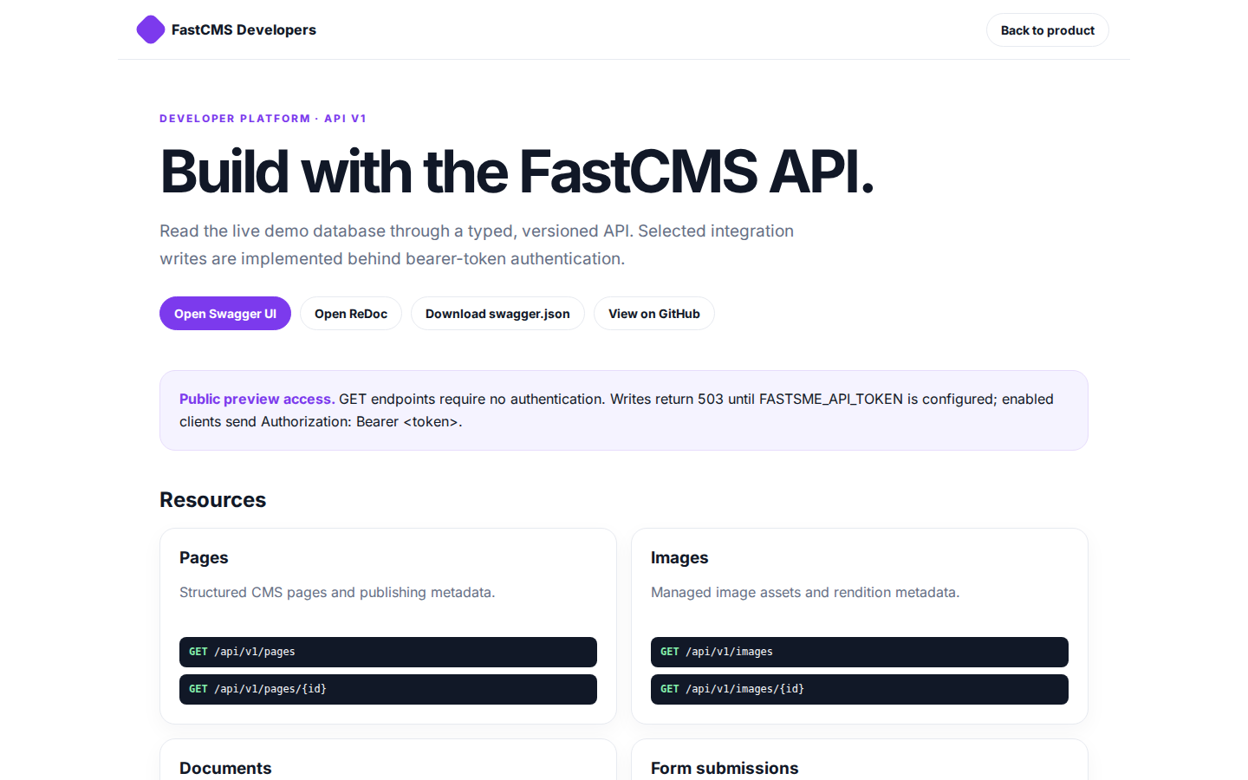
Build with the FastCMS API.
FastCMS Developers Back to product DEVELOPER PLATFORM · API V1 Build with the FastCMS API. Read the live demo database through a typed, versioned API. Selected integration writes are implemented behind bearer-token authentication. Open Swagger UI Open ReDoc Do
https://cms.fastsme.com/developers

Slide 4
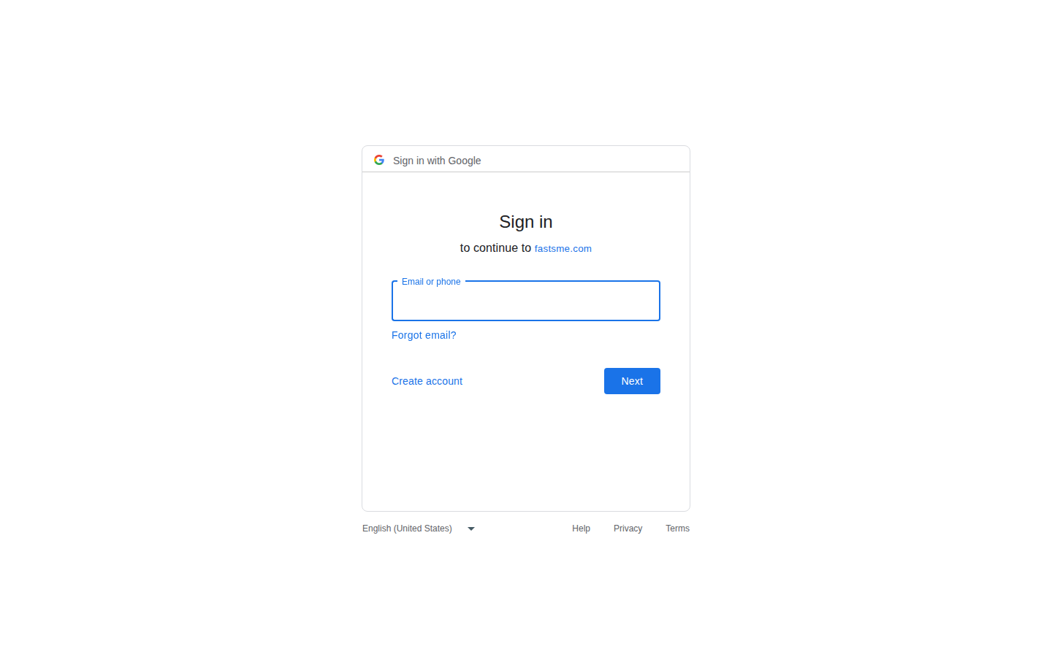
Sign in
Sign in with Google Sign in to continue to fastsme.com Email or phone Forgot email? Next Create account Afrikaans azərbaycan bosanski català Čeština Cymraeg Dansk Deutsch eesti English (United Kingdom) English (United States) Español (España) Español (Latinoam
https://accounts.google.com/v3/signin/identifier?opparams=%253F&dsh=S1413076949%3A1787122582397586&access_type=online&client_id=887059023987-2a7spj1m82eivobdbt1itb3cqca6tpt1.apps.googleusercontent.com&o2v=2&prompt=select_account&redirect_uri=https%3A%2F%2Fcms.fastsme.com%2Fauth%2Fgoogle%2Fcallback&response_type=code&scope=openid+email+profile&service=lso&state=fYfBKNo8eXPkf8DgHL6UySPei3Z5QYVNrSDF5RzTAQg&flowName=GeneralOAuthLite&continue=https%3A%2F%2Faccounts.google.com%2Fsignin%2Foauth%2Flegacy%2Fconsent%3Fauthuser%3Dunknown%26part%3DAJi8hAMAw_icrPGJ2PQ-z2lclOUz7U3BJ9yS58xcerjmHI6UpgEFv19d9RNp0r3a1vaIrldoejMX0a_X9TDtvZZOnwbgYNSECbTF8106rcJSAGWMDmNdZq_dDeo_6L_HZ8hY8AnxCjLd-hMjxbWklLfAl5b8ncb1bioXW2-jgK2nICqiE59rDNftxjGG9e9bG3l5GUyBy6W0qigiDpqN9UU4EwG5QQrkH_2zJRRYHp1eyf6ja3omAjdVTO8qhn-Z5E5ex_9mzTgoEtSgdOARMBq286ppt5sgAEtj4jux-4B1IgF-u20dPaNmw0JLKOyeS_VaupgI2c8nLpm4koDgI4CW7trWO9c_RB4ZulDfGe3ZqAw9RYsB3CAixqNgN-sWFy_i0Kh847qZt_G_QwyxHS-wI7ej2QEOh-qlo5z7NmM6Ei0_GimZcLro20fbx35XRzSULaui5E7szWpWQAUtJO1IVnkG0AGQNw%26flowName%3DGeneralOAuthFlow%26as%3DS1413076949%253A1787122582397586%26client_id%3D887059023987-2a7spj1m82eivobdbt1itb3cqca6tpt1.apps.googleusercontent.com%23&app_domain=https%3A%2F%2Fcms.fastsme.com&rart=ANgoxcdCjiXwN5EXcyVL47g-eOfYvAysnOAR8CvEBd4hY8Q0-mqafi-nbmiN7JIvdNnXUSJM2u5ZMb4w5KwtZc14chU3MGop0Seahj0Ha_0HhHeb_Eo6-hQ

