Slide 1
FastHelpdesk
Platform Guide
2026-08-19 • https://helpdesk.fastsme.com
**FastHelpdesk** is an open-source **customer-support desk** built with — a server-side, HTMX-driven port of the core of . Python-first, no JavaScript framework: a ticket queue with **live SLA timers**, threaded ticket conversations, agents & teams, a knowledge base, customers, and an AI assistant grounded in your live

Slide 2
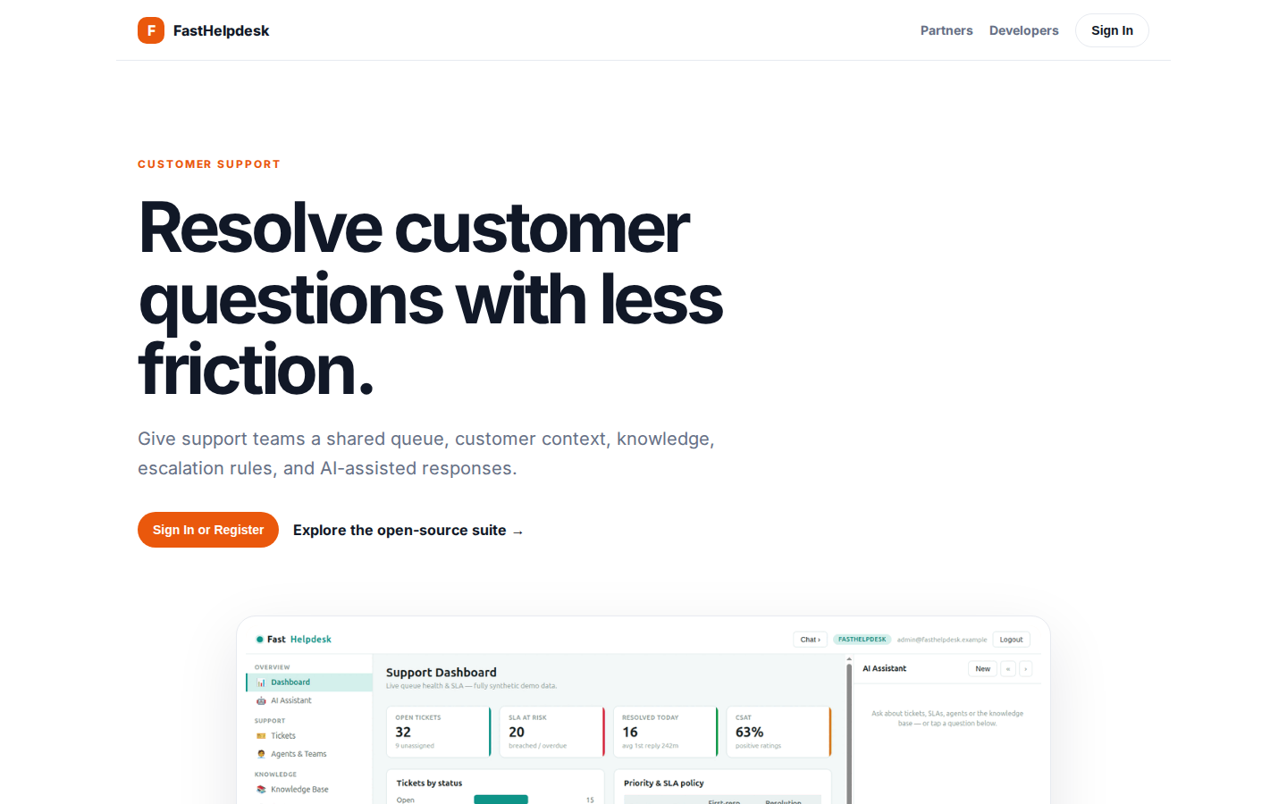
Resolve customer questions with less friction.
CUSTOMER SUPPORT Resolve customer questions with less friction. Give support teams a shared queue, customer context, knowledge, escalation rules, and AI-assisted responses. Sign In or Register Explore the open-source suite → Product tour · see the workspace in
https://helpdesk.fastsme.com/

Slide 3
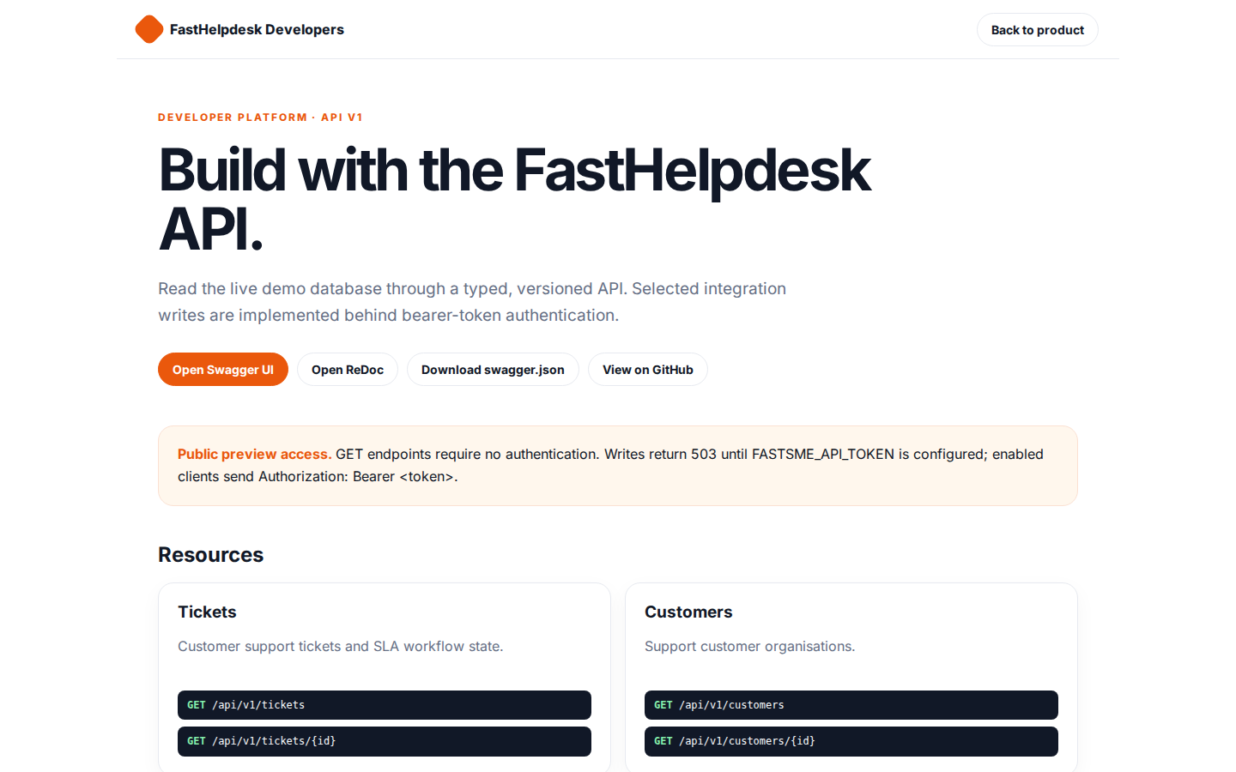
Build with the FastHelpdesk API.
FastHelpdesk Developers Back to product DEVELOPER PLATFORM · API V1 Build with the FastHelpdesk API. Read the live demo database through a typed, versioned API. Selected integration writes are implemented behind bearer-token authentication. Open Swagger UI Ope
https://helpdesk.fastsme.com/developers

Slide 4
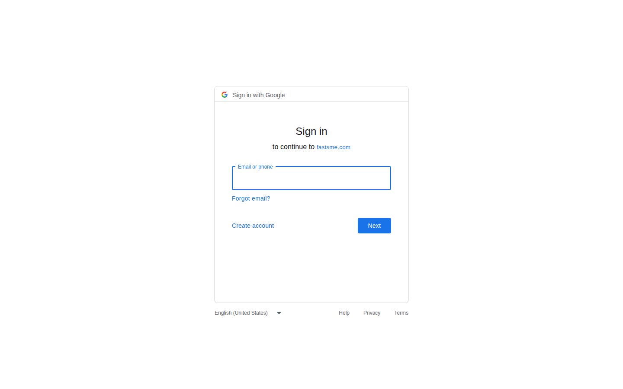
Sign in
Sign in with Google Sign in to continue to fastsme.com Email or phone Forgot email? Next Create account Afrikaans azərbaycan bosanski català Čeština Cymraeg Dansk Deutsch eesti English (United Kingdom) English (United States) Español (España) Español (Latinoam
https://accounts.google.com/v3/signin/identifier?opparams=%253F&dsh=S-1575712528%3A1787122773035626&access_type=online&client_id=887059023987-2a7spj1m82eivobdbt1itb3cqca6tpt1.apps.googleusercontent.com&o2v=2&prompt=select_account&redirect_uri=https%3A%2F%2Fhelpdesk.fastsme.com%2Fauth%2Fgoogle%2Fcallback&response_type=code&scope=openid+email+profile&service=lso&state=X92SplIE74-wSc-gitzv5YU1x23ZEu4vIpEaS6XCKg8&flowName=GeneralOAuthLite&continue=https%3A%2F%2Faccounts.google.com%2Fsignin%2Foauth%2Flegacy%2Fconsent%3Fauthuser%3Dunknown%26part%3DAJi8hAOxPBwv4p3-iFG25i1G-_Y-Y0xKxLLR--slxzD9rVzHzW8r4Ew0gYc4qqOvJWe_G5H5uEmUnYUJZOCzMvwY2aHx21ybh3Ry3nu63yIKUlzJCQ-qkm4e10T31ZITD-Zcvltdc7z1YTBEpTtSkfwweZnkpUz86fxPZlfdosotNO2gH3pWjm_3fs7sy9zVZrQqhqMBVkIzroniypLS5cDpc8xE7WsDrNdFFMRlUzBkZABIaIfLDX892xMPI1YUajO6Rh6I6ZUFIbn3qEz1TzBNwYT464pe4UH50OJPTT97MLHrNCa6pP_-CMlNmc3IqEZNhIIoMRIQHqLL_Kvr8uox1ApndJdd9cxd0Vsu-HBJ8hBDzwCPVGSgpxDXS7J8ouBqbpFRLXqJAdUIEZHWC8T6MUqKSzItHofwpu9PCXPIXL-U4cRjDM1g0avc65YuAlNDLaoRPa3a53ONR4HMIjCVCz79GgPJiseoeYGqrA37pFKt3OxyONk%26flowName%3DGeneralOAuthFlow%26as%3DS-1575712528%253A1787122773035626%26client_id%3D887059023987-2a7spj1m82eivobdbt1itb3cqca6tpt1.apps.googleusercontent.com%23&app_domain=https%3A%2F%2Fhelpdesk.fastsme.com&rart=ANgoxcfmYG_iXNthV6Hp4UkmRkc_UZI4laXaCc0Zuca4GEr5dR66cjZoP1Nq1-Ee1zQtmiJJAOpE30V_yaYRDvShbzHaPp_ARxcRBIfDSP-4tnyZHUlrQ7s

