Slide 1
FastMail
Platform Guide
2026-08-19 • https://mail.fastsme.com
**FastMail** is an open-source **webmail client** built with — a server-side, HTMX-driven take on the *client* half of . Python-first, no JavaScript framework: folders, a message list, a threaded reading pane, compose, an address book, and **AI summarise-thread / draft-reply**.

Slide 2
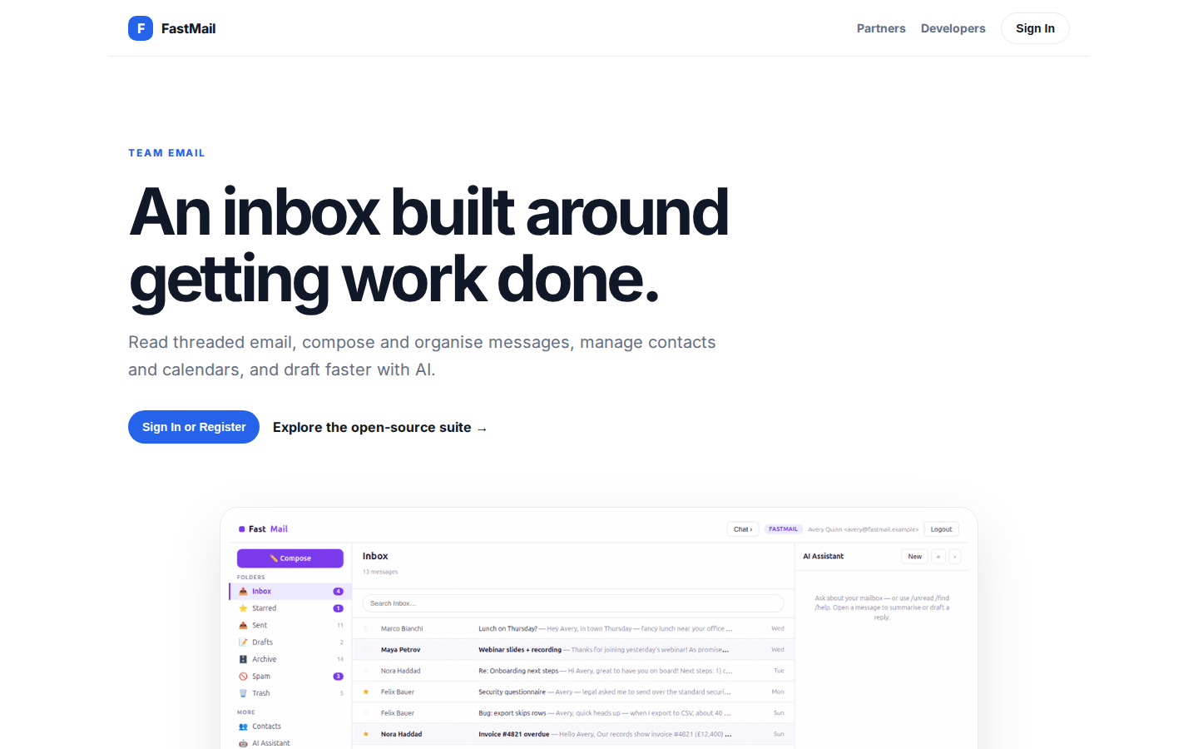
An inbox built around getting work done.
TEAM EMAIL An inbox built around getting work done. Read threaded email, compose and organise messages, manage contacts and calendars, and draft faster with AI. Sign In or Register Explore the open-source suite → Product tour · see the workspace in action 01 T
https://mail.fastsme.com/

Slide 3
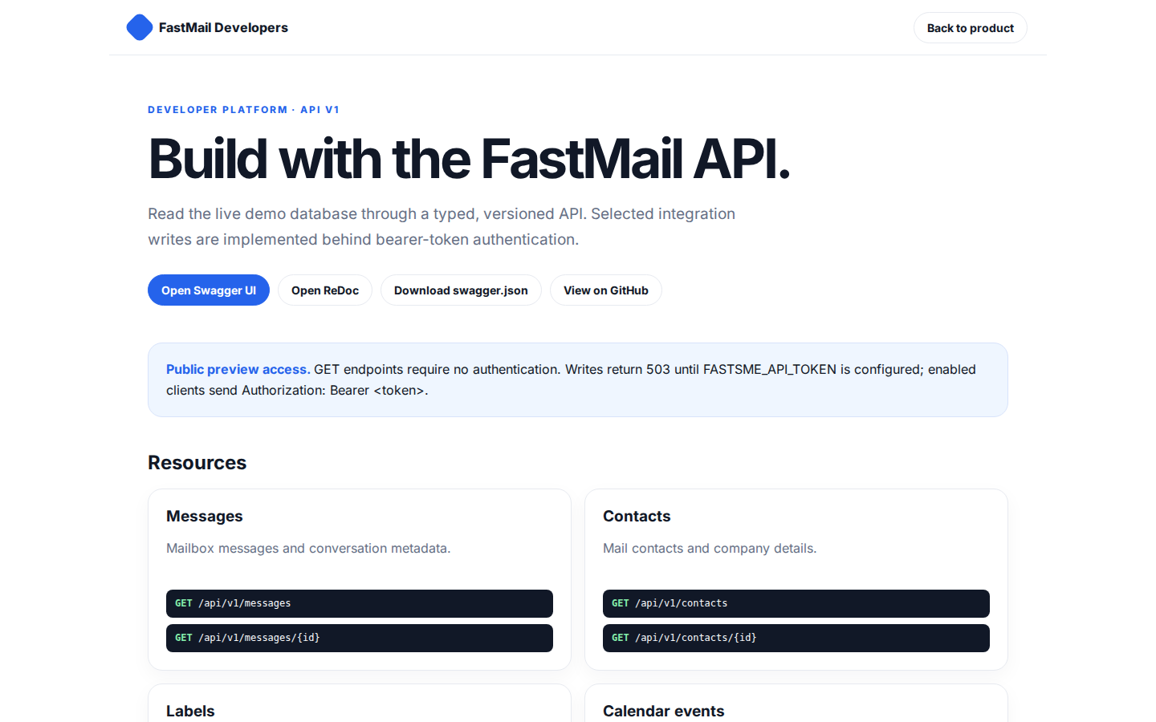
Build with the FastMail API.
FastMail Developers Back to product DEVELOPER PLATFORM · API V1 Build with the FastMail API. Read the live demo database through a typed, versioned API. Selected integration writes are implemented behind bearer-token authentication. Open Swagger UI Open ReDoc
https://mail.fastsme.com/developers

Slide 4
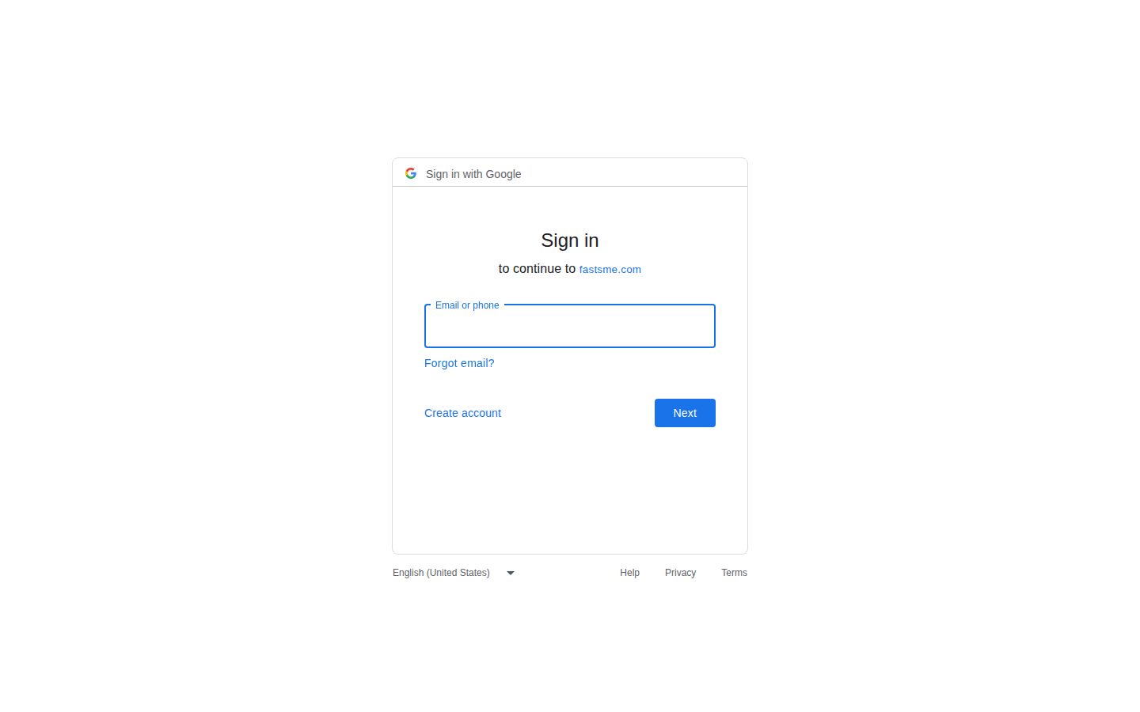
Sign in
Sign in with Google Sign in to continue to fastsme.com Email or phone Forgot email? Next Create account Afrikaans azərbaycan bosanski català Čeština Cymraeg Dansk Deutsch eesti English (United Kingdom) English (United States) Español (España) Español (Latinoam
https://accounts.google.com/v3/signin/identifier?opparams=%253F&dsh=S960243515%3A1787122791160142&access_type=online&client_id=887059023987-2a7spj1m82eivobdbt1itb3cqca6tpt1.apps.googleusercontent.com&o2v=2&prompt=select_account&redirect_uri=https%3A%2F%2Fmail.fastsme.com%2Fauth%2Fgoogle%2Fcallback&response_type=code&scope=openid+email+profile&service=lso&state=Ts7Ae8n26eaiepwwdNH8XmymKRHeFE4L_W8FcuuNtNM&flowName=GeneralOAuthLite&continue=https%3A%2F%2Faccounts.google.com%2Fsignin%2Foauth%2Flegacy%2Fconsent%3Fauthuser%3Dunknown%26part%3DAJi8hAO2tQ68nqvorkZeNv0w-caccZOTOq_EJwo3XG6mr2PuDIJHgHcKFrbjDl8EkDJxoHox2-uXth75y6AmLleSNl_t3SPTwb38UW6JLGmiBEkvLl2jtZ7-OFsAiNG4-X2tVaW-SJKEVaWPRnm4YIh3GifRAAZ528nptUwUqGC7ENOjeL3r0XvQuZvuUkavxtid4Dg8gy7xXZ7amwVNBmVSFTlwX6Y97cy1_BrxxEHD3rGK-8TjHe5S0cOz3W9248_BXlNRWKYoF5bmP9V49q8YoTDa7SLDUbNQCsTpY5spug4XI4pjhUYddwUk2rimBW6o0G6vQxH-ziF4NfTDCshnyFzSGipNepOjHF2fPM_odtXZXNxE4antvdp1MCbI9Dh7eMmxVGmzaH35355YGQPxH_RrzWJ2R4Xst6PnR3QLK8KhcIDf2UdLzSnxmxn_xt74-Aa4Okyl_ObZDM00_apgaUq3l93fFQ%26flowName%3DGeneralOAuthFlow%26as%3DS960243515%253A1787122791160142%26client_id%3D887059023987-2a7spj1m82eivobdbt1itb3cqca6tpt1.apps.googleusercontent.com%23&app_domain=https%3A%2F%2Fmail.fastsme.com&rart=ANgoxceAO616X5MvGSvbY2WfvepYQh1zhjrfzIrOYP7lEydthhCoLnxDTT2D29LeuomFs1Robk34XuHR9464nKoG-oiszf7nrNoaTIiQQQj8EgvHvaDculE

