Slide 1
FastMeet Platform Guide
2026-08-19 • https://meet.fastsme.com
**FastMeet** is an open-source **meeting scheduler** built with — a server-side, HTMX-driven port of the scheduling & rooms half of . Python-first, no JavaScript framework: a dashboard, upcoming/past meetings, meeting detail with participants & agenda, a (simulated) room lobby, scheduling, and **AI agenda generation +

Slide 2
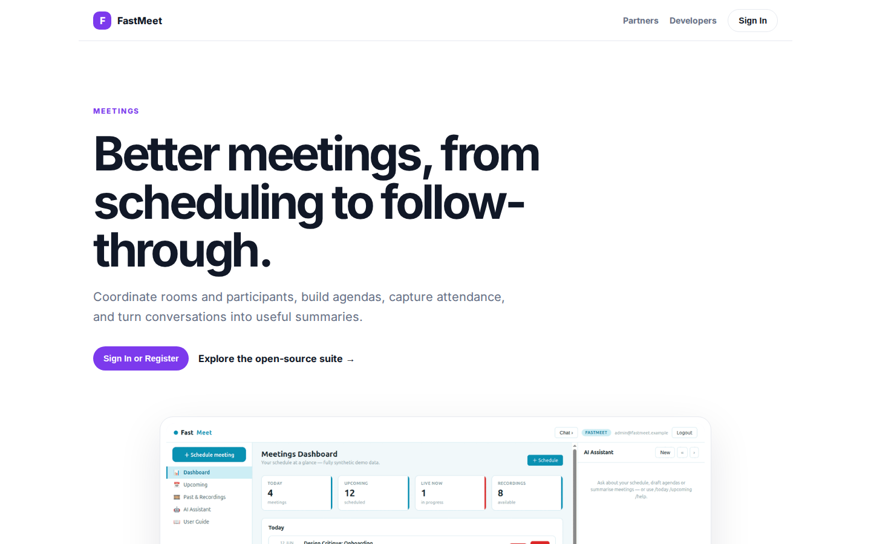
Better meetings, from scheduling to follow-through.
MEETINGS Better meetings, from scheduling to follow-through. Coordinate rooms and participants, build agendas, capture attendance, and turn conversations into useful summaries. Sign In or Register Explore the open-source suite → Product tour · see the workspac
https://meet.fastsme.com/

Slide 3
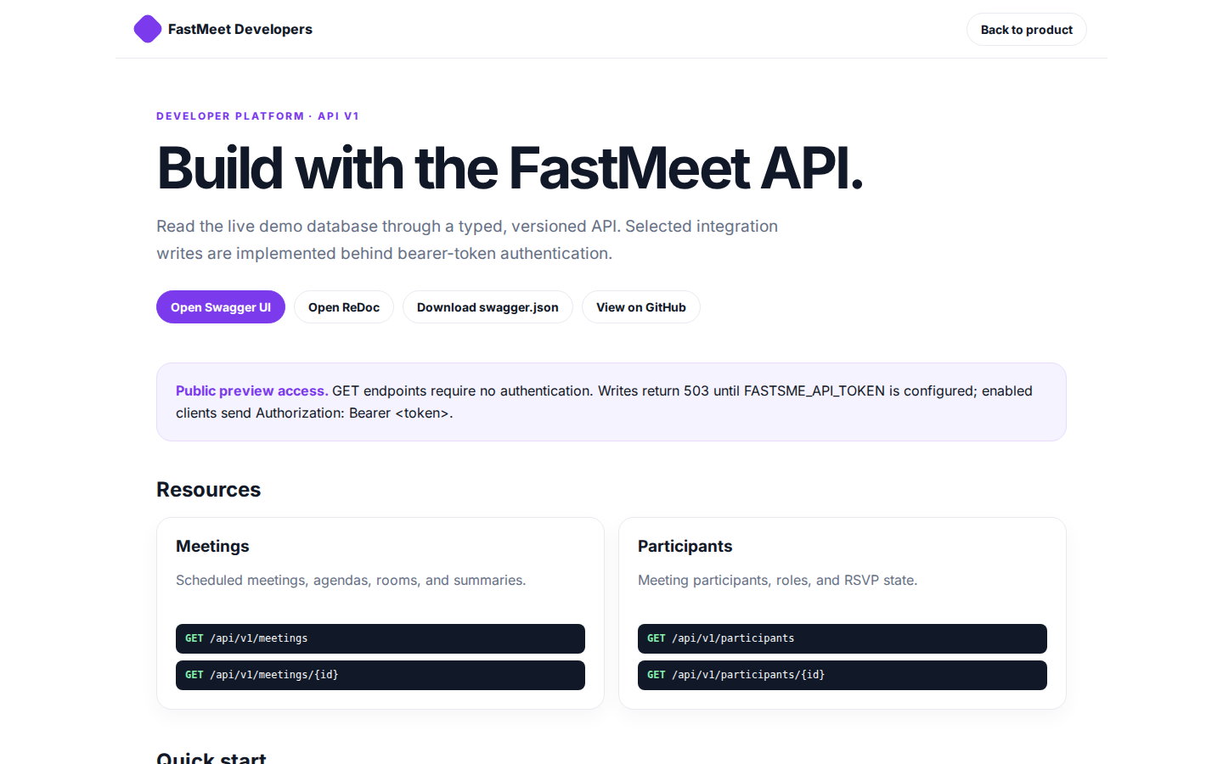
Build with the FastMeet API.
FastMeet Developers Back to product DEVELOPER PLATFORM · API V1 Build with the FastMeet API. Read the live demo database through a typed, versioned API. Selected integration writes are implemented behind bearer-token authentication. Open Swagger UI Open ReDoc
https://meet.fastsme.com/developers

Slide 4
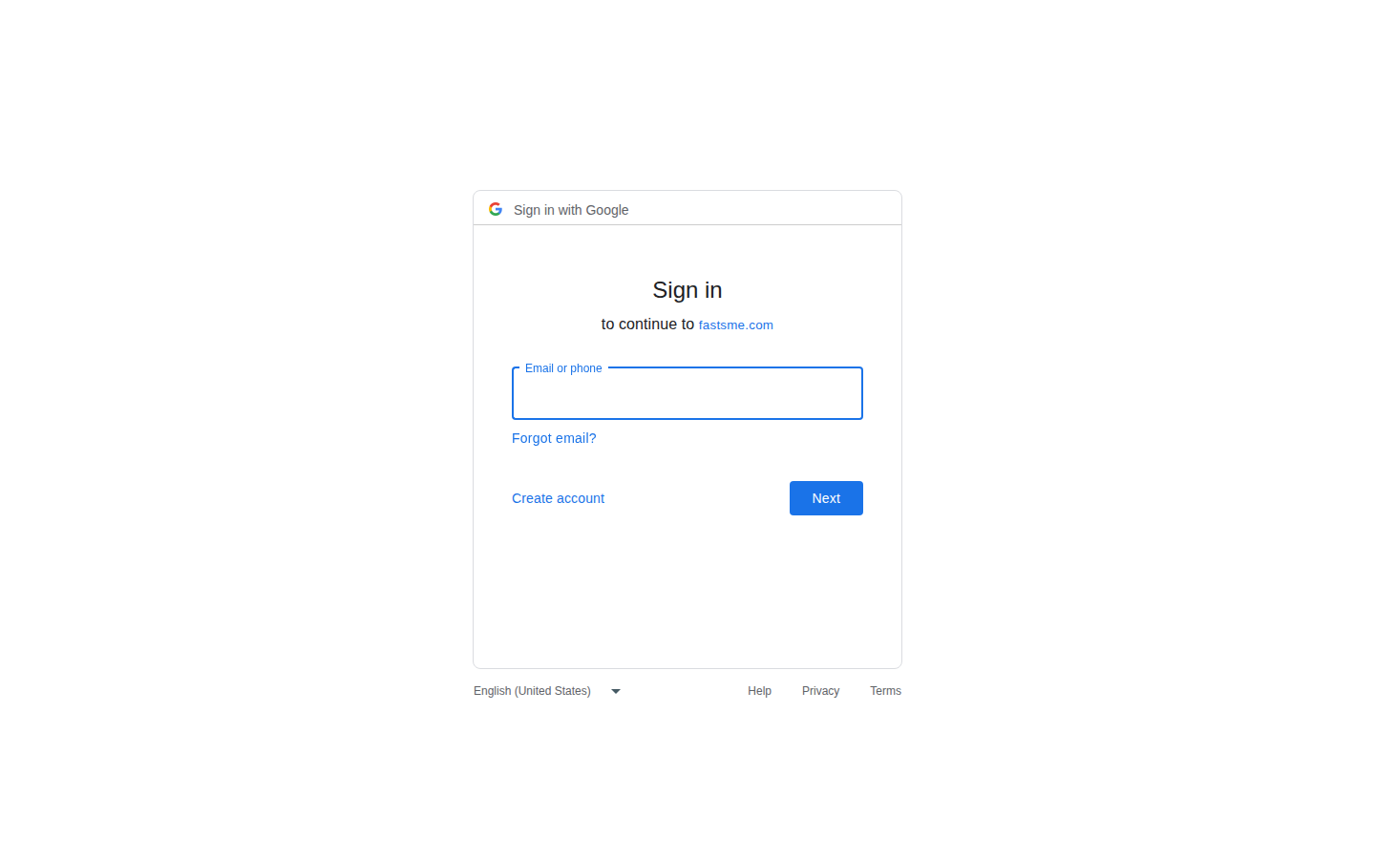
Sign in
Sign in with Google Sign in to continue to fastsme.com Email or phone Forgot email? Next Create account Afrikaans azərbaycan bosanski català Čeština Cymraeg Dansk Deutsch eesti English (United Kingdom) English (United States) Español (España) Español (Latinoam
https://accounts.google.com/v3/signin/identifier?opparams=%253F&dsh=S-331771831%3A1787122800311098&access_type=online&client_id=887059023987-2a7spj1m82eivobdbt1itb3cqca6tpt1.apps.googleusercontent.com&o2v=2&prompt=select_account&redirect_uri=https%3A%2F%2Fmeet.fastsme.com%2Fauth%2Fgoogle%2Fcallback&response_type=code&scope=openid+email+profile&service=lso&state=-K8IQRtF7Q44ozfnLys-8TKCYHqkqDg0rRzI5opS7b0&flowName=GeneralOAuthLite&continue=https%3A%2F%2Faccounts.google.com%2Fsignin%2Foauth%2Flegacy%2Fconsent%3Fauthuser%3Dunknown%26part%3DAJi8hAOY3ev1p_Co15ZcKcWm36b0xLHdJJJbs2xvOm5dcmc5TNGzG_2rygi3SNgq194eODNxI3BSM-h_x2lKzhS0EG3eE552PYoLnBv3TyYkHJU05HcvaMO6wwjzwNP8EFBvs5QIjUw8_DSETbI4eDVz8uMCpprzuhKvg2PDgvLnBF1TU66VXO1tun2IJPF7KvmhKUa3AkLhfuAabwyTQpeod_Gvj-B2vdq8PQBvMaKv-n-S5S2kF99I4c941kArcgoiBkbYkiUF3tJCkim6f_9zFGxxBzjxoD5Q8jxS6L8pym6Yz4gVPfbGdb3oZJO6gX7gfxQVcFc4Po1x4ao26lAKarTXAWw8qv8qVAfjpaigtij6e0VkR-kxKezQ9QrJ6U2wEz42BjqV-ei3Fr-ZLBtLez1YRF2Te4DJyutvoSgyvKUl0XlzUnJhcUtxQMC1EZCB-fDs_zeIEZ4zwAtht8suByFcaOjHRg%26flowName%3DGeneralOAuthFlow%26as%3DS-331771831%253A1787122800311098%26client_id%3D887059023987-2a7spj1m82eivobdbt1itb3cqca6tpt1.apps.googleusercontent.com%23&app_domain=https%3A%2F%2Fmeet.fastsme.com&rart=ANgoxcfDSbdsWfDqB_xDUQ6Z0KqF4G0F3JHrGOhfLlw08T4YR8q781ZfKQYGsT6E75bXd65MEF_fJnCSRQcmG-F10z0mp-EUy4hCPW8rOUkIw_Zs_pWfJvI

