Slide 1
FastOffice
Platform Guide
2026-08-19 • https://office.fastsme.com
FastOffice is the open-source productivity suite and control plane for FastDocs, FastSheets, FastSlides, FastDrive, FastMeet, FastInsights, FastMail, FastCalendar, and FastPilot.

Slide 2
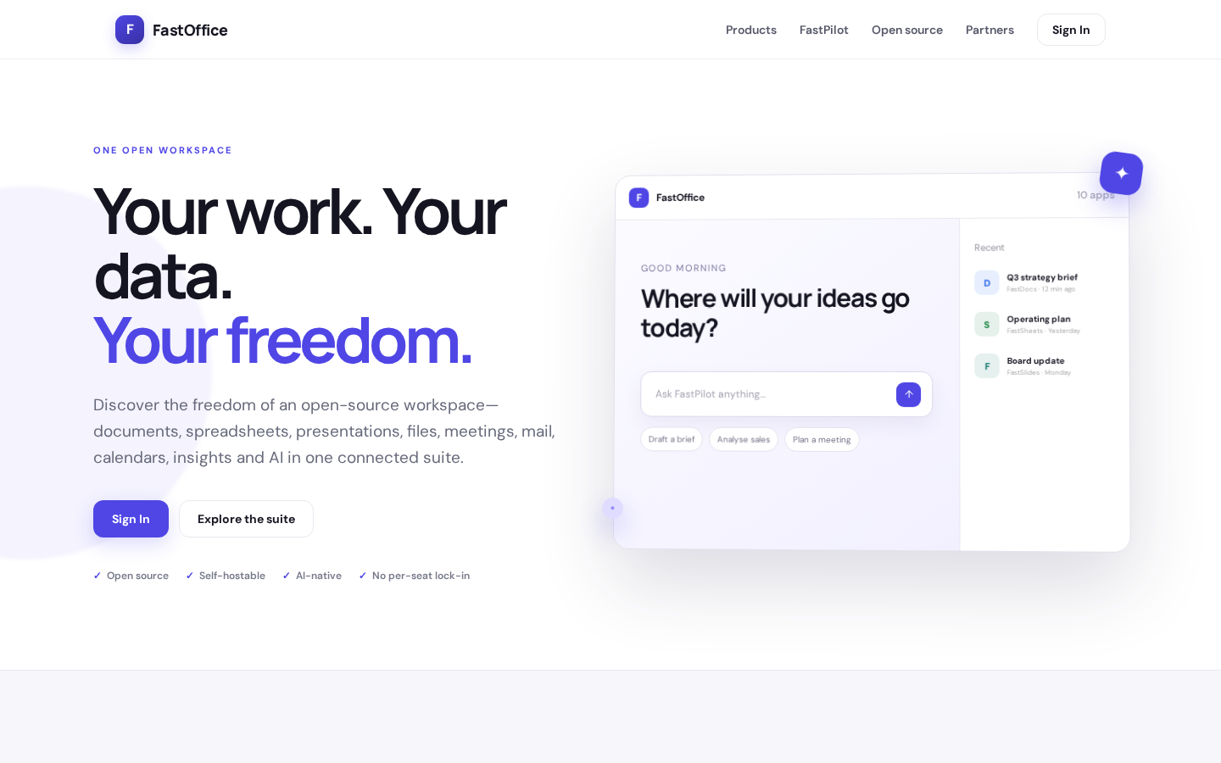
Your work. Your data. Your freedom.
ONE OPEN WORKSPACE Your work. Your data. Your freedom. Discover the freedom of an open-source workspace—documents, spreadsheets, presentations, files, meetings, mail, calendars, insights and AI in one connected suite. Sign In Explore the suite Open source Self
https://office.fastsme.com/

Slide 3
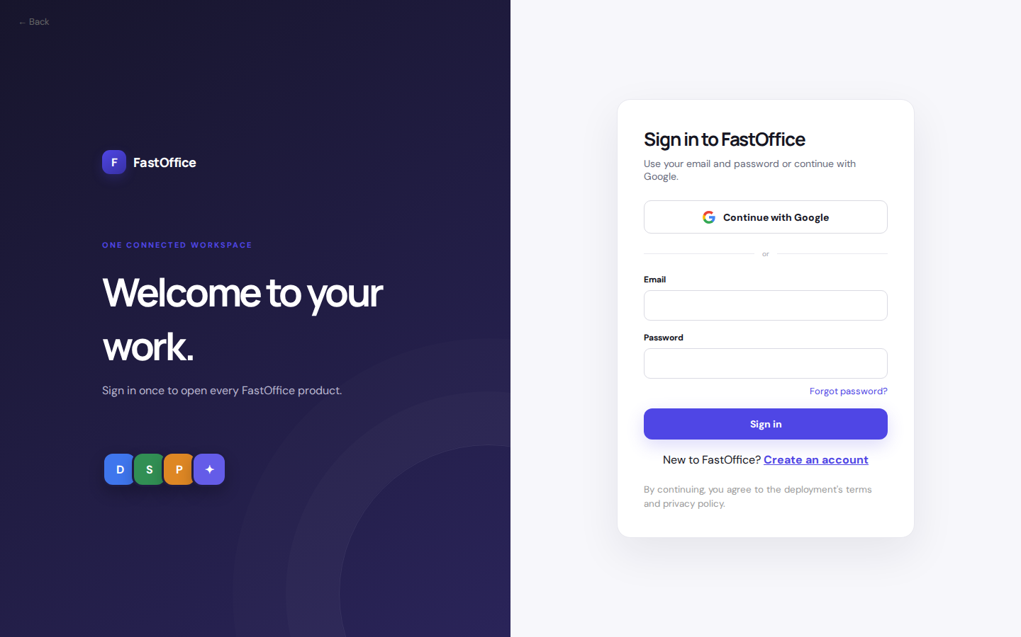
Welcome to your work.
← Back F FastOffice ONE CONNECTED WORKSPACE Welcome to your work. Sign in once to open every FastOffice product. D S P ✦ Sign in to FastOffice Use your email and password or continue with Google. Continue with Google or Email Password Forgot password? Sign in
https://office.fastsme.com/login

Slide 4
Welcome to your work.
← Back F FastOffice ONE CONNECTED WORKSPACE Welcome to your work. Sign in once to open every FastOffice product. D S P ✦ Sign in to FastOffice Use your email and password or continue with Google. Continue with Google or Email Password Forgot password? Sign in
https://office.fastsme.com/login?next=/pilot

Slide 5
Welcome to your work.
← Back F FastOffice ONE CONNECTED WORKSPACE Welcome to your work. Sign in once to open every FastOffice product. D S P ✦ Sign in to FastOffice Use your email and password or continue with Google. Continue with Google or Email Password Forgot password? Sign in
https://office.fastsme.com/login

