Slide 1
FastPE Platform Guide
2026-08-19 • https://pehero.chat
Agentic AI for private equity — specialist agents that source, underwrite, close, and operate your deals.

Slide 2
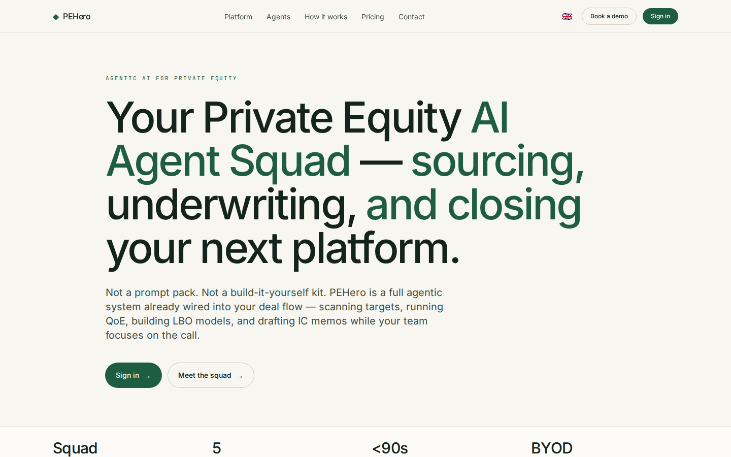
Your Private Equity AI Agent Squad — sourcing, underwriting, and closing your next platfor
AGENTIC AI FOR PRIVATE EQUITY Your Private Equity AI Agent Squad — sourcing, underwriting, and closing your next platform. Not a prompt pack. Not a build-it-yourself kit. PEHero is a full agentic system already wired into your deal flow — scanning targets, run
https://pehero.chat/

Slide 3
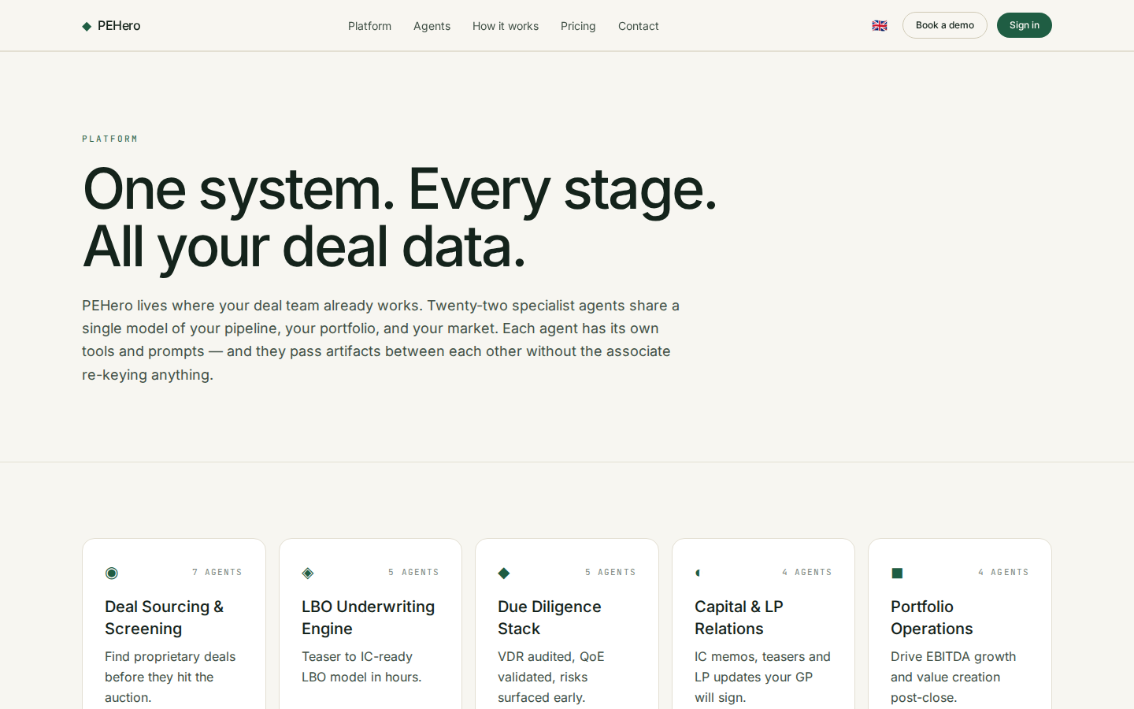
One system. Every stage. All your deal data.
PLATFORM One system. Every stage. All your deal data. PEHero lives where your deal team already works. Twenty-two specialist agents share a single model of your pipeline, your portfolio, and your market. Each agent has its own tools and prompts — and they pass
https://pehero.chat/platform

