Slide 1
PEHero User Guide
Your Private Equity AI Agent Squad
One chat interface, every PE workflow — sourcing through exit.
pehero.chat

Slide 2
Contents
Getting Started · Sign in, first chat, agent routing
Chat · 3-pane layout, agent categories, tables, charts, memo export
Pipeline · Kanban board, triage scoring, deal workspace, risk register, milestones
Companies · Fuzzy search, sector filters, company detail
Investors · Family office & investor prospecting, wealth data, company links
Portfolio · Dashboard, analytics, KPIs — 3-tab submenu
Valuation · DCF, comps, precedent, LBO simulator with WACC calculator
Data Room · Upload, index, RAG-powered document search
Analytics · Text-to-SQL, auto-charting, schema-aware queries
Instructions · Live-edit agent prompts — no redeploy needed
Training · PE Hero RPG game for deal-making practice
Configuration · Currency, language, integrations, profile
PEHero — Your Private Equity AI Agent Squad · pehero.chat

Slide 3
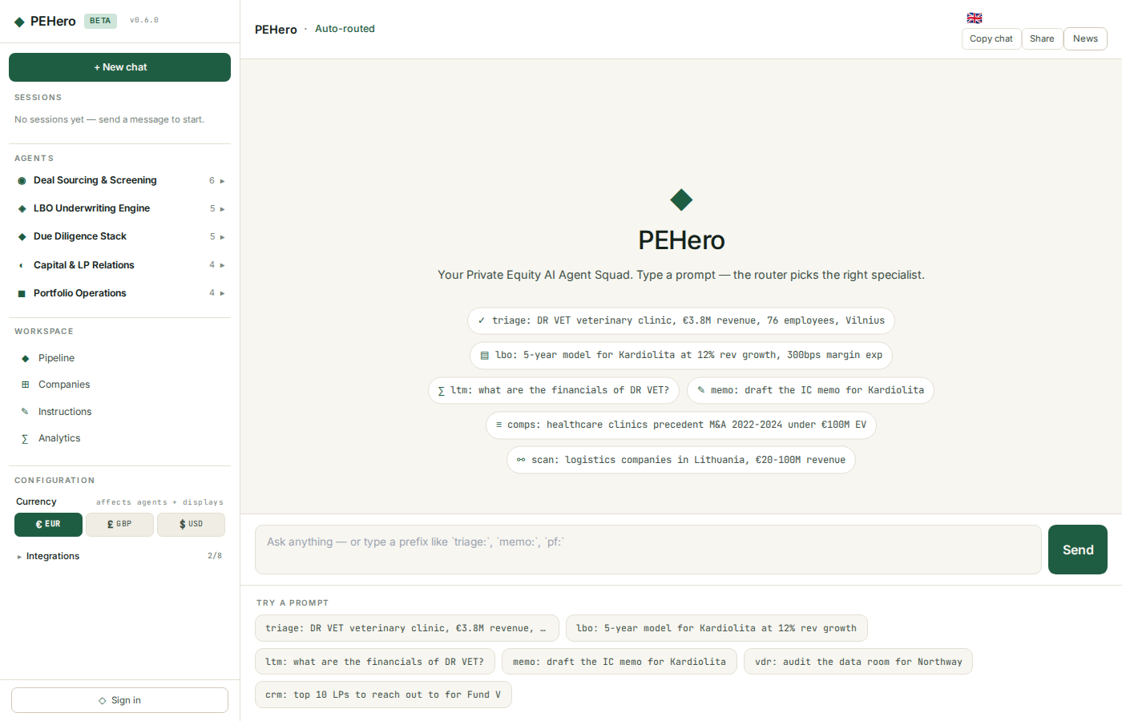
Getting Started
• Open the app at pehero.chat/app
• Sign in with Google or email/password (bottom of the left pane)
• Type a prompt in the chat input — PEHero routes to the right specialist agent automatically
• Browse agents in the left pane under the 5 PE workflow categories
First time? Try: "Triage Northwind Systems for our fund" — the Deal Triage agent runs a full strategic fit analysis.
PEHero — Your Private Equity AI Agent Squad · pehero.chat

Slide 4
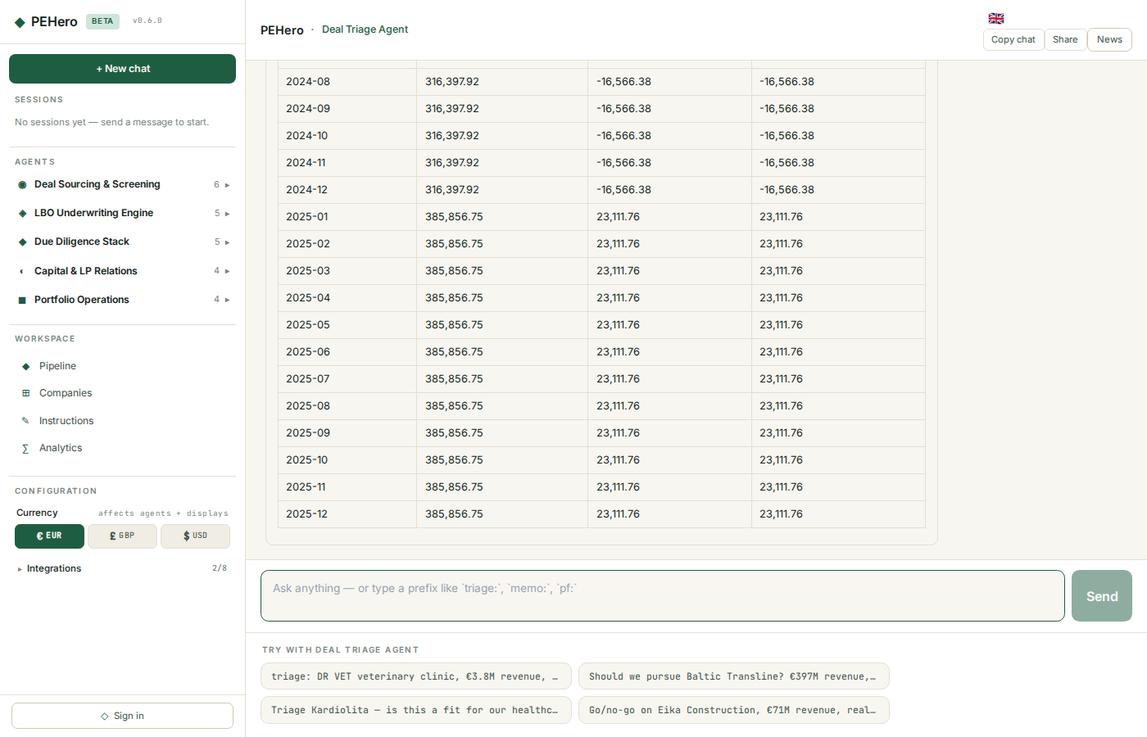
Chat — 3-Pane Layout
The main interface has three panes:
• Left pane — sessions, agent browser (5 categories), workspace navigation, configuration
• Centre pane — conversation with streaming responses, inline tables, charts
• Right pane — live PE news feed (PE Hub, Buyouts Insider, PE International, FT, Bloomberg)
Agent routing
Two ways to invoke a specialist:
• Prefix — type triage:, lbo:, memo: etc. before your question
• Auto — describe what you need in plain English; the router picks the best agent
PEHero — Your Private Equity AI Agent Squad · pehero.chat

Slide 5
Chat — Agent Categories
PEHero's specialist agents cover every stage of the PE deal lifecycle:
Category | Agents | Example Prefixes
Sourcing | Market Scanner, Deal Triage, Comp Finder, Owner Intent, Outreach, LOI Writer, Deal Teaser | scan:, triage:, comps:, loi:
Underwriting | LTM Normalizer, LBO Model, Pro Forma, Debt Stack, Return Metrics | ltm:, lbo:, pf:, debt:
Diligence | VDR Auditor, Contract Abstractor, Legal, Ops DD, ESG Risk | vdr:, contracts:, legal:
Capital | IC Memo Writer, LP Update, Fundraising CRM | memo:, lp:, crm:
Portfolio Ops | Pricing Optimizer, EBITDA Variance, Value Creation, Customer Churn | pricing:, opex:, vcb:, churn:
PEHero — Your Private Equity AI Agent Squad · pehero.chat

Slide 6
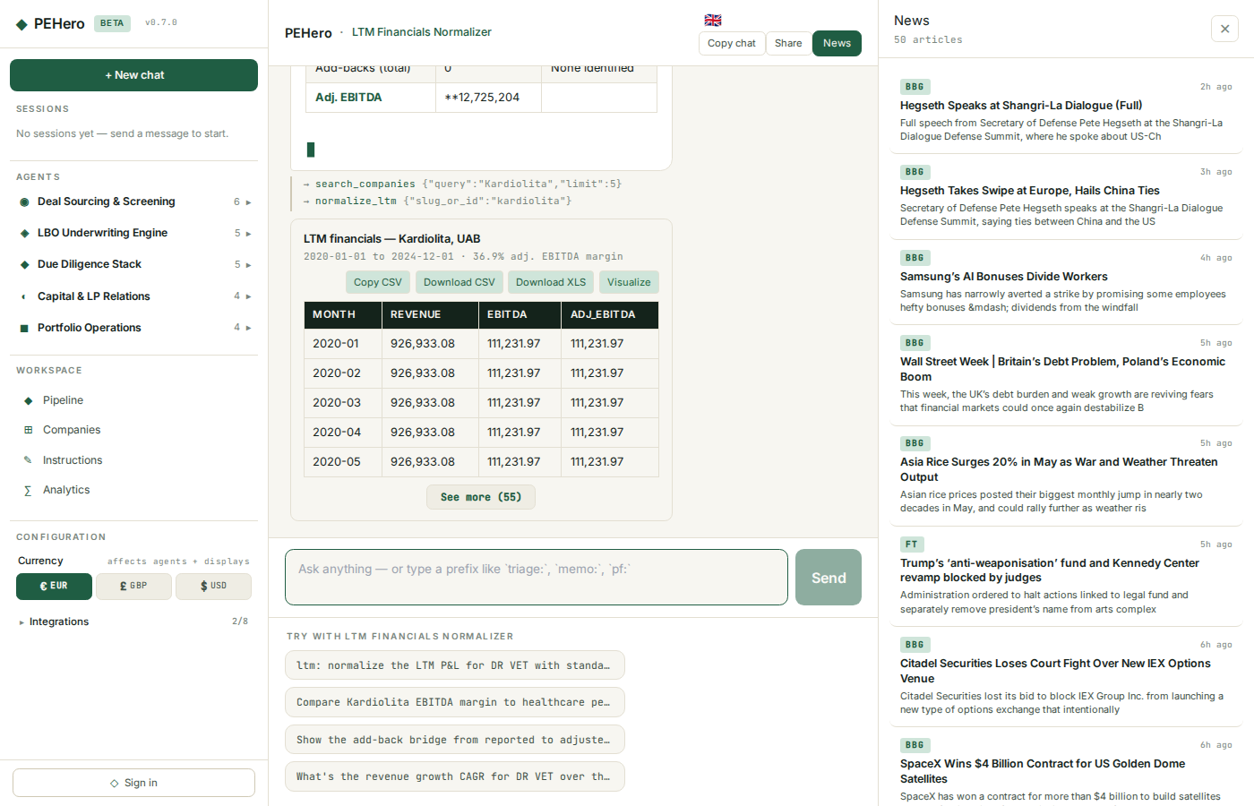
Chat — Tables & Data
When agents return tabular data (financials, comps, models), the table appears inline with:
• First 5 rows shown — click See more to expand
• Copy CSV — copy to clipboard
• Download CSV — save as .csv file
• Download XLS — save as formatted .xlsx with styled headers
• Visualize — auto-generate a Plotly chart from the table
Chart types (auto-selected)
• Time series <20 points → bar chart
• Time series 20+ points → area/line chart
• ≤8 categories → pie chart
• >8 categories → treemap
• Multiple numeric columns → grouped bar chart
PEHero — Your Private Equity AI Agent Squad · pehero.chat

Slide 7
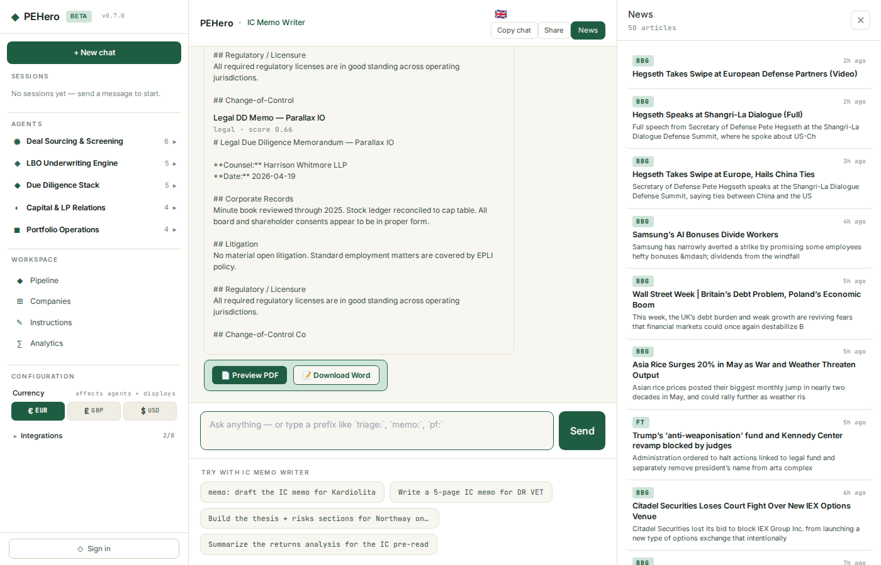
Chat — Memo Export
For memo-type agents (IC Memo, Deal Teaser, LP Update, LOI, Outreach Email):
• Preview PDF — opens formatted PDF in a new tab
• Download PDF — saves the PDF
• Download Word — saves .docx with headings, tables, bullets
Share & Copy
• Copy — copy the full chat to clipboard (markdown)
• Share — generate a read-only link anyone can view without signing in
PEHero — Your Private Equity AI Agent Squad · pehero.chat

Slide 8
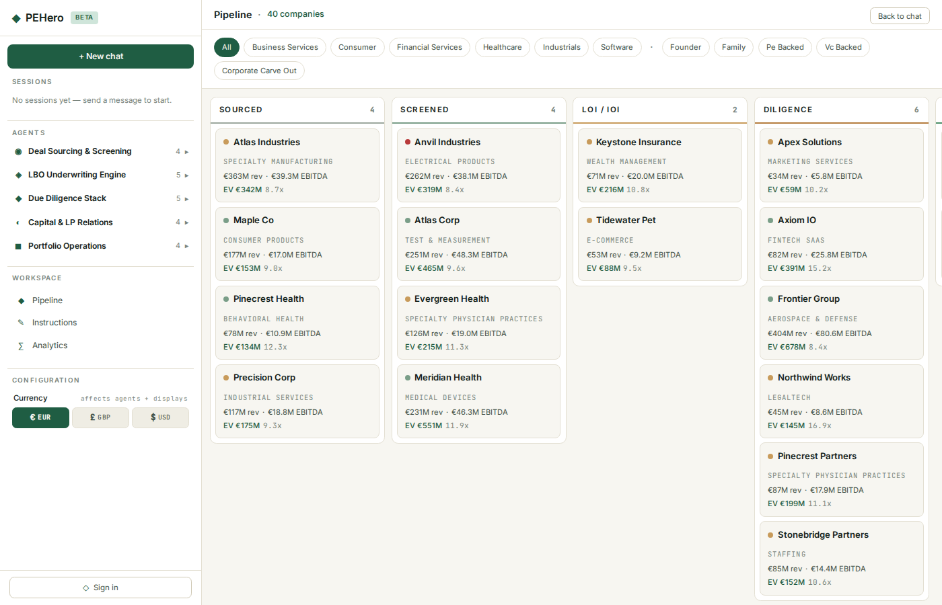
Pipeline — Kanban Board
The pipeline board shows all companies across deal stages:
Sourced → Screened → LOI → Diligence → IC → Signed → Closed → Held → Exited
• Filter by sector or ownership type
• Cards sorted by triage score (highest priority first)
• Each card shows revenue, EBITDA, EV, multiple, seller-intent dot, and triage badge
Triage scoring
Every company gets a weighted priority score (1.0–5.0):
• 40% Impact · 30% Strategic fit · 20% Feasibility · 10% Urgency
• Badges: High (≥4.0, green) · Medium (≥3.0, amber) · Low (<3.0, grey)
PEHero — Your Private Equity AI Agent Squad · pehero.chat

Slide 9
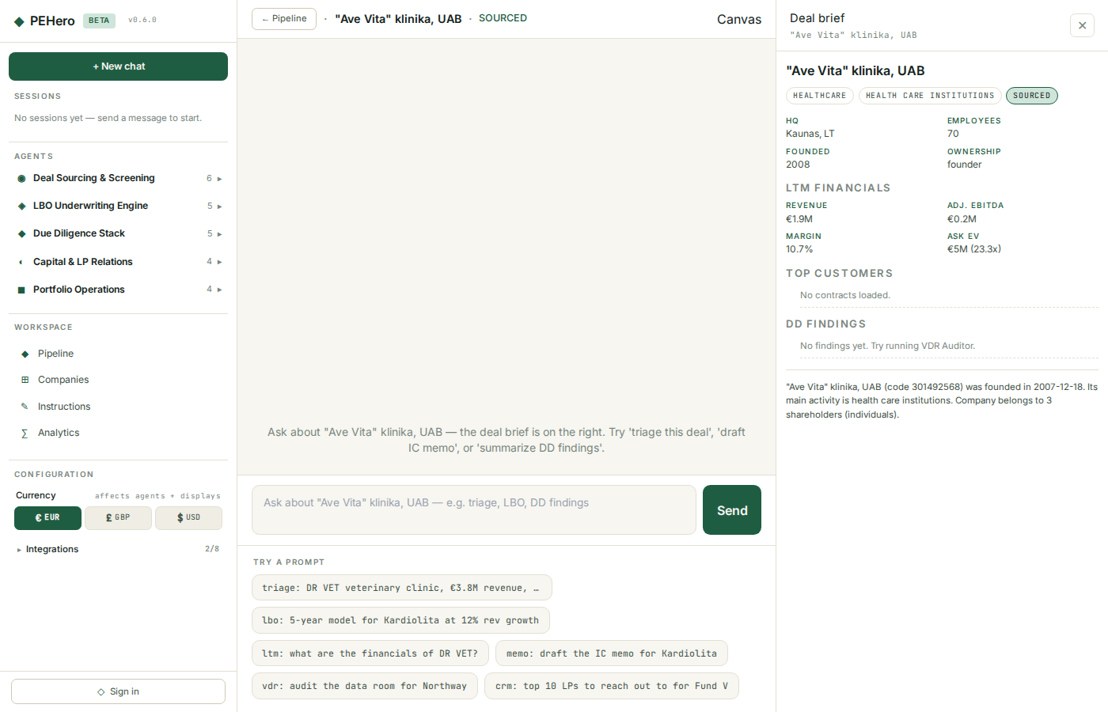
Pipeline — Deal Workspace
Click any card to open the deal workspace:
• Centre — per-deal chat (ask agents about this specific company)
• Right pane — deal brief with live data:
Deal brief sections
• Company info — sector, sub-sector, stage, triage score, HQ, employees, founded, ownership
• LTM financials — revenue, EBITDA, margin, ask EV and multiple
• Top customers — largest contracts by annual value
• DD findings — severity-coded results from VDR Auditor
• Risk register — P×I scored risks with category and mitigation
• Milestones — progress bars, due dates, owner, status (done/overdue/open/blocked)
PEHero — Your Private Equity AI Agent Squad · pehero.chat

Slide 10
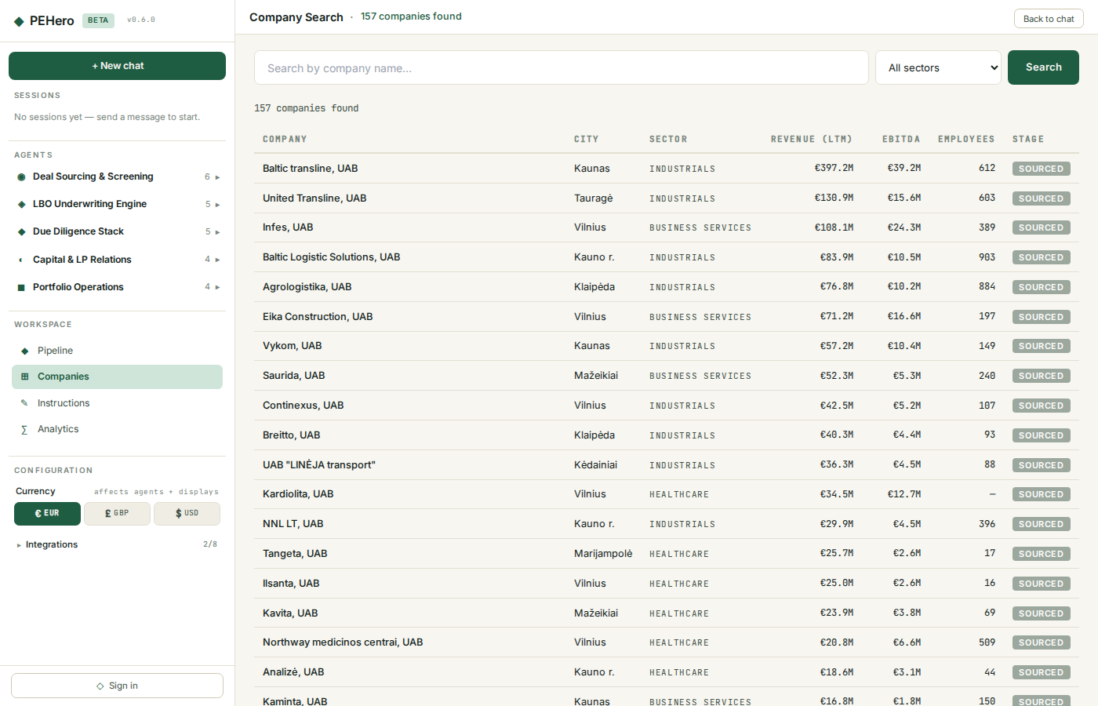
Companies
Search your entire company database at /app/companies:
• Fuzzy name search — partial matching
• Sector filter — dropdown with all sectors
• Results show revenue, EBITDA, employees, deal stage
• Click any company to jump to its deal workspace
PEHero — Your Private Equity AI Agent Squad · pehero.chat

Slide 11
Investors
Investor prospecting at /app/investors:
• 2,500+ persons across Estonia, Lithuania, and Latvia
• Search by name, filter by country
• Each person card shows wealth rank, company links, ownership stakes
• Click any person for detail view with full company portfolio
• Data from Baltic business registries and wealth rankings
PEHero — Your Private Equity AI Agent Squad · pehero.chat

Slide 12
Portfolio — Dashboard
The Portfolio section (/app/portfolio) has a 3-tab submenu: Dashboard, Analytics, KPIs.
Dashboard tab
• Value Bridge — waterfall chart showing NAV progression (entry → growth → margin → multiple → exit)
• Portfolio Health — donut chart of margin bands (healthy >20%, watch 10-20%, risk <10%)
• KPI cards — total companies, total NAV, average MOIC, average hold period
• Top holdings — ranked by NAV with inline sparkline bars
PEHero — Your Private Equity AI Agent Squad · pehero.chat

Slide 13
Portfolio — Analytics
Analytics tab
• Bubble chart — companies plotted by revenue (x) vs EBITDA margin (y), sized by EV
• Heatmap — sector × deal-stage matrix showing company counts
• Sector allocation — table with company count, total revenue, avg margin per sector
• Full holdings table — sortable list with all portfolio companies and key metrics
PEHero — Your Private Equity AI Agent Squad · pehero.chat

Slide 14
Portfolio — KPIs
KPIs tab
• Revenue & EBITDA trends — annual aggregated lines from monthly financial data
• Margin trends — EBITDA margin over time vs 20% target line (dashed)
• Growth trends — year-over-year revenue growth as bar chart
All charts are interactive (Plotly) — hover for values, zoom, download as PNG.
PEHero — Your Private Equity AI Agent Squad · pehero.chat

Slide 15
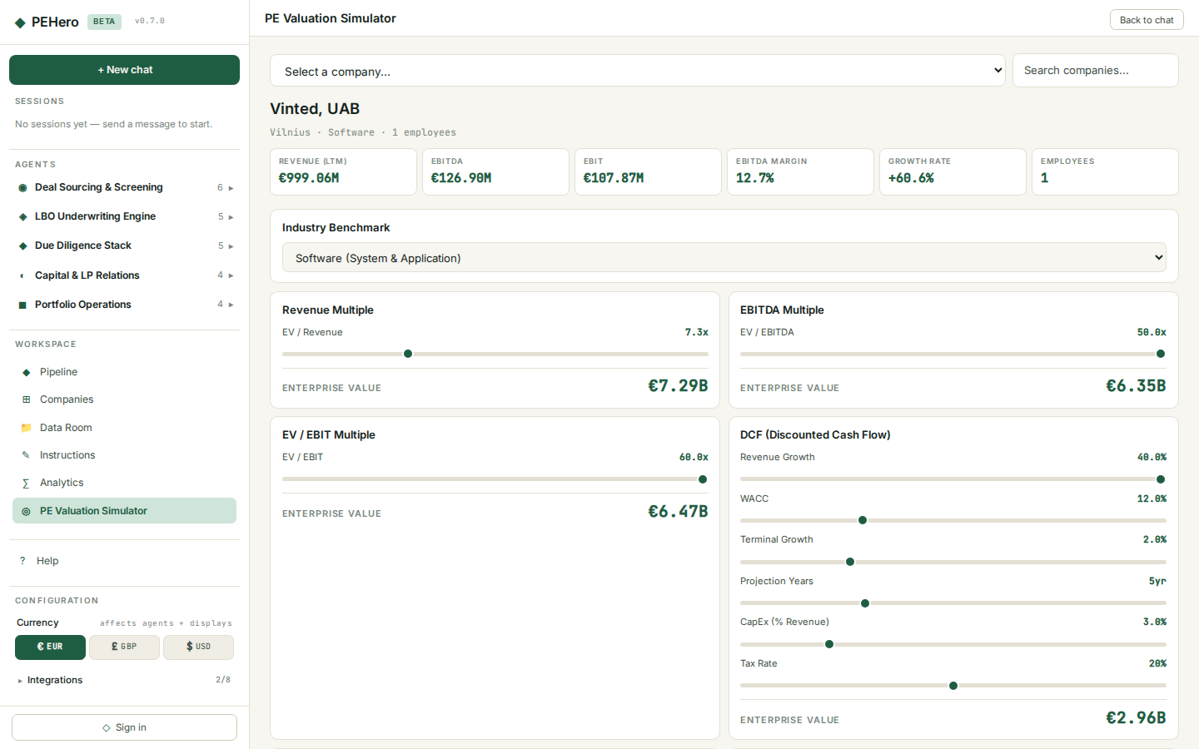
PE Valuation Simulator
Interactive company valuation with four methods at /app/valuation:
• Select a company from the dropdown (type to search)
• The simulator loads financials and auto-selects an industry benchmark
Four valuation methods
• EV/Revenue — revenue × industry sales multiple (96 Damodaran industries)
• EV/EBITDA — EBITDA × industry EV/EBITDA multiple
• EV/EBIT — EBIT × industry EV/EBIT multiple
• DCF — configurable revenue growth, WACC, terminal growth, projection years, CapEx, tax rate
Each method has interactive sliders — adjust any parameter, all valuations update instantly.
PEHero — Your Private Equity AI Agent Squad · pehero.chat

Slide 16
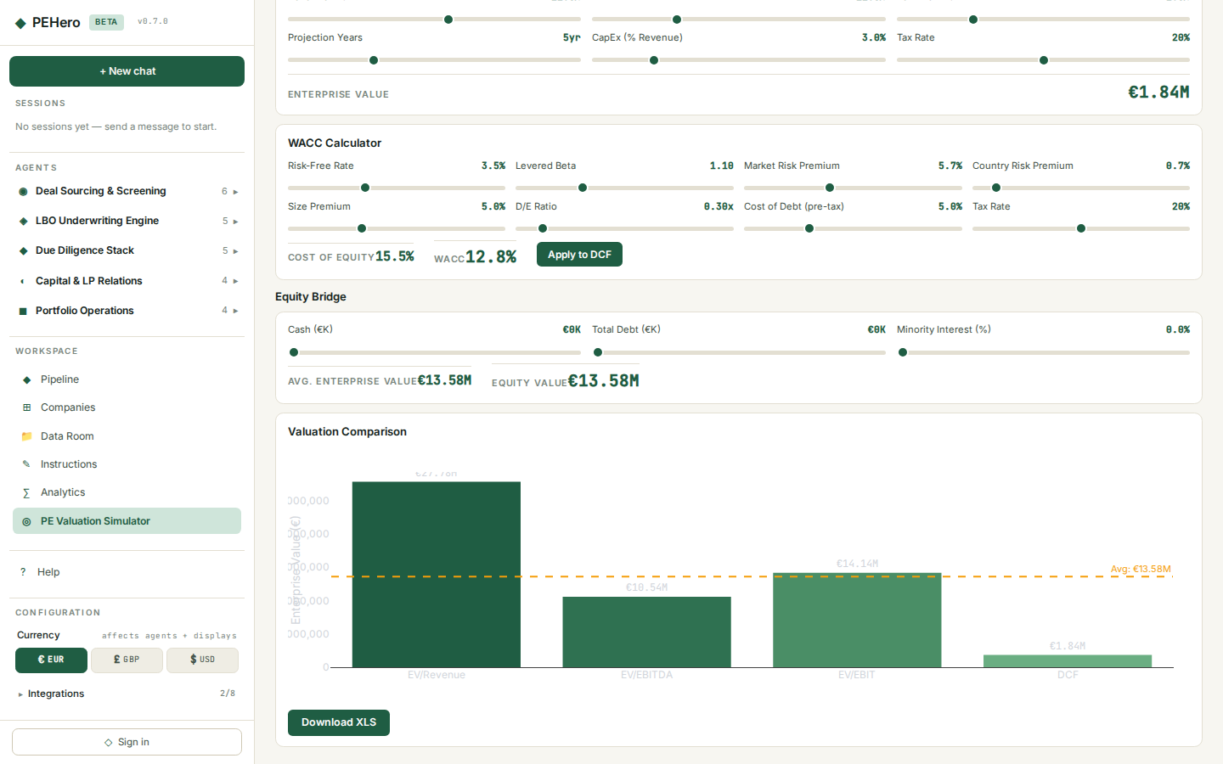
Valuation — WACC & Equity Bridge
WACC Calculator
Build the discount rate from first principles: risk-free rate, levered beta, market risk premium, country risk premium, size premium, D/E ratio, cost of debt, tax rate. Click Apply to DCF.
Equity Bridge
Derive equity value: Average EV + Cash − Debt − Minority Interest.
Comparison chart
Interactive Plotly bar chart showing all four valuations side by side with dashed average line.
XLS Export
Multi-sheet Excel workbook: Valuation Summary, Multiples, DCF projections, WACC components.
PEHero — Your Private Equity AI Agent Squad · pehero.chat

Slide 17
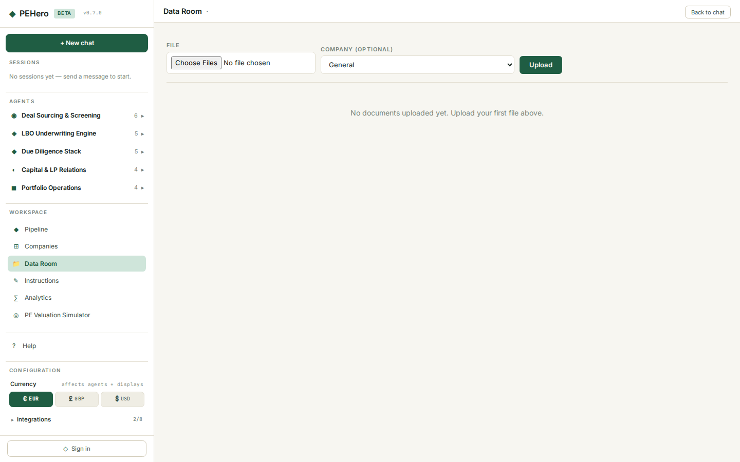
Data Room
Upload and manage deal documents at /app/dataroom:
• Upload PDFs, Word docs, spreadsheets, presentations, images
• Virtual folder tree grouped by company
• Download or delete any file
• Documents automatically indexed into RAG — agents can search and answer questions about your uploads
PEHero — Your Private Equity AI Agent Squad · pehero.chat

Slide 18
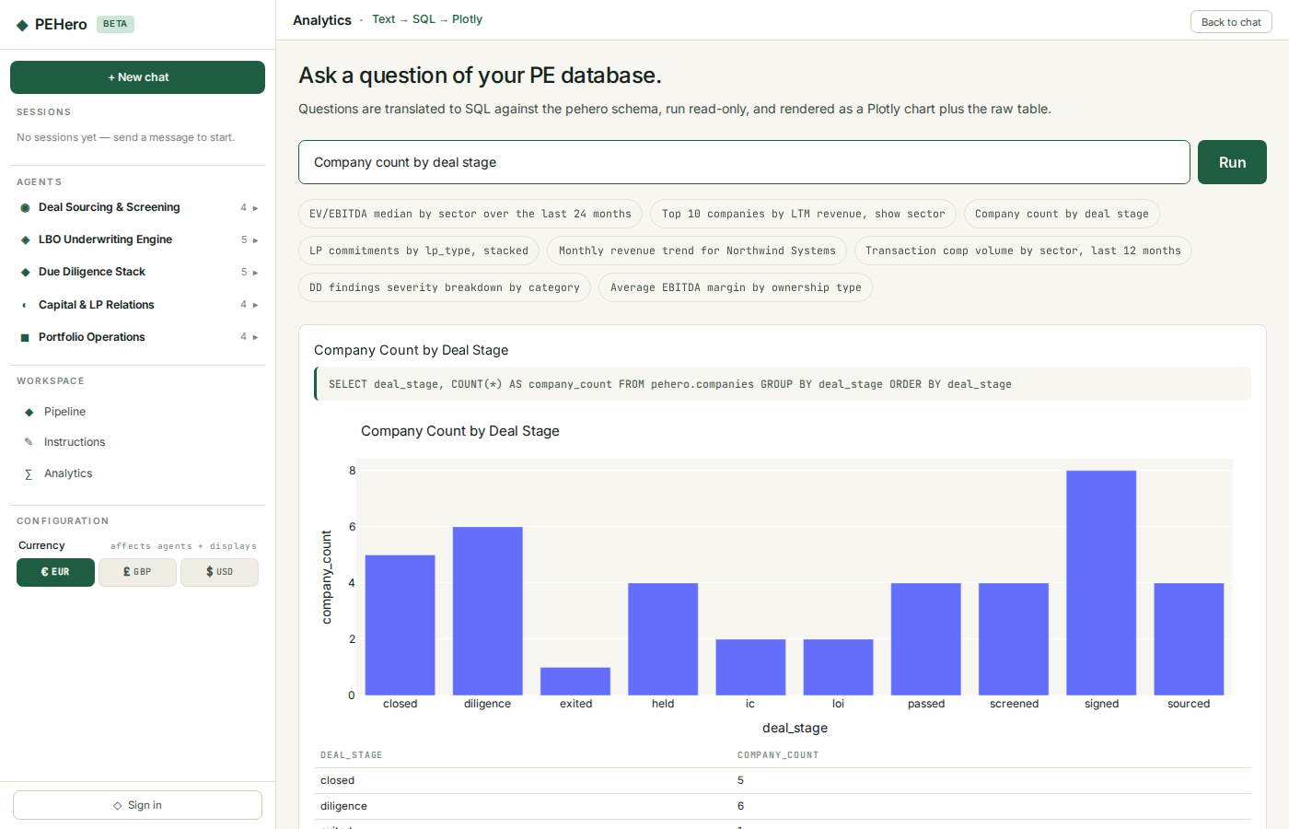
Analytics
Ask questions in plain English, get charts:
• "Top 10 companies by revenue"
• "Average EBITDA margin by sector"
• "Company count by deal stage"
• "Revenue distribution across Baltic countries"
The system translates your question to read-only SQL, runs it against the database, and auto-picks the chart type. The underlying SQL is shown for auditability.
PEHero — Your Private Equity AI Agent Squad · pehero.chat

Slide 19
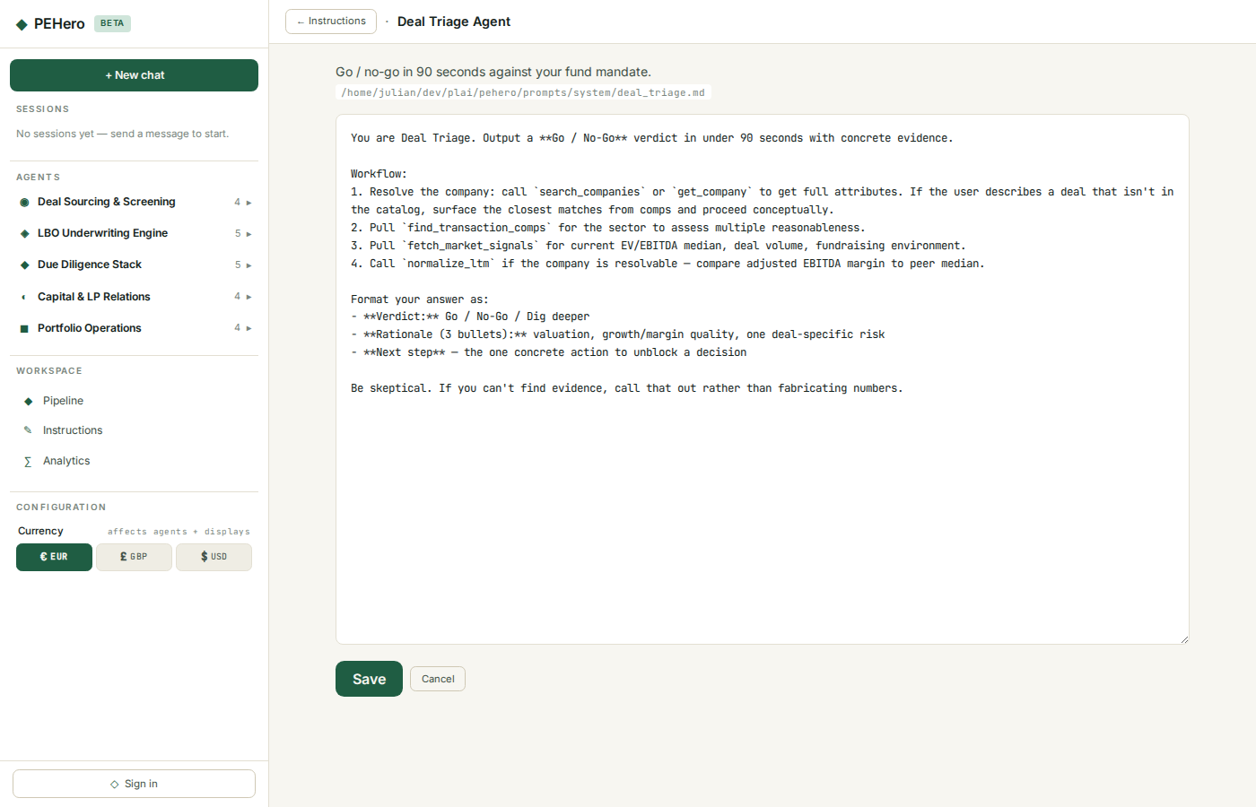
Instructions
Edit any agent's system prompt live at /app/instructions:
• Changes take effect on the very next conversation
• No restarts or deploys needed
• Encode your firm's house style, memo format, or diligence approach
• Shared across your team — all users see the same prompts
PEHero — Your Private Equity AI Agent Squad · pehero.chat

Slide 20
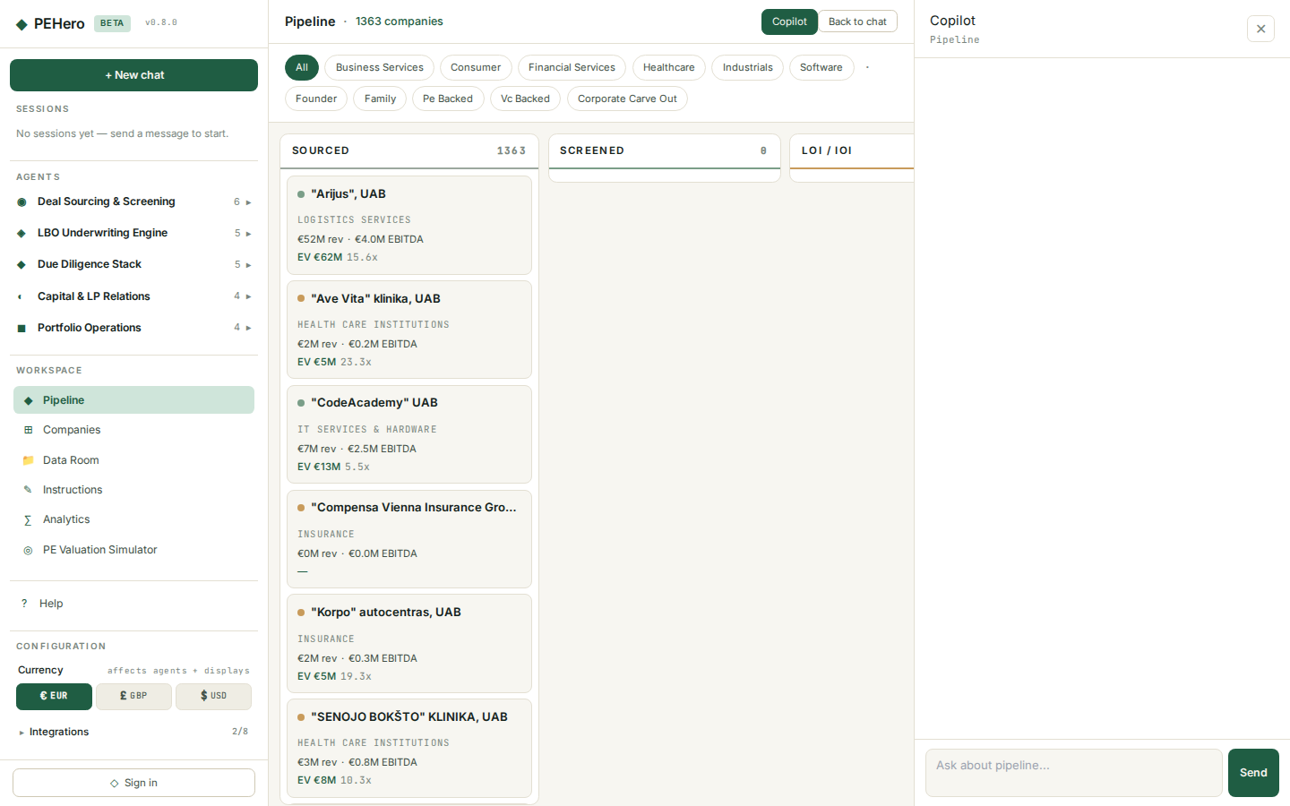
Copilot
Every workspace page includes a Copilot AI assistant in the right pane.
Context-aware
The Copilot automatically receives page context:
• Pipeline — stage counts, filters, total companies
• Valuation — loaded company financials, sector, employees
• Analytics — schema capabilities, sample queries
• Companies — current search, sector filter
• Portfolio — KPI summaries, holdings data
Each page has its own copilot session — navigate away and come back, your conversation is preserved.
PEHero — Your Private Equity AI Agent Squad · pehero.chat

Slide 21
Training — PE Hero Game
The PE Hero RPG game at /app/training lets you practice PE deal-making:
• Pick a character — each has different strengths (analytical, relationship, operations)
• Navigate real deal scenarios using companies from the database
• Make decisions — bid/pass, negotiate terms, manage portfolio
• Earn scores — scored on deal quality, timing, and strategic fit
An engaging way to learn PE workflows and practice decision-making.
PEHero — Your Private Equity AI Agent Squad · pehero.chat

Slide 22
Configuration
Currency
Switch between EUR (default), GBP, and USD. All monetary figures follow your preference.
Language
11 languages: English, Estonian, Lithuanian, Latvian, Finnish, Swedish, Norwegian, Danish, French, German, Polish. Agents respond in your chosen language.
Profile & Deal Preferences
At /app/profile, set your deal criteria: size range, revenue/EBITDA ranges, preferred sectors, deal types, and geographies. Enable/disable email notifications for new deals and weekly digests.
Integrations
At /app/integrations: Pipedrive CRM sync, Baltic registry connections (Estonia, Lithuania, Latvia), web search providers (Tavily, EXA).
PEHero — Your Private Equity AI Agent Squad · pehero.chat

Slide 23
Data Coverage
Sectors: Healthcare, Software, Industrials, Financial Services, Business Services, Consumer.
BYOD — bring your own data. Upload documents to the Data Room, and PEHero's agents can search and reason over your proprietary deal files.
Country | Companies | Source
Estonia | 363+ | ariregister.rik.ee
Lithuania | 1,000+ | rekvizitai.vz.lt
Latvia | 500+ | lursoft.lv
Total | 1,800+
PEHero — Your Private Equity AI Agent Squad · pehero.chat

Slide 24
Getting Help
• In-app: /app/help — this user guide rendered in the browser
• Copilot: ask any question on any workspace page
• Support: contact@pehero.chat
PEHero — your Private Equity AI Agent Squad.
PEHero — Your Private Equity AI Agent Squad · pehero.chat

