Slide 1
FastPPM Platform Guide
2026-08-19 • https://ppm.fastsme.com
A conversational-first project-management and use-case-tracking tool for a single PE portfolio company's **Transformation Office**. FastPPM ingests messy, siloed documents (PDF status reports, Excel trackers, PowerPoint decks, Word charters), normalises them to a canonical schema, and delivers a unified master reposito

Slide 2
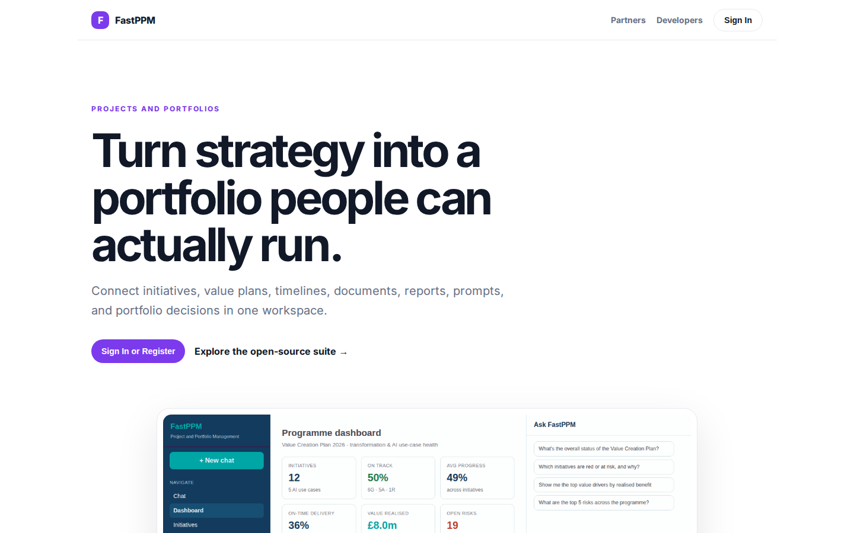
Turn strategy into a portfolio people can actually run.
PROJECTS AND PORTFOLIOS Turn strategy into a portfolio people can actually run. Connect initiatives, value plans, timelines, documents, reports, prompts, and portfolio decisions in one workspace. Sign In or Register Explore the open-source suite → Product tour
https://ppm.fastsme.com/

Slide 3
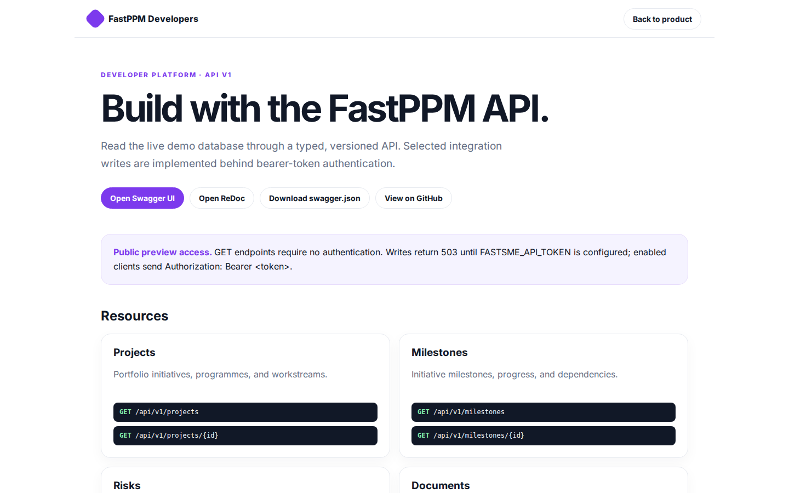
Build with the FastPPM API.
FastPPM Developers Back to product DEVELOPER PLATFORM · API V1 Build with the FastPPM API. Read the live demo database through a typed, versioned API. Selected integration writes are implemented behind bearer-token authentication. Open Swagger UI Open ReDoc Do
https://ppm.fastsme.com/developers

Slide 4
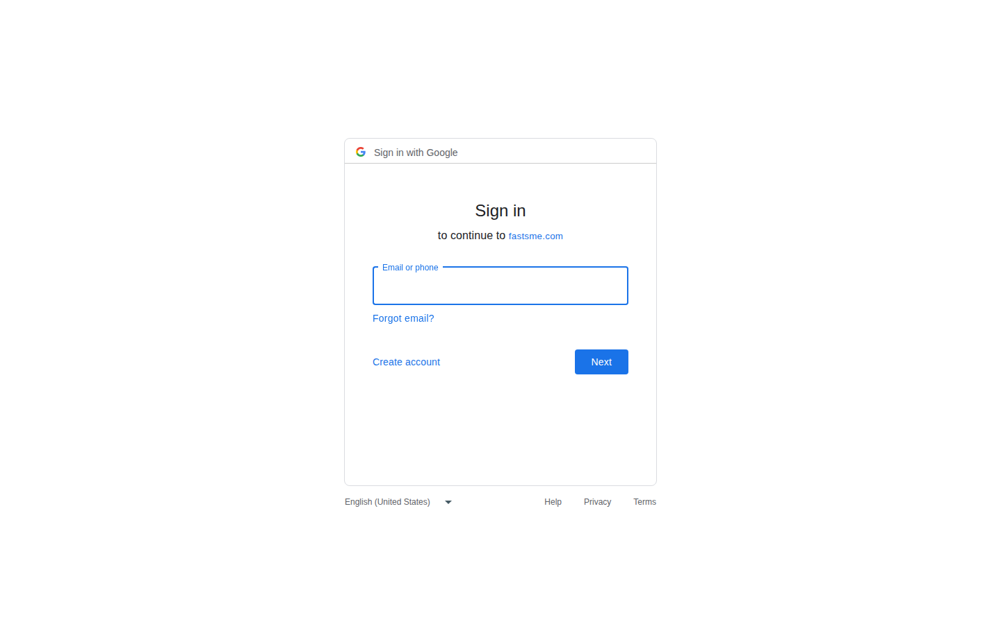
Sign in
Sign in with Google Sign in to continue to fastsme.com Email or phone Forgot email? Next Create account Afrikaans azərbaycan bosanski català Čeština Cymraeg Dansk Deutsch eesti English (United Kingdom) English (United States) Español (España) Español (Latinoam
https://accounts.google.com/v3/signin/identifier?opparams=%253F&dsh=S-650794498%3A1787122829828716&access_type=online&client_id=887059023987-2a7spj1m82eivobdbt1itb3cqca6tpt1.apps.googleusercontent.com&o2v=2&prompt=select_account&redirect_uri=https%3A%2F%2Fppm.fastsme.com%2Fauth%2Fcallback&response_type=code&scope=openid+email+profile&service=lso&state=awPUeuM2fyEP6zB73icpqUDPznE_s8XA&flowName=GeneralOAuthLite&continue=https%3A%2F%2Faccounts.google.com%2Fsignin%2Foauth%2Flegacy%2Fconsent%3Fauthuser%3Dunknown%26part%3DAJi8hAMefWK8WifqhZxK0f_CcV6Go89fOSRPVuhC6f6xEengJY3nIRKg69YP6H0ELszo2blhnbxYQxaMsn_dQifpGVWWKEBb777XfAF01wLkFiP4-mbIE5wR0ZiS4YR20Z4ViwpJvPTtJlLYgdyWVq3SNtJh4oHv5HB7KX5WchsMu4V-sRIrvr1L2CzUMXuitAO-Oj04ojsclGBz3DZ_6rWTooNeFZxBz_xbiYtU7VLXx-HcOAAxrSTTzO57kqUFEVaIXfk85HBIZzKlBaWZ2pWeRAxjJ9en7Fq5nDP1NMCnoXFLEbjQ_lZUYtJBwT49lFp44HRGNpuIO-cpcS5baf61fgc1qhyLI0Zi-g92JK2gOVGepA3JZT-CiZUzPKa8UxYmQbraz3bymv8Kwm_B0VL-XdU8adVy8Ps-npzqaNBPu3TCp1BIbdvGnXAocCaMuQyogNHkHQncbjnzYN048J4-NcTKs7bTnA%26flowName%3DGeneralOAuthFlow%26as%3DS-650794498%253A1787122829828716%26client_id%3D887059023987-2a7spj1m82eivobdbt1itb3cqca6tpt1.apps.googleusercontent.com%23&app_domain=https%3A%2F%2Fppm.fastsme.com&rart=ANgoxcdIDViz07Yf4xxxsMyKxPWsVaxZ1hMykZXe_hhMt3KdCo46Z4ZyF9DcrcgsH7CCRckGzByrMpfvAz5wDIZN-Ft45moPA8PHGgRDg5ZqMOEQ4ce8DEs

