Slide 1
FastSSO Platform Guide
2026-08-19 • https://sso.fastsme.com
FastSSO is an open-source, self-hostable **enterprise SSO integration broker**. An application integrates once through OpenID Connect (OIDC) or the small REST API, while each customer organization can bring a SAML 2.0 or OIDC identity provider.

Slide 2
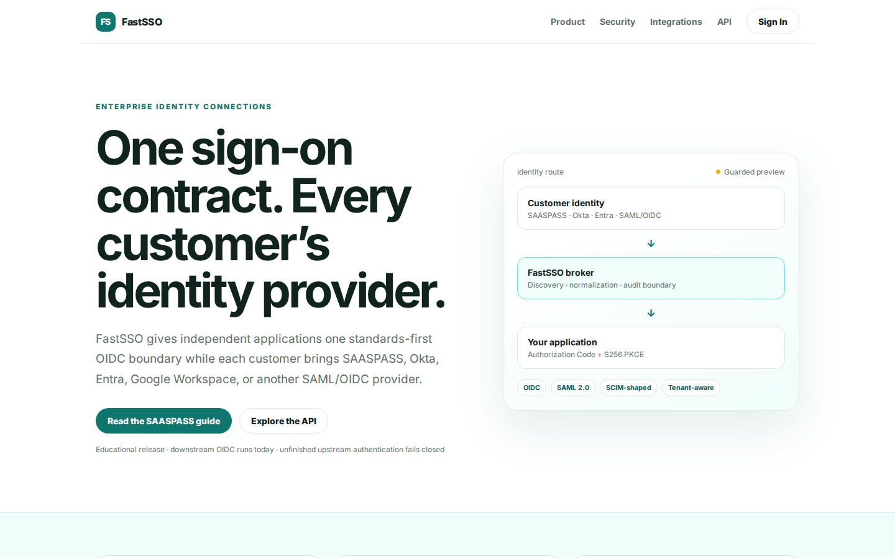
One sign-on contract. Every customer’s identity provider.
ENTERPRISE IDENTITY CONNECTIONS One sign-on contract. Every customer’s identity provider. FastSSO gives independent applications one standards-first OIDC boundary while each customer brings SAASPASS, Okta, Entra, Google Workspace, or another SAML/OIDC provider
https://sso.fastsme.com/

Slide 3
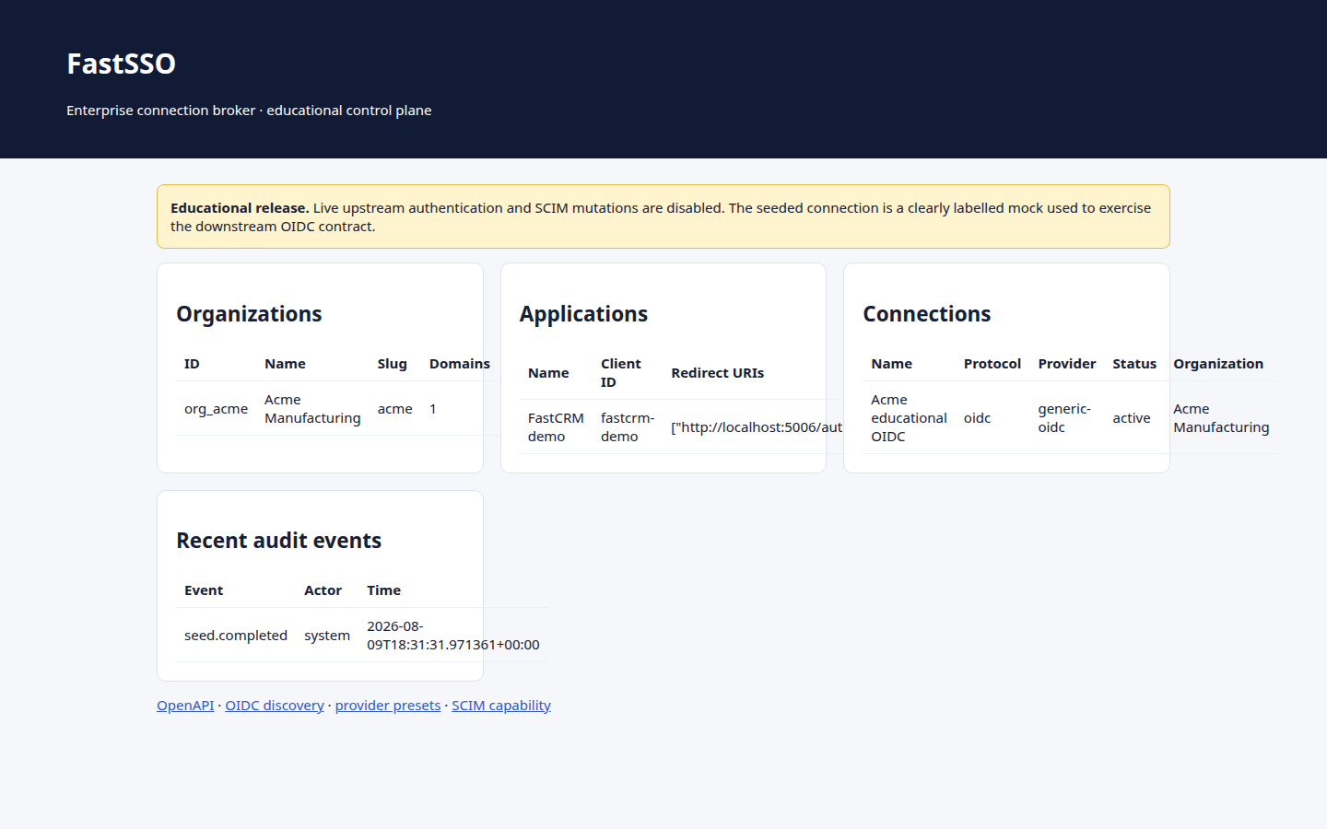
FastSSO
Educational release. Live upstream authentication and SCIM mutations are disabled. The seeded connection is a clearly labelled mock used to exercise the downstream OIDC contract. Organizations ID Name Slug Domains Connections org_acme Acme Manufacturing acme 1
https://sso.fastsme.com/admin

Slide 4
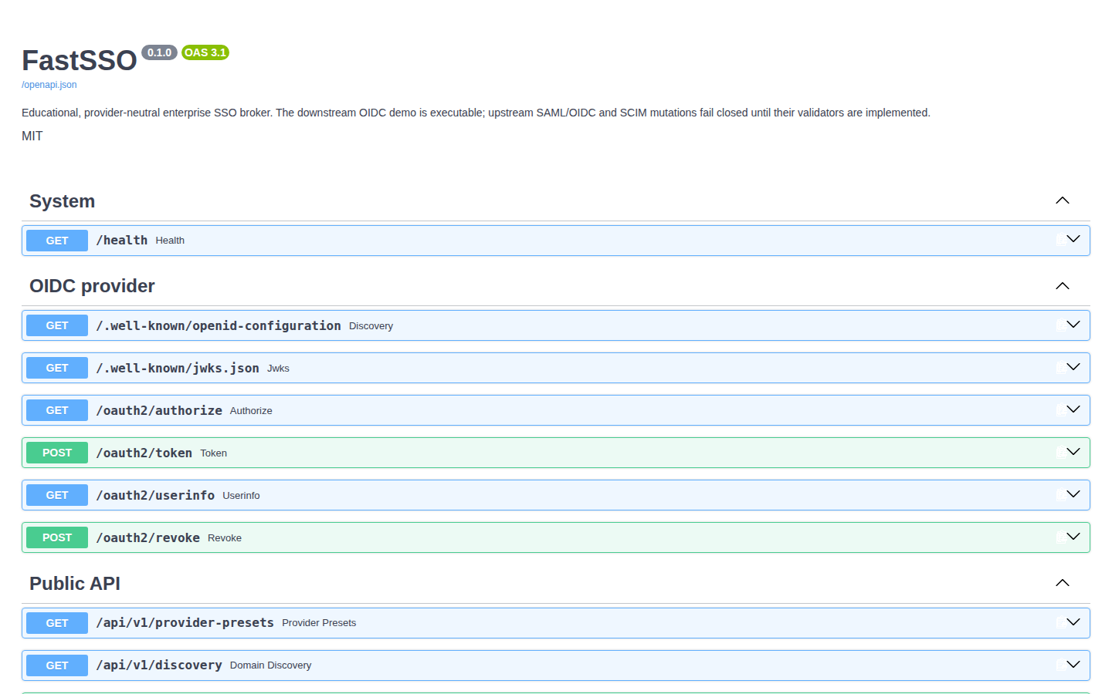
FastSSO 0.1.0 OAS 3.1
System GET /health Health OIDC provider GET /.well-known/openid-configuration Discovery GET /.well-known/jwks.json Jwks GET /oauth2/authorize Authorize POST /oauth2/token Token GET /oauth2/userinfo Userinfo POST /oauth2/revoke Revoke Public API GET /api/v1/pro
https://sso.fastsme.com/docs

Slide 5
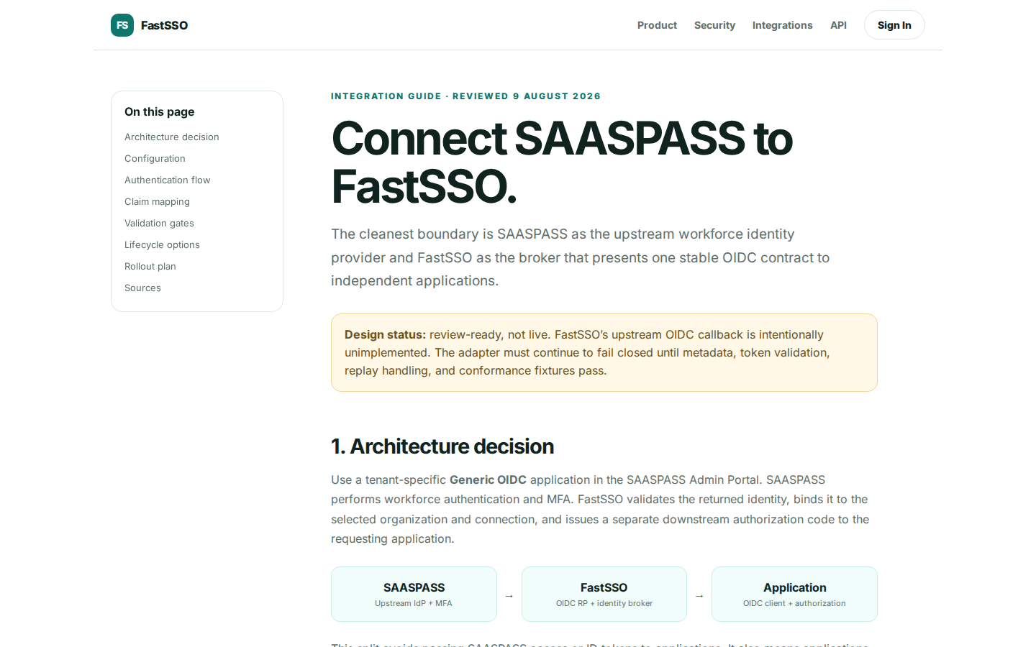
Connect SAASPASS to FastSSO.
On this page Architecture decision Configuration Authentication flow Claim mapping Validation gates Lifecycle options Rollout plan Sources INTEGRATION GUIDE · REVIEWED 9 AUGUST 2026 Connect SAASPASS to FastSSO. The cleanest boundary is SAASPASS as the upstream
https://sso.fastsme.com/integrations/saaspass

