Slide 1
FastShop
User Guide — Build and Run Your Own Store
Classical editing. Conversational building. One shared site.
Worked example: H2 | 4 YOU · h24you.com
21 September 2026 · Local demonstration edition

Slide 2
Contents
The PDF and PowerPoint use the same page/slide sequence, following FastClinic's sectioned guide pattern. Screenshots show a local H24YOU fixture—not a live-site audit, an actual customer, a payment-provider test or regulatory approval.
Section | Pages / slides | What you will do
01 · Get started | 3–6 | Understand the two flows and the H24YOU page plan
02 · Build with classical controls | 7–13 | Edit pages, products, media, shared content and research
03 · Build with chat | 14–26 | Use the H24YOU prompt library, preview changes and undo
04 · Prepare commerce | 27–34 | Review merchant data; try checkout, subscriptions, accounts and email
05 · Review and launch | 35–39 | Separate Phase 1 approval from commerce acceptance; replace placeholders
FastShop · Build your store, your way · v0.1.0 · 2026-09-21 · shop.fastsme.com · 2

Slide 3
SECTION 01
Get started
Use H24YOU as a worked example. Build the design and content first, review it, then prepare commerce in a separate, explicitly approved phase.
FastShop · Build your store, your way · v0.1.0 · 2026-09-21 · shop.fastsme.com · 3

Slide 4
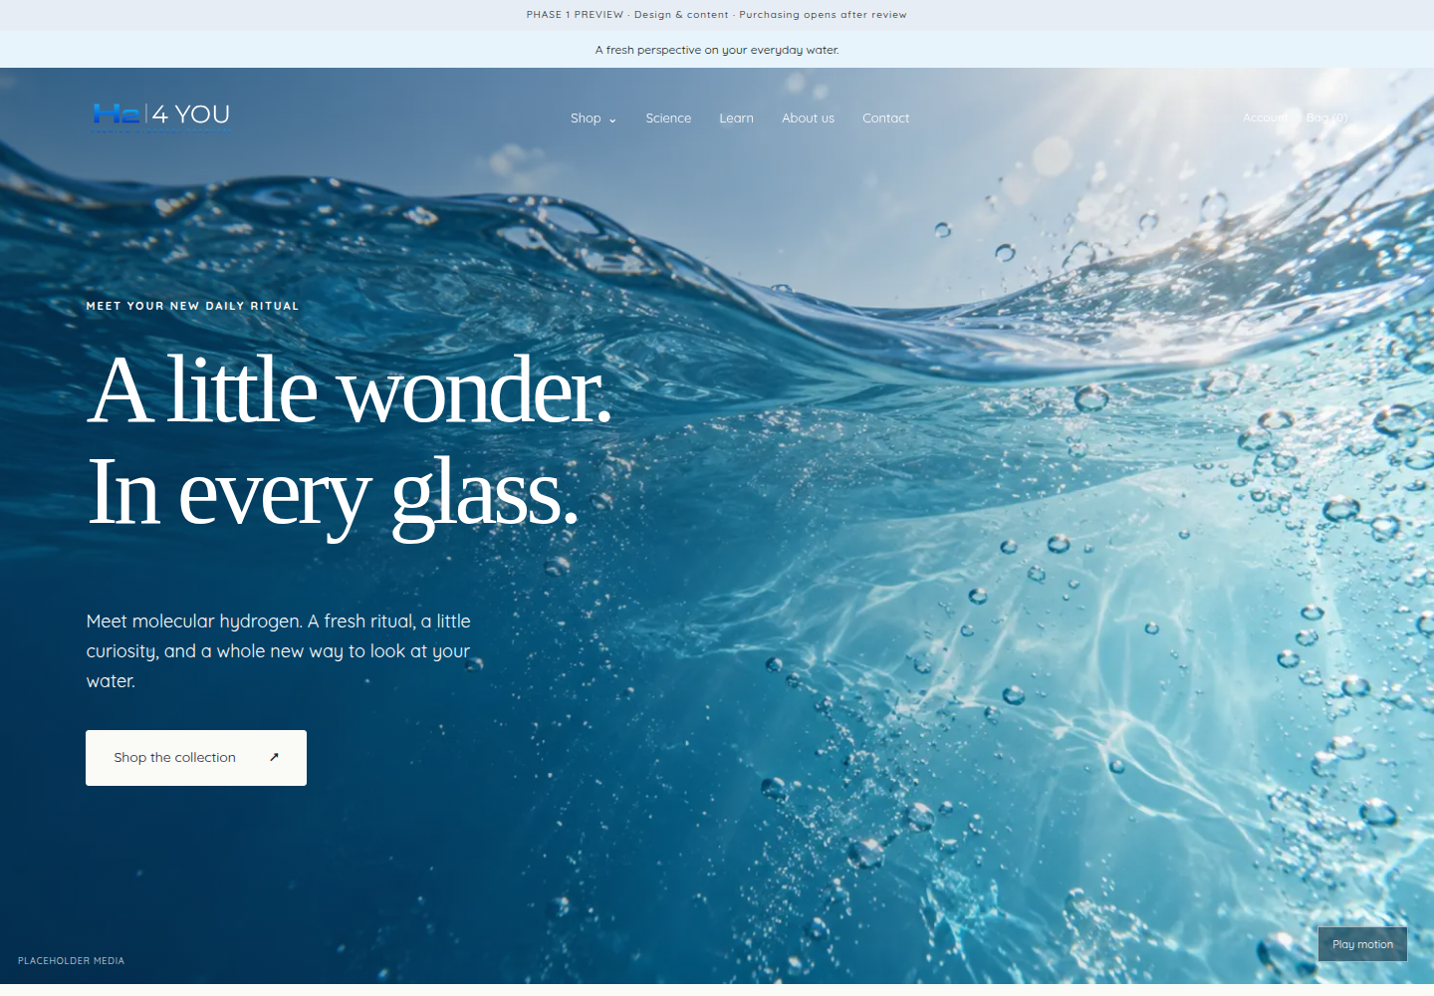
Your sample store: H2 | 4 YOU
H24YOU demonstrates a content-rich US store: hydrogen tablets in Unflavoured, Raspberry and Pineapple, plus a branded Hydroxy Go bottle. The brief specifies English and USD. In running copy use H2 4 You; the logo uses H2 | 4 YOU.
FastShop is the platform. Your storefront has its own visual identity; FastShop's merchant controls retain FastShop branding.
The original brief requested Shopify. The subsequent implementation direction uses FastShop's embedded content editor and Stripe boundary, not Shopify hosting, Shopify Email or Shopify Subscriptions. No domain/DNS setup is implied.
FastShop · Build your store, your way · v0.1.0 · 2026-09-21 · shop.fastsme.com · 4

Slide 5
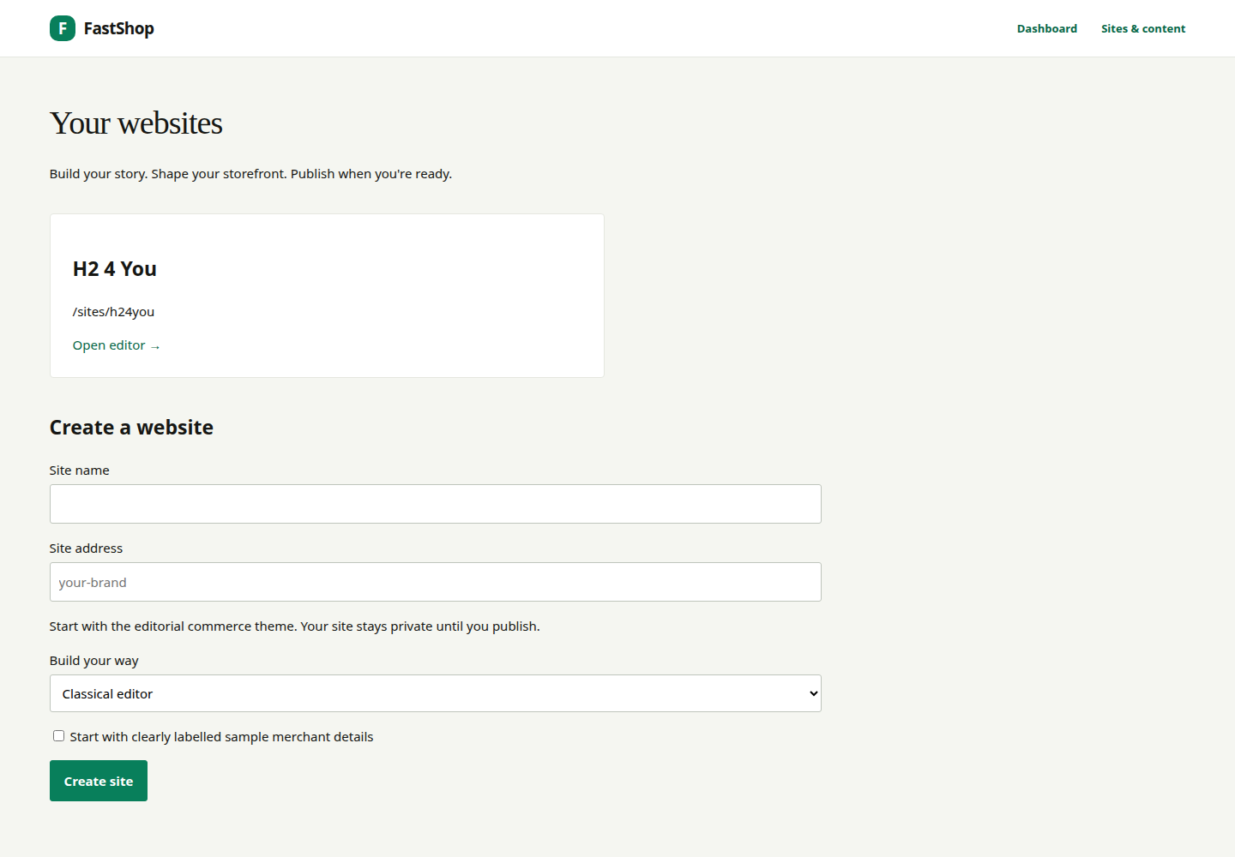
Sign in and choose your building flow
• Sign in at your FastShop installation's /login.
• Open Sites & content at /admin/sites.
• Open H2 4 You, or enter a new site name and unique slug.
• Choose Classical editor or Build with AI / guided presets.
• Optionally start a new private site with labelled sample merchant details.
Both flows edit the same draft. Switching flows does not duplicate the site. For the sample storefront, /sites/h24you/ works when its preview is published. The builder's authenticated preview remains the place to inspect unpublished edits.
FastShop · Build your store, your way · v0.1.0 · 2026-09-21 · shop.fastsme.com · 5

Slide 6
Plan H24YOU's pages before editing
The seeded example contains 17 page routes. Navigation and legal links are shared settings; articles and product storytelling are editable pages. Underlying product variants and prices are separate catalog records.
Area | Pages and purpose
Home and Shop | Home, Shop, Hydrogen Tablets collection, Hydrogen Water Bottles collection
Products | Hydrogen tablets; Hydroxy Go bottle
Science | Research library, source links and grouped research themes
Learn | Index plus three educational launch articles
Company | About us; Contact
Policies | Terms and Conditions; Privacy Policy; FAQ; Returns and Refunds
Shared components | Header, menu, footer, announcement, first-order banner, cookie preferences
FastShop · Build your store, your way · v0.1.0 · 2026-09-21 · shop.fastsme.com · 6

Slide 7
SECTION 02
Build with classical controls
Use forms when you know exactly what to change. Save drafts, preview them and publish deliberately. These are the same drafts that chat edits.
FastShop · Build your store, your way · v0.1.0 · 2026-09-21 · shop.fastsme.com · 7

Slide 8
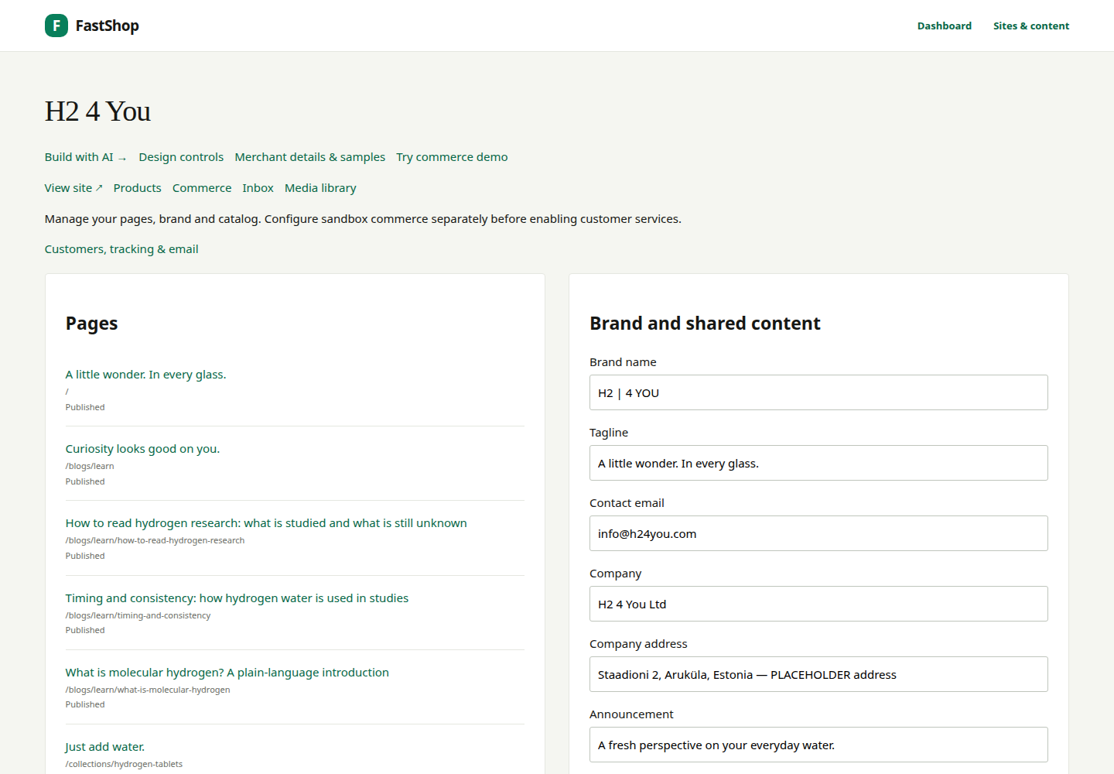
Brand, navigation, banner and footer
Open the Classical editor. In Brand and shared content, edit the brand name, tagline, contact email, company details, announcement and first-order banner. Set menu labels/paths, social links, research figures and the footer disclaimer here.
For H24YOU, keep Shop, Science, Learn, About us, Contact in the main menu. Use the supplied dark logo on light backgrounds and the light logo on dark media.
Choose Save draft settings first. Publish shared settings exposes the reviewed shared content. The brief's legal address is a placeholder—not a confirmed warehouse address. Changing a reviewed merchant value requires another review.
FastShop · Build your store, your way · v0.1.0 · 2026-09-21 · shop.fastsme.com · 8

Slide 9
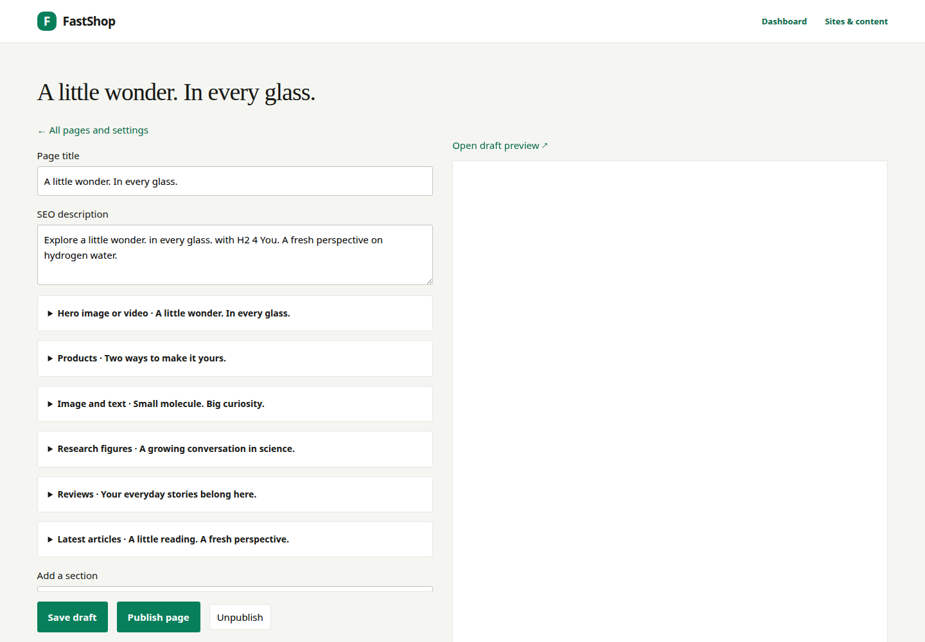
Edit a page without code
• Open the page from the site's page list.
• Edit its title and SEO description.
• Expand a content section to change its heading, body, image or link.
• Add supported sections; reorder or remove them using the editor controls.
• Choose Save draft and inspect the private preview.
• Use Publish page only after review.
For H24YOU's home page, retain the sequence: hero, products, research counters, research introduction, clearly labelled review area and latest Learn articles. Page revisions allow restoration; a draft save alone does not replace published content.
FastShop · Build your store, your way · v0.1.0 · 2026-09-21 · shop.fastsme.com · 9

Slide 10
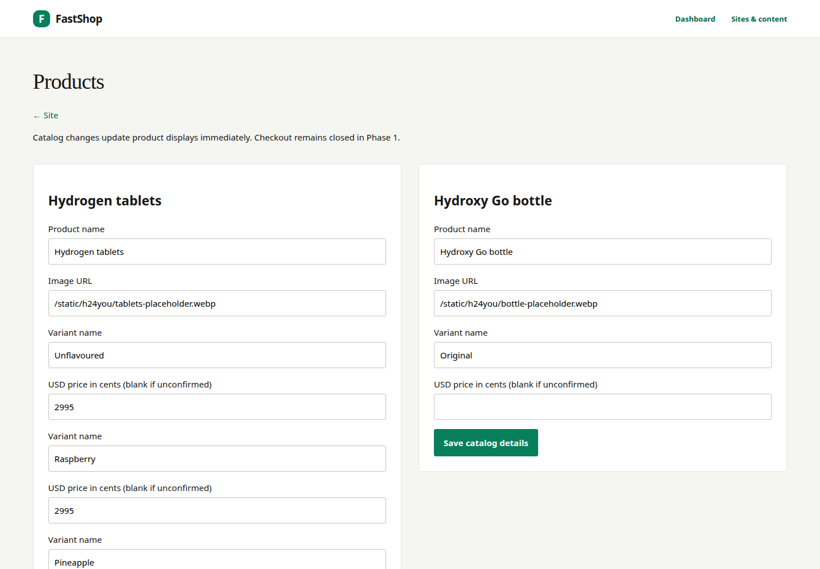
Product records versus product pages
Use Products for names, variants, product images and prices. Use the page editor for the gallery, introduction, accordions and supporting content.
• Tablets: Unflavoured, Raspberry and Pineapple.
• The brief's $29.95 price is 2995 USD cents and remains provisional.
• The bottle's final USD price must be supplied; do not invent a conversion.
• Leave ingredients and Supplement Facts visibly pending until supplied.
Catalog changes can affect operational prices immediately; they are not page-draft edits. Configure monthly tablet eligibility separately in Commerce. The bottle should not inherit tablet subscription eligibility.
FastShop · Build your store, your way · v0.1.0 · 2026-09-21 · shop.fastsme.com · 10

Slide 11
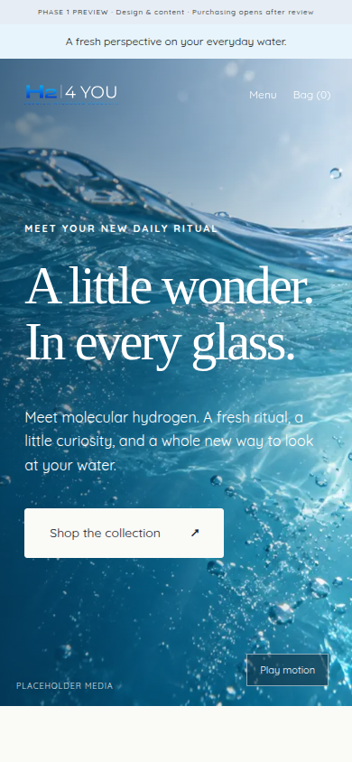
Replace media and preview mobile layouts
Upload approved images through Media library, with meaningful alt text. Copy the resulting URL into the page's image field. Keep placeholder labels until the asset is genuinely replaced.
H24YOU's supplied SVG logos are brand assets; generated product/lifestyle images and motion studies are concepts, not actual product or customer photography.
Inspect phone, tablet and desktop layouts. Check the mobile menu, product gallery, readable text, focus states and video pause control. The brief requests a compressed hero with a mobile fallback; the final media still needs merchant approval.
FastShop · Build your store, your way · v0.1.0 · 2026-09-21 · shop.fastsme.com · 11

Slide 12

Science and Learn: edit, source, review
The brief supplies counters 2,000+, 120+ and 68. These are supplied draft figures, not figures verified by this guide. Keep the source and confirmation date visible, and recheck them before publishing.
Use neutral research descriptions and original-source links. Do not place product buy buttons inside study lists. Keep unapproved benefit statements disabled in shared settings; an AI edit is not regulatory approval.
Learn has three draft launch articles. Review the full text, author label, source links and study-reference boxes before publication. The prompt library later in this guide identifies each article and its brief-supplied references.
FastShop · Build your store, your way · v0.1.0 · 2026-09-21 · shop.fastsme.com · 12

Slide 13
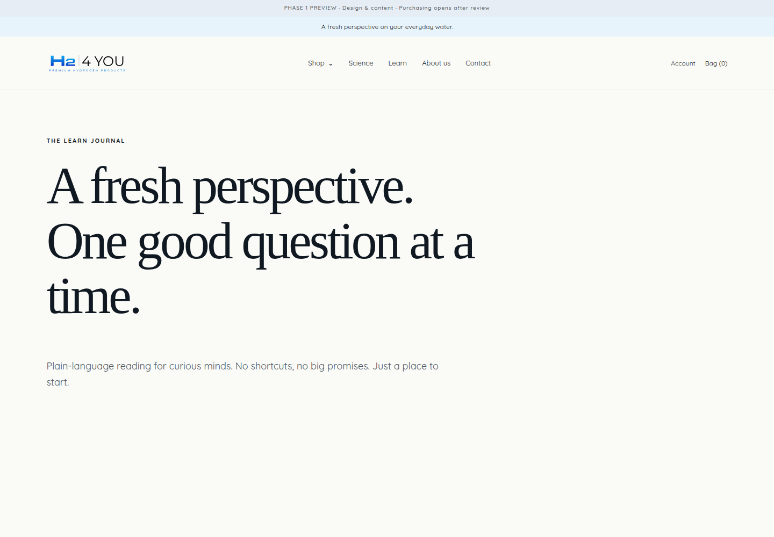
Contact, cookies and analytics
Set info@h24you.com as the brief's contact destination, then verify delivery in the deployed environment. Contact entries are retained in Inbox; a stored entry is not proof that an email was delivered.
Review cookie Accept, Decline and Preferences behavior. Optional GA4 is configured in shared settings and should load only after analytics consent on public pages. Private previews are not an analytics acceptance test.
The brief says no Meta pixel yet. Marketing opt-in is separate from contact messages and account/order email. Replace privacy and other legal placeholders with reviewed text before public launch.
FastShop · Build your store, your way · v0.1.0 · 2026-09-21 · shop.fastsme.com · 13

Slide 14
SECTION 03
Build with chat
Ask for one focused change, inspect the actual draft and keep editorial control. The following prompt library turns the H24YOU brief into repeatable tasks.
FastShop · Build your store, your way · v0.1.0 · 2026-09-21 · shop.fastsme.com · 14

Slide 15
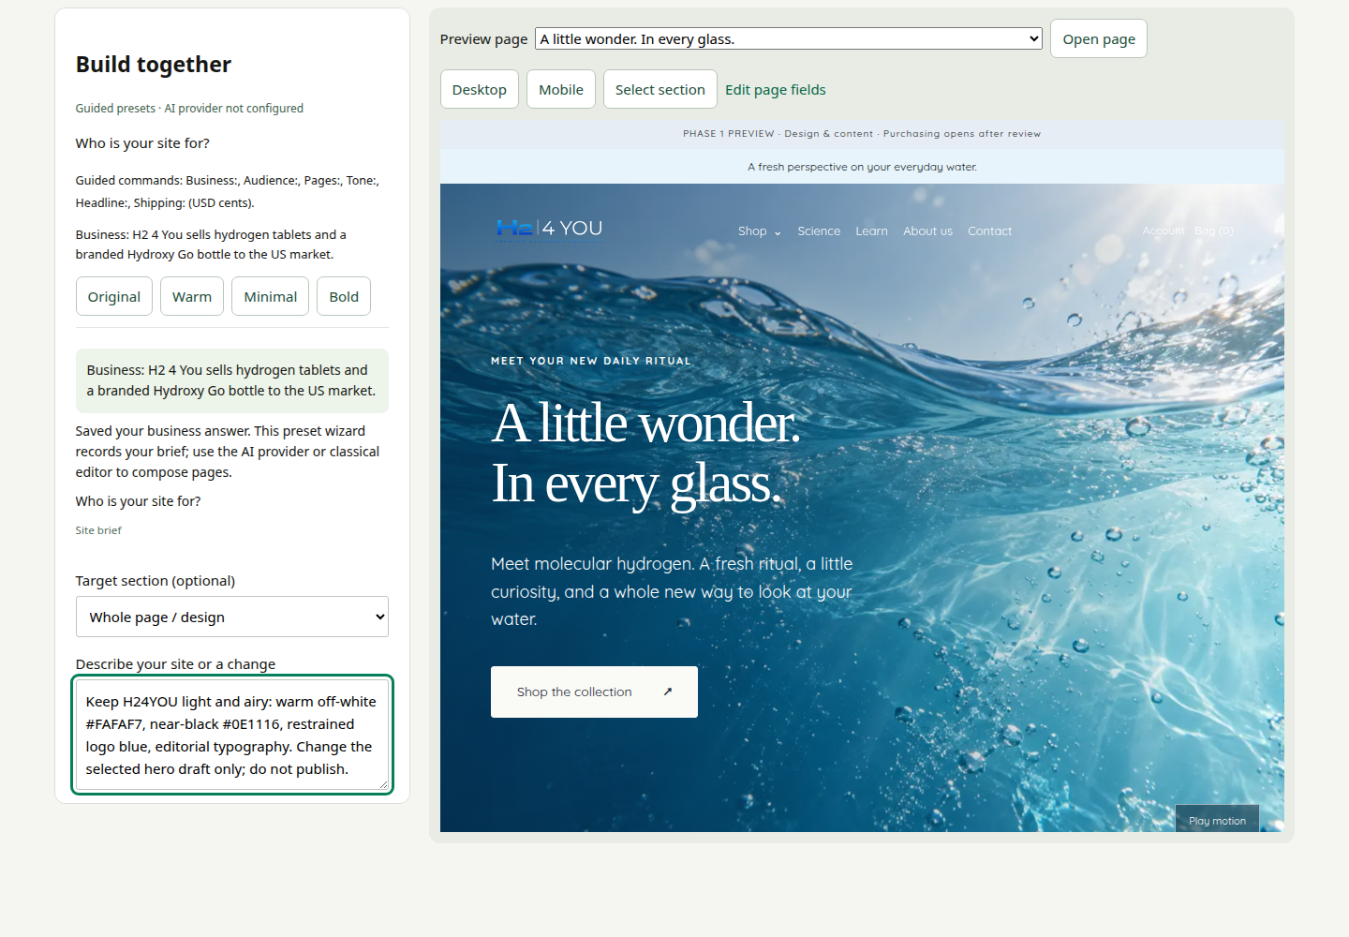
The chat workspace and its limits
Choose Build with AI. Select a page, then use Select section or Target section to focus the request. The preview refreshes after a validated draft save. On phones, switch between Editor and Preview.
With a configured model, use the natural-language prompts on the following pages. The server accepts only supported structured edits—not arbitrary code, payments or autonomous publication.
Without a key, the label says Guided presets · AI provider not configured. The screenshot contains a prepared natural-language request, not evidence that an LLM executed it. Do not paste the entire brief: messages are limited to 4,000 characters.
FastShop · Build your store, your way · v0.1.0 · 2026-09-21 · shop.fastsme.com · 15

Slide 16
Start with the brief's original phase instruction
Original wording — brief §0. Use this to establish the review boundary; it is an instruction to the assistant, not a substitute for the publication controls.
Build in two phases and show me the result of Phase 1 before starting Phase 2. Phase 1 – Design and content: home page, Shop, product pages, Science, Learn (3 articles), About us, Contact, header, footer, banner, cookie banner. Phase 2 – Commerce: subscriptions, tax and shipping settings, checkout, discount codes, My account, order tracking, email capture. If any instruction here is unclear or two instructions conflict, ask me before guessing.
For this FastShop implementation, add: “Use FastShop's existing components. Keep all edits as drafts. Do not enable commerce or publish without my approval.”
FastShop · Build your store, your way · v0.1.0 · 2026-09-21 · shop.fastsme.com · 16

Slide 17
Save your H24YOU brief one answer at a time
Copy-ready guided commands — adapted from brief §§1, 3 and 5. These work in the labelled preset fallback as well as providing a useful outline for AI chat.
Business: H2 4 You sells hydrogen tablets and a branded Hydroxy Go bottle.
Audience: US customers; English-language site; prices in USD.
Pages: Home, Shop, tablet and bottle collections and products, Science, Learn with three articles, About us, Contact, Terms, Privacy, FAQ and Returns.
Tone: Warm, energetic, curious and confident. Short, lively sentences. Enthusiasm about the experience and research, not health promises.
Expected result: the answers appear in the saved brief and the next question advances. Guided mode records the page plan; it does not generate all those pages.
FastShop · Build your store, your way · v0.1.0 · 2026-09-21 · shop.fastsme.com · 17

Slide 18
Prompt: H24YOU's design language
AI prompt — adapted from brief §3. Select the home page. Split further if the assistant asks which section to change.
Keep H24YOU clean, modern, fresh and premium but approachable. Use warm off-white #FAFAF7, white and near-black #0E1116. Use logo blue sparingly, with pale aqua #E8F4FB and sand #EFE8DE accents. Keep the site light and airy. Prefer editorial typography, generous whitespace and asymmetric composition. Avoid purple/rainbow gradients, glowing orbs, endless identical rounded cards and filler slogans. Update supported design settings only. Preserve the logos and FastShop administration branding. Keep the changes in draft.
Review: inspect desktop and mobile. Bounded theme controls cannot express every design detail. Lovera requires the supplied licensed font; the H24YOU fixture uses a heading fallback and local Quicksand. Chat does not install arbitrary fonts.
FastShop · Build your store, your way · v0.1.0 · 2026-09-21 · shop.fastsme.com · 18

Slide 19
Prompt: home hero and content rhythm
AI prompt — adapted from brief §§3 and 5.1. Target the home hero first.
Rewrite this H24YOU hero with a short, original headline and a Shop call to action. Make it warm, energetic and curious, focused on the first glass and everyday ritual. Do not promise health outcomes or reuse another brand's slogan. Keep the water imagery visibly identified as placeholder content. Change only this section's copy; do not publish.
Then select the next section and ask for its specific edit. Keep research figures in their shared settings rather than inventing new counters in body text.
No-key exercise: Headline: A little wonder. In every glass. updates the selected heading. It does not create a video or rebuild the entire home page.
FastShop · Build your store, your way · v0.1.0 · 2026-09-21 · shop.fastsme.com · 19

Slide 20
Prompt: tablets and bottle storytelling
AI prompt — adapted from brief §§5.3–5.4. Select the tablets product page and the relevant text section; use catalog forms for variants and prices.
Draft inviting H24YOU tablet copy around convenience, flavour and the daily water ritual. Flavours are Unflavoured, Raspberry and Pineapple. Keep $29.95 per box and pack size marked for confirmation. For ingredients and product details use: “Supplement Facts and ingredients to be added”. Do not invent doses, ingredients, specifications, testimonials or health claims. Save a draft.
Bottle follow-up: “Adapt only the approved Hydroxy Go text I provide. If specifications or the USD price are missing, leave visible placeholders.”
The builder does not fetch or verify the Hydroxy website for you. Supply reviewed source text; do not treat an assistant's recollection as a product specification.
FastShop · Build your store, your way · v0.1.0 · 2026-09-21 · shop.fastsme.com · 20

Slide 21
Prompt: Science, counters and claims
AI prompt — adapted from brief §§5.5, 7 and 8. Select a Science introduction section. Use classical settings for the counters and claim-approval switches.
Write a short, factual Science introduction that invites readers to explore original research. Use “Researchers have studied…” and “More research is needed.” Do not imply that our products diagnose, treat, cure or prevent a disease. Do not invent studies, endorsements or benefit statements. Keep product purchase buttons out of research lists. Save only a draft.
Counter review task: confirm the brief's 2,000+ / 120+ / 68 figures with their source and a merchant-confirmed date. Do not add disease-model or benefit counters.
The brief's benefit statements are drafts pending adviser review. Keep them disabled until approved; the footer disclaimer alone does not approve a claim.
FastShop · Build your store, your way · v0.1.0 · 2026-09-21 · shop.fastsme.com · 21

Slide 22
Prompt: Learn article 1
AI prompt — adapted from brief §5.6. Open /blogs/learn/what-is-molecular-hydrogen and target its main text section.
Draft “What is molecular hydrogen? A plain-language introduction” for H2 4 You. Aim for 600–900 words, calm and educational. Author: H2 4 You team. End with a “Studies referenced” box using only the two references supplied below. Do not invent citations or make product health promises. If source text is unavailable, ask me for it rather than inventing findings. Save for review.
Brief-supplied references: Ichihara et al. 2015 and Dixon et al. 2013.
Provide the source excerpts and links in a follow-up message. The builder is not a research browser. Review word count, references and rendered structure manually; split the work into sections if a request exceeds supported output size.
FastShop · Build your store, your way · v0.1.0 · 2026-09-21 · shop.fastsme.com · 22

Slide 23
Prompt: Learn article 2
AI prompt — adapted from brief §5.6. Open /blogs/learn/timing-and-consistency and target its main text section.
Draft “Timing and consistency: how hydrogen water is used in studies” for H2 4 You. Aim for 600–900 words, calm and educational. Describe differences in study methods without converting study protocols into a product dose or medical recommendation. Author: H2 4 You team. End with a “Studies referenced” box using the supplied references. Ask for source text if needed. Save a draft.
Brief-supplied references: LeBaron et al. 2019 and Mikami et al. 2019.
Review: check every factual sentence against supplied source material. This guide reproduces the brief's reference list; it does not independently verify the studies or endorse any health conclusion.
FastShop · Build your store, your way · v0.1.0 · 2026-09-21 · shop.fastsme.com · 23

Slide 24
Prompt: Learn article 3
AI prompt — adapted from brief §5.6. Open /blogs/learn/how-to-read-hydrogen-research and select its text section.
Draft “How to read hydrogen research: what is studied and what is still unknown” for H2 4 You. Aim for 600–900 words. Explain study limitations and why a research result is not a promise about our products. Author: H2 4 You team. End with a “Studies referenced” box using only supplied sources. Ask for source text rather than inventing findings. Save for human review.
Brief-supplied references: Li et al. 2024, Zhou et al. 2023 and Todorovic et al. 2023.
Keep the article educational. Check source metadata, links, claims and final word count before publishing. The merchant must approve all three launch articles.
FastShop · Build your store, your way · v0.1.0 · 2026-09-21 · shop.fastsme.com · 24

Slide 25
Prompt: About, Contact and policies
AI prompt — adapted from brief §§1 and 5.7–5.9. Select the appropriate page; send separate requests rather than rewriting all company pages at once.
Adapt the founder story I supply for H2 4 You in warm, natural English. Include Andres Randma as the creator of Lumiorav magnesium water, as stated in our brief, but do not invent a biography. Use photo placeholders. Express that we are health enthusiasts who care about supporting our own health and sharing it with others. Ask for missing founder details. Save a draft only.
Contact task: use H2 4 You Ltd and info@h24you.com. Keep the legal address centralized and clearly marked for confirmation; do not reuse it as the warehouse.
Policy task: organize merchant-supplied Terms, Privacy, FAQ and Returns text. Missing policy wording stays a placeholder; generated text is not legal approval.
FastShop · Build your store, your way · v0.1.0 · 2026-09-21 · shop.fastsme.com · 25

Slide 26
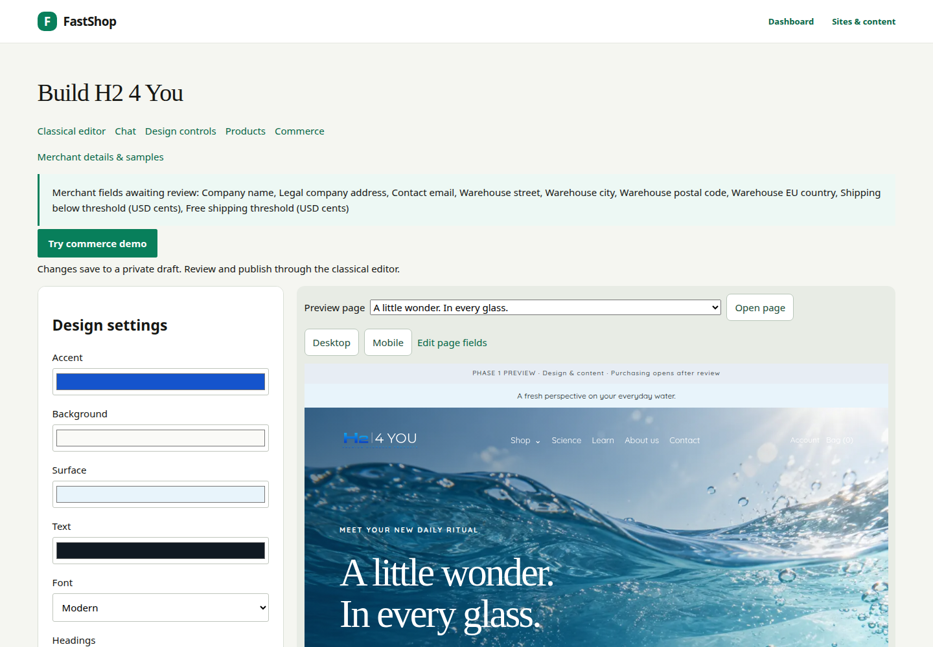
Preview, switch modes and undo
Choose Design controls for exact supported colors, spacing and typography. Choose Classical editor for pages, navigation and publication. Return to chat without copying content: all three views use the same saved draft.
Expand Draft revision history to inspect the latest 50 changes. Undo latest change works only while that unchanged revision is current. It does not rewind payments, catalog operations or published pages.
For a slow request, use Cancel pending edit. After a timeout, reload and inspect the saved result before trying again. If another editor changed the draft, the stale request is rejected rather than overwriting their work.
FastShop · Build your store, your way · v0.1.0 · 2026-09-21 · shop.fastsme.com · 26

Slide 27
SECTION 04
Prepare commerce
Only after Phase 1 review: confirm merchant details, try the isolated simulator and prepare Stripe sandbox acceptance. Simulation is not a live store.
FastShop · Build your store, your way · v0.1.0 · 2026-09-21 · shop.fastsme.com · 27

Slide 28
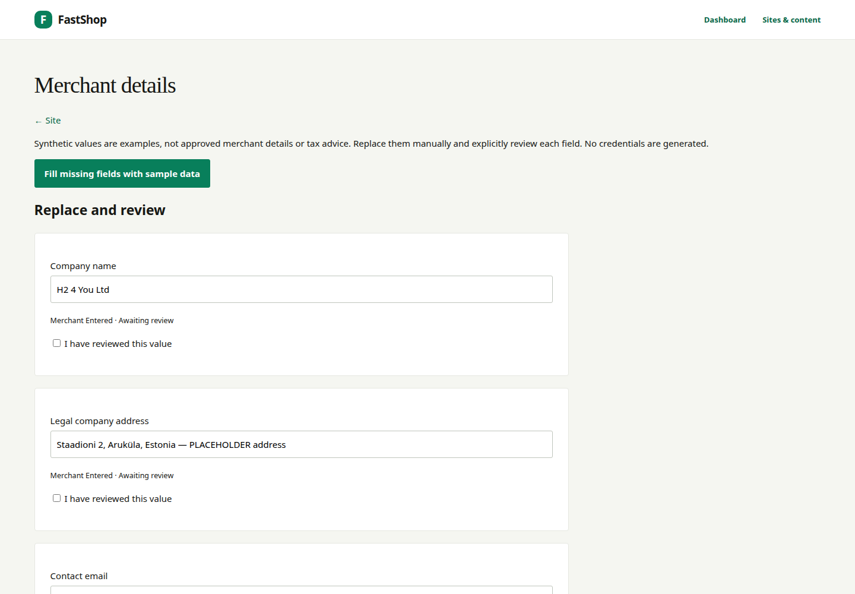
Replace and review merchant sample data
Open Merchant details & samples. On a private draft with commerce disabled, Fill missing fields with sample data provides clearly labelled examples. Existing values and previously reviewed fields are not blindly overwritten.
Replace company identity, legal address, contact email and EU warehouse details. The shipping origin is distinct from the legal address. The final warehouse may be in Estonia or another supported EU country; confirm it with the merchant.
Amounts are USD cents: 1000 is $10; 7500 is $75. The former is a training example, not a confirmed H24YOU fee. Explicitly review each field. Saving does not publish, approve tax registrations or activate payments.
FastShop · Build your store, your way · v0.1.0 · 2026-09-21 · shop.fastsme.com · 28

Slide 29
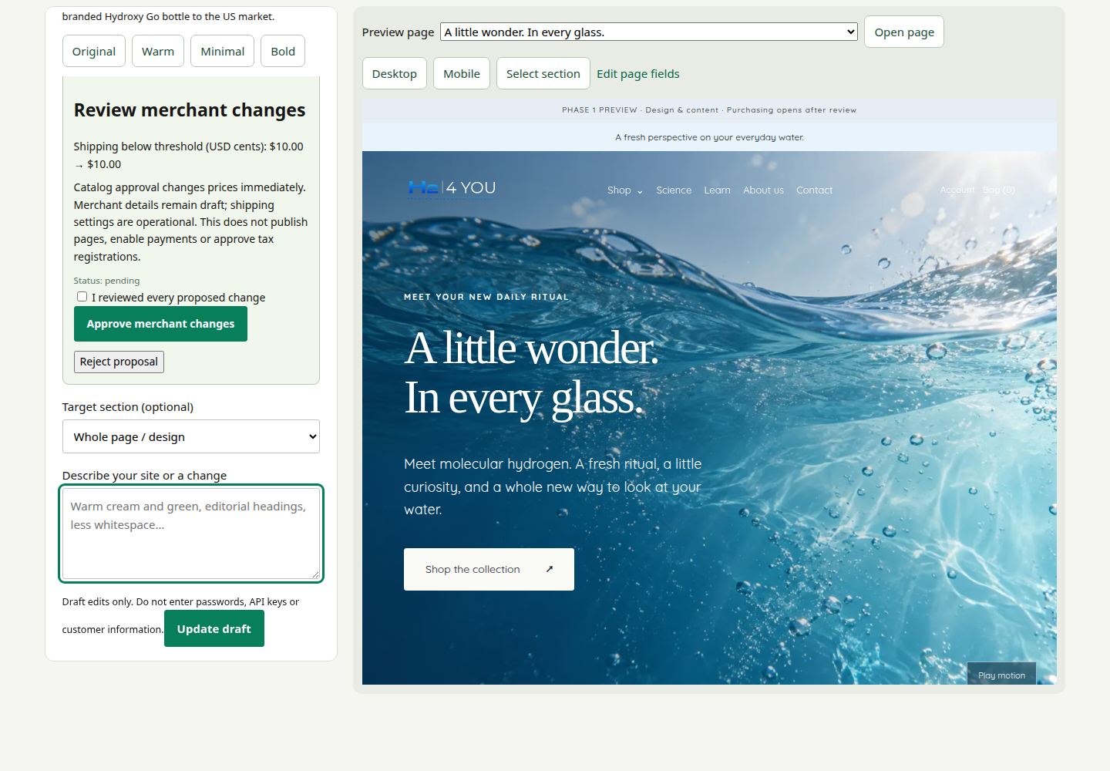
Prompt: propose shipping, then approve it
AI prompt — adapted from brief §6 and subsequent EU-origin direction:
Propose US-only shipping from our confirmed EU warehouse. For this training example only, use a $10 flat fee and a $75 free-shipping threshold. Show the proposed values for merchant review. Do not enable payments or approve tax registrations. Do not change anything until I explicitly approve the proposal.
No-key exercise: Shipping: 1000 proposes the $10 fee only.
Inspect Review merchant changes, tick I reviewed every proposed change and approve—or reject. Stale proposals need a fresh request. Approved prices and shipping are operational changes, not reversible page edits. Merchant-detail proposals currently require commerce disabled.
FastShop · Build your store, your way · v0.1.0 · 2026-09-21 · shop.fastsme.com · 29

Slide 30
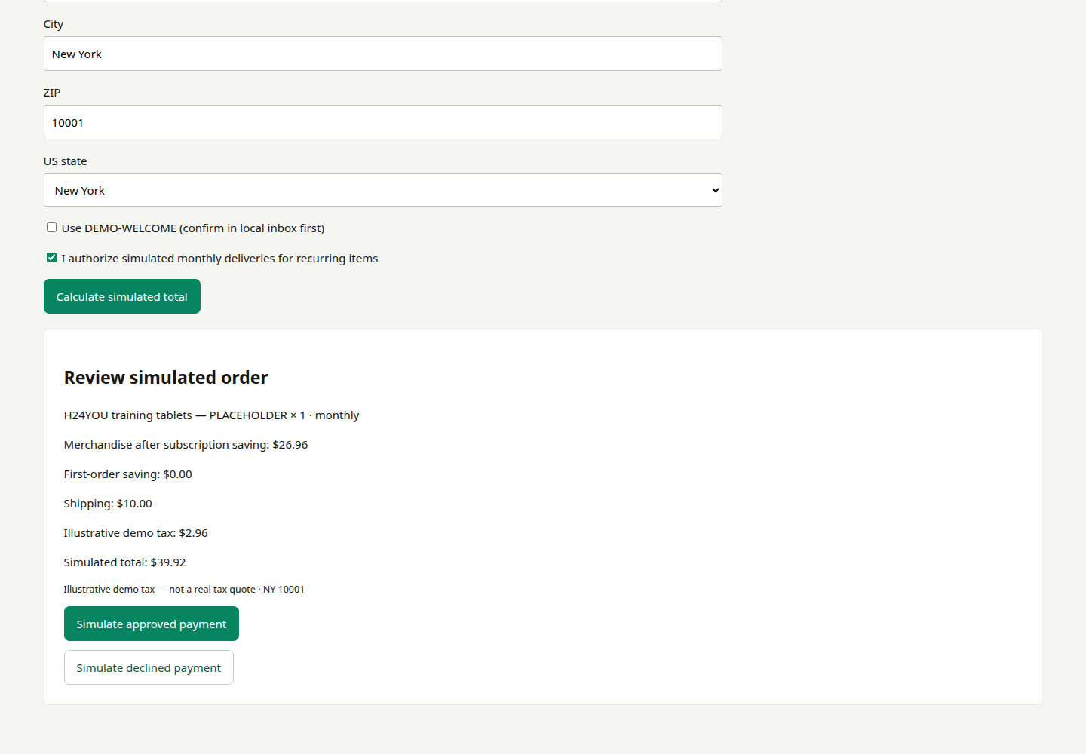
Try checkout without credentials
Open Try commerce demo → Start private demo. Its catalog, stock, shopper and orders are separate from your real store. For this walkthrough, one sample item was manually renamed H24YOU training tablets — PLACEHOLDER; other simulator defaults are not H24YOU's approved catalog.
Set quantity and one-time/monthly purchase, then open Checkout. Enter a sample US destination, confirm recurring consent where applicable and calculate the total. Try both simulated approval and decline.
The displayed tax is an illustrative fixture, not a real state or ZIP rate. No card details, actual payment, real email or fulfillment request is used.
FastShop · Build your store, your way · v0.1.0 · 2026-09-21 · shop.fastsme.com · 30

Slide 31
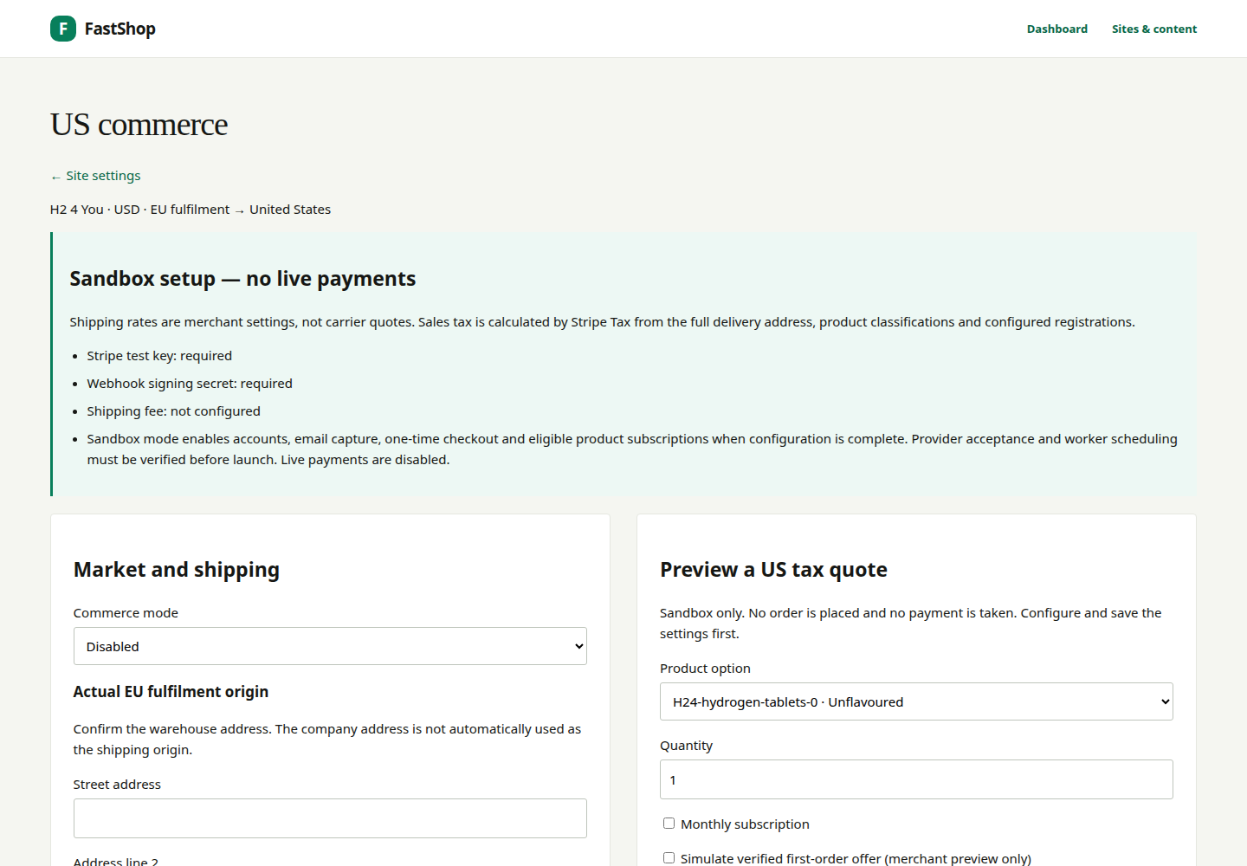
Configure US commerce through the explicit forms
In Commerce, confirm EU origin, US destinations, shipping fee and threshold. Review product tax classifications and registrations with the responsible merchant. Use Stripe test credentials only for sandbox acceptance; live mode is not offered.
Real sandbox tax is calculated through Stripe Tax using the full delivery address, not a hard-coded state percentage. A failed tax lookup must not become zero tax. The final total must be reviewed before payment.
The first-order 10% offer and subscription 10% saving stack sequentially: 19% combined before cent rounding, not 20%. Verify supported payment methods; do not show PayPal or wallet icons as accepted merely because the original brief listed them.
FastShop · Build your store, your way · v0.1.0 · 2026-09-21 · shop.fastsme.com · 31

Slide 32
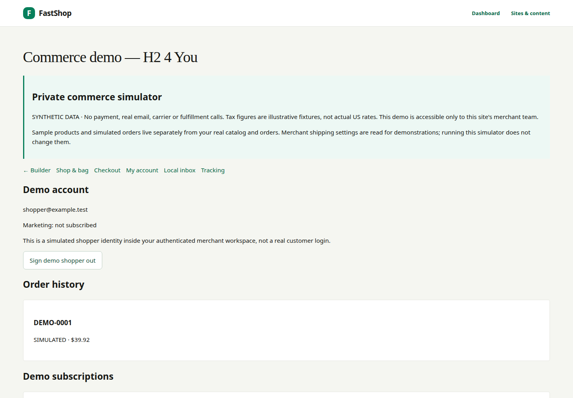
Subscriptions: monthly tablets, explicit controls
The H24YOU brief calls for monthly tablet delivery with 10% savings and future flavour changes. In real catalog settings, enable subscriptions for tablets only. The customer must explicitly consent before a recurring purchase.
In the simulator's My account, practice skipping a delivery, pausing/resuming, changing frequency or flavour, updating address/payment and cancelling. Simulate successful and failed renewals to inspect the resulting history.
The sample payment update is a label, not a stored card. Real recurring billing, card updates, recovery, scheduled workers and notices require the separate Stripe sandbox acceptance steps. Chat cannot activate or charge a subscription.
FastShop · Build your store, your way · v0.1.0 · 2026-09-21 · shop.fastsme.com · 32

Slide 33
My account and order tracking
After simulated checkout, request a local demo sign-in and confirm it in the local inbox. This signs in the synthetic shopper inside the merchant simulator; it is not a public customer account or proof of real email delivery.
Open My account for order history and subscription controls. Open Tracking to mark a simulated order shipped and delivered, then return to the account to see the updated history.
Real-store accounts use the configured customer email flow. Tracking events are merchant-managed; the presence of a tracking field does not imply automatic DHL, FedEx or postal-carrier integration.
FastShop · Build your store, your way · v0.1.0 · 2026-09-21 · shop.fastsme.com · 33

Slide 34
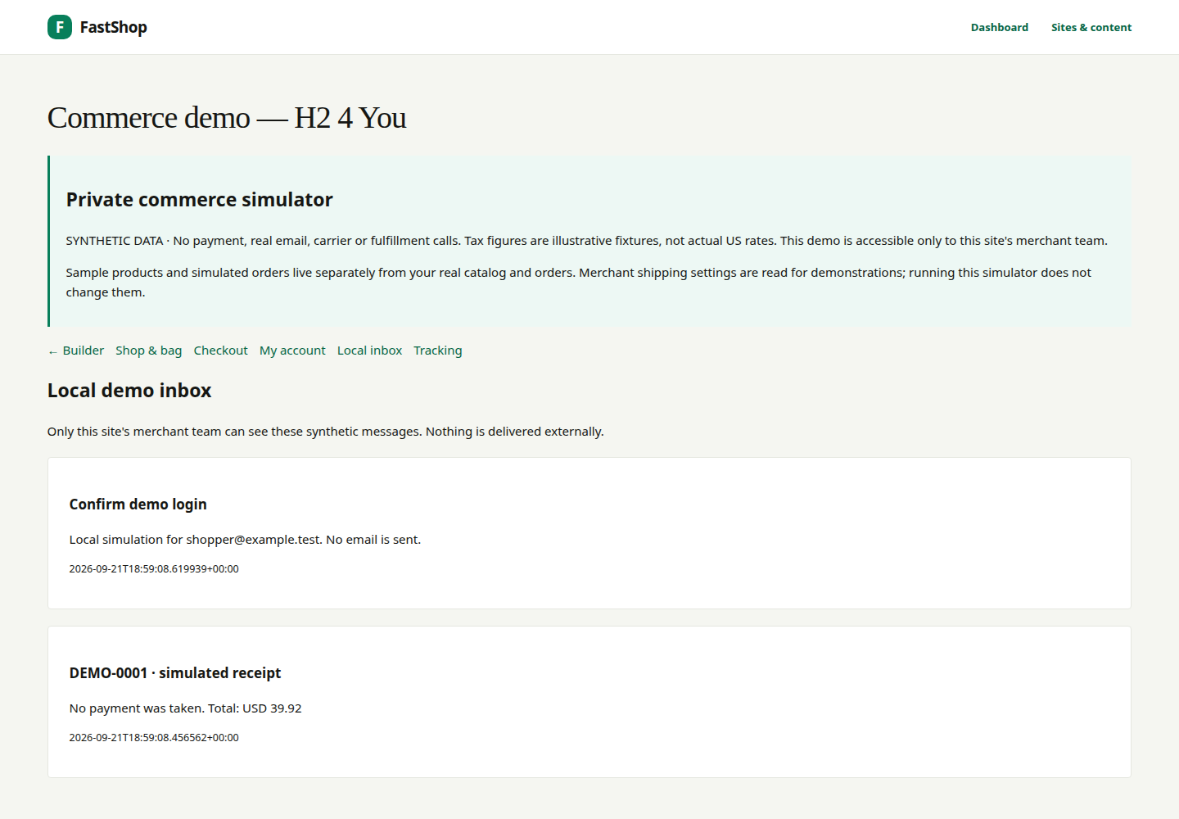
Email capture and the first-order offer
In the simulator, tick the separate marketing-consent checkbox and request the welcome offer. Confirm the newsletter in Local inbox before using DEMO-WELCOME. Newsletter confirmation and account sign-in are separate actions.
For the real storefront, use the configured email-provider workflow and verify consent, confirmation, offer eligibility and unsubscribe. Do not call it Shopify Email: this implementation uses FastShop's email boundary.
Brief copy: “I agree to receive marketing emails from H2 4 You. Unsubscribe anytime.” Keep consent unticked by default and link the reviewed privacy policy. Verify that banner dismissal is remembered and the banner never blocks the page.
FastShop · Build your store, your way · v0.1.0 · 2026-09-21 · shop.fastsme.com · 34

Slide 35
SECTION 05
Review and launch
Approve the design/content result separately from commerce. A complete-looking preview can still contain unconfirmed prices, imagery, source figures and policies.
FastShop · Build your store, your way · v0.1.0 · 2026-09-21 · shop.fastsme.com · 35

Slide 36

Phase 1 review: show the site before commerce
Walk through home, Shop, both products, Science, all three Learn articles, About, Contact and legal pages with the merchant. Review header, footer, announcement, offer preview and cookie controls on phone, tablet and desktop.
Confirm tone, visual language, navigation, SEO descriptions, alt text and video fallbacks. Check research sources and remove invented or unapproved claims. Keep sample reviews visibly labelled—or omit them until genuine reviews exist.
Record merchant approval before moving to commerce acceptance. Publishing the first page can expose a public noindex preview: noindex is not private access. Use authenticated previews for unpublished work.
FastShop · Build your store, your way · v0.1.0 · 2026-09-21 · shop.fastsme.com · 36

Slide 37
Phase 2 review: simulation, sandbox, launch
Never migrate simulated paid orders, fake cards or demo subscriptions into the real store. Live payments remain a separate release decision. See the repository's Phase 2 acceptance register for unresolved provider gates.
Gate | Evidence required
Private demo | Synthetic checkout, offers, account, subscriptions, tracking and local mail work
Merchant review | Confirmed legal details, EU origin, US rates, product prices and tax settings
Stripe sandbox | Real test-provider tax, payment success/failure, webhooks and idempotency checked
Recurring operations | Renewal scheduling, payment updates, failure/recovery and notices exercised
Customer communications | Real test delivery, sign-in, marketing opt-in and unsubscribe verified
Launch decision | Reviewed content/policies, payment-method acceptance and deployment checks complete
FastShop · Build your store, your way · v0.1.0 · 2026-09-21 · shop.fastsme.com · 37

Slide 38
H24YOU placeholder replacement register
Item | Merchant action before launch
Company and warehouse | Confirm legal address separately from actual EU fulfillment origin
Prices and shipping | Confirm tablet pack size/price, bottle USD price, flat fee and $75 threshold
Product facts | Supply ingredients, Supplement Facts, directions and approved bottle specifications
Photos and video | Replace generated hero/product/lifestyle concepts and motion studies
People and reviews | Supply founder details, approved portraits and genuine testimonials
Research | Recheck 2,000+ / 120+ / 68 figures, date, reference metadata and article drafts
Claims and policies | Obtain the brief-requested review; enable only approved statements
Brand and links | Supply licensed Lovera if wanted; replace social destinations and missing assets
Commerce providers | Verify tax, payment methods, mail, scheduled jobs and fulfillment workflow
FastShop · Build your store, your way · v0.1.0 · 2026-09-21 · shop.fastsme.com · 38

Slide 39
Quick reference and source brief
Source: H24YOU website build brief, §§0–11. Prompt pages distinguish original wording from adapted examples. Linked studies are the brief's references, not research newly verified for this guide. Never paste passwords, payment details, API keys or customer records into chat.
I want to… | Go to
Change copy or page structure | Classical editor → page → Save draft
Ask for a focused draft change | Build with AI → select page/section → Update draft
Change design precisely | Design controls
Change menu, banner, footer or counters | Brand and shared content
Edit variants/prices | Products; review operational impact
Replace merchant samples | Merchant details & samples
Try a safe shopping journey | Try commerce demo
Review payments, shipping and tax | Commerce; then the sandbox acceptance register
FastShop · Build your store, your way · v0.1.0 · 2026-09-21 · shop.fastsme.com · 39

